Slide 1
Lecture 11: Financial Markets and Banking
Juuso Välimäki
October 11, 2022

Slide 2
A. Intertemporal choice: saving and borrowing

Slide 3
Money
Up to now, we have measured budgets etc. in terms of money, but
Nobody really cares about money!
... only about its instrumental value in obtaining goods
Of course money is an important invention
medium of exchange
overcoming the problem of double coincidence of wants
store of value
originally: coins are easier to store than grain
unit of measurement for valuing goods
Money can be exchanged for goods since…
everybody trusts that others will accept money in payment for goods (and therefore are also willing to accept it)
government backs the trust (not by promising to pay in gold)
by accepting money for payment of taxes, by trustworthy policy making

Slide 4
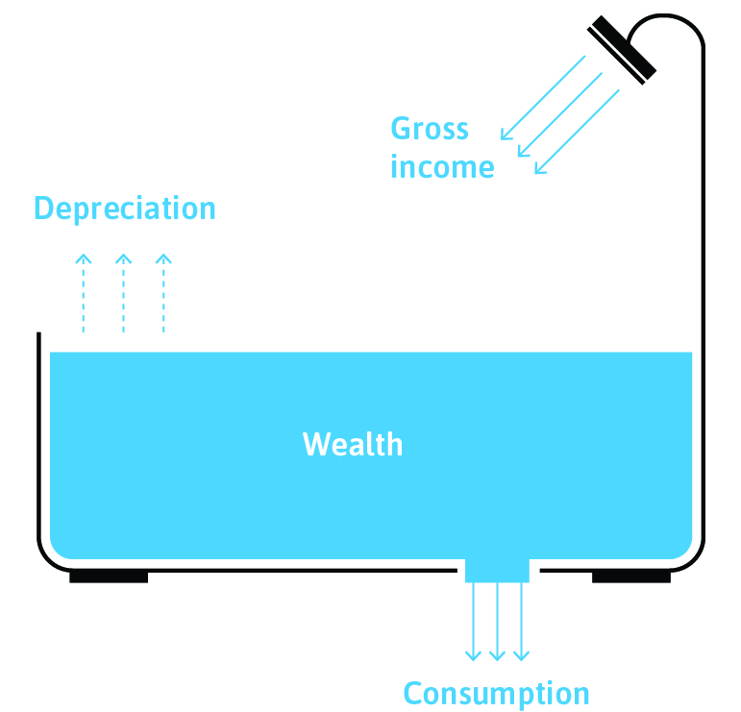
Income and wealth
Wealth: the value of assets owned by an individual
land, buildings, machinery, financial assets etc
may yield revenues, but may also depreciate in value
Income: the flow of monetary revenues accruing to an individual
labor income, capital income, transfers, gifts etc.

Slide 5
Saving and borrowing
Income and consumption needs come at different points in the life cycle
In particular labor market income is concentrated in the working years
To increase consumption in old age, retirement savings are necessary
For a typical household in Finland, buying housing is the largest single investment
Biggest needs for young families with children: borrowing in the mortgage market
Student loans etc. to finance consumption prior to working years
Need to take out loans to finance other large purchases
Life-cycle model: the discounted value of consumption equals the value of lifetime income stream

Slide 6
Optimal timing of consumption
Interest rate r determines how individuals can transfer income across time periods
If interest rate is r per time unit, then an agent can borrow x units of money in period t by promising to pay (1+r)x units in t+1.
The agent can consume (1+r)x units in t+1 by lending x units in t.
By lending x for 2 periods, the agent can consume (1+r)²x units in t+2.
Suppose that the agent gets an income stream y = (y₁, y_{2,…,}y_{T}) over time. We can compute the present value of this stream by asking how much money the agent can borrow against this stream in the first period t=1.
PV(y) = $\sum_{t=1}^{T}{\frac{y_{t}}{{(1+r)}^{t−1}}}$

Slide 7
Optimal timing of consumption
Similarly, we can compute the present value of a consumption stream c= (c₁, c₂,…,c_{T}) over time:
PV(c) = $\sum_{t=1}^{T}{\frac{c_{t}}{{(1+r)}^{t−1}}}$.
The intertemporal budget constraint of the economic agent just requires that the PV of the stream of consumptions not exceed the NPV of the income stream.
For example, consider the case where T=3 and where y = (0, 100, 20) and r = .1,
PV(y) = $\frac{100}{1.1}$ + $\frac{20}{\left(1.1\right)2}$= 107.
Then the largest feasible constant consumption stream c = (c,c,c) has consumption level
107 =$\sum_{t=1}^{3}{\frac{c}{{(1.1)}^{t−1}}}$ = or c = $\frac{107\left(1.1\right)2}{1+1.1+\left(1.1\right)2}$ = 39

Slide 8
Optimal timing of consumption
What determines optimal division of consumption over time:
Avoiding big drops in consumption level
Consumption smoothing (I am more willing to give up a unit of consumption in periods where I have high consumption level)
Pure time preference (impatience)
Expectations of higher future incomes
Instant gratification
Fear of not being there in future periods

Slide 9
Optimal and individual investments
How to think about timing of consumption if there are additional investment opportunities?
Assume an agent lives for two (30-year) periods and has 100,000 of money in t=1.
She also has a great project that yields a sure 40% return on the investment.
There is also a possibility to save or lend at r=20% between the periods
What is the best way to use the money? The NPV from investing is
(1.4/1.2)100,000 = 116,000.
Hence it is best to invest and borrow money for consumption c₁ in period t=1.
c₂ = 140,000 – 1.2 c₁.
Optimal c₁ and c₂ are determined as in the problem sets by the indifference curve and the budget set with slope -1.2 through (0,140000)

Slide 10
Private investment
140
Investment up to €100k in a project with return 40%
For simplicity, assume no risk and any amount of investment between 0 and € is feasible
Is borrowing at 20% a good deal here?
€140k income next period -> NPV gives maximal consumption of €116k this period
Full investment and borrowing for current consumption at this rate of interest
repayment + interes
56
c₂
investment
c₁ (=borrowing)
70
100
116

Slide 11
Borrowing and lending in the corporate sector
Firms have large investment opportunities and an access to a credit market where they can borrow the money needed
If the NPV of the investment is positive (using the interest rate available for the firm), then the firm will borrow in the market
Firms have accumulated profits that they can lend in the market at the going interest rate
Hence both firms and consumers are active participants in the market for saving and loans
We call this market the credit market
At a higher interest rate r, more firms and consumers are willing to save (the supply of credit)
At a higher interest r, there is less demand for credit
The interest rate r is the relevant price in this market

Slide 12
Equilibrium interest rate determination
Supply of credit
Demand for credit

Slide 13
Shifting the demand for credit
One of the most important shifters of demands for credit is borrowing by the government
An increase in government borrowing increases demand for credit. This leads to an increase in equilibrium interest rate
But this results in more private supply of credit
Since private supply of credit is by private savings, this reduces private consumption
Since interest rates increase, private demand for credit also falls (since investments are less profitable as their NPV has decreased due to the increased interest rate)
These two effects are called crowding out by induced by the government borrowing
In the next slide, an increase of 2000 in gov’t borrowing reduces both private consumption and investment by 1000 each

Slide 14
Equilibrium interest rate determination
Supply of credit
Demand for credit

Slide 15
B. Banks and credit markets

Slide 16
Special features of financial markets
Two ways of operating in financial markets:
Direct financing: households, firms, public entities and foreign agents supply funds for the market
The demand for funds comes from the same sources: households, firms, public entities and foreign actors
Since each transaction has a lender and a borrower, the two sides must meet to transact: two ways for this
direct financial markets: money market and capital markets
sales of equities and corporate and public bonds directly in between the parties (the market for saving and loans above corresponds to this)
financial intermediation: banks and other financial institutions often play a role in this
Why is financial intermediation needed?

Slide 17
Commercial banks
Take deposits from individual depositors
firms and households with excess funds deposit money in banks
the bank lends these funds to firms and households that have a current need for funds
A key function of the banks is to perform the maturity transformation
deposits are liquid: they can be withdrawn at any point
bank loans are paid over a long horizon
without financial intermediation, it is hard to see how the market could overcome the double coincidence of wants problem
banks also monitor the creditworthiness of the debtors
individual small lenders would not have the expertise for this

Slide 18
Commercial banks
Banks can specialize in specific sectors for lending (comparative advantage and gains from specialization)
Banks make money by charging an interest rate differential: the rate paid for deposits is lower than the lending rate
Banks also charge for special services that they provide for their customers

Slide 19
Banks create money
Fractional-reserve banking
banks must hold a fraction of the deposits that they collect from the depositors as a reserve in the central bank
at the moment, the minimum reserve requirement for the ECB is 1%
Credit expansion
Bank A borrows 100€ from ECB and deposits the required 1€ on its account at the central bank and lends the remaining 99€ to Ann
Ann makes a purchase of 99€ at Beth’s store
Beth deposits her 99€ in Bank B
Bank B deposits the required 0.99€ on its central bank account and lends the remaining 98.01€ to Cecilia who purchases goods at Dolores’ store… Until the original 100€ is transformed to 10,000 € of loans

Slide 20
Risks in banking
Credit risk
maybe the borrowers are not able to pay back their loans (firms firms or individuals go into bankruptcy) -> this results in a loss to the bank
under normal circumstances, this is an accepted part of the business and banks can protect themselves by diversifying
this becomes problematic with aggregate disturbances (the banking crises of 1990’s following the collapse of Soviet Union)
the bank may become insolvent (liabilities exceed assets)
Liquidity risk
loans are have a long maturity whereas deposits are short-term
This exposes the banks to sudden shifts in the demand for liquidity and even solvent banks may be in trouble

Slide 21
Risks in banking
Bank run
If all customers want to cash in their deposits simultaneously, this is not possible because the bank has lent the deposits out in long-term loans
If customers expect a bank run, it is in their best interest to run on the bank, i.e. take out their deposits
But this makes bank runs self-fulfilling prophesies
Solutions against runs: deposit insurance (FDIC was implemented after the bank runs in the Great Depression), central banks as lenders of last resort
Systemic risks
The banking sector is interconnected in the sense that all banks are creditors to other banks. If one (big) bank fails, all banks are in trouble
Proposed regulations: increased capital requirements (reduced maximum leverage), restrictions on bank size

Slide 22
Risks in banking
Difficulties in regulation
If banks are under heavy regulation, other types of financial institutions will emerge where the regulations do not apply
This kind of unregulated banking sector does not have the protections of the banking sector
Nevertheless because of the interconnections between financial sector firms, trouble spreads from unprotected banking to regular banking and the government may feel a need to bail out these operators as well
This gives rise to moral hazard: you can take large risks if you know that in the event of a bankruptcy, public money will be used to bail you out to shore up the system
It is impossible to cover any of these issues in detail in this course, but the course on Money and Banking and many courses at the Finance department take you further

Slide 23
Central bank
Base Money creation
Central bank is the only bank allowed to create notes and coins (base money / high-powered money)
Central bank created money is called legal tender as the law requires that it be accepted for payment
Central bank creates legal tender by crediting commercial banks’ accounts at the central bank: Central bank is the bank of commercial banks
Central bank also controls the money market rates
ECB deposit facility rate or federal funds rate in the US
Goal: to achieve price stability and to maintain aggregate output
More on this in Principles of Economics II
Maintaining the stability of the financial system

Slide 24
Asset markets: stock market
In a stock market, shares of ownership to listed companies are sold
Raising funds for the firm to undertake investments
Buyers of shares entitled to future profits in the company
The prospects of any company are inherently uncertain
How do we know what the right value of a company is?
Allow individual investors to bid for shares and allow current owners of shares to set ask prices for them
One of the purposes of a stock market is to obtain the market valuation for the company as the equilibrium price where demand for shares equals the supply of shares
This is again an instance of how markets function to provide signals regarding the economic value
A related instance where this information aggregation of markets manifests is in betting markets

Slide 25
Asset markets: stock market
How should the shares be priced
A share gives the right to receive dividends from the company
The fundamental price of an asset is its expected NPV of all its future dividends
The term expected NPV arises since the future dividends are uncertain, but at this point, we do not have the tools to talk about valuing uncertain objects
Does it matter whether a company gives out money as current dividends or reinvests its profit?
Since shares are like money and their only use in creating and storing value is for future purchases of goods (and this is done with money from dividends), firms should just maximize their total value
Future selling prices of the assets reflect again future dividends…

Slide 26
Asset markets: stock market
Can there be bubbles in asset markets?
For sure looks like that, but this is not a trivial question: what exactly is a bubble?
After all, how can you tell that the market value is not the expected NPV of profits?
Even though it is easy to tell stories about chain letters or Ponzi schemes where all traders are sure that they are clever enough to abandon the scheme before the bubble bursts, it is hard to find good models of this
Yet, ex post we seem to be able to identify bubbles
Some mechanistic trading rules can create large swings unrelated to market expectations on the fundamentals

Slide 27
C. Credit rationing

Slide 28
Debt as a principal-agent problem
Debt contracts are always risky and incomplete
asymmetric information between the lender (principal) and the borrower (agent): the borrower can misreport the financial prospects, the borrower can divert funds for own consumption rather than investment etc.
Solutions
own capital in the project: the borrower also stands to lose some of her own capital if there is no repayment (skin in. the game)
similar solutions: collateral, third party guarantees
Such solutions are possible only for some borrowers
if you cannot put up enough own capital, collateral or other guaranteed sources, you are exposed to a higher interest rate or even total exclusion from credit
Access to credit is an important factor explaining inequality

Slide 29
Summary
Transferring funds and consumption across periods
borrowing, saving, financial and real investments
optimal behavior depends on the timing of the stream of income
interest rates, desire for consumption smoothing and pure time preferences determine choices
Financial markets
bring together borrowing and lending (saving)
direct and indirect markets
central bank money creation and bank money creation
central bank controlling money market rates (and thus effecting other rates)
challenges: incomplete contracts -> credit rationing

Slide 30
In the next lecture
Summary of the main content in this course

