Slide 1
Accounting and profitability
Case study
Accounting and profitability
Projects and investing
Production as a part of value chain
Production processes and production control
Production systems and organizations
Creating value
Notes:
This week we will be taking a look at accounting and profitability
This case study is a little different than previous ones as we will mostly be looking at different formulas and their implications
Remember to pay close attention as it’s easy to make mistakes with all of the new formulas and concepts in use

Slide 2
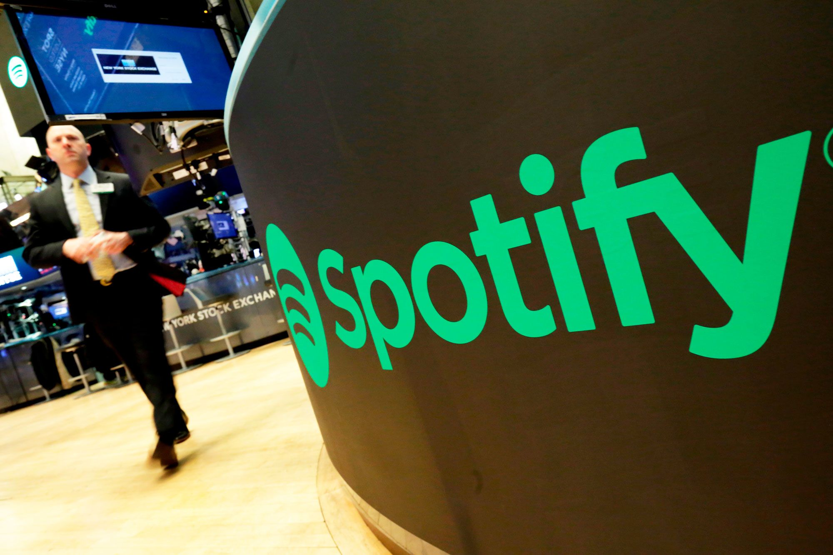
To maintain liquidity: Spotify
Kuva: https://www.cnbc.com/2018/05/22/spotifys-ipo-disrupted-wall-street-what-lies-ahead-now-for-unicorns-looking-to-go-public.html
Liquidity: https://www.investopedia.com/terms/l/liquidity.asp
Notes:
This week’s company under examination will be Spotify, the audio streaming service that you all are familiar with
The main theme is liquidity, which means the ease with which an asset can be converted into ready cash without affecting its market price. (Investopedia)
Liquidity allows a company to cover immediate expenses or short-term debt like rent, wages, or paying suppliers without needing external capital from investors or debtors
Liquidity is important to allow the continuing function of a company, but on the other hand, too much liquidity can be a sign of a company that’s failing to invest in its future
Case-esimerkki käsittelee kaikille tuttua Spotify suoratoistopalvelua
Teemana on maksuvalmiuden säilyttäminen, eli miten varmistetaan että yrityksen kassassa on rahaa
Jos raha loppuu, seuraa konkurssi, eli firma lopettaa toimintansa ja omaisuus jaetaan velkojille

Slide 3
In this exercise:
Spotify’s financial statement
Market share, revenue and net income
Cash flow statement
Liquidity
Balance sheet
Financial indicators
Notes:
We will be going through Spotify’s financial statement

Slide 4
In this exercise:
Spotify’s financial statement
Market share, revenue and net income
Cash flow statement
Liquidity
Balance sheet
Financial indicators
Notes:
First, we will go through some basic information about Spotify’s market share, revenue and net income
After that we take a look at their three main cash flow statements, liquidity and balance sheet
The second part of this case study will introduce you to some financial indicators and what can be learned from them

Slide 5
Market share
Music streaming service, released in 2008
381 million active users in September 2021, of which 172 million are paying "premium" users
Spotify Global Market Share 30% (as of Q1 2020)
The highest market share in the industry
Spotify has agreements with major record labels
The rights to use their music
https://newsroom.spotify.com/company-info/
https://www.businessofapps.com/data/spotify-statistics/
https://www.statista.com/statistics/653926/music-streaming-service-subscriber-share/
https://www.rollingstone.com/music/music-news/spotify-record-labels-dispute-720512/
Notes:
Spotify has been on the market since 2008 and as of the beginning of October 2021, they had 381 million active users of which 172 million are paying a subscription
They are the most popular music streaming service in the world at 30% market share (with Apple music at 25% as the closest competitor) this has fallen over the last couple of years due to heavy competition from Apple, Amazon, and Google
Spotify has agreements with all major record labels and those allow it to use their music
They have paid over 21 billion euros total for these rights since launch
As with the IKEA case study, these agreements help safeguard the delivery of supplies or in their case music for the service as without it the service would lose its value for almost all customers
Spotify on ollut markkinoilla vuodesta 2008 asti
Ajan myötä käyttäjien määrä on kasvanut ja Spotify on saavuttanut suurimman markkinaosuuden musiikin suoratoistomarkkinoilla
Markkinaosuus: kuinka paljon alan kokonaismyynnistä kuuluu yritykselle
Spotify on solminut sopimuksia merkittävimipien levy-yhtiöiden kanssa
Samoin kuin IKEA-esimerkissä, tavoitteena on turvata toimitusten saatavuus (tässä tapauksessa turvataan musiikin saatavuus Spotify-palveluun)

Slide 6
Revenue and net income
Despite increasing revenue, Spotify has always made yearly net losses
How is this possible?
Data: https://www.businessofapps.com/data/spotify-statistics/
Notes:
Spotify’s revenue has grown almost exponentially up to 2016 and the growth has continued linearly even after that
Still, the company has yet to make profit after 12 years of operation
So how is this possible? This brings us to the case study question: How are they able to grow their business and pay all expenses while operating at a loss?
Vaikka olettaisi, että Spotify tekisi paljon tuottoa kulujen jälkeen, yritys on toiminut koko ajan negatiivisella tilikauden tuloksella
Vasta 2018 neljännellä kvartaalilla Spotify ylsi positiiviseen tulokseen
Koko vuoden 2018 tilikauden tulos oli kuitenkin negatiivinen
Tästä päästään case-kysymykseen: Jos Spotify on toiminut aina tappiolla, miten yritys kykenee kasvattamaan liiketoimintaa ja samalla maksamaan kaikki kulut?

Slide 7
In this exercise:
Spotify’s financial statement
Market share, revenue and net income
Cash flow statement
Liquidity
Balance sheet
Financial indicators
Notes:
To dive deeper, let’s next look at the three cash flow statements: from operating, investing and financing activities

Slide 8
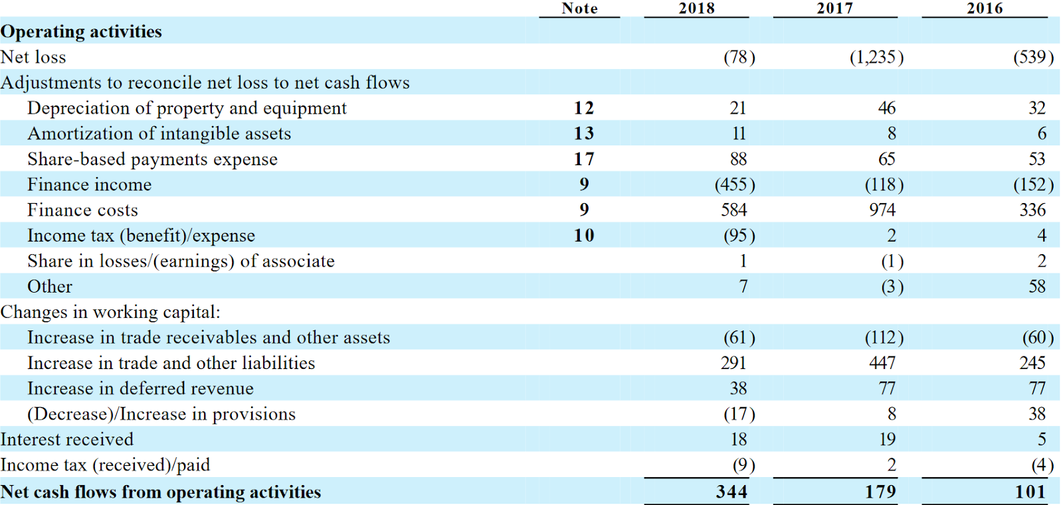
Cash flow from operating activities CF_{OPS}
CF_{OPS} =Net income
+ Non-Cash expenditures
- non-cash income
- change in working capital
Non-cash expenditures include depreciation
CF_{ops} is the total cash flow from operating activities
Data: https://www.marketwatch.com/investing/stock/spot/financials/cash-flow
Notes:
Cash flow from operating activities is the amount of money a company gets from its regular business activities like manufacturing and selling goods and services
To get this cash flow, we first take the net income of a company and add all non-cash expenses and remove all non-cash income. This is done because the income statement includes some transactions where no cash is transferred. An example are the depreciations, which are marked as an expense even though no cash is paid for them.
Then we remove the change in working capital which is the difference between a company’s current assets and its current liabilities (with current here meaning with a term of under 1 year)
This should always be positive, as a negative operating cash flow means that you can’t cover your costs because you either don’t earn enough or aren’t getting paid quick enough
There are many different formulas but the main point is to adjust the profit or loss from the income statement to showcase the actual flow of cash
This is how you can transfer from accrual accounting which records transactions immediately, to cash accounting, which records the transactions when they are paid in cash
Liiketoiminnan rahavirta kuvaa nimensä mukaisesti liiketoiminnasta saatuja maksuja ja maksettuja kuluja
Tämän lisäksi liiketoiminnan rahavirtaan kuuluu korot
Laskukaavoja on monia, mutta pointtina on ‘korjata’ suoriteperusteinen tilikauden tulos maksuperusteiseksi rahavirraksi, josta on otettu pois muista toiminnoista aiheutuvat tulot ja kulut
Myyntisaamisten ja maksuvelkojen vaikutus voidaan mitätöidä laskemalla käyttöpääoman muutos

Slide 9
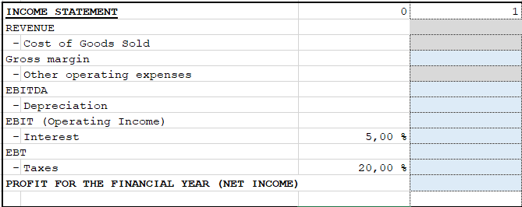
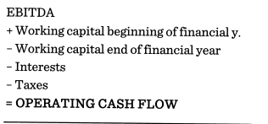
CF_{OPS} =Net income
+ Non-Cash expenditures
- non-cash income
- change in working capital
MyCourses -> Accounting -> Formulas
Notes:
For your assignment, the formula might look a little different. On the left is the one I just described, but you might find the one on the bottom to be more applicable for this exercise.
That one can be found in the formulas document in the accounting section on MyCourses and also in the Excel provided for this week
EBITDA is short for earnings before interest, taxes, depreciation, and amortization and it can also be used for calculating cash flow from operating activities
On the top is the section of the document that will give you EBITDA
You will need to fill it out with your values in the grey cells and the correct formulas in the blue ones

Slide 10
Cash flow from investing activities CF_{INV}
CF_{INV} =
New fixed assets
- Short term investments
Return on short term investments
+/- other investment income / expenses
In general, cash flow from investing activities is negative, but this is not necessarily a bad thing
Notes:
Next, we have cash flow from investing activities
In short, this is all cash flow related to investments, be it payments for new physical assets or profits from loans or securities granted by the business
For a restaurant this can often be negative due to payments for new kitchen equipment
The negativity of investment cash flow often means that the business is investing into new production which can increase its long-term health
For your assignment, you will only have to consider fixed assets. Since the growth in fixed assets requires outgoing cashflow, the change in fixed assets will be negative. It’s also necessary to subtract depreciations from this as they reduce the value of fixed assets without actual cash flow happening.
Investointien rahavirta on investoinneista syntyneet maksuperusteiset rahavirrat
Esim. Maksut uusista tuotantolaitteista
Investointien tuotot ovat yrityksen myöntämien lainojen tuotot, jne
Investointien tuotot eivät tarkoita esimerkiksi uusien tuotantolaitteiden valmistavien tuotteiden myyntiä
Laskutapoja investointien rahavirralle on monta, mutta pointtina on laskea kaikki saapuneet ja lähteneet rahavirrat investointeihin liittyen

Slide 11
Cash flow from financing activities CF_{FIN}
CF_{FIN} =
change in short-term loans
+ change in share capital
- repurchase of shares
+/- other financing income / expenses
Positive CF_{FIN}: Company’s assets increase
Negative CF_{FIN}: Company is paying its debts, dividends to investors or repurchasing stock
Notes:
Lastly, we have cash flow from financing activities
This showcases cash flow related to funding the company, such as loans from creditors (or convertible notes), selling and buying back shares, and paying dividends
Cash flow from financing activities can tell us about the capital structure of a company
It can be positive if the company is taking on more debt or selling shares
This can be negative if the company is paying off its debts, paying investors dividends or repurchasing its stock
For your assignment, the formula looks like this
We first have the change in shareholder’s equity or the buying and selling of stock. Then we subtract the dividends that are being paid out and finally account for the change in loans outstanding
Viimeisenä rahoituksen rahavirta
Sijoittajien myöntämät lainat (convertible notes) kuuluvat rahoituksen rahavirtaan
Lainan myöntäminen + ja lainan takaisinmaksu -
Osakepääoma (eli osakkeiden myyminen) kuuluu rahoituksen rahavirtaan
Vastaavasti osakkeiden ostaminen takaisin kuuluu rahoituksen rahavirtaan
Osakkeiden myyminen nostaa osakepääomaa, osakkeiden takaisinosto laskee osakepääomaa
Kaavoja on jälleen monia rahavirran laskuun, mutta tuloksena on maksuperusteinen rahoitustapahtumista syntynyt rahavirta

Slide 12
In this exercise:
Spotify’s financial statement
Market share, revenue and net income
Cash flow statement
Liquidity
Balance sheet
Financial indicators
Notes:
Now let’s finally move on to liquidity

Slide 13
Liquidity
In general:
Cash at the end of accounting period$= CFOPS + CFINV + CFFIN+cash at the start of accounting period$
The figure shows that cash and cash equivalents have been positive at the end of each financial year
Spotify has thus maintained its liquidity despite a negative result
Notes:
In general, liquidity can be calculated from the previous three cash flows, and it shows the available cash at the end of the accounting period
Companies maintain liquidity by having cash and cash equivalents always available
As you can see from the table, despite operating at a net loss, Spotify has always maintained positive cash and equivalents at the end of the year, which means that they have maintained liquidity
In the table, we have also accounted for the gains or losses in currency exchange
Tämä asia kuuluu sisäistää: rahavirtojen vaikutus rahavaroihin
Kolmen rahavirran summa kertoo, kuinka paljon yrityksen rahavarat muuttuvat tilikautena
Spotifyn rahavirtalaskelmissa huomioidaan valuuttakurssien vaikutus
Pointtina on ymmärtää, että Spotifyn rahavarat ovat aina olleet positiiviset, eli maksuvalmius on säilynyt

Slide 14
Company liquidity
The company can run at a loss, as long as it has enough cash!
A negative result for the financial year alone does not indicate that the business is unprofitable
Startups in particular, start out at a loss and need external financing to keep cash flow positive
If you run out of cash, you will go bankrupt
-The company's assets are converted into cash and distributed to creditors
Notes:
The main lesson of this segment is that the company can also run at a loss if they maintain enough cash to cover it
As such, a negative result for the financial year in the income statement is not enough to indicate that a business is unprofitable
Businesses often run at a loss in the beginning and require external financing such as selling shares or taking loans to keep a positive cash flow
If a business runs out of cash, they will go bankrupt, their assets will be converted into cash and distributed to creditors
Rahavirtalaskelmien merkitys maksuvalmiutta tarkasteltaessa kannattaa vetää rautalangasta (eli panostakaa tämän asian opettamiseen)
Opiskelijat helposti luulevat tuloslaskelman olevan keino selvittää yrityksen rahavarat ja vastaavat tentin laskutehtäviin väärin
Jos yritys ei kykene ylläpitämään rahavaroja omalla liiketoiminnallaan, tarvitaan ulkoista rahoitusta
Startup-yritykset
Konkurssi seuraa, jos rahavarat loppuvat

Slide 15
In this exercise:
Spotify’s financial statement
Market share, revenue and net income
Cash flow statement
Liquidity
Balance sheet
Financial indicators
Notes:
Together with the income and cash flow statements, the balance sheet is the last of the three core financial statements that are used to evaluate a business
It represents the company’s financial situation up to the date of publication
A balance sheet has two sides, one for assets and the other for equity and liabilities

Slide 16
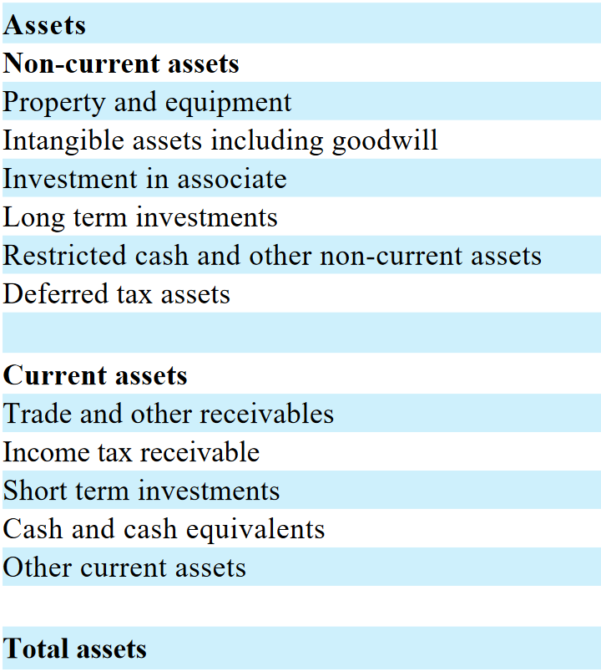
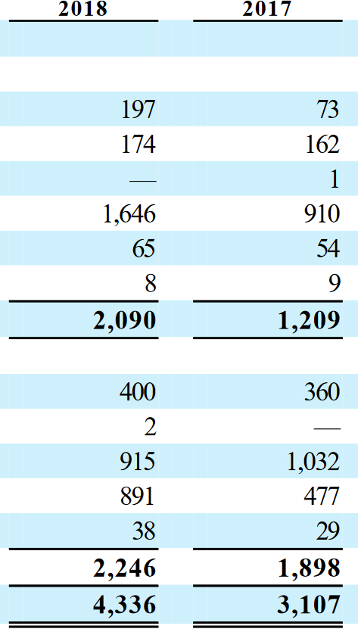
Assets
From the balance sheet we can see the development of the value of long-term investments
2017: 910 M€
2018: 1646 M€
Spotify's investments may include contracts with record companies and artists
Cash and cash equivalents is a part of company’s balance sheet
Notes:
Assets are divided into non-current and current assets
Non-current assets cannot be quickly converted into cash without affecting their market price, which means that they are not very liquid
This includes things like equipment, patents, and long-term investments
Current assets however can easily be converted into cash if necessary. In addition to cash itself, they include things like inventory and accounts receivable (or upcoming payments)
In Spotify’s case, their long-term investments are growing rapidly, which can represent money tied up in contracts with record companies and other rights holders
Different companies choose to showcase different parts of the balance sheet. For example, it wouldn’t make much sense for Spotify to have inventory in its balance sheet since they have no physical products
Eri yritykset esittävät taseesta eri osia
Esim. Spotifyn on turha esittää “varastoituja tuotteita” omaisuudessa
Vastaavaa on siis sama kuin omaisuus
Vastaavaa jakautuu pysyviin vastaaviin (non-current assets) ja vaihtuviin vastaaviin (current assets)
Pysyviä vastaavia ei voi muutta rahaksi nopeasti (esim. Laitteet, patentit, pitkäaikaiset investoinnit)
Vaihtuvat vastaavat voivat muuttua rahaksi nopeasti (esim. Myyntisaamiset, veronpalautukset, lyhytaikaiset investoinnit, rahavarat)
Investoinnit kuuluvat omaisuuteen
Esim. Laitteet, patentit
Spotifyn tapauksessa pitkäaikaisten investointien arvo on kasvanut
Mahdollisena syynä levy-yhtiöiden kanssa tehdyt sopimukset

Slide 17
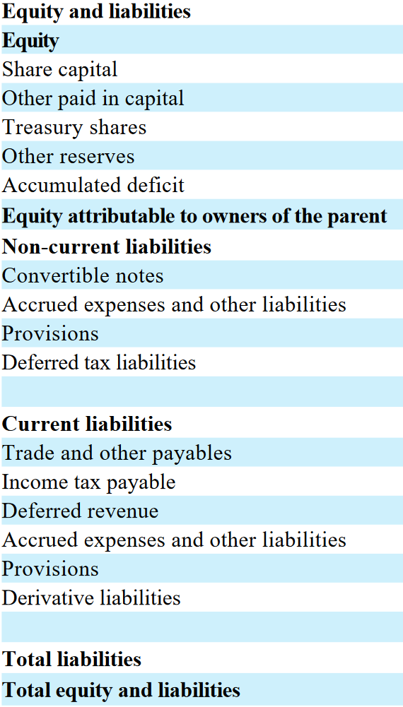
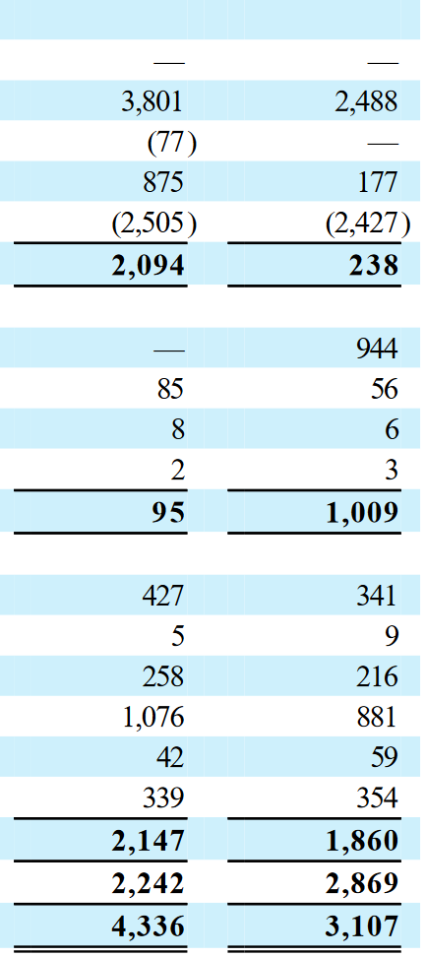
Equity and Liabilities
$Equity Ratio=\frac{Total Equity}{Total assets}$
The higher the ratio, the less risky a company is (as more funds come from shareholders’ equity rather than debt)
Spotify's equity ratio has increased: From 0.08 in 2017 to 0.48 in 2018
No long-term debt in 2018
Notes:
On the other side of the balance sheet, we have equity and liabilities
They describe the sources of cash for acquiring assets
Equity includes share capital, accumulated earnings and other capital reserves
As you can see, Spotify’s equity grew substantially over the period as they launched on the stock market and raised a lot of new capital
Liabilities on the other hand include current and non-current liabilities with current liabilities expiring within the next year
From the balance sheet, we can calculate the equity ratio by dividing total equity with total assets
Higher equity ratio means that the company is less risky as more of their funds come from shareholders’ equity rather than debt
Over this period of the Initial public offering, Spotify’s equity ratio increased from 0.08 to 0.48
Vastattavaa on omaisuuden hankkimisen rahanlähteet
Vieras- ja oma pääoma
Omaan pääomaan kuuluu tilikauden tulos, kertynyt tulos ja osakepääoma
Vieraaseen pääomaan kuuluu pitkä- ja lyhytaikaiset velat
Huomioitavaa on Spotifyn oman pääoma osuuden kasvu vastattavissa
Listautuminen pörssiin kasvatti omaa pääomaa
Samalla Spotify antoi velkojille mahdollisuuden muuttaa pitkäaikainen velka omaksi pääomaksi (eli vieraasta pääomasta omaksi pääomaksi)
Tämä voi olla velkojille parempi vaihtoehto, jos yrityksen oman pääoman kustannus on korkeampi tulevaisuudessa

Slide 18
2018 2017
Total balance sheet value has increased
2017: 3107 M€
2018: 4336 M€
Notes:
So, in summary Spotify’s assets have grown due to investments in the form of contracts with rights holders
They also have had a growth of cash and cash equivalents which means that their liquidity has improved
As the name suggests, the balance sheet should always be balanced, with total assets equaling total equity and liabilities
If the numbers don’t match, you have either missed some transactions, or classified or recorded them incorrectly
Yhteenvetona: Spotifyn omaisuus on kasvanut
Investoinnit levy-yhtiöiden sopimuksiin
Rahavarojen kasvu
Taseyhtälö pätee aina
Total assets = Total equity and liabilities

Slide 19
In this exercise:
Spotify’s financial statement
Market share, revenue and net income
Cash flow statement
Liquidity
Balance sheet
Financial indicators
Notes:
Now we will look at four financial indicators to understand the financial viability of Spotify
These are: Return on equity, profitability, current ratio and debt ratio
There are also many others but we will be using these four for this study

Slide 20
Spotify’s financial indicators
Return on equity:
$ROE−\%=100∗\frac{Net income 2018}{Equity (2017 and 2018 average)}$ = $100∗\frac{−78 M€}{\frac{\left(2094 M€+238 M€\right)}{2} }=−6,689…\%$ Negative ROE is generally interpreted as being bad for profitability
Investments made by Spotify may not have generated cash flow yet, which should be taken into account when assessing profitability
Apple’s ROE is 50,92 % and Alphabet’s (Google) ROE is 18,34 %
Competitors' ROE has been significantly higher
https://www.macrotrends.net/stocks/charts/AAPL/apple/roe
https://www.macrotrends.net/stocks/charts/GOOG/alphabet/roe
https://www.almatalent.fi/tietopalvelut/tunnuslukuopas
Notes:
The return on equity is calculated by dividing net income by total equity.
In the case of Spotify, this is -7% as their net income is negative
A reason for this might be that their investments have not generated enough cash flow yet
Spotify’s biggest competitors have significantly higher Return on equity but we need to remember that they are operating on multiple other markets in addition to music streaming
Dioista näkyy tarvittavat tiedot

Slide 21
Spotify’s financial indicators
Profitability:
Profit margin$−\%=100∗\frac{Net income}{Revenue}$
2016: $100∗ \frac{−349 M€}{2952 M€}=−11,822…\%$
2017: $100∗ \frac{−378 M€}{4090 M€}=−9,242…\%$
2018: $100∗ \frac{−43 M€}{5259 M€}=−0,817… \%$
A negative profit margin indicates that the business is unprofitable
Increasing profit margin indicates that the business might become profitable
2019: $100∗ \frac{−186 M€}{6750 M€}=−2,755…\%$
2020: $100∗ \frac{−581 M€}{7850 M€}=−7,401…\%$
Notes:
Profit margin is calculated by dividing net income by revenue
A negative profit margin obiviously means that the business is unprofitable
A negative profit margin may be the result of poor sales or overspending, but if it is increasing, it might indicate that the business will be profitable in the future
As we see with Spotify, in 2018 it looked like they were just about to be profitable but after that the margins have dropped again

Slide 22
Spotify’s financial indicators
$Current Ratio=\frac{Current assets}{Current liabilities }=\frac{2246 M€}{2147 M€}=1,046…$
the current ratio describes how a company can pay its current liabilities (debt that is due within a year)
If Current Ratio is 1, the company is barely able to meet current liabilities with cashable assets
The higher the Current Ratio, the better the liquidity
Alphabet’s Current Ratio 3,92 and Apple’s is 1,30
https://www.macrotrends.net/stocks/charts/AAPL/apple/current-ratio
https://www.macrotrends.net/stocks/charts/GOOG/alphabet/current-ratio
Notes:
The current ratio is calculated by dividing current assets with current liabilities
Because the current ratio uses the short term variant of these values, it describes how the company will be able to pay its liabilities within the next year
A company with a current ratio of 1 is barely capable to meet its current liabilities with the quickly convertable current assets
The higher it is, the better a company’s liquidity
These numbers indicate that Spotify’s liquidity is quite bad especially when compared to its competitors
This can be a result of Spotify always running at a loss and therefore being unable or unwilling to start accumulating more capital

Slide 23
Spotify’s financial indicators
Solvency:
Debt ratio$−\%=100∗ \frac{Total Debts }{Total Assets}=100∗ \frac{0 M€}{2147 M€}=0 \%$
Spotify had no interest-bearing debt at the end of 2018
In the case of Spotify, the interest-bearing debt had been converted into equity
-- Debtors were able to collect debts in the form of shares
Alphabet’s debt ratio is 2 % and Apple’s is 79 %
The level of indebtedness can vary widely between companies in the industry
https://www.vox.com/2018/1/3/16847786/spotify-tpg-tencent-debt-dragoneer-ipo-music-streaming
https://www.macrotrends.net/stocks/charts/AAPL/apple/debt-equity-ratio
https://www.macrotrends.net/stocks/charts/GOOG/alphabet/debt-equity-ratio
Notes:
The debt ratio is calculated by dividing a company’s total debts by its total assets
If the company has a debt ratio of more than 100% it means that the company has more debt than assets, which increases the risk from higher interest rates and can make getting future credit more difficult
The level of indebtedness can vary widely between companies, especially when comparing different industries
As Spotify had no interest-bearing debt in the end of 2018, their debt ratio was 0, which is lower than their competitors. This indicates that although Spotify has been operating at a loss, they could most likely still raise more funds by taking loans

Slide 24
Assignment 6: Financial statements and indicators
Financial statements excel file
Fill in the Excel file in MyCourses with your own values
Approximate the numbers in the grey cells of the Excel file yourself, and add correct formulas in the blue cells
- Blue cells’ values ​​are obtained using gray cells’ numbers
Your company is doing business in years 1-4 and in 5th year it has been closed down
- In year 5, net sales, depreciations, debt, fixed assets and working capital will be valued at 0 €
Assessment of profitability, liquidity and solvency (1 page)
Calculate at least one indicator for profitability, liquidity and solvency
- Balance sheet values ​​for profitability ratios are averaged over two consecutive years!
- The indicators are calculated in an Excel file
Compare the values ​​of your indicators with those of other companies in the industry
- Financial indicators for other companies can be found on the Internet
- Compare them in text
Return the Excel file and your text part as a PDF to MyCourses!
Notes:
For this week’s assignment, you will have to submit two separate files: An excel sheet with your calculations and a pdf document with assessment of profitability, liquidity, and solvency
Download the excel file from MyCourses, fill the grey cells with your group’s own data, and create formulas for the blue cells to fill out the rest of the sheet
In this exercise, your company will be doing business in years 1-4 and in the 5th year it has been closed down
This means that in year 5, net sales, depreciations, debt, fixed assets and working capital will be valued at 0
You can use the analysis from previous assignments to determine your revenue
In the second part you will be assessing your company’s profitability, liquidity, and solvency by calculating at least one indicator for each
Note that balance sheet values for profitability ratios should be averaged over two consecutive years
Calculate these indicators to an empty area in the excel sheet
Compare these indicator values to other companies in your industry
These values can be found openly on the internet
The comparison should be done in text

Slide 25
Assignment 6: Accounting and profitability
Return Excel-file and a pdf with the text part to MyCourses. The weekly assignment must be returned on Sunday the 6th of November by 18.00 (in two weeks)
Include your names and student numbers
Remember to give feedback:
How long did it take to do the assignment?
What new did you learn?
What should be developed in this exercise?
General comments on the course so far?
Notes:
Return both files to MyCourses by Sunday the 6th of November. This means that this week there will be no submission and next week you will be submitting two assignments
As always, include your names and student numbers in the pdf and excel files and remember to give feedback
Next week we will look at investment profitability

