Slide 1
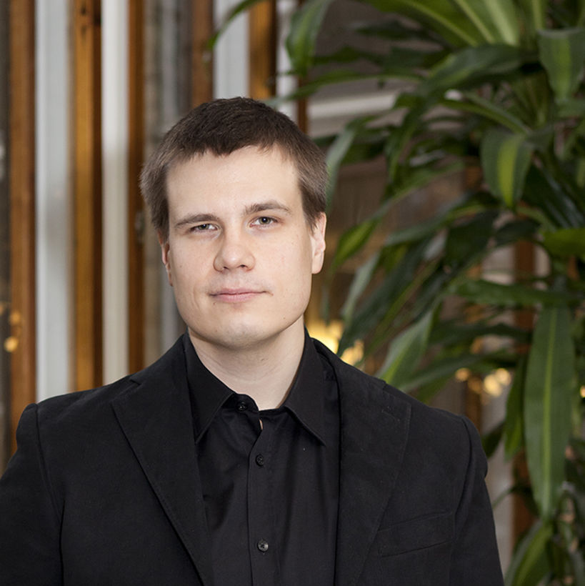
Philipp Back's doctoral journey
Photo: Aalto University / Roope Kiviranta
Philipp Back
Department of Information and Service Management
Pekka Malo
Notes:
Pekka Malo. Associate Professor (tenured), statistics Management Science

Slide 2
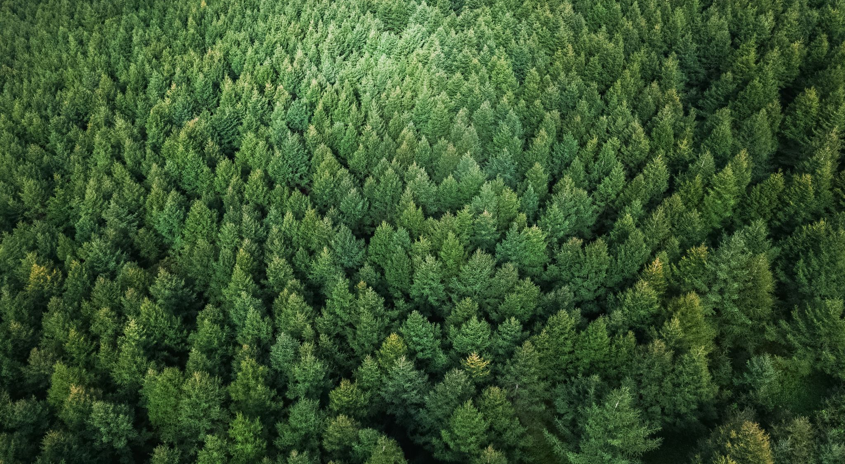
AI for Optimal and Sustainable Forest Management
How to improve forest management?
Article I
01
Multi-objective evolutionary algorithms to compute and evaluate multi-objective forestry strategies, without the need for policy makers to assign preferences a priori.
Article II
02
Marks a methodological shift and explores the necessary preconditions for successful real-world application of reinforcement learning.
Article III
03
Reinforcement learning to solve a high-dimensional optimal harvesting problem that correctly includes stochasticity in forest growth and in the occurrence of natural disasters.
Notes:
How can forest owners reconcile timber revenues, carbon sinks, and biodiversity?
Harvesting.
Advanced optimization methods.
creates a random population of solutions and records the best values ..
"Forests are precious multi-use resources with high economic, ecologic, and societal value. Forests not only produce wood - a renewable resource that is increasingly replacing fossil-based materials - but also preserve biodiversity and sequestrate CO2 from the atmosphere. Optimal forest management is therefore crucial."
Philipp's Doctoral dissertation: novel methods and insights on optimal and sustainable forest management by applying AI-based optimization techniques that have not been previously used in economic forest research.
Current topic of interest to public institutions and private companies – very well so in Finland

Slide 3
Background

Slide 4
Collaborations

Slide 5
Proactivity and community

Slide 6
Supervisor and supervisee tandem

Slide 7
Looking out of the box
"- multiple objective evolutionary algorithm - has been used for so many other domains and it seems to work on this type of problem very well, but nobody has ever used it in a forest context"​​ (Philipp Back)
​

Slide 8
Work-life balance

Slide 9
Regrets

Slide 10
Role building

Slide 11
Research with impact

Slide 13
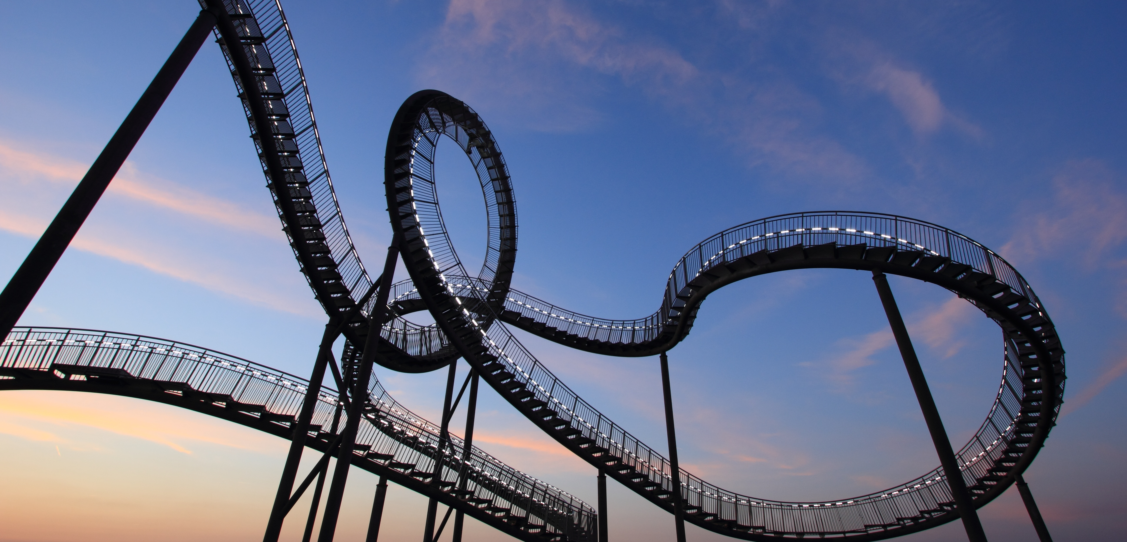
On a "rollercoaster" journey: Success is impact and balance
Notes:
: patents and business – patenting their algorithm.
Business background, Data Engineering and peer pressure
Method first
Collaborations: 1st paper and multidisciplinarity
Looking out of the box
Work-life balance , regrets, role building and research with impact

Slide 14
Thank you!
Presentation by Anastasiya Koptsyukh
This Photo by Unknown author is licensed under CC BY-NC-ND.

