Slide 1
Systems, equipment and procedures supporting ship safety
Marine and Ship Systems Engineering course
Dr Victor Bolbot

Slide 2
Contents
Introduction
Learning outcomes
Firefighting systems
Lifesaving appliances
Safety systems
Regulatory framework and standards
Concluding remarks

Slide 3
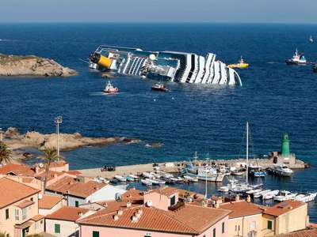
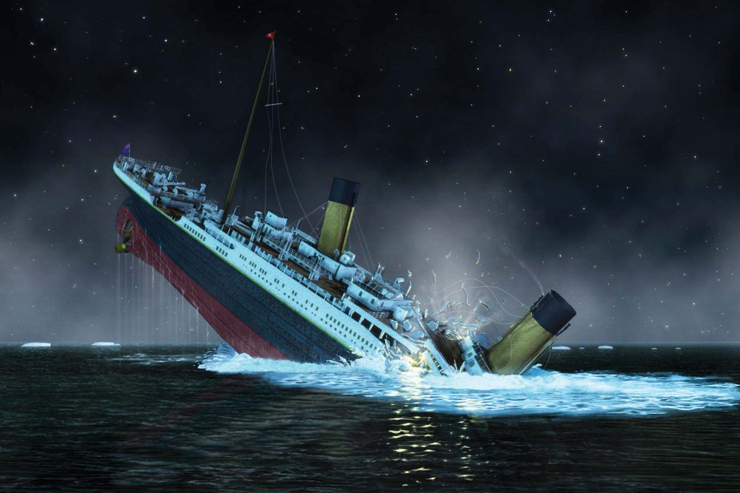
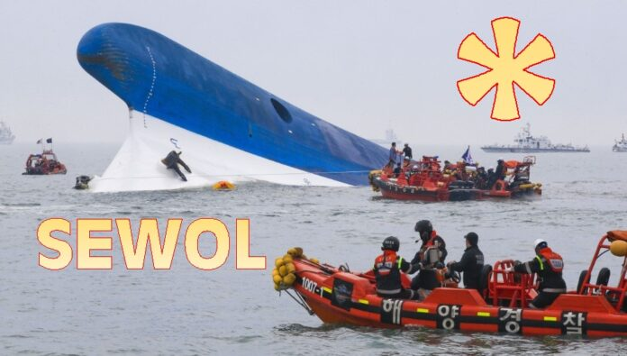
Introduction
Ships operate in a harsh environment - Accidents do happen on ships
© Encyclopaedia Brittannica
© Maritime Cyprus

Slide 4
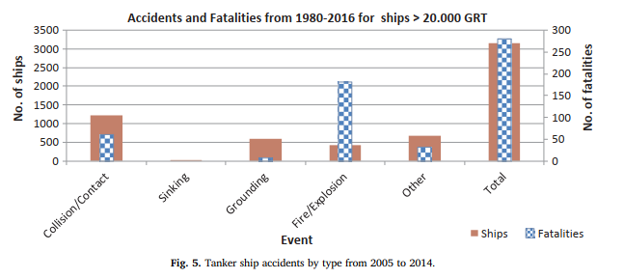
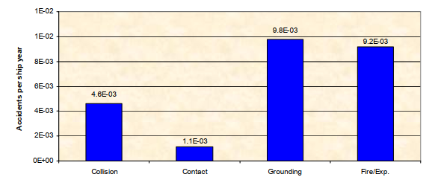
Introduction
The main accident types:
Fire / Explosion
Foundering (sinking)
Machinery damage
Operating personnel injury or death
Collision – two or more ships colliding
Contact (allision) – ship colliding with pier
Grounding – ship hitting the seabed or rocks
Vidmar and Perkovič 2018 Safety assessment of crude oil tankers
© MSC 85/INF.2 for cruise ship with GT>20000

Slide 5
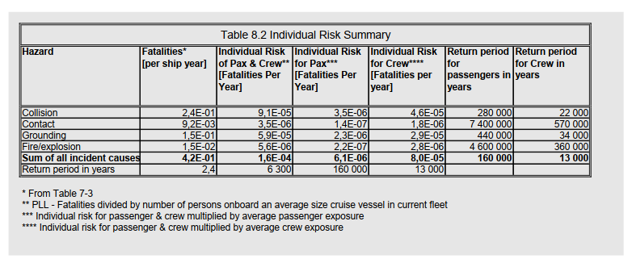
Introduction
The main accident types:
Fire / Explosion
Foundering (sinking)
Machinery damage
Operating personnel injury or death
Collision – two or more ships colliding
Contact (allision) – ship colliding with pier
Grounding – ship hitting the seabed or rocks

Slide 6
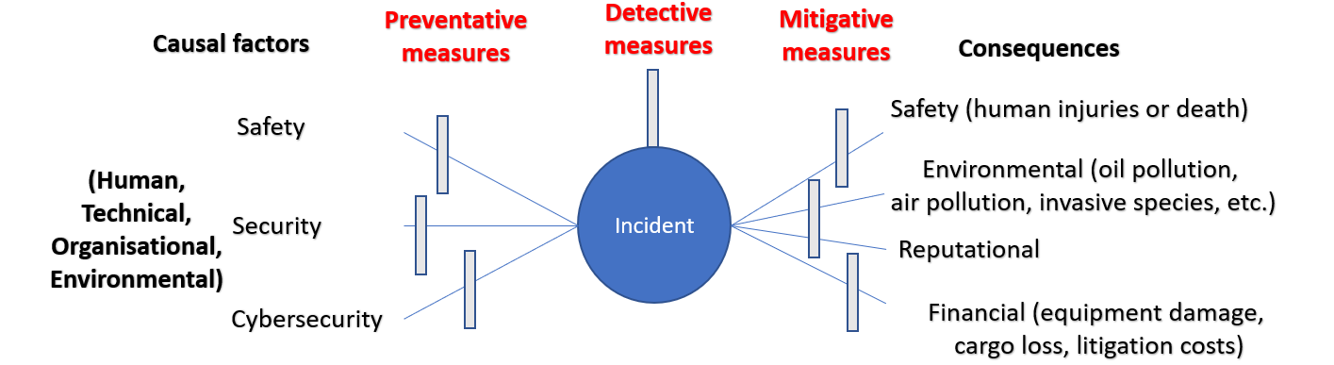
Introduction
A ship in harbor is safe, but that is not what ships are built for. – U.S. Navy Rear Admiral Grace Murray Hopper
We cannot design out all the hazards
Technical and organisational barriers to address the hazards

Slide 7
Learning outcomes
Understand why fires occur
Know the main systems used for fire detection fighting and their working principles, advantages disadvantages and selection criteria
The different types of life-saving appliances and evacuation systems.
The factors to consider when selecting the type and number of life-saving appliances and evacuation systems.
Safety systems
Regulations concerning systems ensuring safety

Slide 8
Learning outcomes
The material is highly relevant for assignment 5
Identify and shortly describe the safety systems, the cargo handling system, and the mooring and anchoring systems for your ship. Briefly reflect on the applicable regulation and the executed calculations for the selected systems.
You will need to talk about firefighting equipment, life-saving appliances, and other safety related equipment

Slide 9
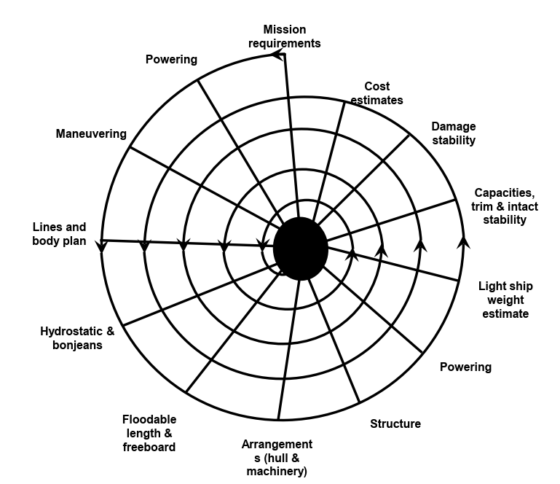
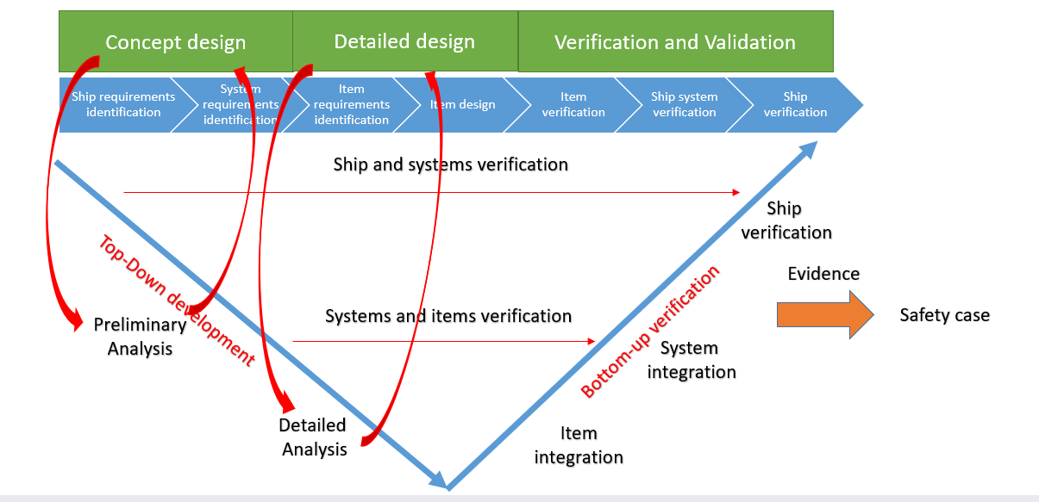
Learning outcomes
This information is required during subsequent design repetition steps
© Autoship

Slide 10
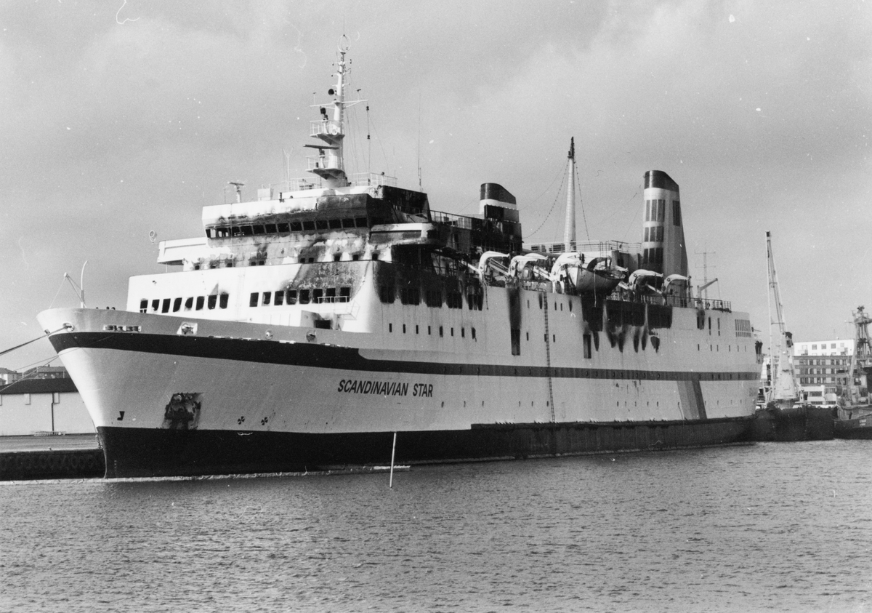
Firefighting systems
The importance of firefighting systems
MS Scandinavian Star
1990 – Oslo-Frederikshavn line
Fire caused by a convicted arsonist
159 persons died out of 492 totally onboard
Highly disputed
The importance of fire accidents
© Wiki

Slide 11
Firefighting systems
The fire triangle
We need three elements to start the fire (chain reaction)
Explosion can also occur (fuel in gaseous mode and is specific concentration)
Toxic fumes, CO, CO2, unburnt CxHy, smokes
Death from burnt, suffocation
If you remove one of the elements, fire won’t start-continue
There are some exceptions e.g. Li-On batteries
You can stop-prevent the fire by stopping the chain reaction
© Wiki

Slide 12
Firefighting systems
The fire triangle
Fuel
Hydrocarbons (CxHy)
Hydrogen
Li-on batteries
Etc.
Can be
Liquid (Diesel, Heavy fuel, Li-on batteries)
Gaseous form (Methane, Hydrogen, Acetylene, Anhydrous Ammonia, Ethylene)
Solid (Wood based material, textiles, plastic)
Depending on the temperature
© Wiki

Slide 13
Firefighting systems
The fire triangle
Heat
Main engines and generators
Scrubbers
Electrical panels
Switches
Electric motors
Short circuits (electrical equipment)
Arcing (switchboards)
Electrical overloads
Arson
Impact
Can be transferred
Conduction (through solid body by contact)
Radiation
Convection (moving of hot air masses)
© Wiki

Slide 14
Firefighting systems
IMO Resolution A.602(15) – 1987 revoked
IMO Resolution A.951(23) – 2003
Types of fire
ISO Standard 3941 | NFPA 10
Class A: Fires involving solid materials, usually of an organic nature, in which combustion normally takes place with the formation of glowing embers | Class A: Fires in ordinary combustible materials, such as wood, cloth, paper, rubber and many plastics.
Class B: Fires involving liquids or liquefiable solids. | Class B: Fires in flammable liquids, oils, greases, tars, oil-based paints, lacquers and flammable gases.
Class C: Fires involving gases. | Class C: Fires which involve energized electrical equipment where the electrical non-conductivity of the extinguishing medium is of importance. (When electrical equipment is de-energized, extinguishers for class A or B fires may be used safely.)
Class D: Fires involving metals. | Class D: Fires in combustible metals, such as magnesium, titanium, zirconium, sodium, lithium and potassium.
Class F: Fires involving cooking oils. | Class K: Fires involving cooking grease, fats and oils.

Slide 15
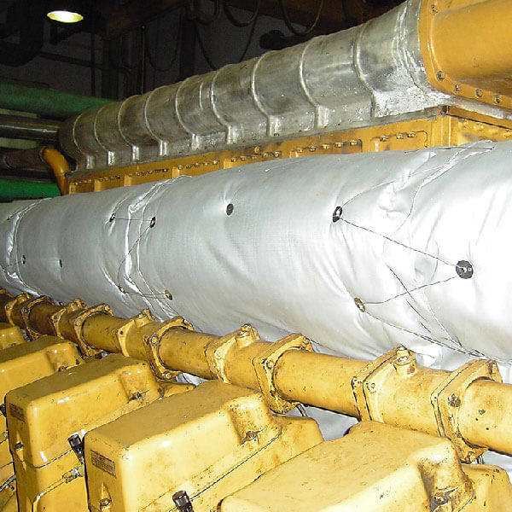
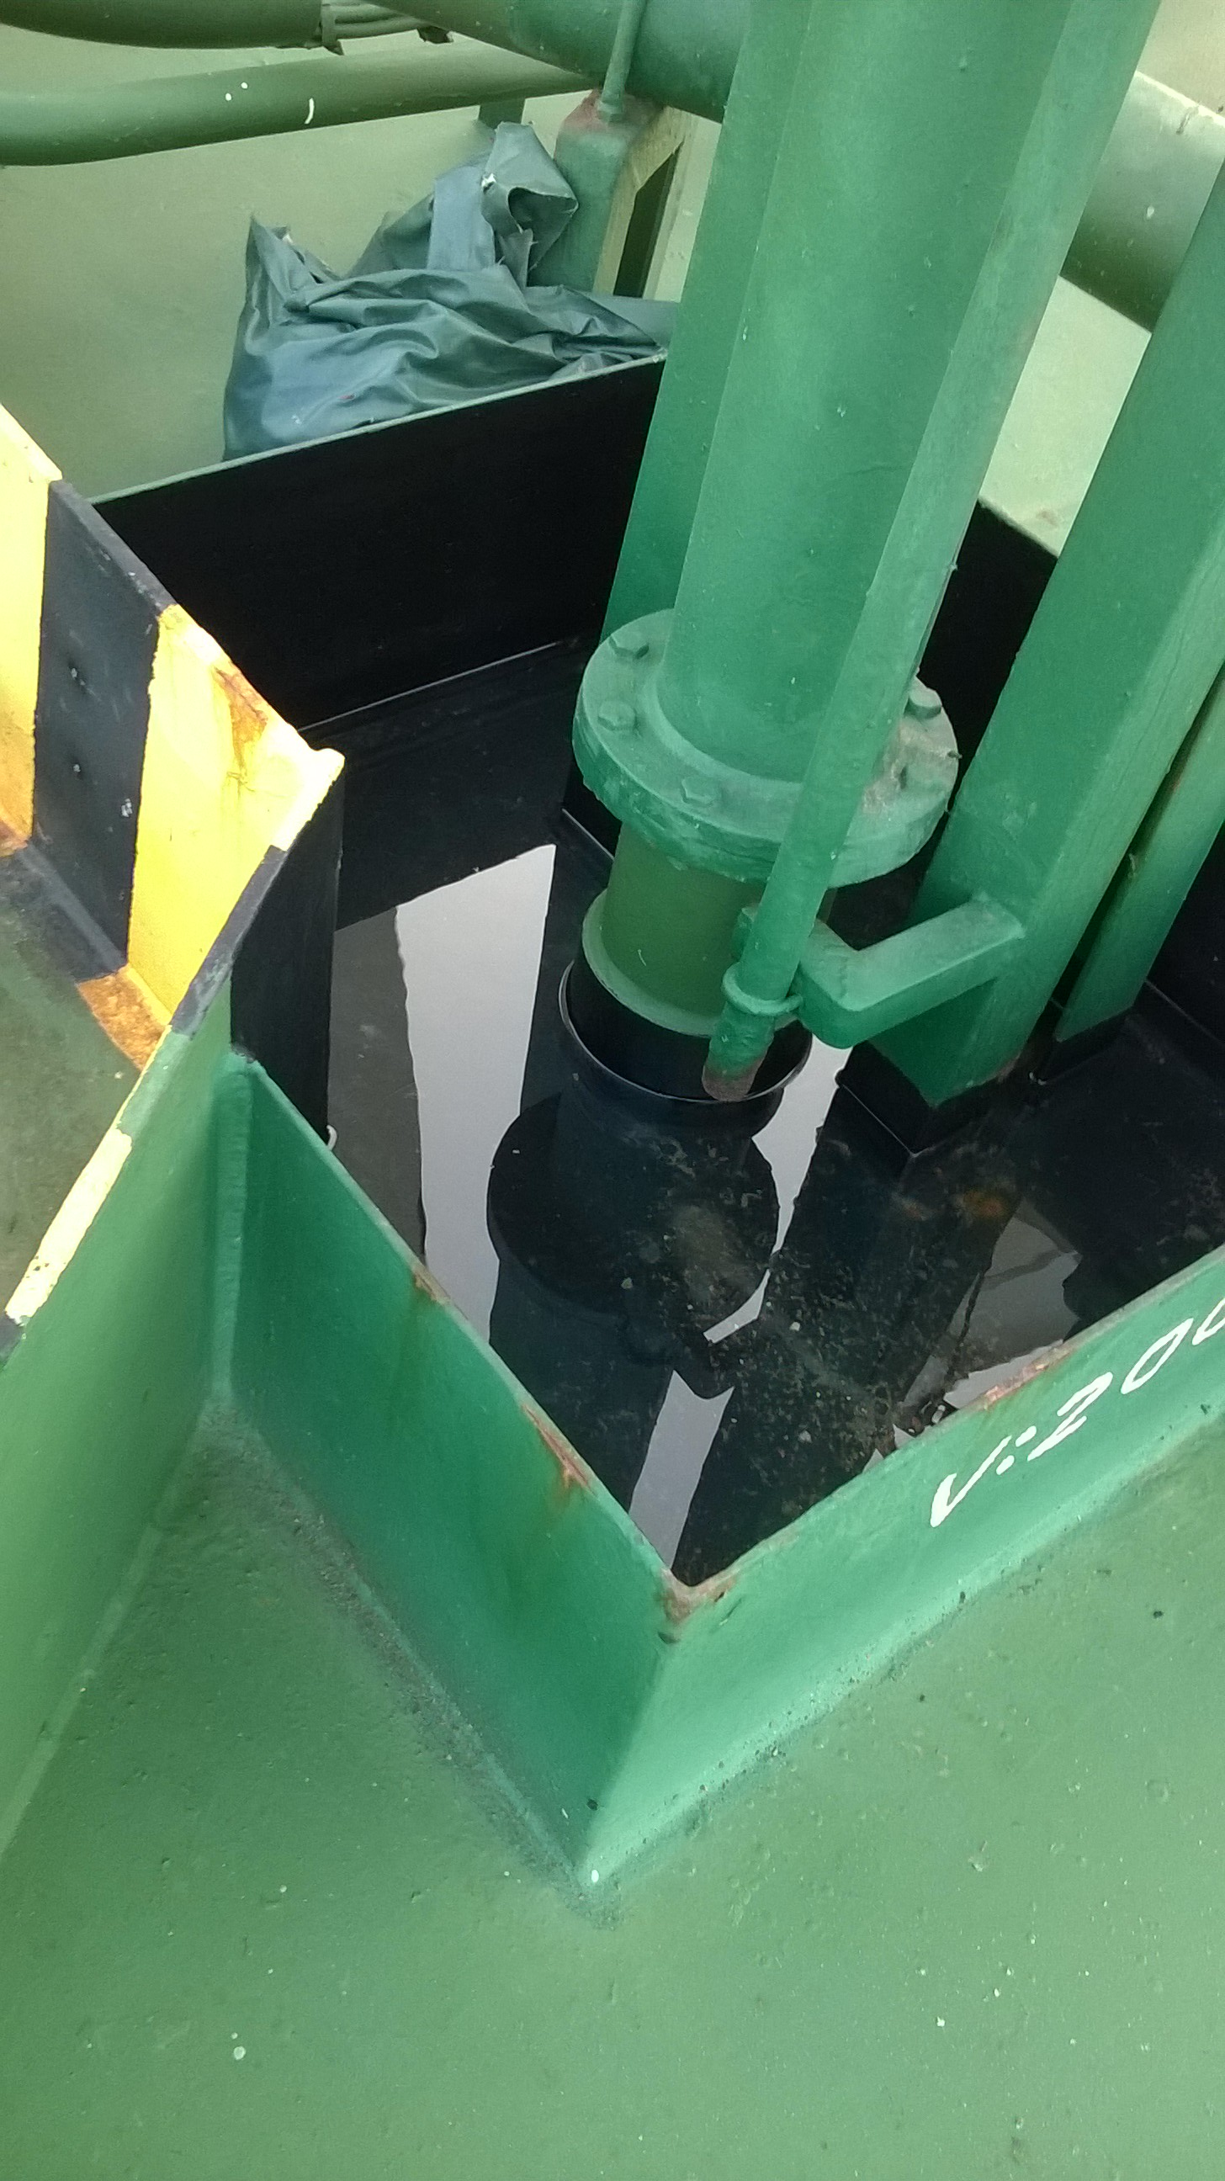
Firefighting system – Fire prevention
Segregation of fuel oil purifiers for heated oil
Segregation of high-pressure hydraulic units
Leakage containment systems
Insulation on heated surfaces
Piping material with low conductivity
Ventilation to avoid build up of vapour oil
Segregating fuel tanks and machinery
© https://www.smart-shield.org/product/marine-engine-room-insulation-blankets/
© Wiki

Slide 16
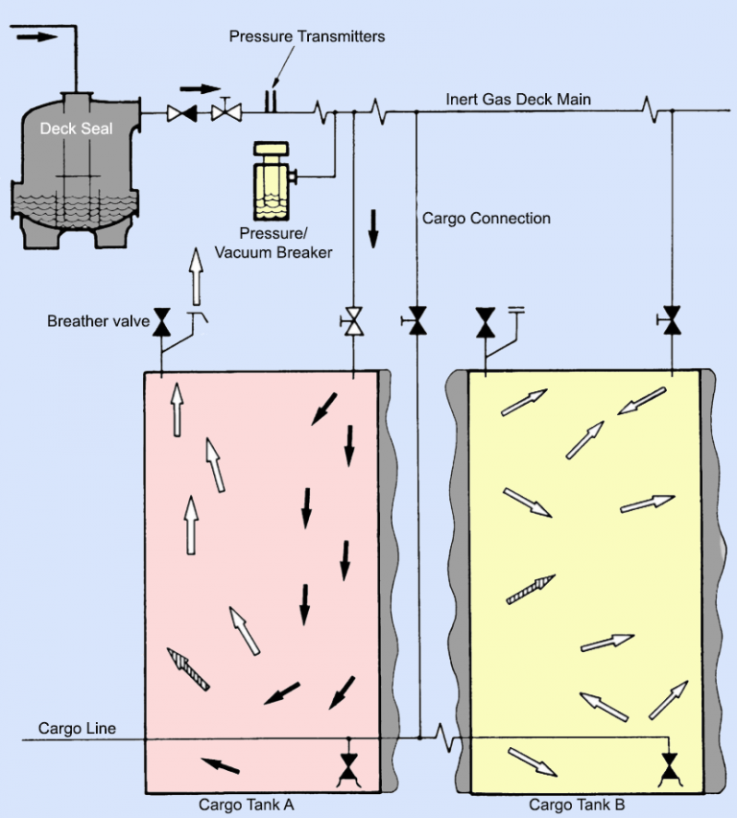
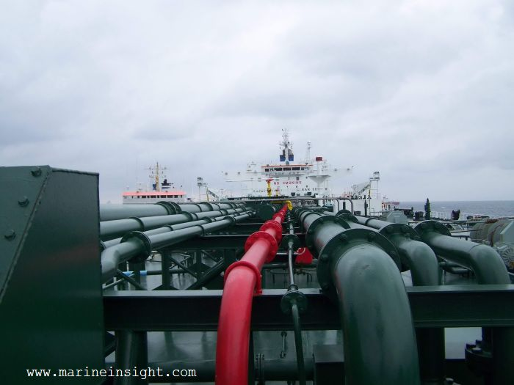
Firefighting system – Fire prevention
Eliminate one of the elements (heat, fuel, oxygen)
1970s – explosions on tankers
Static electricity as a source of sparks
Inerting gas system
Used on tankers, LNG, LPG carriers
Takes exhaust gases from main-auxilliary engine and send to the cargo tanks
If inadequate, boiler can be used
Keeps the level of O2 less than 5% (8%)
Much lower than 21% in the atmosphere
Potential use on unmanned ships?
© https://www.marineinsight.com/marine-safety/protection-against-explosion-the-i-g-system/
© https://www.marineinsight.com/marine-safety/protection-against-explosion-the-i-g-system/

Slide 17
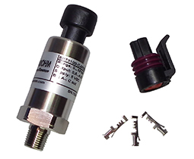
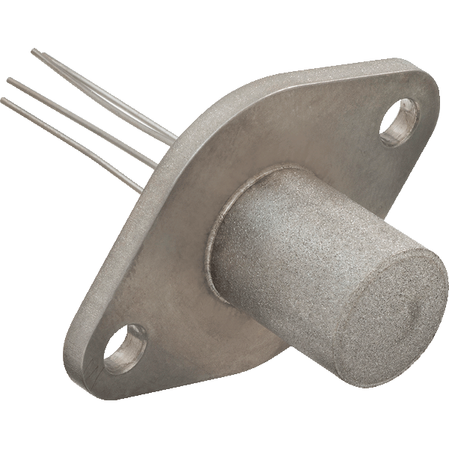
Firefighting system – Fire prevention
Fuel detectors
Leakages in fuel and lubricating pipes through pressor sensors
Hydrocarbon gas detection in tankers cargo pump room
Oil mist detector in the main engine crankcase
O2 detectors
In cargo tanks of tankers, LNG, LPG carriers
Heat detectors
bi-metallic type detecting elements – a thick strip and a thin strip
Temperature sensors on critical components (exhaust gases, main engine, etc.)
Infrared cameras
Gas detectors
© https://shopbhp.com/products/link-g4-pressure-sensor-ps150
© https://sstsensing.com/applications/marine-inerting-systems/

Slide 18
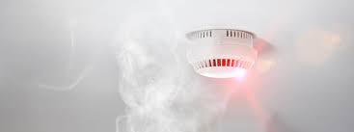
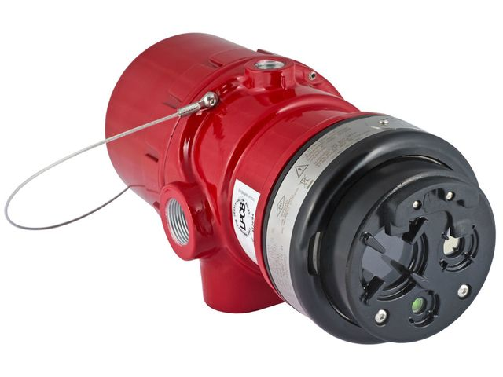
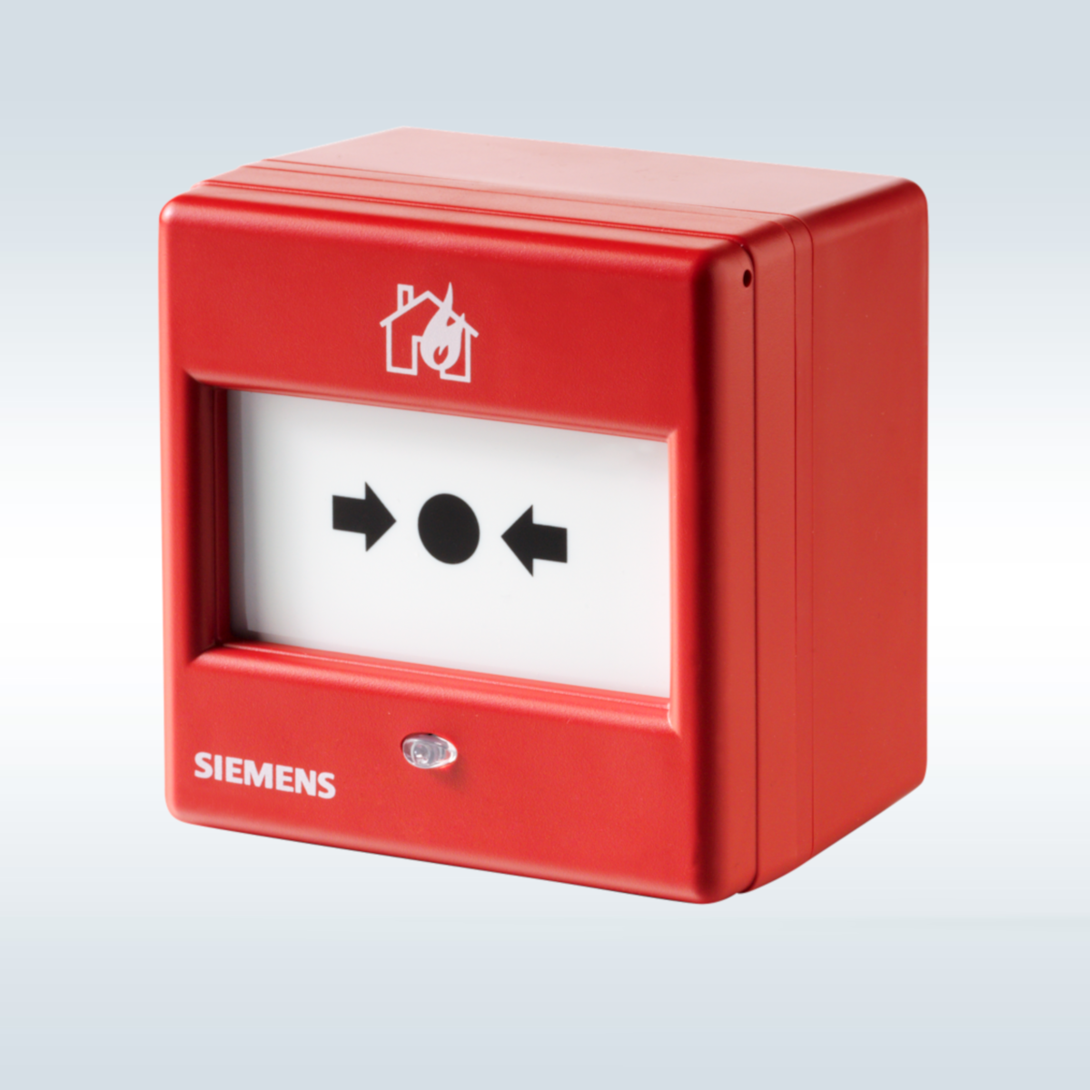
Firefighting system – Fire detection
Smoke detectors
Light obscuration type
Ionization type .
Flame detectors
Flame has a characteristic flicker frequency of about 25Hz
The spectrum in the infra red or ultra-violet range can be monitored to give an alarm
Suitable for oil fires
Manual call points
CCTV with image recognition
Fire patrols with portable radiotelephone apparatus
https://www.caverion.com/catalog/services/fire-detection-systems-and-fire-alarm-specialty-equipment/
© https://www.industry-plaza.com/simple-ir-flame-detector-x9800-p339502385.html
© https://new.siemens.com/global/en/products/buildings/fire-safety/detection/manual-call-points.html

Slide 19
Firefighting system – Fire mitigation
Types
Active – need to be activated
Passive – built into structure
Escape – previous measures failed
Mechanisms
Remove fuel
Fuel closing valve (engine room)
Remove Oxygen
Stop ventilation
Foam systems (and cool)
Powder
CO2 system
Fire blankets
Remove heat (and oxygen)
Water
Mobility
Fixed systems
Portable systems

Slide 20
Firefighting system – Fire mitigation
Fuel closing valve (engine room)
Sometimes conflicts of safety occur (blackouts due to operation of fuel closing valve)
Similar systems for oil system
Remote stop as well
https://www.iims.org.uk/beware-fuel-oil-quick-closing-valve-deficiencies/

Slide 21
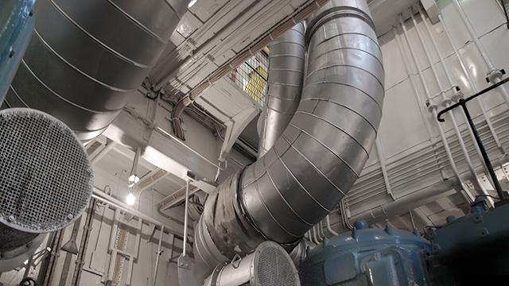
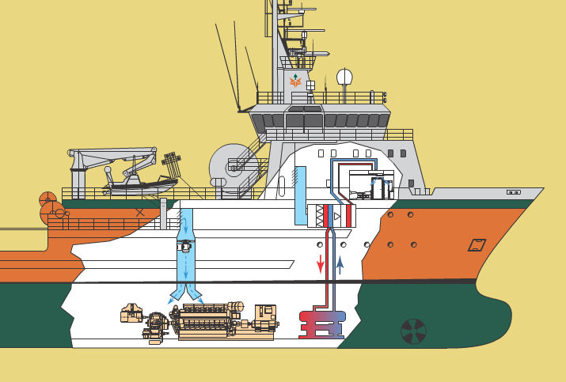
Firefighting system – Fire mitigation
Stop air supply from remote control
Reduce the oxygen supply
https://www.plm.automation.siemens.com/global/cz/industries/marine/ship-hvac-design.html
https://www.nauticexpo.com/prod/aeron/product-30720-197362.html

Slide 22
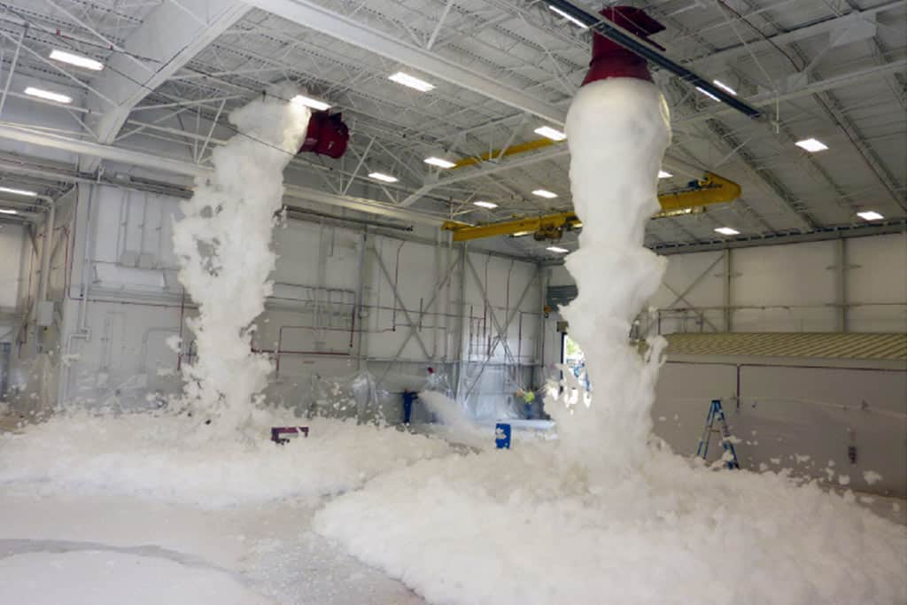
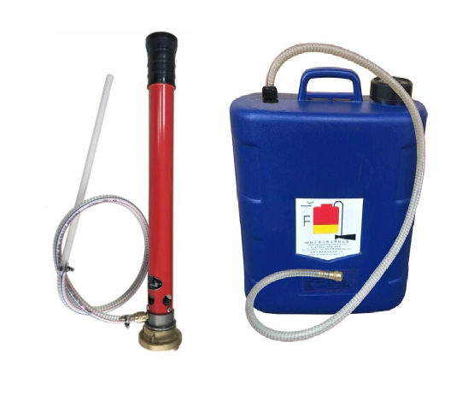
Firefighting system – Fire mitigation
Foam firefighting system
Can be fixed or portable
Forms a blanket on the surface
Offers good coverage of space
Absorbs heat
Fuel and steam resistance (not methanol)
Suitable for oil spills
Not suitable for electrical fires
Types
Chemical foam
Mechanical foam
Low expansion
Mid low expansion
High-expansion
Fixed system is required on tankers of 20000 DWT and more on deck area, all chemical tankers, helicopter landing areas
Not recommended for engine rooms
https://firesystems.net/2020/10/23/how-does-a-foam-fire-suppression-system-work/
https://technomarine.com.sg/products/portable-foam-applicator/

Slide 23
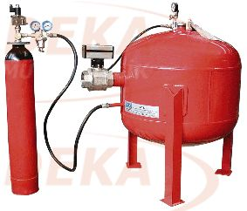
Firefighting system – Fire mitigation
Dry powder fire extinguisher
Can be fixed or portable
break the chemical reaction chain formed during the fire
forms a layer on the combustion substances and stop the contact of the flames with air
Some types suitable for fires of type D
Required on gas carriers in the deck area

Slide 24
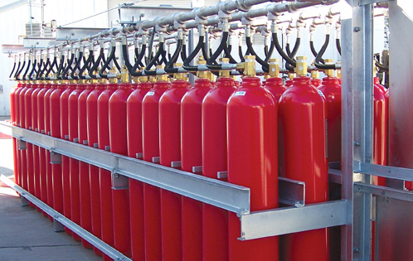
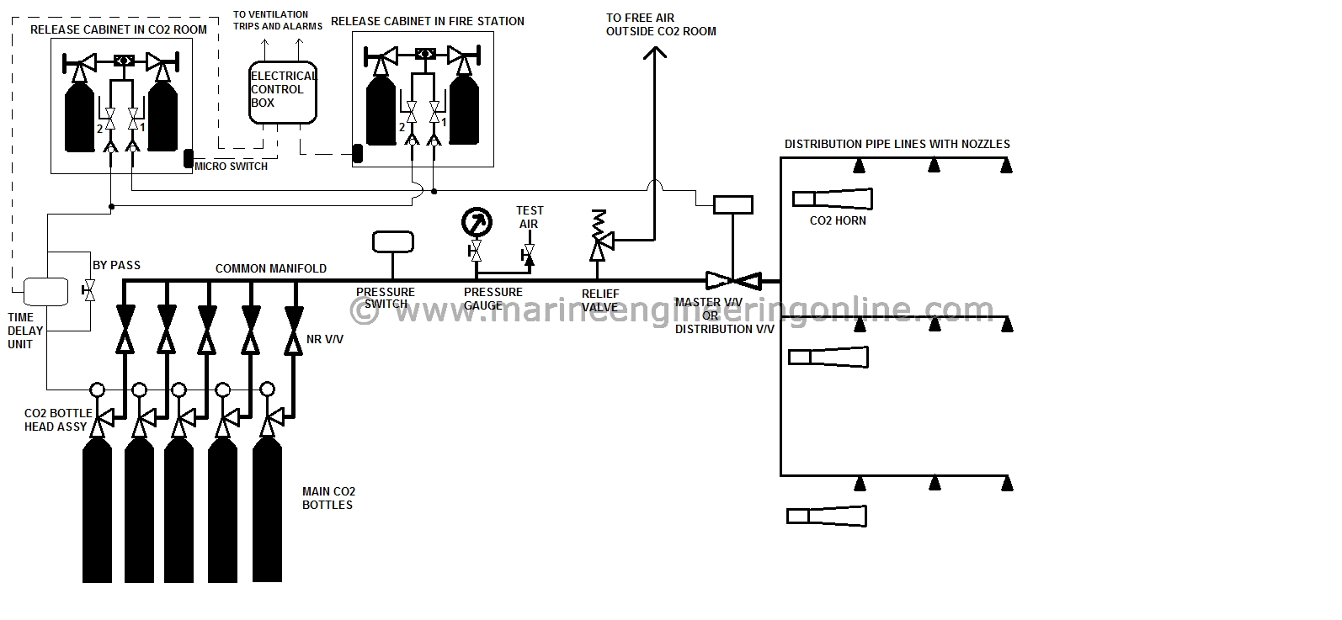
Firefighting system – Fire mitigation
CO2 firefighting system
Advantages of fixed gas systems over water-based systems
Damage to sensitive equipment can be avoided, especially in the case of electronic equipment.
Clean up time and equipment down time is substantially reduced.
Disadvantages:
Some gaseous agents are hazardous to personnel.
Cooling effect of gas systems is significantly less than water-based systems.
Unlike the unlimited supply of water for fire-fighting systems, the quantity of gas available is limited to that carried in the cylinders protecting the space.
Applications
Machinery space systems
Cargo pump on tankers
Cargo hold systems
https://www.gielle.it/carbon-dioxide-co2-fire-systems/
https://marineengineeringonline.com/co2-flooding-system-on-ships/

Slide 25
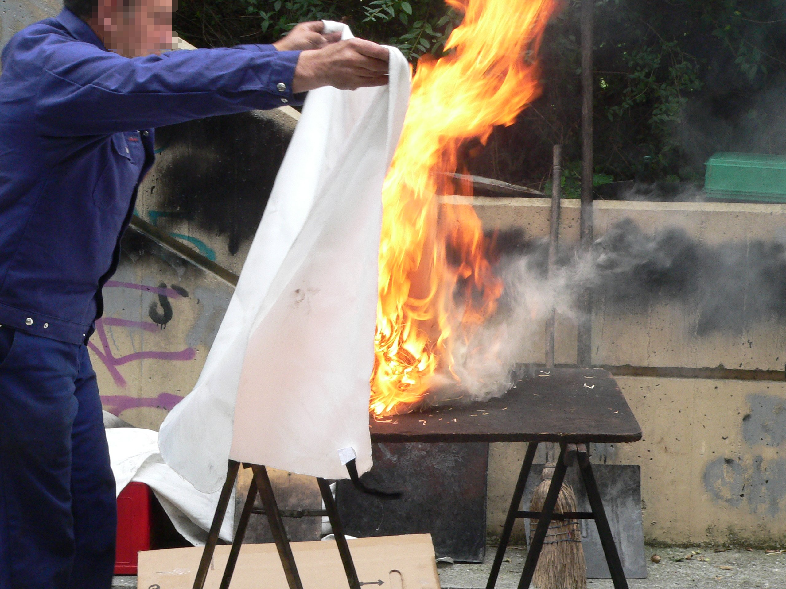
Firefighting system – Fire mitigation
Fire blanket
In the galley areas
Near helicopter area
© Wiki

Slide 26
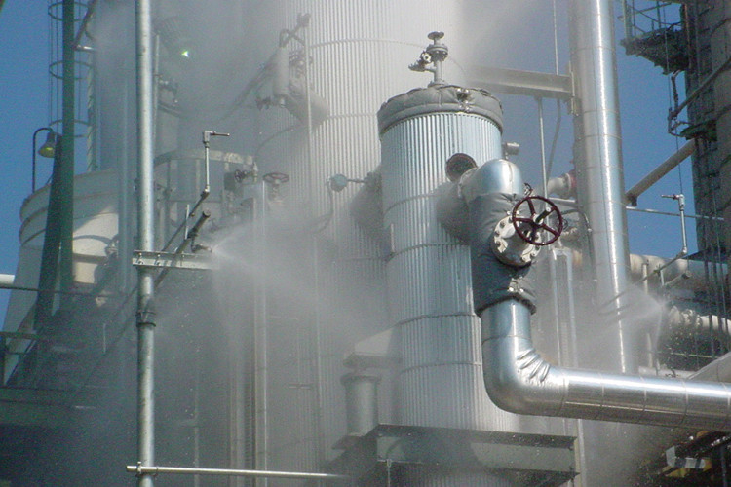
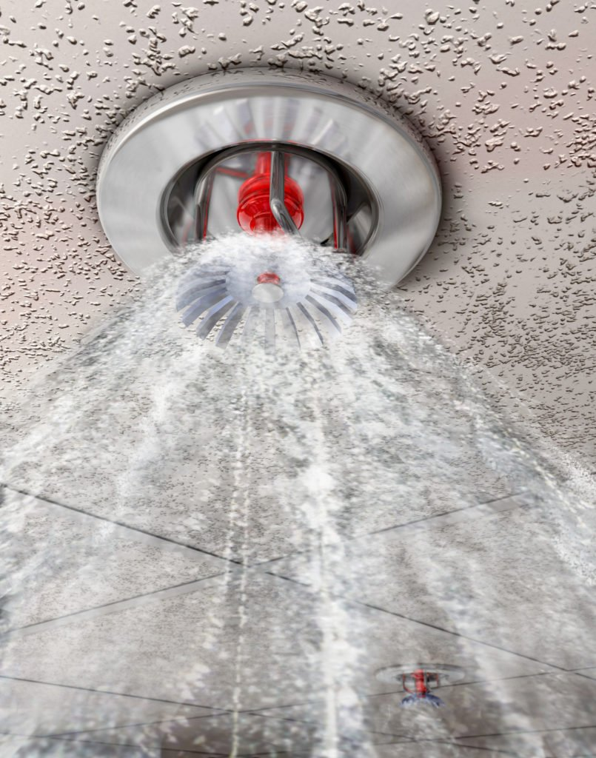
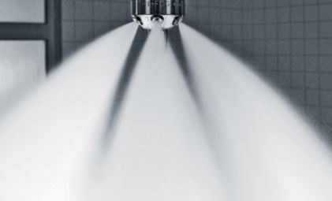
Firefighting system – Fire mitigation
Water fire-extinguishing system
It is readily available,
has great heat absorbing capabilities
can be used on a variety of fires.
Fixed or portable
Fixed types
Water spray systems
Water sprinkler systems
Water mist systems
Application areas
Spray in RoRo cargo spaces
Sprinkler to be fitted in the accommodations spaces, galleys and other service areas.
Mist in machinery spaces and cargo pump (potentially accommodation spaces as well)
Fresh water as medium
http://www.incontrolsystems.net/water-spray-systems
https://www.ifsecglobal.com/fire-sprinkler-systems/
https://www.ifsecglobal.com/fire-news/water-mist-fire-protection-guide-responsible-person/

Slide 27
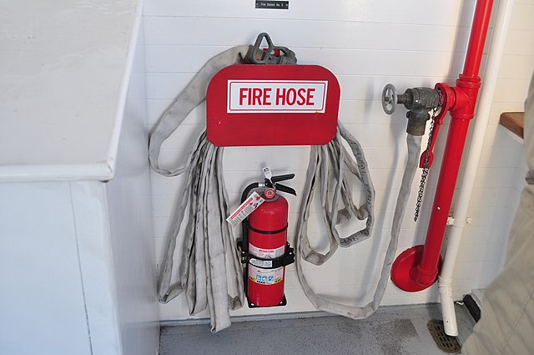
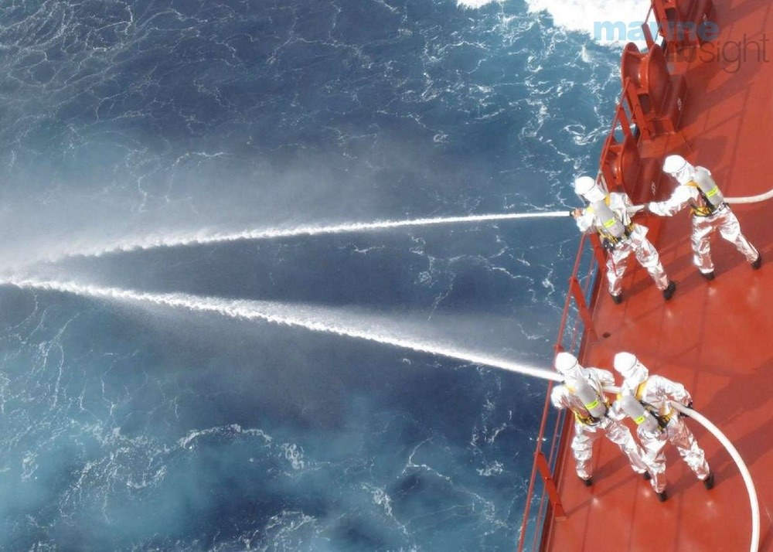
Firefighting system – Fire mitigation
Fire main systems
At least 2 main + 1 emergency fire pump + 1 at the bow
Hoses
Sea water
Wiki
https://www.marineinsight.com/tech/guide-to-fire-pumps-on-ship/

Slide 28
Firefighting system – Fire mitigation
Extinguishing medium | Recommended for use on fires involving
Water Water with additives | Wood, paper, textiles and similar materials
Foam | Wood, paper, textiles and flammable liquids
Dry powder/dry chemical (standard/ classes B, C ) | Flammable liquids, electrical equipment and flammable gases
Dry powder/dry chemical (multiple or general purpose/classes A, B, C) | Wood, paper, textiles, flammable liquids, electrical equipment and flammable gases
Dry powder/dry chemical (metal) | Combustible metals
Carbon dioxide | Flammable liquids and electrical equipment (Type B and C)
Wet chemical for class F or K | Cooking grease, fats or oil fires

Slide 29
Firefighting system – Fire mitigation
Summary for some of locations for firefighting equipment
Machinery Spaces. Category “A” machinery spaces are required to be fitted with a fixed gas extinguishing system, fixed water spray/mist system or high expansion foam system.
Cargo Tanks. In addition to an inert gas system intended to maintain the cargo tanks in an inerted condition, oil and chemical carriers with cargo tanks carrying flammable liquid cargoes are required to be fitted with a foam system for coverage on the deck. The cargo pump rooms for such spaces are also required to be fitted with fixed fire extinguishing systems (water or CO2).
Ro-Ro Spaces. Ro-ro spaces are required to be fitted either a fixed gas extinguishing system or a water spray system.
Paint Lockers. Paint lockers must be fitted with a CO2 system, a fixed water spray system or a dry powder system.
Accommodation. Water based systems (sprinkler or water mist)
Helicopter landing area. Fixed foam system
Portable extinguishers should be available as per requirements in various locations

Slide 30
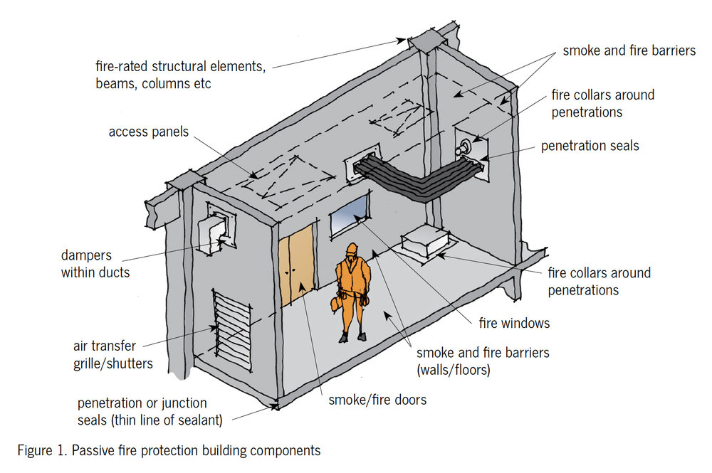
Firefighting system – Fire mitigation
Passive firefighting equipment
Divisions formed by bulkheads, decks, etc.
Steel or equivalent material
Class A, B or C according to SOLAS
https://www.safetyfirst.co.nz/news/passive-fire-protection

Slide 31
Firefighting system – Fire mitigation
Class A:
A class divisions are “insulated with approved non-combustible materials such that the average temperature of the unexposed side will not rise more than 140℃ above the original temperature, nor will the temperature, at any one point, including any joint, rise more than 180℃ above the original temperature, within the time listed below:” (from SOLAS)
class “A-60” 60 min
class “A-30” 30 min
class “A-15” 15 min
class “A-0” 0 min
preventing the passage of smoke and ﬂame to the end of the one-hour standard ﬁre test

Slide 32
Firefighting system – Fire mitigation
Class B:
have an insulation value such that the average temperature of the unexposed side will not rise more than 140℃ above the original temperature, nor will the temperature at any one point, including any joint, rise more than 225℃ above the original temperature, within the time listed below:” (from SOLAS)
class “B-15” 15 min
class “B-0” 0 min
preventing the passage of ﬂame to the end of the ﬁrst half hour of the standard ﬁre test
Class C:
No special requirements
Check SOLAS for design purposes

Slide 33
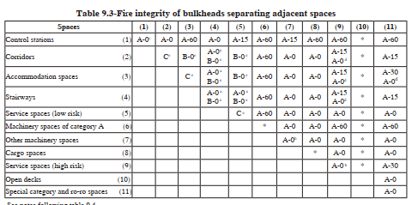
Firefighting system – Fire mitigation
Check tables 9.1 to 9.8 in SOLAS, Chapter II-2

Slide 34
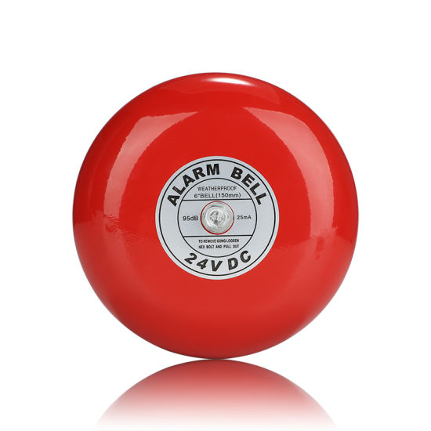
Firefighting system – Fire mitigation
Escape
Alert system should be provided
Safe escape routes should be provided
Emergency escape breathing devices
https://t-iss.com/shop/solas-safety-products/emergency-escape-breathing-device/
https://ansorl.en.made-in-china.com/product/qwzmiOdbLJcH/China-Factory-Direct-Sale-Fire-Alarm-Bell-Sound-For-Buildings.html

Slide 35
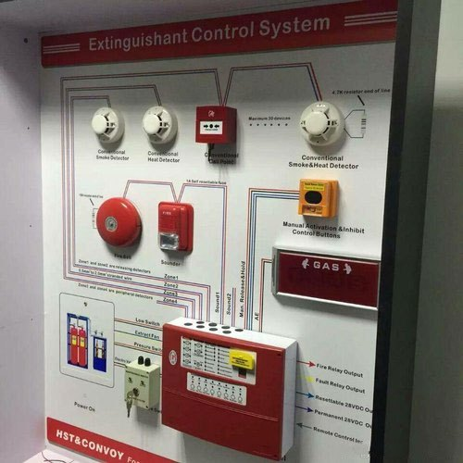
Firefighting system – Operation
Fire alarm monitoring system
The sensors measurements are collected from various locations on ships
If a critical threshold is exceeded, alarm to crew is given
Firefighting equipment is activated (in many cases automatically)
More advanced solutions are possible
https://www.indiamart.com/proddetail/conventional-fire-alarm-system-8961979355.html

Slide 36
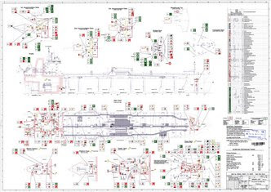
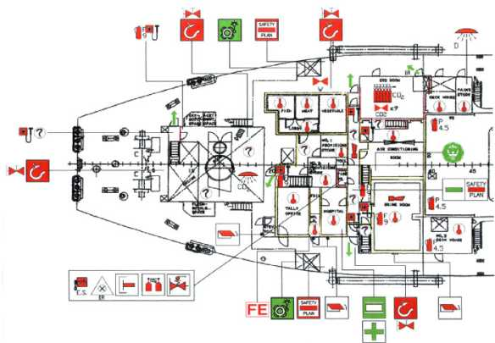
Firefighting system – Design
Following the rules and regulations
Fire control plan
Based on General Arrangement
Resolution A.952(23), “Graphical symbols for shipboard fire control plans”
http://www.inec.de/show.php%3Fid=169.html
http://classars.com/content.php?ContentID=39

Slide 37
Firefighting system – Design
Fire control plan
Control stations
Various fire sections enclosed by “A” class divisions
Sections enclosed by “B” class divisions
Particulars of the fire detection and alarm systems
Particulars of the sprinkler installation
Particulars of the fire-extinguishing appliances
Means of access to different compartments, decks, etc.
Ventilating system including particulars of the fan control positions, the position of dampers and identification numbers of the ventilating fans serving each section

Slide 38
Firefighting system
Drills – an important part of SOLAS regulations
Fire drill includes:
1 reporting to stations and preparing for the duties described in the muster list required by regulation 8;
2 starting of a ﬁre pump, using at least the two required jet of water to show that the system is in proper working order;
3 checking of ﬁreman's outﬁt and other personal rescue equipment;
4 checking of relevant communication equipment;
5 checking the operation of watertight doors, ﬁre doors, ﬁre doors, ﬁre dampers and main inlets and outlets of ventilation systems in the drill area; and
6 checking the necessary arrangements for subsequent abandoning of the ship

Slide 39
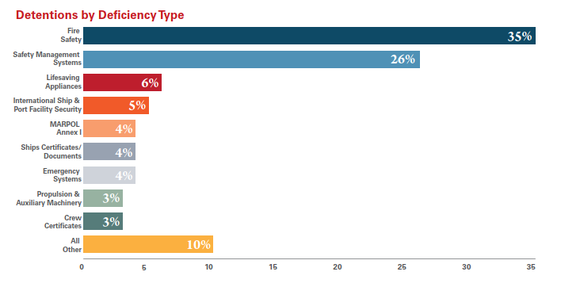
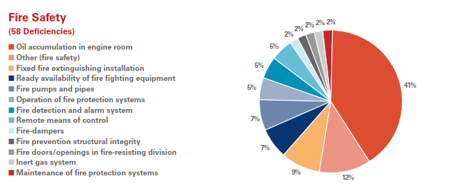
Firefighting systems
Common issues (USCG)
https://www.dco.uscg.mil/Portals/9/DCO%20Documents/5p/CG-5PC/CG-CVC/CVC2/psc/AnnualReports/annualrpt2020.pdf

Slide 40
Firefighting system - Questions
What system would you use to extinguish fire in the Li-On batteries?
Which spaces are the most prone to fire on the ship?
Where would you use A-60 class subdivisions for passive protection?
Which fire-fighting equipment would you use to extinguish fire caused by short circuit?
Which drawing you need to develop fire control plan?

Slide 41
Firefighting system – Design
Simulation models for fire
CFD
An Introduction to Fire Dynamics Third Edition Dougal Drysdale University of Edinburgh, Scotland, UK
Check SURSHIP report
https://www.vttresearch.com/sites/default/files/pdf/tiedotteet/2009/T2497.pdf

Slide 42
Break
10 minutes break

Slide 43
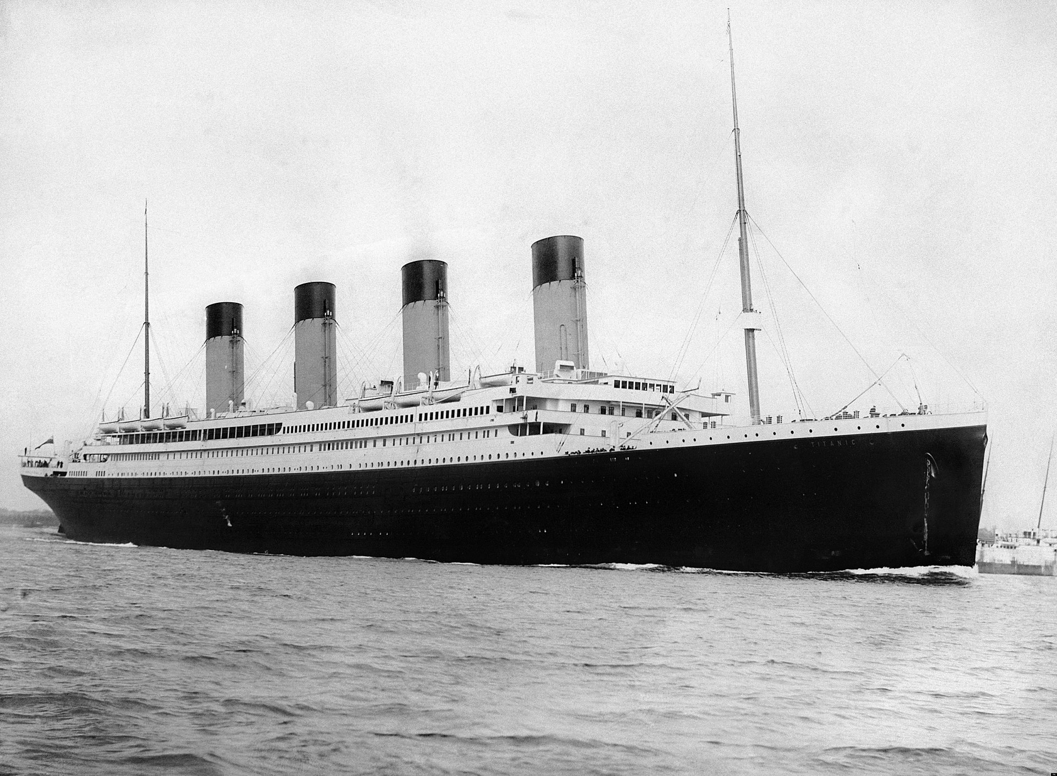
Life saving appliances
- The most famous accident?
Collision with the iceberg
3327 passengers and crew
Only 710 survived
What were the causes of accident?
The classical example of arrogance
© Wiki © Encyclopaedia Brittannica

Slide 44
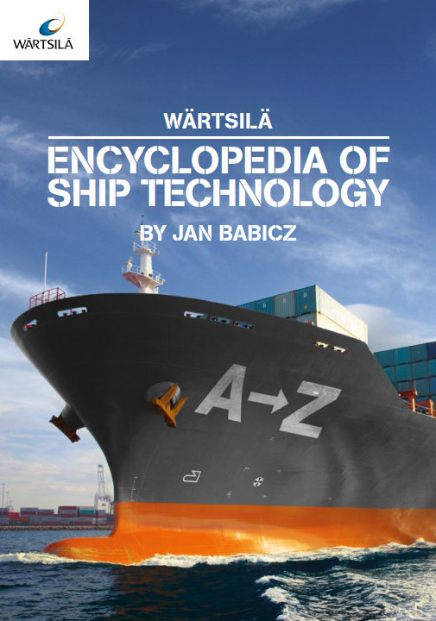
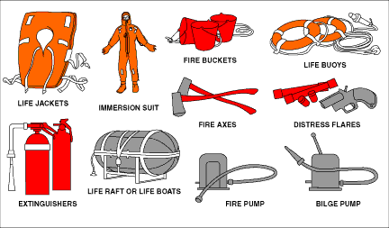
Life saving appliances
Life saving appliances
Lifeboats, liferafts, personal life-saving appliances (lifebuoys, lifejackets, immersion suits, etc) (Wärtsilä Encyclopaedia)
© https://paula-maritime-english.blogspot.com/2012/05/life-saving-appliances.html

Slide 45
Life saving appliances
Lifeboats
A motor-propelled survival craft carried by a ship for use in emergency. A ship should be its own best lifeboat but there are sometimes situations where abandonment of the ship is unavoidable
Two types of Lifeboats
Free-fall davits
Gravity davits

Slide 46
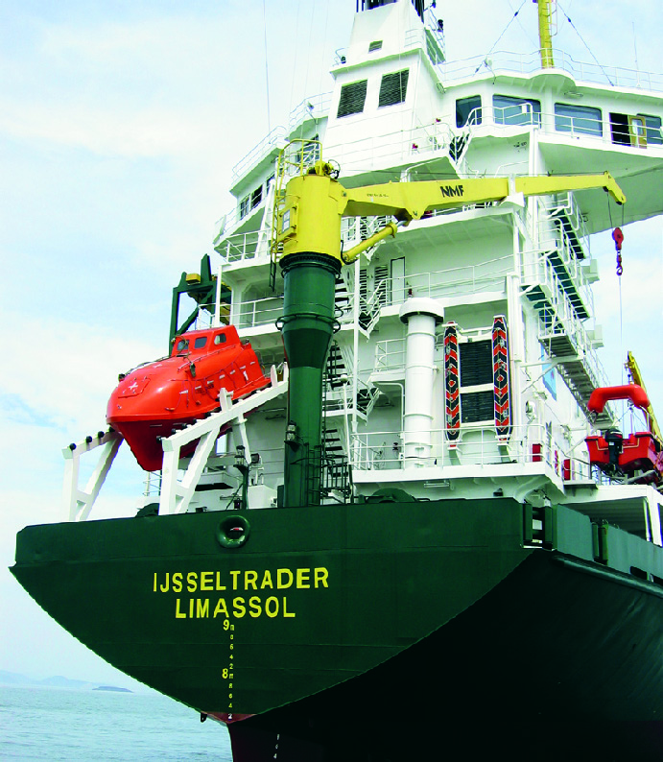
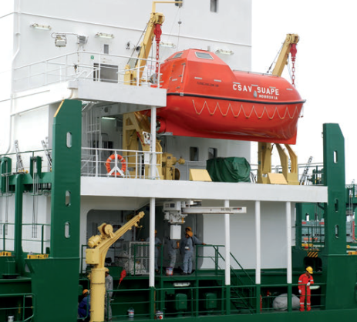
Life saving appliances
Lifeboats
Free-fall davits Gravity davits
© Wärtsilä
© Wärtsilä
https://www.youtube.com/watch?v=W5QvxugfQm0

Slide 47
Life saving appliances
Lifeboats
Safety concerns during testing
Issues with on-load release hook
General requirements
The lifeboat should not be less than 7.3 m in length.
The lifeboat of a cargo ship with 20,000 GT must be capable of launching when the ship’s speed is at 5 knots.
The lifeboats are to be painted with an internationally-approved bright orange colour and the ship’s call sign is to be printed on it.
Lifeboats are required to have the necessary safety and survival equipment onboard (compass, signaling mirror, embarkation ladder, dipper, first aid kit, food rations)
Free-fall davits | Gravity davits
Faster | Slower
More injuries during fall | Less injuries

Slide 48
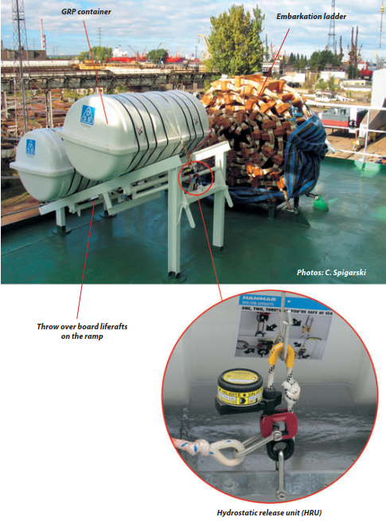
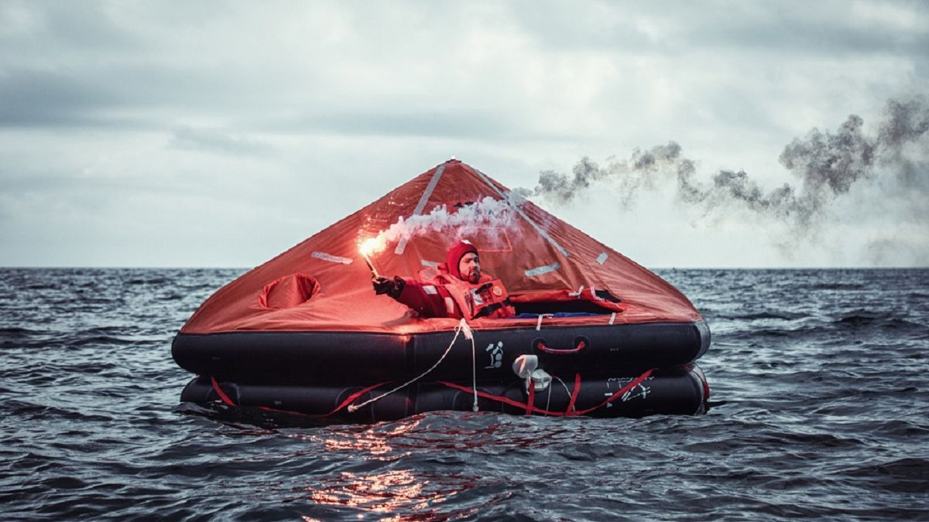
Life saving appliances
Life rafts
https://www.rivieramm.com/news-content-hub/news-content-hub/survitec-raftxchange-rental-liferafts-in-perfect-condition-after-more-than-30-months-of-service-62354

Slide 49
Life saving appliances
The number of lifeboats and life rafts should be enough to accommodate at least 125% of the number of passengers and crew.
According to SOLAS on cargo ships
One or more lifeboats is required on each side
One or more inflatable or rigid liferaft on each side
At least one rescue boat
If it is free-fall lifeboat on the stem, one lifeboat can be sufficient
Passenger ships on international voyages
must carry partially or totally enclosed lifeboats on each side to accommodate not less than 50% of the total number of persons on board
Some lifeboats can be substituted by liferafts
Passenger ships on short international voyages
must carry partially or totally enclosed lifeboats for at least 30% of persons on board, plus inflatable or rigid liferafts to make a total capacity of 100% with the lifeboat
In addition, they must carry inflatable or rigid lifeboats for 25% of total number of persons on board

Slide 50
Life saving appliances
Rescue boat
Rescue boat is a boat designed to rescue persons in distress and to marshal survival craft. (SOLAS) It is a davit-launched, motor-propelled light boat provided to perform man-overboard retrieval and raft marshalling duties.
Lifeboat can be used as a rescue boat, if it fulfils the requirements
For passenger ships in accordance with current IMO regulations:
1. Passenger ships of 500 gross tonnage and over shall carry at least one rescue boat on
each side of the ship,
2. Passenger ships of less than 500 gross tonnage shall carry at least one rescue boat,
3. At least one of rescue boats on a ro-ro passenger ship shall be a fast rescue boat with
a minimum length of 6m and a top speed of at least 20 knots (MSC/Cir.809
For cargo ships:
At least on one rescue boat

Slide 51
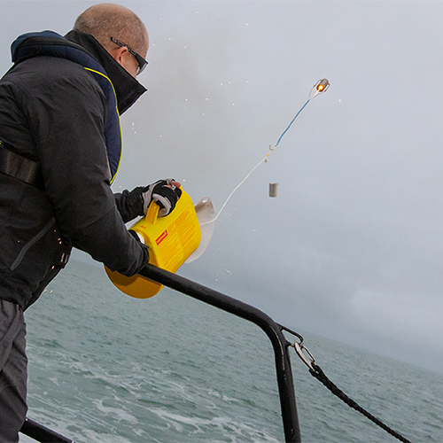
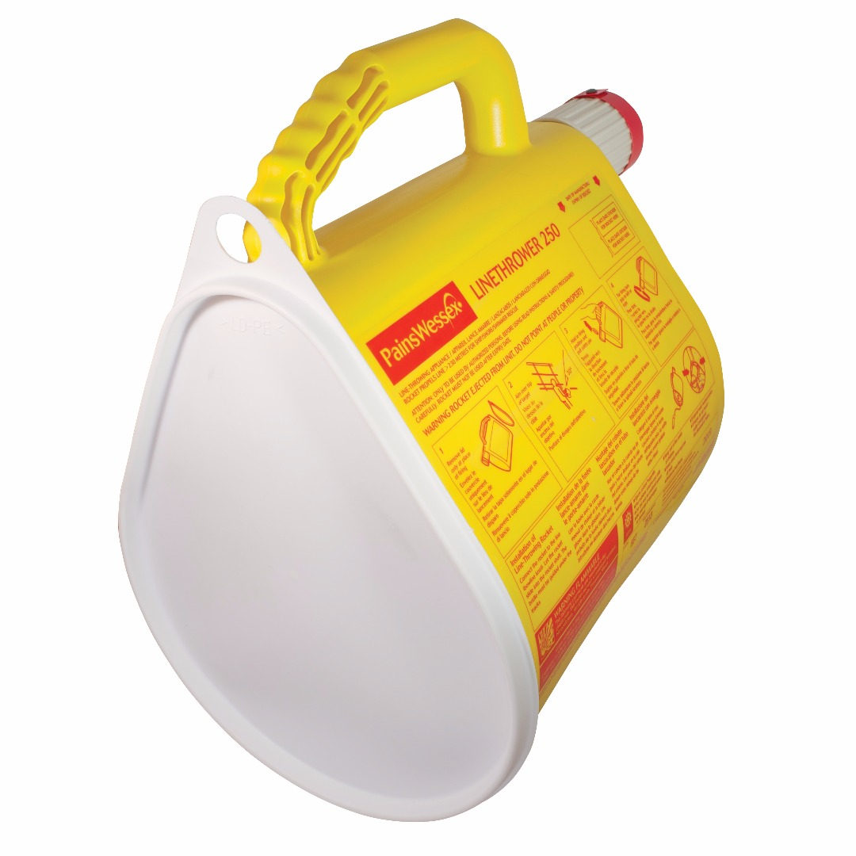
Life saving appliances
Line throwing appliances
https://survitecgroup.com/survitecproducts/15045/linethrower250

Slide 52
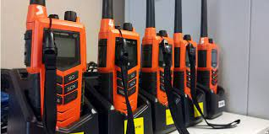
Life saving appliances
Two-way VHF (usually at least 3)
Radar transponder (EPIRB)
at least 2 on each ship if GT>500
https://www.highlandwireless.com/look-best-marine-vhf-two-way-radios-2018/
https://en.m.wikipedia.org/wiki/File:EPIRB@.png

Slide 53
Life saving appliances
Distress flares
at least 12 on the bridge
Public address system
© https://www.cambrianboats.com/news/distress-flares/203/
https://en.wikipedia.org/wiki/Public_address_system

Slide 54
Life saving appliances
Lifebuyos
readily available, on each deck and side,
half with self-igniting light
Immersion suits
for each member of rescue boat
https://www.motonet.fi/fi/tuote/386119/Lalizas-pelastusrengas?gclid=Cj0KCQiAys2MBhDOARIsAFf1D1eSL-ZoWc_eWqDoFOnwIzJFQv9SUJ3_014v3y9XqyvgYpyTi89jazQaApa-EALw_wcB
© Wärtsilä

Slide 55
Life saving appliances
Lifejackets
at least 1 for each person
10% should be dedicated to children

Slide 56
Life saving appliances
Drills – an important part of SOLAS regulations
Abandon ship drill includes:
1 summoning of passengers and crew to muster stations with the alarm required by regulation 6.4.2
followed by drill announcement on the public address or other communication system and
ensuring that they are made aware of the order to abandon ship;
2 reporting to stations and preparing for the duties described in the muster list;
3 checking that passengers and crew are suitably dressed;
4 checking that lifejackets are correctly donned;
5 lowering of at least one lifeboat after any necessary preparation for launching;
6 starting and operating the lifeboat engine;
7 operation of davits used for launching liferafts;
8 a mock search and rescue of passengers trapped in their staterooms; and
9 instruction in the use of radio life-saving appliances.

Slide 57
Life saving appliances
Evacuation ways as per SOLAS
Alternative designs
Evacuation simulation tools
Agent based models
Important for cruise ships
Real-time decision making
© Safety at Sea

Slide 58
Lifesaving appliances
Common issues (USCG)
https://www.dco.uscg.mil/Portals/9/DCO%20Documents/5p/CG-5PC/CG-CVC/CVC2/psc/AnnualReports/annualrpt2020.pdf

Slide 59
Lifesaving appliances
Questions:
How many lifeboat types exist?
How many lifeboats need to be on a large cargo ship?
How many EPIRBs are required on a large passenger ship?

Slide 60
Safety systems
Safety systems –
An automatic control system designed to automatically lead controlled machinery to a predetermined less critical condition in response to a fault which may endanger the machinery or the safety of personnel and which may develop too fast to allow manual intervention. (Wärtsilä Marine Encyclopaedia)
Of interest for hackers aiming at systems damage

Slide 61
Safety systems
Control Logic Unit
Pressure switches
Pressure transmitters
Temperature transmitter
Flow transmitter
Gas detectors
Smoke detectors
Flame detectors
Push button
Emergency shutdown valve
Solenoid valve
Process control valve
Pressure relief valve
Down hole safety valve
Circuit breaker
Relay
Final element
Input element
Pneumatic, mechanic,
electric actuated
Physical process
Simple Cyber-Physical System
Mechatronic system
Wiki

Slide 62
Safety systems
Typical examples of safety systems
Engine safety - Trips the engine
Too high exhaust gas temperature
Overspeed (115% of the engine speed)
Low lubrication pressure
High temperature cooling water temperature and pressure
Thrust-main bearing temparature
Oil mist in crankcase
Cuts the fuel or air supply
https://marineonlineyou.blogspot.com/2017/12/engine-safety-system.html

Slide 63
Safety systems
Generator safety - Trips the generator
Over current
Short-circuits
Differential faults
Under-overvoltage
Reverse power
Important during synchronisation
https://www.victoryelectric.net/generator-safety

Slide 64
Safety systems
Pressure-Vacuum valve on tankers
Protects cargo tanks from excessive over/under pressure
Arc detection system
Arc in switchboards – rare but disastrous
Protection against catastrophic scenarios
Use of optical sensors for better detection
© Meyle
© Meyle
© Meyle

Slide 65
Safety systems
Winch safety
Mooring rope snapping back– one of the most serious incidents
Cut legs, hands, high fatality rate
Winch brake to control tensile strength
Circuit breaker
Electrical faults
© IMCA
© INI hydravlic

Slide 66
Safety systems
Watertight doors
Control damage stability
Usually closed during operation
Not always in the reality
Remotely controlled
Express Samina case
Greek RoPax accident

Slide 67
Safety systems
Damage stability recovery system
Innovative solution
Injecting highly expandable foam resin and hardener agents in the compartments

Slide 68
Safety systems
Advanced safety systems
Using condition monitoring data and safety models
Making decisions on their own

Slide 69
The main rules, regulations, standards used for the safety on ships
SOLAS
Life-saving appliances, equipment safety, firefighting equipment
Chapter II-2 – Fire safety
Chapter III – Life saving appliances
Chapter II-1 – Equipment safety
Fire safety systems code
Life saving appliances code
The International Safety Management Code - for ship operation

Slide 70
The main rules, regulations, standards used for the safety on ships
Not necessary to follow SOLAS
Design of alternatives IMO MSC.1/circ.1455
Equivalence in terms of safety or regulations
Design according to specified safety level
Compare the safety level for design according to SOLAS and the novel design
Useful tool for autonomous ships

Slide 71
The main rules, regulations, standards used for the safety systems
IEC 61508
Specifically for safety systems

Slide 72
The main rules, regulations, standards used for the safety systems
Class rules
Open access
Very wide and extensive
Use elements from IMO documents

Slide 73
The main rules, regulations, standards used for the safety systems
Questions
What are the basic elements of safety system
What protection system is required against engine overspeed?
What are the main regulatory documents to consider when designing the ship? Operating the ship?
How do you see the safety systems - as preventative or mitigative control measures?

Slide 74
Concluding remarks
There are preventative, detective and mitigative measures
Fire occurs if heat, fuel, oxygen can make a chemical reaction
We have passive and active firefighting systems / portable and fixed
We can have firefighting systems using foam, CO2, powder, water
Ships should have sufficient capacity of lifeboats/life rafts to evacuate 125% of passengers/crew
Safety systems - An automatic control system designed to automatically lead controlled machinery to a predetermined less critical condition
SOLAS, FSS code, LSA code, SMS code, class rules, IMO MSC.1/circ.1455, IEC 61508

Slide 75
Thank you for your attention
Contact
victor.bolbot@aalto.fi

