Slide 1
Week 5 theme: Taking stock of the covered issues on (co)design for social change to inform your project

Slide 2
Day Schedule
9:15 – 9:40 Own project brief and forming of project groups
9:50 – 12:00 What to consider in codesign for social change
13:15 – 15:30 Start group projects; Tutoring round at 15 before available for questions

Slide 3
What to consider in codesign for social change
Assessing change domain characteristics
Assessing agendas
Assessing issue characteristics
Assessing and selecting relevant participants and participations
Assessing designer-user approach
Assessing involvement arrangements
Assessing material and social mediation
Assessing recording and take-aways
Assessing the not-so-small matter of time
Planning design iterations and expansion strategies

Slide 4
Assessing change domain characteristics

Slide 5
Assessing change domain characteristics, A
Vacuum of structures (material, digital, social, behavioral, cognitive): ‘first time build-up’, ‘all hot/malleable situation’ or ‘low systemicity’ (example: small scale permaculture in cities, just interest people into doing more of it!)
|
|
|
Interlocked sociotechnical regime: Strong and interdependent path dependencies across technologies, materialities, infrastructures, regulation, social institutions and norms, behavior and culture. (Example: petroleum private car transport regime, decades to change)

Slide 6
Assessing change domain characteristics, B
What ‘inertia’ and resistance to change is there?
  The presense and depth of path dependencies
  Size of sunk investments to be capitalized on (and by what actors?)
  The amount of prestige and power loss (and by what actors?)
  The depth and width of infrastructural lock-in and interdependencies
  The societal/commercial criticality of operation
  The lack of, readiness and feasibility of alternatives

Slide 7
Assessing change domain characteristics, C
What drivers of change there are?
  The possibility of a ‘design-fix’ with new technology
  The potential of alternative solutions and their current feasibility
  External pressures to change from neighbouring systems or from collateral harms
  Political coalitions and potential to politize the issue
  Capacity to regulate the issue (simple replacement or enforceable ban vs system rehaul) and civil cervant and politician credibility in pushing it
  Extent of social movements and citizen advocacy regarding the issue

Slide 8
Assessing agendas

Slide 9
Assessing agendas
No strong agendas relate to the change initiative, ie ‘open field’
|
|
|
The change initiative is nested within strong and fortified agendas by several implicated actor groups, all action will instill reaction

Slide 10
Assessing agendas
What are the relevant social groups that exert conservation or change in the issue?
How are these groups related beyond the issue ie what is the ‘ecology of actors’ and their interlinkages
What ‘multi-level games’ are involved ie to what the issue is bundled to by different groups and actors?
How fixed are actor positions and coalitions; what could make them move?
How do different agendas ‘carry through’ to practice ie where are points of influence for change/resistance and how might different actor groups target these?

Slide 11
Assessing issue characteristics

Slide 12
Assessing issue characteristics
Simple and wellknown issue ‘everybody can describe well’
|
An issue known to implied people, who have their own representations of it
|
An issue requiring high expertize and information support
|
Emergent, fuzzy and/or complex issue ‘experts struggle to understand’

Slide 13
Assessing and selecting relevant participants and participations

Slide 14
Assessing and selecting participants and participations
Spearhead activist community with high ability
|
Diverse coalition of willing change makers
|
Balanced mix of all implicated groups of actors
|
Encompassing and representative participation

Slide 15
Assessing and selecting participants and participations
What is the ‘theory of change’ you have regarding the sought social change?
What actor groups/people must be included in any action?
What actor groups and agendas must be considered? What can be ‘nice to have’?
Which actor groups cannot be ‘brought to same table’ due to dominance or conflicting interests
What resources do different participant groups bring with them: design capacity, domain knowledge, political power, regulation access, networking capacity, marketing lever…

Slide 16
Assessing designer-user approach

Slide 17
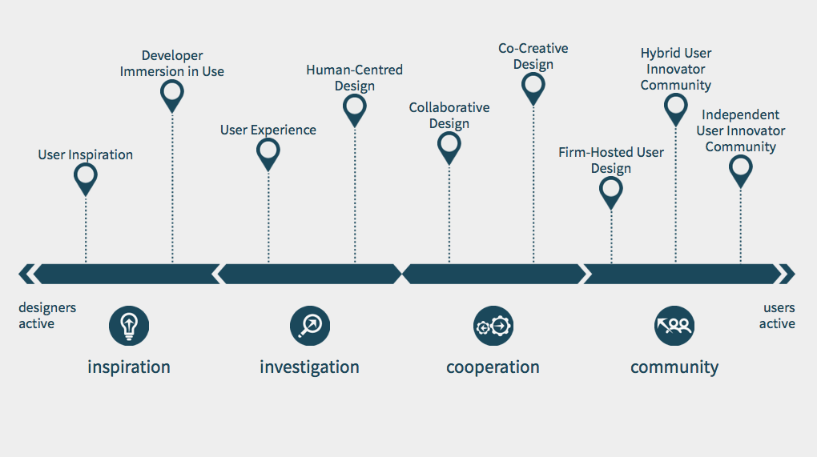

Slide 18
WHY DESIGN FOR, WITH AND BY USERS - DIFFERENCES
Four major orientations, each stressing an important reason, but not fully aligned
INFORMATION TRANSFER
  Only important if “sticky” information is needed
  Criteria for whom to collaborate with is capacity and willingness to provide it
  User innovation research, relationship marketing
RESOURCE OPPORTUNITY / COST-BENEFIT
  Benefits must exceed costs
  Only important if users are willing and able to contribute time, money or power
  User innovation research, crowdsourcing, Open source software (but not free/libre software)
RESPONSIBLE DESIGN:
  Only important if the design professional cannot ascertain this alone
  The citizen/user/customer is not important during design but only as implied by it
  HCD, UX, UIFD, service design
DEMOCRATIC PARTICIPATION:
  Only important if it is citizens/users/customers right to affect technology (vs art, commissions to one self, professional autonomy, professional judgement)
  Criteria for whom to collaborate with must be equal and representatative in an acceptable way
  Participatory design, participatory planning, free & libre software, community design
Notes:
scope which appears unclear to many academics and practitioners

Slide 19
Assessing involvement arrangements

Slide 20
Assessing involvement arrangements
How much effort is attainable from the participants?
Do all relevant people want to participate similarly and as a one group? If not:
  Are there multiple channels, places and times to be involved?
  Have you build quicker and more superficial and deeper and more encompassing involvement opportunities?
  What practical arrangments do these require? (workshop, web participation, protest march, petition writing, town hall events…)
  What pro’s and con’s do different arrangement options have? (see example next slide)

Slide 21
Codesign series – pro’s and con’s
Upsides:
  More time from participants: mutual learning among, from, and by
  Allows deepening engagement with the design and/or topical area
  More demanding and refined outcomes can be pursued
  More time to develop and commitment to an emerging agenda
  More complex and powerful toolsets can be made use of
Downsides:
  ’as strong as the weakest link in the chain’ : a failure (=loss of participant motivation) in an early workshop may collapse the series
  Adds to the seriousness of planning
  Outside surprize events can dramatically alter participation and organizing (e.g. Covid in 2020 spring citizen energy arena)
  Adds to contingency planning and resourcing … and improvisation!

Slide 22
Assessing material and social mediation

Slide 23
Assessing material and social mediation
Just talk and interaction
|
Design facilitator, papers, post-its and pens
|
Designed workshop with thought through interaction patterns and material support
|
A structured design game to guide group participation

Slide 24
Assessing material and social mediation
Are specific participation methods necessary? Why? When?
What specific methods of involvement are best suited for the involvement action?
How is the method operationalized materially? Does it need to be tailored re the participants, timeslots, recording …
How are participants expected to support, hinder and ‘channel’ each other during their involvement? Ie what ‘social scaffolding’ will be in place.
What ‘intermediate designs’ or ‘material scaffolds’ are there or should be built to adequately support the participation? (note: participant skill and competency levels matter a lot here!)

Slide 25
Assessing recording and take-aways

Slide 26
Assessing recording and take-aways
Just event impressions on organizers minds
|
Participant outputs sought and gathered
|
Note taking and recording organised, codesign arrangements tuned for recording
|
The whole participation arrangement is organized so it produces high amount and specific type of design or data

Slide 27
Assessing recording and take-aways
What traces are generated ‘naturally’ in the participation arrangements? Is this enough of a recording?
How much people power and resources there are to analysing the participation process and participation outcomes?
Can social and material orchestration made to include better recording (or sought take-aways)?
Must the arrangement, methods and operationalizations be changed for the sake of adequate recording?
Are the outputs and take-aways the primary goal, and if so, should ways to adequately record take the drivers seat?

Slide 28
Assessing the not-so-small matter of time

Slide 29
Assessing the not-so-small matter of time
Recourse: how much time is possible to get from the participants? In what kind of time-slots? When?
How do the involvement arrangements and methods structure the time-slots? what are minimum time requirements to meaningfully carry them through?
What cognitive and biological time-slots need to be factored in?
How can time be condenced by better social and material mediation?
How do people’s the involvement change over time? In the course of a workshop, of a series, of a change initiative?

Slide 30
Planning design iterations and expansion strategies

Slide 31
Planning design iterations and expansion strategies
Just one occasion, e.g. a workshop feeding to one-time design output e.g. a new product
|
Series of events and iterations leading to a launch
|
From pre-design to design-in-use and community empowerment
|
An elaborate plan for how to build a cascade of outputs and deepen and widen participation into a community or movement

Slide 32
Planning design iterations and expansion strategies
What steps are needed before the aims of social change action are reached?
Does the design need to be closed and if so in what respects and for what reasons?
Does the action need to gradually expand and enrol more people?
What control of outcomes do the organizers/host/designers need to retain?

Slide 33
And most of the time these considerations are are at least partly interdependent
Translation and trade-off choices are at the heart of design participation

