Slide 1
Design for Social Change – Week 2
Theme: CoDesign and sociotechnical democracy a.k.a how to involve implicated people in envisioning and deciding on changes

Slide 2
Botero, A., Hyysalo, S., Kohtala, C., & Whalen, J. (2020). Getting participatory design done: From methods and choices to translation work across constituent domains. International Journal of Design, 14(2), 17-34.
The questions you wrote down: lets start discussing them, 60 mins

Slide 3
WEEK 2, TOPIC 1: DESIGN DEMOCRACY: VARIANTS AND DECISION CONTROL

Slide 4
WHY DESIGN FOR, WITH AND BY USERS - DIFFERENCES
Four major orientations, each stressing an important reason, but not fully aligned
COST OF INFORMATION
  Only important if “sticky” information is needed
  Criteria for whom to collaborate with is capacity and willingness to provide it
  User innovation research, relationship marketing
RESOURCE OPPORTUNITY
  Benefits must exceed costs
  Only important if users are willing and able to contribute time, money or power
  User innovation research, crowdsourcing, Open source software (but not free/libre software)
RESPONSIBLE DESIGN:
  Only important if the design professional cannot ascertain this alone
  The citizen/user/customer is not important during design but only as implied by it
  HCD, UX, UIFD, service design
DEMOCRATIC PARTICIPATION:
  Only important if it is citizens/users/customers right to affect technology (vs art, commissions to one self, professional autonomy, professional judgement)
  Criteria for whom to collaborate with must be equal and representatative in an acceptable way
  Participatory design, participatory planning, free & libre software, community design
Notes:
scope which appears unclear to many academics and practitioners

Slide 5
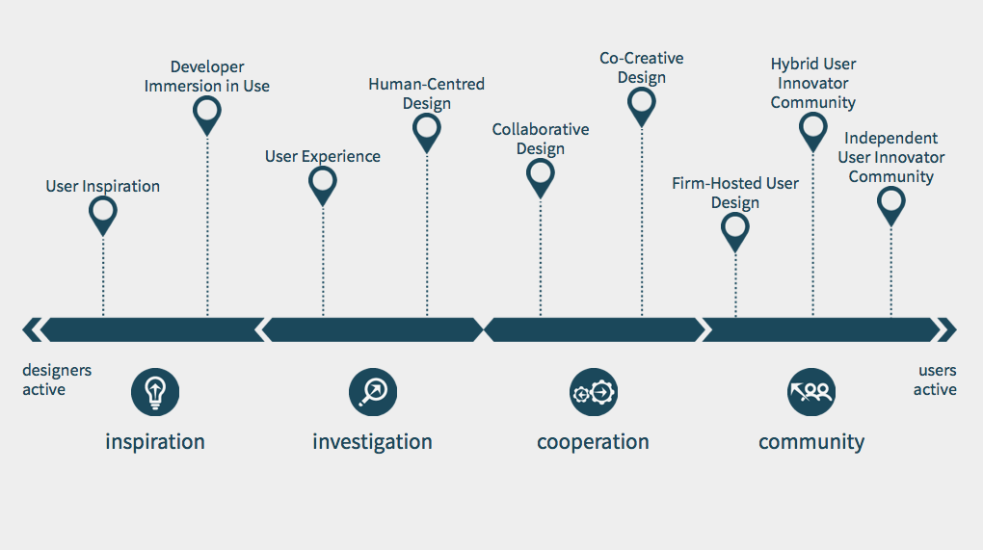

Slide 6
Recap: COLLABORATIVE DESIGN
Collaborative design means taking users in as design partners, often as experts of their own work or everyday practice
Users are seen as best experts in determining what is needed in the product or service and how it is to work for them
Designers seen as experts in design, technical realization and organizing the (usually synchronous) collaboration
Collaboration is facilitated by designers with tools that help users to design such as work modeling, idea cards and mock-ups
The stronghold of collaborative design are new products and services in domains
  that are difficult to access or grasp by designers;
  which feature multiple interacting groups of users as their interrelated needs are difficult to work out otherwise

Slide 7
Variants of collaborative design
SOME KEY VARIANTS OF COLLABORATIVE DESIGN
  Codesign, without background theory or assumptions
    Involving users to get better products or services
    Focus on creating a good design or concept with users
  Sociotechnical systems design (1960-)
    Mutual benefits for producer (profit) and users (satisfaction)
    Improving “fit” between human and technical system
  Classical Scandinavian participatory design (1970-)
    End-user control over design process and outcomes
    Improving end-user control over technological change
  Emancipatory participatory design, designing with commons, infrastructuring (2000-)
    Developing not only technology but the competency of users in dealing with new technology in the future
    Improving the capabilities of users

Slide 8
…TO VARIANTS OF CO-CREATIVE DESIGN
Co-realization / Aging Together (2000-)
  Continued design in use by developers and users;
  Initial collaborative design to get a seed solutions to build on.
Metadesign (2000-)
  Designing an architecture and tools on which users can design;
  Aiding users’ design as it evolves.
End-user development (1990-)
  Building tools and methodologies for programming competent users to self-serve in building, maintaining and evolving their systems.
Living Labs (2000-) (Exploratory ones, not just test beds)
  Setting an exploratory space and agreements where new technologies and their users can be explored in real-life setting;
  Can be hosted by company, academic institution, municipality or a community; key issue that somebody records and acts on findings.
Minimum Viable Product media design (2000- )
  Launching a purposefully bare application to gauge its desirability and viability
  Developing it rapidly to the directions of user need
Notes:
Notice: the by and large same developer-user configuration has been arrived from multiple directions

Slide 9
…TO HYBRID AND INDEPENDENT USER INNOVATOR COMMUNITIES
Independent user innovator community means that users are independently designing and maintaining products, services or processes.
Users hold full control over decisions, development direction, funding sources, finances etc.
‘True’ design democracy
Open and free software, wikipedia are well known examples, but independent user innovator communities exist for physical products, service platforms, digital-physical making etc.
Hosted community dependency can be either direct resource dependency or follow from the use of sponsor’s technology platform or facilities
  Independent developer groups within users groups for particular company can hold independence, peer coordination and independent finance but fundamentally depend on company consent for advancing and proliferating their solutions.
  Examples: developer groups within Ducati, Oracle, Adult fans of Lego.

Slide 10
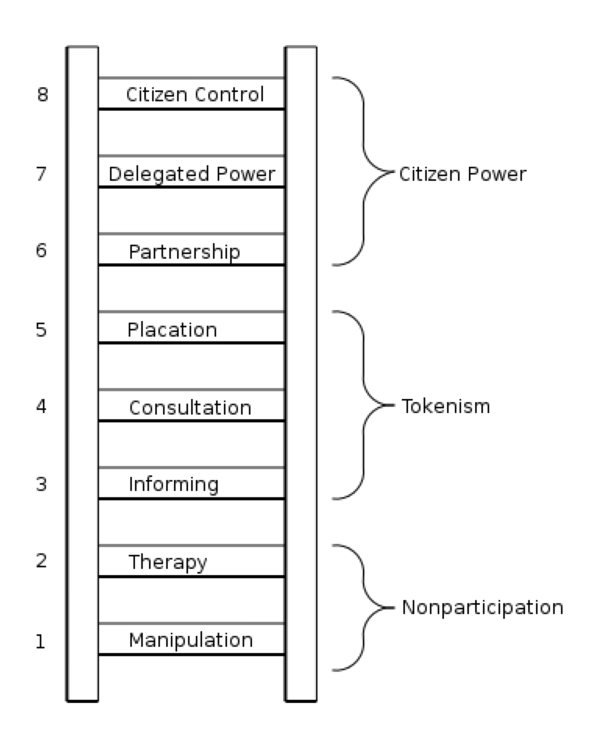
LADDER OF CITIZEN PARTICIPATION (ARNSTEIN, 1967)

Slide 11
WEEK 2, TOPIC 2: DESIGN DEMOCRACY: INFORMATION TRANSFER

Slide 12
WHY DESIGN FOR, WITH AND BY USERS - DIFFERENCES
Four major orientations, each stressing an important reason, but not fully aligned
COST OF INFORMATION
  Only important if “sticky” information is needed
  Criteria for whom to collaborate with is capacity and willingness to provide it
  User innovation research, relationship marketing
RESOURCE OPPORTUNITY
  Benefits must exceed costs
  Only important if users are willing and able to contribute time, money or power
  User innovation research, crowdsourcing, Open source software (but not free/libre software)
RESPONSIBLE DESIGN:
  Only important if the design professional cannot ascertain this alone
  The citizen/user/customer is not important during design but only as implied by it
  HCD, UX, UIFD, service design
DEMOCRATIC PARTICIPATION:
  Only important if it is citizens/users/customers right to affect technology (vs art, commissions to one self, professional autonomy, professional judgement)
  Criteria for whom to collaborate with must be equal and representatative in an acceptable way
  Participatory design, participatory planning, free & libre software, community design
Notes:
scope which appears unclear to many academics and practitioners

Slide 13
PRODUCERS AND USERS KNOW, DO AND INVENT DIFFERENT THINGS
P
U
Producers:
Design, produce and sell goods
Production domain knowledge
What is profitable to produce
Innovation in “dimensions of merit”
Users:
Use goods
User domain knowledge
What is valuable
Innovation in novel functions “what new should be done”

Slide 14
UNPACKING “STICKY INFORMATION TRANSFER”
Design – use interaction is difficult because producer (P) and user (U) domain information is “sticky” - costly to explicate and transfer successfully
Most information does not reach the other party in the form desired.
Von Hippel, Eric. 1994. “‘Sticky Information’ and the Locus of Problem Solving: Implications for Innovation.” Management Science 40 (4): 429–39.
Heiskanen, E., Hyysalo, S., Kotro, T., & Repo, P. (2010). Constructing innovative users and user-inclusive innovation communities. Technology Analysis & Strategic Management 22 (4) 495 — 511.
P
U
Why such “information” is “sticky”?
Knowing embedded in practice: learned as part of membership and accumulation of skill
Knowledge situated in context: defies full explication, not all details relevant for design
Rooted in interests and priorities in the practice and held by practitioners
Translated, by default, across functional orientation difference: to use technology vs to produce it
Translated, by default, across exchange value vs use value conflict of interest between producer (P) and user (U)

Slide 15
P
U
U
U
U
U
P
P
U
P
U
U
U
U
U
Heiskanen, E., Hyysalo, S., Kotro, T., & Repo, P. (2010). Constructing innovative users and user-inclusive innovation communities. Technology Analysis & Strategic Management 22 (4) 495 — 511.

Slide 16
BASIC ELEMENTS
Information transfer: cannot be presumed as automatic
  Requires means, skills coordination
Exchange context: platform, community, enquiry
  Immersion, legitimacy, learning, cumulation
Benefits: why different parties join
  Benefits and interests can be same or different for P and U
  Economic, risk management, accountability of design, democratic opportunities
Ability and willingness: not all users design it all for themselves
  Support, means, sharing
Control: ideas, information, IPR, execution of design, outcomes
Receptivity: the participants and further Communities of practice
  Information adoption, use, translation and costs

Slide 17
BASIC CONSTRAINTS
User oriented design transforms, not replaces, designer responsibility and competence
  Customers and users are not the only relevant source of information
  Requires design of arrangements to attract, work with, refine and incorporate user insight
Resources gained from customers and users require spending resources: cost – benefit game
Creating ownership means also handling different interests – it lessens control over outcomes, information and actions
The deeper the customer relation the more commitment is needed
User involvement is always inclusive AND exclusive
  One cannot invest in all customers or users equally, segmentation needed to invest to those that are more important
Also affect the project dynamics: potential lock-in with ”bygone” customers

Slide 18
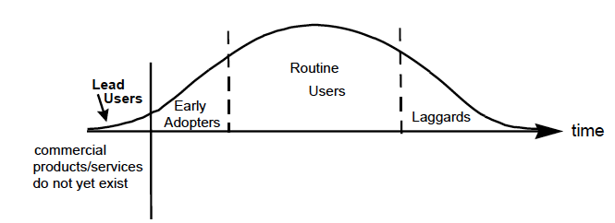
Different users – Different likely yield
Crucial users;
first early majority
Lead-users
  + Solutions and trends, people who live in the future of others
  Over motivated. Will use whatever if it solves their problem
Domain experts
  + Visionaries
  - Mix ought and is, gatekeepers, busy, less gain than lead users
Crucial users – reasoned “early majority”
  + Will use only when benefits outweight costs
  + Able to tell what needs to be in the product for the majority to adopt
  - Difficult to identify in early stages
Regular Joes, laggards
  “The products I have are ok” ; Disinterest and lack of vision

Slide 19
WEEK 2, TOPIC 3: CODESIGN AS PRACTICAL ARRANGEMENT

Slide 20
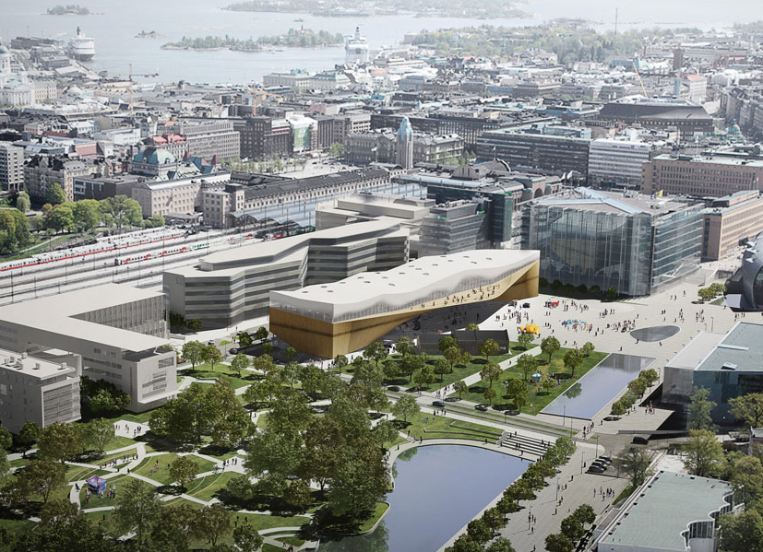
Work of democratized design: setting-up a hosted citizen-designer community
Sampsa Hyysalo, Aalto University, Department of Design
Louna Hakkarainen, Aalto University, Department of Design
Virve Miettinen, Helsinki City Library Services & University of Lapland, Department of Design

Slide 21
Central Library’s Friends – user designer community

Slide 22
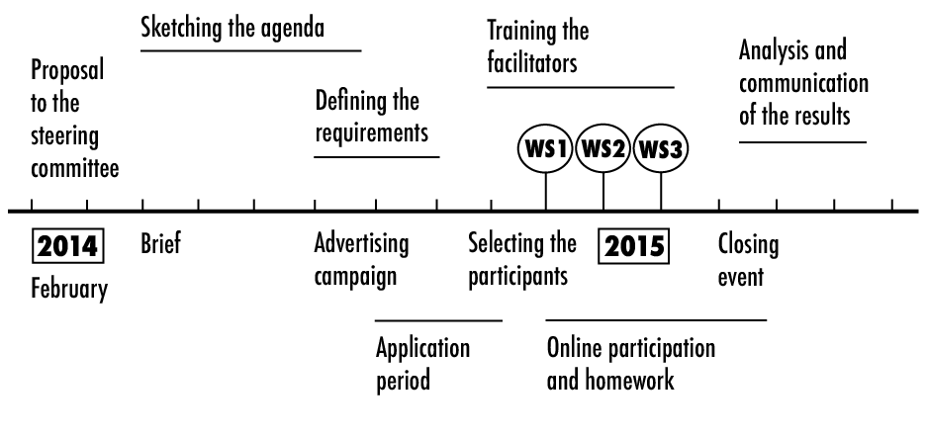
STEPS & PROCESS…

Slide 23
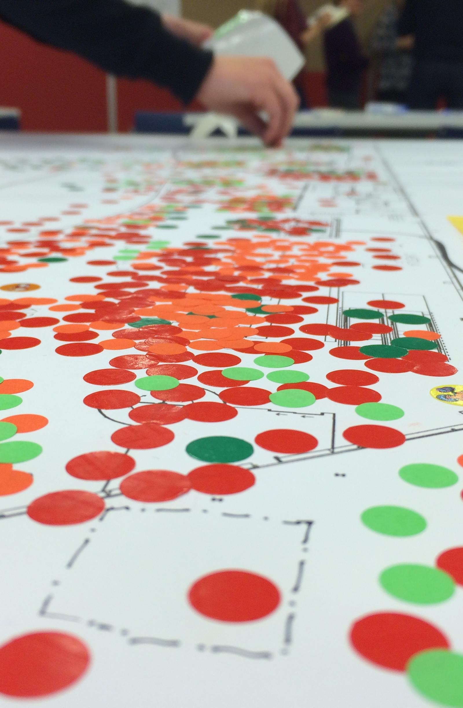
GOALS
For us as a library and as a public service
Getting to know our customers more personally, finding new target groups, understanding citizens’ needs
Testing and prototyping ideas
Creating service concepts and solutions that can compelement or question those constructed by library staff, architects & planners
Creating a culture of experimention instead of rigid planning processes
Building ”design readiness” in the public sector
For participants and citizens
Influence the planning process, make an impact
It’s not just about knowing the customers but building trust and a community
Meet new people, learn new skills, discover new things
What is relevant for you, and what is relevant to the person sitting next to you – learning empathy & democracy in practice
Make library matter to you and to your community
Have fun, be useful, help others

Slide 24

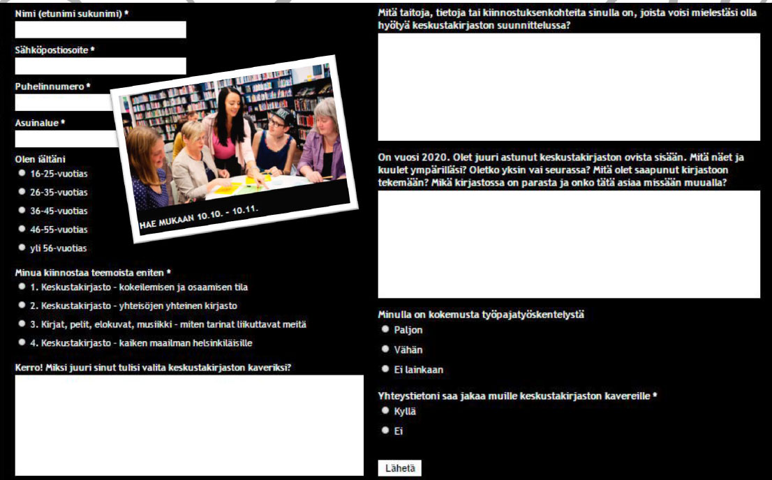
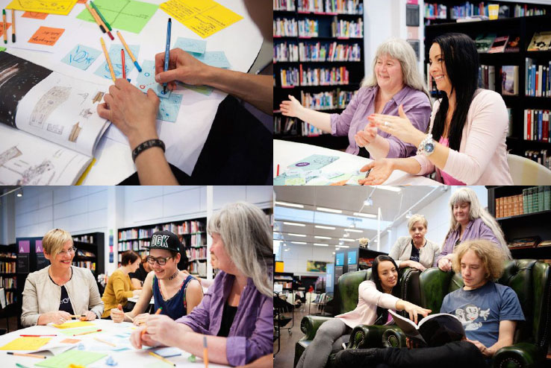
13 000 visits to the website by 6 700 different people, resulting in 95 applications to the FCL community, 28 participants were chosen
The advertisement campaign for FCL was launched one and a half months before the first workshop. The campaign was formulated as a “job application”
with a slogan:
“The central library will not be completed without you. Join us!”

Slide 25
AGENDA & THEMES
Defining requirements around four themes
(1) Service offering in the 2nd floor – a place for citizen skills, learning, exploration and know-how: peer to peer, gaming, studios, workshops & makerspaces
(2) A library for communities: volunteering, services and contents for families & children, rules for communal-space use, how to create peer to peer spirit
(3) How library can meet the needs of immigrants and tourists better?
(4) How to market contents better? How to make visible and share people’s experiences and recommendations? Books, games, movies, music, e-content in space

Slide 26
RESULTS
7 articulated concepts for CeLib development
Answers, views and solutions to tens planner and architect problems
New solutions for making meaning as a library: sketches and ideas for transitioning the library to a space for citizens and community connections
New perspectives and critical insights to ongoing planning directions
Deeper understanding of our customers and their needs
Empowered citizens to build a better city
Empowered staff members open for experiments and co-creation
Concretized what the City strategy on increased citizen participation can mean
Positive feedback from participants (25) and participating staff members (12)

Slide 27
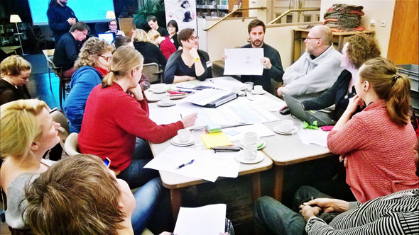
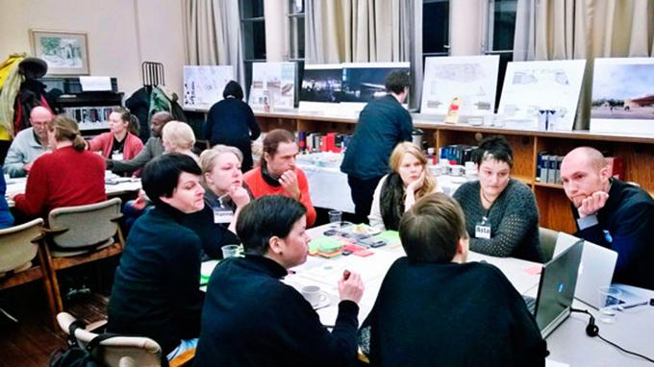
EXPERIENCES & FEEDBACK FROM PARTICIPANTS
For the first time I really identified myself as a Helsinki resident. I felt [FCL] was something very important. I also felt that my opinions and ideas were truly cared about. Our group worked well towards shared goals in a positive way. Thanks also to the organizers—it was great to participate in such carefully planned sessions.
The good spirit [was memorable]. The creative ideas that grew and that people refined together. Also, thanks for well-coordinated and well-planned sessions ... After the sessions the feeling was as if one had just run a marathon (I was always pretty exhausted from all the innovating).

Slide 28
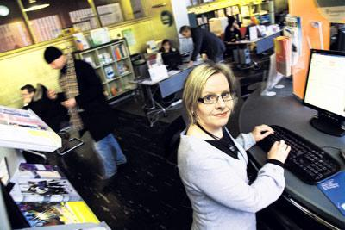
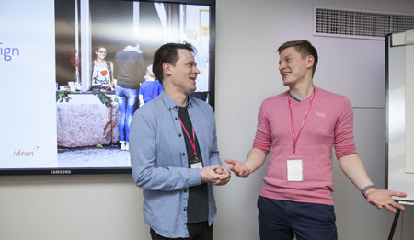
EXPERIENCES & FEEDBACK FROM FACILITATORS
“I work as a planner, and I don’t have so many possibilities to observe or interview customers, or simply have a chat with them. Workshops were a brilliant way to make a real-time contact and have a chance to directly hear from citizens how they experience our services.”
From my point of view participatory design is definitely the direction in which we should be heading in the public sector. Citizens today expect more transparent, accessible, and responsive services—and those expectations are rising... I gained a lot of joy from this to enrich my own work.

Slide 29
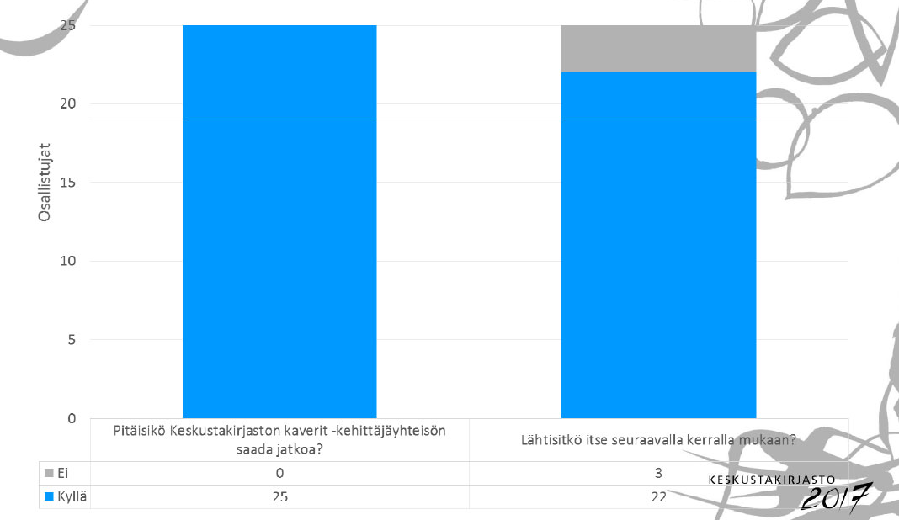
Should we continue working with FCL?
YES 25/ 25
NO 0/25
Would you join us for the next round?
YES 22/ 25
NO 3/25

Slide 30
What does it take TO DO CODESIGN: work in setting up a designer-user community CeLib Friends

Slide 31
Framing work: Elaborating where the value of user-designer community lies
1. Design participation of citizens in public service development is a complementarities win–win
  For Host: Search costs, instruction costs, search speed, timing
  For Citizens: Voluntary work, competence building, learning, influencing
2. Empowering citizens to influence and actively engage in the planning of a major public undertaking, as well as in implementing the city strategy
3. Design participation as a means to raise awareness of CeLib in the public and among city board decision makers (=within the institutions of representative democracy)
4. Creating more dialogical and closer relations between citizens and planners in renewing library services in the long term

Slide 32
Concretization work:
Setting targets and making an action plan
THEME AREAS
A place for exploration and know-how: peer learning, gaming, citizenship skills
A library for communities: volunteering, families, children, rules for communal-space use
Library for all citizens: Multiculturalism, immigrants, tourists
How to find content and share experiences and recommendations: Books, games, movies, music: E-content in space…

Slide 33
Relevance work: Establishing the design and information needs, forms and timing of the host
Optimum situation: Host managers and lead designers
  Indicate how much need and room for new concepts there is
  Give clear problem sets and indicate when and how they need answers
CeLib planning behind schedule 2014, no specs
Project team identified the biggest challenges in theme areas
Requirements specification process to determine what is clear and what needs elaboration in these

Slide 34
Selection work: who are sought as participats, how and to what exactly?
“Job add” by themes in media to gauge motivation and skillsets and to ensure representativeness
13000 visits by 6700 people, 95 applications, 28 selected
Mix of representativeness and ability in selection
Crucial users;
first early majority
I live in the future of others, I do whatever to solve my problem
The products I have are ok

Slide 35
Constituency and competence building work: finding and training staff facilitators
Decision to run internally: 12 faciliators and note takers needed for evening job!
Staff time scarce resource: simplified pre-training (just talk through), simplified templates
Enthusiastic and intersted people who did a great job!

Slide 36
Intermediate design work: Workshop principles, methods, templates and timing
Arrangements to help participants interact with each other;
Consideration how to best foster the ownership and high quality of deliberation among the participants;
Methods and templates to be used in each phase;
Breaks and fatigue estimations;
Considerations of atmosphere in different stages of each workshop and the series;
Eventual scheduling and phasing of the each workshop down to 5 minute level;
Likely contingency measures;
Guidance on how to facilitate and record the discussions and solutions.
So that trade-offs would not prove untenable regarding any one aspect

Slide 37
Collaborative design: Workshop facilitation, results archeology and concept refinement
First workshop dialogue with chief architect lasted longer than planned: planned speed up and all introductions and ideation worked well
Second workshop concept design from ideas: various adjustments, different working styles…
’Results archeology’ due to difficulties to capture all the conversations and ideas into templates
Third workshop refined concepts back to participants and improved + solutions to known problems by planners and architects

Slide 38
Take home messages on fCL process

Slide 39
Citizen panels, testing, just inspiration form citizens … has its place … in the 1980s
Democracy, resourcing, resourcing, and insights can be gained directly involving users
’Just asking’ works only with lead-users, who are rare
Hosted communities can involve more ’ordinary’ citizens: interaction and ’intermediate designs’ helps
Work in setting up Hosted user-designer community
  Framing and scoping
  Concretization to themes, tasks, scheduling, action plan
  Participant selection criteria and process
  Constituency and competency building internally
  Intermediate designs
  Collaborative design: facilitating, adjusting, polishing outcomes
  Evaluating and adjusting the continuance strategy

Slide 40
THREE THINGS TO DEVELOP WERE RAISED BY FACILITATORS:
1. More integral participation from the management and top-level planners from the onset
2. More clear indication of how results would be implemented in CelLib planning
3. Deeper training in the participative methods

Slide 41
TAKE HOME MESSAGES BY THE LIBRARY PLANNERS
Get past the co-design buzz and put it into practice – in a way that works for you.
Build trust. Both parties (professionals + citizens) need to show their true selves and be able to step in another’s shoes.
Don’t hide behind your professional role. Facilitate the process but let the citizens decide the direction and create the contents.
It isn’t always easy – co-design takes work. But eventually it will change the way you work.
While the planning component can feel (and sometimes be) lengthier, the process is almost always more efficient overall. Co-design eliminates confusions & misconceptions, and brings greater clarity to everyone involved.
Co-design leads to empathy and consideration for all users – both internally and externally.
Strategic codesign is a way of working that forces you to tackle the real issues, not “tick the participation box” / “hope they will show up & magic happens” –orientation.

Slide 42
WEEK 2, TOPIC 3: INTERMEDIATE DESIGNING CONTD’
Intermed des

Slide 43


Intermediate (co)designing in transitions governance
Sampsa Hyysalo, Tatu Marttila, Karoliina Auvinen, Sofi Perikangas, Aalto University
(Raimo Lovio, Armi Temmes, Allu Pyhälammi, Kaisa Savolainen,Louna Hakkarainen, Jani Lukkarinen, Paula Kivimaa,
Mikko Rask, Kaisa Matchoss, Janne Peljo)

Slide 44
Type of intermediate design | Bricolaged intermediate design | Gamified intermediate design | Intermediate meta-design
Typical features | - Open setting, where ready made materials are available - May include phases, themes, topics - May include facilitator to help the process - Designed templates, if any, are open and lightly structured Example: Ideation workshop with post-its, flip charts and facilitator with a guide | - Structured, gamified along processual and material qualities - Facilitator introduces rules, may guide the game - Intermediacy dictated by rules and materials Example: A design game to explore organizational transformation in service design | - Semi-open setting - Available building blocks or making tools for design - Facilitator may or may not be present - Intermediacy dictated by tools and materials Example: A tool-kit for elements which participants can use to envision their own further designs

Slide 45
But what goes into designing intermediate designs?
Julkistustilaisuus 28.11. – Tervetuloa!

Slide 46
Characteristics of intermediate designing
Intermediate codesigning of deliberative governance tools blends the design of physical elements, designing of and for interactions among participants, procedures, principles and facilitation and documentation.
    None of these can be designed in isolation and the understanding of their mutually constitutive relations is difficult to achieve without continuous protytyping and testing how the interactions actually play out.
Multiple and potentially conflicting design goals are common in most design, but the goal conflicts are particularly salient in intermediate designing
Designing for the distribution of agency in using the intermediate design and acting on its outcomes.
Continuous blending and trade-offs between elaborate ideals and mightily unimpressive mundane considerations.
Reducing complexity of the intermediate design within the minimal complexity required by the target system.
The net outcome of the above considerations were efforts to ‘channel participant action’, not to produce all open or designed-in interaction.

Slide 47
Conclusions
Moving beyond ‘bricolage intermediate design’ is time consuming, but often needed to ensure actionable outcomes
The challenge resides in avoiding ‘designing the participations’, which would hamper participants’ freedom to deliberate, express, create and take ownership of the process and its results, whilst ensuring the types of outcomes sought after (by participants themselves, by designers, by funders…).
Intermediate designing for transitions governance was characterized by highly iterative process and efforts to ‘channel action’ in meaningful and adequate way without designing-in users unduly (which would be more adequate in gamified intermediate design)
Elements of ‘gamifying’ and ‘bricolage’ intermediate designs, and arguably the processes of producing them, differs from designing ‘intermediate meta-designs’.
Some blending of these is common when designers seek to catalyze deliberation and design by participants (as in the present case a drift from bricolaged towards meta and towards gamified
Transition pathway tools started from intermediate meta-design orientation and moved to introducing more structured and proceduralized elements

