Slide 1
Week 4 theme: Using codesign to fostering long-term difficult change

Slide 2
RECAP: Path dependency – typewriters
David: Clio and Economics of qwerty
  Writing “typewriter” with just up-most row without getting the arms tangled
  People trained to qwerty, shifting causes moderate effort
  Dvorsak faster, ABCD easier to learn … specialist typing machines three times faster
  Best design vs. Path dependency
  The stock of (touch) typists available for US industry + the switching costs from typist to another.
Some contingent factor(s) pushed the development to particular channel
    Sunk investment, Learning effects, Network effects
    Sub-optimum continues to reign despite
    No typewriter arms
    Keyboards customizable at will: we could all have our favourite keyboard all the time regardless of switching to another typing machine

Slide 3
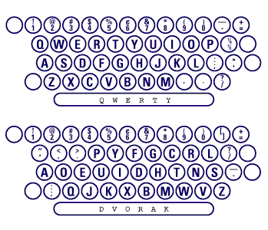

Slide 4
RECAP: Interlinked path dependencies: Sociotechnical regimes
When path dependencies take place as large system level they form interdependent networks
Petroleum car 1890s to 1990s
  Petrol stations (every 30-100km all directions)
  Oil extraction, refinement, storage and delivery
  Road infrastructure (from gravel to asphalt, parking lots, garages)
  Standards and regulation for driving (man running in front to highways and car requirement in city planning)
  Markets and retail for cars (who sells small e-cars and how)
  Consumer habits (freedom, closet, summer cabin, baby stuff storage…)
  Finance and investment (…norwegian oil fund, Saudi’s 800bn share in US economy)
  Research into “normal(ized) transit”, production, extraction
”Inevitable” even if problematic at landscape level eg climate change
“Alternatives” are not technology against technology, but new sociotechnical system against the (massive) old system: concept e-cars ever since 1970s
➔ change is ruthlessly difficult to attain: requires competing alternative and landscape change.
Not a switch, but a transition.

Slide 5
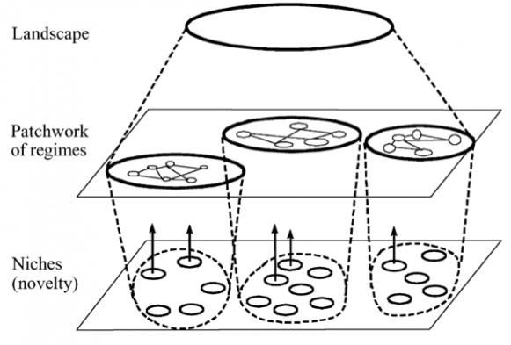

Slide 6
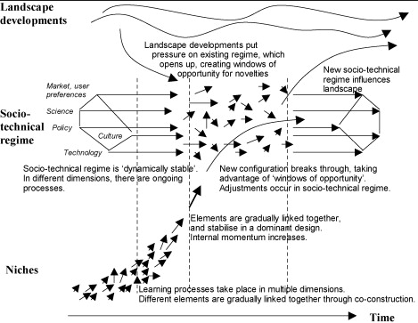

Slide 7
Week 4 topic 1: What is infrastructure?
What characterizes it?

Slide 8
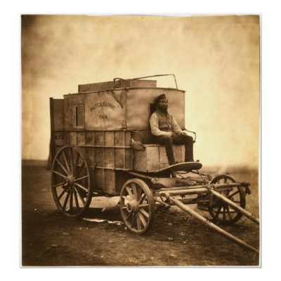
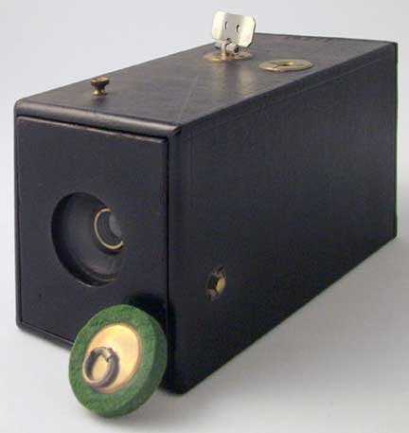
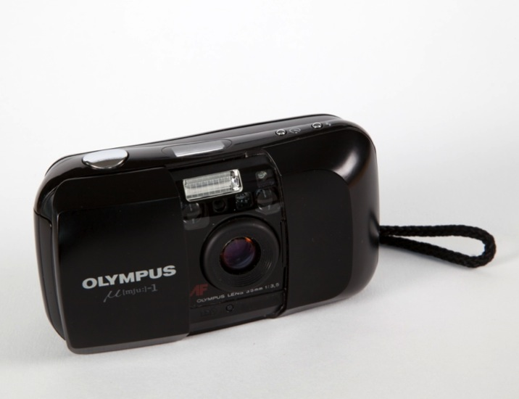
From complex to simple system: early photography
Risto Sarvas: From snap-shots…
Simple process, no chemicals, film for 100 photos, small & light camera, one button, no aperture changing, no changing of exposure, standard size…
Complex process, poisonous chemicals, heavy glass plates, big cameras…
Notes:
Remember this?

Slide 9

Get paper
prints
Buy film
Print of
paper
THE KODAK ERA 1920 – 2000
Develop
film
Take film for
development
Snap!
Notes:
Making the tricky, dirty, complex part of photography automatic. And in that way making photography accessible to a wider variety of people.

Slide 10
What are ordinary snapshots famous for?
Being very similar, aesthetically challenged, and not that very expressive.
Notes:
Many choices that a photographer can make are made for the snapshooter: aperture, exposure, lens & focal length, shape of photo… also few make any post-production (especially in the Kodak era) so the images all look very similar… and also, the unwritten rules of snapshot photography (the practice and conventions) encourage us to take very standardized photos: specific times, specific people, specific framing, specific faces (smiling) etc… Take a look at the images people share of Facebbok and be surprised how similar they are (or even better look at people’s family albums from the film era).

Slide 11
Complexity
Difficult
Manual
Variability
More control
Simplicity
Usability
Automation
Standardization
Less Control
A messy and chaotic
infrastucture.
A clean and established
infrastucture.

Slide 12
User can decide
Automated
(invisible)
Simple & restricted
Complex & Expressive
Notes:
Can you come up with examples: film photography Kodak vs. doing yourself; app store vs. HTML5; buying a ready product vs. making your own; restaurant vs. cooking home.

Slide 13
Simplicity
Usability
Automation
Standardization
Less Control
Complexity
Usability
Automation
Quick control
More control
A initially chaotic digital
infrastucture.
A clean and established
kodak infrastucture.

Slide 14
Star & Ruhleder, 1996: Characteristics of Infrastructure (Steps to an ecology of infrastructure)
Embeddedness. Infrastructure is "sunk" into, inside of, other structures, social arrangements and technologies;
Transparency. Infrastructure is transparent to use, in the sense that it does not have to be reinvented each time or assembled for each task, but invisibly supports those tasks;
Reach or scope. This may be either spatial or temporal—infrastructure has reach beyond a single event or one-site practice;

Slide 15
Infrastructure characteristics
Learned as part of membership. The taken-forgrantedness of artifacts and organizational arrangements is a sine qua non of membership in a community of practice. Strangers and outsiders encounter infrastructure as a target object to be learned about. New participants acquire a naturalized familiarity with its objects as they become members;
Links with conventions of practice. Infrastructure both shapes and is shaped by the conventions of a community of practice, e.g. the ways that cycles of day-night work are affected by and affect electrical power rates and needs. Generations of typists have learned the QWERTY keyboard; its limitations are inherited by the computer keyboard and hence by the design of today's computer furniture;

Slide 16
Infrastructure characteristics
Embodiment of standards. Modified by scope and often by conflicting conventions, infrastructure takes on transparency by plugging into other infrastructures and tools in a standardized fashion.
Built on an installed base. Infrastructure does not grow de novo: it wrestles with the "inertia of the installed base" and inherits strengths and limitations from that base. Optical fibers run along old railroad lines; new systems are designed for backward compatibility; and failing to account for these constraints may be fatal or distorting to new development processes
Becomes visible upon breakdown. The normally invisible quality of working infrastructure becomes visible when it breaks; the server is down, the bridge washes out, there is a power blackout. Even when there are back-up mechanisms or procedures, their existence further highlights the now-visible infrastructure.

Slide 17
In sum, infrastructure and design for change
One must assess the nature of infrastructure(s) that affect the change initiative
Being compatible with all the needed infra
  allows one to design just the addition or change envisioned
  can constrain heavily what can and cannot be done
Incompatibility with existing infra(s) or its future direction of travel can cause massive amount of extra design work to establish alternative infra or to build needed links to the infra
Anticipating infrastructural compatibility and dependencies may require understanding the production and running details of a proposed design

Slide 18
Week 4, topic 2: Affecting sociotechnical inertia a.k.a
Long-term transitional change and transition codesign

Slide 19


Transition Management & Transition Arenas
Julkistustilaisuus 28.11. – Tervetuloa!

Slide 20
Transition Management
Establishing a transition arena(s)
Developing a common vision
Pathway development through back-casting techniques
Experimenting with pathway options and
Monitoring, evaluation and revisions to pathways and experiments

Slide 21
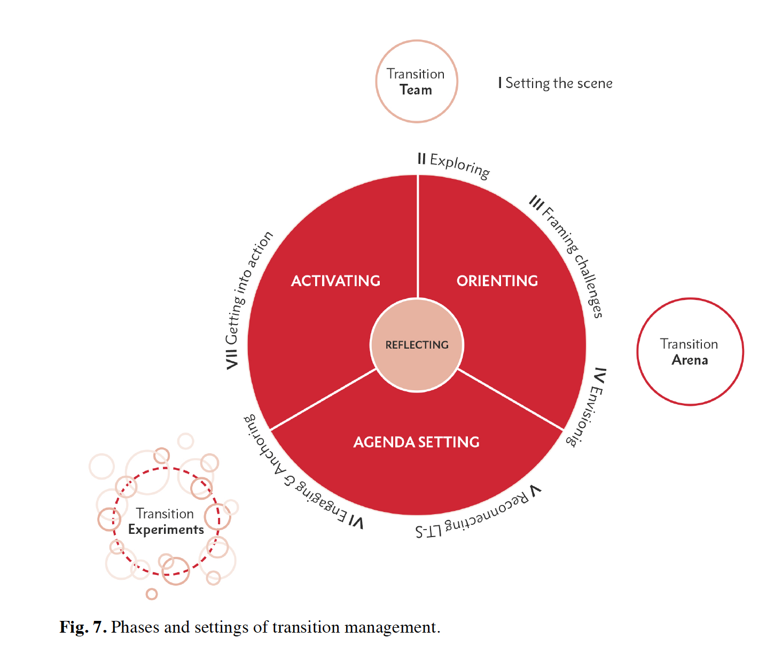

Slide 22
Adapting transition arenas to Finnish Context
Transition management was applied in Finland in early 2000s: “Too Dutch”: too loose in comparison to regulation and too determining regarding market based selection
Policy instruments and culture and deliberative forms vary from a country to another
Finland has deliberatively formed parliamentary Energy and climate roadmap to 2050, Mid-range climate plan to 2030 and Governmental energy and climate strategy to 2030 for setting mid-range goals
140 energy related pilots www.energiakokeilut.fi and high emphasis on experimentation by current government
Transition arenas could connect the two

Slide 23
Design Issue | Transition management concept | Transition management in practice | Re-designing transition management | SET-Response in Energy Implementation TA
1. Goals | Overcoming ‘persistent problems’ of environmental policy, achieving transition in pervasive socio-technical systems | The promotion of technological niches with commercial potential for the world market | Nurture broader societal discourse on sustainable development, objectives of transitions, and challenge the legitimacy of existing socio-technical systems | Refocus on cross sectoral implementation of energy transition
2. Organisation of transition arena | Visionary regime actors and innovative newcomers | Dominance by regime incumbents with vested interests | Establish principles and guidelines for selection of participants and moderation of interaction processes to ensure broad participation | As suggested originally but enforced
3. Role of visions | Construction of visions by frontrunners informs and precedes strategydevelopment and design of experiments | Visions are constructed by incumbents and lack concreteness to inform strategies or select experiments | Construction of visions by participants to make tension between normative desires and feasibility considerations productive and generate creativity | National 2030 government vision taken as starting point: additions and alternatives spelled out. Focus on implementation of paths to overcome vagueness
4. Experiment-ation | Real world experiments with portfolio of options for alternative socio-technical systems | Evasion of political choices with respect to public support for technological options | Procedures to select, design experiments to secure linkage with public debate about sustainability | Experiments linked to transformation paths. Gaps identified.
5. Evaluation and Learning | Evolutionary selection process, options prove their feasibility in real world context, evaluation with respect to potential to contribute to the vision | Evaluation by insiders according to narrow techno-economic criteria | Evaluation criteria negotiated widely for the broad societal implications of alternative pathways to sustainable development, learning from experiments and overall process embedded in democratic Institutions. | Process and outcome evaluation in and of TA, fostering learning among participants and from participants after TA
6. Sources of legitimacy | The goal of sustainable development | Economic and technological position and expertise of participants | Inclusive participation, transparency and publicity of choices, coupling with established institutions of representative democracy | Anchoring to ECS 2030, Hosted by Sitra’s PSPC, wide cross sectoral and civil society participation
7. Embedding in political context | Transition management is being implemented by choice of government, transition arenas recommend successive changes to political institutions | Transition management is held up as an ideal concept while established institutions and power constellations constrain implementation | Policy design as innovation process, work towards realisation of objectives by continually designing in context | TA to connect experiments and policy –Finland has many committees or visioning bodies running, over 100 experiments related to energy transition
8. Participation support | Facilitated TA deliberation | Talk with schematic representations | The support for the quality of deliberation not addressed | Purpose built collaborative design means to aide interactions
Based on: Voß, J.-P., Smith, A., & Grin, J. (2009). Designing long-term policy: rethinking transition management. Policy Sciences, 42(4), 275–302.

Slide 24
Redesign Issue | SET-Response: Helsinki 2017 transition process | Evaluation of the SET response
1. Goals | Refocus on cross sectoral implementation of energy transition in the mid-range | The ‘systemic’ framing of energy issues and tight focus on implementation were considered successful, though some of the participants called for an even stronger policy focus. Goals were adapted from the Energy and Climate Strategy of 2016
2. Organisation of transition arena | As suggested originally but enforced with spelled out principles to diversity and expertise | The diversity of actors, inclusiveness and transparency regarding stakeholder selection principles were strong positives, but inclusion of key regime actors remains an unexplored possibility.
3. Role of visions | The ECS2030 vision taken as starting point (with raising of ambition level and additional topics spelled out); Focus on implementation of transition paths to overcome vagueness | The participants considered a raised ambition level important – increasing shared ownership of the process; the general transition agenda was eventually considered more central than the individual pathways and actions.
4. Experimentation | Experiments linked to transformation paths (by identifying crucial gaps) | The pathways produced propositions for new areas of real-world experimentation to accelerate transitions but their implementation remained uncertain and was dependent on individual activities of the participants.
5. Evaluation and Learning | The arena process was geared to facilitate learning among participants. Process and outcome evaluation transition arena process; Constructive assessment of experiments | The participants reported learning related to the systemic nature of changes as an important aspect of the process. Formal evaluation provided insights on learning, networking, policy impacts and methodological tinkering
6. Sources of legitimacy | Diverse selection of participants, anchoring to the ECS2030 and hosting by national innovation fund SITRA | The legitimacy of the TA was not questioned by the participants, or (at least) openly by outside parties
7. Embedding in political context | Transition arena embedded in Finnish national and policy context specifics (e.g. long-term planning history, energy system features) | The implementation focus and critical positioning towards regime policies aided the work but even tighter feeding into topical policy processes (RED2 implementation, government strategy 2019) was desired. Yet some policy impact has already been reported.
8. Participation process support | Purpose built collaborative design means to aide interactions | The process design was considered excellent for interactive and goal-oriented work by the strong majority of participants.

Slide 26
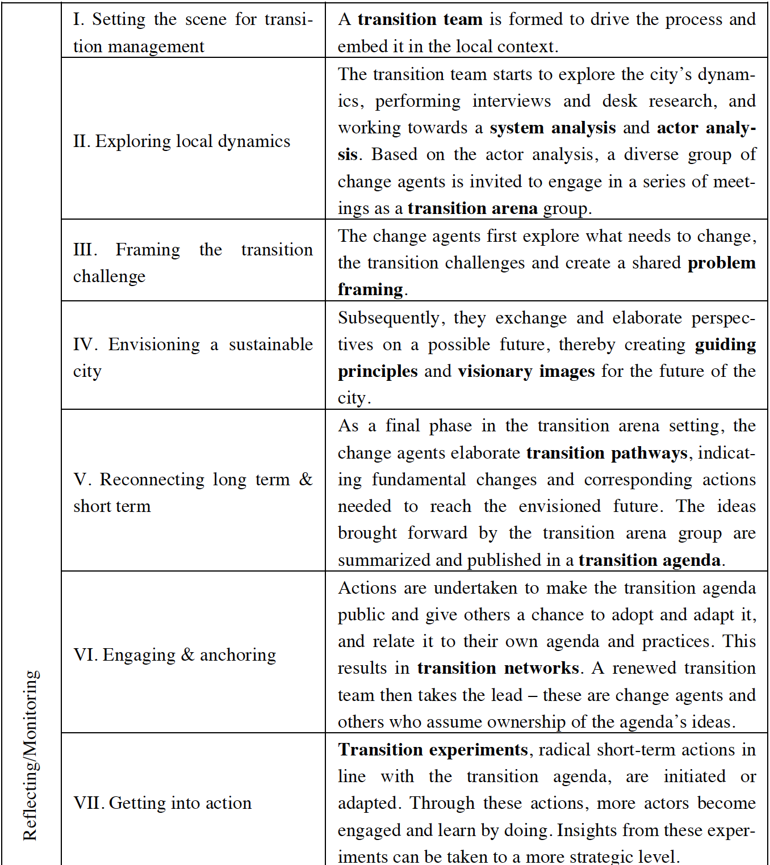

Slide 27
Energy Transition Arena
2030: Overview
Participant’s backgrounds
MPs
Ministries: TEM, YM, EV, LVM,
Cleantech start ups
Energy company change makers
Energy technology companies
Large industrial energy users
Forerunner cities
Carbon neutral municipalities
NGOs and Citizens
Sitra, Tekes, Investors
Researchers
16.2. KICK-OFF
16.3.2017 Workshop 1: Current challenges and drivers
20.4.2017 Workshop 2: Vision and goals for 2030
18.5.2017 Workshop 3 Pathways of change
15.6.2017 Workshop 4. Prioritization of pathway steps
24.8.2017 Workshop 5. Immediate actions and experiments
19.10.2017 Workshop 6. Final report preparation

Slide 28
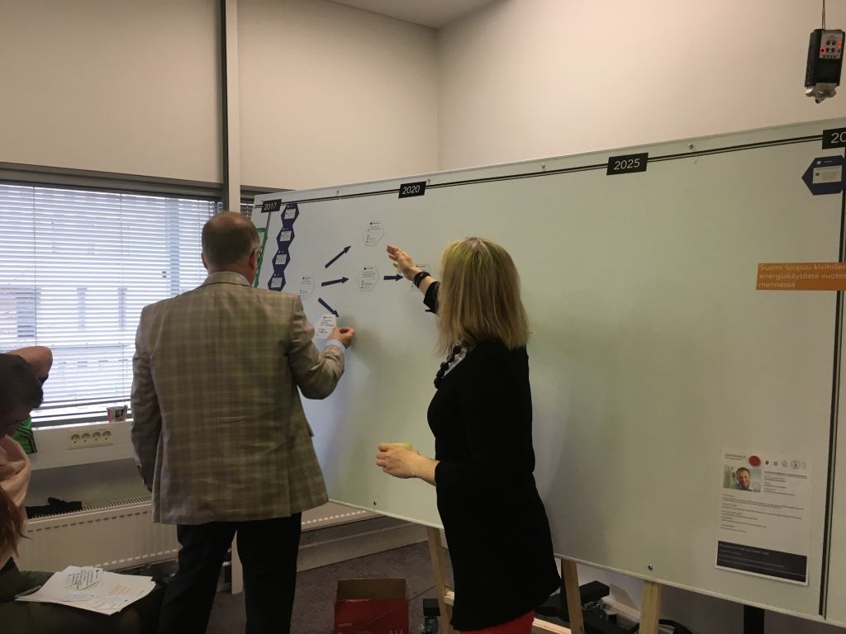
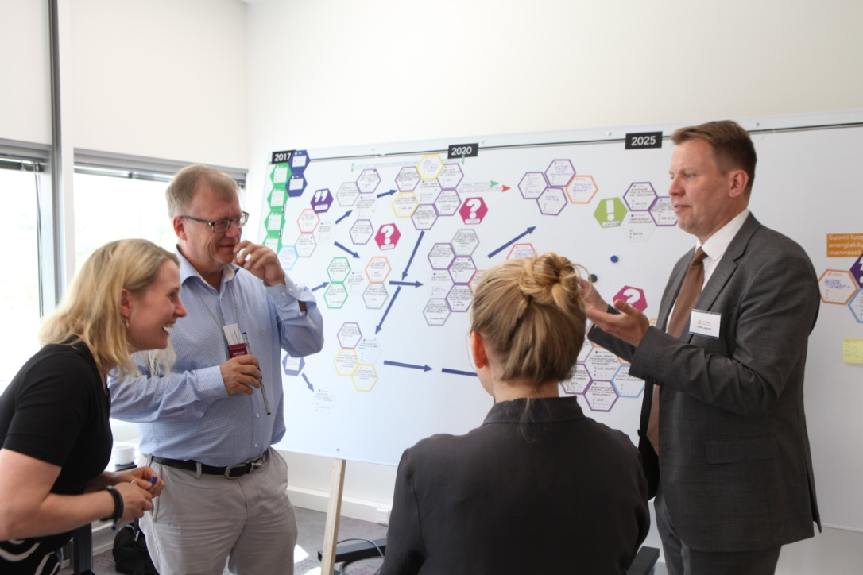
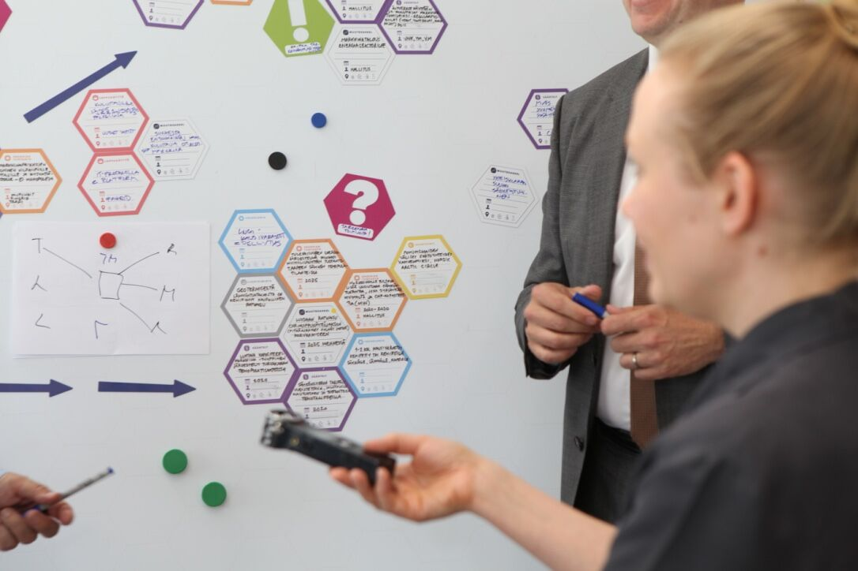
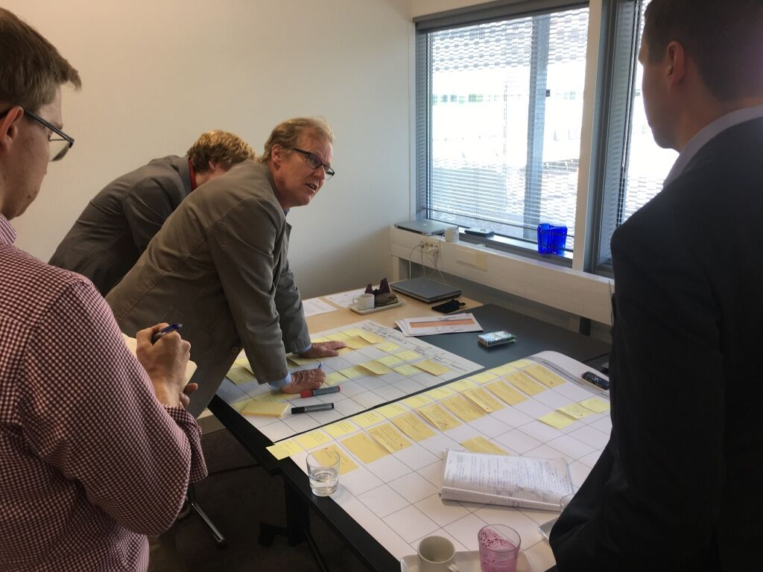

Slide 29
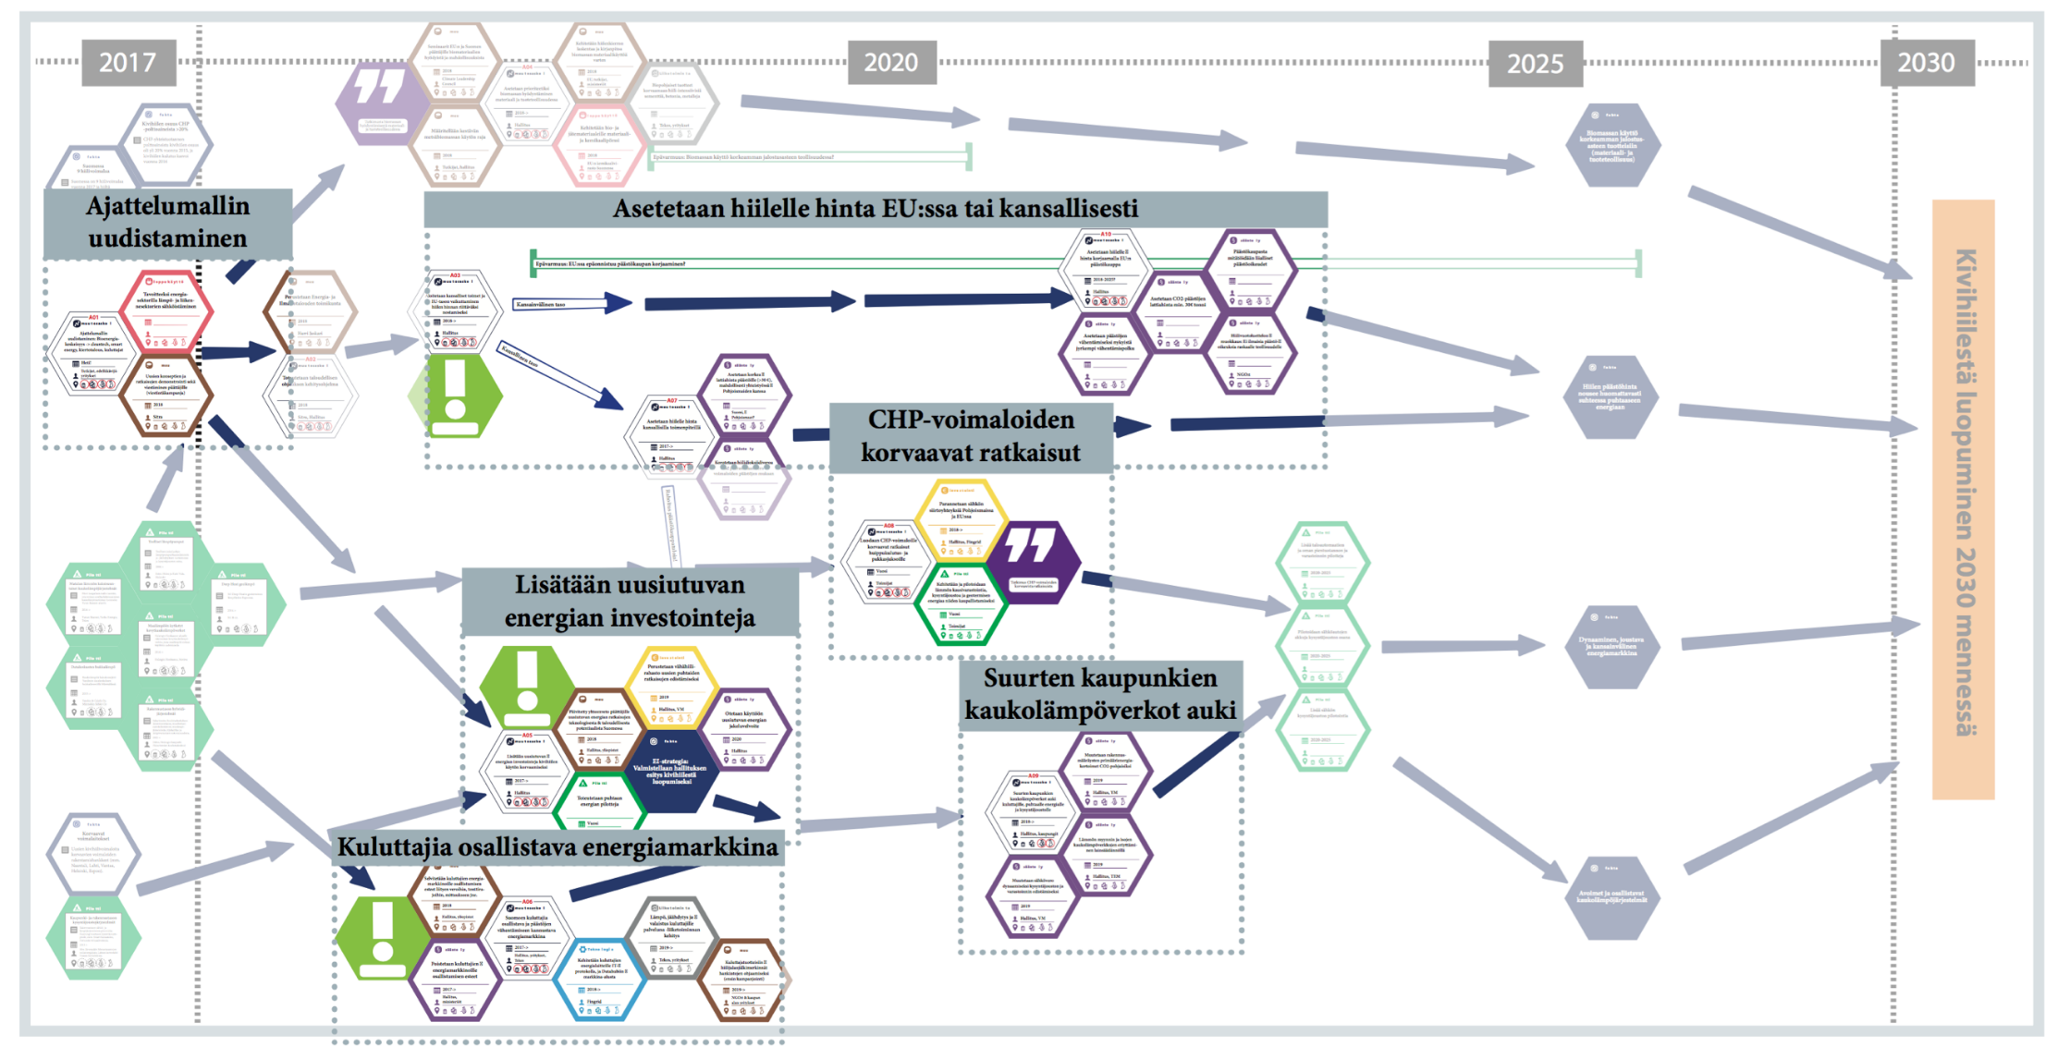
End of coal use by 2030

Slide 30
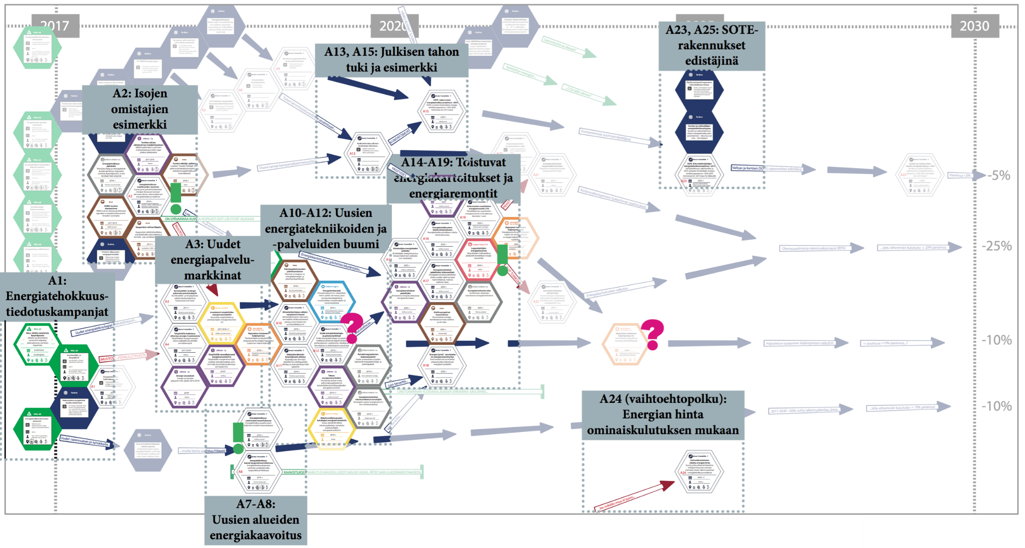
Building stock net energy consumption down 50% by 2030

Slide 31
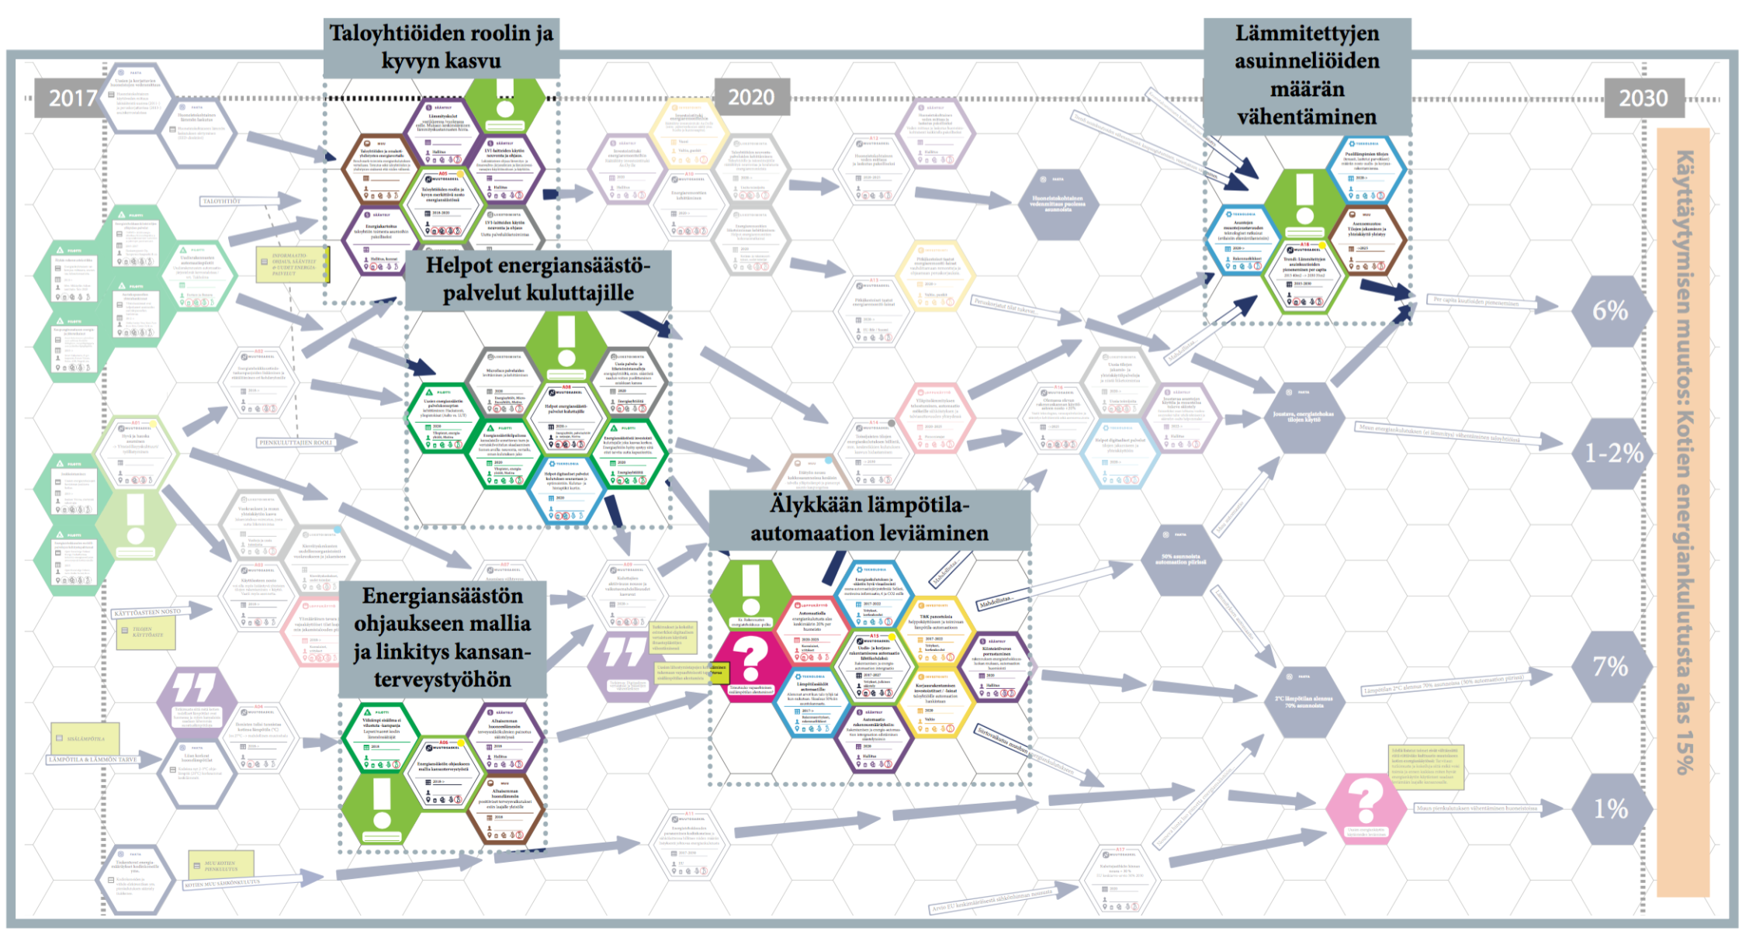
Domestic energy consumption 15% down with behavior change by 2030

Slide 32
Some Preliminary Success
2017 transition arena report was handed over to Cabinet Minister
Discussed in a panel of four MPs and head of Business Finland
Featured in headline TV news and was covered by 16 newspaper articles in major Finnish media.
Over 30 blogs and columns
Its discussion in social media received over 150 comments in “new energy policy” discussion group
Discussion invitations to key energy system institutions in 2018: Federation of technology industries, Ministry of Employment and Economy, Largest energy company…
Five new arenas within and outwith energy sector in city, region and ministry scales…

Slide 33
ANOTHER DESIGN STRATEGY: TARGETTING AND ANTICIPATING “REVERSE SALIENTS” THAT HINDER SUSTAINABLE CHANGE

Slide 34
Designing for Sustainable Transition through
Value Sensitive Design
By Luisa Mok, Sampsa Hyysalo, Jenni Väänänen
Department of Design, School of Arts, Design and Architecture,
Aalto University, Helsinki, Finland.
Notes:
Our topic here today is Designing for Sustainable Transition thru Value Sensitive Design, co-written by Luisa Mok, Sampsa Hyysalo and Jenni Väänänene from Aalto Univeristy.

Slide 35
Designing for Sustainable Transition through Value Sensitive Design.
Sustainable Design
“There are professions more harmful than industrial design, but only a few of them.”
“The increasing complexity of global problems requires new and better solutions from designers.”
(Victor Papanek, 1971)
Notes:
We would like to start fm 2 early concerns for sus des in this case
Here r 2 quotes fm VP who knows that designers r, there is a need for sus des but designers dun necessarily know how to do it well for desirable outcomes
Today, the increasing complexity of global pbms has been much highlighted in the recent work on sustainability transitions.

Slide 36
System transitions analysis – systems change
everyday work and consumption practices are comprised of interdependent elements, Shove, 2012
the issue in the sociotechnical interdependencies is aggravated in the large technical systems such as road transit system or energy system Geels & Schot, 2007; Hoogma et al., 2002
Any sustainable design requires a range of associated changes to become effective, and if these do not follow the introduced novelty tends to wither away
Notes:
The transition analysis notes that many of the sus des projs have withered the way coz
production & consumptions practices comprises elements that
often form even larger sociotechnical systems, which raises interdependencies and
form path dependencies that
Any alternatives suggestion by des is easily overruled coz it’s not quite fit to the existing regime.

Slide 37
What room is there for creative efforts for doing sustainable design?
Notes:
Now we can ask what room that is for sus des…

Slide 38
Designing for Sustainable Transition through Value Sensitive Design.
Designers can do much for a more sustainable future
even in large sociotechnical systems, yet requires
How sustainable design is positioned strategically, &
The available and adequate principles for working this strategy
Notes:
And in this paper, we argue that designers can do much more for sus des… in the future... even in large sociotechnical syss… yet this requires design to position strategically… & then we figure out what r the adequate principles for working this strategies in the particular case.
In this paper,
We argue that there is a way out for sus design
But, 2 criteria
Design has to be oriented strategically
To work out this strategy, we need a available and appropriate principle
How design can help to achieve a transition to a more sustainable system?
A more sustainable future
Even modest efforts can made add to an ongoing sustainability transition

Slide 39
One possibility: anticipate ‘reverse salients’ in the systems change and target design to them
T.P. Hughes, 1983 ‘Electrification of America’ identifies system building as a long-term advance across existing technology, institutions, companies, regulation, markets, daily practices etc.
Anticipatory work by system protagonists to remove present and future barriers to advance
Halted by ‘reverse salients’ that blok the advancing front before the salient is removed

Slide 40
CASE
Advancing Solar PV proliferation in Finland
Targeting strategic design to Reverse Salients prior to their full effect slows system change, Hughes, 1983
Siting solar arrays into existing building stock: esthetics and heritage concerns may rule out considerable proportion of roofs
Notes:
This leads us to Str Des
To target RS of siting solar arrays into existing bldg. stocks.

Slide 41
Designing for Sustainable Transition through Value Sensitive Design.
A contingent opportunity in timing & spacing of intervention: Aalto University campus
Strategic positioning:
Energy self-sufficiency by 2030
Dipoli, in Espoo, Finland, 1965, high cultural value heritage; currently under extensive renovation & change in purpose.
An anticipatory design for ecological modernization without aesthetic Brutalization
  Standard solar array would ruin the building
  Standard full preservation would freeze the building in 1960s
Time
Reference: Multi-level perspective on transitions (adapted from Geels 2007, p401).
Notes:
we see there is opp at our own Uni campus
where there is a heritage blding called Dipoli built in 1965
which is going into extensive renovation and change in the progress.
Siting renewable E as much as possible into this bldg is foreseeable in the campus str.
Yet to mitigate the foreseeable barrier/dilemma of RS, we proposed an anticipatory design looking into ecological modernization but at the same time aesthetic brutalization…

Slide 42
Designing for Sustainable Transition through Value Sensitive Design.
Value Sensitive Design,
Competing values between
Preservation – Modernization – Aesthetics
Notes:
VSD, Friedman, Kahn & Borning (2013)
So in order to figure out whether and in what form would solar pv could be
we turn to Value sensitive design framework (a proper principle that we could count upon in working out the str)
We particularly focus on the competing values btw preservation value, modernization and aesthetics. We conducted 3 investigations: CI, EI & TI in iterative fashion in which VSD typically practises
And let’s see how these found out.

Slide 43
Designing for Sustainable Transition through Value Sensitive Design.
Conceptual Investigations
Value Sensitive Design:
Value investigations
Human values, with ethical import
A diverse group, multi-stakeholders
Technology design
Integrative & iterative process
Large-scale system
Long-term consequences
Explicitly supported values and stakeholder values identified, analyzed and prioritized.
Empirical Investigations
Key a priori values articulated by stakeholders, studied empirically and evaluated.
The values guide the technology design.
Technical Investigations
The properties of technology and analysis.
The design supports the committed values.
Reference: Value Sensitive Design, Friedman et al. 2003.
Notes:
VSD
Human values, with ethical import
A diverse group and multi-stakeholders
Tripartite methodology – Conceptual, Empirical and Technical Investigations
Integrative approach and employed iteratively
Guide technology design
Long-term consequences of alternative technical choices
Note:
VSD is an integrative tripartite methodology and worked/employed iteratively.
Integrative: that involves people working together and having an influence on each other; that allows information to be passed continuously and in both directions between a computer and the person who uses it
Interactive: to combine two or more things so that they work together; to combine with something else in this way
Explicitly supported values:
Cultural heritage preservation: cultural heritage preservation as restorative practice would preclude any modernization of ht ebldg
Campus prestige and identity: require new uses & access for the roof areas then outlaw installation
Ecological modernization
Economic costs and space viability: max the amt & yield of solar panels for E eff will → result in a loss of aesthetic & cultural heritage values → “ecological brutalization” (greenwashing)
Key stakeholders identified:
Aa Uni Presidency, Aa Uni Properties, the solar tech providers, architect constituency (incl some architects int eh renovation proj & the National Board of Antiques; also students & alumni of Aa who has less power
Their key & corresponding values; of the direct & indirect stakeholders
Analyzing value comparison & prioritization btw gps
Prioritized values:
Aesthetic quality, functionality, cost- and E-eff, and building the ID of Aa

Slide 44
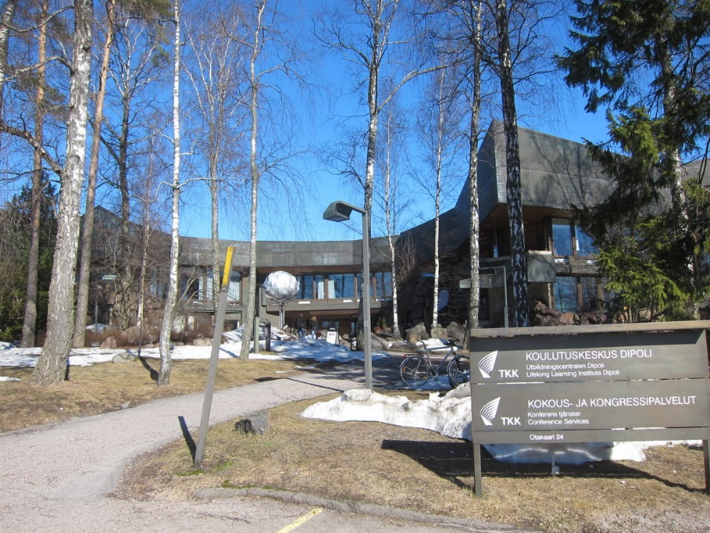
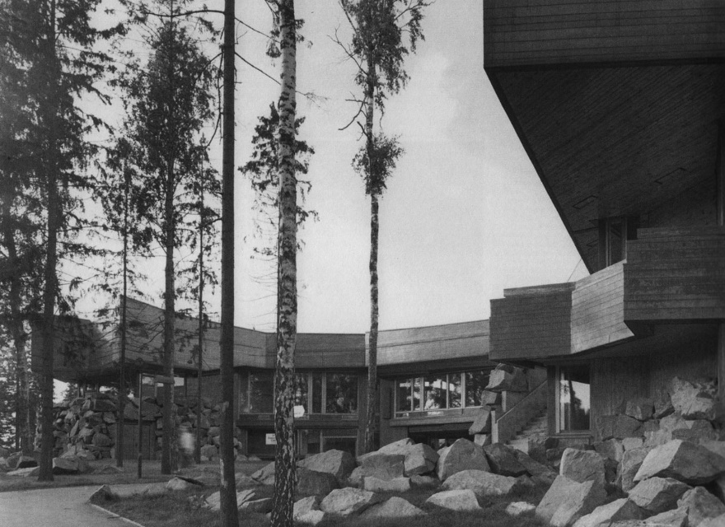
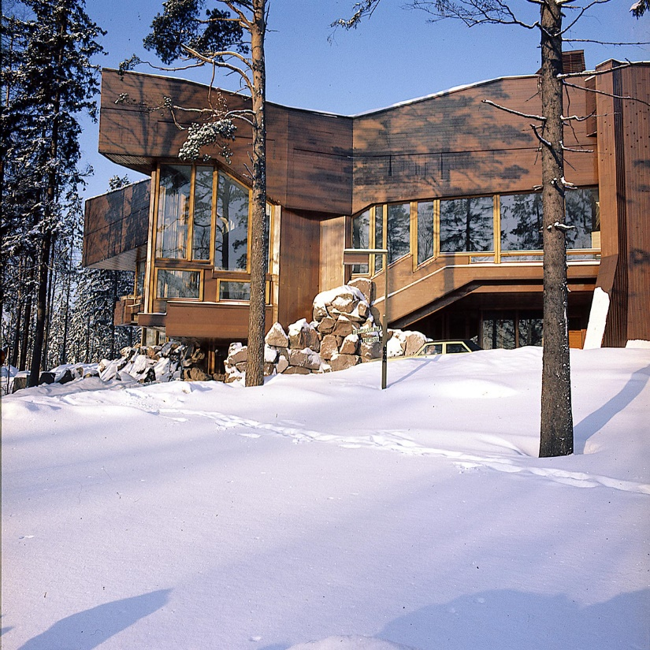
Designing for Sustainable Transition through Value Sensitive Design.
The Dipoli case
3.
1.
2.
1, 2. Martti I Jaartinen, Arkkitehti 9/1967. From Fundación ICO et al. 2009.
3. http://virtualwelt.blogspot.fi/

Slide 45
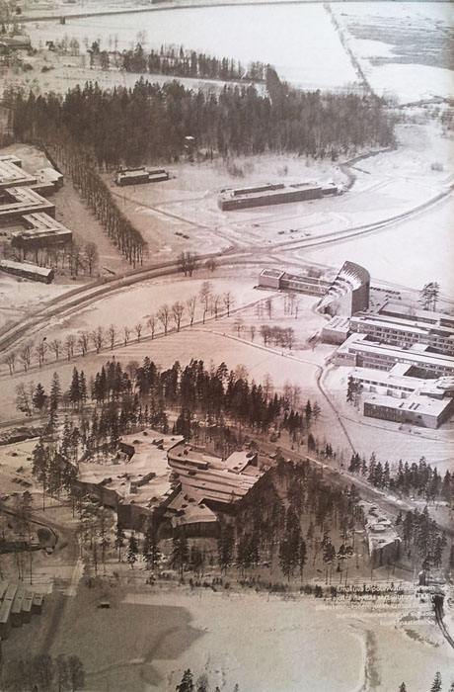
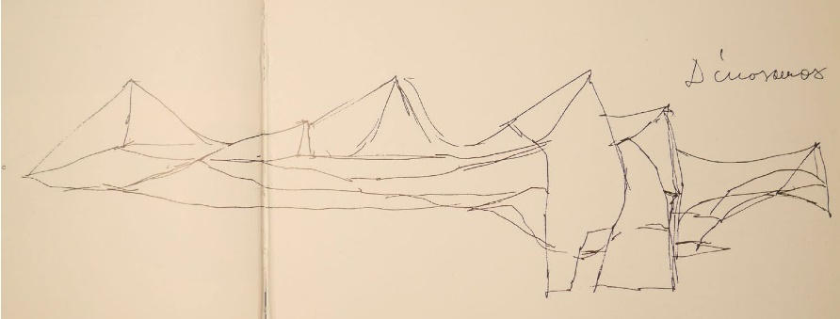
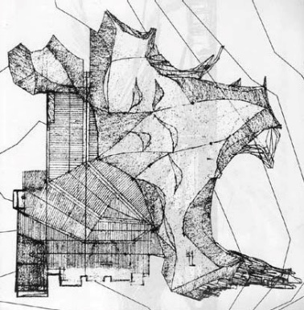
Designing for Sustainable Transition through Value Sensitive Design.
Architectural literature
The architectural value of Dipoli, 1965:
designed by Reima and Raili Pietilä (1923-1993, 1926-)
Environmental experiment
  ”Modern appropriately” is important (Quantrill, 1985)
  The roof design is one of the keys to the form
  Design alternations due to technical/construction constraints, functional changes & commercial-related changes throughout the 50 year since 1966
Quantrill 1985:51.
Quantrill 1985:48-5.
Martti I Jaartinen, 1966-67,. Archive MFA
1.
2.
3.
Notes:
First look at the archi rev Dipoli in 1965 we looked into what was at the bkgd of this landmark bldg. by R P.
We know that v quickly that instead of not changing the bldg so preserving the bldg. is not the only option
coz this bldg. was actually constructed as an env experiment & to be modern appropriately.
The roof is one of the des key to the form of the bldg of the elements of it. … raised from the rock
EI – Archi lit:
Going to arch lit help us to understand the preservation significance.
Here the keys are
The design is by Pietilla, 1965, 50 yrs ago
Contextual rs w the env
Hidden in the forest pin trees
Roof contour
designed by Reima and Raili Pietilä (1923-1993, 1926-)
The architectural value:
Environmental experiment,
to explore the interaction btw the bldg & env
The experiment engaged a natural extension of the landscape
contextual relationship, Hidden in the forest pine trees
Experiment of contradiction:
between geometry and freeform featured Dipoli’s dual character:
in providing functional & expressive aspects
Mimicry of hte underlying contour of rock & dinosarus silhouette
Both FI localness & intl modernism → ”Modern appropriately” is important (Quantrill, 1985)
EI – Heritage History:
Plan view shows the modifications of Dipoli have been carried out since 1966.
And also there have been already changes before now due to the functional changes
Incl changes due to construction techniques at its time
Functional changes & commercial-related changes incl wall colour, flooring matls, staircase & window blockages
It’s abt the preservation significance
EI – the heritage constituency:
The archi history is a key to understand the nature of its heritage value
An imp bkdrop for perceptions, which the heritage constituency holds abt the bldg.
Fm interviews: identified a key legacy holder of P’s architecture stressed the imp of the roof recognizing that modernization could take place if done properly
Empirical Investigations
The heritage constituency – their perceptions
“The roof of the Dipoli is a very important element of the building… of course there are areas of the roof you could not place [solar panel] installation without them ruining the silhouette… It is all right as long it does not ruin the valuable building’s architectural appearance – the very reason that building in a heritage building”
(Annukka Pietilä, 16 November 2014).
“I'm afraid that the thought of installing solar panels on Dipoli is a dead-end thought because of the architectural value of the building… Otaniemi is full of anonymous, mediocre brick buildings. There would be no harm covering them with solar panels… This sounds fun and dangerous simultaneously. Hopefully she really has permit to enter the fragile copper roof and an insurance!”
“the original is interesting to see, … interesting feature to go back”
(the architect commissioned for making a heritage preservation study, 28 April 2015). → Reverse salient:
the heritage researcher wanted to see the original design
So a limitation to modernization, or even a step back
the rooftop flooring materials,
1965: All flat surf in bitum-felt topped w gravel for waterproofness & costs effectiveness
All non-flat surfs in copper folio due to tech limitations
1986 (21 yrs later): renovation for maintenance: all surf replaced by new Bitumen-felt incl slopes due to tech advance

Slide 46
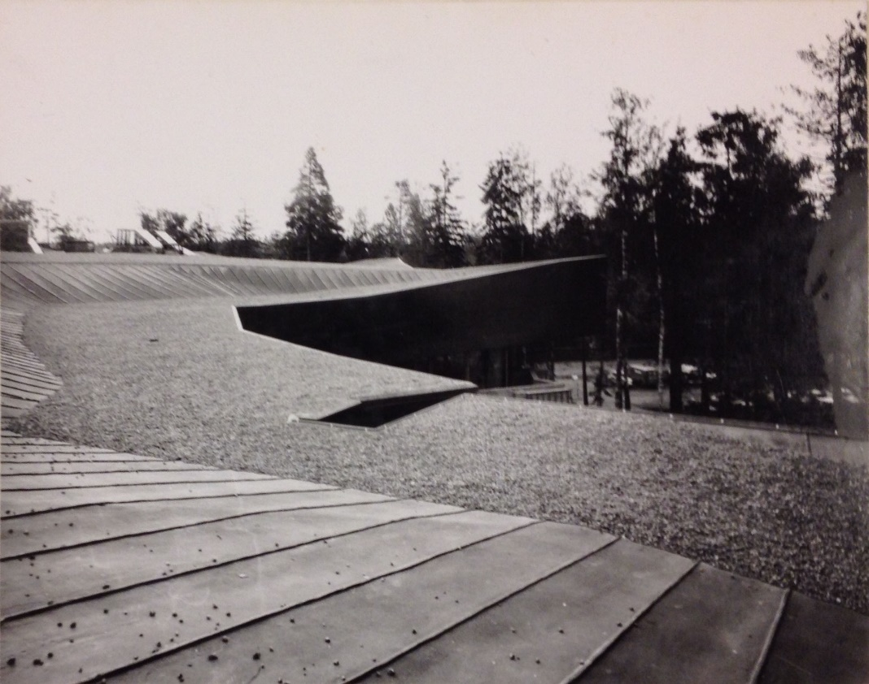
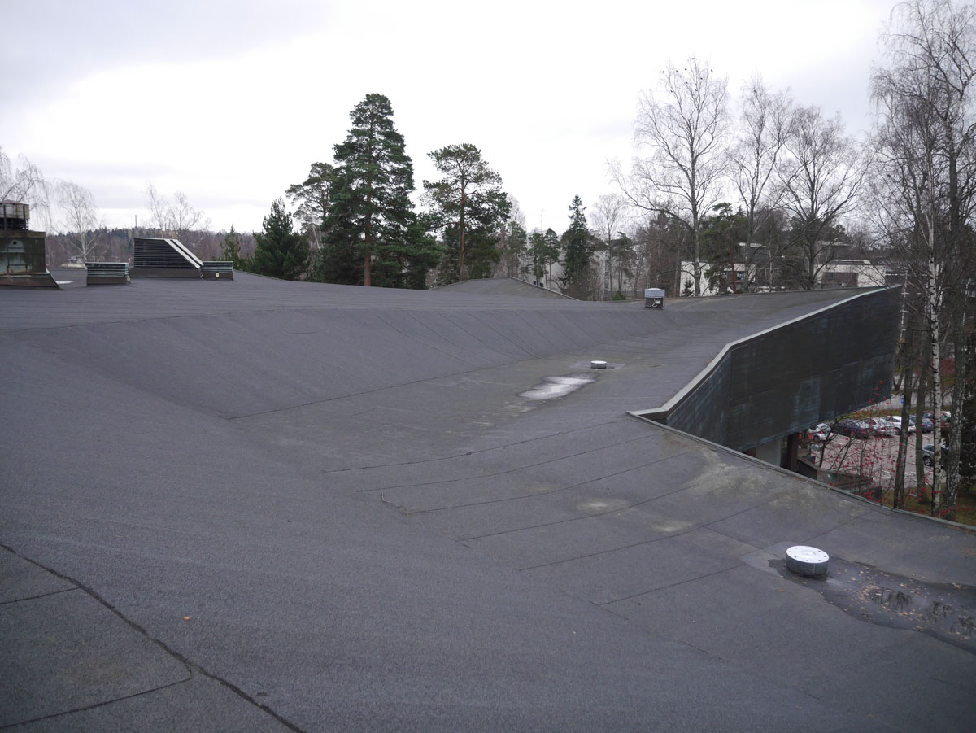
Designing for Sustainable Transition through Value Sensitive Design.
Empirical Investigations
– the perception held up by the architectural constituency
Dipoli rooftop, photo by Martti I Jaartinen, 1966-1967. Archive MFA.
Dipoli rooftop, 17 November 2014.
Notes:
The roof:
it’s a cultural heritage bldg.
And the roof is one of the key features to the form of the bldg
(1) that it rises fm the rock (and hidden in the forest).
Dipoli the roof was never was what it was drawn (designed) but the arch constituency is actually that they are convinced that (2) the roof is made of copper.
Archi constituency
However, the archi constituency has absolutely neglected the fact that the roof has never been worked as planned.
The plan was to be all copper but never was realized in that way.
There was rather bitum-felt at the onset and then 20 yrs later it was all covered in bitum-felt and it has not been the way as it was envisioned in the first place.
The preservation constituency would rather seek restore to its original form not even one drawn …has built.. .as it has always been all kinds of renovations done in the building process. …
EI – Fieldwork, History & Perception of the heritage constituency:
The most mystified point is about the rooftop flooring materials,
1965: All flat surf in bitum-felt topped w gravel for waterproofness & costs effectiveness
All non-flat surfs in copper folio due to tech limitations
1986 (21 yrs later): renovation for maintenance: all surf replaced by new Bitumen-felt incl slopes due to tech advance

Slide 47
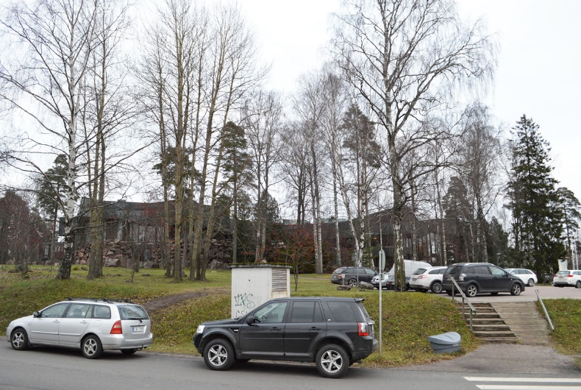
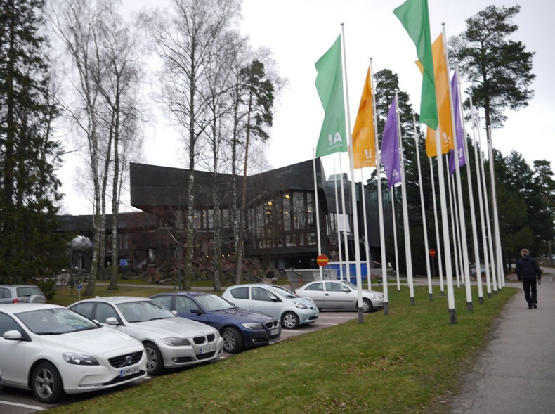
Designing for Sustainable Transition through Value Sensitive Design.
Empirical Investigations
Changing contextual relationship
between Dipoli & the environment, social & cultural development
Diminishing of pine forest, replaced by birch, bushes
Extended car park
Tall ground poles mounted with colourful university flags
Dipoli, 17 November 2014.
Notes:
And when we look at its current bldg., the image of this bldg.
has been hidden in the pine forest,
have also been spoiled quite heavily for the fact that there is now carpark & colourful flags and the forest has diminished round the bldg..
So there is nat evolution around the bldg. that we have.
EI – Fieldwork:
Changing contextual r/s
Hidden in the pine forest is now hving less pine but more birch & bushes
Car park in front & around
Tall ground poles mounted with colourful university flags

Slide 48
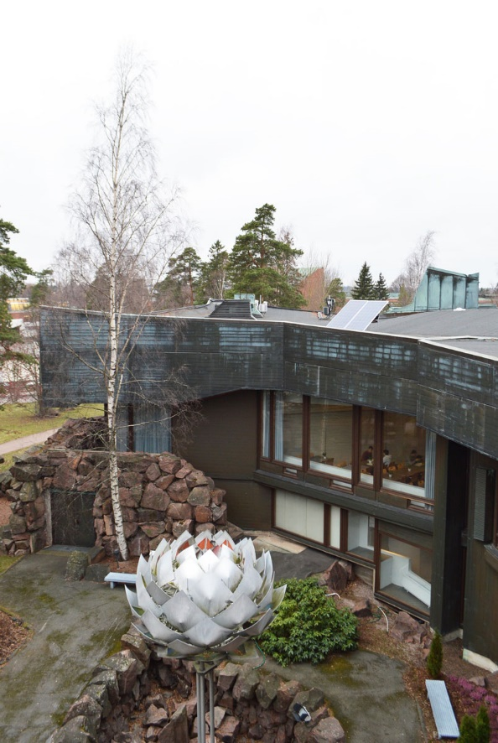
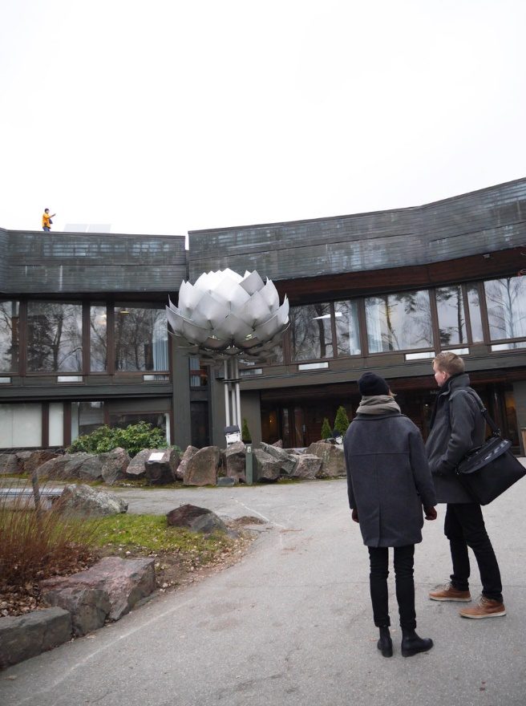
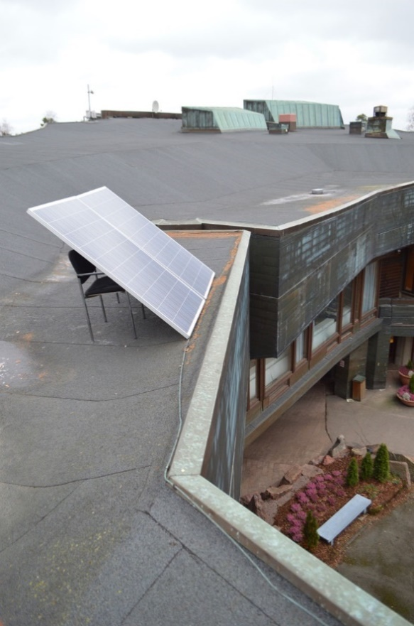
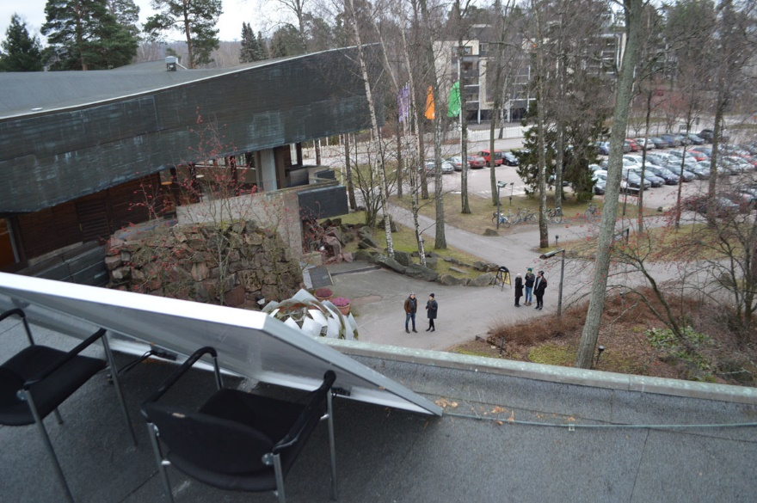
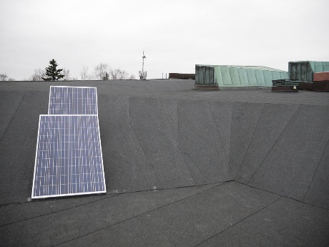
Designing for Sustainable Transition through Value Sensitive Design.
Empirical Investigations
– Design Visualization
Dipoli rooftop,
2 December 2014.
Notes:
Prototype:
And then we kept in mind these investigations
we started thinking could we renew the silhouette of the bldg. so the bldg. the renovation would redeem the modern appropriate & in an ecologically way as well.
So we run the prototype experiment on how the diff ways of siting solar panel would be slightly diff for ppl who enter the bldg. and
we realize that we can hide the solar panel entirely in the roof (if we wish) or we can make some of them visible
EI – Design Visualization:
We also put 2 real PV panels on the roof to visualize to people (visitors) really siting PV panel on Dipoli
Want to further see stakeholders to articulate, express their feelings clearly (interest or resist).
We placed them in diff locations, and talked to people

Slide 49
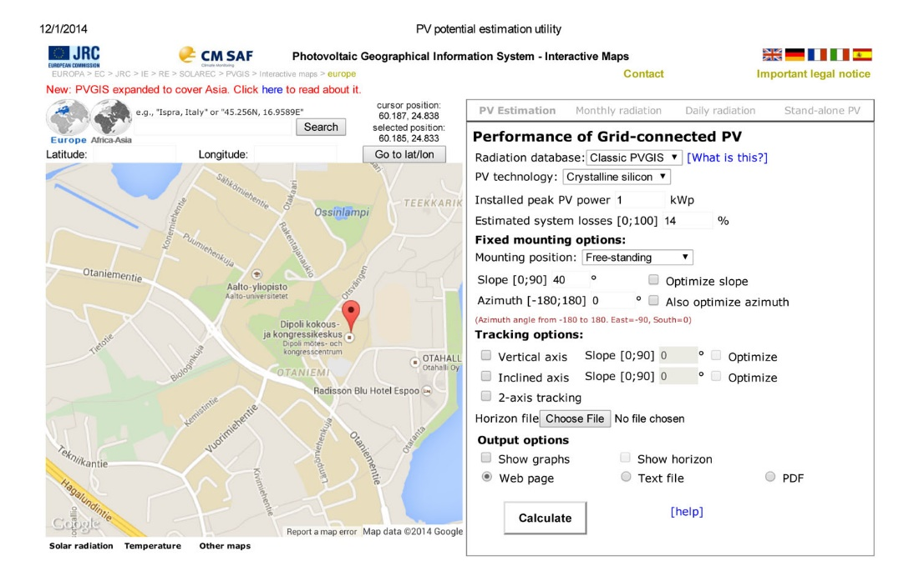
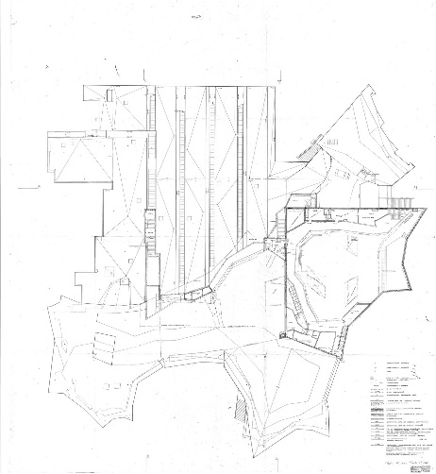
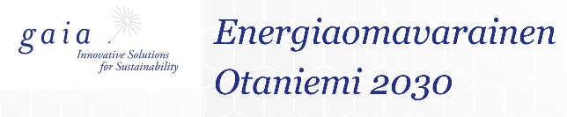
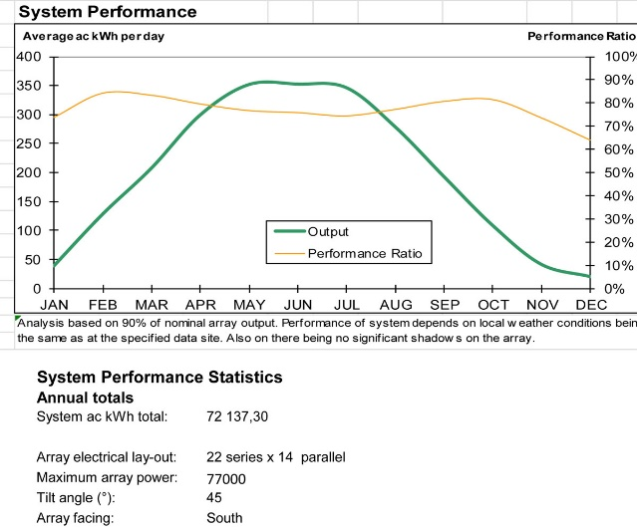
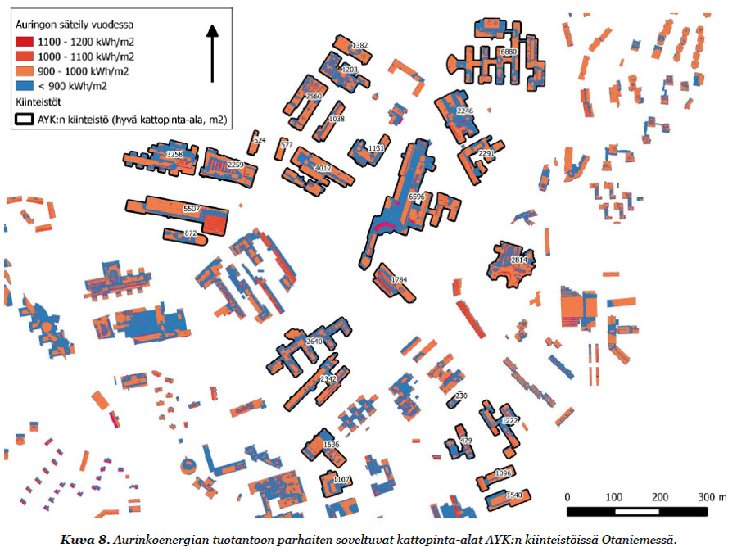
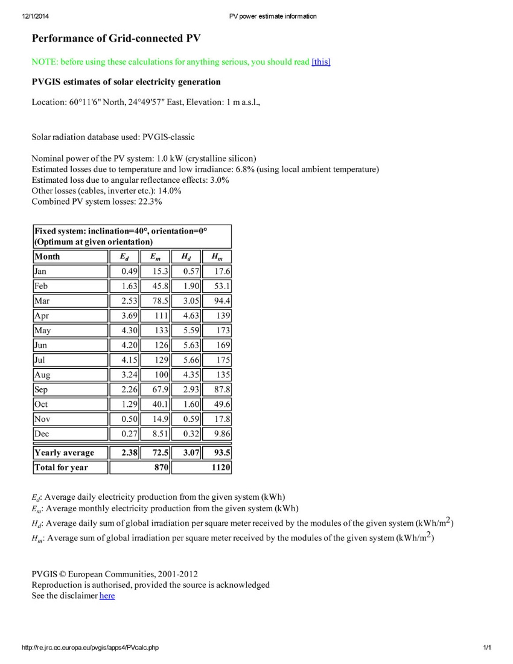
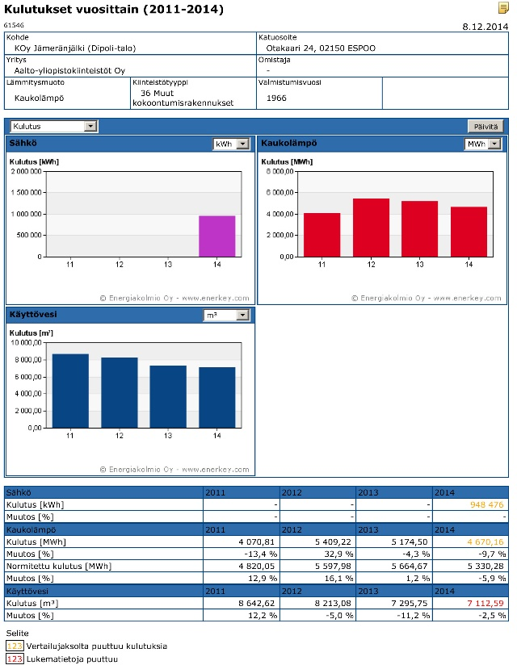
Designing for Sustainable Transition through Value Sensitive Design.
Technical Investigations
– properties of the technology, statistical analysis
Notes:
also we made calculation over the yield so that would make econ sense/viability &
where the siting would be what level of the PV would go beyond the green wash & be actually meaningful.
TI:
To start Technical Investigations:
We studied the properties of the tech, document analysis because we need to find appropriate design to support the values (“value suitabilities”)
We calculate and refine and refine for the optimum energy eff to avoid being greenwashing or ecological brutalization
Solar Irradiance Map of Otaniemi Campus
PV Estimation (Performance of Grid connected PV) from PVGIS, Institute for Energy and Transport (IET), EC.
Electricity consumption of Dipoli from Aa Uni Properites, both on electricity & heating from 2009-2014
GAIA report the solar energy evaluation on Otamniemi
Rooftop area 5,554m2
Naps sys the System Performance statistics, PV cost per watt, infrastructure set up and maintenance costs. Also the size and the PV mount design.

Slide 50
Designing for Sustainable Transition through Value Sensitive Design.
Results – Subtle Visibility
Notes:
The cpt resulted in what we called “subtle visibility” that
we followed the contour of the roof that the renovation doesn’t hide the solar array w the roof contour w such visible
& just visible fm the entry to the bldg. fm 150m away so that
we actually build the rocky form of the roof silhouette and then it disappears when u come closer to the bldg..

Slide 51
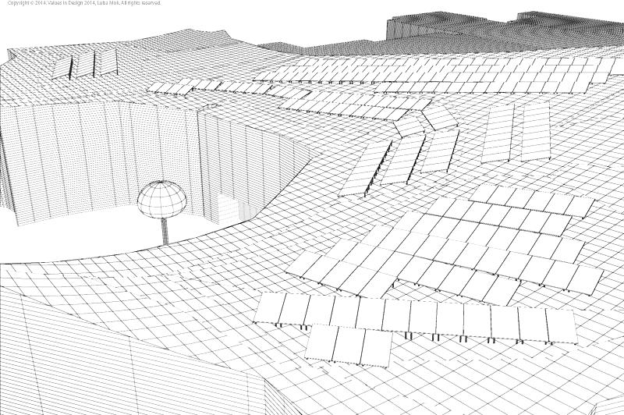
Designing for Sustainable Transition through Value Sensitive Design.

Slide 52
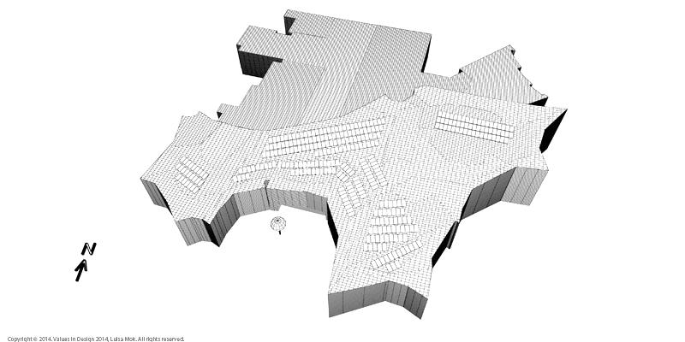
Designing for Sustainable Transition through Value Sensitive Design.

Slide 53
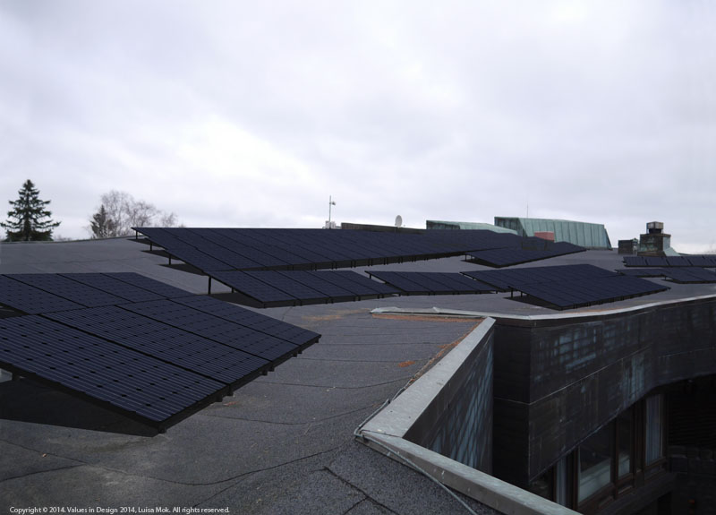
Designing for Sustainable Transition through Value Sensitive Design.

Slide 54
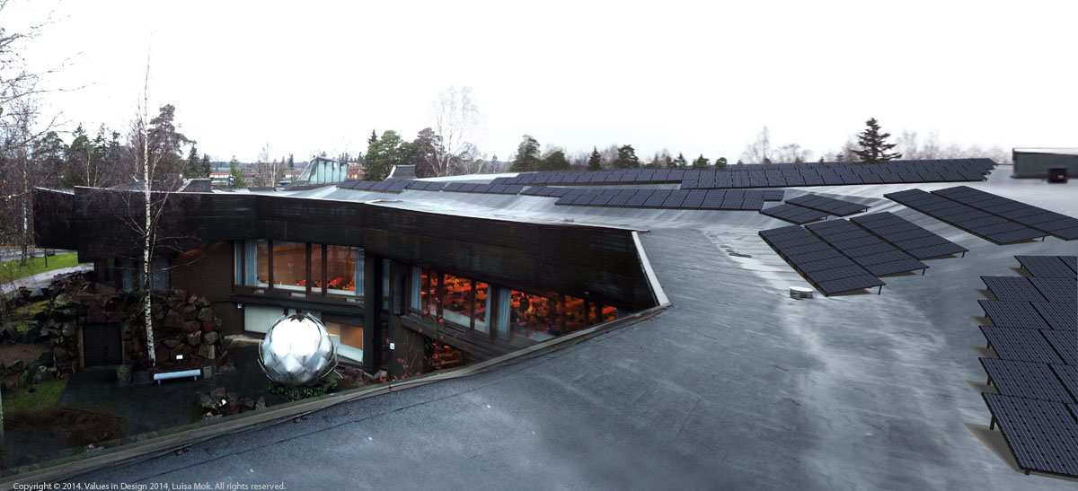
Designing for Sustainable Transition through Value Sensitive Design.

Slide 55
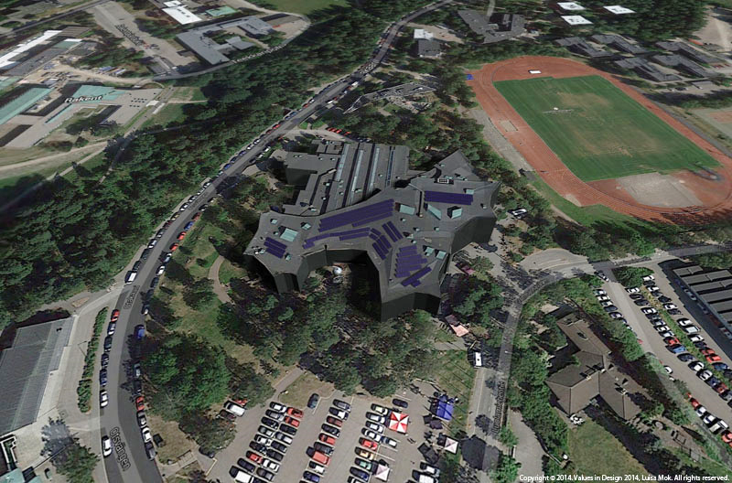
Designing for Sustainable Transition through Value Sensitive Design.
Notes:
The solar arrangement follows the contour

Slide 56
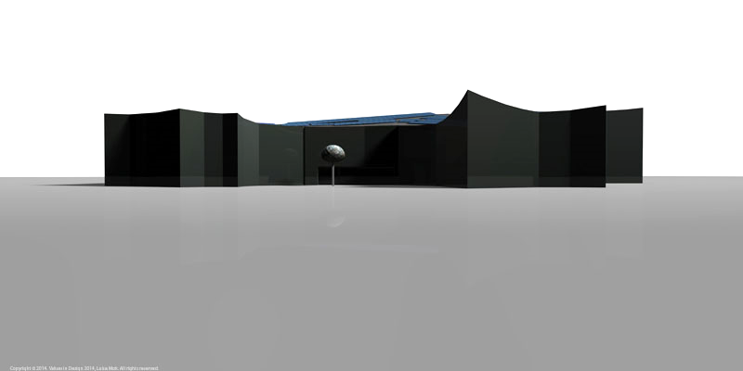
Designing for Sustainable Transition through Value Sensitive Design.

Slide 57
Designing for Sustainable Transition through Value Sensitive Design.
Conclusions

Slide 58
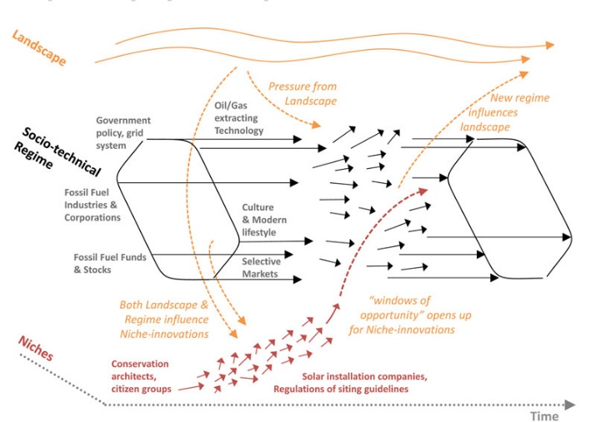
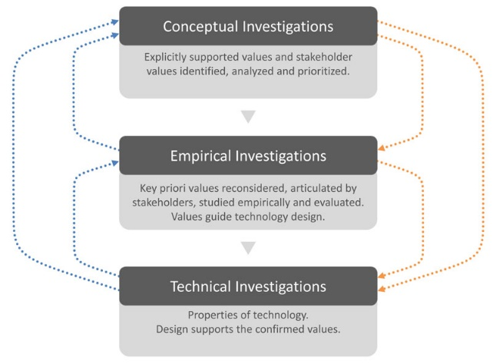
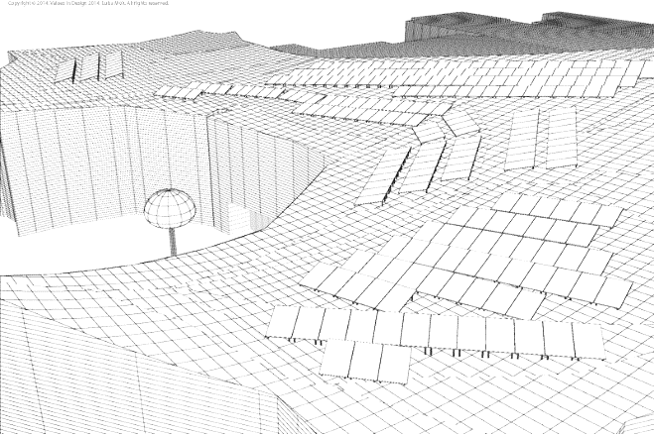
Designing for Sustainable Transition through Value Sensitive Design.
Conclusions,
Implications to Strategic design for sustainable transition
Sustainable Transition research
Different orientation for new types of strategic design,
to define strategic aims and making strategic actions
For common environmental and social good
Value investigations
Strategic move:
Value Sensitive Design (VSD)
investigation of values, target to eliminate foreseeable reverse salients in the near future
Strategic design visualizations:
Visualization & documentation, an anticipatory design,
to provide mid- to long-range design engagement in projected timeframes
Notes:
And in this what we hv hoped to demo thru this proj is that str des visualization
in this even in this rather modest scale of proj can help anticipatory design to help the stakeholder gps, the planners to note that you don’t need to have cat of yes or no and it also informs the installation comp they r just always go for the cheapest way of maybe sthg..
as conclusions,… as implications.. And ensure that it could be done in siting PV in heritage bldg. is not necessary as such a monster that we should rule it out at the onset.
Conclusions:
At the end,
Transition Res:
enable us to see the system with the interdependencies
Find our engagement point for design to intervene for improving the transition, &
In our study, to eliminate foreseeable Reverse Salient to hinder the advancing
VSD:
Value investigation, enabling us to inform a value-sensitive solar installation design (value-charged).
To eliminate reverse salient
Design Visualization
The prototyping let stakeholders to express/articulate their value of interests or problems clearly
The realistic architectural (rendering) visualization & documentation as a guideline or evidence of a demonstration project for scaling up to other sites, to inform larger-scale of renewable energy plans

Slide 59
Designing for Sustainable Transition through Value Sensitive Design.
Conclusions,
Sustainable design paradigm for sustainability transition
Sustainable design links to the broader sustainability transitions, choose their modes of engagement point
Visualization and documentation of demonstration projects provide concreteness to guidelines and statutes to planners and installers
Frameworks of value sensitive design can be a useful addition to the toolbox of sustainable transitions
Notes:
Conclusions:
The 3 suggestions
sustainable design initiatives would, in general, do wise to consider how they link to broader sustainability transitions and choose their modes of engagement accordingly, in order to improve their relevance and potential for change;
the visualizations and documentation of successful demonstration projects are be included to provide concreteness to guidelines and statutes – in this case to guidelines pertaining to the siting of solar on heritage buildings (these are currently written from a categorical “solar is always an aesthetic violation of heritage value” perspective, which does not hold true);
frameworks such as VSD can be a useful addition to the toolbox of sustainability transitions.
At the end, VSD did not guide us to one workable design solution,
But a new sustainable design paradigm for sustainable transition to bring up a new perspective to study sus design
Thank you.

Slide 60
In sum, designing for long-term sociotechnical change
‘Beyond’ designability, necessarily multi-party interactive, slow and political process
Design can contribute in several ways
  Operative: designing needed new products, services and PSS; communications, interfaces
  Tactical: issue identification and anticipatory designs
  Strategic: designing new ways and means to steer and foster change amongst decision makers and planners
New orientation to (co)design: designing proposals and mediated changes
Understanding the change dynamics key for success
Importance of multidisciplinary collaboration e.g. business and political analysts

Slide 61
EXTRA: HOW ARE INFRASTRUCTURES AND PRACTICES ENACTED
Orlikowski: Using technology and Constituting Structures: A practice lens for Studying Technology in Organizations

Slide 62
”A practice lens” (Orlikowski 2000): Practice, materiality, enactment
A synthesis view from four key recent social science / socio-technical approaches
  Structuration theory (Giddens, 1984) in IS research (Poole, 1994; Orlikowski, 1992)
  Social shaping of technology (Law & Bijker eds, 1992)
    Implicitly: actor network theory; pragmatism
  Communities of practice (Lave, 1988; Wenger, 1998)
    Implicitly: Socio-historical psychology, activity theory
All these approaches share the idea of ”socio-materiality”; social, material and any other elements becoming human reality only through lived practice.

Slide 63
Orlikowski: Practice lens, enactment of structures & lotus notes
Everyday understandings
  Technology has a designed in features that are used right or wrong
  Technology’s features reflect developers culture, values and choises in building it—these affect users if they don’t explicitly reject or resist the technology
Technology has ”embodied” social structures for possible use e.g. rules and resources (DeSanctis & Poole, 1994)
  Users choosing of theose structures depends on their contexts and its structures (/cultures)
Technology and other structures bear effect on human action only insofar as they are enacted in practice.

Slide 64
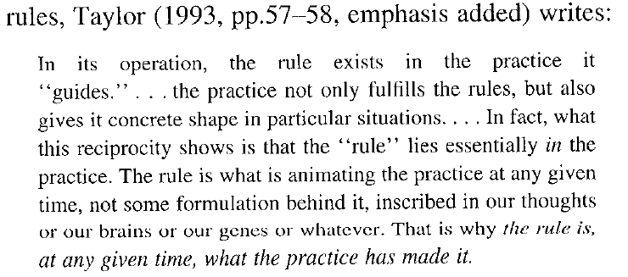
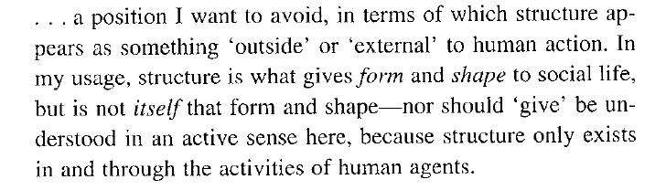
Giddens, 1979, 65

Slide 65
Versions: Arena-Setting (Lave, 1988)

Slide 66
Material and symbol properties of technology—Enacted, emergent structures
”While technology can be seen to embody particular symbol and material properties, it does not embody structures…
When humans interact regularly with a technology, they engage with (some or all of) the material and symbol properties of the technology. Through such repeated interaction, certain of the technology’s properties become implicated in ongoing process of structuration.
The resulting recurrent social practice produces and reproduces a particular structure of technology use.
Thus structures of technology use are constituted recursively as humans regularly interact with certain properties of the technology and thus shape the set of rules and resources that serve to shape their interaction. Seen through a practice lens, technology structures are emergent, not embodied.” (406-407)

Slide 67
Structural properties of social systems (Giddens, 1994)
Actors never act in situations or enact structures in a vacuum
An array of structures present; constrain and enable action
Mediated through three modalites:
  Facilities (e.g. land, buildings, technology)
  Norms
  Interpetive schemes (Tacit and explicit knowledge about the situation at hand)
Instantiate and reconstitute the rules and resources that structure their action
In reverse: structures exist only as enacted; not unchanging or unilateral, but because of the power of routine, forsaking the available structures is hard
  Rejecting the enablers of action can only be done at great expense
  Interaction and retaining meaningfulness to others depends on similar enough recourse to structures, as does passing their judgements etc.
  Changing knowledge structures difficult and cannot be done wholesale

Slide 70
Example Lotus Notes in different organizational contexts
Groupware application
A range of different collaboration means
Developers + five different groups and ”micro-cultures” wherein notes deployed, in three organizations
  Iris development group
  Alpha consultancy
  Zeta consultancy

Slide 77
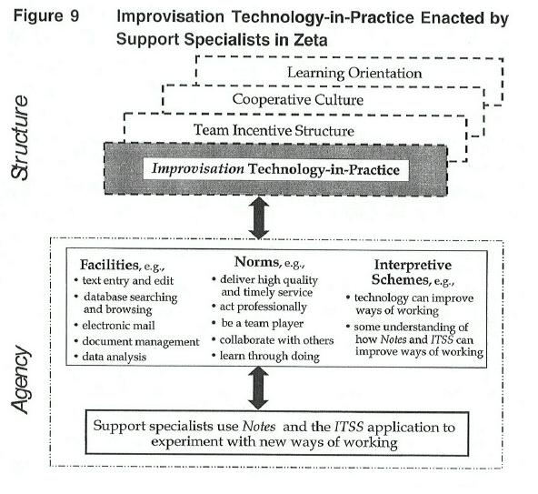

Slide 79
In sum, Enactment of structures
Culture and structures (technical, social) not somehow external to action—albeit the action within which they are a part changes, materiality allows (temporary) non attendance to some of the structures.
Technology never enacted alone in an organization; always part of socio-tech-organizational configuration
Versions of technology can differ drastically; what is ”successful” ”notes” enactment hard to define due to org. Characteristics, rather what is ”relevant” or ”appropriate” enactment in within those org. structures. (fortifying inertia ok if it is highly successful).
Some predictablity for success against the proximity of developer org. culture—adopter org. Culture

