Slide 1
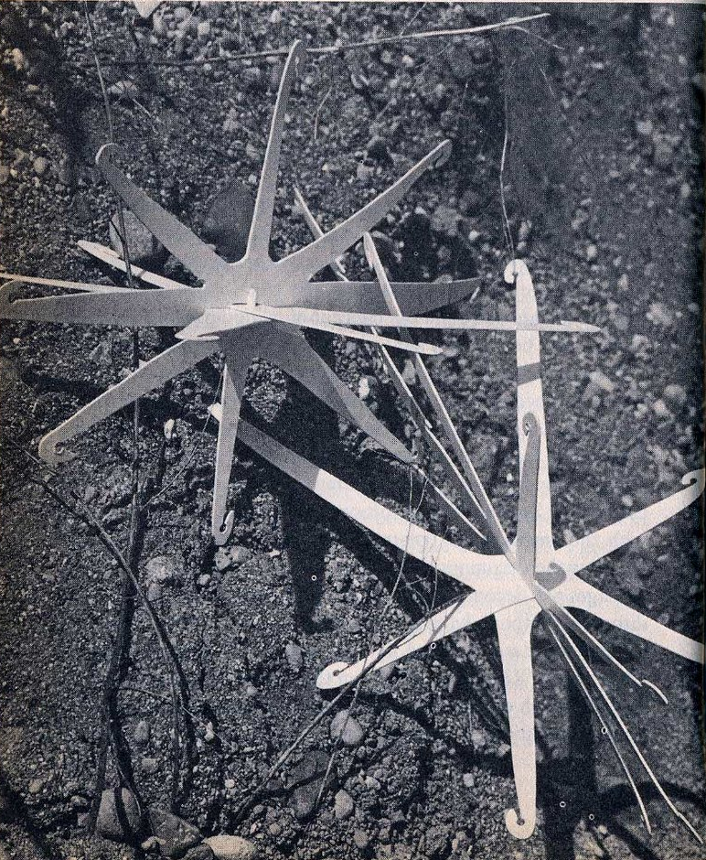
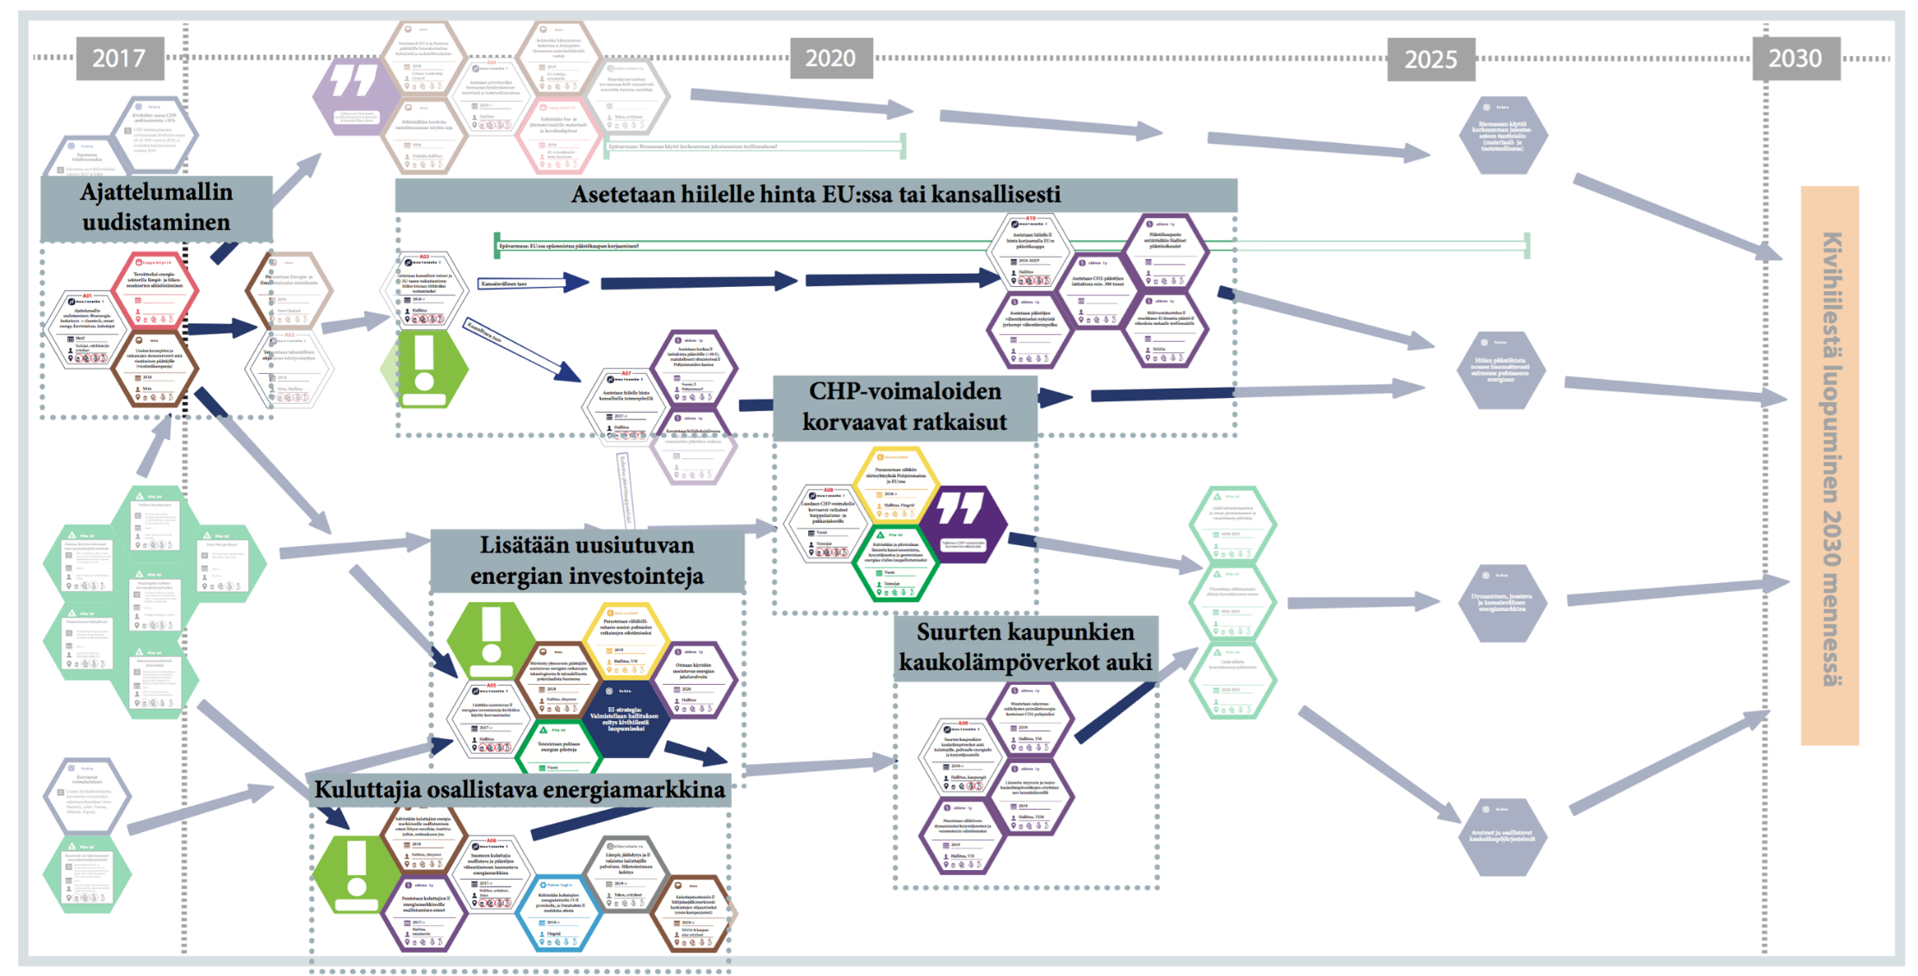
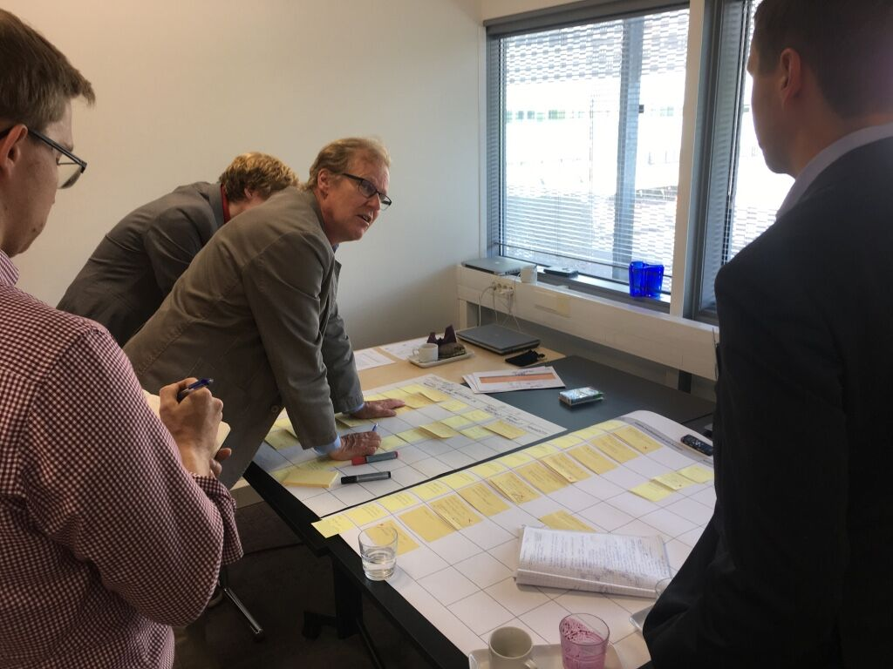
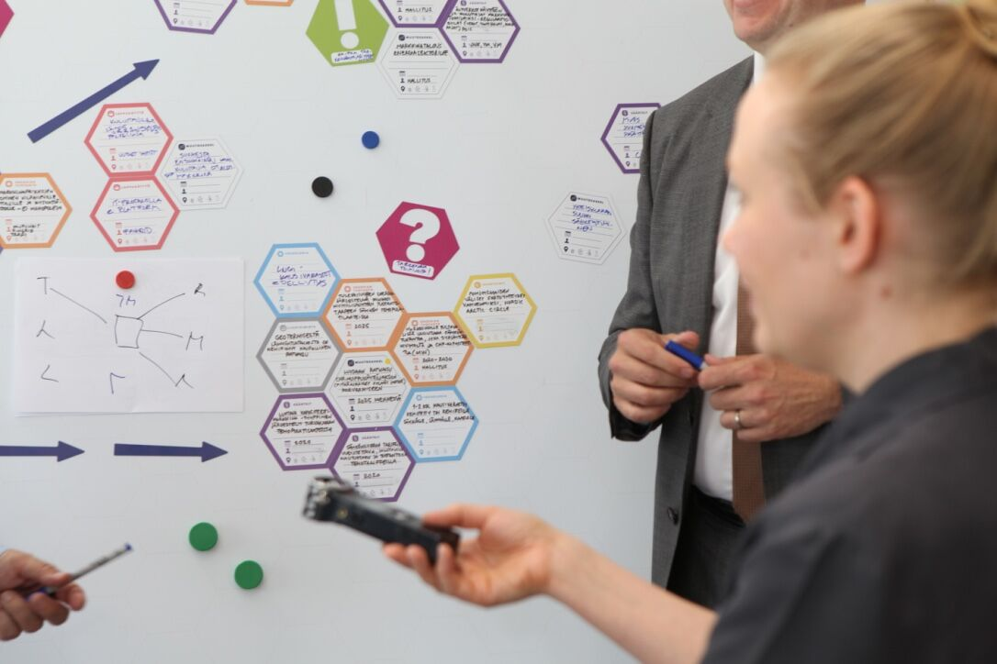
Papanek vs climate change
V. Papanek: design for the real world, 1981 pp., 83. Artificial Burrs for revegetating arid areas by J.Herold and J.Truan
Multi-actor mid-range pathways for energy transition: end of coal use 2030 in Finland.
Eds. Hyysalo, Lovio et al. 2017

Slide 2
DfSC-Codesgin themes
Design within/for SOCIOTECHNICAL change, becoming aware and learning to assess soc-tech-org-inst structuration and what it takes to change it
Recognizing when it is necessary and/or beneficial to involve the impacted peoples (aka ‘users’, ‘partners’, and ‘stakeholders’)
Learning to design for collaboration and in collaboration
Learning the (considerable) differences that result from different ways of designing and organizing collaborative design
With 6 cu, unfortunately, no possibility to rehearse codesign … see CS period 1 with Andrea Botero … and if its any consolation, most modes of codesign in social change cannot be duly rehearsed within 6 week periods either.

Slide 3
Why design social change with and by users
Not all change can be designed – and certainly not by designers alone – orchestrating users, partners and stakeholders is one, and often necessary, design strategy for furthering social change
Participation engages more and different knowledges: what to include in the design, how, what value it has for different peoples, when, how and which contexts?
Design participation increaces ownership of solutions and commitment to future directions (for those who get to participate in solution decisions), adds legitimacy
Brings new and new types of resources: development effort, marketing, new ideas, value clarification … power, influence, access, money…
Reduces risk in design and decision making: helps to know what the involved peoples want and what they need
Can be used to improve social image /brand value through having a more responsive, customer oriented and democratic footing for design initiative
Notes:
scope which appears unclear to many academics and practitioners

Slide 4
Learning objectives
understand how codesign can facilitate social change in different socio-techno-economic settings;
critically assess potentials and pitfalls of different strategies to social change in particular contexts;
plan projects so that the merits and downsides of different ways, combinations, intensities and resources for fostering change are adequately addressed;
assess potentials and pitfalls of different approaches to codesign for social change.

Slide 5
Exercises
1 Designing a solution workshop
2 Designing a mid-range envisioning workshop
3 Designing a participatory design portfolio
4 Designing a chagne management series
5 Own project in small groups: graded

