Slide 1
Design for Social Change_CoDesign
Sampsa Hyysalo 2022

Slide 2
Sociotechnical change: what is it, why it can be hard and how to assess it
a.k.a what do we need to understand if we want to change socio-technical arrangements and systems

Slide 3
Sociotechnical? change?
A way to say that in closer view next to all ‘social’ phenomena are also materially constructed…
…and ‘technical’ matters cannot be separated from social action taken in and around design and in and around use and disposal.
Design, as vehicle and orientation to change, is predicated on changing both humans and materialities (vs. an opinion campaign to change, which also other higher primates can master)
Change always proceeds from existing (sostech) conditions to new one(s) (not ex-nihilo) and never in (sostech) vacuum

Slide 4
TOPIC 1
Politics/values through design

Slide 5
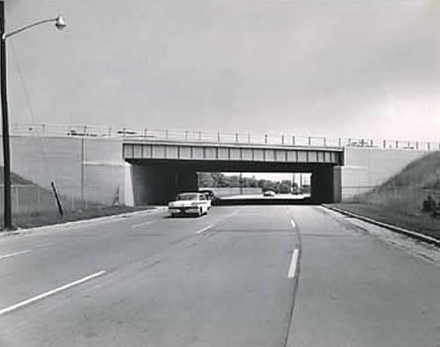
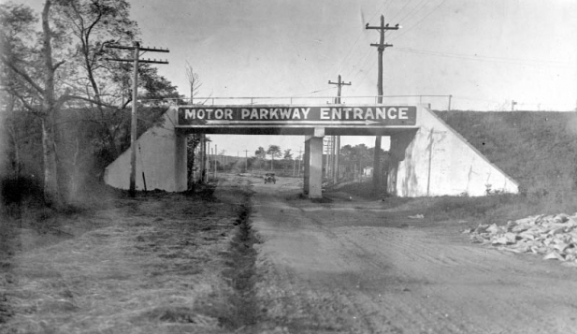
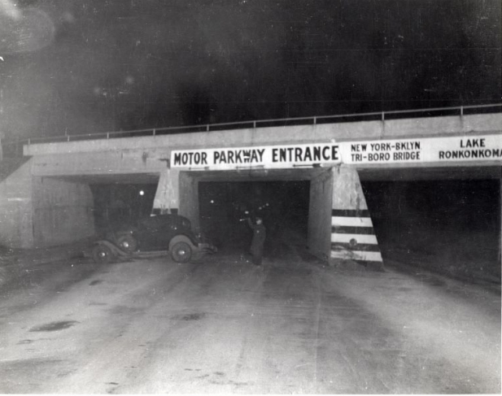
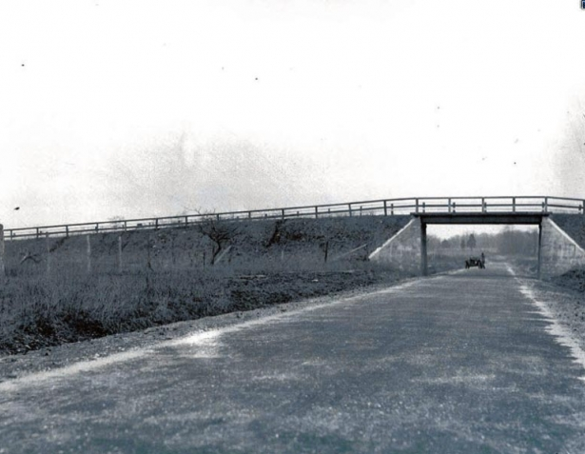

Slide 6
Values/politics built into design: long island bridges
Winner: Do artifacts have politics? (1982)
New York long Island bridges 1930
Robert Moses; cherished long island beaches as a secluded resort (of white upper middle classes)
Built long island parkway bridges so low that buses, and their colored passangers, could not pass under,
as only white upper and middle classes owned private cars, long island beaches remained theirs
= racial segregation by the means of seemingly esthetic bridge building as part of city planning

Slide 7
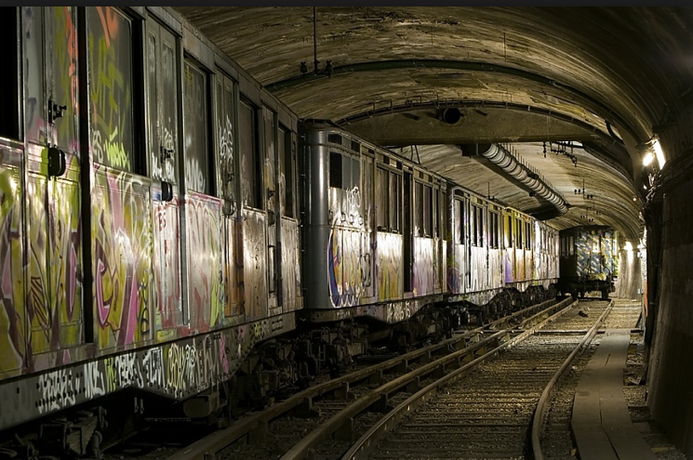

Slide 8
Values /politics built into design: Paris Metro
Latour: Reassembling the social 2005
Why are paris metro and local train networks incompatible?
Trains initially operated by French railroad, conservative and right wing orientation
Paris at the end of 19th century governed by socialists, who wished to ensure that public transit could not be sold to or be taken over by French railroads ever in the future
Tunnels built deliberately narrow and with narrower track width to preclude rail cars from entering

Slide 9
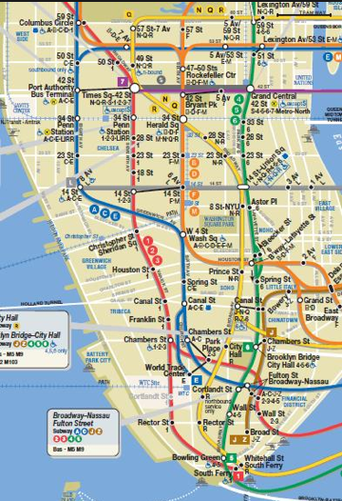

Slide 10
Values /politics build into design: New York Metro & Helsinki broadband networks
Why New York metro has multiple levels and redundant stops in its metrolines?
Why were Helsinki streets around 2000 constantly dug open?
City administrations gave multiple competing companies the right to build their own networks each at their own criteria: non compatible systems
In new york, metro companies became merged after a relatively long time (costs and compatibility being…)
In Helsinki city officials began restricting the way digs for broadband and other basic infra could be organized: restricting competition for the sake of public good (reducing collateral harm from competition)

Slide 11
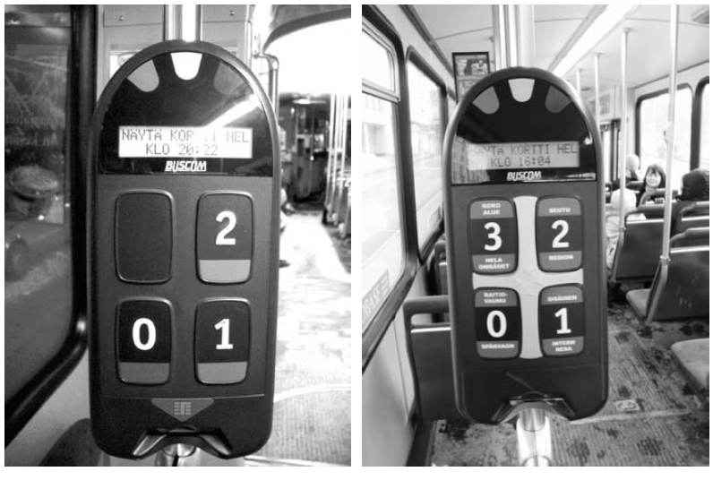

Slide 12
Values /politics built into design: Helsinki public transit card reader
Buscom design:
  won several design prices
  Compatible with the design of new Bombardier tram design language
  Modern and sleek appearance, in harmony with their other products
A meter long slip how to use (=to get into the bus)
Over 35 usability mistakes, many showstoppers for many users
Much frustration, delay in buss lines humiliation particularly to older people

Slide 13
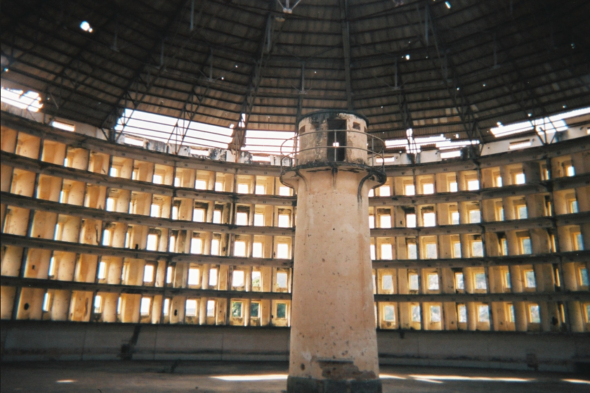

Slide 14
Values /politics built into design: Panopticon
Scheme for organizing all incarceration in a manner that optimizes visibility and inspectability
No regard for privacy or dignity of the surveilled people
Basic needs such as warmth and removal of feces engineered as secondary issues
”Universal design” for prisoners, poor and variously ill people

Slide 15
Topic 1 lessons
Design can be employed for political ends, few designs are ‘value neutral’ or fully ‘inconsequential’ (more or less rubbish produced and resources used at any rate)
Materialization can be costly to reverse, and once it is in place for longer periods, adjoining designs and actions need to be changed as well adding both cost and collateral harms
→DSC has to consider both installed base and implicated base(s) in dealing with materialities (Backwards and preferably also forwards)

Slide 16
Topic 2: Problemis in Inferring politics / values in designs and systems
Sampsa Hyysalo

Slide 18
Revisting Long Island Bridges
Joerges: Do politics have artifacts (1996)
No explicit plan by Moses ever found about the height of the bridges
Buses of the day could pass the long island bridges, hence bridges did not stop blacks from beaches, even a long island bus ticket found
The long island parable remains contested
More important work in Winner’s piece is the analysis of nuclear power
  Compatibility / non-compatibility of adjoining technologies and alternative production
  Precautions required by high-risk centralized power generation
  Concentration of capital, resources and wins in centralized supply cf. Mumfords auhtoritarian and democratic design traditions.

Slide 20
Revisiting Panopticon
Context: alternative to dungeons and ”general hospitals”
That value basis for designing all such institutions has dramatically changed over the centuries is a good witness to importance of values in and change by design
Bentham’s plans were ideas, many practical problems, and close to inhumane aspects are plainly visible for us today, and would have become revealed upon building and operating a panopticon type institution … the few built examplars in caribbean and like temperate climates
”Panopticon +” type surveillance is proudly presented in many mobile and medical devices today

Slide 22
Revisiting Buscom
Original product built for Oulu, Turku and other only one tariff places: only one area to show the card, far fewer messages, few problems
Stretched to Helsinki area: no new design but just added sleekly three tariffs, fourth used in local trains
Usability efforts noteworthy… but went to driver’s systems
Capital Region Transit (HSL) should have demanded usability…for they should know something about Helsinki public transit
The changes followed when I sent my book draft and analysis to researchers working with the company: Adage was hired to make a usability study and showstoppers were dealt with
=More actors involved, no intention, but continuous depriorization.

Slide 23
Why is it important to realize materiality in change initiatives … and why is it tricky to recognize?

Slide 24
Importance of values/politics in design A
  That technology enforces certain behaviors and underlying values makes these more easily accepted:
    if not naturalized, at least normalized
    That road casualities are 100 000 x that of terrorism, yet no war on driving
    That business men have to wear full suit … in Japan in august, accompanied by 22 C indoors… vs. ”cool biz – warm biz” (=1.4 mT Co2) … ”potential cooling demand of metropolitan mumbai 24% of entire US”
  Papanek, 1981; there are professions more harmful than design, but not many

Slide 25
Importance of values/politics in design B
  Coleridges law: The effects of technology are only visible when it has already spread and stabilized, its shape can be only affected before it has stabilized.
    Automobility by petroleum car as the major democratizing and civilizing factor for rular areas… currently major source of environmental pollution and suboptimal land use, hindrance to more beneficial forms of transit
    DDT was endorsed by WHO for long as THE technology in fighting malaria… until insects became resistent but development disorders in birds, waterlife, mammals and humans evident
How to enhance the social desirability of designs-in-the-making?

Slide 26
Challenges of politics/values in design C
  Technology design, use and regulation are by default affected by a range of different values
  Inferring values behind a designed artifact is hard, ”reading them off” is often an educated guess: requires humble work
  Driving a value into design is typically a result many operationalizations, compromizes and trade-offs: not just a value declaration or one-time change initiative design

Slide 27
Importance of values/politics in design D
  Technology’s shape can change dramatically over its life-span
    What it is made of and what it is used for, in conjunction to what, where, how and by whom
    Further development, adjoining technologies, neighbouring technologies
      IBM and “globally no more than 5 computers” in 1950s
  The moments and sites to affect it may not restricted to early phases…but can be
  Requires strategic analysis and understanding of socio-technical dynamics to affect

Slide 28
TOPIC TWO
What is it that technologies ‘do’? And how do they do it?

Slide 29
What is it that technologies do?
To nudge us from our naturalized thinking about our environment different / extreme cases are often helpful
Intrinsic vs circumstantial conception of handicap (Perry et al 1997)
  Intrinsic:
    That you are lacking some ability e.g. a hand
    That it is in you and you only that needs compensation
      You need an artificial hand or some lesser means to compensate
  Circumstantial:
    That in some situations you face kinds of difficulties unaided that most others do not
      Opening a cork requires a fastening hook
    That in some situations you face different difficulties unaided than the majority of the people to whom artifacts have been designed and standards of normalcy reflect
      Soda can prostheses

Slide 30
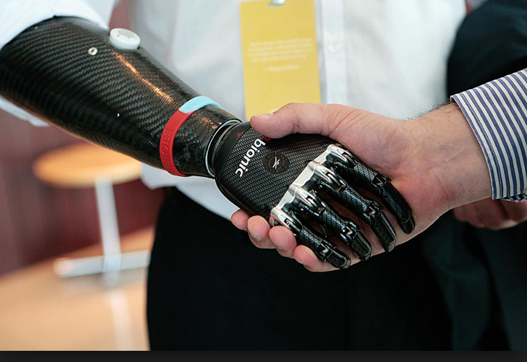

Slide 31
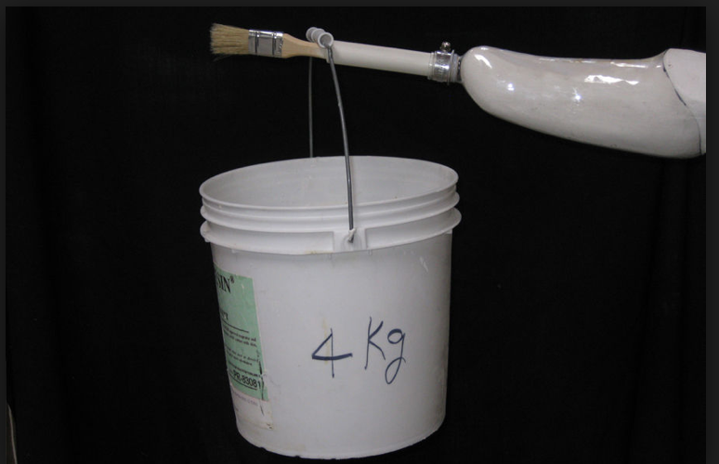
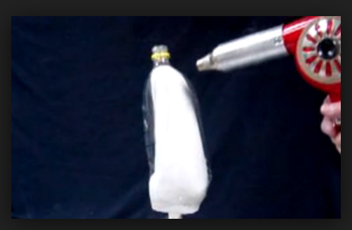


Slide 32
Is technology neutral vs. what are the actor configurations that result from it?
Technology is often seen as neutral ”means” that do not have intentions, or even embody clear intentions / values
”Guns don’t kill people, people do” (NRA)
People do not shoot people without guns
How they shoot people depends on the guns they have: 22mm, sawn shotguns, automatics
  The actor
    ”aggressive drunk with fist”,
    ”aggressive drunk with a knife”
    ”aggressive drunk with a hunting rifle”
    ”aggressive drunk with an automatic ”
    differs in many respects: possible consequences, impulses, even intentions
Similarly many technologies and systems make available new ways of acting, new human-technology actors

Slide 33
Circumstantial handicap / actor configurations / augmentation
…applies to us all in regard to structure of our tasks: our abilities and goal setting depend on the means we have available: not only guns and violence but e.g. literal expression: pens, typewriters, dictionaries, wordprocessors, dictating machines, peers, e-mail, shared wiki workspaces…
DSC is about thinking through how circumstantial conditions make us human in different settings … and what kind of human action and humanity is augmented
Recognized in ’choise architecture’ in the nudging approach and more radically in reconfiguring practices and practice complexes in practice theory

Slide 34
New technology and regulation: New technologies redefine what we can do and how we can do it
Kerr: search and seizure in digital world
Background: ”general search warrants” in 18th century—made up accusation, then search for any excuse to prosecute (& frame as guilty very easy)
Specific search warrants: you are accused of X, police has a right to search you for X and observe ”what is in plain sight”
Worked ok for 200 years… until the question of what is ”in plain sight” in digital formats.
In regards to search for evidence hard drive resembles:
  A small closet in terms of physical size (transportable)
  Diary & trace & calendar in terms of recording (very personal)
  Rows fo filing cabinets in terms of searching (a lot of work)
  Warehouse in terms of content (a huge warrant to go through)
What then is ”in plain sight” in an open computer?

Slide 35
New technology, regulation and expecations of normalcy
New technologies redefine what we can do and how we can do it
  Extant regulation and experience of adverse effects (handled by customs, norms, laws) does not suit unilaterally
  Cf. Copyright and pirating laws in EU vs. Software’s maximal benefits
  Energy Supply – (invisible) energy consumption (1960-2000); 2010: ”everyday energy co-management”
  Para-athletes and rules for overcompensations for regular sports events

Slide 36
TOPIC THREE
Dynamics of socio-technical change
Sampsa Hyysalo

Slide 37
Technological determinism /technology imperative
Technology progresses according to its own laws, inherent to what sciences and technology producers manage to develop
No outside influence apart from curbing innovation and regulation
People, society and organizations must adjust to (inevitable) technological change (if not progress): fall out of competition otherwise
Few explicit proponents: Alvin Toffler 1970 “future shock”,
Implicit proponents: Technology producers, technical research universities, industry lobbyist

Slide 38
Technologies are socially shaped
Technology does not develop according to an inner technical logic
Williams & Edge, 1996, 866:
… but is instead a social product, patterned by the conditions of its creation and use. Every stage in the generation and implementation of new technologies involves a set of choices between different technical options. Alongside narrowly 'technical' considerations, a range of 'social' factors affect which options are selected - thus influencing the content of technologies, and their social implications. (866)

Slide 39
Social Construction of Technology
Background:
  Social Construction of Science a.k.a historical study of scientific controversies
  Laboratory studies – close examination of science and Technology-in-the-making
  History of Technology
Position:
“Process theories” of technological change and innovation
  Actor Network Theory
  Social Shaping of Technology
  Social Construction of Technology
  Innovation journey

Slide 40
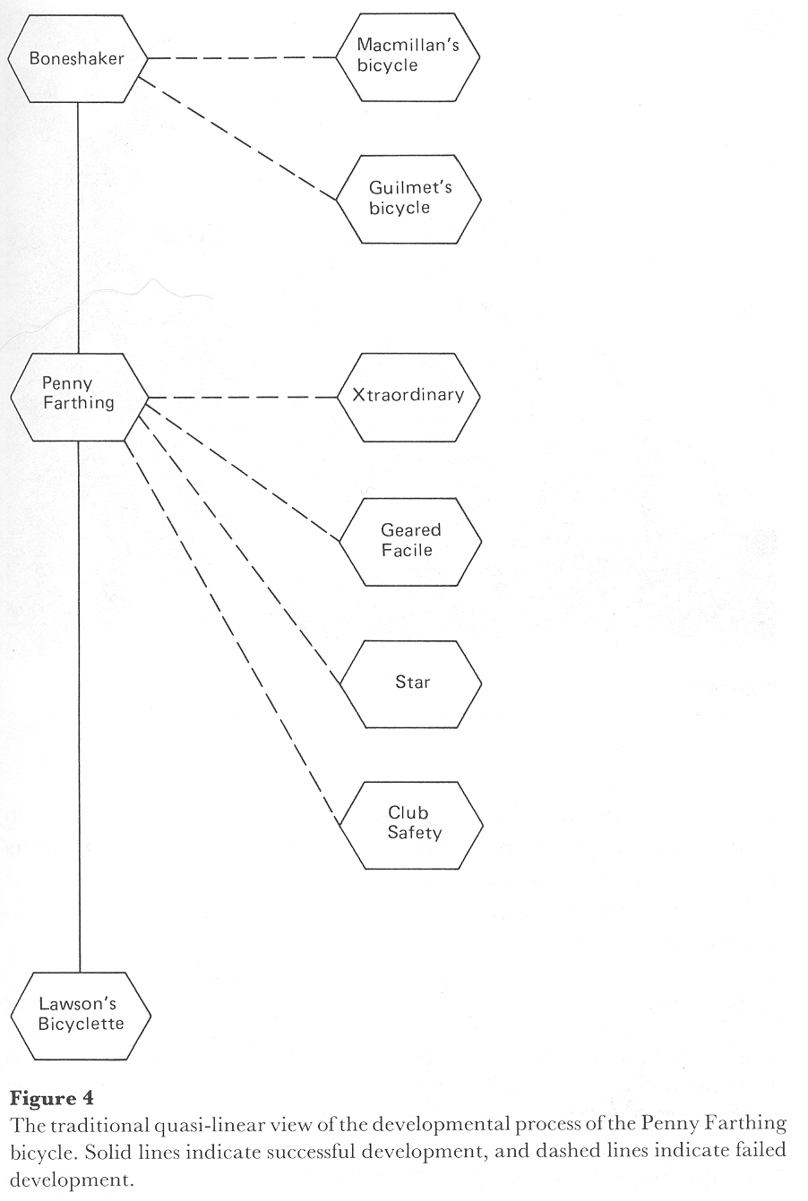
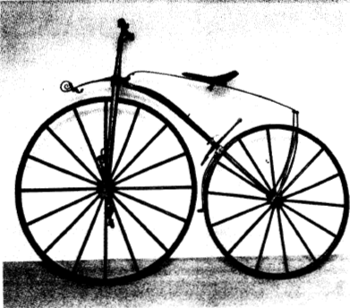
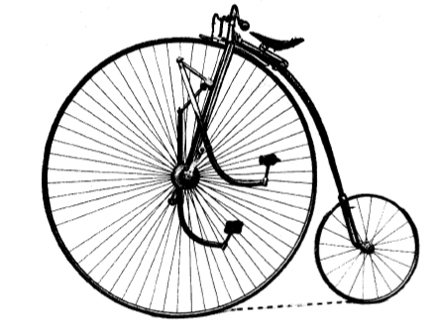
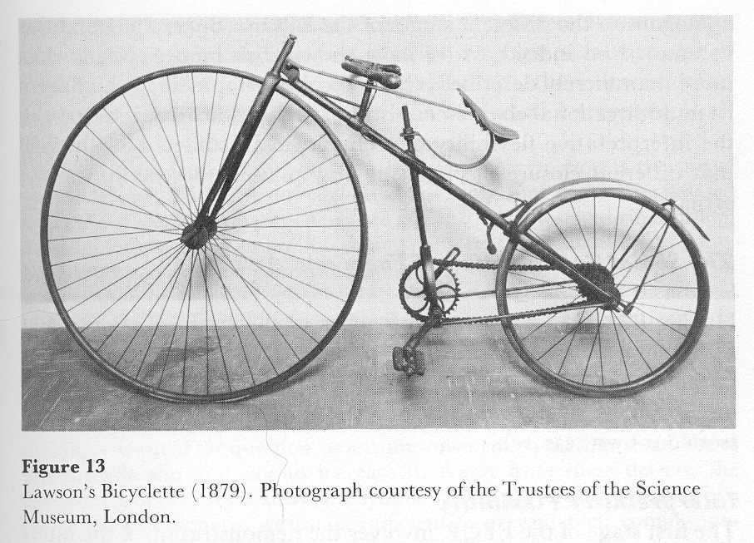

Slide 41
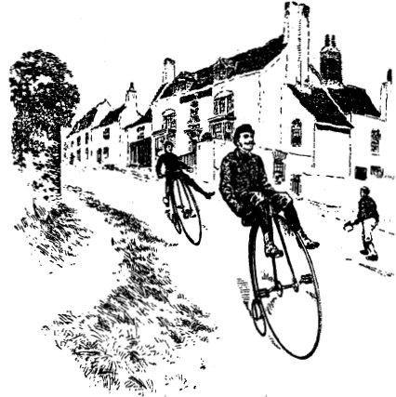
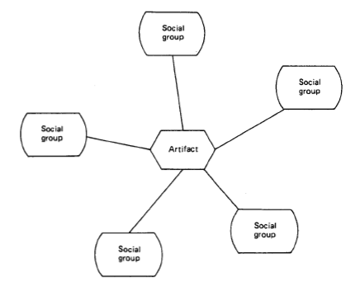
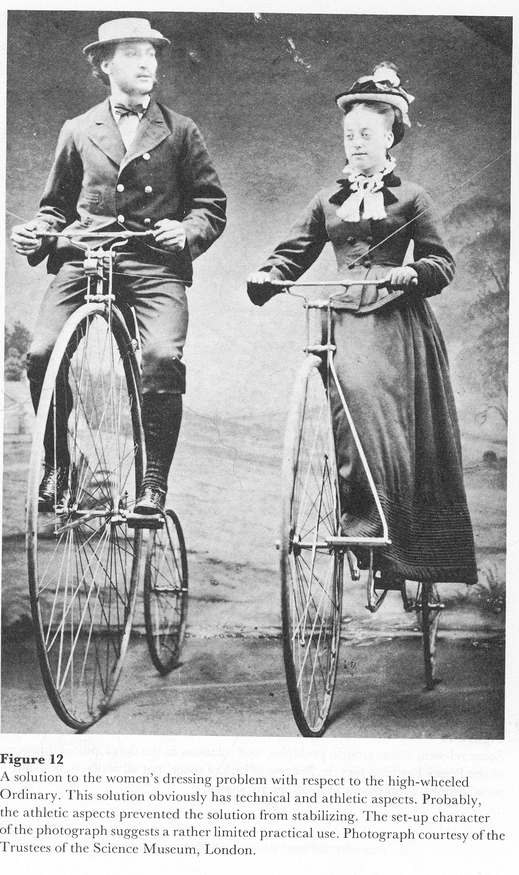

Slide 42
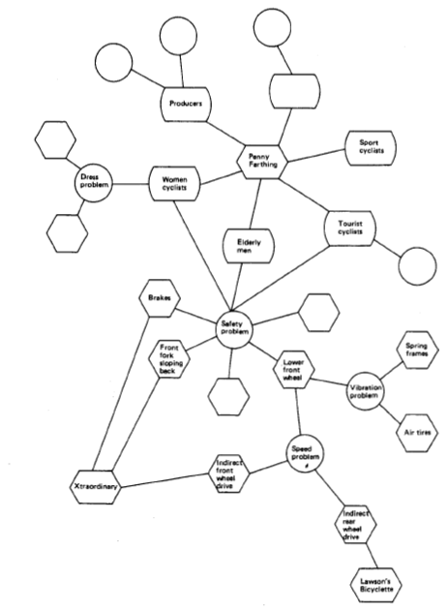

Slide 43
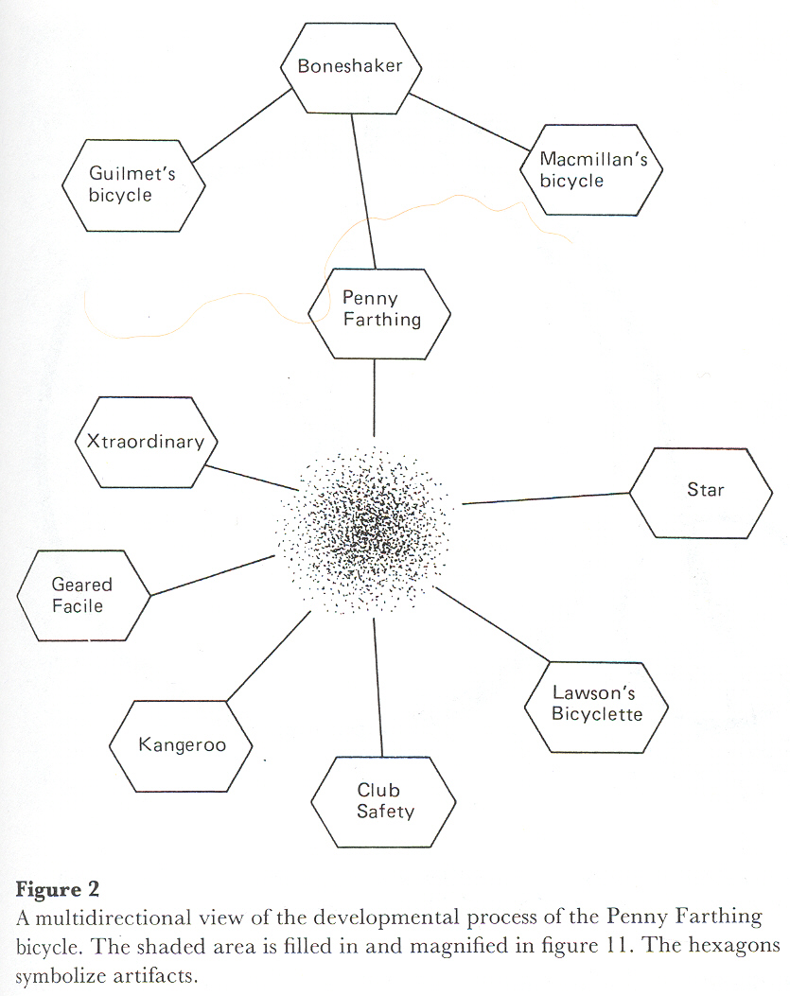

Slide 44
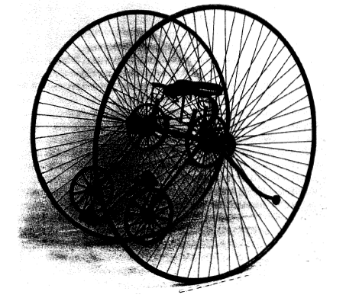
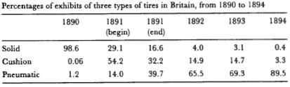

Slide 45
Key concepts
  Interpretative flexibility: Artifacts have different meanings, uses and combinations for different actors
    Relevant social group
    Technological frame
  Closure of meaning between social groups
  Stabilization of the meaning within group
  Mark the end of social forced demanding change in technology
  Symmetry the useful functioning of a machine should not be taken as a cause of socio-technical development, but its result.
  …follow the forces that require change in the artifact

Slide 46
Heterogeneous engineering
Technical, Legal, Organizational, Economic , Esthetic and Social issues are interconvertible and subject to negotiation during design
”Heterogeneous engineering” (Law, 1987) ”Heterogeneous ensembles” (Bijker & Law, 1992)
”Hot” early situation of
  Projects
  User and identity construction
  economy of qualities
  vs.
”Cold” mature situation where
  Objects
  Markets
  Economy of quantities and prices
”Naturalization” of sociotechnical order, it becoming taken for granted by the majority of publics

Slide 47
Path dependency: Clio and the economics of QWERTY

Slide 48
Typewriters – path dependency
Paul David: Clio and Economics of qwerty
Writing “typewriter” with just up-most row without getting the arms tangled
People trained to qwerty, shifting causes moderate effort
Dvorsak faster, ABCD easier to learn … specialist typing machines three times faster
Best design vs. Path dependency
The stock of (touch) typists available for US industry + the switching costs from typist to another.
Some contingent factor(s) pushed the development to particular channel
  Sunk investment, Learning effects, Network effects
  Sub-optimum continues to reign

Slide 49
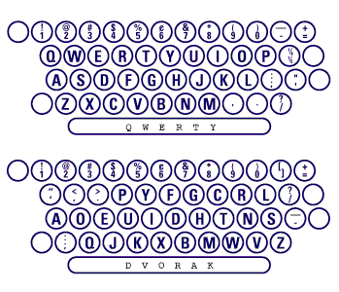

Slide 50
Sociotechnical regimes: interlocked path-dependencies

Slide 51
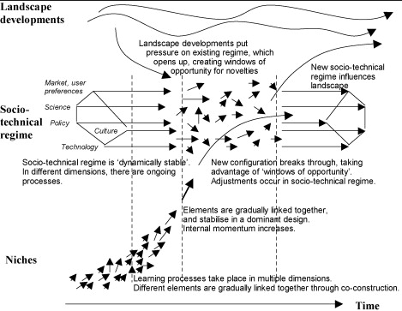

Slide 52
In sum, technology dynamics
Technological determinism / technology imperative misleading
Sociotechnical change involves a social process amongst implicated actor groups
(Early) phases of evenly and rapidly competing designs and business models
Emergence of a dominant design, business model and ecosystem
Path dependency – increasing momentum that is hard to reverse (‘bounded equilibrium’)
Punctuated equilibrium through new technology, collateral damage, social action and/or regulation
Important to assess the level of systemicity of a technology as well as its development stage to work out how difficult it may be to change

Slide 53
END OF DAY ONE

Slide 54
DAY TWO

Slide 55
TOPIC THREE:
DEMOCRATIZED DESIGN AS MEANS FOR SOCIAL CHANGE

Slide 56
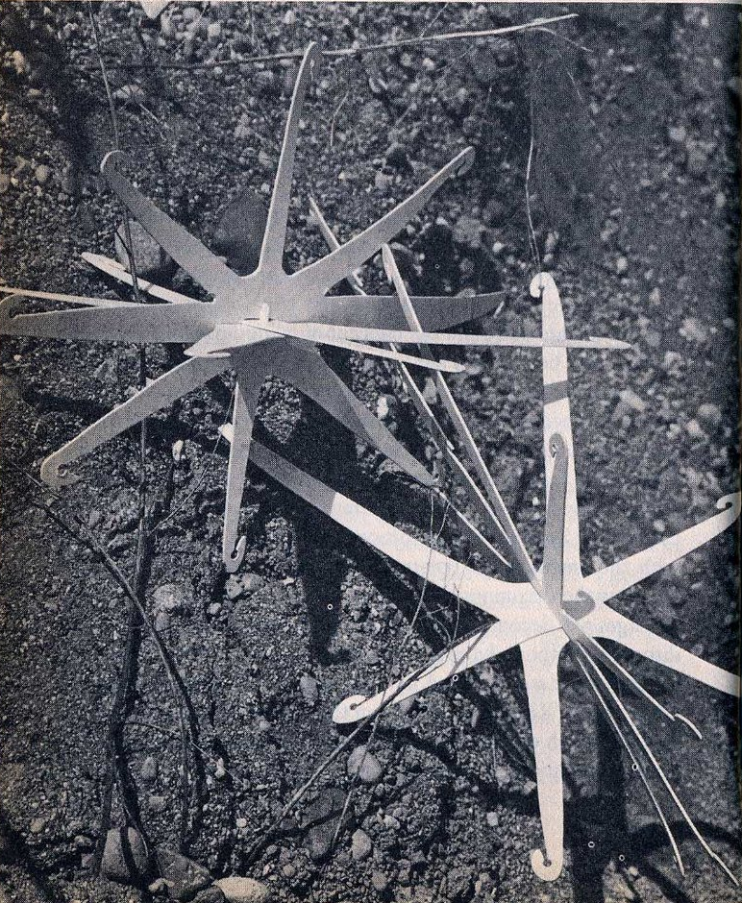
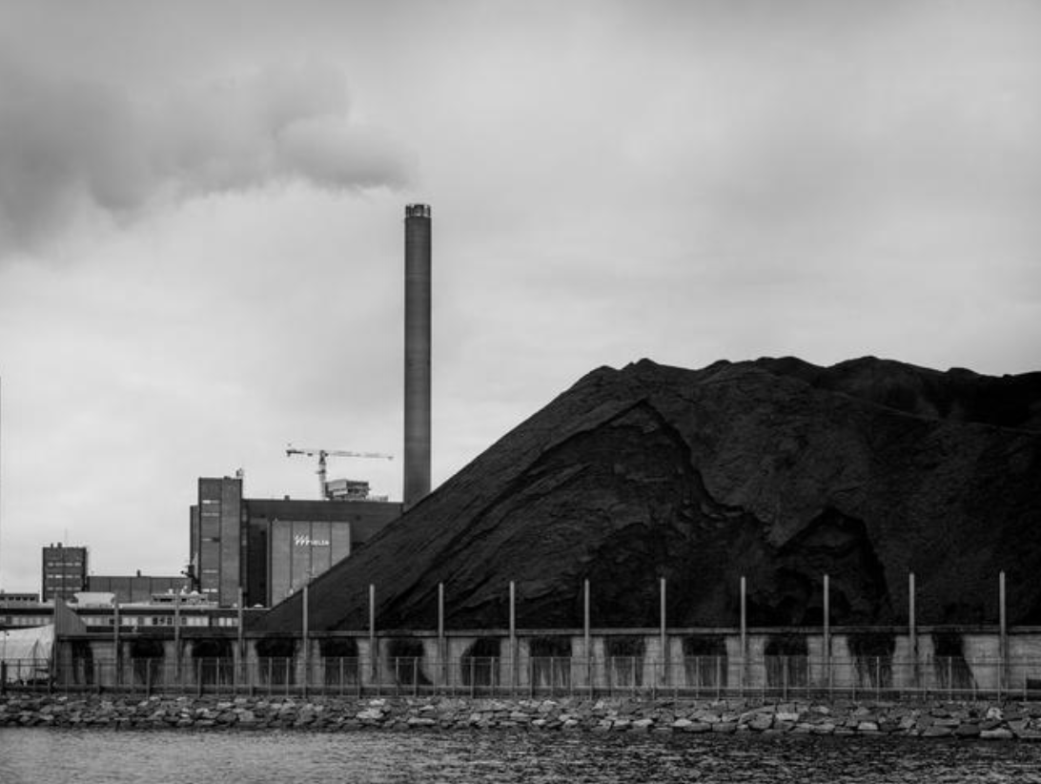
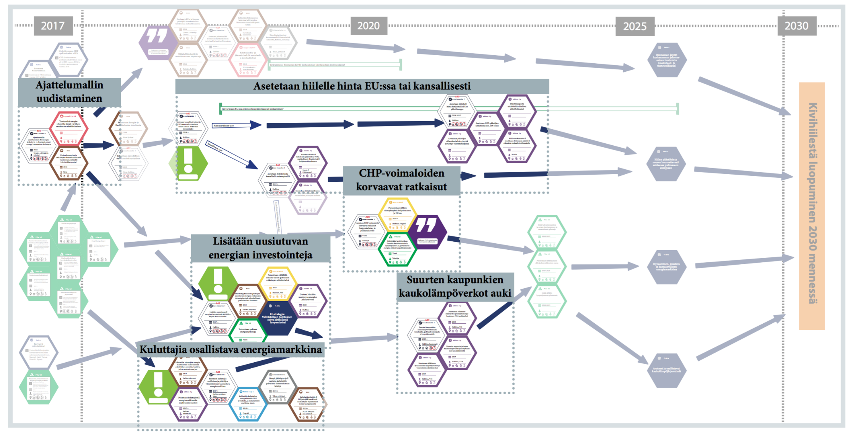
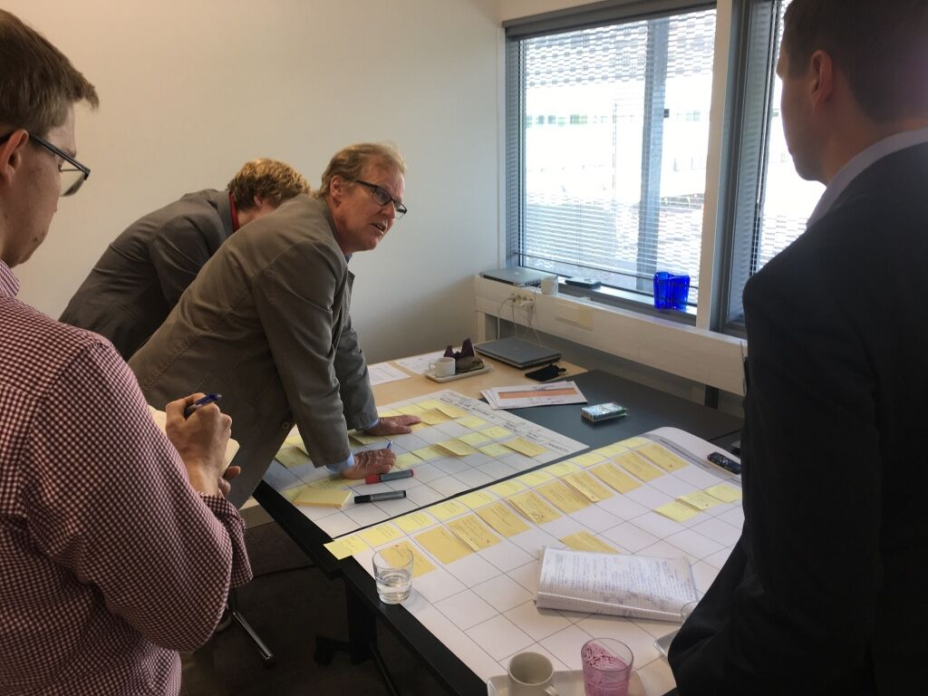
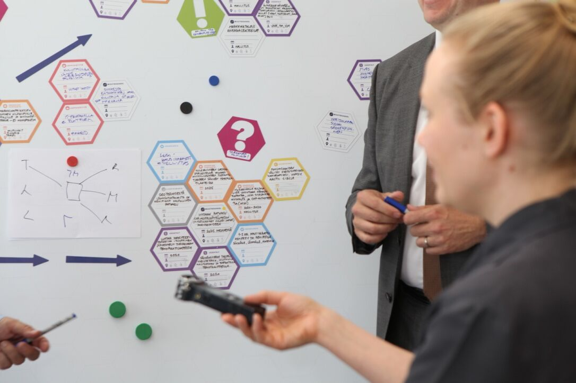
Papanek vs climate change
V. Papanek: design for the real world, 1981 pp., 83. Artificial Burrs for revegetating arid areas by J.Herold and J.Truan
Multi-actor mid-range pathways for energy transition: end of coal use 2030 in Finland.
Eds. Hyysalo, Lovio et al. 2017

Slide 57
Why design social change with and by users
Brings new and new types of resources: development effort, marketing, new ideas, value clarification …
Creates more and different knowledge: what to include in the design, how, what value it has for different peoples, when, how and which contexts?
Increaces ownership of solutions and commitment to future directions (for those who get to participate in solution decisions), adds legitimacy
Reduces risk in design and decision making: helps know what the involved peoples want and what they need
Can be used to improve social image /brand value through having a more responsive, customer oriented and democratic appearance
Notes:
scope which appears unclear to many academics and practitioners

Slide 58
ACADEMICALLY: WHY DESIGN FOR, WITH AND BY USERS ?
Four major orientations, four major reasons:
COST AND RISK OF INFORMATION TRANSFER: User domain knowledge can be costly and difficult “sticky” to transfer, neglecting the transfer difficulties among top failure reasons for design and innovation
RESOURCE OPPORTUNITY: Users are competent in providing contributions to development efforts, participation is a powerful “lure” for participant resources and increased ‘ownership’
RESPONSIBLE DESIGN: Good designer ensures her/his designs produce benefits and do not cause harm to benefactors or stakeholders
DEMOCRATIC PARTICIPATION: Design affects citizens/users/customers and thus they must be included in decisions about it in a democratic society
Notes:
scope which appears unclear to many academics and practitioners

Slide 59
Primary focus: design process
Emansipatory, empowering design; change of tech and subjects
”1980s PD” Conflict perspective,
tradeunion power
Producer-user co-development; often long term & ad hoc
Sociotechnical design;
Mutual benefits, work satisfaction
Ergonomics, cognitive ergonomics
User centred design
Usability research
User experience
Participatory Design
User research
2010
1980
Users hold primary agency and decision making power
DESIGN
in & with & for
USE
1950
Developers hold primary agency and decision making power
Innovation by users
Customer research
User innovation communities; peer content creation
Open Source development
Everyday innovation; domestication, everyday hacking
User Innovations
Market and customer research
Customer relationship manag.
Mass- customization, user design toolkits
Co-creation of value, partnering, user innovation toolkits
Primary focus: product in/to use

Slide 60
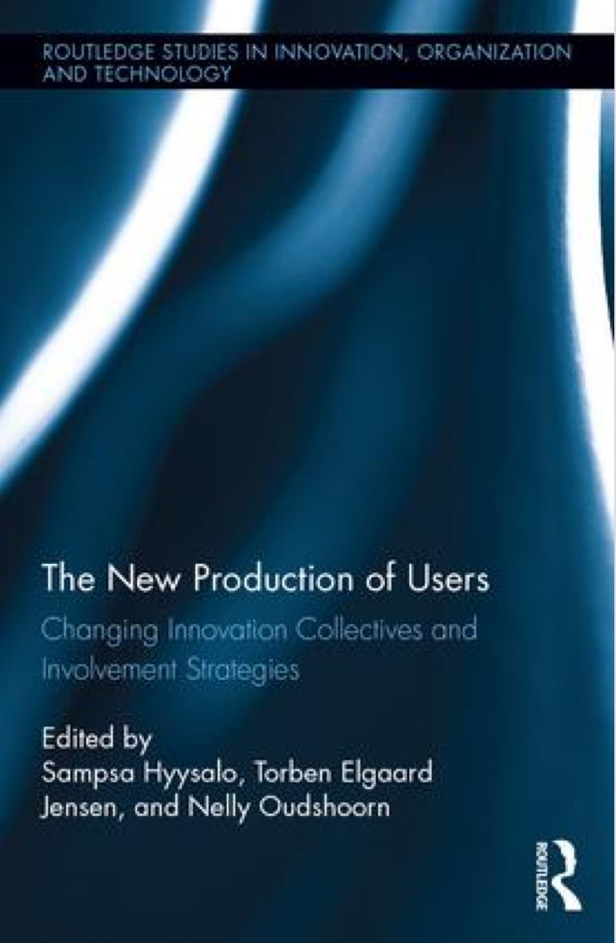

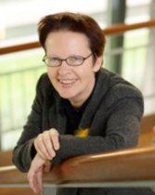
Introduction to the New Production of Users
Sampsa Hyysalo, Torben Elgaard Jensen and Nelly Oudshoorn
Part 1: Rethinking and Extending Theoretical Approaches to the Production of Users in Innovation
Part 2: User-producer Engagements between Democratized Technology and Industrial Strategizing
Part 3: Innovation Practices and User Communities
Part 4: Unwanted Innovation and Non-Users
Sampsa Hyysalo is an Associate Professor in co-design at the Aalto School of, Art, Design and Architecture, Finland.
Torben Elgaard Jensen is a Professor in Techno-Anthropology and Science & Technology Studies at Aalborg University-Copenhagen, Denmark
Nelly Oudshoorn is a Professor Emeritus of Technology Dynamics and Health Care at the University of Twente, the Netherlands.
https://www.routledge.com/products/9781138124561

Slide 61
THE NEW PRODUCTION OF USERS: 2015 vs. 2000
A ‘fact of life’ that users have significant productive capabilities, and these are exercised widely in society
User involvement has become a key object of industrial strategizing: wide efforts to produce productive users
The methods and resources for user involvement are widely available
Empowerment through user involvement can still happen, but not by default
User involvement is still not easy; nor is it automatic or reliable
Few users hold other than insignificant productive capabilities
Managers and designers reluctant to engage with users and downplay their value
Relative scarcity of methods and skills in the market for how to study or involve users
User involvement seen as a maverick activity with an inherently empowering undertone
User involvement seen as value per se or deemed unviable or sold as “design stardust”
Notes:
scope which appears unclear to many academics and practitioners

Slide 62
NEW PRODUCTION OF USERS
Intensification in
User creativity AND involvement strategies
Matter: Stream of opinions, ideas, new uses, subversions (etc) and technical solutions generated by users
Form: Organized ways in which users become productive; independent digital sites, usability tests, automated tracking, user group convening
New production of users is an attempt to provide an updated account of the the matters and forms in the contemporary landscape
Notes:
scope which appears unclear to many academics and practitioners

Slide 63
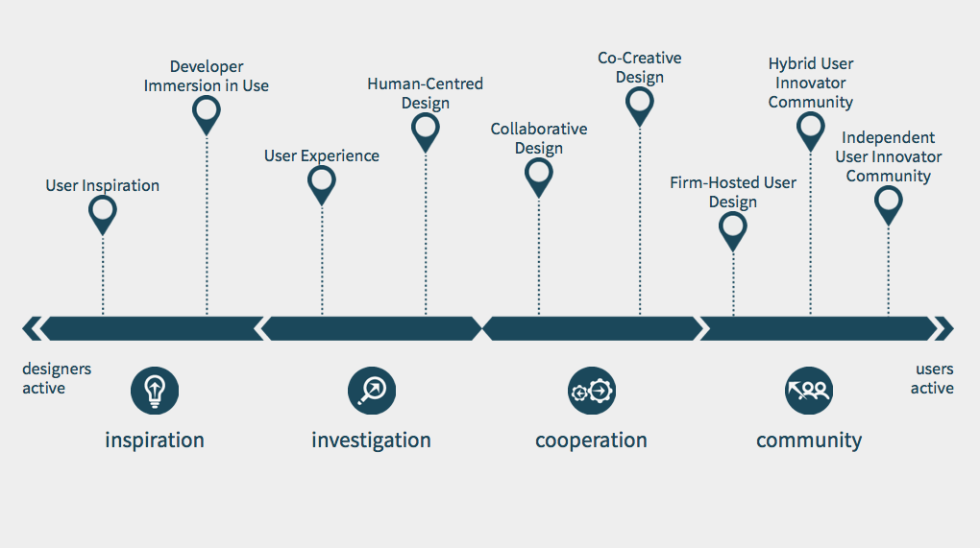

Slide 64
COLLABORATIVE DESIGN
Collaborative design means taking users in as design partners, often as experts of their own work or everyday practice
Users are seen as best experts in determining what is needed in the product or service and how it is to work for them
Designers seen as experts in design, technical realization and organizing the (usually synchronous) collaboration
Collaboration is facilitated by designers with tools that help users to design such work modeling, idea cards and mock-ups
The stronghold of collaborative design are new products and services in domains
  that are difficult to access or grasp by designers;
  which feature multiple interacting groups of users as their interrelated needs are difficult to work out otherwise

Slide 65
SOME KEY VARIANTS OF COLLABORATIVE DESIGN
  Codesign, without background theory or assumptions
    Involving users to get better products or services
    Focus on creating a good design or concept with users
  Sociotechnical systems design (1960-)
    Mutual benefits for producer (profit) and users (satisfaction)
    Improving “fit” between human and technical system
  Classical Scandinavian participatory design (1970-)
    End-user control over design process and outcomes
    Improving end-user control over technological change
  Emancipatory participatory design (1980-)
    Developing not only technology but the competency of users in dealing with new technology in the future
    Improving the capabilities of users

Slide 66
…CO-CREATIVE DESIGN
Co-realization / Aging Together (2000-)
  Continued design in use by developers and users;
  Initial collaborative design to get a seed solutions to build on.
Metadesign (2000-)
  Designing an architecture and tools on which users can design;
  Aiding users’ design as it evolves.
End-user development (1990-)
  Building tools and methodologies for programming competent users to self-serve in building, maintaining and evolving their systems.
Living Labs (2000-) (Exploratory ones, not just test beds)
  Setting an exploratory space and agreements where new technologies and their users can be explored in real-life setting;
  Can be hosted by company, academic institution, municipality or a community; key issue that somebody records and acts on findings.
Minimum Viable Product media design (2000- )
  Launching a purposefully bare application to gauge its desirability and viability
  Developing it rapidly to the directions of user need
Notes:
Notice: the by and large same developer-user configuration has been arrived from multiple directions

Slide 67
CO-CREATIVE DESIGN
CO-CREATIVE DESIGN
Co-creative design means set-ups where part of the design is realized by users, typically on an architecture made by designers.
Co-creative design is often asynchronous: designers provide some solutions, users build on them, designers solve some emerging problems, users continue.
The iterative mode of working typically continues into real life settings and long after an initial launch of the service, system or space designed.
The stronghold of co-creative design lies in the fact that users by default find new uses and places for improvement in technology once they begin using it in their own contexts.
Most co-creative design takes place in services or digital artifacts where incorporation of users’ design inputs can be done in relatively quick cycles.

Slide 68
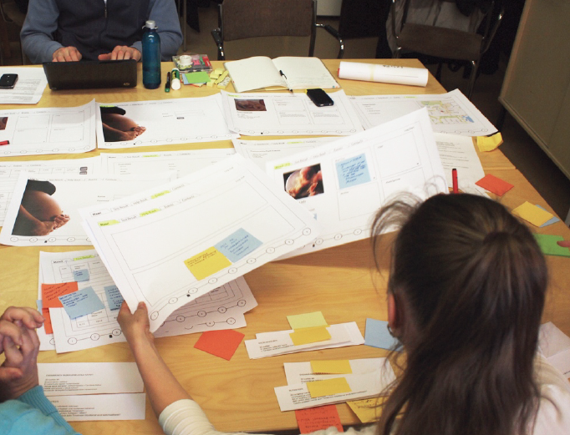
Co-design
Mäkinen, Abhisek, Jung-youn:
Lapsen kanssa/Co-designing the future health IT
Prof. Hyysalo
Aalto ARTs, 2012

Slide 69
P
U
.
In collaborative design users and producer create predominantly synchronous arrangements by which effective interaction between developers and users becomes possible.
In collaborative design producers and users create a collaborative design context (light grey circle), wherein they can exchange information and design together.
U
U
P
P
U
U
Collaborative Design Context

Slide 70
Figure 3 The participants in collaborative design activities typically act as representatives of their background communities (solid line light grey circles). The collaborative design context (dotted line light grey circle) helps finding solutions that fit multiple contexts at the same time. At best, the representatives can translate interests and knowledge between design context and community contexts.
Background User Communities
U
U
U
U
P
P
U
U
U
U
U
Collaborative Design Context
U
U
U

Slide 71
Co-Design, Participatory
design
U
U
U
U
P
P
U
U
U
U
U
U
U
U
Finance
Information
Interest

Slide 72
Co-Design, Participatory
design
U
U
U
U
P
P
U
U
U
U
U
U
U
U

Slide 73
Co-Design, Participatory
design
U
U
U
U
P
P
U
U
U
U
U
U
U
U

Slide 74
P
U
In co-creative design users and producer exchange through asynchronous and typically long term arrangements and complement each others design outputs.
In co-creative design producers and users create a design context (dotted light grey circle), wherein they can exchange information, design together, and also transfer their design outcomes to the other party.
U
P
P
U
U
U
Exchange and collaboration arrangements

Slide 75
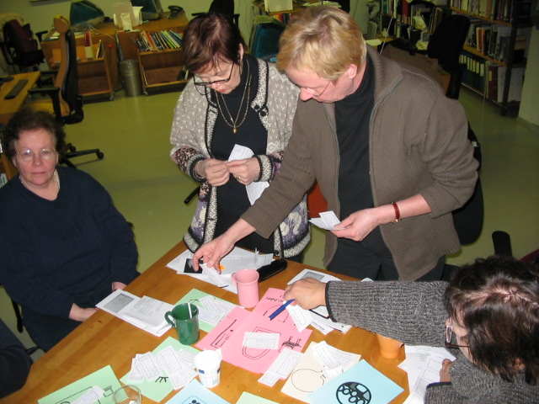
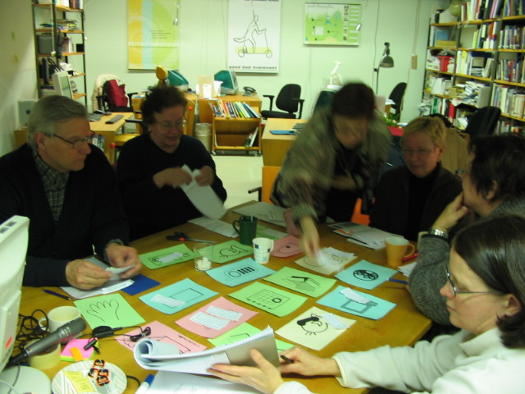
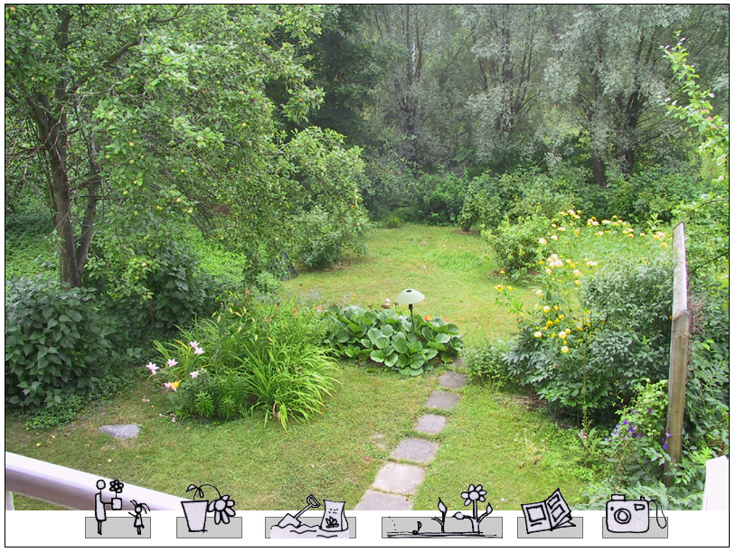
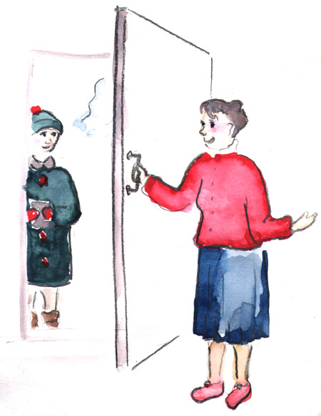
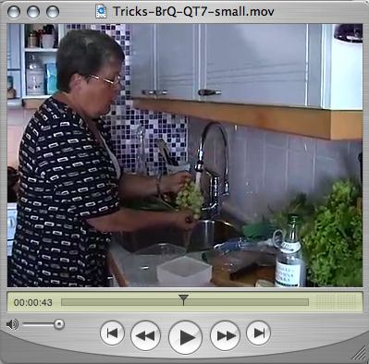
AGING TOGETHER: CO-CREATIVE DESIGN WITH ACTIVE SENIORS
Scenes from workshop and ideation sessions (2005)
Audiovisual library of gardening and cooking tips (Mockups)
Idea for a porter duty role
for the house
(Illustration by K Lehtimäki)

Slide 76
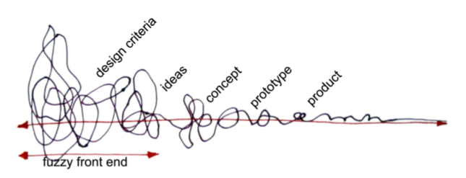
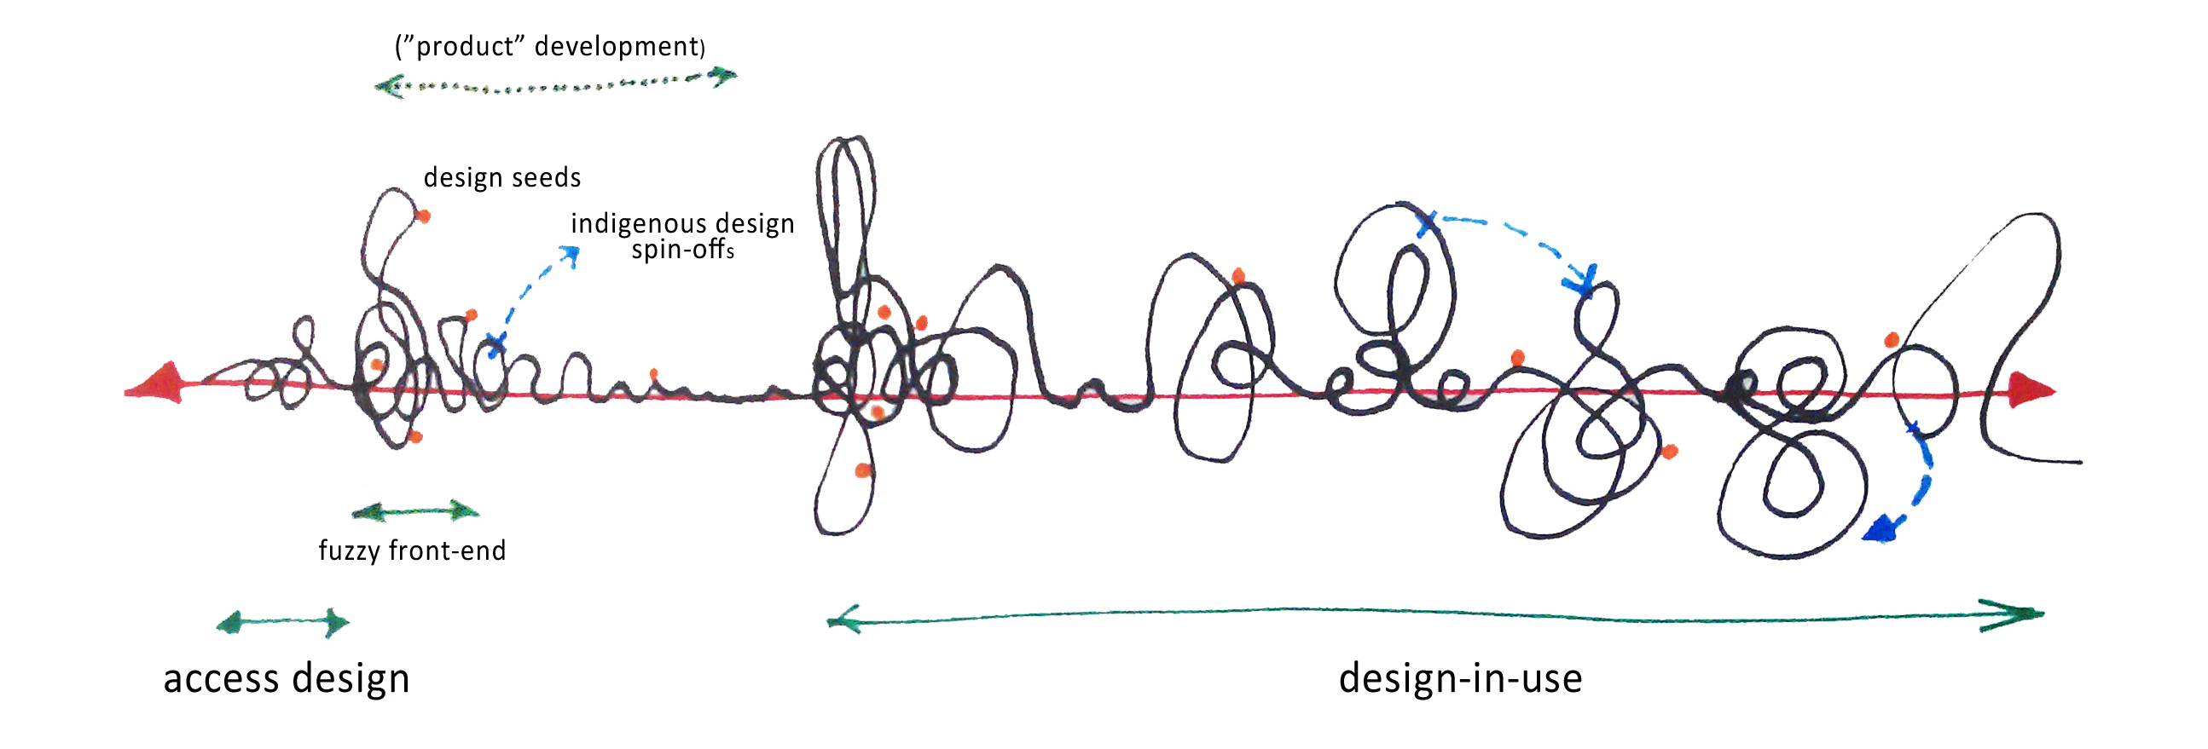
Figure 3 In co-creative design the impetus is on evolutionary long-term realization of design. The upper image depicts typical collaborative product design process where interactions between designers and users (up and down twiggles) seize upon launch. Lower image depicts co-creative design, where the initial launch is followed by heightened interactions and design iterations.
Sanders, E. B.-N., & Stappers, P. J. (2008). Co-creation and the new landscapes of design. CoDesign, 4(1), 5-18.
Botero, A, & Hyysalo, S. 2013. “Ageing Together: Steps towards Evolutionary Co-Design in Everyday Practices.” CoDesign 9 (1): 37–54 .

Slide 78
INDEPENDENT USER INNOVATOR COMMUNITY
Independent user innovator community means that users are independently designing and maintaining products, services or processes.
Users hold full control over decisions, development direction, funding sources, finances etc.
Open and free software are well known examples, but independent user innovator communities exist for physical products, service platforms, digital-physical making etc.

Slide 79
P
U
Independent user innovators and user innovator communities innovate for themselves among themselves. Insofar as users are designers information stickiness is no problem.
U
U
U
U
U
U
U
U
U
U
U
U
U
U
U
U
U

Slide 80
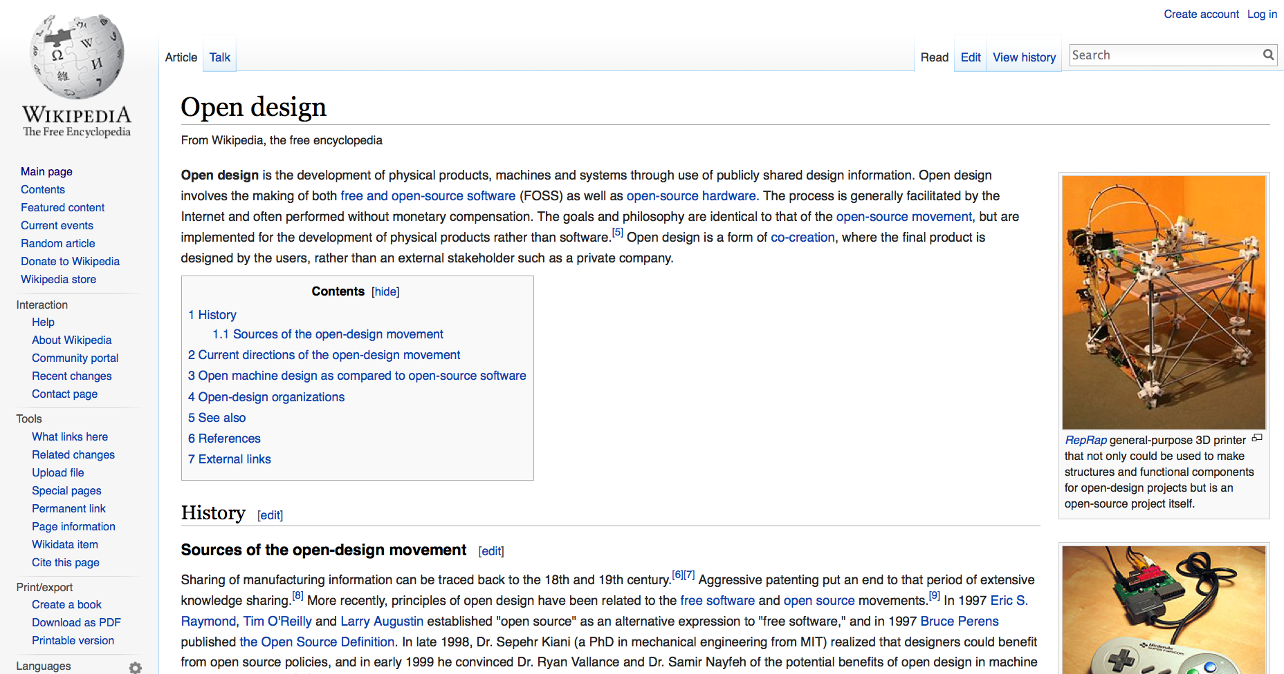

Slide 81
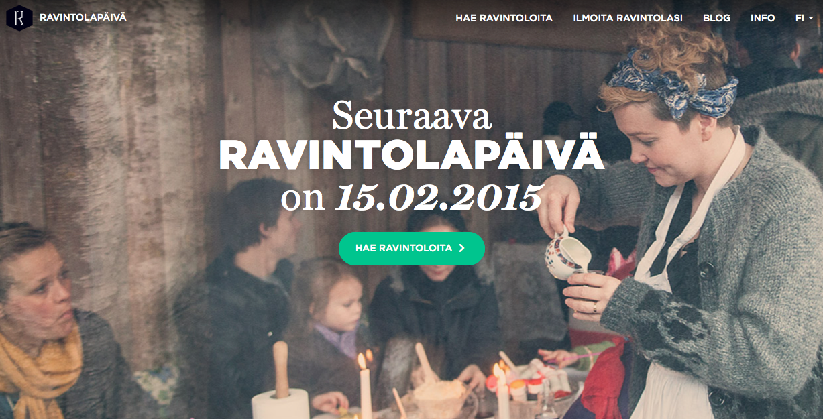
Notes:
60 – 90 + harkka 20

Slide 82
HYBRID USER INNOVATOR COMMUNITY
Hybrid user innovator community means a user community, which holds partial control and resources over their actions but is also fundamentally dependent on a corporate or governmental sponsor.
The dependency can take place through factual resource dependency of finance or critical competences
  E.g. Sun’s sponsorship of Open Office development community, where large part of programmer power comes from the company.
The dependency can follow from the use of sponsor’s technology platform or facilities
  Independent developer groups within users groups for particular company can hold independence, peer coordination and independent finance but fundamentally depend on company consent for advancing and proliferating their solutions.
  Examples: developer groups within Ducati, Oracle, Adult fans of Lego.
Companies endorse such innovation and hacking activities as it improves their products but often seeks to moderate some solutions and directions as potentially harmful for itself.

Slide 83
P
U
Hybrid user innovator communities rely on community of users for design but depend on a resource or IPR owner. Insofar as users are designers information stickiness is no problem.
Hybrid user innovator communities design mostly for themselves. The volunteers typically represent only a subgroup of all users (shaded area), and have further tiered in-groups that have some fluctuation in membership (darker shaded areas).
U
U
U
U
U
U
U
U
U
P
U
U
U
U
U
U
U
U
U

Slide 84
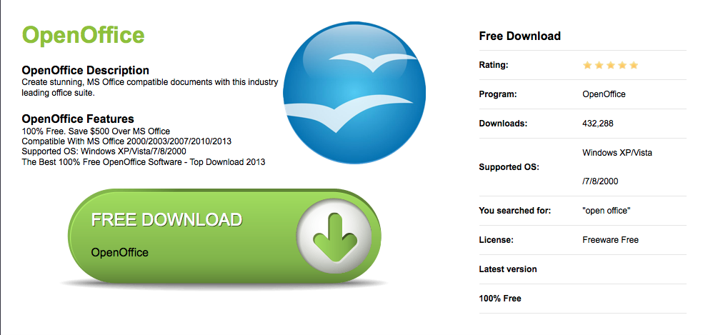

Slide 85
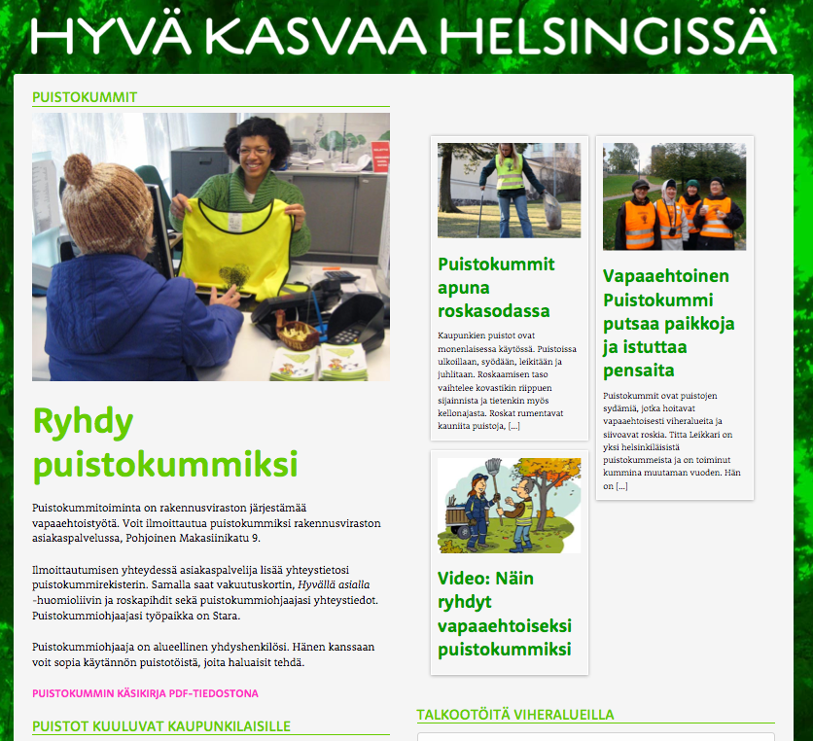

Slide 86
FIRM HOSTED USER DESIGN
Firm (or other host) coordinated user innovation means creating technical and social arrangements by which users can independently provide solutions and ideas to company products or services.
At best the arrangement makes user solutions fit directly to company products or production processes, saving costs in translating the user solution to company offer.
The currently most wide spread forms of firm coordinated user innovation are open APIs, innovation toolkits, and crowdsourcing… but also physical space “hosted activities” in museums, libraries, companies.
Also test-bed type living labs and solution libraries generated mass-customization platforms would fit this category.
The stronghold of firm-coordinated user innovation is products and services where added value can be created by adding variation and added content on a more generic offering.

Slide 87
FIRM HOSTED USER DESIGN: MAIN VARIANTS
Open application programming interfaces (open APIs)
  Open APIs allow users to program (small) applications to a software platform and ensures they work if coded properly;
  This can result in very large added value creation without massive investment from the producer, e.g. Apple 1 300 000 apps.
User Innovation toolkits
  User innovation toolkits provide users a kit of company production materials;
  User creations, then, become easy to adopt by the company and become offered as produced good.
Solution crowdsourcing
  Sourcing (small) solutions, small amounts of work, or other resources from a large base of users to a clearly defined company initiative.

Slide 88
P
U
In firm-hosted user innovation the host creates a platform that allows users to create solutions that fit in directly to its offerings without further translation. The information stickiness is strongly reduced in areas, which the platform mediates.
U
U
P
P
U
U
U
U
Structured platform
Direct translation to product characteristics

Slide 89
Nestle: User innovation toolkits
user innovation toolkits
Nestle’s (Mexican) sauce developmet (von hippel, 2001)
Chefs create a sause in their kitchen; would like to get it ready made & Nestle a product
  Nestle’s production chefs turn it into production compatible one
  Translation problem: Ingredients and machines must be of industrial scope: large processing units, storage, preservatives, additives…
  Only the final taste and some cues can be emulated…with different taste buds.
  Typically 26 weeks from chef design to production because of to and fro between chefs and production chefs to get it right
Innovation tookits: Repartioning development tasks
  Sent to Chefs working in their own kitchens: shifting factory chefs design capability to users.
  Factory production materials kit so that whatever is done fits Nestle’s production
  Module library: Finite set of materials; User friendly: 30 variations
  Iteration at the Kitchen (always local tuning needed!!)
  Improved translation: from chef to factory 3 weeks
  Nestle needed to understand what is the correct solution space (what 30 variations to offer for Chefs … and how to iterate this)
Best in:
  “high sticky info” domains (either dev or use)
  Rapidly changing markets where novelties are needed
  When optimal production is not THE issue (but better user fitting is)
  When majority follows lead-users or other trend setters
  When there is sufficient “maturity” someplace in the equation of use and dev so that users and developers know each other and what the other is doing

Slide 90
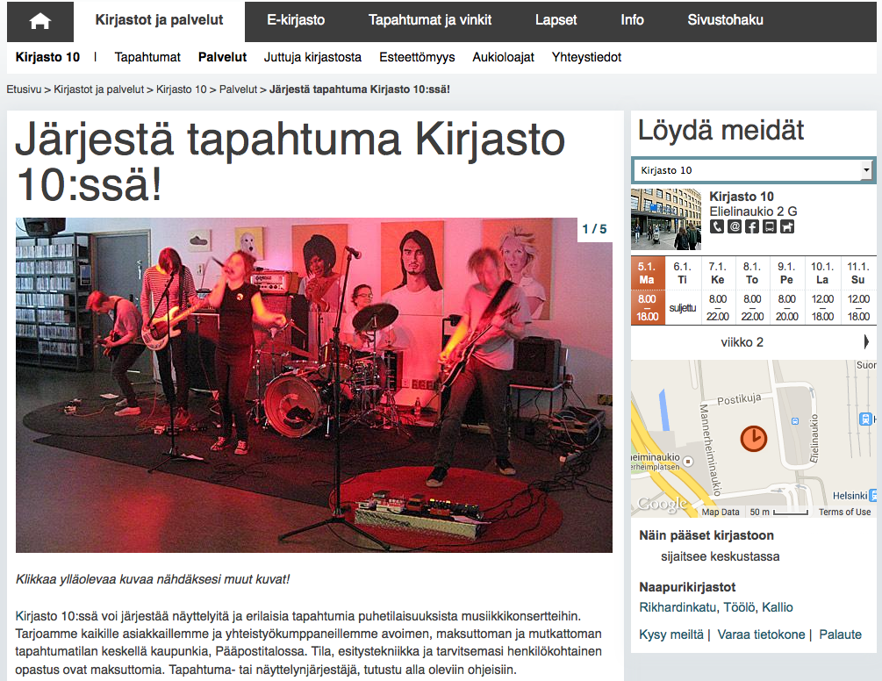

Slide 91
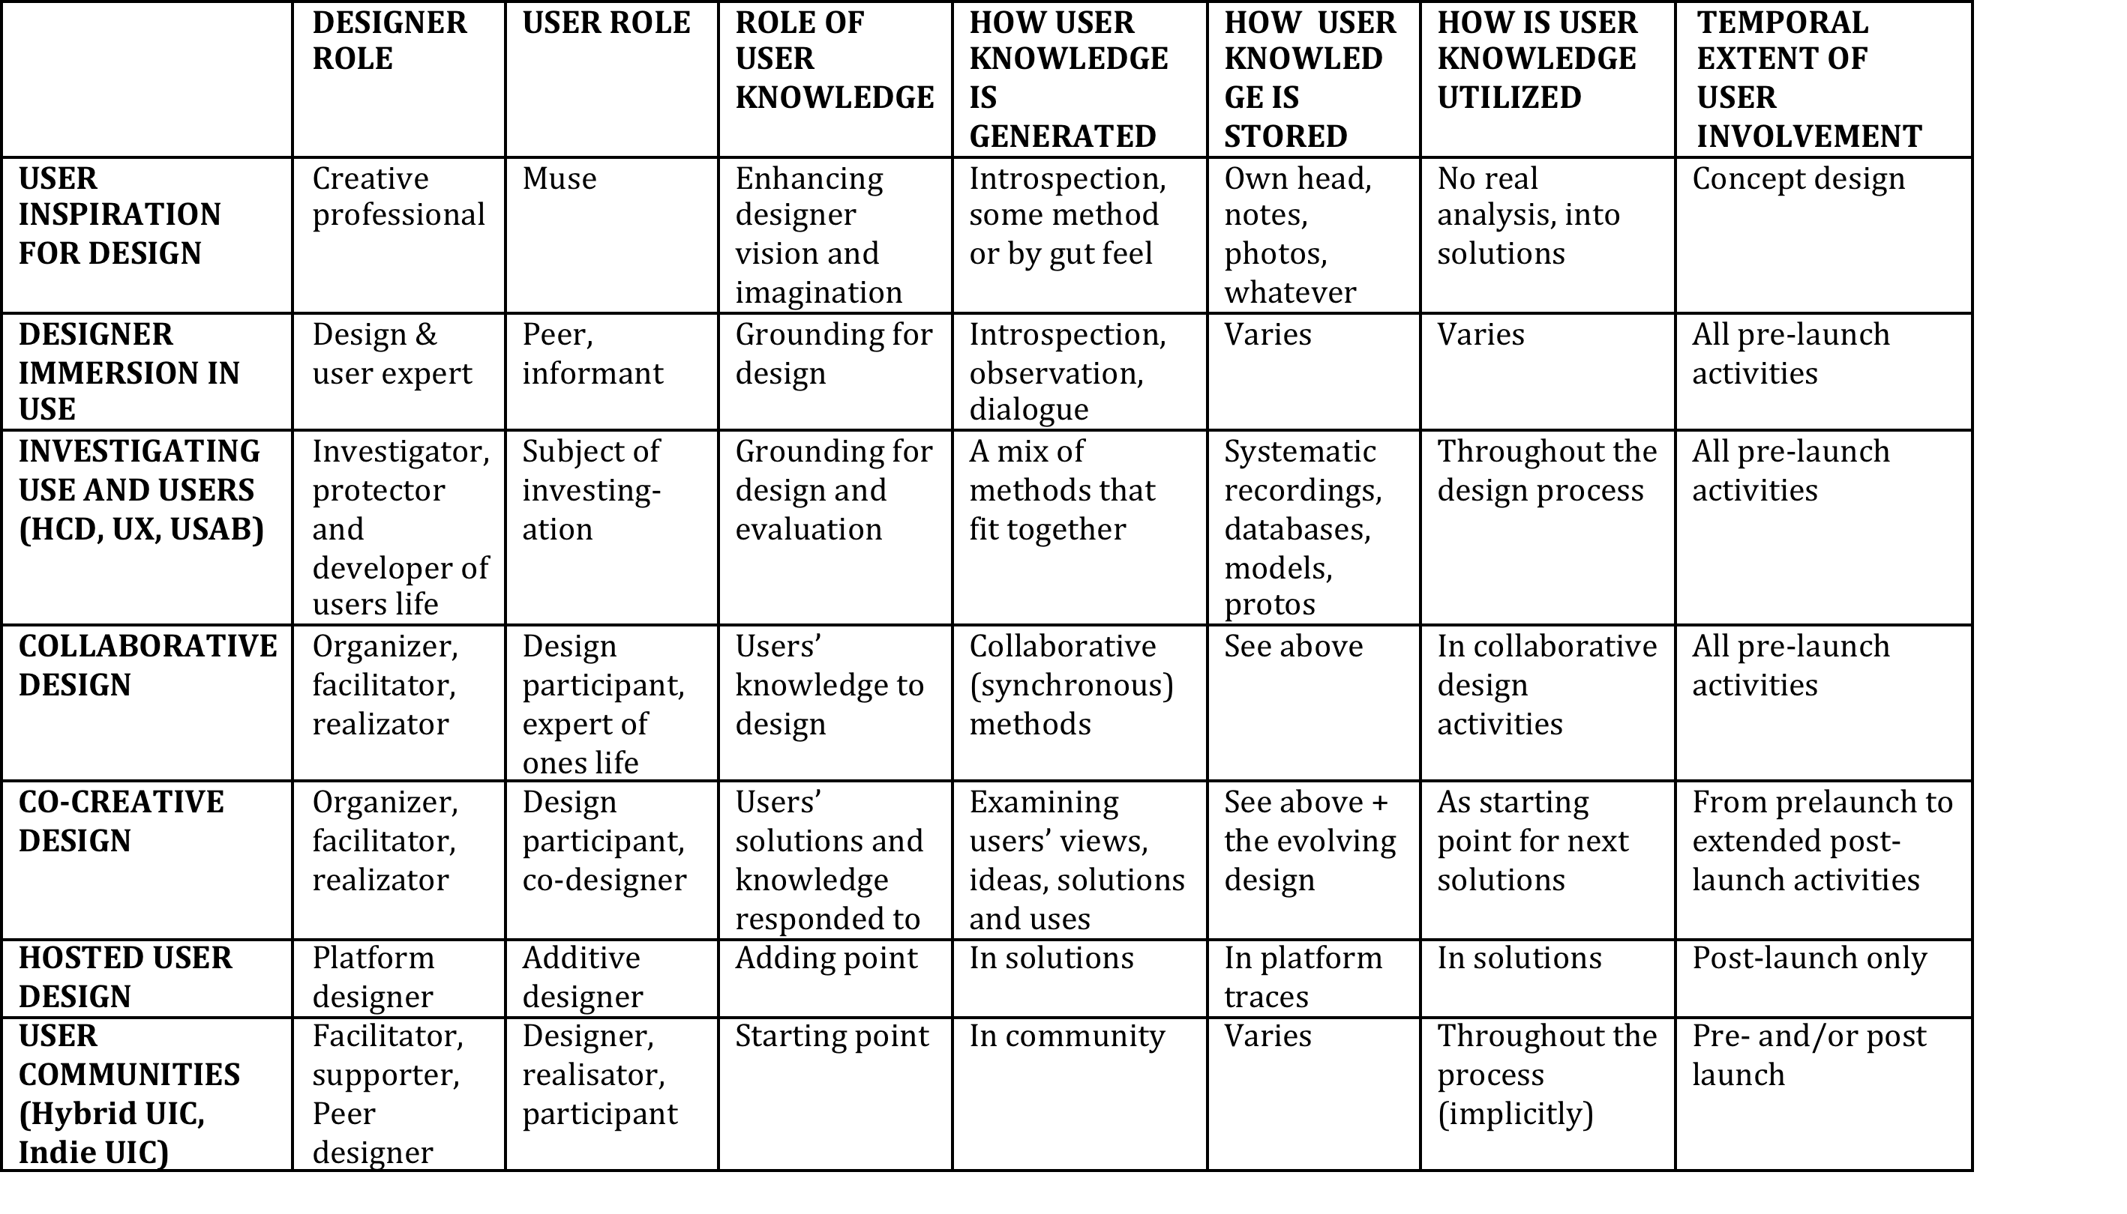
DESIGNER AND USER ROLE CHANGES

Slide 92
RECONSIDERING ACADEMICALLY: WHY DESIGN FOR, WITH AND BY USERS ?
Four major orientations, four major reasons:
COST AND RISK OF INFORMATION TRANSFER: User domain knowledge can be costly and difficult “sticky” to transfer, neglecting the transfer difficulties among top failure reasons for design and innovation
RESOURCE OPPORTUNITY: Users are competent in providing contributions to development efforts, participation is a powerful “lure” for participant resources and increased ‘ownership’
RESPONSIBLE DESIGN: Good designer ensures her/his designs produce benefits and do not cause harm to benefactors or stakeholders
DEMOCRATIC PARTICIPATION: Design affects citizens/users/customers and thus they must be included in decisions about it in a democratic society
Notes:
scope which appears unclear to many academics and practitioners

Slide 93
WHY DESIGN FOR, WITH AND BY USERS - DIFFERENCES
Four major orientations, each stressing an important reason, but not fully aligned
COST OF INFORMATION
  Only important if “sticky” information is needed
  Criteria for whom to collaborate with is capacity and willingness to provide it
  User innovation research, relationship marketing
RESOURCE OPPORTUNITY
  Benefits must exceed costs
  Only important if users are willing and able to contribute time, money or power
  User innovation research, crowdsourcing, Open source software (but not free/libre software)
RESPONSIBLE DESIGN:
  Only important if the design professional cannot ascertain this alone
  The citizen/user/customer is not important during design but only as implied by it
  HCD, UX, UIFD, service design
DEMOCRATIC PARTICIPATION:
  Only important if it is citizens/users/customers right to affect technology (vs art, commissions to one self, professional autonomy, professional judgement)
  Criteria for whom to collaborate with must be equal and representatative in an acceptable way
  Participatory design, participatory planning, free & libre software, community design
Notes:
scope which appears unclear to many academics and practitioners

Slide 94
But what else does it take to achieve effective codesign?

Slide 95
STRATEGIC CODESIGN – MAYBE A NECESSITY
Codesign holds great potential for resulting in no gains
  Post-it-roll-paper-workshop-hell
  Hearing but not listening
  Spending resources to secondary aspects to service / product / change initiative
  Using an ill-suited approach or method
  Involving wrong people(s), not involvign the most important people(s)
  Over or under supported participation re: participant design ability, willingness and time use
  Misguided or mismanaged expectations and/or time use
  Over or undercaution over power relations in collaboration
  Overcaution over changing anything in lack of real contextual understanding
It is not trivial HOW we plan and practice it – intuition should be complemented with understanding and analytic considerations
Notes:
scope which appears unclear to many academics and practitioners

Slide 96
CoDesign action planning template
Assess what are the primary and secondary aims of the codesign action
Assess the change domain characteristics: What is the social issue? What and who is involved? Systemic issue? Nature of Infrastructure and need to change it? Nature and path dependencies in science, tech, markets and pricing, regulation, resource use, logistics, consumer behavior? Cognitive lock-in(s)? …
Assess further the targeted and implied people: ’users’ and ’stakeholders’
  Who are they – unified group or diverse set of different groups? What kind of people are they?
  Motivation – why are they interested?
  Contact – how to reach them?
  Competence – what are they capable of doing?
  Relevance – what are they getting from the project? What is the design project getting from them?
2. Select the approach(es) and methods (mix) to work with these people(s) (see CDJP and methods sites)
3. Tailor the methods and practical arrangements to ensure meaningful inputs: how? What all needs to get done?
4. If relevant, consider ways the participants can share with each other
5. Plan how the results and outcomes will be documented (and see if this affects the methods and arrangements)
6. Plan how you will attract the participants and what are the rewards for them
8. Plan how you integrate results and outcomes into design project (and larger sociotechnical development)
9. If you aim for sustained participation, what are the participation forms and pathways people can take
  Do not try too much at once, work in phases, make it easy for participants (internal/external to your organization)
  Enable multiple ways, intensity and channels of participation
10. Create ways to deepen, extend and pool collaboration with (strategically important) participants

Slide 97
In sum, design participation in social change
A means to involve implicated people into design and decision making rather than imposing design onto them ‘dialogue instead of drama’
Creates a way to create and legitimize ‘counter designs’ to dominant plans
Way to incorporate people’s wishes and concerns from the outset
Makes a smoother entry into design iterations after launch
Creates possibilities to influence sociotechnical make up of democratic societies through democratic means
Different rationales for participation call for different considerations
Realization of design participation requires analytic considerations across issues involved, typically beyond any one of the academic angles to design participation

Slide 98
Exercise 1

Slide 99
END OF WEEK 1, DAY TWO
Before Wednesday must read:
Phaffenberger: ‘Technological dramas’
Before wednesday highly recommended:
Botero et al. 2020 Getting Participatory Design Done: From Methods and
Choices to Translation Work across Constituent Domains

