Slide 1
Principles of Economics II
Introduction
Fall 2022
Kristiina Huttunen

Slide 2
Welcome!
Teacher: Kristiina Huttunen
  Kristiina.huttunen@aalto.fi
  https://sites.google.com/site/krhuttunen/research
TA and review sessions: Anna Holvio
  Anna.holvio@aalto.fi
Lectures: Tue 10–12, Wed 10–12
Review Session: Friday 10-12

Slide 3
Course organization
Course homepage
  mycourses.aalto.fi -> my own courses-> Principles of Economics II
  Lecture slides, problem sets, return of problem sets
Textbook
  CORE-team: The Economy: www.core-econ.org/the-economy
  Relevant chapters indicated in the Syllabus of the course
Lectures
  Indicate the central content in the textbook and develop some themes further

Slide 4
Learning objectives
Principles of Economics (4 separate units) aims to
  Provide an overall view of economic activity in modern societies
  Take a first look at economic modeling and economic analysis
  Give an introduction to the use of data in economics
  Introduce economics behind major societal challenges
Objectives for Part II
  Understand aggregate economic phenomena: labor market, market failures, inflation, the role of public sector

Slide 5
Assessment and grading
Grading
  80% of your grade is based on final examination (Dec 5)
  20% of your grade based on problem sets
Review sessions: discuss the lecture material and suggested solutions to problem sets
  Answers to problem sets returned via MyCourses
  An ideal place to ask questions regarding course material
It is essential to complete the problem sets!
The course (160h) assumes a large amount of independent work on top of the lectures

Slide 6
How to get the most from the course?
Familiarize yourself with the topic of the lecture in advance
Check that you have understood the main concepts in the lecture
  You can do this using the interactive tools in the textbook and by reviewing the list of concepts provided at the end of each chapter
Concentrate on the most relevant concepts and ideas
  One of the learning goals in this course is that you should learn to identify the key ideas
  Lecture material and problem sets are designed with this in mind

Slide 7
Feedback
You will get feedback on
  Performance in the problem sets
  Performance in the final examination
We want to get your feedback
  During lectures: ask questions! If you do not understand something, many others will have the same problem
  After lectures: I am available for short questions immediately after class and can set up an appointment for longer ones
  In review sessions
  A questionnaire during the course and after the course

Slide 8
Outline for the course (tentative)
Lecture 1–2: The labour market: Wages, profits, and unemployment. Unit 9
Lecture 3–4: Markets, efficiency and public policy. Unit 12
Lecture 4-5: Economic fluctuations and unemployment. Unit 13
Lecture 6–7: Unemployment and fiscal policy. Unit 14
Lecture 8–9: Inflation, unemployment, and monetary policy. Unit 15
Lecture 10–11: Technological progress, employment, and living standards in the long run. Unit 16
Lecture 12: Recap

Slide 9
Principles of Economics II
Lecture 1: Labor markets
Fall 2022
Kristiina Huttunen

Slide 10
This weeks lectures
Measuring unemployment (employment)
Competitive Labor market model (briefly)
The Economy’s labour market model (unit 9)
  Price-setting and wage-setting
  Labour market equilibrium
  Involuntary unemployment
  Some applications

Slide 11
Measuring unemployment

Slide 12
The unemployed
The unemployed are the people who:
  are not in paid employment or self-employment
  are available for work
  are actively seeking work

Slide 13
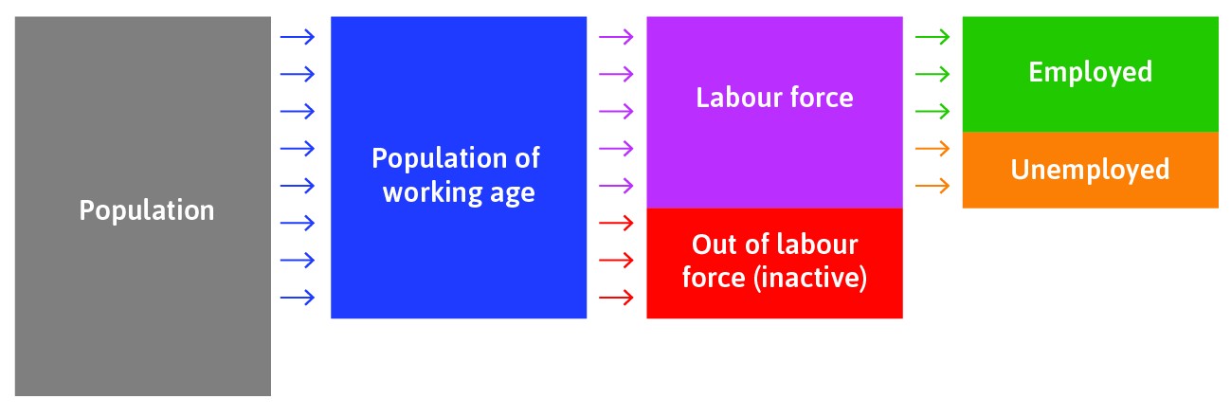
The labour market

Slide 14
The Finnish labour market in 2017
Population of working age (15–74y) : 4.1M
Labour force:
2.7M
Employed:
2.5M
Unemployed:
230 000
Out of labour force: 1.4M

Slide 15
Labour market statistics
Unemployment rate:
  unemployed / labour force = 0.23M/2.7M = 8.5%
Employment rate:
  employed / population of working age = 2.5M/4.1M = 61.0%
Participation rate:
  labour force / population of working age = 2.7M/4.1M = 65.8%

Slide 16
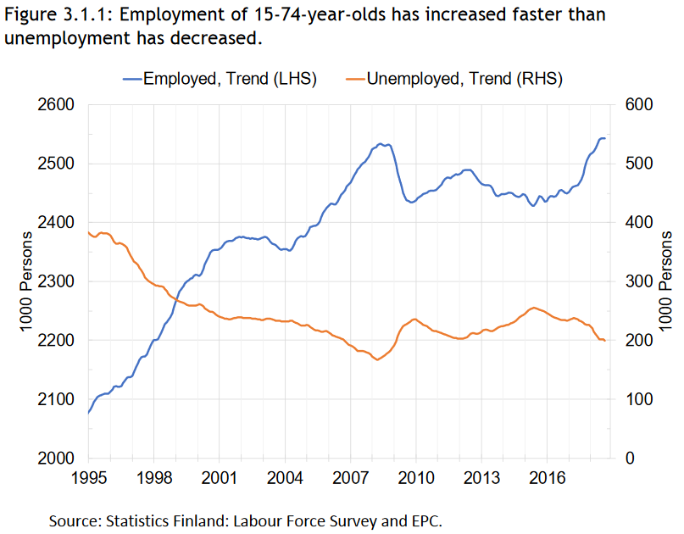
Employment and unemployment

Slide 17
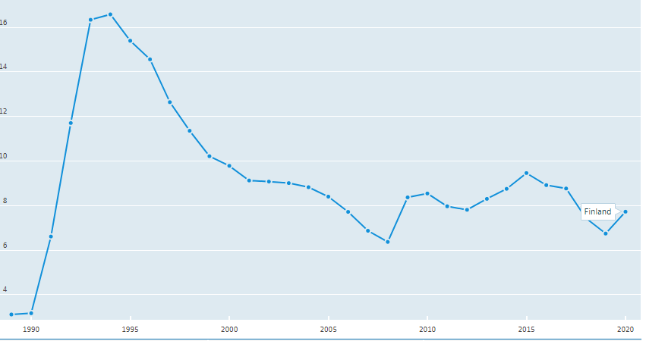
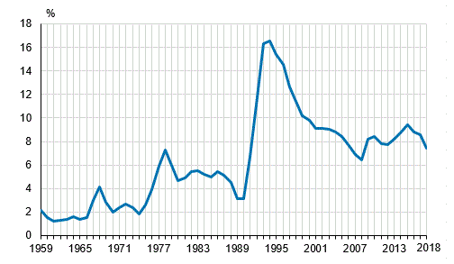
Unemployment rate in Finland 1989-2018
Source: OECD (Labor force survey)

Slide 18
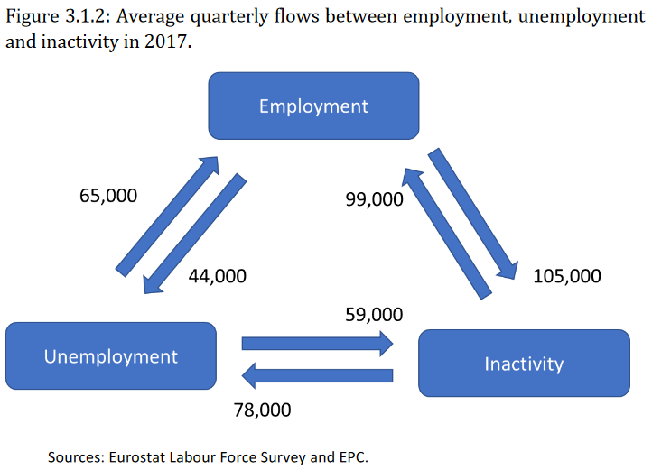
Flows between employment, unemployment and inactivity in 2017
Flows between employment and inactivity are larger than between employment and unemployment
In 2017, 65,000 unemployed persons (28%) found a new job within a typical 3 month unemployment period
44,000 employed (1.5%) into unemployed
As are flows between inactivity and unemployment
Source: Economic Policy Council Report 2018

Slide 19
Two data sources for unemployment rate
Labour Force Survey:
  A random sample from the Statistics Finland population database
  The monthly sample consists of some 12,000 persons and the data are collected with computer-assisted telephone interviews
  Unemployed = respondent says (i) unemployed, (ii) has seeked a job within the last four months and (iii) is willing to accept a job offer within two weeks of the offer
Employment Service Statistics:
  Jobseekers registered at the employment and economic development offices
  Unemployed = person registered as jobseeker who is not working over 4h a week, is not a student, entrepreneur or pensioner
  https://www.stat.fi/til/tyti/tyti_2016-08-23_men_001_en.html

Slide 20
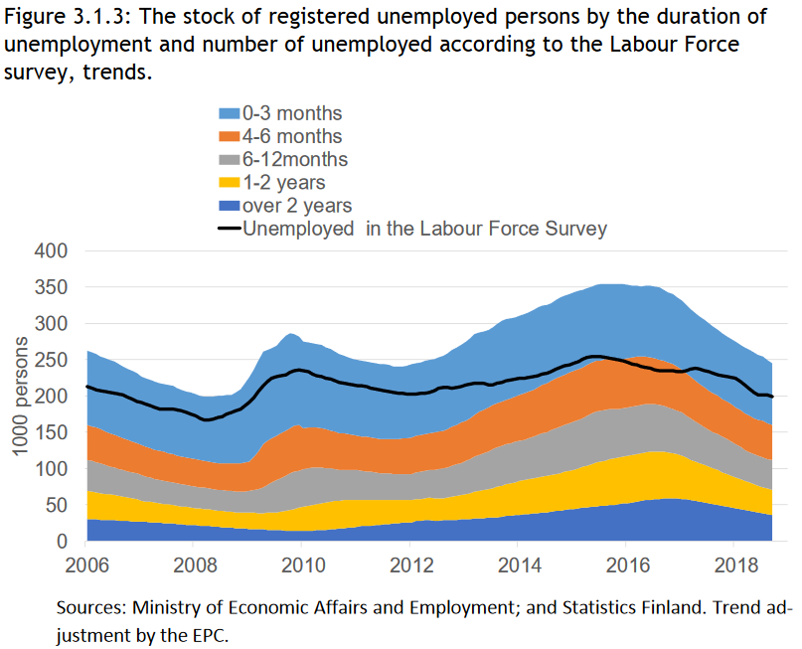
Registered unemployed persons vs. Labour Force Survey

Slide 21
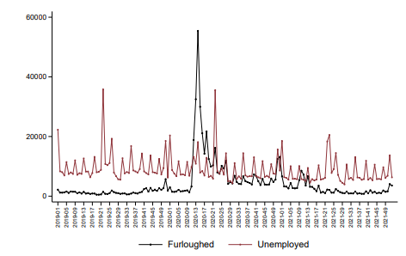
New unemployment and furlough spells during the Covid-19 pandemic
Source: Income statistics

Slide 22
Competitive labour market model
Brief introduction

Slide 23
Building blocks of the model
Firms maximise profits and are competitive both in the product market (seller) and the labour market (buyer)
Workers are the sellers in the labor market
Labour demand: how many workers to hire at a given wage level
  Diminishing marginal product => demand curve slopes down
Labour supply: how much workers are willing to work for a given wage level
  Assume that as wage increases the willingness to work increases => supply curve slopes up

Slide 24
Market equilibrium in competitive labor markets
Wage
S
In equilibrium, demand = supply
Equilibrium wage is w* and equilibrium employment is L*
No unemployment
w*
D
L*
Employment

Slide 25
Market equilibrium
Wage
S
In equilibrium, demand = supply
Equilibrium wage is w* and equilibrium employment is L*
No unemployment
If the wage level would be higher than w* more people would be willing to work than firms would be willing to hire
w*
D
L*
Employment

Slide 26
Market equilibrium
Wage
S
In equilibrium, demand = supply
Equilibrium wage is w* and equilibrium employment is L*
If the wage level would be higher than w* more people would be willing to work than firms would be willing to hire
If the wage level would be lower than w* firms would be willing to hire more people than would be willing to work for this wage
w*
D
L*
Employment

Slide 27
Effect of immigration on wages and employment
This is a simple model, but let’s use it to analyse some important and not so simple questions
  What happens to wages and employment when immigration increases?
  What about when a minimum wage is introduced?

Slide 28
Immigration
Let’s analyse the supply response first
Wage
S
w*
D
L*
Employment

Slide 29
Immigration
Let’s analyse the supply response first
As immigration increases, there are more workers willing to work at any given wage level
We see this as a rightward shift in the labour supply curve
At the initial wage, labour supplied exceeds the quantity demanded
Wage
S
S’
w*
immigrants
D
L*
Employment

Slide 30
Immigration
Let’s analyse the supply response first
As immigration increases, there are more workers willing to work at any given wage level
We see this as a rightward shift in the labour supply curve
At the initial wage, labour supplied exceeds the quantity demanded
This puts downward pressure on wage: w* => w’
But the supply response is not the whole story!
Wage
S
S’
w*
w’
immigrants
D
new jobs
L*
L’
Employment

Slide 31
Immigration
The new workers will of course spend their money
They may become employers etc.
This means that as a result labour demand will also increase
We see this as a rightward shift in the labour demand curve
In the figure, immigration has no effect on the wage level or employment of the native workers
What happens in the end, will depend on the magnitude of the labour demand shift
Wage
S
S’
w*
D’
w’
D
L*
L’
L’’

Slide 32
Effect of immigration on wages and employment
In a more general model we would have heterogeneity among workers
  Some native workers have more similar skills than immigrants (substitutes) => competition in the labour market increases
  For others, the immigrants are complements in terms of skills and tasks => for these natives wages and employment opportunities may increase
The labour market effects of immigration will depend on
  Are immigrants substitutes or complements?
  How fast the economy will adjust to increased labour?

Slide 33
Empirical challenges
The causal question
  For example, what is the average wage of a particular worker group in Helsinki today when immigrant share is x, as oppose to the share being y (the counterfactual)?
How can we construct a plausible counterfactual?
  Experimental research designs difficult/impossible to come by => we need to compare labour markets with high and low immigration

Slide 34
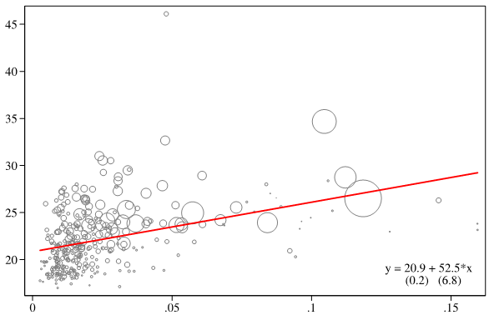
Average income and immigrant share in Finnish municipalities
Is this sorting or due immigrants really increase the local wage level?

Slide 35
How to study impact of immigration: Natural experiments
Card (1990): Cuban mass immigration during the “Mariel boatlift”
  On April 20, 1980, Fidel Castro declared that any Cuban wishing to emigrate to the US can do so from the port of Mariel => a 7% increase in the labour force in Miami
  No effect on the wages or unemployment rates of less-skilled workers
Friedberg (2001): Soviet mass migration
  Mass migration from the former Soviet Union into Israel had no effect or slightly increased Israeli wages and employment

Slide 36
Minimum wage
Wage
Let’s assume that the public sector wants to increase the wages of low-skilled workers (typically low wage workers) by setting a minimum wage (w^{min}) which is higher than the market wage (w*)
S
w*
D
L*

Slide 37
Minimum wage
Wage
Let’s assume that the public sector wants to increase the wages of low-skilled workers (typically low wage workers) by setting a minimum wage (w^{min}) which is higher than the market wage (w*)
S
w^{min}
w*
D
L*

Slide 38
Minimum wage
Wage
Let’s assume that the public sector wants to increase the wages of low-skilled workers (typically low wage workers) by setting a minimum wage (w^{min}) which is higher than the market wage (w*)
At this new higher wage L’’ workers are willing to work, but firms are only willing to hire L’ workers
The result is a surplus or unemployment (at the higher wage level)
S
surplus
w^{min}
w*
D
L’
L*
L’’

Slide 39
Empirical example: New Jersey minimum wage increase
On April 1, 1992, NJ increased the state minimum wage from $4.25 to $5.05; PA’s minimum wage stayed at $4.25
Card & Krueger (1994) surveyed about 400 fast food stores both in NJ and in PA before (February) and after (November) the minimum wage increase
Results: Surprisingly, employment rose in New Jersey!
Other models? If employers have market power in the labour market, this can happen

Slide 40
Newer results on minimum wage
Still an open question and also quite a heated debate
  It seems that major employment effects are rarely found
  At the same time, minimum wage reforms are often quite small
  Large enough minimum wage hikes are going to lower employment

Slide 41
Summary
The model assumes that the labour market is simply a re-labelled product market with complete contracts
Unrealistic, but is the model useful?
  Yes! Real-world markets are typically not perfectly competitive, but some policy problems can be analysed using this rather simple demand and supply model
  You will see lots of more applications in future courses (especially in product markets)
On the other hand, it is too simple to for some markets and questions
  Next we will turn to another labour market model

Slide 42
Principles of Economics II
Lecture 2: The labour market: Wages, profits, and unemployment
Fall 2022
Kristiina Huttunen

Slide 43
Outline
The Economy’s labour market model (unit 9)
  Price-setting and wage-setting
  Labour market equilibrium
  Involuntary unemployment
  Some applications

Slide 44
The Economy’s labor market model
Models price-setting and wage-setting behaviour of firms, which determines economy-wide unemployment rate and real wage
The starting point is the labor discipline model (unit 6)
  Contracts between workers and employers are incomplete (worker’s effort may be hard to measure)
  There are costs related to job loss
  Explains why involuntary unemployment exists even in equilibrium

Slide 45


There are only few jobs where we can directly observe output

Slide 46
Losing a job is costly
Cost of job loss in Finland during 1990’s recession
Earnings of workers that lost their jobs due to plant closure between years 0-1 as compared to earnings of similar worker’s whose plant did not close down

Slide 47
Building blocks of the model
Model the labour market of an entire economy
Firms and employees:
  Firms set wage sufficiently high to make job loss costly, in order to motivate employees to work hard in the absence of complete contracts (employment rent, unit 6)
Firms and customers:
  Firms produce differentiated products and set a markup above the cost of production, to maximise their profits subject to demand (Unit 7)

Slide 48
Building blocks of the model
The real wage is the nominal wage divided by the price level of the bundle of consumer goods purchased:
  Nominal wage (W): wage received by a worker in form of money
  Price level (P): price level of a standard bundle of consumer goods
  Real wage (w): w = W/P amount of goods and services the worker can buy

Slide 49
The setup
Each firm decides on its: price, wage, how many people to hire
Adding up all of these across all firms gives the total employment in the economy and the real wage

Slide 50
The wage-setting curve
Labour
force
The wage-setting curve = the real wage necessary at each level of economy-wide employment to provide workers with incentives to work hard and well
Real wage
Wage-setting
curve
0
0.5
1
Share of the working-age population

Slide 51
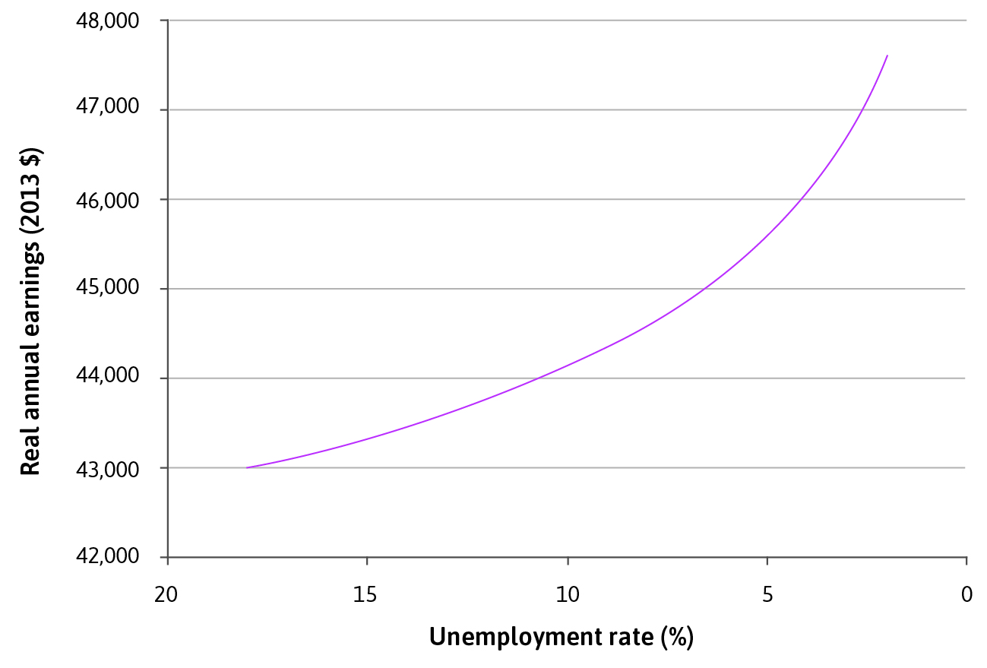
Estimated wage curve
Estimated from area-level US data

Slide 52
The chain of firm’s decisions
Nominal wage = f(other firms’ prices and wages, unemployment rate)
Price = f(own nominal wage, demand for own product)
Output = f(optimal price, demand curve)
Number of employees = f(output, production function)

Slide 53
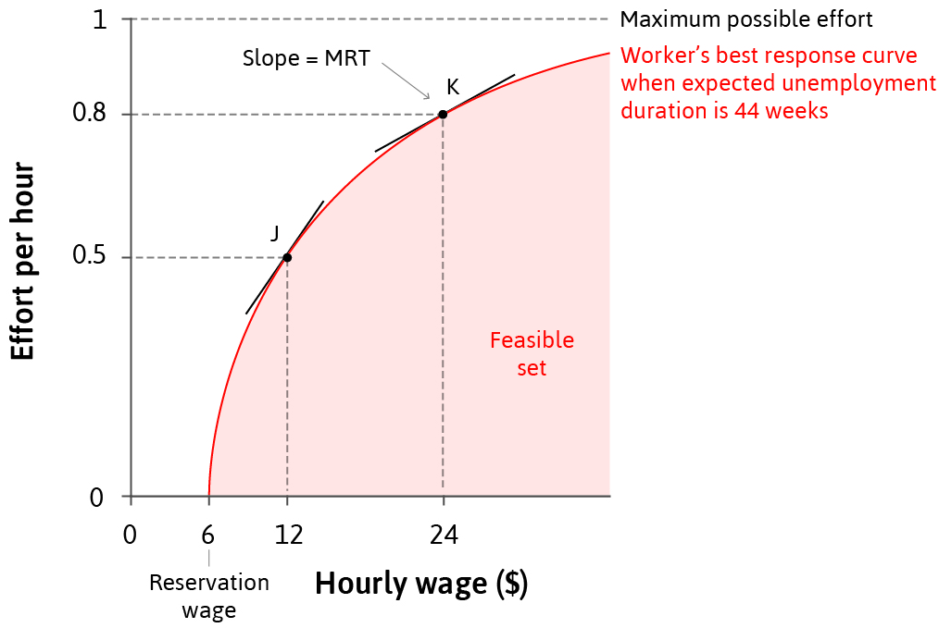
Employee’s best response to the wage
Best response curve shows the optimal amount of effort workers will exert for each wage offered
Represents the firm’s feasible frontier for wages and effort
Slope of best response curve = MRT (employer’s marginal rate of transfomation of high wages into more effort)

Slide 54
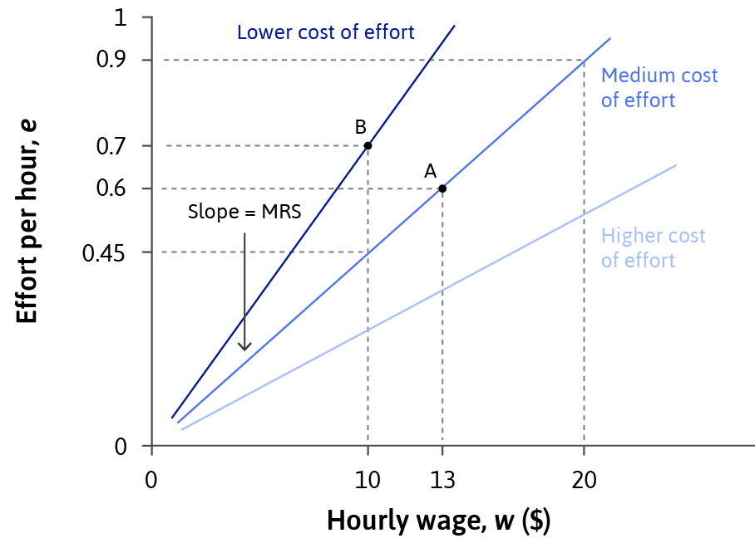
The employer’s indifference curves: isocost lines for effort
The cost of effort is the same at all points on an isocost curve
Slope of isocost curve = MRS =
the rate at which the employer is willing to increase wages to get higher effort

Slide 55
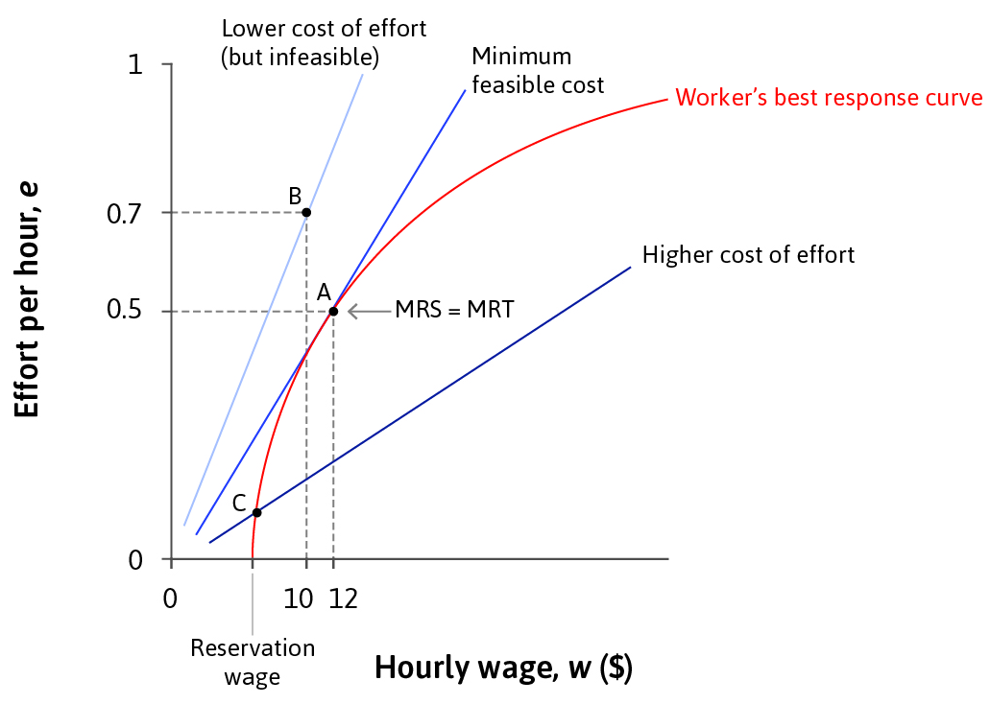
Determining wages
Profits are maximised at the steepest isocost line, subject to the worker’s best response curve
MRS = MRT
Efficiency wage = wages set higher than the reservation wage so workers will care about losing the job and provide more effort

Slide 56
Deriving the wage-setting curve
Best response
function, U=12%
When unemployment is low, workers who lose their jobs can expect a shorter spell of unemployment
Decrease in the duration of a spell of unemployment has two effects:
  It increases the reservation wage: reducing the employment rent per hour
  It shortens the period of lost work time: decreases total employment rents (the cost of job loss)
Isocost curve
A
Effort per hour
0
F
0
w_{L}
Hourly wage
Reservation
wages
Wages set by employer

Slide 57
Deriving the wage-setting curve
Best response
function, U = 12%
Lowering the unemployment rate will shift worker’s best response curve to the right (reservation wage↑) and increase wage
At each wage level, the worker is willing to put in less effort because the cost of job loss is lower
This results in an upward-sloping wage-setting curve
Best response
function, U = 5%
B
A
Effort per hour
0
F
G
0
w_{L}
w_{H}
Hourly wage
Reservation
wages
Wages set by employer

Slide 58
The wage-setting curve
The wage-setting curve = the real wage necessary at each level of economy-wide employment to provide workers with incentives to work hard and well
Labour
force
Real wage
Wage-setting
curve
0
0.5
1
Share of the working-age population

Slide 59
The wage-setting curve
Labour
force
A
w_{L}
Real wage
Wage-setting
curve
Employment rate
Unemployment rate = 12%
0
0.5
1
Share of the working-age population

Slide 60
The wage-setting curve
Labour
force
B
w_{H}
A
w_{L}
Real wage
Unemployment rate = 5%
Wage-setting
curve
Employment rate
Unemployment rate = 12%
0
0.5
1
Share of the working-age population

Slide 61
What shifts the wage-setting curve?
For any unemployment rate, increase in employment rent will shift the curve downwards
  Lower unemployment benefit makes it more costly if you lose your job, your employment rent is higher and the firm can set a lower wage and you will work, rather than shirk
  Increase in the labour force: If there are more people searching for jobs, then you can expect to remain without work for longer if you lose your job
  A new monitoring technology: makes detection of shirking less costly (such as the use of GPS trackers in trucks, monitoring their location at any time)

Slide 62
Firm’s hiring decision
Labour is the only input (!), so wage is the only cost
  One hour of labour produces one output (given the wage)
  Average product of labour λ = 1
  So the wage the firm pays (W) is the cost of a unit of output
  Firm’s produce differentiated products
The firm process
  HR (Human resources department) sets the wage W at a level sufficient to motivate the workforce
  MD (Marketing department) sets the price p (taking into account feasible combinations of p and q)
  PD (Production) chooses the amount of workers n* = q*

Slide 63
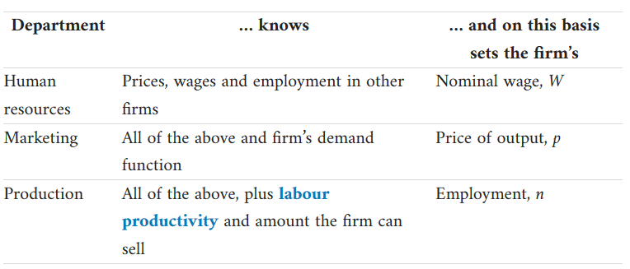
Firms hiring decision

Slide 64
Profit-maximizing price
Iso-profit curve
Firm’s constrained optimisation problem:
goal: maximise profits
constraint: demand curve faced by the firm
B
p*
Marginal cost = wage
W
Demand curve
(given economy-wide demand)
q*
Quantity, q; Employment, n, given a production function where APL = λ = 1
Production function: $q=n$

Slide 65
Profit-maximizing price
Iso-profit curve
Profit per unit output
Wage per unit output
B
p*
Marginal cost = wage
W
Demand curve
(given economy-wide demand)
q*
Quantity, q; Employment, n, given a production function where APL = λ = 1
Production function: $q=n$

Slide 66
Profit-maximizing price
Iso-profit curves
C
B
p*
A
W
Wage
Demand curve
(given economy-wide demand)
q*
Quantity, q; Employment, n, given a production function where APL = λ = 1
Production function: $q=n$

Slide 67
The price-setting curve
When the firm sets the price as a markup on its wage cost, this means that the price per unit of output is split into the profit per unit and the wage cost per unit
For the economy as a whole, when all firms set prices this way, output per worker (labour productivity, or equivalently, the average product of labour, called lambda, λ) is split into
  Real profit per worker Π/P and
  The real wage W/P
This is depicted in the next figures

Slide 68
The price-setting curve
Labour
force
Average product of labour, λ
Average product of labour, Real wage, W/P
Output per worker, λ
0
Employment,
whole economy, N

Slide 69
The price-setting curve
Labour
force
Average product of labour, λ
Real profit per worker, Π/P
Average product of labour, Real wage, W/P
W/P = w^{PS}
Price-setting curve
B
Output per worker, λ
Real wage per worker, W/P
0
Employment,
whole economy, N

Slide 70
The price-setting curve
The price-setting ‘curve’ is just a single number that gives the value of the real wage that is consistent with the markup over costs, when all firms set their price to maximize their profits
The value of the real wage consistent with the markup does not depend on the level of employment in the economy, so it is shown as a horizontal line at the height of w^{PS}
Point B in the figure on the price-setting curve shows the outcome of profit-maximizing price-setting behaviour of firms for the economy as a whole

Slide 71
The price-setting curve
Labour
force
At point A, real wage too high and markup too low; firms raise price; and given demand, output falls
Average product of labour, λ
Average product of labour, Real wage, W/P
A
W/P = w^{PS}
Price-setting curve
B
0
Employment,
whole economy, N

Slide 72
The price-setting curve
Labour
force
At point A, real wage too high and markup too low; firms raise price; and given demand, output falls
Average product of labour, λ
Average product of labour, Real wage, W/P
A
W/P = w^{PS}
Price-setting curve
B
C
At point C, real wage too low and markup too high; firms lower price; and given demand, output rises
0
Employment,
whole economy, N

Slide 73
What determines the height of the price-setting curve?
Competition determines the extent to which firms can charge a price that exceeds their costs
  The less the competition, the steeper the demand curve, the greater the markup and profit per worker
  Since this leads to higher prices across the whole economy, it implies lower real wages, pushing down the price-setting curve
Labour productivity:
  For any given markup, the level of labour productivity—how much a worker produces in an hour—determines the real wage
  The greater the level of labour productivity (λ), the higher the real wage that is consistent with a given markup => the price-setting curve will shift upwards, raising the real wage

Slide 74
Equilibrium
Labour
force
Wage-setting
curve
Average product of labour, λ
Real wage
X
Price-setting curve
0
Employment, N
Employed
Unemployed

Slide 75
Equilibrium
The equilibrium of the labour market is where the wage- and price-setting curves intersect (X)
  This is a Nash equilibrium because all parties are doing the best they can, given what everyone else is doing
    The firms are offering the wage that ensures effective work from employees at least cost (on the wage-setting curve). HR cannot recommend an alternative policy that would deliver higher profits
    Employment is highest it can be, given the wage offered. MD cannot recommend changing prices or output

Slide 76
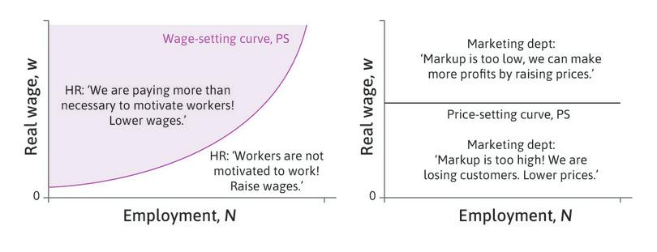
Points outside the curve are not Nash-equilibrium

Slide 77
Involuntary unemployment
Unemployment can exist in Nash equilibrium in the labour market
In fact, there will always be unemployment in labour market equilibrium, i.e. equilibrium unemployment
Reasoning:
  No unemployment → zero cost of job loss → no effort
  Therefore some unemployment is necessary to motivate workers!
  These are the involuntarily unemployed
Unemployment = excess supply in the labour market

Slide 78
Applications

Slide 79
Unemployment and aggregate demand
The firm’s demand for labour depends on the demand for their goods and services (derived demand for labour)
Aggregate demand = sum of the demand for all of the goods and services produced in the economy
The increase in unemployment caused by the fall in aggregate demand is called demand-deficient unemployment

Slide 80
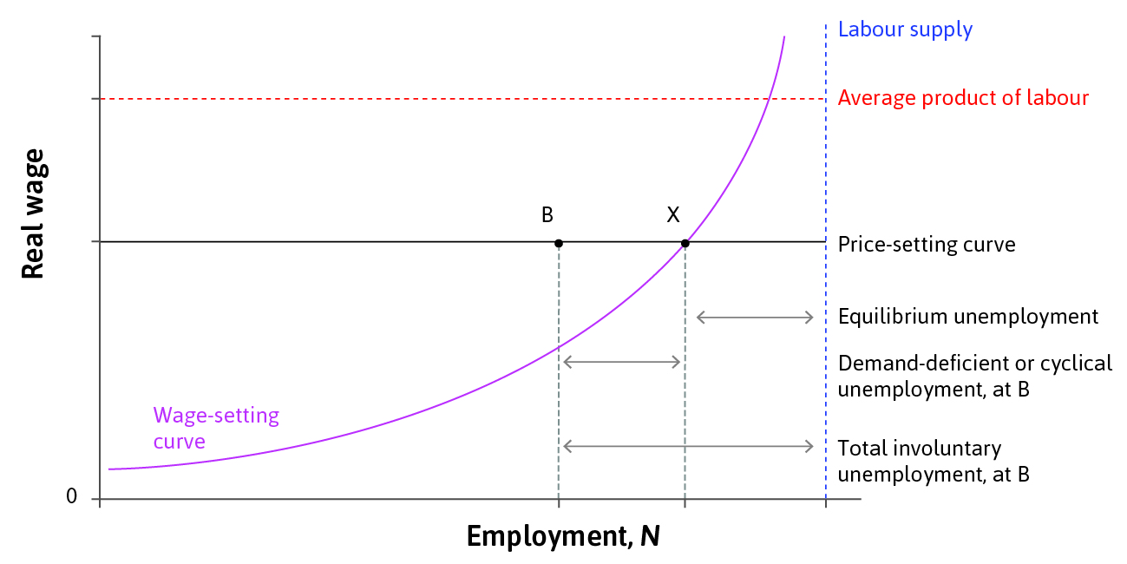
Demand deficient unemployment
Low aggregate demand moves the economy from labour market equilibrium (X) to point B
B is not a Nash equilibrium

Slide 81
Automatic adjustment
Point B is not a Nash equilibrium:
  Firms could lower wages without lowering workers’ effort
  Lower wages allow them to cut their prices
  Lower prices stimulate demand → output rises
  Firms hire more workers to produce more
  … unemployment falls back to X

Slide 82
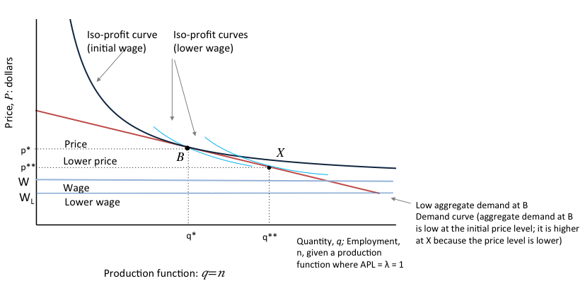
Automatic adjustment

Slide 83
Automatic adjustment in practice
Real economies do not function so smoothly:
  Workers resist cuts to their nominal wage (lower morale, strikes)
  Lower wages means people spend less → aggregate demand falls further
  Falling prices across the economy may lead consumers to postpone their purchases in hope to get even better bargain later

Slide 84
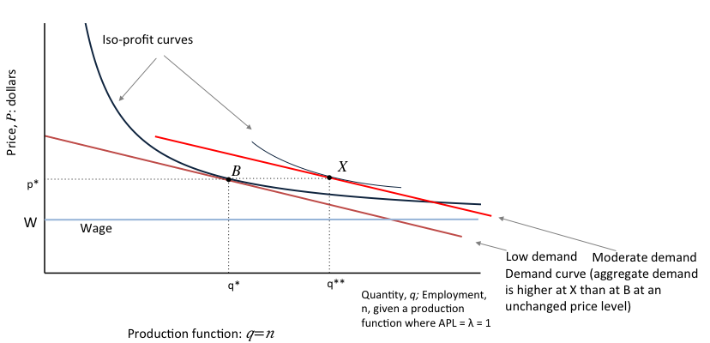
Role of government policy
The government could increase its own spending to expand aggregate demand through monetary or fiscal policy

Slide 85
Effect of immigration on wages and employment
Average product of labour
Price-setting curve
A
Labour force before immigration
Real wage
Wage-setting curve before immigration
Employed
Unemployed
0
Employment, N

Slide 86
Effect of immigration on wages and employment
Labour supply shifts to the right
An increase in labour supply shifts the wage-setting curve downward:
  Greater pool of unemployed
  Higher employment rents
  Lower cost of effort
Average product of labour
Labour force after immigration
Price-setting curve
A
Labour force before immigration
Real wage
Wage-setting curve before immigration
B
Wage-setting curve after immigration
Employed
Unemployed
0
Employment, N

Slide 87
Effect of immigration on wages and employment
Reduction in wage reduces marginal cost
If demand stays the same, firms hire more workers
Employment expands so that the economy is again at the intersection of the PS and the new WS curve
Average product of labour
Labour force after immigration
Price-setting curve
A
Labour force before immigration
C
Real wage
Wage-setting curve before immigration
B
Wage-setting curve after immigration
Employed
Unemployed
0
Employment, N

Slide 88
Other explanations for equilibrium unemployment
Search models
  It takes time and effort to find a new job
  Peter Diamond, Dale Mortensen and Christopher Pissarides were awarded the Nobel Prize for their work in 2010
Union models
  Unions set wages and may set higher in order to benefit some workers but lead to unemployment for others

Slide 89
Summary
Behaviour of firms sets wages and employment in an economy
  The wage-setting curve tracks the combinations of wages and unemployment feasible with workers’ effort
  The price-setting curve determines the real wage corresponding to profit-maximising price
There will always be involuntary unemployment
  Incomplete contracts
  Compare to the competitive model

Slide 90
Summary
We have devoted an entire unit to the labour market for two reasons:
  Its functioning is very important for how well the economy serves the interests of the population
  It is different enough from the way that many familiar markets work that it is essential to know these differences to understand how the economy works
  We will also be using this model when we think about unemployment and fiscal and monetary policy

Slide 91
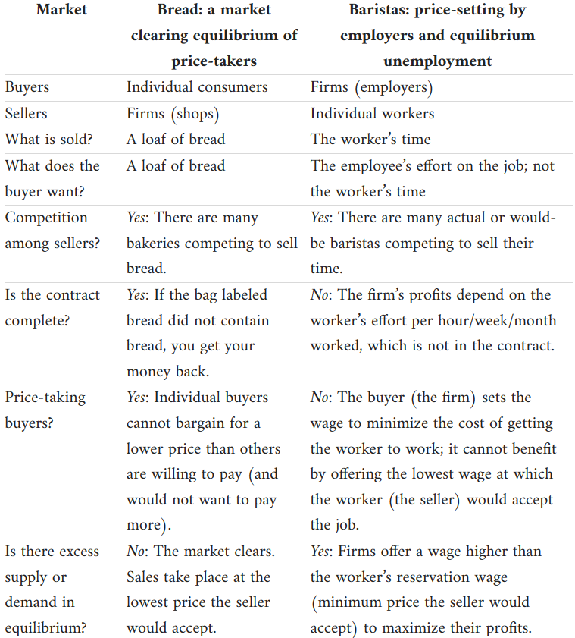
Differences between the labour market and competitive (goods) markets

Slide 92
Next lectures
Market failure: Sources and solutions
The role of private bargaining and government policy

