Slide 1
CHEM Toolkit
Open Access publishing and ACRIS
Lucie Hradecka
CHEM liaison @ Open Science and ACRIS team, Research Services
15.02.2023

Slide 2
Outline
ACRIS
Basic information
Your ACRIS profile
Exercise: Check your ACRIS profile!
Publications and other research outputs in ACRIS
Demo
Open Access publishing
What is Open Access (OA)
How to publish with OA
A few notes on responsible conduct of research and publishing
Aalto services for ACRIS and OA

Slide 3
ACRIS – Aalto Current Research Information System

Slide 4
Information in
Information out
PROFILES
Showcasing individual researchers
PUBLICATIONS and DATASETS
Track and manage
published
research
Portal: research.aalto.fi
Discovery services (Google)
Web Services: aalto.fi via interface (only publications)
National portal Research.fi
OpenAPC
CV’s
Research assessment
Reporting to Ministry of Education
Media and other public impact
Synchronized
HR (Workday)
Finance
Student Systems
Press/media service
Created in ACRIS
Research outputs
Activities
Datasets
Prizes
Infrastructures
.
ACRIS
RESEARCH
INFRA-
STRUCTURE
Track
resources
used
in research
ACTIVITIES
and
AWARDS
Scientific and
artistic
achievements
University’s research information system
PROJECTS
Track funded
research
REPORTS
Measure
research
performance

Slide 5
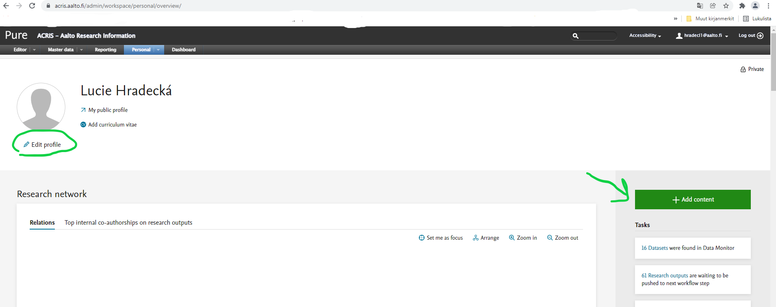
INTERNAL (BACKEND) acris.aalto.fi Log in with your Aalto username and password

Slide 6
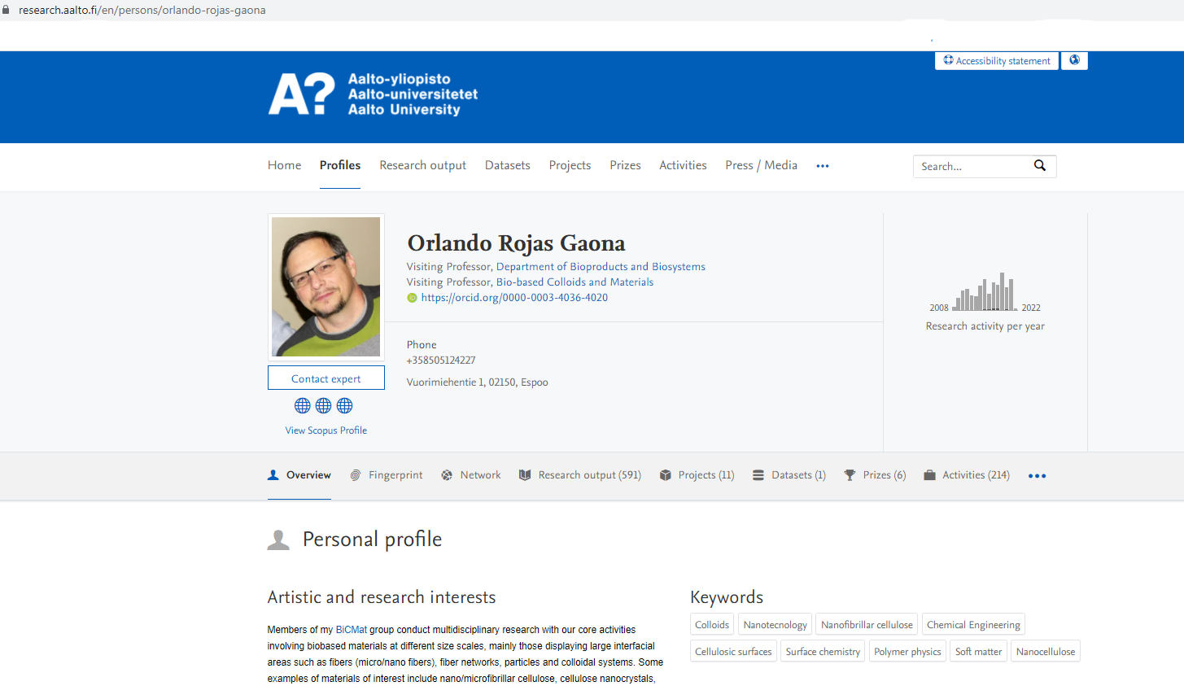
PUBLIC PORTAL research.aalto.fi

Slide 7
Getting started
Doctoral students should have an account automatically set up for them: the information is integrated from HR and student information system. Let’s check if you can access your profile:
If you are not on campus, connect to Aalto VPN (instructions here)
Go to https://acris.aalto.fi/
Sign in with your Aalto identifier and password
If you’re experiencing issues, despite using VPN, send us an e-mail: acris@aalto.fi

Slide 8
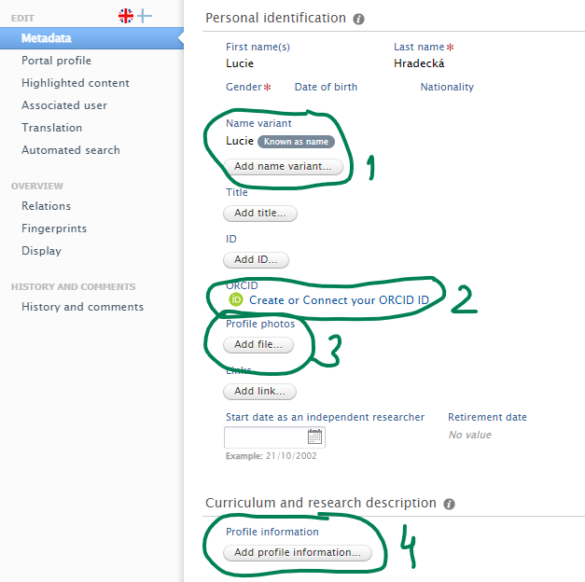
Things to check in your ACRIS profile
Your name: Do you use a different spelling/name format than what ACRIS gets from HR/Sisu? Edit your Known as name (1) – this will be displayed in the public portal.
Is your profile visibility set to public? (5)
Recommended to do later:
Get an ORCiD – especially if you have a name that is very common in your language (2)
Upload a profile picture (3)
Fill in your research interests and keywords (4)
Link to instructions
Notes:
If the name you use in publications and/or the name you want to displayed in the public portal is spelled differently than the version that comes from HR/Student system. You can edit your Known as name – this will be displayed in the public portal.

Slide 9
What is ORCID and why you might need it?
ORCID (Open Researcher and Contributor ID) is a unique persistent identifier that keeps your information even if your name or organization changes.
Distinguish yourself from other researchers and get credit for your own work.
Many publishers and research funders require researchers to have ORCID.
Global, non-for-profit organization and researcher ID that works across many platforms.
Link your ORCID to your ACRIS profile: publication metadata from ACRIS will be pushed to ORCID – no need to maintain another profile
More information: https://www.aalto.fi/en/services/researcher-identification-and-research-profiles

Slide 10
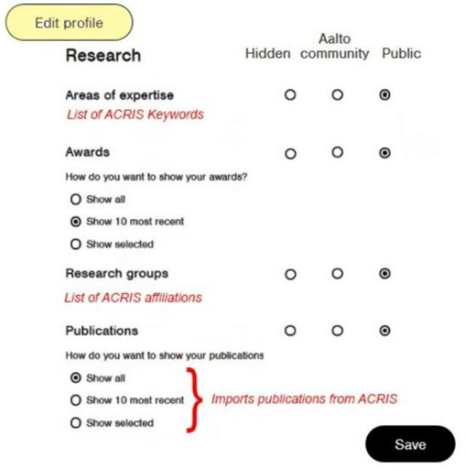
Things to check: ACRIS integrations
Workday (if you have employee status)
Aalto.fi → sign in → Tools – Workday – About me
Check your personal information (name, contact info) and your qualifications information (prior education)
If this info is wrong in Workday, it will be transferred wrong into ACRIS
Aalto.fi: enabling ACRIS integration
Log in to aalto.fi
Go to your profile → Edit profile
Set profile visibility to public
Set publication visibility to public

Slide 11
Publications in ACRIS

Slide 12
Adding your work to ACRIS
IMPORTING
The ACRIS team searches two main international databases (Scopus, Web of Science) for publications with Aalto affiliation
We search for media appearances and datasets for you as well
Some journals or conference publications are not included in international databases:
Check and add missing outputs yourself or email us at acris@aalto.fi
Please note that publications appear in databases with some delay – recent publications may be added a little later
ADDING MANUALLY
Log into ACRIS and click the button on the front page
Research outputs / Datasets
Activities (e.g. talk or poster presentation at a conference, organizing a conference,…)
Prizes

Slide 13
ACRIS process
ACRIS input
ACRIS validation
Validators check your entry, add information, ask questions (Note: activities are not validated)
research.aalto.fi
Once validated the output becomes visible in the public portal
Beyond Aalto
The information travels to national depositories (research.fi, OpenAire for EU projects)
Content added by yourself or the ACRIS team

Slide 14
DEMO
Publication and activity types
Relations

Slide 15
Open Access publishing

Slide 16
What is Open Access?
Subscription-based academic publishing model: reader has to subscribe to have access to article
Open Access (OA): reader can access articles without a fee
Fees are usually transferred to the author: Article Processing Charge (APC) before publication
Open is not just about fees, but also determining the conditions of reuse with an Open Access license
Creative Commons (CC) licenses: e.g. CC-BY (attribution), CC-BY-NC-ND (non-commercial, no derivatives)
Plan S: an initiative of research funders, trying to create change towards more OA publishing – OA requirements in publicly funded projects (Academy of Finland, Horizon Europe…)
More information here: Funders’ Open Access requirements

Slide 17
Why publish Open Access?
1. Comply with:
Aalto University Open Science and Research Policy
→ “Aalto University aims to publish all publication types according to
open access principles”
Your funder
Plan S applies to AoF and Horizon Europe projects in funding calls 2021 →
Always check and discuss with your PI/supervising professor
2. Boost and increase impact:
Most studies show that open research is used and cited more than non-OA research [1]
Collaboration with stakeholders and benefit for the society
85.7 % of CHEM peer-reviewed scientific articles from 2022 are available with some form of open access
Source: Aalto Key Information PowerBI

Slide 18
Types of Open Access
Gold OA:
Publish in fully OA journal
Hybrid OA:
Publish OA in subscription-based journal
Green OA:
Self-archiving the final accepted manuscript of your article
Immediate OA
Open licenses (Creative Commons)
Article Processing Charges (APC) may apply
Aalto’s agreements with publishers may cover the APC fees
Plan S :
Immediate OA
Open licenses (Creative Commons)
Article Processing Charges (APC) apply
Aalto’s agreements with publishers may cover the APC fees
Plan S: only “transformative” agreements/journals are supported
Embargos may apply
CC licenses usually not allowed by publisher
Free-of-charge
The final accepted manuscript (FAM) of your article parallel published through ACRIS
Plan S : only if no embargos and if CC licenses allowed

Slide 19
Open Access and the publishing process
Submit to publisher
Agree with co-authors and
submit also to a pre-print server, e.g., ChemRxiv
Use your Aalto e-mail to benefit from
the transformative agreements
Peer-review
Submitted version
Preprint
Edit
Revise
If you were not able to use Aalto’s agreements, keep the accepted manuscript for self-archiving
Accepted by the publisher
Send the final accepted manuscript (FAM) to
manuscripts@aalto.fi
Final accepted manuscript (FAM)
Postprint
Copyediting
Typesetting
If the published version is open access
(with CC-license), this version will be included
in your electronic thesis. If not, the FAM version
is included in the electronic thesis.
Published
Published version
Version of record

Slide 20
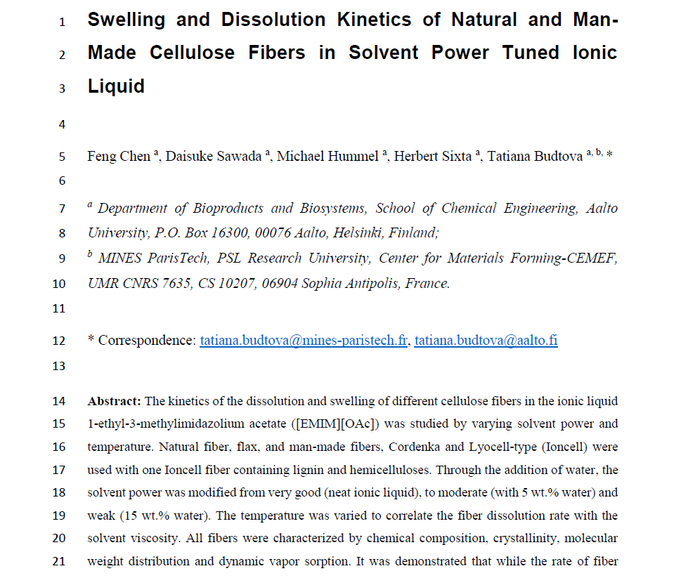
Final (author’s) accepted manuscript
Can be self-archived to ACRIS if published article is not OA
Publisher requires that we wait 12 months since publication before we open the file = embargo
OSA team makes sure we comply with the embargo periods
Link to article in ACRIS

Slide 21
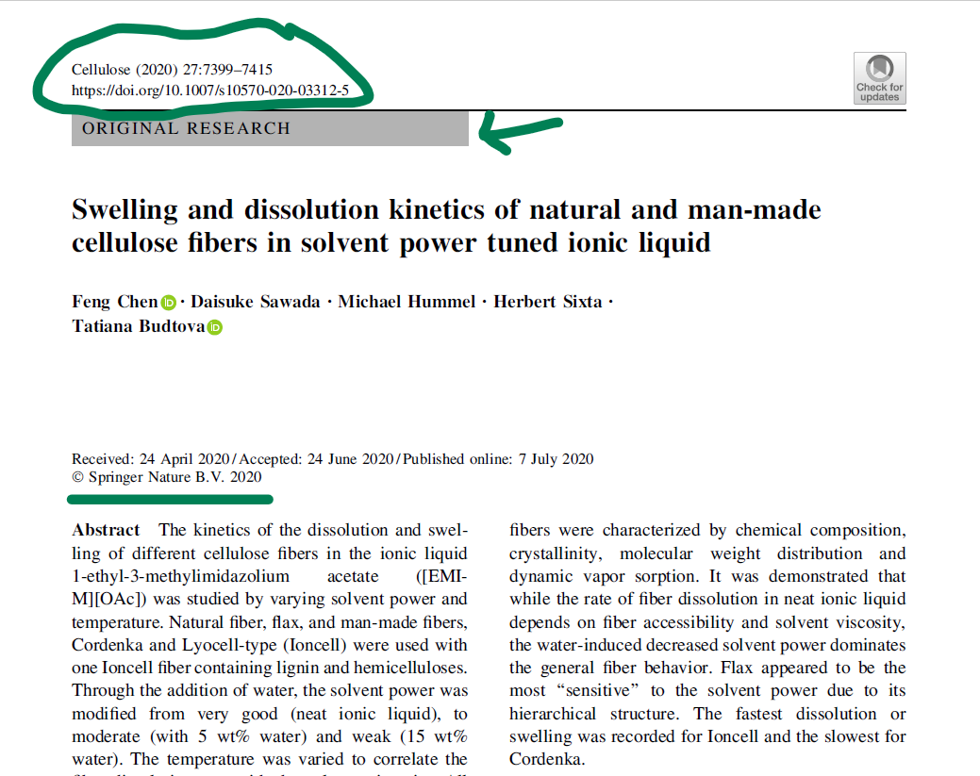
Bibliographic information of the publication
Version of Record: final published article from the journal
NOT OPEN ACCESS
We can only access it within Aalto network because we have a subscription
X WE ARE NOT ALLOWED TO UPLOAD IT TO ACRIS
Journal layout
Publisher copyright

Slide 22
Open Access Quick Guide
Gold & Hybrid
Green
= OA to the final published article in a journal
See if the article processing charge (APC) can be covered or discounted via Aalto university’s agreements with publishers
Publishers require some conditions are met:
The corresponding author communicating with the journal in the submission process must be affiliated with Aalto University
You must use your @aalto.fi email address when submitting
= OA to the accepted manuscript via ‘self-archiving’ in a repository (ACRIS)
Keep the manuscript version that was accepted after peer-review
Send this final accepted manuscript (peer reviewed, but still the author’s version – no journal logo, layout etc.) to manuscripts@aalto.fi
Open Science and ACRIS team will archive it for you, check the publisher’s policy for you and set embargo periods if necessary

Slide 23
Responsible conduct of research and academic publishing
Open access to publications is just one part of Open Science: the way of conducting research that aims for transparency and reproducibility
Can include open data, research protocols, methods, software
When you have time, read Aalto’s policy and recommendations
Agreeing about authorship: part of responsible conduct of research
Finnish national board on research integrity TENK guide
“From the point of view of research integrity, author refers to someone who has made such a substantial contribution to the creation of a scientific article or similar publication that they should be included in the list of authors and contributors.”
Agreeing before publication what contribution is significant enough to be on authors list, or to be mentioned in Acknowledgements
The CRediT taxonomy shows the different types of author contribution
Article dissertation: discuss authorship principles with supervisor

Slide 24
Open Access and ACRIS services @ Aalto

Slide 25
Aalto’s support for ACRIS and Open Access
Helpdesk: acris@aalto.fi
Contact us if you have any questions or issues in ACRIS or with Open Access publishing
Let us know if you need help adding missing publications or datasets
Manuscript green OA service: manuscripts@aalto.fi
Contact person for CHEM: lucie.hradecka@aalto.fi (FIN, ENG)
Open access, open science, ACRIS tutorials, funders’ requirements, research integrity issues
Instructions for Open Access and ACRIS:
Links

Slide 26
Instruction links
Open Access:
Open Access agreements with publishers
How to choose a scientific publication for your research?
Open content licenses – Creative Commons
Open Access terminology
ACRIS:
ACRIS instructions (main page)
Checking and editing your ACRIS profile
ACRIS instruction index

Slide 27
Thank you for your attention!

