Slide 1
CHEM-L1000 - Toolkit for Doctoral Studies, final lecture

Slide 2
Research Ethics
Feedback?

Slide 4
Code of Conduct
Do the web-course! – Go to MyCourses :Aalto University Code of Conduct e-learning for employees
https://www.aalto.fi/aalto-university/code-of-conduct

Slide 5
Ethical channel
Aalto University and its subsidiaries have an ethical channel where staff, students and other members of the university community as well as stakeholders may report any misconduct they perceive.
https://www.aalto.fi/en/aalto-university/ethical-channel

Slide 6
TENK

Slide 7
http://www.tenk.fi/en/resposible-conduct-research-guidelines

Slide 8
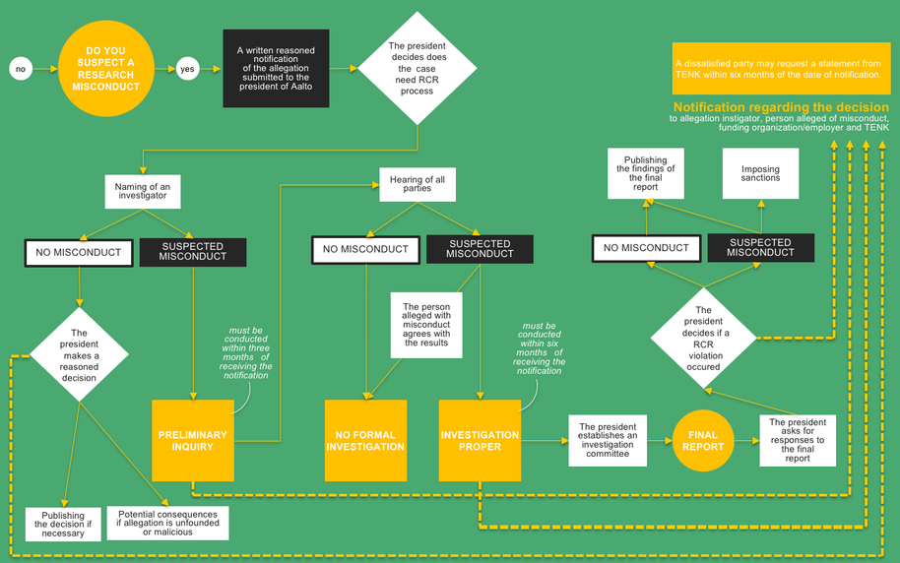
https://www.aalto.fi/en/service-entities/research-ethics-and-integrity-handling-of-misconduct-at-aalto-university

Slide 9
Authorship
https://tenk.fi/sites/tenk.fi/files/TENK_suositus_tekijyys.pdf

