Slide 1
Investing
Investing Case-example
Accounting and profitability
Projects
Production as a part of value chain
Production processes and production control
Production systems and
organizations
Creating value

Slide 2
Investment in production system: BMW Mexico
Kuva: https://eu.usatoday.com/story/money/cars/2016/06/17/bmw-moves-forward-new-plant-mexico/86010572/

Slide 3
In this exercise:
Return on investment
Initial investment and cost of capital
Net present value (NPV)

Slide 4
In this exercise:
Return on investment
Initial investment and cost of capital
Net present value (NPV)

Slide 5
Evaluation of return on investment
The profitability of an investment can be assessed by its investment costs, cash flow from
the investment and cost of capital
Common methods used to assess the profitability of an investment are:
Net present value (NPV)
Internal rate of interest (IRR)
Payback period

Slide 6
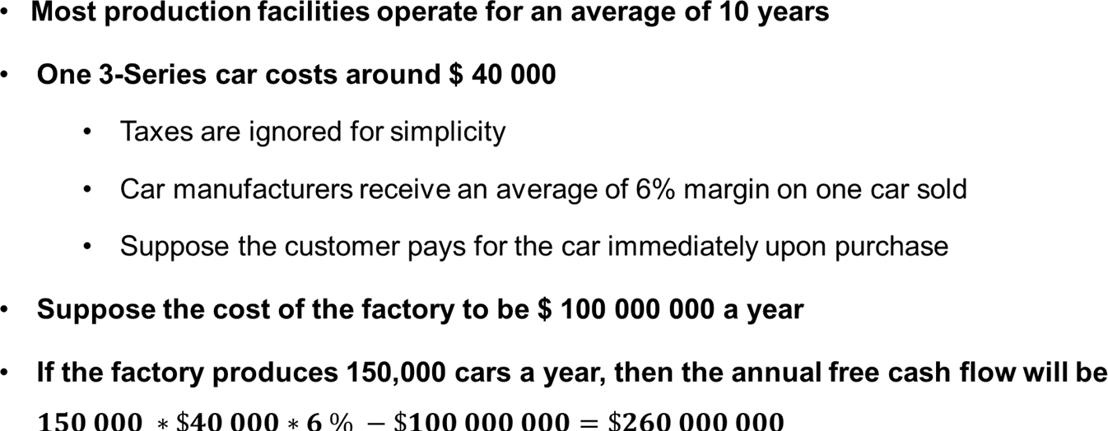
Initial investment and cash flow
Statistics Canada (2007). Manufaturing plants have short lives. [Viitattu 6.8.2019]. Saatavissa: https://www150.statcan.gc.ca/n1/pub/11-402- x/2007/4005/grafx/htm/ceb4005_002_5-eng.htm

Slide 7
Cost of capital
The average capital cost of investment in the automotive industry is about 7.6%
Weighted Average Cost of Capital, WACC
Money is more valuable today than in the future
Capital has a 'cost'
If money is available right away, it can make a profit
The present value of future cash flows is obtained by discounting
KPMG (2017). Cost of Capital Study 2017. [Viitattu 6.8.2019]. Saatavissa: https://assets.kpmg/content/dam/kpmg/ch/pdf/cost-of-capital-study-2017-en.pdf

Slide 8
In this exercise:
Return on investment
Initial investment and cost of capital
Net present value (NPV)

Slide 9
Net present value (NPV)

Slide 10
NPV
NPV is the sum of discounted cash flows
The table below lists free cash flows and their discounted values
Year 0 includes only the initial investment
NPV is approximately $ 721.7 million
NPV gets a positive value
That is, along with the NPV rule, the investment is profitable

Slide 11
Week 9 assignment:
Project plan and return on investment
Evaluating Return on Investment (Excel file)
Estimate your initial investment in euros
-Initial investment includes equipment, facilities and other procurements to start a business
Estimate your company's free cash flow for years 0–4
Year 0 includes only the initial investment In years 1-4, business is conducted normally
Calculate the net present value of your investment using 10% average cost of capital (WACC = 10%)
Is the investment profitable?

Slide 12
Week 9 assignment:
Project plan and return on investment
Return Excel-file to myCourses. The deadline for the assignment is on
Sunday November 6th by 18:00.
Remember to give feedback:
How long did it take to do the assignment?
What new did you learn?
What should be developed in this exercise?
General comments on the course so far?

