Slide 1
Principles of Economics II Lectures 3-4: Markets, efficiency and public policy
Fall 2022
Kristiina Huttunen

Slide 2
Context
In Principles I, you looked at behaviour of buyers and sellers under different market conditions, and conditions under which the competitive equilibrium is Pareto efficient
Sometimes markets may allocate resources in a Pareto-inefficient way (market failure)
What are the sources of these inefficiencies?
How can governments solve the problem?

Slide 3
Outline
External effects
Public goods
Asymmetric information

Slide 4
Do I have too few or too many socks?

Slide 5
Do I have too few or too many socks?
Answer: I have exactly the right amount of socks!
How do I know?
Because I alone get the benefits and I alone bear the costs
There is no reason to think that anybody would know better

Slide 6
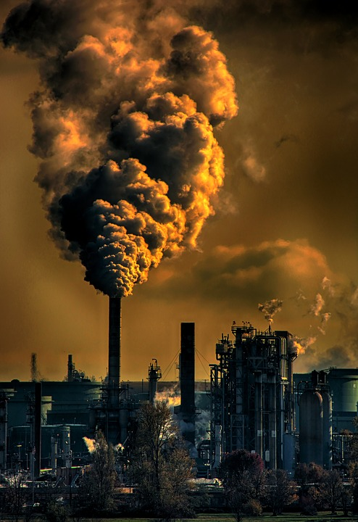
Do we have too little or too much pollution?

Slide 7
Do we have too little or too much pollution?
Answer: we can be pretty sure that we have too much pollution
How do we know?
Because a polluter does not bear the full costs of his/her activity
Some costs spillover to others
Pollution externality or spillover

Slide 8
A. External effects

Slide 9
Other examples of market failure
Pesticides in the Caribbean (textbook example)
Banana plantation owners used harmful pesticides to reduce costs and increase their profits
The chemicals leaked into rivers and contaminated the local seafood (residents fall ill)
Overuse of antibiotics
People overuse antibiotics when other treatments would be better, which creates bacteria-resistant pathogens

Slide 10
External effect (externality, spillover)
External effect = an effect of an economic decision that is not specified as a benefit or liability in the contract
Can be negative (pollution, congestion) or positive (vaccines)
Also called spillovers, externalities
Leads to Pareto-inefficiency
Negative externality: the social cost of the activity is higher than the private cost
Positive externality: the social benefit of the activity is higher than the private benefit

Slide 11
Incentives
If we want to know whether we have too much or too little of some activity, we need to look at the incentives faced by the relevant decision-makers
Ask:
Do they bear all the costs of their activity or do some costs spillover to others?
Do they get all the benefits of their activity or do some benefits spillover to others?
If not, there is an externality problem

Slide 12
Negative externality
Marginal private cost (MPC) = marginal cost to decision-maker (plantation owners)
marginal private cost

Slide 13
Negative externality
Marginal private cost (MPC) = marginal cost to decision-maker (plantation owners)
Marginal external cost (MEC) = costs imposed by decision-maker on society (fishermen)
= costs imposed on fishermen by plantations using pesticide
marginal private cost
marginal external cost

Slide 14
Negative externality
Marginal private cost (MPC) = marginal cost to decision-maker (plantation owners)
Marginal external cost (MEC) = costs imposed by decision-maker on society (fishermen)
Marginal social cost (MSC) = MPC + MEC (full cost to society)
= costs imposed on fishermen by plantations using pesticide
marginal social cost
marginal private cost
marginal external cost

Slide 15
Negative externality
Plantation owners maximize profits in competitive markets and produce where
price = marginal private cost (A)
= costs imposed on fishermen by plantations using pesticide
marginal social cost
price
A
marginal private cost

Slide 16
Negative externality
Plantation owners maximize profits in competitive markets and produce where
price = marginal private cost (A)
But this is not Pareto-efficient
= costs imposed on fishermen by plantations using pesticide
marginal social cost
price
A
marginal private cost

Slide 17
Negative externality
Plantation owners maximize profits in competitive markets and produce where
price = marginal private cost (A)
But this is not Pareto-efficient
To see why, imagine that the fishermen could persuade the plantation owners to produce one tonne less
The fishermen would gain $270, but plantations would lose hardly anything
= costs imposed on fishermen by plantations using pesticide
marginal social cost
$270
price
A
marginal private cost

Slide 18
Negative externality
Moving from 79,999 to 79,998 would also benefit both groups
Using this argumentation, we can see that the point where price is equal to marginal social cost is Pareto-efficient
At this point, production is 38,000 tonnes and beyond this point it is not possible to make both plantations and fishermen better off
= costs imposed on fishermen by plantations using pesticide
marginal social cost
price
A
marginal private cost
Pareto-efficient
output

Slide 19
Negative externality
Moving from 79,999 to 79,998 would also benefit both groups
Using this argumentation, we can see that the point where price is equal to marginal social cost is Pareto-efficient
At this point, production is 38,000 tonnes and beyond this point it is not possible to make both plantations and fishermen better off
= costs imposed on fishermen by plantations using pesticide
marginal social cost
price
A
marginal private cost
Pareto-efficient
output

Slide 20
Solution #1: Bargaining
Pareto improvement is possible: what are the different ways of achieving it?
We already saw that fishermen could pay the plantation owners to produce less, and both would be better off
This insight suggests a remedy that could be implemented in the real world
Coasean Bargaining:
Legally assign property rights to the externality (e.g. the right to pollute, the right to clean water)
Private bargaining between parties involved will result in a Pareto-efficient allocation regardless of which party has the property rights

Slide 21
Bargaining solution
Pesticide use is legal
Plantation owners maximize profits in competitive markets so that price = marginal private cost
= surplus to plantation owners
marginal social cost
price
marginal private cost
Optimal output by plantations

Slide 22
Bargaining solution
Pesticide use is legal
Plantation owners maximize profits in competitive markets so that price = marginal private cost
But the Pareto-efficient output would occur when price = marginal social cost
Plantation owners produce more than the Pareto-efficient amount because they do not consider the harm to fishermen from the pesticide use
= costs imposed on fishermen by plantations using pesticide
marginal social cost
price
marginal private cost
Optimal output by plantations
Pareto-efficient
output

Slide 23
Bargaining solution
What would happen if we move to the Pareto-optimum?
Fishermen would gain
= fishermen’s gain (that is, the reduction in fishermen’s costs)
marginal social cost
price
marginal private cost
Optimal output by plantations
Pareto-efficient
output

Slide 24
Bargaining solution
What would happen if we move to the Pareto-optimum?
Fishermen would gain
Plantation owners would lose
plantation owners’ loss
marginal social cost
price
marginal private cost
Optimal output by plantations
Pareto-efficient
output

Slide 25
Bargaining solution
What would happen if we move to the Pareto-optimum?
Fishermen would gain
Plantation owners would lose
But less than the fishermen would gain!
There is a net social gain that parties could share by reducing production, because the fall in plantations’ profit is smaller than the gain for the fishermen
marginal social cost
social net gain
price
marginal private cost
Optimal output by plantations
Pareto-efficient
output

Slide 26
Bargaining solution
Plantation owners’ minimum acceptable offer (minimum compensation) = lost profits
Equally well-off producing 80,000 and producing 38,000 + receiving the minimum compensation
Fishermen’s reservation option (maximum compensation) = the sum of yellow and green areas
Actual compensation depends on relative bargaining power
marginal social cost
social net gain
price
loss of profit
marginal private cost
Optimal output by plantations
Pareto-efficient
output

Slide 27
Practical limits of bargaining – transaction costs
Impediments to collective action – finding a representative and agreeing on how to split the gains within each party
Missing information – calculating the exact costs imposed on each fisherman and each plantation’s contribution to pollution
Enforcement – it may be difficult for a court to determine whether plantations have complied or not
Limited funds – fishermen may not have enough money to pay plantations the compensation required

Slide 28
Solution #2: Government policies
Regulation of production: cap at socially optimal amount
Pigouvian tax/subsidy: tax/subsidy on firms generating negative/positive external effects
Enforcing compensation for affected parties

Slide 29
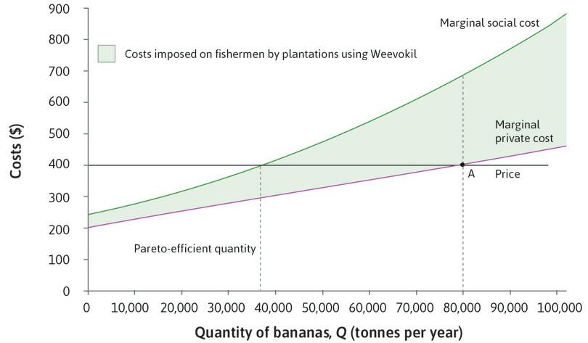
Example: pollution tax

Slide 30
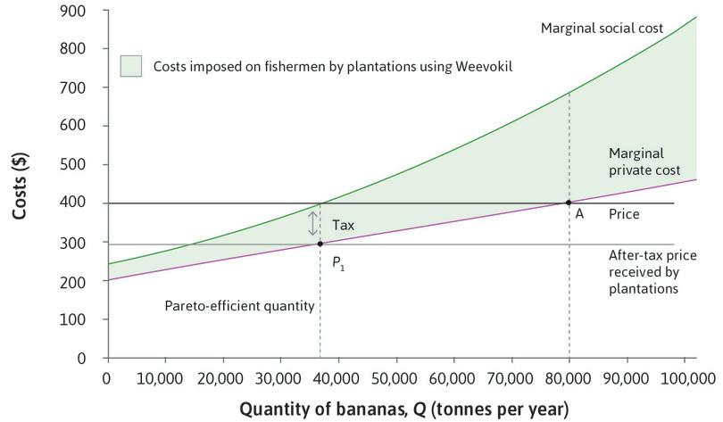
Example: pollution tax
Government puts a per-unit tax on output, equal to the MEC
Profit-maximising producer chooses output where MPC = after-tax price, which is the socially optimal output
The tax forces producers to face the full cost of their decisions

Slide 31
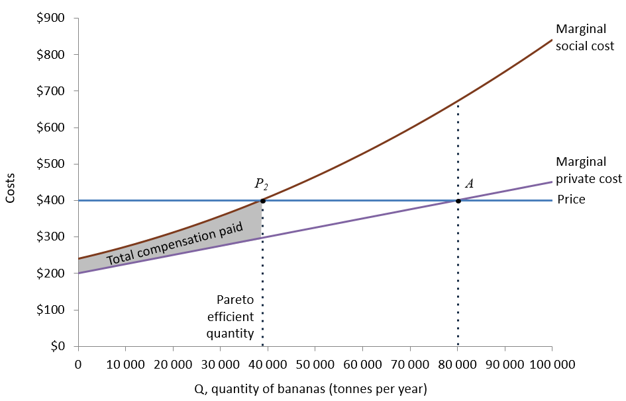
Example: compensation
Government requires plantation owners to pay fishermen compensation for each tonne produced
Required compensation is equal to the difference between the MSC and the MPC (grey area)
Marginal cost
=MPC+ compensation=MSC
Profit are maximized at point P2

Slide 32
Practical limits of policies
Similar limitations to those for private bargaining:
Missing information – government may not know the exact compensation needed to correct the problem
Measurement – Marginal social costs are difficult to measure
Lobbying – The government may favour the more powerful group, in which case it could impose a Pareto-efficient outcome that is unfair

Slide 33
B. Public goods

Slide 34
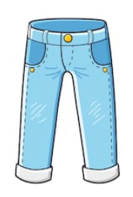
Private goods
Rivalry:
Consumption by one individual prevents others from consuming the same good
If I’m wearing my jeans, no one else can wear them (food, housing, phones etc.)
Excludability:
It is possible (and desirable) to exclude other users
There are well-defined property rights

Slide 35
Public goods Example: Asteroid protection

Slide 36
Example: Asteroid protection
Source: MRUniversity: https://mru.org/courses/principles-economics-microeconomics/public-goods-example-asteroid-defense

Slide 37
Example: Asteroid protection
Unlike jeans, asteroid protection is not excludable
If there is a system in place, you benefit regardless of whether you paid for it or not
You cannot be excluded from enjoying the benefits
In addition, your payment to the privately produced protection system will not decide whether there is such a system
Only two cases to consider
Either enough other people pay and there is a system
Or not enough other people pay and there is no system
You get jeans, only if you pay for them. But the protection system does not depend on your contribution at all!

Slide 38
Example: Asteroid protection
Everyone has an incentive to freeride or take advantage of the fact that other people are paying for the deflection system
This is why producing jeans can be profitable for a private firm, but producing an asteroid protection system cannot
The system will not be produced in free markets => market failure

Slide 39
Public goods
Public goods are
Non-rival goods: it does not cost more to make it available for additional people (once it is available)
Non-excludable goods: others cannot be excluded from goods’ use (the free rider problem)
Note on terminology:
The public sector produces a lot of different goods (health care, housing etc.), but only some are actual public goods
These are not public goods even though they are provided by the public sector
These are publicly provided private goods!

Slide 40
Private and public goods
 | Rival | Non-rival
Excludable | Private goods (food, clothes, housing) | Club goods (subscription TV, WiFi, knowledge subject to intellectual property rights)
Non-excludable | Common-pool resources (fish stocks, common grazing land, public roads) | Public goods (national defence, public broadcasts, rules of calculus)

Slide 41
C. Asymmetric information

Slide 42
Asymmetric information
When information is asymmetric, one party knows something relevant to the transaction, but the other party does not
Two forms of asymmetric information:
Hidden action – leads to a moral hazard problem
Example – Involuntary unemployment because employers cannot observe employees’ exact work effort (Unit 6)
Hidden attributes – leads to an adverse selection problem
Example – Buyers of second-hand cars do not know all the attributes of the car e.g. quality, but the sellers do

Slide 43
Market for lemons (Akerlof 1970)
Buyers valuation
€4,500
€0
€9,000

Slide 44
Market for lemons (Akerlof 1970)
Buyers valuation
€4,500
€0
€9,000
Exit the market
€0
€9,000

Slide 45
Market for lemons (Akerlof 1970)
Buyers valuation
€4,500
€0
€9,000
Exit the market
Buyers valuation
€0
€9,000

Slide 46
Example #1: Health insurance
Insurance company cannot observe the health of the people buying insurance
Buyers know their health status and the less healthy are more likely to buy
To be profitable, the company must charge prices high enough and only the less healthy people are willing to buy
This adverse selection means that most people buying insurance already know they have a health problem
There is a missing market: many (healthier) people who would like to buy insurance will remain uninsured

Slide 47
Example #2: Car insurance
Any form of insurance also has a hidden action problem – the buyer may take more risks now that he/she is insured
Example – purchasing full coverage against damage may make someone more careless in driving
Insurance companies can put some limits in a contract, but cannot enforce other types of behaviour e.g. driving speed
This moral hazard problem is another principal-agent problem, and we can also think of it in terms of external effects (being careful gives external benefits to the company)

Slide 48
Example #3: The banking system
Borrowing and lending is another principal-agent problem in which the borrower’s decisions have external effects on the lender
The lender is reluctant to make loans unless the borrower can be given an incentive not to take undue risk (investing own funds)
For this reason, poor borrowers are often credit-constrained or credit-excluded, which is a form of credit market failure (Unit 10)
Another form of credit market failure is the banks themselves:
If they take risks and go bankrupt, other banks (whom they have borrowed from) will bear some of the costs

Slide 49
Decision | How it affects others | Cost or benefit | Market failure (misallocation of resources) | Possible remedies | Terms applied to this type of market failure
A firm uses a pesticide that runs off into waterways | Downstream damage | Private benefit, external cost | Overuse of pesticide and overproduction of the crop for which it is used | Taxes, quotas, bans, bargaining, common ownership of all affected assets | Negative external benefit, environmental spillover
You take an international flight | Increase in global carbon emissions | Private benefit, external cost | Overuse of air travel | Taxes, quotas | Public bad, negative external effect
You travel to work by car | Congestion for other road users | Private cost, external cost | Overuse of cars | Tolls, quotas, subsidised public transport | Common pool resource, negative external effect
A firm invests in R&D | Other firms can exploit the innovation | Private cost, external benefit | Too little R&D | Publicly funded research, subsidies for R&D, patents | Public good, positive external effect
An employee on a fixed wage decides how hard to work | Hard work raises employer’s profits | Private cost, external benefit | Too little effort; wage above reservation wage; unemployment | More effective monitoring, performance related pay, reduced conflict of interest between employer and employee | Incomplete labour contract, hidden action, moral hazard
Someone who knows he has a serious health problem buys insurance | Loss for insurance company | Private benefit, external cost | Too little insurance offered; insurance premiums too high | Mandatory purchase of health insurance, public provision, mandatory health information sharing | Missing markets, adverse selection
Someone who has purchased car insurance decides how carefully to drive | Prudent driving contributes to insurance company’s profits | Private cost, external benefit | Too little insurance offered; insurance premiums too high | Installing driver monitoring devices | Missing markets, moral hazard

Slide 50
D. Limits to markets

Slide 51
Should markets allocate everything?
Arguments against using markets for everything:
Repugnant markets: creating a market for certain goods/services would violate ethical/social norms e.g. slavery, kidneys
However, see: https://www.youtube.com/watch?v=r7vzgexzXOk
Other institutions may be more effective e.g. governments, families
Market mechanisms may crowd out norms of social preferences
Merit goods: goods that should be available to everyone, independently of their ability to pay e.g. education

Slide 52
Summary
Sources of market failure
External costs or benefits
Public goods, common pool resources
Asymmetric information (hidden action/hidden attributes)
Possible solutions
Regulation, taxation, compensation, public provision, antitrust policy
Limits to markets – not every good should have a market

