Slide 1
Course Assignment: Marine and Ship Systems engineering 2022
Assignment 3 - Select the propulsion system
V. Bolbot

Slide 2
Assignments schedule
Assignment | Description | Submission deadline | Feedback
1 | 31/10/2022 | 14/11/2022 | 21/11/2022
2 | 14/11/2022 | 28/11/2022 | 7/12/2022
3 | 28/11/2022 | 16/01/2023 | 23/01/2023
4 | 16/01/2023 | 30/01/2023 | 06/02/2023
Conference abstract | 28/11/2022 | 30/01/2023 | 06/02/2023
Conference paper | 28/11/2022 | 08/02/2023 | 13/02/2023
Conference | 28/11/2022 | 20/02/2023 | 06/12/2023 & 13/02/2023 (prior and during conference)

Slide 3
Assignment aim
Select the propulsion system for your ship

Slide 4
What needs to be included in the assignment
Investigate the potential alternatives of main engines for your ship using relevant literature and manufacturers catalogues. You will need to check the applicable emission rules for your operational profile. (Tip keep an eye on assignment 1).
Preselect two possible alternatives for your ship and define the machinery setup. Justify your choices of the alternative and the setup (number of engines, size, redundancy, transmission, power output). Present a comparative analysis of the two selected options and justify the final selection.
According to the selected main engines identify the 2 possible alternatives for the propulsion system of your ship. Select one option and justify your choice. Refine the initial space reservation and weight estimation of the engines and propulsion system.​
Identify the required sub-systems for the selected engines and present a layout of the sub-systems (See Lecture 4 – Machinery auxiliary systems). Refine the initial space reservation and weight for the main engines and the sub-systems based on your selection.

Slide 5
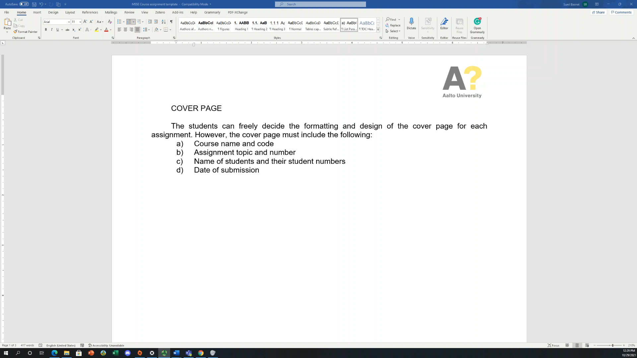
Format
​
Pls use the provided template
Some guidelines are available here at the link and the video
​
https://aalto.cloud.panopto.eu/Panopto/Pages/Viewer.aspx?id=3e17b4ae-5aa3-48d1-9d17-add0009c71a4

Slide 6
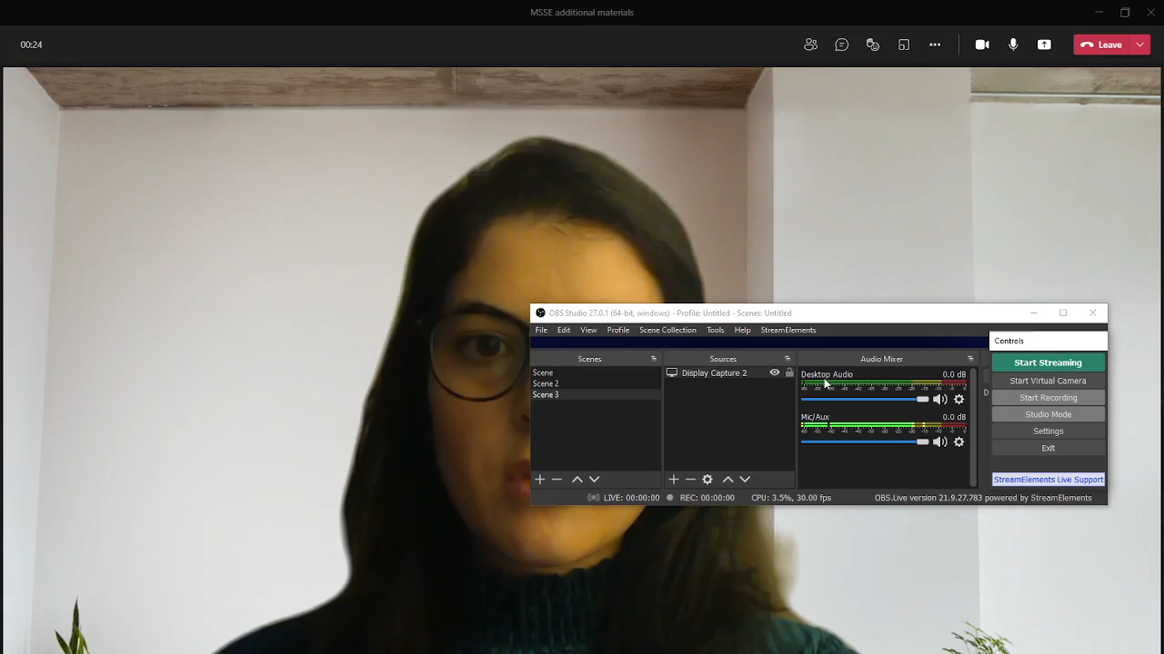
Looking for literature
​
​
Some guidelines are available here at the link and the video
​
https://aalto.cloud.panopto.eu/Panopto/Pages/Viewer.aspx?id=0ace5f99-e6a5-473c-8682-add000d48d4f

Slide 7
Criteria for the assessment
Content – 80%
  50% answers (results)
  10% introduction
  10% methodology
  10% conclusions
Layout – 20%
  Figure caption below figure
  Table caption above table
​
​

Slide 8
Questions
You can ask your questions at the following emails: victor.bolbot@aalto.fi
osiris.valdez.banda@aalto.fi

