Slide 2
Conference aim
Gain experience with writing scientific publications
Receive feedback on their writing style
Enhance presentation skills
20% - conference paper
15% - presentation

Slide 3
Topics of the conference paper
Assignment 1 - Ship energy sources and their related systems identification
Assignment 2 - Select the HVAC and ballast water systems for your ship
Assignment 3 - Select the propulsion system
Assignment 4 - Estimate the total electricity consumption and select the power plant and PMS
One for each group
Topics are randomly assigned

Slide 4
What needs to be included in the conference paper (additionally to assignment)
Abstract
300 words max
Summarize the paper
Motivation, aim, methodology, main results
Ship description
The description of your ship, operational profile, description of the system (components and functions)
Introduction – different from you have used
Background to general shipping problems, motivation
5 references to similar publications (of your choice) – lit review subsection
Consider the novel aspects of your research in comparison to the 5 papers

Slide 5
What needs to be included in the conference paper (additionally to the assignment)
Methodology
Abstract thinking
A flowchart of your methodology – generic and independent from your case study
Step of your methodology and rationale
Subsection describing each step
Software tools
Results and discussion
The results section must follow the same structure with the methodology section;
Make critical comments on the results
Conclusions
Give main findings of the study with bullet points.

Slide 6
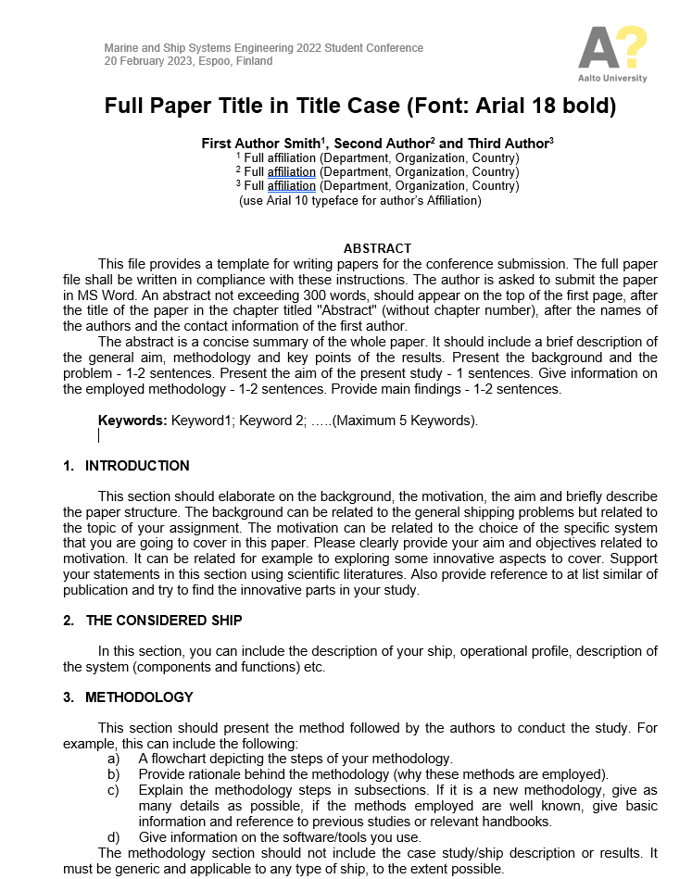
Format
​
Pls use the provided template
It is on mycourses
​

Slide 7
Looking for literature
​
​
Some guidelines are available here at the link and the video
​
https://aalto.cloud.panopto.eu/Panopto/Pages/Viewer.aspx?id=0ace5f99-e6a5-473c-8682-add000d48d4f

Slide 8
Conference – 20th February
Each group 20 mins + 5 mins for questions
Every person must speak (at least 5 mins)
Reflect the contents of the paper
Introduction
Aim and objectives
The ship description
Methodology
Results
Conclusions
QA
​

Slide 9
Criteria for the paper assessment
Content – 80%
10% Abstract
10% Introduction
10% The ship description
10% Methodology
30% Results
10% Conclusions
Layout – 20%
Figure caption below figure
Table caption above table
​
​

Slide 10
Criteria for the presentation assessment
​
Students and audience will rank
10% Introduction
10% Aim
10% The ship description
20% Methodology
20% Results
10% Conclusions
10% QA
10% Time keeping
​
​

Slide 11
Best paper and presentation award
There will be a present for the best paper
We want to see clear innovative aspects
​
​

Slide 12
Questions
You can ask your questions at the following emails: victor.bolbot@aalto.fi
osiris.valdez.banda@aalto.fi

