Slide 1
Course Assignment: Marine and Ship Systems engineering 2022 Assignment 4 - Estimate the total electricity consumption and select the power plant and PMS. V. Bolbot

Slide 2
Assignments schedule
Assignment | Description | Submission deadline | Feedback
1 | 31/10/2022 | 14/11/2022 | 21/11/2022
2 | 14/11/2022 | 28/11/2022 | 7/12/2022
3 | 28/11/2022 | 16/01/2023 | 23/01/2023
4 | 16/01/2023 | 30/01/2023 | 06/02/2023
Conference abstract | 28/11/2022 | 30/01/2023 | 06/02/2023
Conference paper | 28/11/2022 | 08/02/2023 | 13/02/2023
Conference | 28/11/2022 | 20/02/2023 | 06/12/2023 & 13/02/2023 (prior and during conference)

Slide 3
Assignment aim
Estimate the total electricity consumption and select the power plant and PMS

Slide 4
Assignment aim and particulars
1. Define the loading from the different ship systems according to the ship operational profile.
Harbor, maneuvering, sailing, DP , cable laying, etc.
Workshop equipment, engine room auxiliaries, HVAC, deck machinery, accommodation systems, bridge, lightning, etc.
Pay attention if you have Diesel Electric Propulsion system
2. Compute the total electricity consumption.
Modes (maneuvering, harbor, sailing, DP) – general is ok.
3. Identify and analyze the potential options for the power plant of your ship.
SWOT
Consider rules and regulations, loading of DG sets, redundancy and safety aspects
4. Calculate the weight of the system and the reserved space volume. Locate the space in the GA.
Engine manufacturers

Slide 5
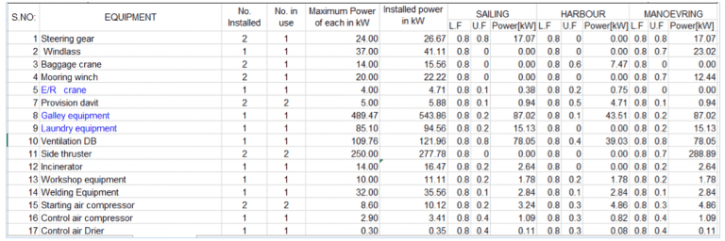
Assignment aim and particulars
/0.9
Power=Power Installed*LF*UF
https://www.marineinsight.com/naval-architecture/power-requirement-ship-estimated/
Load Factor (L.F): It is the ratio of the operating power to the maximum power rating of the component.
Utility Factor (U.F): It is a factor which determines the extent of operation of the particular component in a particular condition

Slide 6
Assignment aim and particulars
Sanity check Pe [kw]$=100+0.55∗{\left(MCR\left[kW\right]\right)}^{0.7},$
"Marine Diesel Power Plant Performance Practices", 1975
(Actual reference in a Greek book)
Pg=Pe/0.85 (Pg=Power at generators, 0.85 efficiency factor)

Slide 7
Assignment aim and particulars
5. Select an emergency power source and capacity for your ship. Reflect on the applicable safety regulation and/or classification rules.
Safe return to Port
SOLAS on redundancy
Emergency load analysis
6. Select the PMS automation for your ship and describe its important features.

Slide 8
Format
​
Pls use the provided template
Some guidelines are available here at the link and the video
​
https://aalto.cloud.panopto.eu/Panopto/Pages/Viewer.aspx?id=3e17b4ae-5aa3-48d1-9d17-add0009c71a4

Slide 9
Looking for literature
​
​
Some guidelines are available here at the link and the video
​
https://aalto.cloud.panopto.eu/Panopto/Pages/Viewer.aspx?id=0ace5f99-e6a5-473c-8682-add000d48d4f

Slide 10
Criteria for the assessment
Content – 80%
50% answers (results)
10% introduction
10% methodology
10% conclusions
Layout – 20%
Figure caption below figure
Table caption above table
​
​

Slide 11
Questions
You can ask your questions at the following emails: victor.bolbot@aalto.fi
osiris.valdez.banda@aalto.fi

