Slide 1
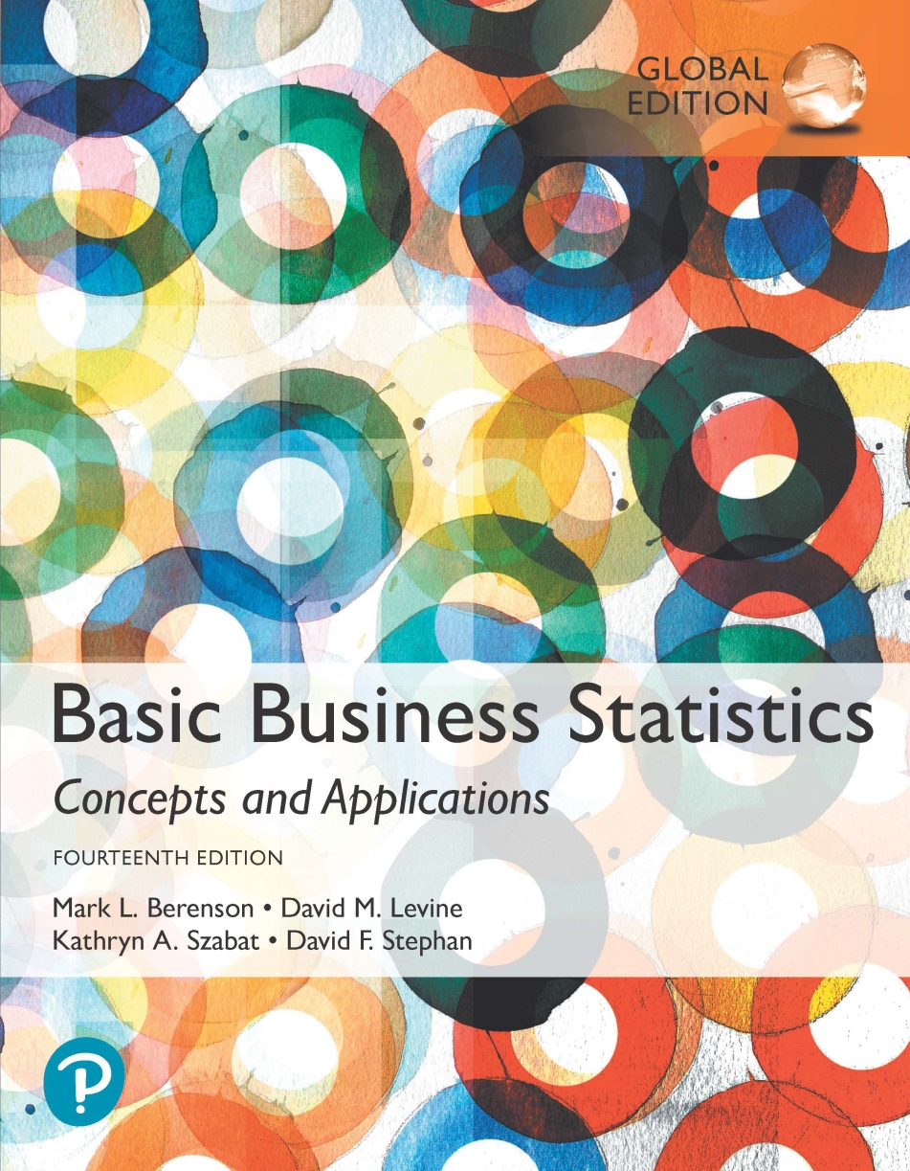
Chapter 5
Discrete Probability Distributions

Slide 2
Objectives
In this chapter, you learn:
The properties of a probability distribution.
How to compute the expected value and variance of a probability distribution.
How to compute probabilities from binomial and Poisson distributions.
How to use the binomial and Poisson distributions to solve business problems.

Slide 3
Additional Online Topics
Covariance of a Probability Distribution and Its Application in Finance: Section 5.4.
Hypergeometric Distribution: Section 5.5.
Using the Poisson Distribution to Approximate the Binomial Distribution: Section 5.6.

Slide 4
Definitions
Discrete variables produce outcomes that come from a counting process (e.g. number of classes you are taking).
Continuous variables produce outcomes that come from a measurement (e.g. your annual salary, or your weight).

Slide 5
Types Of Variables
Types Of
Variables
Ch. 5
Discrete
Variable
Continuous
Variable
Ch. 5
Ch. 5
Ch. 6
Ch. 6
Ch. 6

Slide 6
Discrete Variables
Can only assume a countable number of values.
  Examples:
  Roll a die twice
Let X be the number of times 4 occurs
(then X could be 0, 1, or 2 times).
  Toss a coin 5 times.
  Let X be the number of heads
  (then X = 0, 1, 2, 3, 4, or 5).

Slide 7
Probability Distribution For A Discrete Variable
A probability distribution for a discrete variable is a mutually exclusive list of all possible numerical outcomes for that variable and a probability of occurrence associated with each outcome.
Interruptions Per Day In Computer Network | Probability
0 | 0.35
1 | 0.25
2 | 0.20
3 | 0.10
4 | 0.05
5 | 0.05

Slide 8
Probability Distributions Are Often Represented Graphically
P(X)
0.4
0.3
0.2
0.1
0 1 2 3 4 5 X

Slide 9
Before we go to next slide: what is “expected value”?
Weighted average
EV=the sum of the odds of each possible outcome happening X the value of the outcome.
Ex: what’s the EV of the roll of a 6-sided die?
EV=(1/6)(1)+(1/6)(2)+..+(1/6)*(6)=3.5

Slide 10
Say I offer to give you 10 euros if you roll a 6, nothing otherwise. What is EV of your payout?
EV=(1/6)(0)+(1/6)(0)+(1/6)(0)+(1/6)(0)+(1/6)(0)+(1/6)(10)=1.66

Slide 11
Say you are a 40% free throw shooter and you get two free throws for one point each. What is the EV of points on two shots?
EV={(.4)(1)+(.6)(0)}+{(.4)(1)+(.6)(0)}= .8

Slide 12
Expected Value Of Discrete Variables, Measuring Center
Expected Value (or mean) of a discrete
variable (Weighted Average):
Interruptions Per Day In Computer Network (x_{i}) | Probability P(X = x_{i}) | x_{i}P(X = x_{i})
0 | 0.35 | (0)(0.35) = 0.00
1 | 0.25 | (1)(0.25) = 0.25
2 | 0.20 | (2)(0.20) = 0.40
3 | 0.10 | (3)(0.10) = 0.30
4 | 0.05 | (4)(0.05) = 0.20
5 | 0.05 | (5)(0.05) = 0.25
 | 1.00 | μ = E(X) = 1.40

Slide 13
Discrete Variables:
Measuring Dispersion
Variance of a discrete variable.
Standard Deviation of a discrete variable.
where:
E(X) = Expected value of the discrete variable X
x_{i} = the i^{th} outcome of X
P(X=x_{i}) = Probability of the i^{th} occurrence of X

Slide 14
Discrete Variables: Measuring Dispersion
(continued)
Interruptions Per Day In Computer Network (x_{i}) | Probability P(X = x_{i}) | [x_{i} – E(X)]² | [x_{i} – E(X)]²P(X = x_{i})
0 | 0.35 | (0 – 1.4)² = 1.96 | (1.96)(0.35) = 0.686
1 | 0.25 | (1 – 1.4)² = 0.16 | (0.16)(0.25) = 0.040
2 | 0.20 | (2 – 1.4)² = 0.36 | (0.36)(0.20) = 0.072
3 | 0.10 | (3 – 1.4)² = 2.56 | (2.56)(0.10) = 0.256
4 | 0.05 | (4 – 1.4)² = 6.76 | (6.76)(0.05) = 0.338
5 | 0.05 | (5 – 1.4)² = 12.96 | (12.96)(0.05) = 0.648
 |  |  | σ² = 2.04, σ = 1.4283

Slide 15
Probability Distributions
Probability Distributions
Ch. 5
Discrete
Probability Distributions
Continuous
Probability Distributions
Ch. 6
Binomial
Normal
Poisson
Uniform

Slide 16
Binomial Probability Distribution
A fixed number of observations, n.
  e.g., 15 tosses of a coin; ten light bulbs taken from a warehouse.
Each observation is classified into one of two mutually exclusive & collectively exhaustive categories.
  e.g., head or tail in each toss of a coin; defective or not defective light bulb.
The probability of being classified as the “event of interest,” π, is constant from observation to observation.
  Probability of getting a tail is the same each time we toss the coin.
  Since the two categories are mutually exclusive and collectively exhaustive, when the probability of the event of interest is π, the probability of the event of interest not occurring is 1 – π.
The value of any observation is independent of the value of any other observation.

Slide 17
Possible Applications for the Binomial Distribution
Use to compute prob of the occurrence of a number of events of interest from a sample n.
A manufacturing plant labels items as either defective or acceptable.
  Ex) What is the prob of 25 defects in a sample of 200 items?
A firm bidding for contracts will either get a contract or not.
A marketing research firm receives survey responses of “yes I will buy” or “no I will not.”
New job applicants either accept the offer or reject it.

Slide 18
The Binomial Distribution
Counting Techniques
Suppose the event of interest is obtaining heads on the toss of a fair coin. You are to toss the coin three times. In how many ways can you get two heads?
Possible ways: HHT, HTH, THH, so there are three ways you can get two heads.
3 possible combinations
This situation is fairly simple. We need to be able to count the number of ways for more complicated situations.

Slide 19
Counting Techniques
Rule of Combinations
The number of combinations of selecting x objects out of n objects is:
where:
n! =(n)(n - 1)(n - 2) . . . (2)(1)
x! = (X)(X - 1)(X - 2) . . . (2)(1)
0! = 1 (by definition)

Slide 20
Counting Techniques
Rule of Combinations
How many possible 3 scoop combinations could you create at an ice cream parlor if you have 31 flavors to select from and no flavor can be used more than once in the 3 scoops?
The total choices is n = 31, and we select X = 3.

Slide 21
Binomial Distribution Formula
n
!
P(X=x |n,π)
=
x
n
−
x
π
(1-π)
x!
(
−
)
n
x
!
= (number of combinations)(prob a particular combination)
P(X=x|n,π) = probability that X = x events of interest, given n and π
x = number of “events of interest” in sample,
(x = 0, 1, 2, ..., n)
n = sample size (number of trials)
π = probability of “event of interest”
1 – π = probability of not having an
event of interest
Example: Flip a coin four times, let x = # heads:
n = 4
π = 0.5
1 - π = (1 - 0.5) = 0.5
X = 0, 1, 2, 3, 4

Slide 22
Example:
Calculating a Binomial Probability
What is the probability of one success in five observations if the probability of an event of interest is 0.1?
x = 1, n = 5, and π = 0.1

Slide 23
The Binomial Distribution
Example
Suppose the probability of an invoice payment being late is 0.10. What is the probability of 1 late invoice payment in a group of 4 invoices?
x = 1, n = 4, and π = 0.10

Slide 24
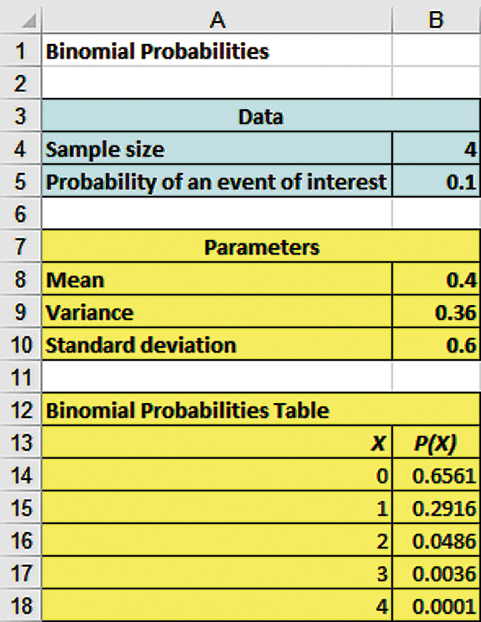
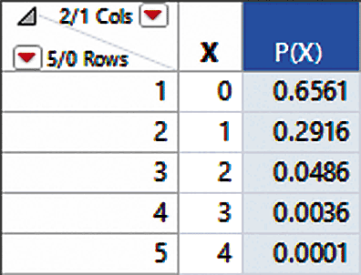
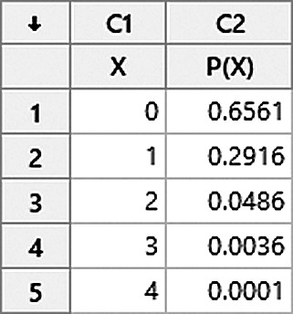
Excel, JMP, & Minitab Can Be Used To Calculate Binomial Probabilities

Slide 25
The Binomial Distribution
Shape
The shape of the binomial distribution depends on the values of π and n.
P(X=x|5, 0.1)
.6
.4
.2
Here, n = 5 and π = 0.1
0
0
1
2
3
4
5
x
P(X=x|5, 0.5)
.6
.4
Here, n = 5 and π = 0.5
.2
0
0
1
2
3
4
5
x

Slide 26
Binomial Distribution Characteristics
Mean:
Variance and Standard Deviation:
Where n = sample size
π = probability of the event of interest for any trial
(1 – π) = probability of no event of interest for any trial

Slide 27
The Binomial Distribution
Characteristics
Examples
P(X=x|5, 0.1)
.6
.4
.2
0
0
1
2
3
4
5
x
P(X=x|5, 0.5)
.6
.4
.2
0
0
1
2
3
4
5
x

Slide 28
The Poisson Distribution
Definitions
You use the Poisson distribution when you are interested in the number of times an event occurs in a given area of opportunity.
An area of opportunity is a continuous unit or interval of time, volume, or such area in which more than one occurrence of an event can occur.
  The number of scratches in a car’s paint.
  The number of mosquito bites on a person.
  The number of computer crashes in a day

Slide 29
The Poisson Distribution
Apply the Poisson Distribution when:
  You are interested in counting the number of times a particular event occurs in a given area of opportunity. An area of opportunity is defined by time, length, surface area, and so forth.
  The probability that an event occurs in a given area of opportunity is the same for all the areas of opportunity.
  The number of events that occur in one area of opportunity is independent of the number of events that occur in any other area of opportunity.
  The probability that two or more events will occur in an area of opportunity approaches zero as the area of opportunity becomes smaller.
The average number of events per unit is λ (lambda).

Slide 30
Poisson Distribution Formula
where:
x = number of events in an area of opportunity
λ = expected number of events
e = base of the natural logarithm system (2.71828...)

Slide 31
Poisson Distribution Characteristics
Mean:
Variance and Standard Deviation:
where λ = expected number of events.

Slide 32
The Poisson Distribution Example
The mean number of customers who arrive per minute at a bank during the noon-to-1pm hour is 3.0. What is the probability that 2 customers arrive in a given minute?
x = 2, λ = 3.0

Slide 33
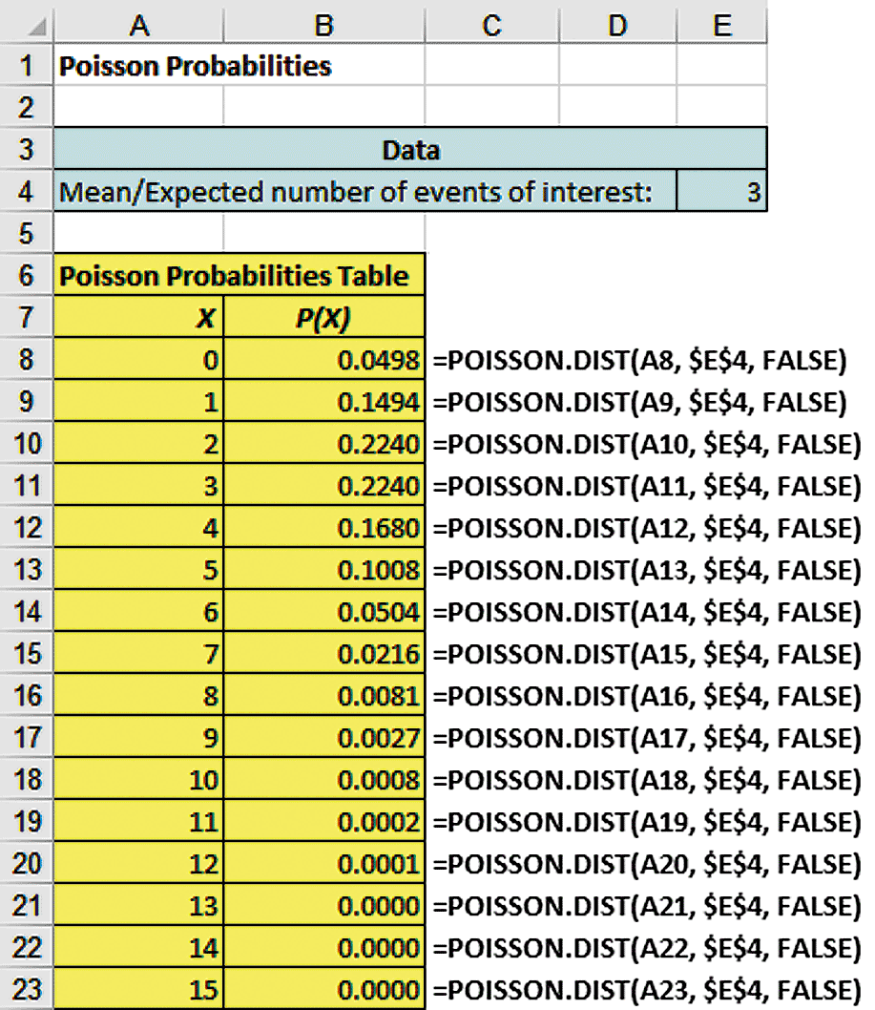
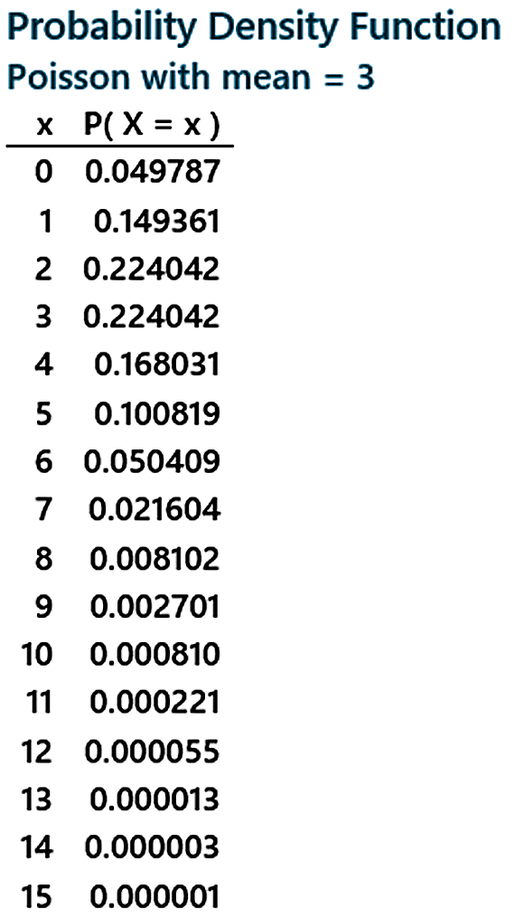
Excel, JMP, & Minitab Can Automate Poisson Probability Calculations
The mean number of customers who arrive per minute at a bank during the noon-to-1pm hour is 3.0.
λ = 3.0

Slide 34
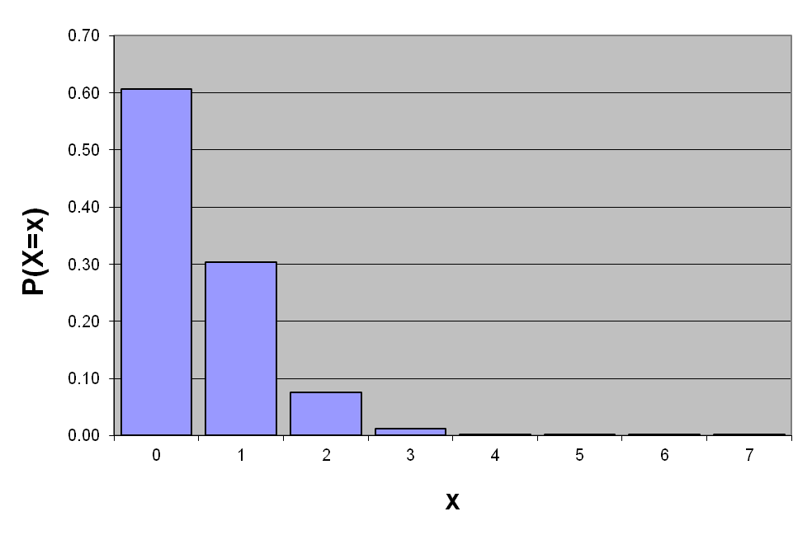
Graph of Poisson Probabilities
Graphically:
with λ = 0.50
X | λ = 0.50
0 1 2 3 4 5 6 7 | 0.6065 0.3033 0.0758 0.0126 0.0016 0.0002 0.0000 0.0000
P(X = 2 | λ=0.50) = 0.0758

Slide 35
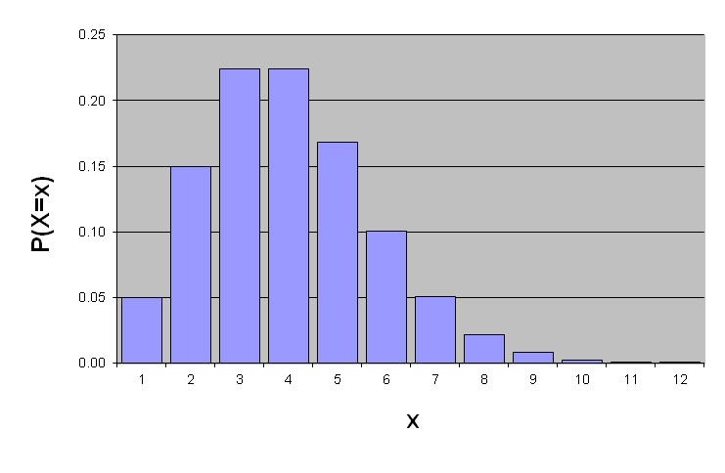
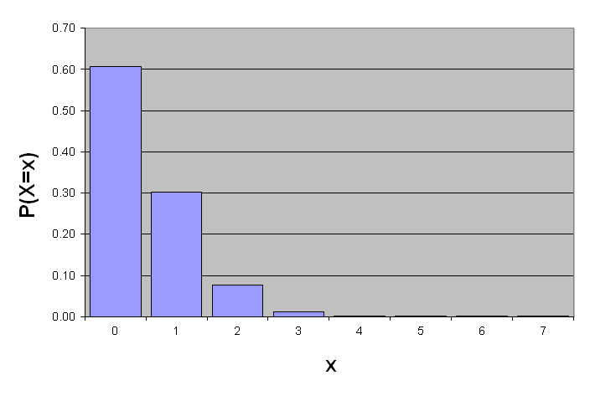
Poisson Distribution Shape
The shape of the Poisson Distribution depends on the parameter λ:
λ = 0.50
λ = 3.00

Slide 36
Chapter Summary
In this chapter we covered:
The properties of a probability distribution.
Computing the expected value and variance of a probability distribution.
Computing probabilities from binomial and Poisson distributions.
Using the binomial and Poisson distributions to solve business problems.

