Slide 1
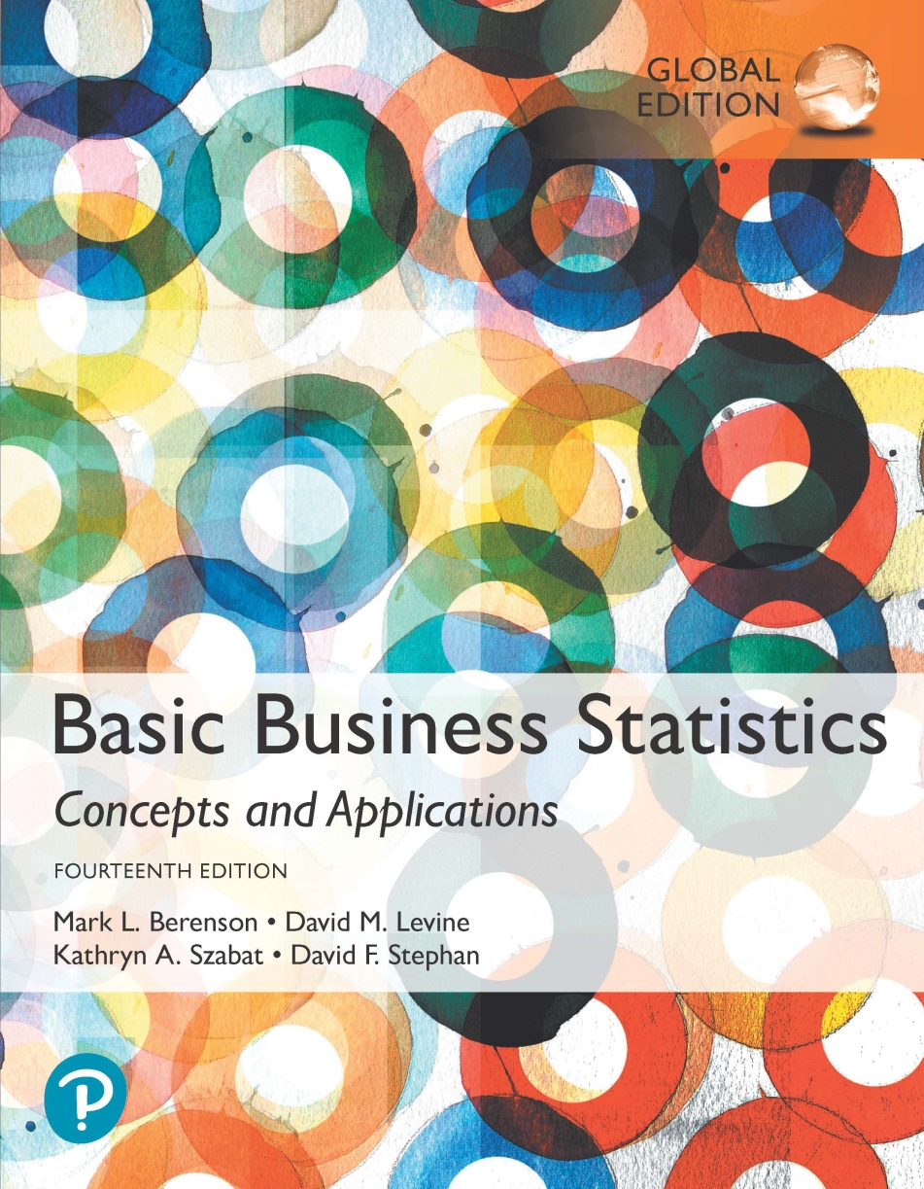
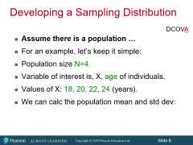
Chapter 7
Sampling Distributions

Slide 2
Objectives
In this chapter, you learn:
The concept of the sampling distribution.
To compute probabilities related to the sample mean and the sample proportion.
  This difference requires a modification of the formulas discussed in Chapter 6
The importance of the Central Limit Theorem.

Slide 3
What the heck is a “sampling distribution”?
Think about the distribution of a single 6-sided die.
The outcome is a random variable, uniformly distributed
But what if I gave each of you two dice and asked you to report the mean of your two rolls?

Slide 4
First note that the result of a single roll, and the result of the average across two rolls are different concepts.
Single roll: 1-6 (uniformly distributed)
The possible result of the average ranges from 1-6 as well, but is it uniformly distributed?
  i.e. is the average just as likely to be a 1 as it is to be a 3?
  No. The mean is not uniformly distributed even if the outcome of a single die roll is!

Slide 5


Compare…
Compare the distribution of X…
As well, note that:

Slide 6
Usually we have statistics taken from a sample
  Xbar and/or s
Every xbar and s we pull will be a little different, even if drawn from the same pop
So Xbar is a random variable too, but it’s properties won’t necessarily all be the same as X
Topic for today: What is the behavior of these random vars that happen to be statistics generated via a sample?

Slide 7
Sampling Distributions
DCOVA
A sampling distribution is a distribution of all of the possible values of a sample statistic for a given sample size selected from a population.
  There are a heck of a lot of different sample we could draw. Most likely we are only going to have one.
For example, suppose you sample 50 students from your college regarding their mean GPA. If you obtained many different samples of size 50, you could compute a different mean for each sample. We are interested in the distribution of all potential mean GPAs we might calculate for samples of 50 students.

Slide 8
Developing a Sampling Distribution
DCOVA
Assume there is a population …
For an example, let’s keep it simple:
Population size N=4.
Variable of interest is, X, age of individuals.
Values of X: 18, 20, 22, 24 (years).
We can calc the population mean and std dev:

Slide 9
Developing a Sampling Distribution
(continued)
DCOVA
Summary Measures for the Population Distribution:
P(x)
.3
.2
.1
0
18 20 22 24
A B C D
x
Uniform Distribution

Slide 10
How many possible samples can be drawn?
4^2=16

Slide 11
Now consider all possible samples of size n=2.
Developing a Sampling Distribution
(continued)
DCOVA
16 Sample Means
1st Obs | 2nd Observation
 | 18 | 20 | 22 | 24
18 | 18,18 | 18,20 | 18,22 | 18,24
20 | 20,18 | 20,20 | 20,22 | 20,24
22 | 22,18 | 22,20 | 22,22 | 22,24
24 | 24,18 | 24,20 | 24,22 | 24,24
16 possible samples (sampling with replacement)

Slide 12
16 possible samples and thus 16 possible sample means
Will each of those possible means be equally likely to be drawn?
Nope.
There is only one way to make the sample mean equal 18: draw (18,18) as your sample, so odds are 1/16
But there four ways to make xbar=21, so odds are 4/16

Slide 13
Sampling Distribution of All Sample Means.
Developing a Sampling Distribution
(continued)
DCOVA
16 Sample Means
Sample Means Distribution
_
P(X)
.3
.2
.1
0
_
18 19 20 21 22 23 24
X
(no longer uniform)

Slide 14
What do the descriptive stats for our xbars look like?
Note that the mean of all the sample means will also equal mu
  So mu of xbar=mu of population
And also note that if we’ve taken every possible sample, the mean and std dev are population parameters (population of 16 possible)
Do we expect the std dev of the means to be bigger or smaller than for the x’s?

Slide 15
Summary Measures of this Sampling Distribution:
Developing A Sampling Distribution
(continued)
DCOVA
Note: Here we divide by 16 because there are 16
different samples of size 2.

Slide 16
Comparing the Population Distribution to the Sample Means Distribution
DCOVA
Population
Sample Means Distribution
_
P(X)
P(X)
.3
.3
.2
.2
.1
.1
0
0
_
18 20 22 24
A B C D
X
18 19 20 21 22 23 24
X

Slide 17
Note that the sample means should vary less than the value itself
  More extreme values are mixed with less extreme values
Consider all of the possible means: there will be a standard deviation of that variable.
  We call that the standard error of the mean

Slide 18
Sample Mean Sampling Distribution:
Standard Error of the Mean
DCOVA
Different samples of the same size from the same population will yield different sample means.
A measure of the variability in the mean from sample to sample is given by the Standard Error of the Mean:
(This assumes that sampling is with replacement or
sampling is without replacement from an infinite population.)

Slide 19
In the previous example, sigma=2.236
So the std error must= 2.236/sqrt(2)=1.583 which is exactly what we got.
Note that the standard error of the mean decreases as the sample size increases
As n gets bigger, the variability smooths out b/c extreme values have less impact as they mixed in and averaged with more and more “regular” values

Slide 20
Ok, we know/understand a little about xbar
  It’s a random var
  Has a standard deviation (which we call stand error)
What distribution does is have?
If the population xbar is drawn from is normal, xbar is also normal
  but the std dev for this variable is

Slide 21
Sample Mean Sampling Distribution:
If the Population is Normal
DCOVA
If a population is normal with mean μ and standard deviation σ, the sampling distribution of is also normally distributed with:
and

Slide 22
If sigma=90 an n=10
Sigma of xbar=28.46
An n goes up, the spread of xbar shrinks
If n=11, Sigma of xbar=27.14

Slide 23
In chapter/session 6, we looked at how an individual observation might vary from the mean
  i.e.: What is the probability that a student scores below an 81 (with some provided mean and std dev for the population)?
Now, we are looking not at an individual draw of a single observation, but the average from a randomly drawn sample
  i.e. looking at an xbar rather than an x

Slide 24
Z-value for Sampling Distribution of the Mean
DCOVA
Z-value for the sampling distribution of :
where: = sample mean
= population mean
= population standard deviation
n = sample size

Slide 25
Sampling Distribution Properties
DCOVA
Normal Population Distribution
(i.e. is unbiased )
Normal Sampling Distribution
(has the same mean)

Slide 26
Sampling Distribution Properties
(continued)
DCOVA
  As n increases,
  decreases
Larger sample size
Smaller sample size

Slide 27
Sampling Distribution Properties
(cereal box example)
(continued)
DCOVA
  As n increases,
  decreases
Larger sample size
Smaller sample size means more prob distribution in left tail
368
365

Slide 28
Something we will do a lot is to find the interval that will contain some specific proportion of either a specific value from one observation or from all the possible sample means.
i.e. We may wish to find the interval that will contain 95% of all possible observations or we may want to find the interval containing 95% of all possible sample means.
  Not exactly the same task

Slide 29
For practice from yesterday: Find a symmetrically distributed interval around µ that will include 95% of the observations when µ = 368, σ = 15.
  Since the interval contains 95% of values, 5% of the values will be outside the interval.
  Since the interval is symmetric 2.5% will be above the upper limit and 2.5% will be below the lower limit.
  From the standardized normal table, the Z score with 2.5% (0.0250) below it is -1.96 and the Z score with 2.5% (0.0250) above it is 1.96.

Slide 30
Z=(x-mu)/sigma
1.96=(x-368)/15
29.4=x-368
397.4
-1.96=(x-368)/15
-29.4=x-368
338.6

Slide 31
397.4 to 338.6 is the interval that will “catch” 95% of observations.
So a new draw will have a 95% chance of being in this interval.
But what about the mean of a draw of 25?
What’s the interval that will catch 95% of all possible xbars?
  First question: do you expect it to be wider or tighter than the above????

Slide 32
Determining An Interval Including A Fixed Proportion of the Sample Means
DCOVA
Find a symmetrically distributed interval around µ that will include 95% of the sample means when µ = 368, σ = 15, and n = 25.
  Since the interval contains 95% of the sample means 5% of the sample means will be outside the interval.
  Since the interval is symmetric 2.5% will be above the upper limit and 2.5% will be below the lower limit.
  From the standardized normal table, the Z score with 2.5% (0.0250) below it is -1.96 and the Z score with 2.5% (0.0250) above it is 1.96.

Slide 33
Determining An Interval Including A Fixed Proportion of the Sample Means
(continued)
DCOVA
Calculating the lower limit of the interval:
Calculating the upper limit of the interval:
Based on samples of size 25, the sample means in 95% of all samples are between 362.12 and 373.88.

Slide 34
Another Example
The foreman of a bottling plant has observed that the amount of soda in each “32-ounce” bottle is actually a normally distributed random variable, with a mean of 32.2 ounces and a standard deviation of .3 ounce.
1) If a customer buys one bottle, what is the probability that the bottle will contain more than 32 ounces?
2) If a customer buys a carton of four bottles, what is the probability that the mean amount of the four bottles will be greater than 32 ounces?

Slide 35
1) First get the z-score.
Z=(32-32.2)/.3=-0.67
Consulting table or excel, we see that the probability that the randomly selected bottle has >32 ounces is 74.68%

Slide 36
2) Now, we are wanting to find P(xbar>32)
Mu xbar= mu= 3.32
Sigma xbar=sigma/sqrt(n)=0.3/2=0.15
Z=(xbar-mu)/(sigma/sqrt(n))
Z=-1.33
Consulting the table, we see P(Z>-1.33)=0.9082

Slide 37
Ok, fine: if the population you’re drawing from is normal, all the possible xbars are distributed normally as well. (Seems pretty obvious).
But what if the population you are drawing from is not normal…
…turns out that the xbars from such a population are (or at least might be roughly) normal!

Slide 38
Sample Mean Sampling Distribution:
If the Population is not Normal
DCOVA
We can apply the Central Limit Theorem:
  Even if the population is not normal,
  …sample means from the population will be approximately normal as long as the sample size is large enough.
  Properties of the sampling distribution:
  and

Slide 39
Central Limit Theorem
DCOVA
the sampling distribution of the sample mean becomes almost normal regardless of shape of population.
As the sample size gets large enough…
n↑

Slide 40
Sample Mean Sampling Distribution:
If the Population is not Normal
(continued)
Population Distribution
DCOVA
Sampling distribution properties:
Central Tendency
Sampling Distribution
(becomes normal as n increases)
Variation
Larger sample size
Smaller sample size

Slide 41
How Large is Large Enough?
DCOVA
For most distributions, n > 30 will give a sampling distribution that is nearly normal.
For fairly symmetric distributions, n > 15 is large enough.
For a normal population distribution, the sampling distribution of the mean is always normally distributed.

Slide 42
Example
DCOVA
Suppose a population has mean μ = 8 and standard deviation σ = 3. The population is non-normal.
Suppose a random sample of size n = 36 is selected.
What is the probability that the sample mean is between 7.8 and 8.2?

Slide 43
Example
(continued)
DCOVA
Solution:
Even if the population is not normally distributed, the central limit theorem can be used (n > 30).
… so the sampling distribution of is approximately normal.
… with mean = 8 .
…and standard deviation .

Slide 44
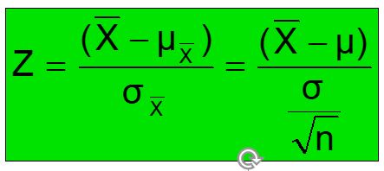
Example
(Eq 7.4)
DCOVA
Population Distribution
Sampling Distribution
Standard Normal Distribution
?
?
?
?
?
?
?
?
?
?
?
Sample
Standardize
?
7.8 8.2
-0.4 0.4
Z
X

Slide 45
Many variables that we deal with will be binary
  Yes/no, won/lost, etc.
You will often want to know what proportion of your observations have a binary characteristic
Binary variables are not normally distributed (they are binomially distributed)…
  …but if the sample is large enough, we can use the normal dist to approximate the distribution of the mean

Slide 46
Population Proportions
DCOVA
π = the proportion of the population having
some characteristic.
Sample proportion (p) provides an estimate of π:
0 ≤ p ≤ 1.
p is approximately distributed as a normal distribution when n is large.
(assuming sampling with replacement from a finite population or without replacement from an infinite population.)

Slide 47
Main thing you have to remember: the standard error for a proportion/binary variable is:
So if you are calculating Z values for this type of data, be sure to use the above as the standard error and not sigma/sqrt n

Slide 48
Sampling Distribution of p (proportion)
DCOVA
Approximated by a
normal distribution if:
  where
  and
Sampling Distribution
P( p_{s})
.3
.2
.1
0
0 . 2 .4 .6 8 1
p
(where π = population proportion)

Slide 49
Z-Value for Proportions
DCOVA
Standardize p to a Z value with the formula:

Slide 50
Example
DCOVA
If the true proportion of voters who support Proposition A is π = 0.4, what is the probability that a sample of size 200 yields a sample proportion between 0.40 and 0.45?
i.e.: if π = 0.4 and n = 200, what is
P(0.40 ≤ p ≤ 0.45) ?

Slide 51
Example
(continued)
DCOVA
if π = 0.4 and n = 200, what is
P(0.40 ≤ p ≤ 0.45) ?
Find :
Convert to standardized normal:

Slide 52
Example
(continued)
DCOVA
if π = 0.4 and n = 200, what is
P(0.40 ≤ p ≤ 0.45)?
Utilize the cumulative normal table:
P(0 ≤ Z ≤ 1.44) = 0.9251 – 0.5000 = 0.4251
Standardized
Normal Distribution
Sampling Distribution
0.4251
Standardize
0.40
0.45
p
0
1.44
Z

Slide 53
Chapter Summary
In this chapter we discussed:
The concept of a sampling distribution.
Computing probabilities related to the sample mean and the sample proportion.
The importance of the Central Limit Theorem.

