Slide 1
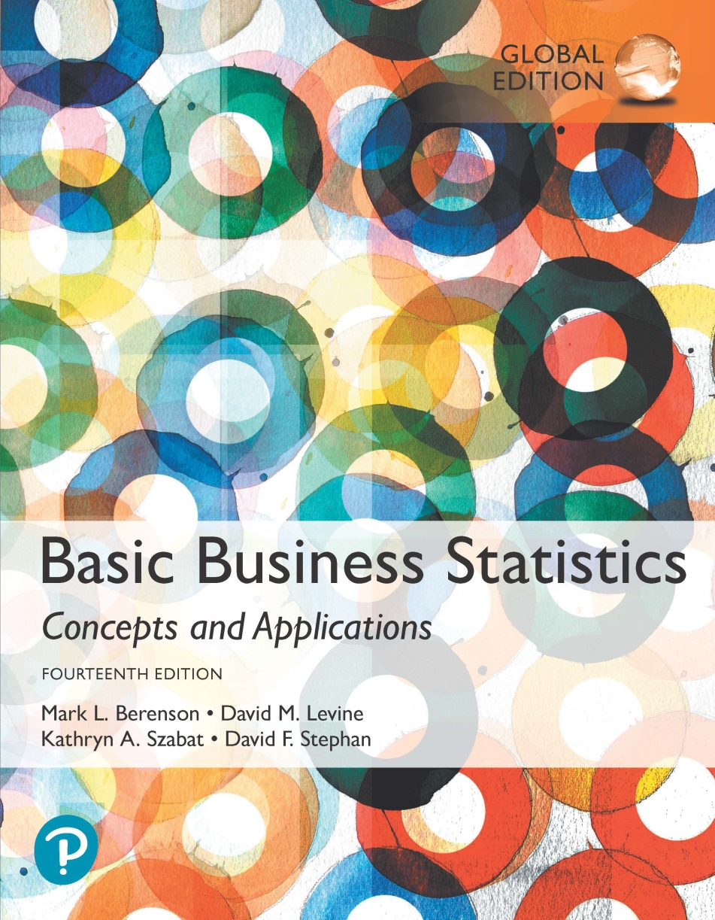
Chapter 9
Fundamentals of Hypothesis Testing: One-Sample Tests

Slide 2
Objectives
In this chapter, you learn:
The basic principles of hypothesis testing.
How to use hypothesis testing to test a mean or proportion.
To identify the assumptions of each hypothesis-testing procedure, how to evaluate them, and the consequences if they are seriously violated.
The pitfalls & ethical issues involved in hypothesis. testing.
How to avoid the pitfalls involved in hypothesis testing.

Slide 3
What is a Hypothesis?
DCOVA
A hypothesis is a claim (assertion) about a
population parameter:
  population mean:
  population proportion:
Example: The mean monthly cell phone bill in this city is μ = $42.
Example: The proportion of adults in this city with cell phones is π = 0.88.

Slide 4
The Null Hypothesis, H₀
DCOVA
States the claim or assertion to be tested.
  Example: The mean diameter of a manufactured bolt is 30mm ( )
Is always about a population parameter, not about a sample statistic .

Slide 5
The Null Hypothesis, H₀
(continued)
DCOVA
Begin with the assumption that the null hypothesis is true.
  Similar to the notion of innocent (H₀) until proven guilty.
Represents the current belief in a situation.
Always contains “=“, or “≤”, or “≥” sign.
May or may not be rejected.

Slide 6
The Alternative Hypothesis, H₁
DCOVA
Is the opposite of the null hypothesis.
  e.g., The mean diameter of a manufactured bolt is not equal to 30mm ( H₁: μ ≠ 30 ).
Challenges the status quo.
Never contains the “=“, or “≤”, or “≥” sign,
  Can be <, > in a “one-tail” test.
May or may not be supported.
Is generally the hypothesis that the researcher is trying to support.

Slide 7
The Hypothesis Testing Process
DCOVA
Claim: The population mean age is 50.
  H₀: μ = 50, H₁: μ ≠ 50
Sample the population and find the sample mean.

Slide 8
The Hypothesis Testing Process
(continued)
DCOVA
Suppose the sample mean age was X = 20.
This is significantly lower than the claimed mean population age of 50.
If the null hypothesis were true, the probability of getting such a different sample mean would be very small, so you reject the null hypothesis .
In other words, getting a sample mean of 20 is so unlikely if the population mean was 50, you conclude that the population mean must not be 50.

Slide 9
The Hypothesis Testing Process
(continued)
If 45 is smpl mean, what then ??
DCOVA
Sampling Distribution of X
X
20
μ = 50
If H₀ is true
... then you reject the null hypothesis that μ = 50.
If it is unlikely that you would get a sample mean of this value ...
... When in fact this were
the population mean…

Slide 10
The Test Statistic and
Critical Values
DCOVA
If the sample mean is close to the stated population mean, the null hypothesis is not rejected.
If the sample mean is far from the stated population mean, the null hypothesis is rejected.
  How far is “far enough” to reject H₀?
  The critical value of a test statistic creates a “line in the sand” for decision making -- it answers the question of how far is far enough.

Slide 11
The Test Statistic and
Critical Values
(continued)
DCOVA
Sampling Distribution of the test statistic
Region of Rejection
Region of Rejection
Region of
Non-Rejection
Critical Values
“Too Far Away” From Mean of Sampling Distribution

Slide 12
Risks in Decision Making Using Hypothesis Testing
DCOVA
Type I Error:
  Reject a true null hypothesis.
  A Type I error is a “false alarm.”
  The probability of a Type I Error is α.
    Called level of significance of the test.
    Set by researcher in advance.
Type II Error:
  Failure to reject a false null hypothesis.
  Type II error represents a “missed opportunity.”
  The probability of a Type II Error is β.

Slide 13
Possible Errors in Hypothesis Test Decision Making
DCOVA
(continued)
Possible Hypothesis Test Outcomes
 | Actual Situation
Decision | H₀ True | H₀ False
Do Not Reject H₀ | Correct Decision Confidence = 1 - α | Type II Error P(Type II Error) = β
Reject H₀ | Type I Error P(Type I Error) = α | Correct Decision Power = (1 – β)

Slide 14
Possible Errors in Hypothesis Test Decision Making
DCOVA
(continued)
The confidence coefficient (1-α) is the probability of not rejecting H₀ when it is true.
The confidence level of a hypothesis test is (1-α)*100%.
The power of a statistical test (1-β) is the probability of rejecting H₀ when it is false.

Slide 15
Type I & II Error Relationship
DCOVA
Type I and Type II errors cannot happen at
the same time.
  A Type I error can only occur if H₀ is true.
  A Type II error can only occur if H₀ is false.
If Type I error probability (α) , then
Type II error probability (β)

Slide 16
Factors Affecting Type II Error
DCOVA
All else equal,
  β when the difference between hypothesized parameter and its true value .
  β when α .
  β when σ .
  β when n .

Slide 17
Level of Significance and the Rejection Region
DCOVA
H₀: μ = 30 H₁: μ ≠ 30
Level of significance =
α
α
α
/2
/2
30
Critical values
Rejection Region
This is a two-tail test because there is a rejection region in both tails

Slide 18
Hypothesis Tests for the Mean
DCOVA
Hypothesis
Tests for μ
σ Known
σ Unknown
(Z test)
(t test)

Slide 19
Z Test of Hypothesis for the Mean (σ Known)
DCOVA
Convert sample statistic ( ) to a Z_{STAT} test statistic.
X
Hypothesis
Tests for μ
σ Known
σ Known
σ Unknown
σ Unknown
(Z test)
(t test)
The test statistic is:

Slide 20
Critical Value Approach to Testing
DCOVA
For a two-tail test for the mean, σ known:
Convert sample statistic ( ) to test statistic (Z_{STAT}.)
Determine the critical Z values for a specified
level of significance α from a table or by using computer software.
Decision Rule: If the test statistic falls in the rejection region, reject H₀ otherwise do not reject H₀.

Slide 21
Two-Tail Tests
DCOVA
H₀: μ = 30 H₁: μ ≠ 30
There are two cutoff values (critical values), defining the regions of rejection.
α/2
α/2
X
30
Reject H₀
Do not reject H₀
Reject H₀
-Z_{α/2}
0
+Z_{α/2}
Z
Lower critical value
Upper critical value

Slide 22
Steps in The Critical Value Approach To Hypothesis Testing
DCOVA
State the null hypothesis, H₀ and the alternative hypothesis, H₁.
Choose the level of significance, α, and the sample size, n. The level of significance is based on the relative importance of Type I and Type II errors in the situation.
Determine the appropriate test statistic and sampling distribution.
Determine the critical values that divide the rejection and nonrejection regions.

Slide 23
Steps in The Critical Value Approach To Hypothesis Testing
(continued)
DCOVA
Collect the sample data, organize the results, and compute the value of the test statistic.
Make the statistical decision, determine whether the assumptions are valid, and state the managerial conclusion in the context of the theory, claim, or assertion being tested. If the test statistic falls into the nonrejection region, you do not reject the null hypothesis H₀. If the test statistic falls into the rejection region, reject the null hypothesis.

Slide 24
Hypothesis Testing Example
DCOVA
Test the claim that the true mean diameter of a manufactured bolt is 30mm.
(Assume σ = 0.8)
1. State the appropriate null and alternative
hypotheses:
  H₀: μ = 30 H₁: μ ≠ 30 (This is a two-tail test).
2. Specify the desired level of significance and the sample size:
  Suppose that α = 0.05 and n = 100 are chosen for this test.

Slide 25
Hypothesis Testing Example
(continued)
DCOVA
3. Determine the appropriate technique:
  σ is assumed known so this is a Z test.
4. Determine the critical values:
  For α = 0.05 the critical Z values are ±1.96.
5. Collect the data and compute the test statistic.
  Suppose the sample results are:
  n = 100, X = 29.84 (σ = 0.8 is assumed known).
  So the test statistic is:

Slide 26
Hypothesis Testing Example
(continued)
DCOVA
6. Is the test statistic in the rejection region?
α/2 = 0.025
α/2 = 0.025
Reject H₀ if Z_{STAT} < -1.96 or Z_{STAT} > 1.96; otherwise do not reject H₀.
Reject H₀
Do not reject H₀
Reject H₀
-Z_{α/2} = -1.96
0
+Z_{α/2} = +1.96
Here, Z_{STAT} = -2.0 < -1.96, so the test statistic is in the rejection region.

Slide 27
Hypothesis Testing Example
(continued)
DCOVA
6 (continued). Reach a decision and interpret the result.
α = 0.05/2
α = 0.05/2
Reject H₀
Do not reject H₀
Reject H₀
-Z_{α/2} = -1.96
0
+Z_{α/2}= +1.96
-2.0
Since Z_{STAT} = -2.0 < -1.96, reject the null hypothesis and conclude there is sufficient evidence that the mean diameter of a manufactured bolt is not equal to 30.

Slide 28
p-Value Approach to Testing
DCOVA
p-value: Probability of obtaining a test statistic equal to or more extreme than the observed sample value given H₀ is true.
  The p-value is also called the observed level of significance.
  It is the smallest value of α for which H₀ can be rejected.

Slide 29
p-Value Approach to Testing:
Interpreting the p-value
DCOVA
Compare the p-value with α:
  If p-value < α , reject H₀.
  If p-value ≥ α , do not reject H₀.
Remember
  “If the p-value is low then H₀ must go”

Slide 30
p-value Hypothesis Testing Example
DCOVA
Test the claim that the true mean diameter of a manufactured bolt is 30mm.
(Assume σ = 0.8)
1. State the appropriate null and alternative
hypotheses:
  H₀: μ = 30 H₁: μ ≠ 30 (This is a two-tail test).
2. Specify the desired level of significance and the sample size:
  Suppose that α = 0.05 and n = 100 are chosen for this test.

Slide 31
p-value Hypothesis Testing Example
(continued)
DCOVA
3. Determine the appropriate technique:
  σ is assumed known so this is a Z test.
4. Collect the data, compute the test statistic and the p-value.
  Suppose the sample results are:
  n = 100, X = 29.84 (σ = 0.8 is assumed known.)
  So the test statistic is:

Slide 32
p-Value Hypothesis Testing Example:
Calculating the p-value
(continued)
DCOVA
4. (continued) Calculate the p-value.
  How likely is it to get a Z_{STAT} of -2 (or something further from the mean (0), in either direction) if H₀ is true?
P(Z < -2.0) = 0.0228
P(Z > 2.0) = 0.0228
0
Z
-2.0
2.0
p-value = 0.0228 + 0.0228 = 0.0456

Slide 33
p-value Hypothesis Testing Example
(continued)
DCOVA
5. Is the p-value < α?
  Since p-value = 0.0456 < α = 0.05 Reject H₀.
State the managerial conclusion in the context of the situation.
  There is sufficient evidence to conclude the mean diameter of a manufactured bolt is not equal to 30mm.
Demo 9.1

Slide 34
Connection Between Two Tail Tests and Confidence Intervals
DCOVA
For X = 29.84, σ = 0.8 and n = 100, the 95% confidence interval is:
29.6832 ≤ μ ≤ 29.9968
Since this interval does not contain the hypothesized mean (30), we reject the null hypothesis at α = 0.05.

Slide 35
Do You Ever Truly Know σ?
DCOVA
As discussed previously, probably not!

Slide 36
Hypothesis Testing for the Mean: σ Unknown
DCOVA
If the population standard deviation is unknown, you instead must resort to using our best guess for it: the sample standard deviation S.
Because of this change, you use the t distribution instead of the Z distribution to test the null hypothesis about the mean.
When using the t distribution you must assume the population you are sampling from follows a normal distribution unless the sample is large enough
All other steps, concepts, and conclusions are the same.

Slide 37
t Test of Hypothesis for the Mean (σ Unknown)
DCOVA
Convert sample statistic ( ) to a t_{STAT} test statistic
X
Hypothesis
Tests for μ
Hypothesis
Tests for μ
Hypothesis
Tests for μ
σ Known
σ Known
σ Known
σ Known
σ Known
σ Known
σ Unknown
σ Unknown
σ Unknown
σ Unknown
σ Unknown
σ Unknown
(Z test)
(Z test)
(Z test)
(t test)
(t test)
(t test)
The test statistic is:
The test statistic is:
The test statistic is:

Slide 38
Example: Two-Tail Test
(σ Unknown)
DCOVA
The mean cost of a hotel room in New York is said to be $168 per night. To determine if this is true, a random sample of 25 hotels is taken and resulted in an X of $172.50 and an S of $15.40. Test the appropriate hypotheses at α = 0.05.
(Assume the population distribution is normal)
H₀: μ = 168 H₁: μ ≠ 168

Slide 39
Example Solution:
Two-Tail t Test
DCOVA
H₀: μ = 168 H₁: μ ≠ 168
α/2=.025
α/2=.025
α = 0.05.
n = 25, df = 25-1=24.
σ is unknown, so
use a t statistic.
Critical Value:
±t_{24,0.025} = ± 2.0639.
Reject H₀
Do not reject H₀
Reject H₀
-t _{24,0.025}
t _{24,0.025}
0
-2.0639
2.0639
1.46
Do not reject H₀: insufficient evidence that true mean cost is different from $168.

Slide 40
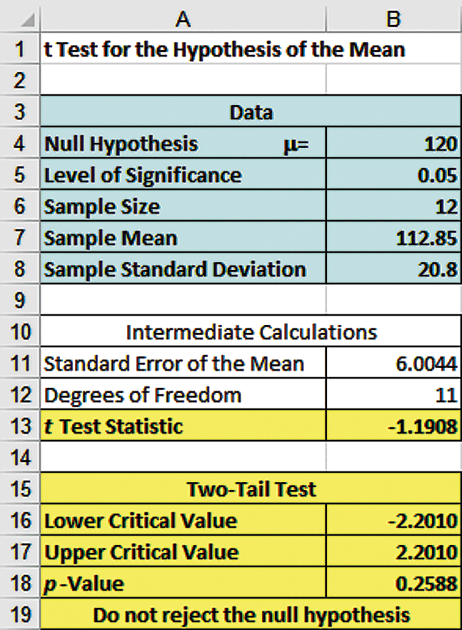
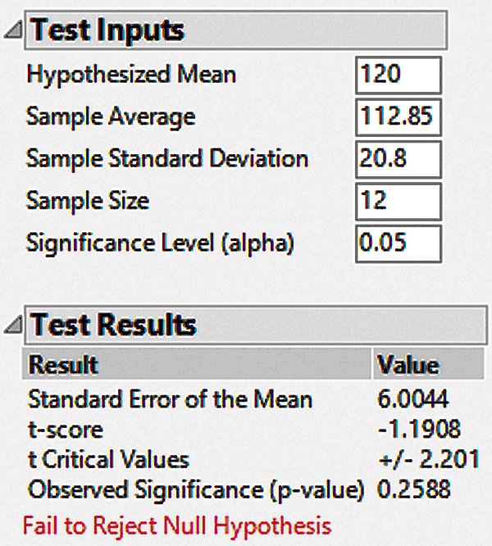
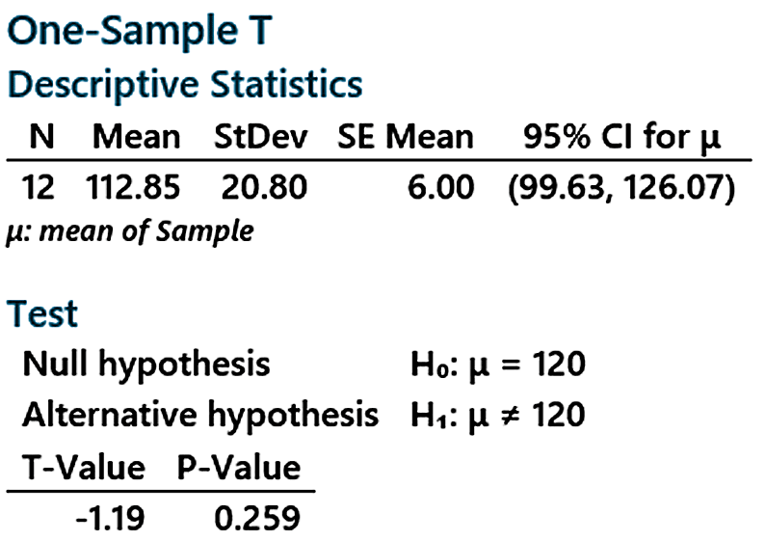
Example Two-Tail t Test Using A p-value from Excel, JMP, & Minitab
DCOVA
Since this is a t-test we cannot calculate the p-value without some calculation aid.
The Excel, JMP, & Minitab output below all do this:

Slide 41
Connection of Two Tail Tests to Confidence Intervals
DCOVA
For X = 172.5, S = 15.40 and n = 25, the 95% confidence interval for µ is:
172.5 - (2.0639) 15.4/ 25 to 172.5 + (2.0639) 15.4/ 25
166.14 ≤ μ ≤ 178.86
Since this interval contains the Hypothesized mean (168), we do not reject the null hypothesis at α = 0.05.

Slide 42
Thus far our null has been that the mean equals some value and the alt is that it doesn’t.
A very large or very small value of xbar will help us to reject the null.

Slide 43
One-Tail Tests
DCOVA
In many cases, the alternative hypothesis focuses on a particular direction:
This is a lower-tail test since the alternative hypothesis is focused on the lower tail below the mean of 3.
H₀: μ ≥ 3
H₁: μ < 3
H₀: μ ≤ 3
H₁: μ > 3
This is an upper-tail test since the alternative hypothesis is focused on the upper tail above the mean of 3.

Slide 44
Lower-Tail Tests
DCOVA
H₀: μ ≥ 3
H₁: μ < 3
There is only one critical value, since the rejection area is in only one tail.
α
Reject H₀
Do not reject H₀
Z or t
-Z_{α} or -t_{α}
0
μ
X
Critical value

Slide 45
Upper-Tail Tests
DCOVA
H₀: μ ≤ 3
H₁: μ > 3
There is only one critical value, since the rejection area is in only one tail.
α
Z or t
Do not reject H₀
Reject H₀
0
Z_{α} or t_{α}
_
X
μ
Critical value

Slide 46
Example: Upper-Tail t Test for Mean (σ unknown)
DCOVA
A phone industry manager thinks that customer monthly cell phone bills have increased, and now average over $52 per month. The company wishes to test this claim. (Assume a normal population.)
Form hypothesis test:
H₀: μ ≤ 52 the mean is not over $52 per month
H₁: μ > 52 the mean is greater than $52 per month
(i.e., sufficient evidence exists to support the
manager’s claim)

Slide 47
Example: Find Rejection Region
(continued)
DCOVA
Suppose that α = 0.10 is chosen for this test and n = 25.
Find the rejection region:
Reject H₀
α = 0.10
Do not reject H₀
Reject H₀
0
1.318
Reject H₀ if t_{STAT} > 1.318

Slide 48
Example: Test Statistic
(continued)
DCOVA
Obtain sample and compute the test statistic.
Suppose a sample is taken with the following results: n = 25, X = 53.1, and S = 10.
  Then the test statistic is:

Slide 49
Example: Decision
(continued)
DCOVA
Reach a decision and interpret the result.
Reject H₀
α = 0.10
Do not reject H₀
1.318
Reject H₀
0
t_{STAT} = 0.55
Do not reject H₀ since t_{STAT} = 0.55 < 1.318.
There is not sufficient evidence that the
mean bill is over $52.

Slide 50
Example: Utilizing The p-value for The Upper Tail t-Test
DCOVA
P-val=0.2937
p-value = .2937
Reject H₀
α = .10
0
Do not reject H₀
1.318
Reject H₀
t_{STAT} = .55
Do not reject H₀ since p-value = .2937 > α = .10

Slide 51
Hypothesis Tests for Proportions
DCOVA
Involves categorical variables.
Two possible outcomes:
  Possesses characteristic of interest.
  Does not possess characteristic of interest.
Fraction or proportion of the population in the category of interest is denoted by π.

Slide 52
Proportions
(continued)
DCOVA
Sample proportion in the category of interest is denoted by p.
When both nπ and n(1-π) are at least 5, p can be approximated by a normal distribution with mean and standard deviation:

Slide 53
Hypothesis Tests for Proportions
DCOVA
The sampling distribution of p is approximately normal, so the test statistic is a Z_{STAT} value:
Hypothesis
Tests for p
nπ ≥ 5
and
n(1-π) ≥ 5
nπ < 5
or
n(1-π) < 5
Not discussed in this chapter

Slide 54
Z Test for Proportion in Terms of Number in Category of Interest
DCOVA
An equivalent form to the last slide, but in terms of the number in the category of interest, X:
Hypothesis
Tests for X
X ≥ 5
and
n-X ≥ 5
X < 5
or
n-X < 5
Not discussed in this chapter

Slide 55
Example: Z Test for Proportion
DCOVA
A marketing company claims that it receives 8% responses from its mailing. To test this claim, a random sample of 500 were surveyed with 25 responses. Test at the α = 0.05 significance level.
Check:
n π = (500)(.08) = 40
n(1-π) = (500)(.92) = 460
✓

Slide 56
Z Test for Proportion: Solution
DCOVA
Test Statistic:
H₀: π = 0.08 H₁: π ≠ 0.08
α = 0.05
n = 500, p = 0.05
Critical Values: ± 1.96
Decision:
Reject H₀ at α = 0.05
Reject
Reject
Conclusion:
.025
.025
There is sufficient evidence to reject the company’s claim of 8% response rate.
z
-1.96
0
1.96
-2.47

Slide 57
p-Value Solution
(continued)
DCOVA
Calculate the p-value and compare to α
(For a two-tail test the p-value is always two-tail.)
Do not reject H₀
Reject H₀
Reject H₀
p-value = 0.0136:
α/2 = .025
α/2 = .025
0.0068
0.0068
-1.96
0
1.96
Z = -2.47
Z = 2.47
Reject H₀ since p-value = 0.0136 < α = 0.05.

Slide 58
Questions To Address In The Planning Stage
What is the goal of the survey, study, or experiment?
How can you translate this goal into a null and an alternative hypothesis?
Is the hypothesis test one or two tailed?
Can a random sample be selected?
What types of data will be collected? Numerical? Categorical?
What level of significance should be used?
Is the intended sample size large enough to achieve the desired power?
What statistical test procedure should be used and why?
What conclusions & interpretations can you reach from the results of the planned hypothesis test?
Failing to consider these questions can lead to bias or incomplete results.

Slide 59
Statistical Significance vs Practical Significance
Statistically significant results (rejecting the null hypothesis) are not always of practical significance.
  This is more likely to happen when the sample size gets very large.
Practically important results might be found to be statistically insignificant (failing to reject the null hypothesis.)
  This is more likely to happen when the sample size is relatively small.

Slide 60
Reporting Findings & Ethical Issues
Should document & report both good & bad results.
Should not just report statistically significant results.
Reports should distinguish between poor research methodology and unethical behavior.
Ethical issues can arise in:
  The use of human subjects.
  The data collection method.
  The type of test being used.
  The level of significance being used.
  The cleansing and discarding of data.
  The failure to report pertinent findings.

Slide 61
For Practice
1) Say we rent a billboard from a local tv station that claims an avg of 500 cars drive past it everyday from 5-7pm. We know the actual number on a given day is a random var with σ=20
We wish to test their claim and we count cars for 25 randomly chosen evenings.
We find our xbar to be 480. (We take their word for it regarding the std deviation.)
Can we reject the claim above?

Slide 62
For Practice
2) It is believed that traditionally the GPA in econ classes is 2.7 with sigma=0.6. You are skeptical and think it’s higher.
You take a sample of 64 students and find xbar=2.9. Assume sigma=0.6 and alpha=0.05
  Bonus question: what if xbar had been 2.6?
  Could we instantly reject or fail to reject the null?

Slide 63
For Practice
3) H0: mu=170
H1: mu ≠170
n=25
xbar=174.52
s=10.31
Set alpha=0.01
Can we reject the null?

Slide 64
For Practice
4) Ho: mu>=30
H1<30
n= 35
Xbar=29
s=2.5.
Can you reject the null?

Slide 65
5) H0: pi=0.5
H1: pi ≠0.5
n=100
Set alpha=0.05
p=0.53
Can we reject the null?

Slide 66
Solutions
1) Z = (480-500)/(20/5) = -5
Z crit: 1.96 and -1.96
Reject claim
2) Ho: mu<=2.7
H1: mu > 2.7
Crit val: 1.645
Test stat: z= 2.67
Conclusion: Reject null
Interpretation: GPAs are higher than 2.7

Slide 67
3) t-crit: 2.797 and -2.797
t= 2.19
Fail to reject
4) H0: mu>=30
H1: mu<30
t-crit for alpha= 0.05: -1.69
t-crit for alpha=0.01: -2.44
t=-2.36

Slide 68
5)
0.03/(sqrt(.5(.5)/100)=
0.03/0.05=0.6
Z-crit: 1.96 and -1.96
Fail to reject

Slide 69
Thus far we have only tested a mean against a specific value
  i.e. Is mu=50 or not?
Often we might find ourselves in situations where we want to compare two means from two different groups to see if they are the same

Slide 70
Examples:
You screen two different endings to your new movie to two different test audiences and have them rate how much they like it. Is there a significant difference?
You head the tourism office for Tybee Island and are interested to know if people from in-state spend more/less than people that come from out of state.
  Disney recently asked a similar question
Is there a difference between Millennials and Gen Z in screentime per day

Slide 71
What are the null/alt hypoths here?
H0: mu1=mu2
  There is no difference between the group means
H1: mu1 ≠ m2
  There is a difference between the means
Also possible we may want to do a one-tailed test
  Ho: mu1<=mu2, H1: mu1>mu2

Slide 72
This gets a little complicated to do by hand, but luckily Excel handles it easily.

