Slide 1
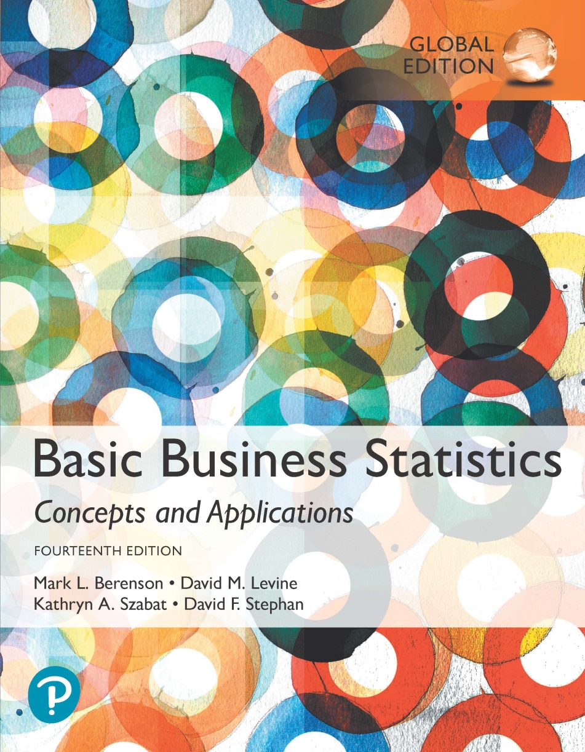
Chapter 13
Simple Linear Regression

Slide 2
Objectives
In this chapter, you learn:
To understand the usefulness of regression analysis.
To understand the meaning of the regression coefficients b₀ and b₁.
How to properly perform regression analysis.

Slide 3
Some usually unavoidable facts about research in business and the social sciences:
  1) We are usually interested in some form of the questions “how does X affect y?”
    How does education affect earnings?
    How does a product redesign affect sales?
    How does a new mkting campaign affect brand awareness?
    How does cap expenditures affect profitability?
  2) We usually must rely on observational data
    What problems does this cause?

Slide 4
If we are not running a tightly controlled experiment, there are many things happening all at once that can confound our results
  Many other things can be correlated with the treatment that could have some impact on the result
    Thus its hard to say if X affected Y…it could have been Z if Z is correlated with X!

Slide 5
Examples:
  Use an agent or FSBO?
  Education and earnings?
  Treatment intensity and insurance status?
  etc.
Creating experiments is usually impossible, or at least way beyond our budget
We have to try and do our best with what we have: observational data

Slide 6
Main idea: How does X affect Y, controlling for A, B, C….
  How does using an agent affect the sales price of the house controlling for the type/size/characteristics of house?
Linear Regression is our attempt at this: isolating the impact of one variable, while controlling for the effects of other confounding factors.

Slide 7
No question about it: this is imperfect. An experiment would be better.
But hey, we do our best with what we have.
If done well, regression analysis can probably tell us a lot.
This technique is used extensively.
We start our study of it with the simplest case: one independent variable

Slide 8
Regression Analysis Techniques Help Uncover Relationships Between Variables
DCOVA
Regression analysis is used to:
  Predict the value of a dependent variable based on the value of at least one independent variable.
  Explain the impact of changes in an independent variable on the dependent variable.
Dependent variable: the variable we wish to
predict or explain.
Independent variable: the variable used to predict or explain the dependent variable.

Slide 9
Preliminary Analysis – Scatter Plots
DCOVA
A scatter plot can be used to:
  Visualize the relationship between X and Y.
  Suggests a starting point for regression analysis.

Slide 10
Types of Relationships
DCOVA
Y
Y
Linear Relationships
X
X
Y
Y
Y
Curvilinear Relationships
X
X
X
Y
Y
No Relationship
X
X

Slide 11
Simple Linear Regression Model
DCOVA
Only one independent variable, X.
Relationship between X and Y is described by a linear function.
  Recall y = mx + b from algebra. (slide 8)
Changes in Y are assumed to be related to changes in X.

Slide 12
Simple Linear Regression Model
DCOVA
Population Slope
Coefficient
Random Error term
Population
Y intercept
Independent Variable
Dependent Variable
Linear component
Random Error
component

Slide 13
Simple Linear Regression Model
Equation of a line:
Y = mX + b
m is slope = rise/run = ΔY/ΔX
β1 is slope
DCOVA
(continued)
Y
Observed Value of Y for X_{i}
ε_{i}
Slope = β₁
Predicted Value of Y for X_{i}
Random Error for this X_{i} value
Intercept = β₀
X_{i}
X

Slide 14
Simple Linear Regression Equation (Prediction Line)
DCOVA
The simple linear regression equation provides an estimate of the population regression line.
Estimated (or predicted) Y value for observation i
Estimate of the regression
intercept
Estimate of the regression slope
Value of X for observation i

Slide 15
The Least Squares Method
DCOVA
b₀ and b₁ are obtained by finding the values that minimize the sum of the squared differences between Y and :
The coefficients b₀ and b₁, and other regression results in this chapter, are found using Excel or other software.
The calculations for b₀ and b₁ are not shown here but are available in the text.

Slide 16
Interpretation of the
Slope and the Intercept
DCOVA
b₀ is the estimated mean value of Y when the value of X is zero. (it is the vertical intercept of a linear relationship.)
b₁ is the estimated change in the mean value of Y as a result of a one-unit increase in X.
    b1 * ΔX = ΔY
To Ch13 XL

Slide 17
Simple Linear Regression Example
DCOVA
A real estate agent wishes to examine the relationship between the selling price of a home and its size (measured in square feet).
A random sample of 10 houses is selected.
  Dependent variable (Y) = house price in $1,000s.
  Independent variable (X) = square feet.

Slide 18
Simple Linear Regression Example: Data
DCOVA
House Price in $1000s (Y) | Square Feet (X)
245 | 1,400
312 | 1,600
279 | 1,700
308 | 1,875
199 | 1,100
219 | 1,550
405 | 2,350
324 | 2,450
319 | 1,425
255 | 1,700

Slide 19
Simple Linear Regression Example: Scatter Plot
DCOVA
House price model: Scatter Plot

Slide 20
Simple Linear Regression Example: Excel Output
DCOVA
Regression Statistics
Multiple R | 0.76211
R Square | 0.58082
Adjusted R Square | 0.52842
Standard Error | 41.33032
Observations | 10
ANOVA | df | SS | MS | F | Significance F
Regression | 1 | 18934.9348 | 18934.9348 | 11.0848 | 0.01039
Residual | 8 | 13665.5652 | 1708.1957
Total | 9 | 32600.5000
 | Coefficients | Standard Error | t Stat | P-value | Lower 95% | Upper 95%
Intercept | 98.24833 | 58.03348 | 1.69296 | 0.12892 | -35.57720 | 232.07386
Square Feet | 0.10977 | 0.03297 | 3.32938 | 0.01039 | 0.03374 | 0.18580
The regression equation is:

Slide 21
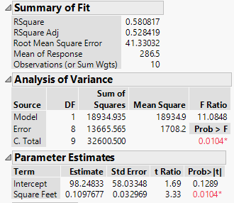
Simple Linear Regression Example: JMP & Minitab Output
DCOVA
The regression equation is
Price = 98.2 + 0.110 Square Feet
Predictor Coef SE Coef T P
Constant 98.25 58.03 1.69 0.129
Square Feet 0.10977 0.03297 3.33 0.010
S = 41.3303 R-Sq = 58.1% R-Sq(adj) = 52.8%
Analysis of Variance
Source DF SS MS F P
Regression 1 18935 18935 11.08 0.010
Residual Error 8 13666 1708
Total 9 32600

Slide 22
Simple Linear Regression Example: Graphical Representation
DCOVA
House price model: Scatter Plot and Prediction Line
Slope
= 0.10977
Intercept
= 98.248

Slide 23
Simple Linear Regression Example: Interpretation of b_{o}
DCOVA
b₀ is the estimated mean value of Y when the value of X is zero (if X = 0 is in the range of observed X values)
Because a house cannot have a square footage of 0, b₀ has no practical application

Slide 24
Simple Linear Regression Example: Interpreting b₁
DCOVA
b₁ estimates the change in the mean value of Y as a result of a one-unit increase in X.
Here, b₁ = 0.10977 tells us that the mean value of a house increases by 0.10977($1,000) = $109.77, on average, for each additional one square foot of size.

Slide 25
Simple Linear Regression Example: Making Predictions
DCOVA
Predict the price for a house with 2,000 square feet:
The predicted price for a house with 2,000 square feet is 317.85($1,000s) = $317,850

Slide 26
Simple Linear Regression Example: Making Predictions
DCOVA
When using a regression model for prediction, only predict within the relevant range of data
Relevant range for interpolation
Do not try to extrapolate beyond the range of observed X’s

Slide 27
Computing b₀ & b₁
DCOVA
For small data sets, b₀ & b₁ can be calculated using a hand calculator
Where:

Slide 28
Computing b₀ & b₁ -- Home Prices
House | House Price in $1000s (Y) | Square Feet (X) | X² | Y² | XY
1 | 245 | 1,400 | 1,960,000 | 60,025 | 343,000
2 | 312 | 1,600 | 2,560,000 | 97,344 | 499,200
3 | 279 | 1,700 | 2,890,000 | 77,841 | 474,300
4 | 308 | 1,875 | 3,515,625 | 94,864 | 577,500
5 | 199 | 1,100 | 1,210,000 | 39,601 | 218,900
6 | 219 | 1,550 | 2,402,500 | 47,961 | 339,450
7 | 405 | 2,350 | 5,522,500 | 164,025 | 951,750
8 | 324 | 2,450 | 6,002,500 | 104,976 | 793,800
9 | 319 | 1,425 | 2,030,625 | 101,761 | 454,575
10 | 255 | 1,700 | 2,890,000 | 65,025 | 433,500
Total | 2865 | 17,150 | 30,983,750 | 853,423 | 5,085,975
DCOVA

Slide 29
Computing b₀ & b₁ -- Home Prices (Con’t)
DCOVA

Slide 30
Measures of Variation
DCOVA
Total variation is made up of two parts:
Total Sum of Squares
Regression Sum of Squares
Error Sum of Squares
where:
= Mean value of the dependent variable
Y_{i} = Observed value of the dependent variable
= Predicted value of Y for the given X_{i} value

Slide 31
Measures of Variation
(continued)
DCOVA
SST = total sum of squares (Total Variation.)
  Measures the variation of the Y_{i} values around their mean Y.
SSR = regression sum of squares (Explained Variation.)
  Variation attributable to the relationship between X and Y.
SSE = error sum of squares (Unexplained Variation.)
  Variation in Y attributable to factors other than X.

Slide 32
Measures of Variation
(continued)
Y
DCOVA
Y_{i}
∧
∧
SSE = ∑(Y_{i} - Y_{i} )²
Y
_
SST = ∑(Y_{i} - Y)²
∧
Y
_
∧
_
SSR = ∑(Y_{i} - Y)²
_
Y
Y
X
X_{i}

Slide 33
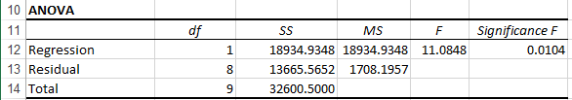
Excel Output Of The Measures Of Variation
DCOVA
SST = SSR + SSE
32,600.5000 = 18,934.9348 + 13,665.5652

Slide 34
Coefficient of Determination, r²
DCOVA
The coefficient of determination is the portion of the total variation in the dependent variable that is explained by variation in the independent variable.
The coefficient of determination is also called r-square and is denoted r².
note:
To Ch13 XL

Slide 35
Examples of Approximate r² Values
DCOVA
Y
Perfect linear relationship between X and Y.
100% of the variation in Y is explained by variation in X.
X
r² = 1
Y
X
r² = 1

Slide 36
Examples of Approximate r² Values
DCOVA
Y
0 < r² < 1
Weaker linear relationships between X and Y.
Some but not all of the variation in Y is explained by variation in X.
X
Y
X

Slide 37
Examples of Approximate r² Values
DCOVA
r² = 0
Y
No linear relationship between X and Y.
The value of Y does not depend on X. (None of the variation in Y is explained by variation in X.)
X
r² = 0

Slide 38
Simple Linear Regression Example: Coefficient of Determination, r² in Excel
DCOVA
Regression Statistics
Multiple R | 0.76211
R Square | 0.58082
Adjusted R Square | 0.52842
Standard Error | 41.33032
Observations | 10
ANOVA | df | SS | MS | F | Significance F
Regression | 1 | 18934.9348 | 18934.9348 | 11.0848 | 0.01039
Residual | 8 | 13665.5652 | 1708.1957
Total | 9 | 32600.5000
 | Coefficients | Standard Error | t Stat | P-value | Lower 95% | Upper 95%
Intercept | 98.24833 | 58.03348 | 1.69296 | 0.12892 | -35.57720 | 232.07386
Square Feet | 0.10977 | 0.03297 | 3.32938 | 0.01039 | 0.03374 | 0.18580
58.08% of the variation in house prices is explained by variation in square feet.

Slide 39
Coefficient of Determination, r² in JMP & Minitab
DCOVA
The regression equation is
Price = 98.2 + 0.110 Square Feet
Predictor Coef SE Coef T P
Constant 98.25 58.03 1.69 0.129
Square Feet 0.10977 0.03297 3.33 0.010
S = 41.3303 R-Sq = 58.1% R-Sq(adj) = 52.8%
Analysis of Variance
Source DF SS MS F P
Regression 1 18935 18935 11.08 0.010
Residual Error 8 13666 1708
Total 9 32600

Slide 40
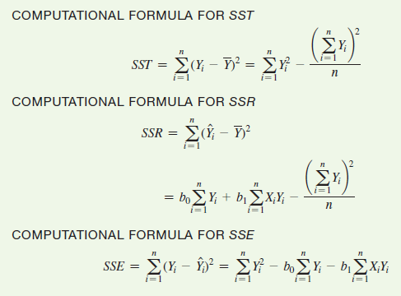
Sum Of Squares Computational Formulae
DCOVA
Actual
Mean
Predicted

Slide 41
Standard Error of Estimate
DCOVA
The standard deviation of the variation of observations around the regression line is estimated by:
Where
SSE = error sum of squares
n = sample size

Slide 42
Simple Linear Regression Example:
Standard Error of Estimate in Excel
DCOVA
Regression Statistics
Multiple R | 0.76211
R Square | 0.58082
Adjusted R Square | 0.52842
Standard Error | 41.33032
Observations | 10
ANOVA | df | SS | MS | F | Significance F
Regression | 1 | 18934.9348 | 18934.9348 | 11.0848 | 0.01039
Residual | 8 | 13665.5652 | 1708.1957
Total | 9 | 32600.5000
 | Coefficients | Standard Error | t Stat | P-value | Lower 95% | Upper 95%
Intercept | 98.24833 | 58.03348 | 1.69296 | 0.12892 | -35.57720 | 232.07386
Square Feet | 0.10977 | 0.03297 | 3.32938 | 0.01039 | 0.03374 | 0.18580
To Ch13 XL

Slide 43
Standard Error of Estimate in JMP & Minitab
DCOVA
The regression equation is
Price = 98.2 + 0.110 Square Feet
Predictor Coef SE Coef T P
Constant 98.25 58.03 1.69 0.129
Square Feet 0.10977 0.03297 3.33 0.010
S = 41.3303 R-Sq = 58.1% R-Sq(adj) = 52.8%
Analysis of Variance
Source DF SS MS F P
Regression 1 18935 18935 11.08 0.010
Residual Error 8 13666 1708
Total 9 32600

Slide 44
Comparing Standard Errors
DCOVA
S_{YX} is a measure of the variation of observed Y values from the regression line.
Y
Y
X
X
The magnitude of S_{YX} should always be judged relative to the size of the Y values in the sample data.
i.e., S_{YX} = $41.33K is moderately small relative to house prices in the $200K - $400K range

Slide 45
Assumptions of Regression
L.I.N.E
DCOVA
Linearity:
  The relationship between X and Y is linear.
Independence of Errors:
  Error values are statistically independent.
  Particularly important when data are collected over a period of time.
Normality of Error:
  Error values are normally distributed for any given value of X.
Equal Variance (also called homoscedasticity):
  The probability distribution of the errors has constant variance.

Slide 46
Residual Analysis
DCOVA
The residual for observation i, e_{i}, is the difference between its observed and predicted value.
Check the assumptions of regression by examining the residuals:
  Examine for linearity assumption.
  Evaluate independence assumption.
  Evaluate normal distribution assumption.
  Examine for constant variance (homoscedasticity) for all levels of X. (Heteroscedasticity is a problem.)
Graphical Analysis of Residuals
  Can plot residuals vs. X.

Slide 47
Residual Analysis for Linearity
DCOVA
Y
Y
x
x
residuals
x
x
residuals
Not Linear
✓
Linear

Slide 48
Residual Analysis for Independence
DCOVA
Cyclical Pattern:
Not Independent
✓
No Cyclical Pattern Independent
residuals
X
residuals
X
residuals
X

Slide 49
Checking for Normality
DCOVA
Examine the Boxplot of the Residuals.
Examine the Histogram of the Residuals.
Construct a Normal Probability Plot of the Residuals.
Review ordered array of residuals, check stdev of residuals in one-third segments

Slide 50
Residual Analysis for Normality
DCOVA
When using a normal probability plot, normal errors will approximately display in a straight line.
Percent
100
0
-3 -2 -1 0 1 2 3
Residual

Slide 51
Residual Analysis for
Equal Variance
DCOVA
Y
Y
x
x
residuals
x
x
residuals
✓
Non-constant variance
Constant variance
To Ch13 XL

Slide 52
Residual Analysis: Checking For Linearity
DCOVA
RESIDUAL OUTPUT
 | Predicted House Price | Residuals
1 | 251.9232 | -6.9232
2 | 273.8767 | 38.1233
3 | 284.8535 | -5.8535
4 | 304.0628 | 3.9371
5 | 218.9928 | -19.9928
6 | 268.3883 | -49.3883
7 | 356.2025 | 48.7975
8 | 367.1793 | -43.1793
9 | 254.6674 | 64.3326
10 | 284.8535 | -29.8535
Linear Model Assumption Is Appropriate

Slide 53
Residual Analysis: Checking For Independence (con’t.)
DCOVA
RESIDUAL OUTPUT
 | Predicted House Price | Residuals
1 | 251.9232 | -6.9232
2 | 273.8767 | 38.1233
3 | 284.8535 | -5.8535
4 | 304.0628 | 3.9371
5 | 218.9928 | -19.9928
6 | 268.3883 | -49.3883
7 | 356.2025 | 48.7975
8 | 367.1793 | -43.1793
9 | 254.6674 | 64.3326
10 | 284.8535 | -29.8535
Independence Assumption Is Appropriate

Slide 54
Residual Analysis: Checking For Normality (con’t.)
DCOVA
RESIDUAL OUTPUT
 | Predicted House Price | Residuals
1 | 251.9232 | -6.9232
2 | 273.8767 | 38.1233
3 | 284.8535 | -5.8535
4 | 304.0628 | 3.9371
5 | 218.9928 | -19.9928
6 | 268.3883 | -49.3883
7 | 356.2025 | 48.7975
8 | 367.1793 | -43.1793
9 | 254.6674 | 64.3326
10 | 284.8535 | -29.8535
Normality Assumption Is Appropriate

Slide 55
Residual Analysis: Checking For Constant Variance (con’t.)
DCOVA
RESIDUAL OUTPUT
 | Predicted House Price | Residuals
1 | 251.9232 | -6.9232
2 | 273.8767 | 38.1233
3 | 284.8535 | -5.8535
4 | 304.0628 | 3.9371
5 | 218.9928 | -19.9928
6 | 268.3883 | -49.3883
7 | 356.2025 | 48.7975
8 | 367.1793 | -43.1793
9 | 254.6674 | 64.3326
10 | 284.8535 | -29.8535
Constant Variance Assumption Is Appropriate

Slide 56
Measuring Autocorrelation:
The Durbin-Watson Statistic
DCOVA
Used when data are collected over time to detect if autocorrelation is present.
Autocorrelation exists if residuals in one time period are related to residuals in another period.

Slide 57
Autocorrelation
DCOVA
Autocorrelation is correlation of the errors (residuals) over time.
Here, residuals show a cyclical pattern, not random. Cyclical patterns are a sign of positive autocorrelation.
Violates the regression assumption that residuals are random and independent.

Slide 58
The Durbin-Watson Statistic
DCOVA
The Durbin-Watson statistic is used to test for autocorrelation.
H₀: positive autocorrelation does not exist
H₁: positive autocorrelation is present
The possible range is 0 ≤ D ≤ 4.
D should be close to 2 if H₀ is true.
D less than 2 may signal positive autocorrelation, D greater than 2 may signal negative autocorrelation.

Slide 59
Testing for Positive Autocorrelation
DCOVA
H₀: positive autocorrelation does not exist
H₁: positive autocorrelation is present
Calculate the Durbin-Watson test statistic = D.
(The Durbin-Watson Statistic can be found using Excel.)
Find the values d_{L} and d_{U} from the Durbin-Watson table.
(for sample size n and number of independent variables k.)
Decision rule: reject H₀ if D < d_{L}
Reject H₀
Inconclusive
Do not reject H₀
0
d_{L}
d_{U}
2

Slide 60
Testing for Positive Autocorrelation
(continued)
DCOVA
Suppose we have the following time series data:
Is there autocorrelation?

Slide 61
Testing for Positive Autocorrelation
(continued)
DCOVA
Example with n = 25:
Excel/PHStat output:
Durbin-Watson Calculations
Sum of Squared Difference of Residuals | 3296.18
Sum of Squared Residuals | 3279.98
Durbin-Watson Statistic | 1.00494

Slide 62
Testing for Positive Autocorrelation
(continued)
DCOVA
Here, n = 25 and there is k = 1 one independent variable
Using the Durbin-Watson table, d_{L} = 1.29 and d_{U} = 1.45
selection depends on alpha, n, and # of indep vars
D = 1.00494 < d_{L} = 1.29, so reject H₀ and conclude that significant positive autocorrelation exists
Decision: reject H₀ since
D = 1.00494 < d_{L}
Reject H₀
Inconclusive
Do not reject H₀
0
d_{L}=1.29
d_{U}=1.45
2
To Ch13 XL

Slide 63
Simple Linear Regression Example: Excel Output
DCOVA
Regression Statistics
Multiple R | 0.76211
R Square | 0.58082
Adjusted R Square | 0.52842
Standard Error | 41.33032
Observations | 10
ANOVA | df | SS | MS | F | Significance F
Regression | 1 | 18934.9348 | 18934.9348 | 11.0848 | 0.01039
Residual | 8 | 13665.5652 | 1708.1957
Total | 9 | 32600.5000
 | Coefficients | Standard Error | t Stat | P-value | Lower 95% | Upper 95%
Intercept | 98.24833 | 58.03348 | 1.69296 | 0.12892 | -35.57720 | 232.07386
Square Feet | 0.10977 | 0.03297 | 3.32938 | 0.01039 | 0.03374 | 0.18580
The regression equation is:

Slide 64
Inferences About the Slope
DCOVA
The standard error of the regression slope coefficient (b₁) is estimated by:
where:
= Estimate of the standard error of the slope.
= Standard error of the estimate.

Slide 65
Inferences About the Slope: t Test
DCOVA
t test for a population slope:
  Is there a linear relationship between X and Y?
Null and alternative hypotheses:
  H₀: β₁ = 0 (no linear relationship)
  H₁: β₁ ≠ 0 (linear relationship does exist)
Test statistic :
where:
b₁ = regression slope
coefficient
β₁ = hypothesized slope
S_{b1} = standard
error of the slope

Slide 66
Inferences About the Slope: t Test Example
DCOVA
Estimated Regression Equation:
House Price in $1000s (y) | Square Feet (x)
245 | 1400
312 | 1600
279 | 1700
308 | 1875
199 | 1100
219 | 1550
405 | 2350
324 | 2450
319 | 1425
255 | 1700
The slope of this model is 0.1098
Is there a relationship between the square footage of the house and its sales price?

Slide 67
Inferences About the Slope: t Test Example
DCOVA
H₀: β₁ = 0
H₁: β₁ ≠ 0
From Excel output:
 | Coefficients | Standard Error | t Stat | P-value
Intercept | 98.24833 | 58.03348 | 1.69296 | 0.12892
Square Feet | 0.10977 | 0.03297 | 3.32938 | 0.01039
b₁

Slide 68
Inferences About the Slope: t Test Example
DCOVA
H₀: β₁ = 0
H₁: β₁ ≠ 0
Test Statistic: t_{STAT} = 3.329
d.f. = 10- 2 = 8
Decision: Reject H₀.
α/2=.025
α/2=.025
There is sufficient evidence that square footage affects house price.
Reject H₀
Do not reject H₀
Reject H₀
-t_{α/2}
t_{α/2}
0
-2.3060
2.3060
3.329

Slide 69
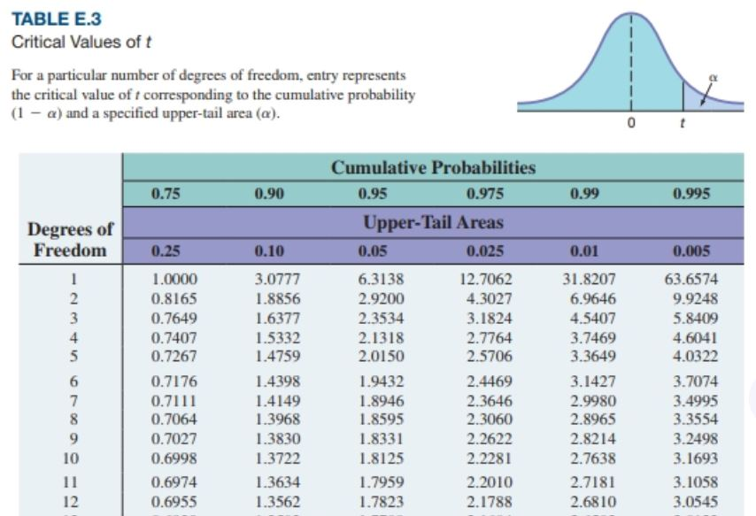

Slide 70
Inferences About the Slope: t Test Example
DCOVA
H₀: β₁ = 0
H₁: β₁ ≠ 0
From Excel output:
 | Coefficients | Standard Error | t Stat | P-value
Intercept | 98.24833 | 58.03348 | 1.69296 | 0.12892
Square Feet | 0.10977 | 0.03297 | 3.32938 | 0.01039
p-value
Decision: Reject H₀, since p-value < α.
There is sufficient evidence that square footage affects house price.

Slide 71
F Test for The Slope
DCOVA
F Test statistic:
where
where F_{STAT} follows an F distribution with 1 numerator and (n – 2) denominator degrees of freedom.

Slide 72
F-Test for The Slope
Excel Output
DCOVA
Regression Statistics
Multiple R | 0.76211
R Square | 0.58082
Adjusted R Square | 0.52842
Standard Error | 41.33032
Observations | 10
ANOVA | df | SS | MS | F | Significance F
Regression | 1 | 18934.9348 | 18934.9348 | 11.0848 | 0.01039
Residual | 8 | 13665.5652 | 1708.1957
Total | 9 | 32600.5000
With 1 and 8 degrees of freedom
p-value for the F-Test

Slide 73
F-Test for The Slope
JMP & Minitab Output
DCOVA
F_{STAT}
The regression equation is
Price = 98.2 + 0.110 Square Feet
Predictor Coef SE Coef T P
Constant 98.25 58.03 1.69 0.129
Square Feet 0.10977 0.03297 3.33 0.010
S = 41.3303 R-Sq = 58.1% R-Sq(adj) = 52.8%
Analysis of Variance
Source DF SS MS F P
Regression 1 18935 18935 11.08 0.010
Residual Error 8 13666 1708
Total 9 32600

Slide 74
F Test for The Slope
(continued)
DCOVA
H₀: β₁ = 0
H₁: β₁ ≠ 0
α = .05
df₁= 1 df₂ = 8
Test Statistic:
Decision:
Conclusion:
Critical Value:
F_{α} = 5.32
Reject H₀ at α = 0.05.
α = .05
There is sufficient evidence that house size affects selling price.
0
F
Do not
reject H₀
Reject H₀
F_{.05} = 5.32

Slide 75
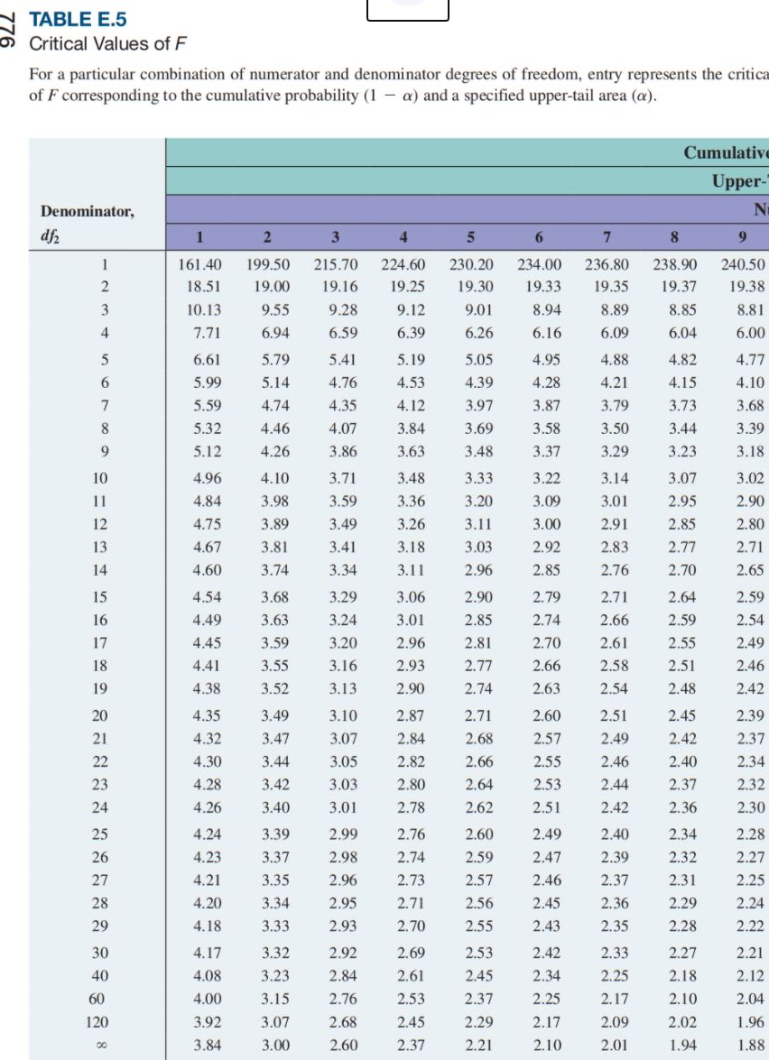
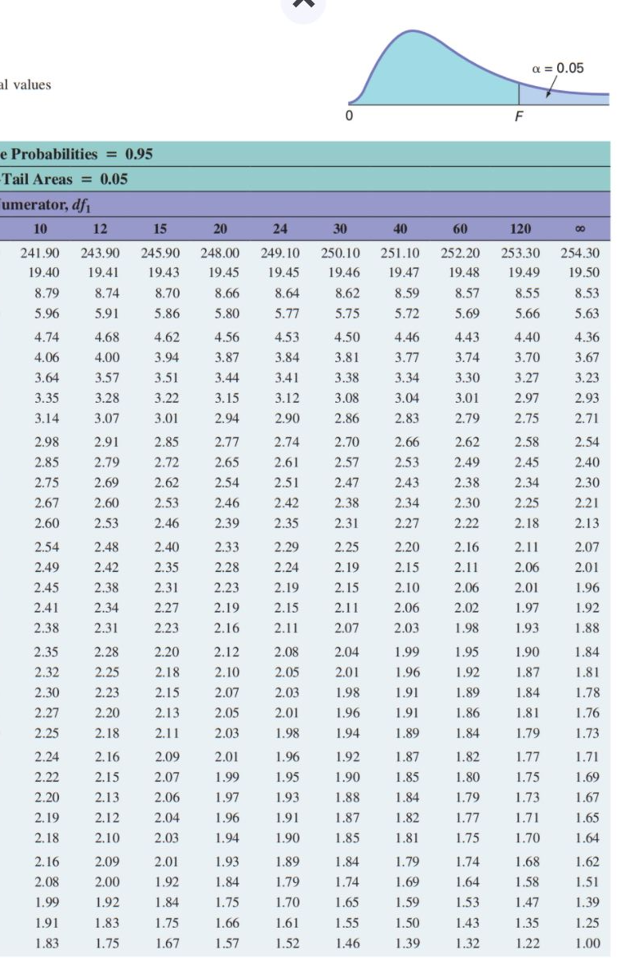

Slide 76
Confidence Interval Estimate for the Slope
DCOVA
Confidence Interval Estimate of the Slope:
d.f. = n - 2
Excel Printout for House Prices:
 | Coefficients | Standard Error | t Stat | P-value | Lower 95% | Upper 95%
Intercept | 98.24833 | 58.03348 | 1.69296 | 0.12892 | -35.57720 | 232.07386
Square Feet | 0.10977 | 0.03297 | 3.32938 | 0.01039 | 0.03374 | 0.18580
At 95% level of confidence, the confidence interval for the slope is (0.0337, 0.1858).

Slide 77
Confidence Interval Estimate for the Slope
(continued)
DCOVA
 | Coefficients | Standard Error | t Stat | P-value | Lower 95% | Upper 95%
Intercept | 98.24833 | 58.03348 | 1.69296 | 0.12892 | -35.57720 | 232.07386
Square Feet | 0.10977 | 0.03297 | 3.32938 | 0.01039 | 0.03374 | 0.18580
Since the units of the house price variable is $1,000s, we are 95% confident that the average impact on sales price is between $33.74 and $185.80 per square foot of house size
This 95% confidence interval does not include 0.
Conclusion: There is a significant relationship between house price and square feet at the .05 level of significance.

Slide 78
t Test for A Correlation Coefficient
DCOVA
Hypotheses
  H₀: ρ = 0 (no correlation between X and Y)
  H₁: ρ ≠ 0 (correlation exists)
Test statistic
(with n – 2 degrees of freedom)

Slide 79
t-test For A Correlation Coefficient
(continued)
DCOVA
Is there evidence of a linear relationship between square feet and house price at the .05 level of significance?
H₀: ρ = 0 (No correlation)
H₁: ρ ≠ 0 (correlation exists)
α =.05 , df = 10 - 2 = 8

Slide 80
t-test For A Correlation Coefficient
(continued)
DCOVA
Decision:
Reject H₀.
Conclusion:
There is evidence of a linear association at the 5% level of significance.
d.f. = 10-2 = 8
α/2=.025
α/2=.025
Reject H₀
-t_{α/2}
Do not reject H₀
t_{α/2}
Reject H₀
0
-2.3060
2.3060
3.329

Slide 81
Estimating Mean Values and Predicting Individual Values
DCOVA
Goal: Form intervals around Y to express uncertainty about the value of Y for a given X_{i}.
Confidence Interval for the mean of Y, given X_{i}.
Y
∧
Y
∧
Y = b₀+b₁X_{i}
Prediction Interval for an individual Y, given X_{i}.
X_{i}
X

Slide 82
Confidence Interval for the Mean of Y, Given X
DCOVA
Confidence interval estimate for the
mean value of Y given a particular X_{i}.
Size of interval varies according to distance away from mean, X.

Slide 83
Prediction Interval for an Individual Y, Given X
DCOVA
Confidence interval estimate for an
Individual value of Y given a particular X_{i}.
This extra term adds to the interval width to reflect the added uncertainty for an individual case.

Slide 84
Estimation of Mean Values: Example
DCOVA
Confidence Interval Estimate for μ_{Y|X=X}
Find the 95% confidence interval for the mean price of 2,000 square-foot houses.
i
∧
Predicted Price Y_{i} = 317.85 ($1,000s)
The confidence interval endpoints (from Excel) are 280.66 and 354.90, or from $280,660 to $354,900.

Slide 85
Estimation of Individual Values: Example
Prediction Interval Estimate for Y_{X=X}
DCOVA
Find the 95% prediction interval for X
an individual house with 2,000 square feet.
i
∧
Predicted Price Y_{i} = 317.85 ($1,000s)
The prediction interval endpoints from Excel are 215.50 and 420.07, or from $215,500 to $420,070.

Slide 86
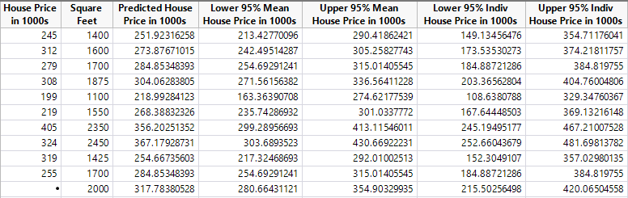
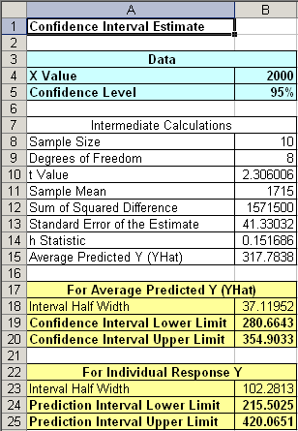
Confidence and Prediction Intervals in Excel, JMP, & Minitab For 2000 Sq. Ft. Home
(continued)
DCOVA
Predicted Values for New Observations
New
Obs Fit SE Fit 95% CI 95% PI
1 317.8 16.1 (280.7, 354.9) (215.5, 420.1)
Values of Predictors for New Observations
New Square
Obs Feet
1 2000

Slide 87
Pitfalls of Regression Analysis
DCOVA
Lacking an awareness of the assumptions of least-squares regression.
Not knowing how to evaluate the assumptions of least-squares regression.
Not knowing the alternatives to least-squares regression if a particular assumption is violated.
Using a regression model without knowledge of the subject matter.
Extrapolating outside the relevant range.
Concluding that a significant relationship identified always reflects a cause-and-effect relationship.

Slide 88
Seven Steps for Avoiding the Potential Pitfalls
DCOVA
Be clear about the problem or goal being investigated and the variables that need to be examined.
Construct a scatter plot of X vs. Y to observe the possible relationship.
Perform a residual analysis to check the assumptions:
  Plot the residuals versus X to check for violations of assumptions such as equal variance.
  Use a histogram, boxplot, or normal probability plot of the residuals to uncover possible non-normality.
  Plot the residuals versus time to check for independence. (This step is necessary only if the data are collected over time.)

Slide 89
Seven Steps for Avoiding the Potential Pitfalls
(continued)
DCOVA
If there are violations of the assumptions, use alternative methods to least-squares regression or alternative least-squares models.
If there are no violations of the assumptions, carry out tests for the significance of the regression coefficients and develop confidence and prediction intervals.
Refrain from making predictions and forecasts outside the relevant range of the independent variable.
Remember that the relationships identified in observational studies may or may not be due to cause-and-effect relationships (While causation implies correlation, correlation does not imply causation.)

Slide 90
Chapter Summary
In this chapter we discussed:
How to use regression analysis to predict the value of a dependent variable based on a value of an independent variable.
Understanding the meaning of the regression coefficients b₀ and b₁.
Evaluating the assumptions of regression analysis and know what to do if the assumptions are violated.
Making inferences about the slope and correlation coefficient.
Estimating mean values and predicting individual values.

