Slide 1
ELEC-E8423 - Smart Grid Electrical energy use in residential buildings, flexibility and DR potential of different energy uses
Xinyi Hu
26.04.2022

Slide 2
Introduction
Residential electricity consumption
Demand response (DR)
DR potential of different energy uses
Applications
Challenges and future Works
Conclusions
Electrical energy use in residential buildings, flexibility and DR potential of different energy uses

Slide 3
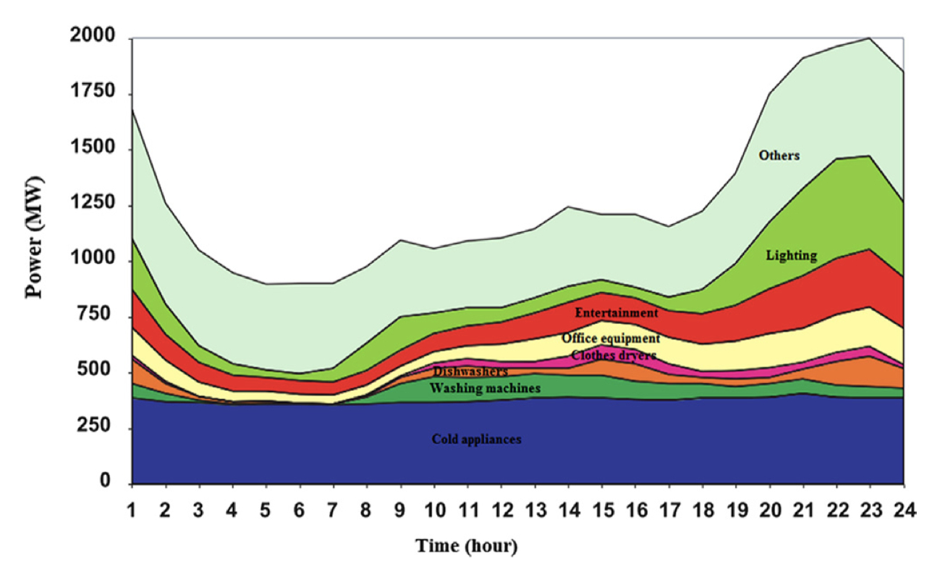
Residential electricity consumption
Figure. Load proﬁle of the residential sector
Electrical energy use in residential buildings, flexibility and DR potential of different energy uses
Source: Soares, A., et al. (2014). Categorization of residential electricity consumption as a basis for the assessment of the impacts of demand response actions. Renewable and Sustainable Energy Reviews, 30, 490-503.

Slide 4
Demand Response (DR)
Definition by the European Commission
“voluntary changes by end-consumers of their usual electricity use patterns – in response to market signals (such as time-variable electricity prices or incentive payments) or following the acceptance of consumers' bids (on their own or through aggregation) to sell in organized energy electricity markets their will to change their demand for electricity at a given point in time.”
Electrical energy use in residential buildings, flexibility and DR potential of different energy uses
Source: European Commission. (2013). Incorporating demand side flexibility, in particular demand response, in electricity markets, SWD(2013) 442 final.

Slide 5
Demand Response (DR)
Pros and cons
End-consumers’ side
Lower electricity bills both for participants and nonparticipants
Increased control over energy use and bills
Supply side
More efficient system and less pollutant emissions
Contribution to power system reliability
Lower cost of integrating renewable power to power system
Electrical energy use in residential buildings, flexibility and DR potential of different energy uses
Source: Annala, S. (2015). Households’ willingness to engage in demand response in the Finnish retail electricity market: an empirical study.

Slide 6
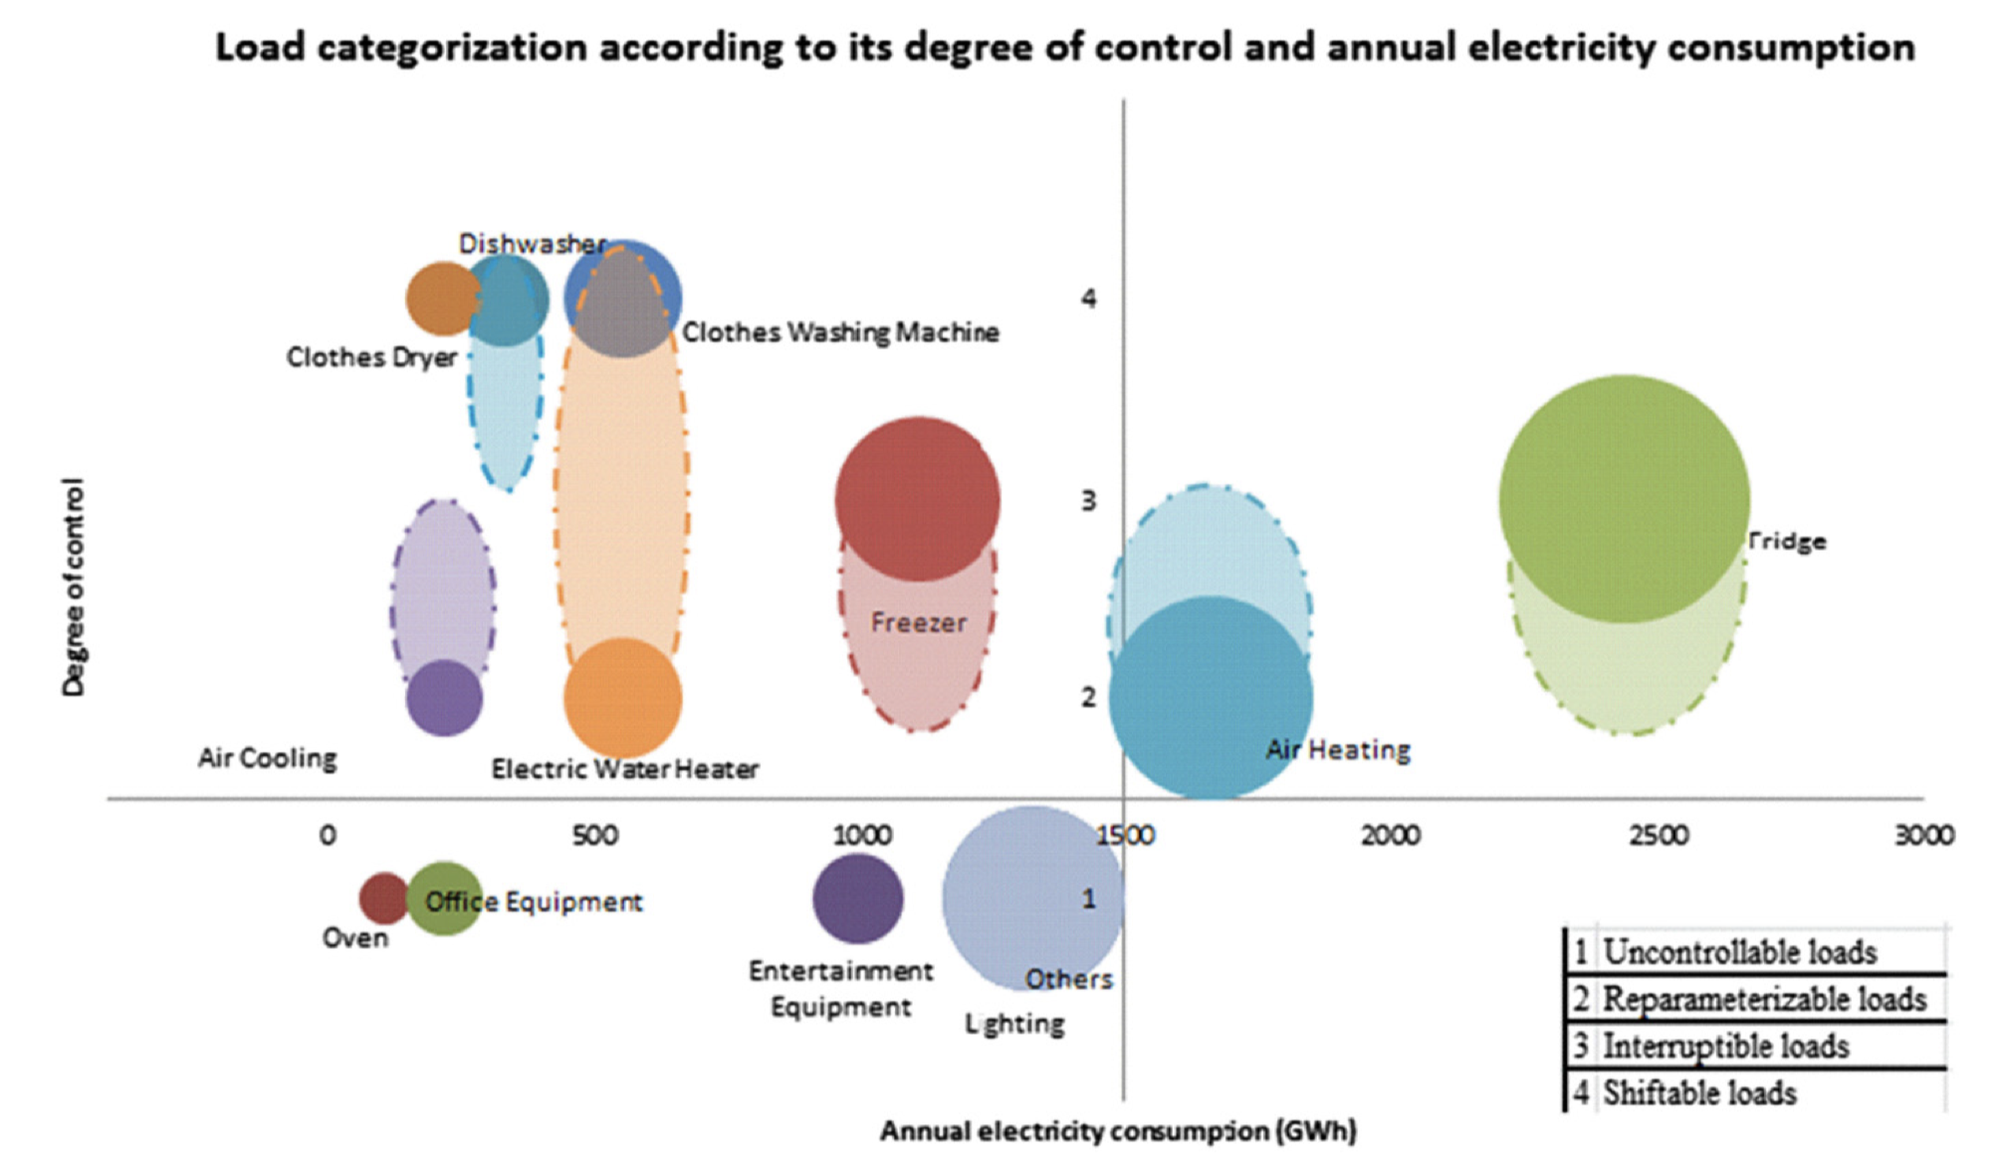
DR potential of different energy uses
Figure. Load categorization according to its degree of control and annual electricity consumption, data from Portugal
1. Non-controllable loads 3. Interruptible loads
2. Re-parameterizable loads 4. Shiftable loads
Electrical energy use in residential buildings, flexibility and DR potential of different energy uses
Source: Soares, A., et al. (2014). Categorization of residential electricity consumption as a basis for the assessment of the impacts of demand response actions. Renewable and Sustainable Energy Reviews, 30, 490-503.

Slide 7
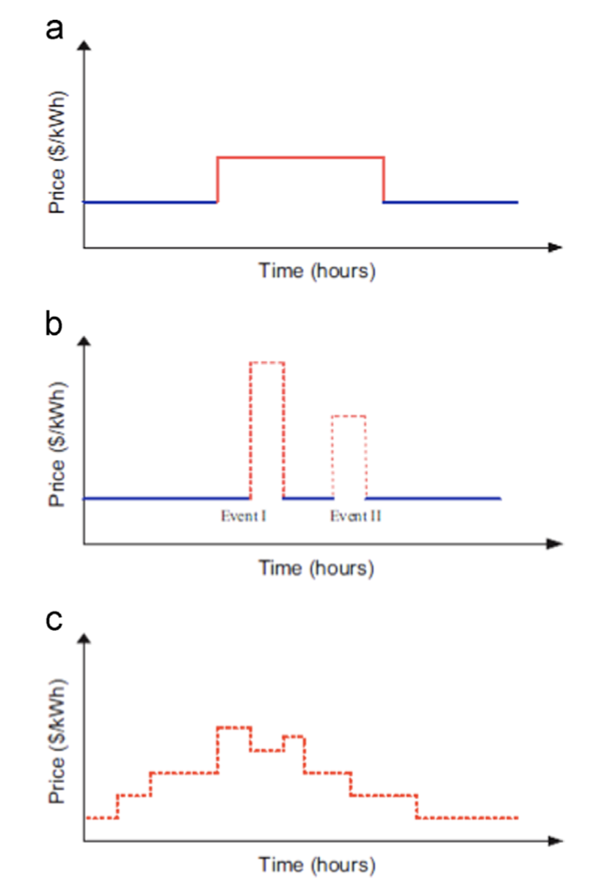
Applications
DR schemes
Price-based
Incentive-based
Type of control
Centralized
Distributed
Hierarchical
Load scheduling techniques
Accurate optimization method
Communication infrastructure
Time-of-Use (ToU)
Critical-Peak Pricing
Real-Time-Pricing
Figure. Time varying price schemes
Electrical energy use in residential buildings, flexibility and DR potential of different energy uses
Source: Haider, H. T., et al. (2016). A review of residential demand response of smart grid. Renewable and Sustainable Energy Reviews, 59, 166-178.

Slide 8
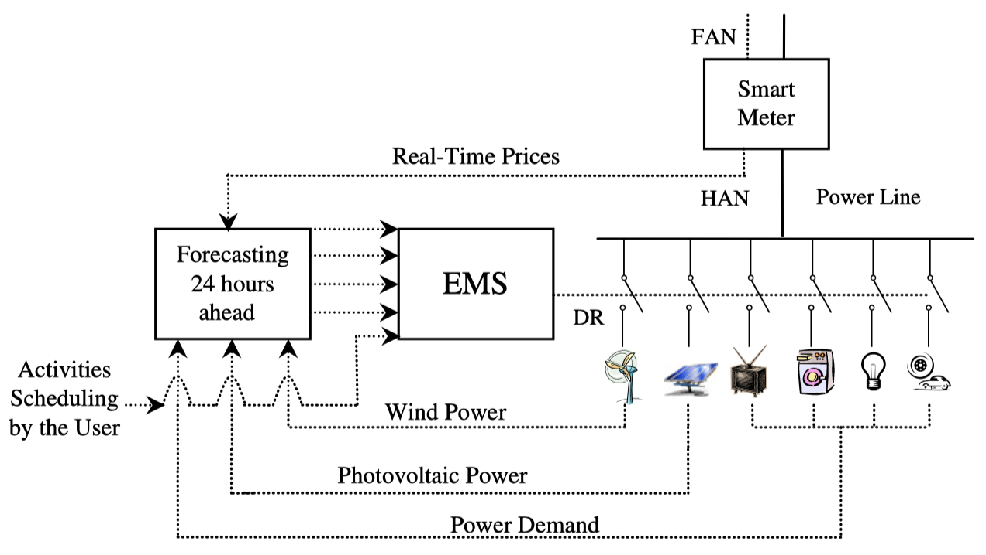
Applications
Figure. A typical house actively participating in smart grid with real time pricing (RTP) demand response programs
FAN = Field Area Network; HAN = Home Area Network; EMS = Energy Management System
Electrical energy use in residential buildings, flexibility and DR potential of different energy uses
Source: Lujano-Rojas, et al. (2012). Optimum residential load management strategy for real time pricing (RTP) demand response programs. Energy policy, 45, 671-679.

Slide 9
Challenges and future works
Modeling customers’ behavior and participation
-- Prediction and optimization
Concerns about privacy and autonomy issues (direct load control)
-- Transparency and trust
Complexity and effort to response and shift demands
-- Automation
Electrical energy use in residential buildings, flexibility and DR potential of different energy uses
Source: Parrish, B., et al. (2020). A systematic review of motivations, enablers and barriers for consumer engagement with residential demand response. Energy Policy, 138, 111221.

Slide 10
Conclusions
Demand response is voluntary changes by end-consumers of their usual electricity use patterns, responding to DR schemes.
The classification of residential energy uses based on control degree reveals their potential for DR.
Future work involves increasing consumers’ responsiveness and participation willingness, as well as simulation accuracy.
Electrical energy use in residential buildings, flexibility and DR potential of different energy uses

Slide 11
Source material used
Annala, S. (2015). Households’ willingness to engage in demand response in the Finnish retail electricity market: an empirical study. [Doctoral dissertation, Lappeenranta University of Technology]. https://lutpub.lut.fi/bitstream/handle/10024/113819/Salla%20Annala%20A4.pdf?sequence=2
Bari, A., Jiang, J., Saad, W., & Jaekel, A. (2014). Challenges in the smart grid applications: an overview. International Journal of Distributed Sensor Networks, 10(2), 974682.
European Commission. (2013). Incorporating demand side flexibility, in particular demand response, in electricity markets, SWD(2013) 442 final. https://ec.europa.eu/energy/sites/ener/files/documents/com_2013_public_intervention_swd07_en.pdf.
Haider, H. T., See, O. H., & Elmenreich, W. (2016). A review of residential demand response of smart grid. Renewable and Sustainable Energy Reviews, 59, 166-178.
Lujano-Rojas, J. M., Monteiro, C., Dufo-López, R., & Bernal-Agustín, J. L. (2012). Optimum residential load management strategy for real time pricing (RTP) demand response programs. Energy policy, 45, 671-679.
Parrish, B., Heptonstall, P., Gross, R., & Sovacool, B. K. (2020). A systematic review of motivations, enablers and barriers for consumer engagement with residential demand response. Energy Policy, 138, 111221.
Soares, A., Gomes, Á., & Antunes, C. H. (2014). Categorization of residential electricity consumption as a basis for the assessment of the impacts of demand response actions. Renewable and Sustainable Energy Reviews, 30, 490-503.
Electrical energy use in residential buildings, flexibility and DR potential of different energy uses

