Slide 1
ELEC-E8423 - Smart Grid ”DR limitations set by human comfort requirements. Heat gains, heating and cooling, and demand flexibility.”
Minzhou Chen
Fabian Wegener
26.04.2022

Slide 2
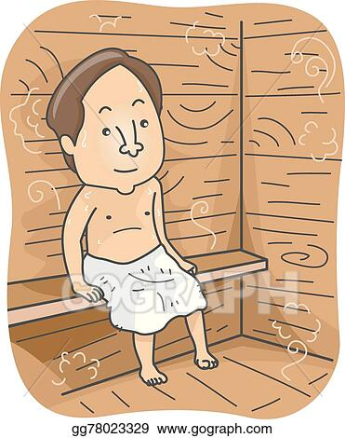
Content
Human comfort
Definition & Impacts
Comfort requirements & DR
Demand flexibility
Electrical demand & loads in Finland
Energy consumption in households
Types of loads & DSM
DSM in heating systems
DR limitations & potentials
Conclusion
Bibliography

Slide 3
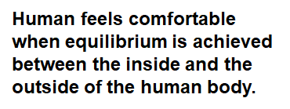
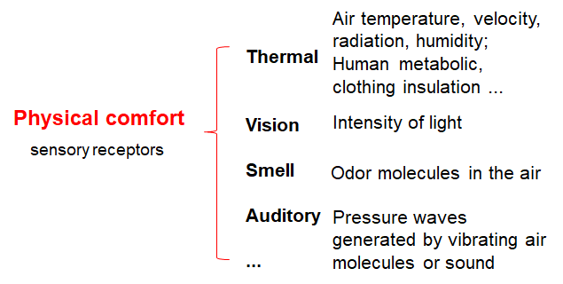
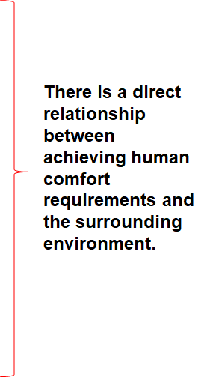
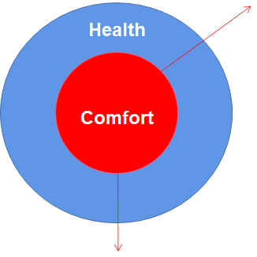
Human Comfort

Slide 4
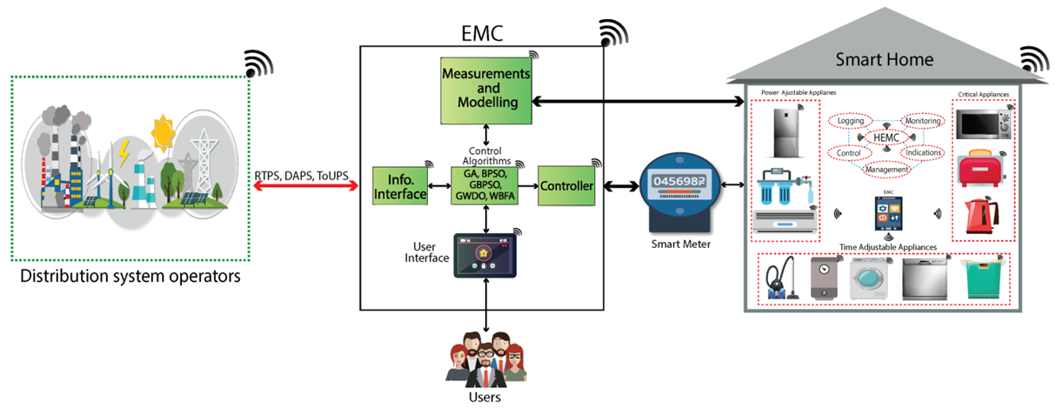
Comfort requirements & Demand Response
Demand Response (DR) can be defined as the changes in electric usage by end-use customers from their normal consumption patterns in response to changes in the price of electricity over time

Slide 5
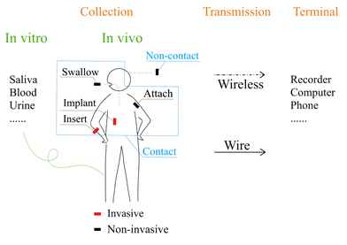
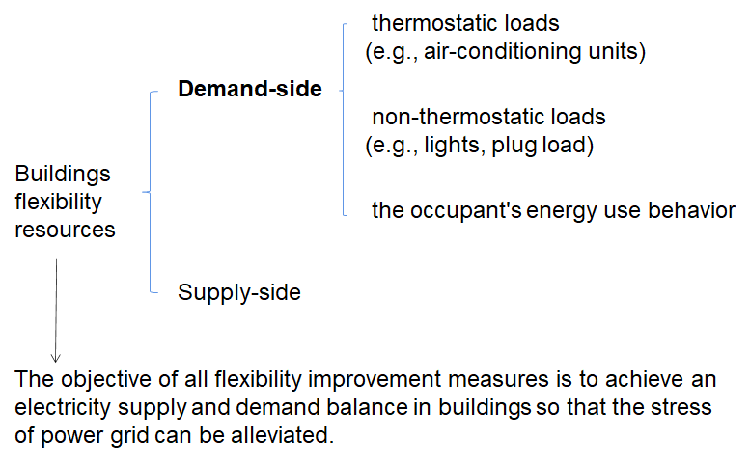
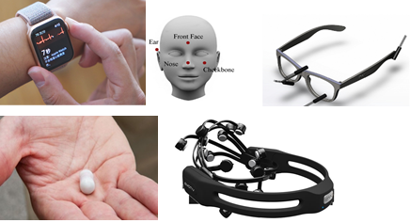
Demand flexibility

Slide 6
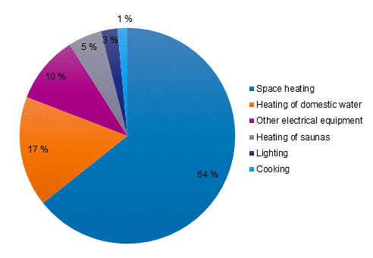
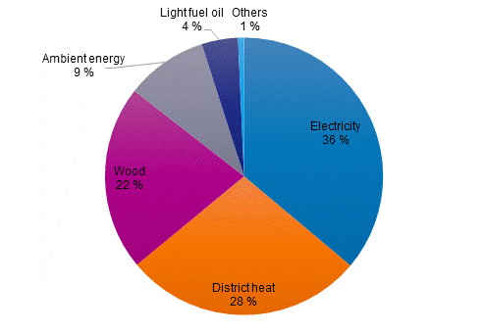
Electricity demand & loads in Finland
Energy consumption in Finnish households by use in 2020
→ Space heating & Tap water heating responsible for 81% of consumed energy
Energy consumption in Finnish households by energy source in 2020
→ Electricity & District heating responsible for 64 % of consumed energy

Slide 7
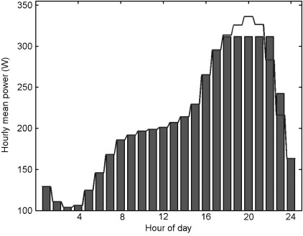
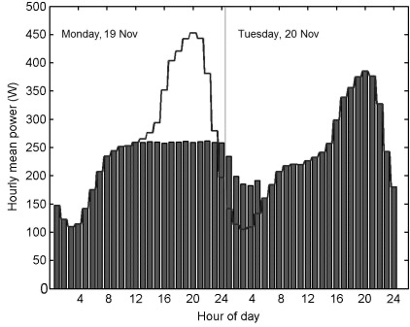
Types of loads & DSM
Type of loads
Time critical (e.g. Lighting, Cooking stove, Home entertainment, hot domestic water)
Not time critical (e.g. Washing machine, Dishwasher)
Continuous (e.g. Space heating, refrigerator, ventilation)
Demand side management (DSM)
Shifting of use to a later time
Turning off the appliance
Priorities to keep houshold operational
Case 1: Time shifting of cold appliances (-7.2%)
Case 2: Time shifting of not time critical loads and cutting off time critical loads (-42.0%)

Slide 8
DSM in space heating and domestic water
New residential buildings in Nordic countries are well-insulated and the thermal mass acts as a buffer to provide load shifting capacities
Cutting of space heating during peak demand leads to max. 0,5$∘$C/h temperature drop for the heat load design outdoor temperature
Ventilation rate reduced to 50%
Tap water heating systems including heat storage provides buffer for many hours of load shifting
The storage can be heated up, when electricity demand is low and used during peak demand
Type of load changes from time critical to non-time critical load

Slide 9
DR limitations & potentials
DR Limitations
Mainly time critical loads
Inside temperature
Air quality
Entertainment & remote work
Routines and habits (e.g. cooking and sauna)
→ Cannot be compromised without violation of comfort requirements
DR Potentials
Time shifting of space heating
Heat storage for tap water
Time shifting of some not time-critical loads (e.g. EV-charging)
→ Achievable already with simple methods and technology, but synchronization with peak demand appearance required (BMS)

Slide 10
Conclusion
The potential for demand response in space heating and domestic hot water is big, but investments in BMS required.
The willingness of customer to use DR goes hand-in-hand with an ensurement that demand response will not compromise their comfort levels.​
Simple solutions for DR are already available, but further efforts need to be implemented (Link of BSM and TSO; Reward-system for DR-participants)

Slide 11
Bibliography
Statistics Finland. Energy consumption in households by use in 2020. Available online: https://www.stat.fi/til/asen/2020/asen_2020_2021-12-16_kuv_002_en.html
Statistics Finland. Energy consumption in households by energy source in 2020. Available online at: https://www.stat.fi/til/asen/2020/asen_2020_2021-12-16_kuv_001_en.html
Jukka V. Paatero and Peter D. Lund. 2006. A model for generating household electricity load profiles. International Journal of Energy Research, volume 30, number 5, pages 273-290.
Amal Kamal Mohamed Shamseldin. (2018) Considering coexistence with nature in the environmental assessment of buildings. HBRC Journal 14:3, pages 243-254.
Albadi M H, El-Saadany E F. Demand response in electricity markets: An overview[C]//2007 IEEE power engineering society general meeting. IEEE, 2007: 1-5.
Barbierato L, Estebsari A, Pons E, et al. A distributed IoT infrastructure to test and deploy real-time demand response in smart grids[J]. IEEE Internet of Things Journal, 2018, 6(1): 1136-1146.
Hafeez G, Wadud Z, Khan I U, et al. Efficient energy management of IoT-enabled smart homes under price-based demand response program in smart grid[J]. Sensors, 2020, 20(11): 3155.

