Slide 1
ELEC-E8423 - Smart Grid Demand response of commercial loads
Markus Grönblad
Aaro Vasama
19.04.2022

Slide 2
Introduction
In this presentation we are going to talk about what are the possibilities of demand response (DR) in commercial buildings.
Other point that we are going to talk about is that, how this demand response is technically possible and what are the limitations for it.
Main problem that the DR is trying to address is the growth of variable renewable electricity generation that causes increasing uncertainty in the power grid balance
19.04.2022
Notes:
The idea behind demand response (DR) is to adjust the electrict consumption of a given site toi match the the need and the offering on the electricity market

Slide 3
Demand response management
Adjustment of electricity consumption due to external signals
Why would you want to take part in this?
Price based
Adjust loads based on electricity prices
Cost savings
Voluntary
Grid need based
Adjust loads based on grid frequency
Monetary compensation from TSO
Contractual
19.04.2022
Notes:
NOTE: in the case of monetary compensation this case the load can be adjusted up & down
Financial gains from TSO (transmission system operator) and financial gains from this

Slide 4
Commercial buildings
Shops, malls, restaurants, offices, sports halls
Uniform load curve dictated by human behavior
Human behavior is also a limiting factor for DR
Biggest problem is how to integrate human needs while still getting enough demand response capacity
19.04.2022
Notes:
As already mentioned, ~1/3 of total electricity demand
https://www.researchgate.net/figure/1-Representative-daily-load-curve-for-commercial-loads_fig10_276410886

Slide 5
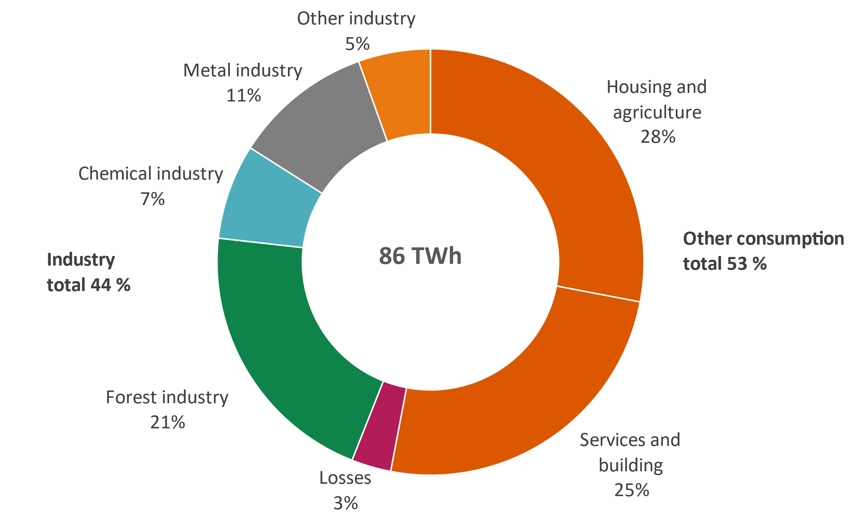
Loads in commercial buildings
HVAC
Lighting
Others
EV charging
IT systems
Kitchens
User mobility
The shares differ significantly depending on climate and building use
19.04.2022

Slide 6
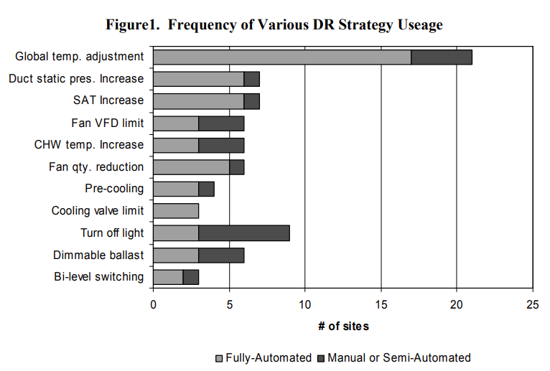
Sources of DR in commercial buildings
Changes need to be applied with the user experience in mind!
Magnitude of change
Rate of change
19.04.2022
Notes:
SAT=supply/static air temperature
Dimmable ballast=Light controller
CHW=Chilled water temperature
Fan VFD= Variable frequency drive or motor controller for fan motors
Bi-level switching = two different light levels

Slide 7
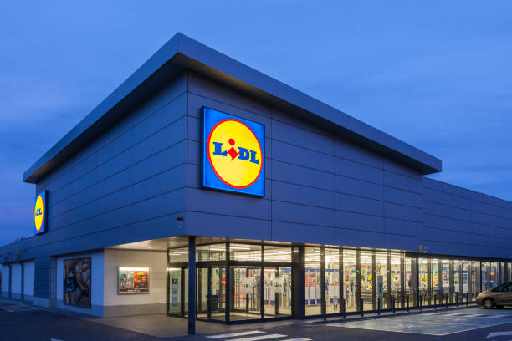
CASE: Vibeco & LIDL
Aggregation of 136 Lidl stores around Finland
Changes in electricity consumption are implemented by regulating ventilation and water-cooling machines.
The changes are momentary and do not interfere with conditions in stores.
19.04.2022
Notes:
https://media.istockphoto.com/photos/lidl-supermarket-building-picture-id699953406?k=20&m=699953406&s=612x612&w=0&h=rH0ekcfVe8yF_Vz6OE-ONrN_Q3nJqGtQuirvECwK3Q4=
In practice, connecting to a virtual power plant means that in the future, Lidl’s stores will automatically increase or decrease electricity consumption in order to balance the electricity grid.
The flexibility of electricity consumption through a virtual power plant reduces the need to use coal-based reserve power in Finland. At the same time, Lidl can participate in the consumer elasticity market and earn income from store properties.

Slide 8
Future developments
Aggregation of multiple small commercial loads, like in previous example
Adoption of EV charging in the DR system
Building automation and IoT will bring new possibilities in regard of virtual power plants
Including novel solutions such as ships into the demand response network
Lots of new startups in this space!
19.04.2022

Slide 9
Conclusions
Demand response management will play a key role in stabilizing our grid as the generation fluctuation increases
User experience is a limiting factor when implementing DR especially in the case of buildings
There is huge potential for DR in commercial loads, but these small loads need to be aggregated in order to have a considerable grid balancing difference
19.04.2022

Slide 10
Source material used
Watson, D., Kiliccote, S., Motegi, N. & Mary Ann Piette, M. A. (2006) Strategies for Demand Response in Commercial Buildings [Online]. Available at: https://www.aceee.org/files/proceedings/2006/data/papers/SS06_Panel3_Paper25.pdf (Accessed 3.4.2022)
Julin, V. (2019) Demand response on commercial buildings [Online]. Available at: https://aaltodoc.aalto.fi/handle/123456789/37112 (Accessed 3.4.2022)
Charoen, P., Kitbutrawat, N. & Kudtongngam, J. (2022) A Demand Response Implementation with Building Energy Management System [Online]. Available at: https://www.mdpi.com/1996-1073/15/3/1220/htm Khorram, M., Abrishambaf, O., Faria, P. & Vale, Z. (2018) Office building participation in demand response programs supported by intelligent lighting management [Online]. Available at: https://energyinformatics.springeropen.com/articles/10.1186/s42162-018-0008-4
Introduction to Commercial Building Control Strategies and Techniques for Demand Response Available at: https://eta-publications.lbl.gov/sites/default/files/59975.pdf
Vibeco (2022). Lidl’s 136 stores in Finland will be connected to the virtual power plant service. Available at: https://vibeco.fi/en/references/lidl-suomi/ (Accessed 14.4.2022)
Jin et al. (2019). ESS Optimal Scheduling considering Demand Response For commercial Buildings. Available: https://doi.org/10.1109/IYCE45807.2019.8991566. (Accessed 4.4.2022)
Khorram, M. et al. (2018). Office building participation in demand response programs supported by intelligent lighting management [Online]. Available at: https://doi.org/10.1186/s42162-018-0008-4. (Accessed 13.4.2022)
19.04.2022

