Slide 1
ELEC-E8423 - Smart Grid Wind power generation variation and its modeling
Arttu Niemelä & Dani Hyttinen

Slide 2
Introduction
Role of wind power has increased in recent years
In 2020, almost 10% of Finnish electricity consumption (8 TWh) was produced with wind power
Potential to increase up to 30 TWh by 2030
To balance the power system, TSO needs to know the amount of generation
Due to the intermittency of wind power, forecasting wind power generation is a crucial task
Both for TSO and energy producer

Slide 3
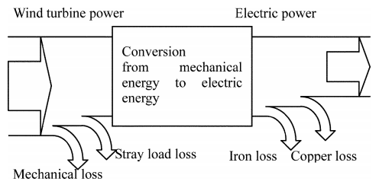
Wind power
Wind power
Where:
A = Surface are receiving the wind
$δ$ = density of air
w = wind speed
C_{p} = power coefficient
$η$ = losses (<1)
$$P_{out}=\frac{1}{2}Aδw^{3}C_{p}η$$
Power output
Source: Inoue et al (2006)

Slide 4
Wind speed variation
Data: Finnish Meteorological Institute

Slide 5
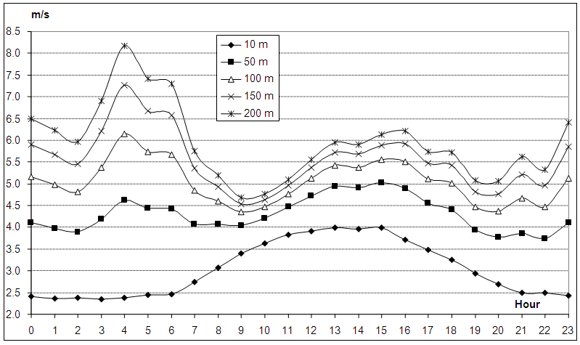
Wind speed variation
Approximate increase of wind speed with height: ${v_{2}=v_{1}\text{(}\frac{H2}{H1} )}^{α}$
Source: Tar et al (2015)
Notes:
Alpha: reflects the changes due to ground roughness and stability of air (temperature related)

Slide 6
Wind speed forecasting
Forecasting is important to the transmission system operator (TSO) to make power transfer to the grid possible.
Types of forecasting
Very short-term (seconds up to 30 minutes)
Short-term (30 minutes to 6 hours)
Medium-term (6 hours to 24 hours)
Long-term (24 hours to 72 hours)
Very long-term (longer than 72 hours)
Notes:
1. TSO needs to know roughly how much wind power will be produced to make power transfer to the grid possible.
2. Very short term is used to control the operation of the wind turbine
3. Short to mid term are used to schedule wind power generation within the energy system
4. Long term mostly used to schedule maintenance and deciding unit commitments.
5. Short-term and mid-term more in use as they are more precise and robust.

Slide 7
Wind speed forecasting examples
Artificial neural networks (ANN) and deep neural networks (DNN) are mostly used for forecasting very short-term wind speeds.
Support vector machine (SVM)
Combination of machine learning methods with a time series model is most used for short term wind speed forecasting.
Auto-regressive integrated moving average (ARIMA)
Long-term and very long-term forecasting can be made with hybrid methods.
Particle swarm optimization combined with adaptive-network-based fuzzy interference system (PSO+ANFIS)
Notes:
2. Short term wind speed forecasting is the most common due to electricity markets.
Used for predicting the power production of the day ahead and setting prices depending on that
3. In this case the Particle swarm optimization is supposed to find the best variables for the adaptive network based fuzzy interference system.

Slide 8
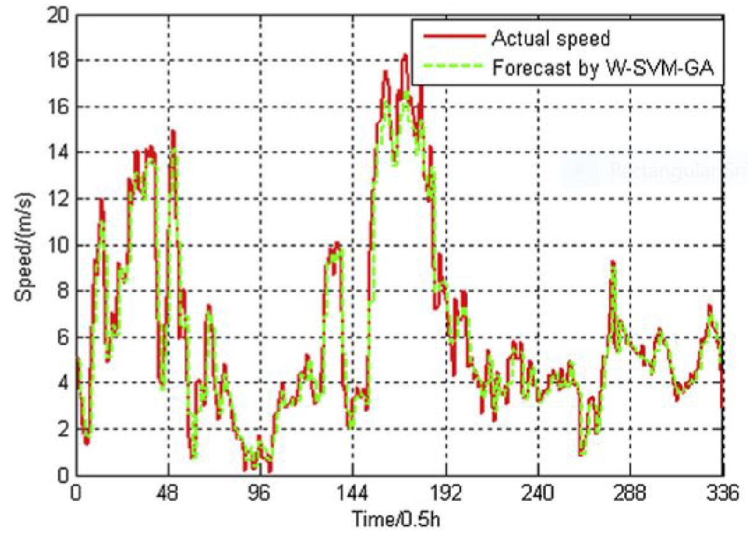
Example of a wind speed forecast
Combination of a wavelet transform, support vector machine and a genetic algorithm (WT-SVM-GA) used to predict short term wind speeds.
Source: HS Dhiman. (2020)
Notes:
1. WT-SVM-GA forecasts the wind speed quite accurately as can be seen from the graph. Mean absolute percentage error MAPE is slightly below 15%

Slide 9
Forecast by Fingrid
Level error
Phase error
Notes:
Mean absolute percentage error MAPE: approx 20% for the updated once a day forecast, 15% for the updated hourly forecast
Level error: error in the level of generation due to badly configured forecast model
Phase error: larger changes in wind speed due to timing of weather front for example

Slide 10
Conclusions
Power output from wind turbine varies with the cube of the wind speed
Wind speed has a high variability
Variations in wind speed has an impact in energy costs
Forecasting wind speed has an important role to TSO and to the energy producer
Various techniques are used for forecasting such as machine learning, neural networks and some other hybrid methods
Notes:
2. Forecasting is needed for the economic operation of the wind farm. TSO needs to know how much wind power will be produced to coordinate the supply and demand.
3. ANN, DNN for very short term, machine learning combined with time series for short term, and other hybrid methods for longer term.

Slide 11
References
Finnish Meteorological Institute. Download observations. https://en.ilmatieteenlaitos.fi/download-observations
A. Inoue. (2006). "A calculation method of the total efficiency of wind generators". Wiley Online Library.
HS Dhiman. (2020). “A Review of Wind Speed & Wind Power Forecasting Techniques” Available: https://arxiv.org/pdf/2009.02279.pdf
K. Tar, A. Kircsi, S. Sándor, T. Tóth, V. Róbert, K. László. (2015). "Investigation of the wind power potential of the Hernád valley". Landscape & Environment.
Official Statistics of Finland (OSF): Production of electricity and heat [e-publication]. ISSN=1798-5099. 2020. Helsinki: Statistics Finland [referred: 21.3.2022]. Access method: http://www.stat.fi/til/salatuo/2020/salatuo_2020_2021-11-02_tie_001_en.html
H. Holttinen, J. Miettinen, S. Sillanpää (2013) ”Wind power forecasting accuracy and uncertainty in Finland”. Espoo: VTT Technology 95.

Slide 12
References
Suomen Tuulivoimayhdistys. Tuulivoimaennusteita. https://tuulivoimayhdistys.fi/tietoa-tuulivoimasta-2/tietoa-tuulivoimasta/tuulivoima-suomessa-ja-maailmalla/tuulivoimaennusteita. [Referred 21.3.2022].

