Slide 1
ELEC-E8423 - Smart Grid Power markets in Nordic Countries: Day-ahead market and intraday balancing
Anette Ryhänen and Jenni Kovalainen
05.04.2022

Slide 2
Introduction
Physical power markets
Scope of the presentation
Day-ahead market (Elspot)
Market pricing
Bidding areas and price coupling
Intraday market (Elbas)
Scope
←
Derivatives markets
Physical deliveries
Balancing markets
Elspot
Key terms
CET = Central European time
Marginal cost = Cost of producing one unit of electric energy (Fuel and variable O&M)
Elbas
Nord Pool
day-ahead market
Nord Pool intraday market
10 y – 1d
36 h – 12 h
36 h – 1 h
1 h -

Slide 3
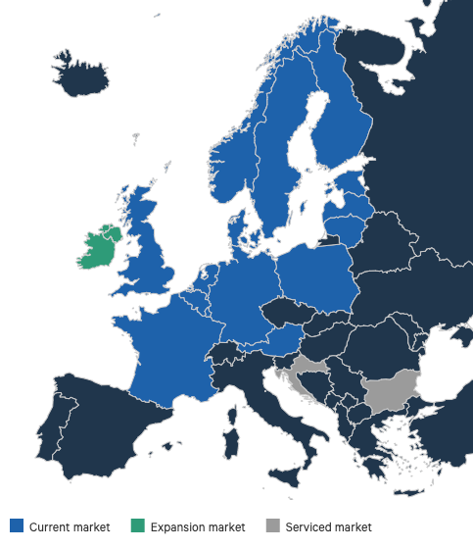
Day-ahead market (Elspot)
The main forum for trading electricity
For the following day, hour by hour, within 12-36 hours before delivery:
A consumer evaluates its energy need and price
A producer decides its deliver energy capacity and cost rate
After 12:00 CET, Nord Pool clears the final hourly trading price for all market participants
The price balance settles at the intersection of supply and demand curves, while considering network constraints
High demand → possibly bottlenecks
Result of the day-ahead market is used as the baseline for planning the next 24-hour period
2023: from a settlement period of 1 hour to 15 minutes

Slide 4
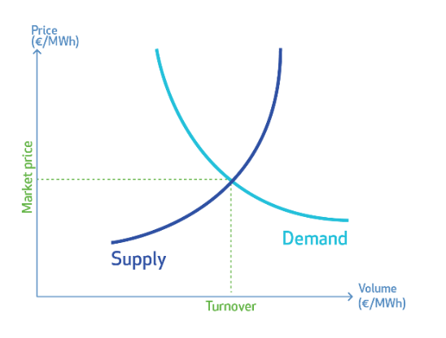
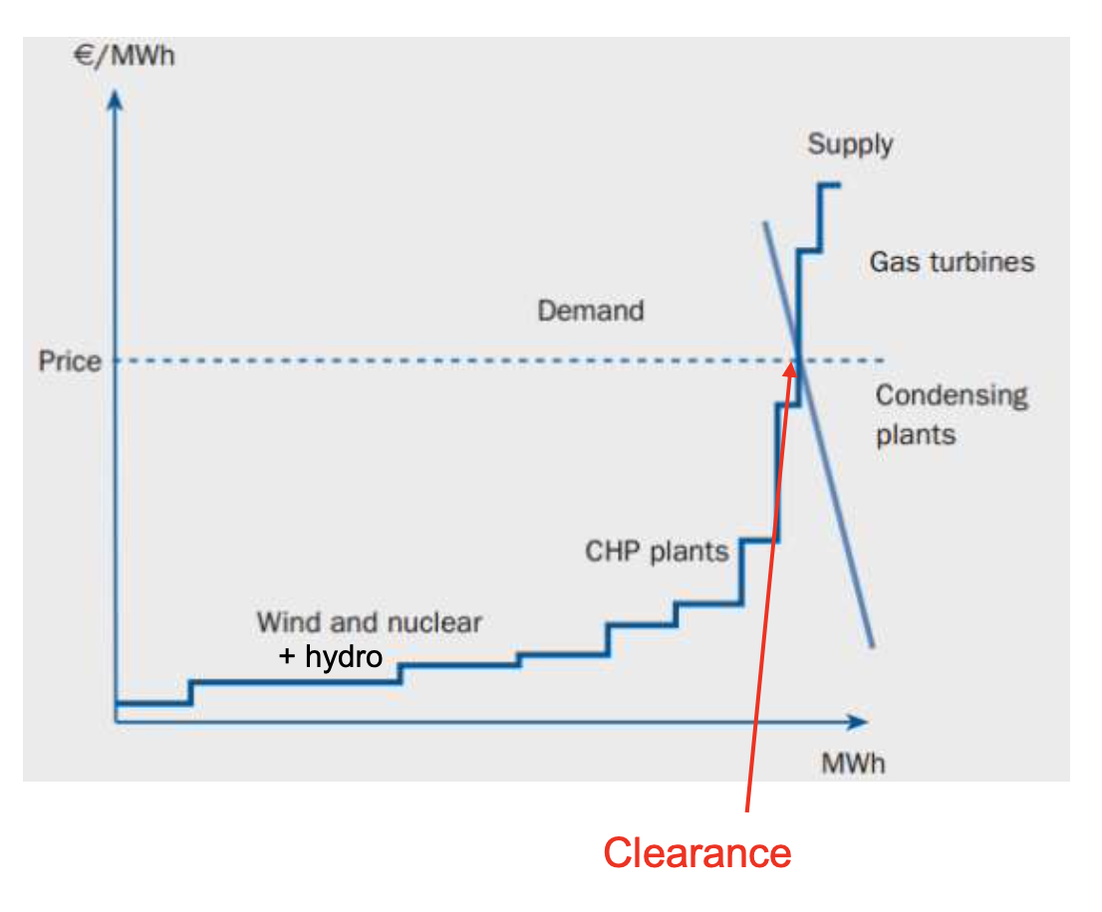
Market pricing and merit order
The market price balances supply and demand for each hour
Challenges: inability to store electricity and high supply failure costs
The merit order is based on the lowest marginal cost of production
Wind, hydro, nuclear used first
Gas turbines, condensing power plants used last
Producer: The cost of production for the most expensive needed source
Customer: What the customer is willing to pay to satisfy demand
Profit

Slide 5
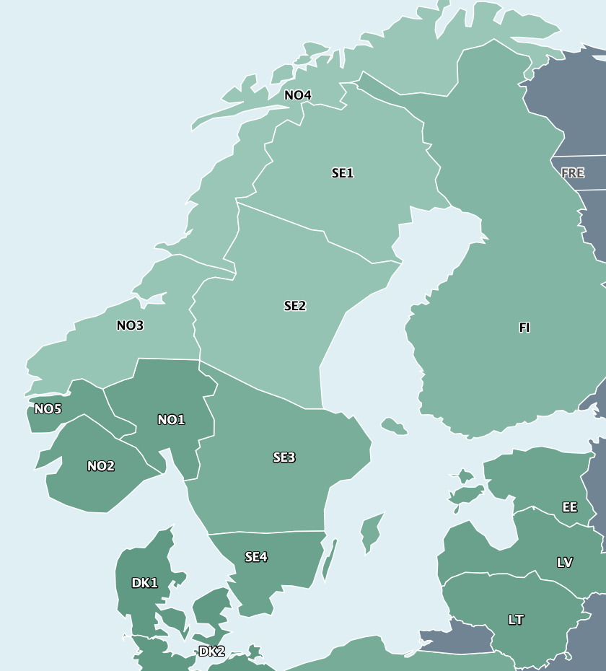
Bidding areas and price coupling
The Nord Pool markets are divided into bidding areas (price areas)
Determined by the local TSO
Identifying constraints and ensuring that the price reflects market conditions
Limits in transmission capacity cause bottlenecks → price difference between bidding areas
Power moves from the low price area to the high price area
Price coupling: Interconnector not in full use → same price between bidding areas
Price decoupling: Interconnector in full use → price difference between bidding areas

Slide 6
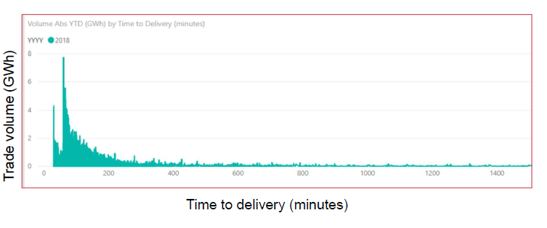
Intraday market (Elbas)
Nord Pool’s Intraday market is continuous market that enables power trading between the closing time of the day-ahead market (12:00 CET) and the next day delivery (00:00 CET) until one hour before the delivery
The Intraday market allows market participants to take unexpected changes in consumption and outages into account
Works together with the day-ahead market to help secure the necessary balance between supply and demand
Prices are set up based on a first-come first-served principle, where best prices come first – highest buy price and lowest sell price

Slide 7
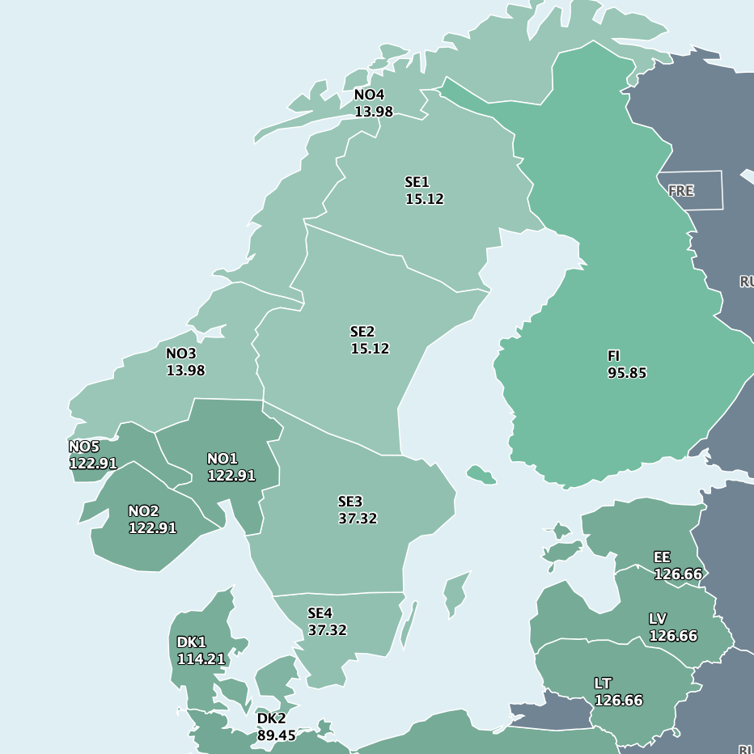
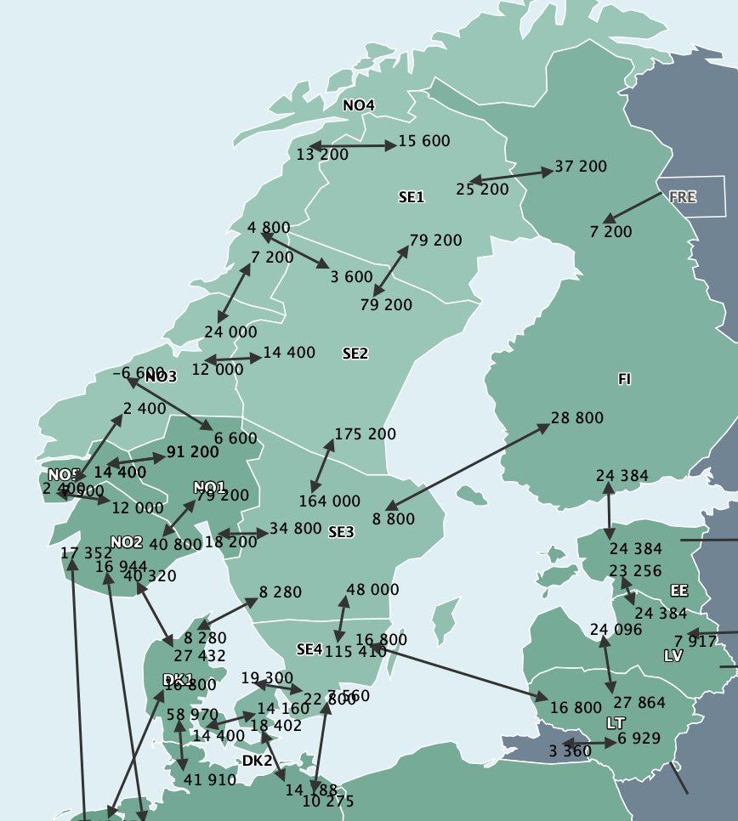
Pricing (€/MWh) and transmission capacity (MW) 21.3.2022
Notes:
The picture on the left shows the price differences in bidding areas, for example in Finland, the price of electricity was many times higher than in Sweden.
Energy prices are currently increasing due to the war in Ukraine and the sanctions imposed on Russia.
Usually in the spring, prices fall in the market, but currently prices have been high.
Oil, gas and coal prices have been at record highs, pushing up electricity prices in the derivatives market.
However, thanks to snow and rainfall, the water situation has improved significantly.
In addition, warm and windy weather and the good operating capacity of nuclear power plants have restrained the hourly market prices.
The figure on the right shows the transmission capacity between the bidding areas.
Transmission capacity should probably be increased in the future, as the amount of intermittent renewable energy will increase, and more flexible thermal power plants are being shut down.

Slide 8
Conclusions
The day-ahead market is the main forum for trading electricity in Nord Pool, and together with the Intraday market it will help to secure the necessary balance between supply and demand
The merit order encourages the use of renewables and makes expensive sources, such as flexible gas turbines less favorable to invest in
The Nordic electricity market prices are affected by hydro and wind production, as well as geopolitical tensions

Slide 9
Source material used
Skajaa, A., Edlund, K., & Morales, J. Intraday Trading of Wind Energy. IEEE. (2015). Available at: https://ieeexplore.ieee.org/stamp/stamp.jsp?tp=&arnumber=7005520.
Empower. (2018). Enabling a Smooth Transition to 15 Minute Balance Settlement. 39 p. Available at: https://energiavirasto.fi/documents/11120570/13026619/Final+Report+-+15+Minute+Balance+Settlement%2C+Delivered+version.pdf/b9d7ae4d-a0e0-ca4d-4d8e-748d382d5436/Final+Report+-+15+Minute+Balance+Settlement%2C+Delivered+version.pdf
Faria, E., Fleten, SE. Day-ahead market bidding for a Nordic hydropower producer: taking the Elbas market into account. Comput Manag Sci 8, 75–101 (2011). Available at: https://doi-org.libproxy.aalto.fi/10.1007/s10287-009-0108-5
Nord Pool. (2021). Market data. [Accessed 22.03.2022]. Available at: https://www.nordpoolgroup.com/Market-data1/#/nordic/map
Nord Pool. (2020a). [Accessed 22.03.2022]. Available at: https://www.nordpoolgroup.com/
Nord Pool. (2020b). Day-ahead market. [Accessed 22.03.2022]. Available at: https://www.nordpoolgroup.com/the-power-market/Day-ahead-market/
Nord Pool. (2020c). Bidding areas. [Accessed 22.03.2022]. Available at: https://www.nordpoolgroup.com/the-power-market/Bidding-areas/
Nord Pool. (2020d). Intraday market. [Accessed 22.03.2022]. Available at: https://www.nordpoolgroup.com/the-power-market/Intraday-market/.
Nord Pool. (2019). Annual Report 2019. [Accessed 22.03.2022]. Available at: https://www.nordpoolgroup.com/49ea17/globalassets/download-center/annual-report/annual-report_2019.pdf
Saulny, N. (2021). Energy Markets, Lecture 9 – Batteries in electricity markets: Case Batcave by Fortum
Spodniak, P., Ollikka,K. Honkapuro, S. (2021) The impact of wind power and electricity demand on the relevance of different short-term electricity markets: The Nordic case
Applied Energy, Volume 283,2021,116063,ISSN 0306-2619, Available at: https://doi.org/10.1016/j.apenergy.2020.116063.
Syri, S. (2021). Energy Markets, Lecture 5 – Nordic Electricity market
Syri, S. (2021). Energy Markets, Lecture 6 – Central European electricity markets
Vattenfall. (2022). Sähkömarkkinakatsaus 3 /2022: Sota Ukrainassa on suistanut energiamarkkinat syvään epävarmuuden tilaan. [Accessed 22.03.2022] Available at: https://www.vattenfall.fi/fokuksessa/sahkomarkkinakatsaus/sahkomarkkinakatsaus-32022/

