Slide 1
ELEC-E8423 - Smart Grid Prosumer / Consumers. Local energy resources and energy matching
Emma Pesonen
Pihla Kössi
26.4.2022

Slide 2
Introduction
Prosumer = Consumer and Producer
Local energy resources = renewable energy which is produced at the site of consumption
Wind power
Solar power
Heat generation (geothermal heat, fireplaces, biomass boilers)
Energy matching: optimize the interaction between energy systems and buildings to maximize RES in built environment
Load side management
Storages

Slide 3
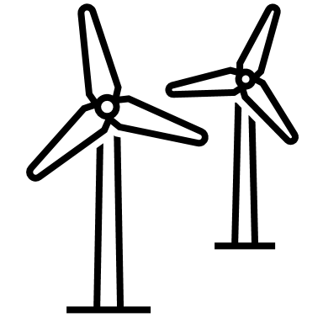
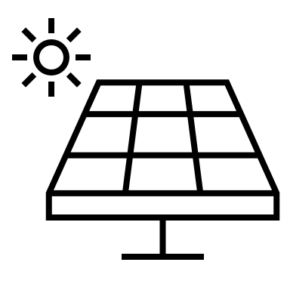
Local Energy Resources
Wind power production
Typical power output 400 W-20 kW
Solar power production
Typical panel size 3-10 kW
Potential depends on the environmental conditions
Production near to consumption
Shorter transport distances → reduce energy losses

Slide 4
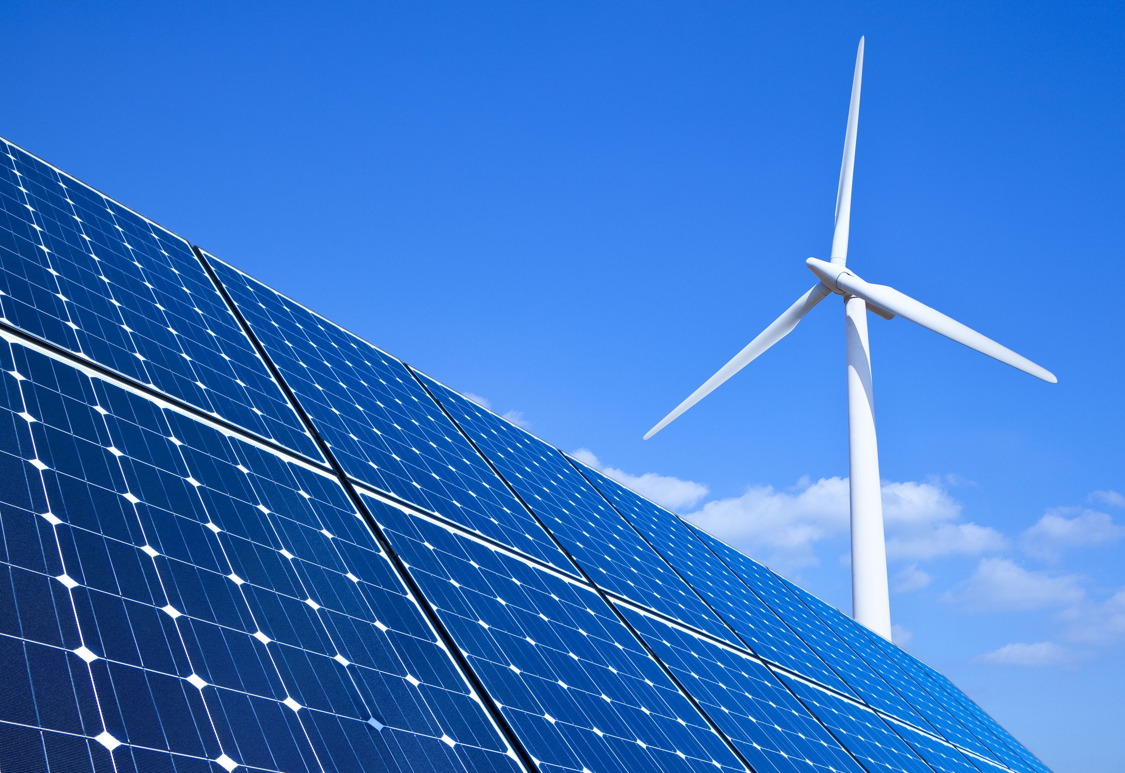
Advantages of Energy Matching
Provide reliability
Improves energy efficiency and reduces CO2 emissions
Increases RES in electricity generation
Reduces costs

Slide 5
Load Side Management
Managing by controlling loads
Load shifting: Consumption shifted from peak hours to periods of lower demand and prices
Typically for industrial processes (heating, drying, refrigeration, data centers)

Slide 6
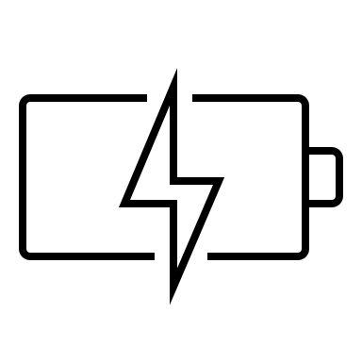
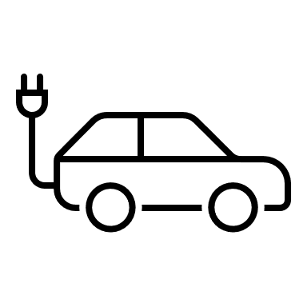
Storages
Managing by storing surplus energy
Reduce peak loads and provide flexibility
Large scale batteries
Electric vehicles
Challenges
Low capacity
Expensive

Slide 7
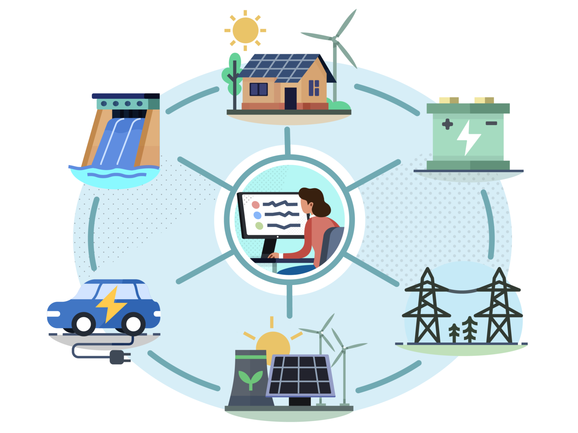
Conclusions
Wind and solar power are local energy resources
Prosumers in smart grid create flexibility
Energy matching improves efficiency, reduces emissions and helps balancing markets

Slide 8
Source material used
Kostkova, K & Omelina, L & Kycina, P & Jamrich, P. An introduction to load management. Electric Power Systems Research. 2013, vol: 95. P 184-191. https://doi.org/10.1016/j.epsr.2012.09.006.
Wang, Caisheng, and M. Hashem Nehrir. "Power management of a stand-alone wind/photovoltaic/fuel cell energy system." IEEE transactions on energy conversion 23.3 (2008): 957-967.
Kayo, G & Hasan, A & Siren, K. Advantage of local energy matching and sharing towards zero-carbon community. 2014. https://www.researchgate.net/publication/273758314_ADVANTAGE_OF_LOCAL_ENERGY_MATCHING_AND_SHARING_TOWARDS_ZERO-CARBON_COMMUNITY
D. Grosspietsch, M. Saenger, and B. Girod, ‘Matching decentralized energy production and local consumption: A review of renewable energy systems with conversion and storage technologies’, Wiley Interdiscip. Rev. Energy Environ., vol. 8, no. 4, pp. 1–18, 2019, doi: 10.1002/wene.336.
Motiva. Pientuulivoima. https://www.motiva.fi/ratkaisut/uusiutuva_energia/tuulivoima/pientuulivoima.
Energy saver. Installing and Maintaining a Small Wind Electric System. https://www.energy.gov/energysaver/installing-and-maintaining-small-wind-electric-system.
Areva Solar. Aurinkopaneelit omakotitaloon. www.arevasolar.fi/fi/aurinkopaneelit-omakotitaloon.
Clean coalition. Value of clean local energy. https://clean-coalition.org/value-of-clean-local-energy/.
Energy Demand-Side Management Benefits Customers. https://cubminnesota.org/energy-demand-side-management/
Battery University. BU-205: Types of Lithium-ion https://batteryuniversity.com/article/bu-205-types-of-lithium-ion
American clean power. Why energy storage. https://energystorage.org/why-energy-storage/applications/transportation-storage/

Slide 9
THANK YOU!

