Slide 1
ELEC-E8423 - Smart Grid Power and Energy Balance Managament in Micro Grids
Jaime Montero de la Plaza
Manuel Enrique Salas Salazar
03.05.2022

Slide 2
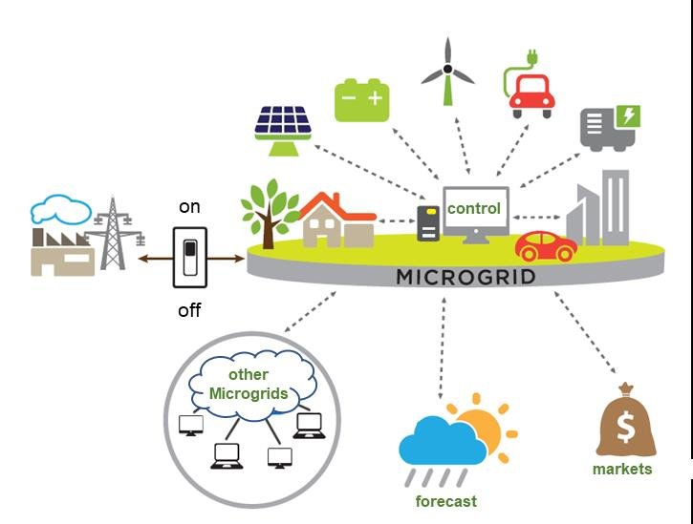
Introduction to microgrid
Microgrid is a local energy system with control capability, which means it can disconnect from the traditional grid and operate autonomously.
Microgrid can connect and disconnect from the grid to enable it to operate in both grid-connected or islanded operation mode.
The intention is for the microgrid's generation sources to come from renewable energies, mainly solar and wind energy.
Preserving the power and energy of the system in balance while the economical cost of the system keeps being viable is one of the challenging things.

Slide 3
Components of microgrid
Energy Supply System
Renewable sources: PV, Wind, Small Hydro and Biomass Plant.
Non-Renewable: Emergency Generator, Microturbine and Fuel Cell
Energy Storage Capacity
Batteries, thermal storage
Demand Response and Efficiency Measures
Minimize overall Energy use
Reduce non-critical load when operating isolation
Energy Management Systems
Real-time response, Predictive and Forecasting análisis
Maintain Balance and Stable Systems
Utility Grid Connection
Provides backup
Loads
Controllable Loads: Electric vehicles, Domestic hot water, etc.
Critical Loads: Illumination and appliances etc.

Slide 4
Microgrid Controls
Grid-Connected Operation:
The MG does not participate in the operation of the main electricity system
The MG contributes to the stable operation of the electricity system
The MG can draw its power from the main grid
The MG can supply power to the main grid
Grid-Islanded Operation: The MG should handle the following considerations:
Balancing of supply and demand
Acceptable power quality
Voltage and frequency balance
Communication among the MG components
Controllable load or source

Slide 5
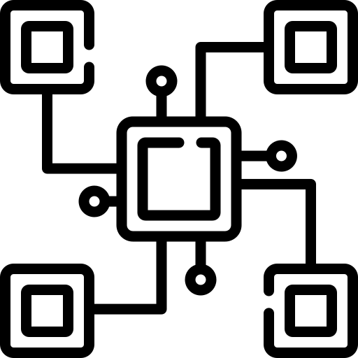
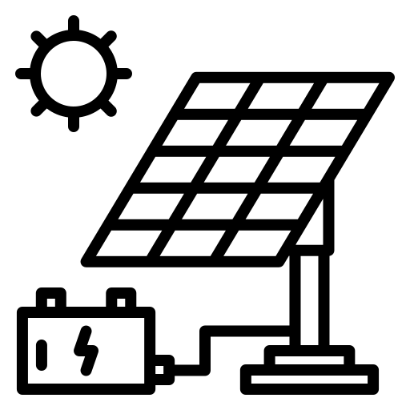
Power and Energy Balance
The MG must solve by itself its own ancillary services (voltage and frequency control, operating reserves, black start…).
The control scheme must balance energy and power with:
Communication based control
Time variance and topological connection changes
Low inertia and stability issues due to new components.
Basic grid-forming control strategies: centralized, decentralized, distributed, and hierarchical.

Slide 6
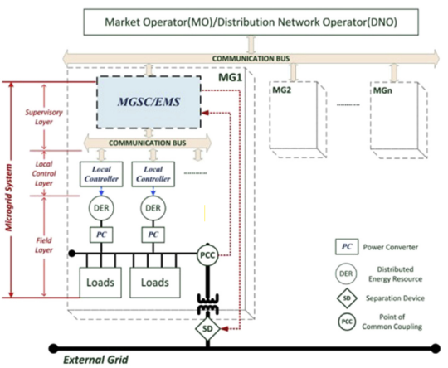
Power and Energy Balance – Infrastructure
Higher level operators
MGSC, Micro Grid Supervisory Controller.
EMS, Energy Management System.
PC, Power Converter.
DG, Distributed Generation.
SG, Smart Grid

Slide 7
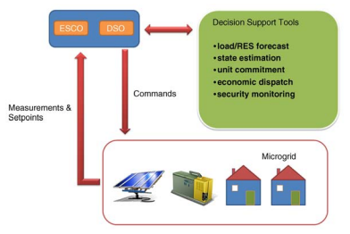
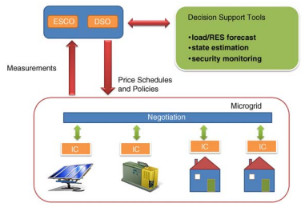
Power and Energy Balance – Control
Centralized: the main responsibility for the maximization of the microgrid value and the optimization of its operation lies with the Micro Grid Supervisory Controller.
Decentralized: the main responsibility is given to the Local Controllers, or DGs itself, that compete or collaborate, to optimize their production, in order to satisfy the demand.
Distributed: the information can be exchanged among Local Controller of the subsystems.

Slide 8
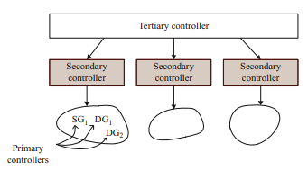
Power and Energy Balance – Control
Control Hierarchy
Primary control: responds to system dynamics and ensures that the system variables (e.g., voltage and frequency) track their set points.
Secondary control: responsible for ensuring power quality and mitigating long term voltage and frequency deviations by determining the set points for the primary control.
Tertiary control: is the highest level of control and sets long-term set points depending on the requirements of the host power system based on the information received about the status of the energy sources, market signals, and other system requirements.

Slide 9
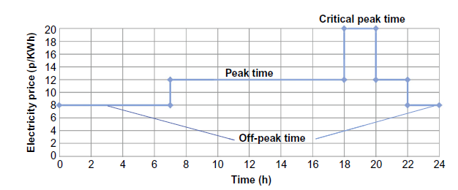
Demand and Storage
Demand Response by incentives:
Offered to customers depending on their behavior in the demand response programs.
Direct load control, curtailable service and demand bidding.
Demand Response by time:
Electricity prices vary according to the cost of generation and the demand for electricity. Customers can then decide on their consumption.
Flat pricing, ToU pricing, critical peak pricing and real time pricing.

Slide 10
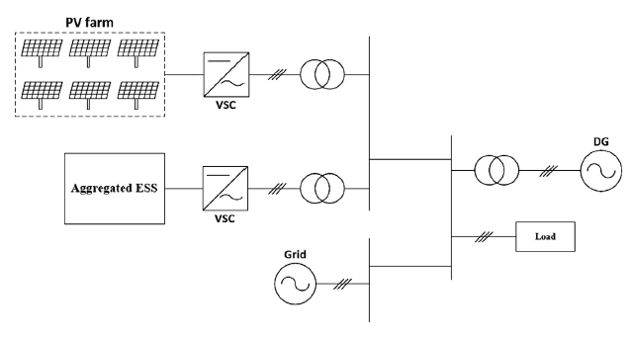
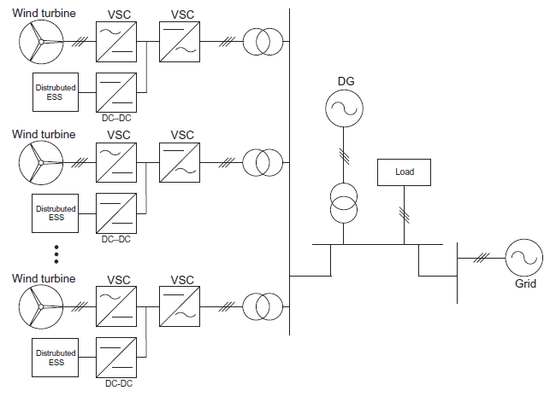
Demand and Storage
Aggregated Energy Storage System:
Big energy storage facility with dedicated housing in the microgrid. It usually has a large capacity to store a huge amount of energy and high-power output ability.
Distributed Energy Storage System:
Connected to an individual generation unit or a local load. This option is easier to maintain and escalate.
Energy storage system can either closer and connected to the generation side or the load side.

Slide 11
Micro Grid Strategy
The type of control mechanism, demand response and energy storage system will depend on the overall goals and interest of the micro grid.

Slide 12
Benefits
Economic Benefits of a MG:
The microgrid can act as an initiator of local retail markets.
The microgrid can act as a hedging tool against potential risks of price volatility.
Technical Benefits of a MG:
Energy loss reduction
Improved voltage quality
Relief of congested networks and devices
Enhancement of supply reliability
Environmental and Social Benefits of a MG:
Shift toward renewable or low-emission fuels
Adoption of more energy-efficient energy supply solutions
Electrification of remote or underdeveloped areas
Creation of new research and job opportunities

Slide 13
Challenges
High costs of electricity storages
The prediction of renewable energy production and demand is a challenge for optimal system management.
Protection System:
Sensitivity: Protection system should be able to identify an abnormal condition that exceeds a nominal threshold value
Selectivity: Protection system should disconnect only the faulted part of the system in order to minimize fault consequences
Speed: Protective relays should respond to abnormal condition in the least possible time in order to avoid damage to equipment and maintain stability

Slide 14
Conclusions
Infrastructure and balance of energy and power of a Micro grid depends on its goals set by the different stakeholders.
It represents an opportunity for expanding cities and electric networks to incorporate renewable energy sources.
Companies and communities in need of a reliable power source are looking to a microgrid system as an efficient, powerful, and ingenious solution.
These resilient, emergency-ready systems can lead to fewer blackouts and outages, generate more savings, and reduce dependence on fossil fuels.

Slide 15
Source material used
[1] M. Mori, M. Gutiérrez, M. Sekavčnik, and B. Drobnič, “Modelling and environmental assessment of a stand-alone micro-grid system in a mountain hut using renewables,” Energies, vol. 15, no. 1, 2022, doi: 10.3390/en15010202.
[2] G. B. Gharehpetian, H. R. Baghaee, and M. M. Shabestary, Microgrids and Methods of Analysis. 2021.
[3] Y. Parag and M. Ainspan, “Sustainable microgrids: Economic, environmental and social costs and benefits of microgrid deployment,” Energy Sustain. Dev., vol. 52, pp. 72–81, 2019, doi: 10.1016/j.esd.2019.07.003.
[4] N. Hatziargyriou, Microgrids: Architectures and Control. 2013.
[5] M. S. Mahmoud, MICROGRID: Advanced Control Methods and Renewable Energy System Integration. Cambridge, MA: Elsevier, 2017.
[6] D. W. Gao, Applications of ESS in Renewable Energy Microgrids. 2015.

