Slide 1
ELEC-E8423 - Smart Grid Role of DR, storages and hydrogen in future energy systems
Heinonen Heta, Markkanen Laura
14.03.2022

Slide 2
Introduction
As more unstable renewable energy sources are added to the grid, the imbalance between supply and demand increases. Demand response (DR) and energy storage solutions have been developed to fight this issue, and are likely to play an important role in future energy systems.
Presentation contents:
DR in smart grids
The role of energy storage systems
Hydrogen in smart grids
Conclusions
Source material

Slide 3
Demand response
DR definition:
Changes in energy usage of consumers in response to changes in the price of electricity over time
Incentive payments to reduce electricity usage during high wholesale market prices or when system reliability is jeopardized
Electricity usage can be managed by:
Load curtailment strategies (incentive based DR)
Moving energy consumption to a different time period (price based DR)
Generating own energy

Slide 4
Demand response
Benefits of DR:
Bill savings:
lower electricity bills and incentive payments
lower wholesale market prices
Reliability benefits and system security:
lower chances of curtailments
added flexibility
Market performance and improved choice:
market power utilization of producers reduced
customers have more options to manage electricity costs
Future of DR:
Improvements in multi-energy systems (MES): different forms of energy coupled with each other to add even more flexibility
Integrated demand response (IDR): customers are able to change the type of consumed energy

Slide 5
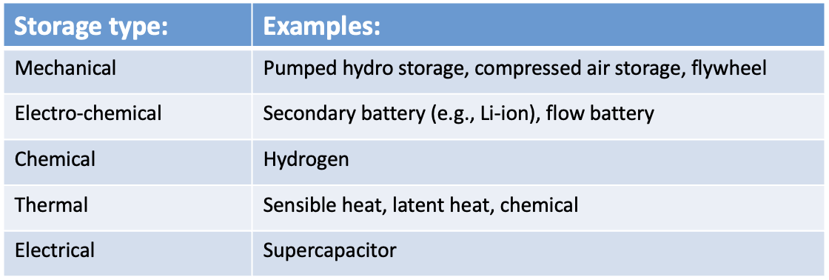
Storages
Most of the current and developing DR solutions include an energy storage
Important especially in future energy systems
Help manage unpredictable loads: with added flexibility, economical benefits and system stability increase
Could be beneficial in e.g., CCHP systems, microgrids and buildings with local RE production
The most common energy storage type is mechanical hydro storage

Slide 6
Hydrogen energy
Hydrogen can be produced from e.g. fossil fuels, renewable energy, and nuclear energy
e.g. by gasification, electrolysis, steam reforming, and fermentation
Hydrogen is emission-free, and the most abundant and light element in the universe with a high energy density:
around 120 MJ/kg for hydrogen vs. 80 MJ/kg for natural gas
For electricity grid, hydrogen
storages are still too expensive
and inefficient
Hydrogen is distributed with:
pipelines
high-pressure tube trailers
liquefied hydrogen tankers
Research related to implementing hydrogen to society
Hydrogen energy in smart grid | - Renewable energy and hydrogen - Microgrid and hydrogen storage - Energy management
Hydrogen fuel cell electric vehicles
Hydrogen economy in smart grids | - Demand side management - Electricity market
Models for energy system in smart grids | - Energy management strategy - Other novel works

Slide 7
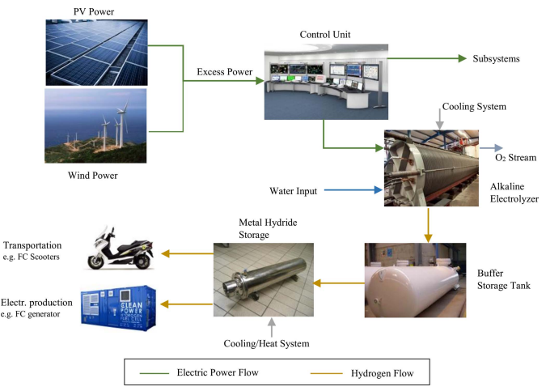
Hydrogen storages in smart grids
Low density of hydrogen creates a technical issue for storage. Hydrogen storages are mostly still in a development phase, and only used as industry spare storages.
Hydrogen can be stored as
pressurized gas
cryogenic liquid
physically or chemically bonded to
appropriate solid-state material
Metal Hybrid Storages as a solid-state
storage system seem to show most
potential.
Challenges of integrating hydrogen
storages into smart grids are e.g.
long-term storage, weight of storages,
and integration strategies.

Slide 8
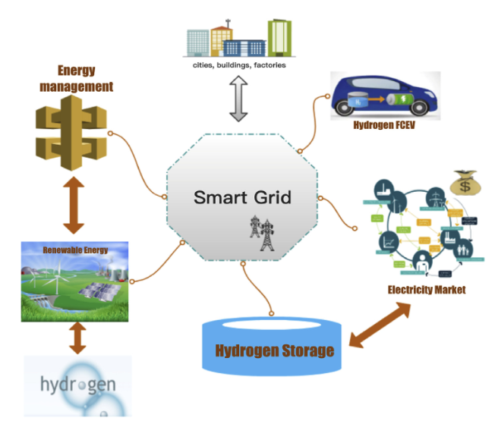
Hydrogen energy in the future
Hydrogen could be implemented to future smart grids as a medium, i.e. storage, transportation, and conversion
Usage of hydrogen energy in the future:
fuel cell in electric vehicles
hydrogen storages
energy management
satisfying peak usage, and the
unstable renewable energy,
in both supply and demand side
electricity markets
reducing peaks with hydrogen
storages and thus reducing costs

Slide 9
Conclusions
DR and energy storages can help to balance the differences between supply and demand resulting from the increasing amount of variable renewable energy sources
In addition to improvements in grid stability, DR and energy storage solutions can bring cost benefits to consumers and producers
Hydrogen has a high energy density in comparison to other energy storages, and it can be produced of renewable sources
Hydrogen storages are still inefficient and expensive, and need more development before being able to replace e.g. natural gas in costs and efficiency

Slide 10
Source material used
Chen, Y. & Xu, P. & Gu, J. & Schmidt, F. & Li, W. 2018. Measures to improve energy demand flexibility in buildings for demand response (DR): A review. Energy & Buildings. Vol. 177. p. 125-139. DOI: 10.1016/j.enbuild.2018.08.003.
Huang, W. & Zhang, N. & Kang, C. & Li, M. & Huo, M. 2019. From demand response to integrated demand response: review and prospect of research and application. Protection and Control of Modern Power Systems. Vol. 4(12). 13 pages. DOI: 10.1186/s41601-019-0126-4.
Liu, Z. & Zhao, Y. & Wang, X. 2020. Long-term economic planning of combined cooling heating and power systems considering energy storage and demand response. Applied Energy. Vol. 279. 115819. DOI: 10.1016/j.apenergy.2020.115819.
Rahman, Md.M. & Oni, A.O. & Gemechu, E. & Kumar, A. 2020. Assessment of energy storage technologies: A review. Energy Conversion and Management. Vol. 223. 113295. DOI: 10.1016/j.enconman.2020.113295.
Robert, F.C. & Sisodia, G.S. & Gopalan, S. 2018. A critical review on the utilization of storage and demand response for the implementation of renewable energy microgrids. Sustainable Cities and Society. Vol. 40. p. 735-745. DOI: 10.1016/j.scs.2018.04.008.
Shariatzadeh, F. & Mandal, P. & Srivastava, A.K. 2015. Demand response for sustainable energy systems: A review, application and implementation strategy. Renewable and Sustainable Energy Reviews. Vol. 45. p. 343-350. DOI: 10.1016/j.rser.2015.01.062.

Slide 11
Source material used
Siano, P. 2014. Demand response and smart grids - A survey. Renewable and Sustainable Energy Reviews. Vol. 30. p. 461-478. DOI: 10.1016/j.rser.2013.10.022.
Vahid-Ghavidel, M. & Javadi, M.S. & Gough, M. & Santos, S.F. & Shafie-khah, M. & Catalao J.P.S. 2020. Energies. Vol. 13(17). 4332. DOI: 10.3390/en13174332.
Lin, R. H., Zhao, Y. Y., & Wu, B. D. (2020). Toward a hydrogen society: Hydrogen and smart grid integration. International Journal of Hydrogen Energy, 45(39), 20164–20175. https://doi.org/10.1016/j.ijhydene.2020.01.047
Abe, J. O., Popoola, A. P. I., Ajenifuja, E., & Popoola, O. M. (2019). Hydrogen energy, economy and storage: Review and recommendation. International Journal of Hydrogen Energy, 44(29), 15072-15086. doi:10.1016/j.ijhydene.2019.04.068
Dincer, I., & Acar, C. (2018). Smart energy solutions with hydrogen options. International Journal of Hydrogen Energy, 43(18), 8579-8599. doi:10.1016/j.ijhydene.2018.03.120
Eghbali, N., Hakimi, S. M., Hasankhani, A., Derakhshan, G., & Abdi, B. (2022). Stochastic energy management for a renewable energy based microgrid considering battery, hydrogen storage, and demand response. Sustainable Energy, Grids and Networks, 30 doi:10.1016/j.segan.2022.100652
Kavadias, K. A., Apostolou, D., & Kaldellis, J. K. (2018). Modelling and optimisation of a hydrogen-based energy storage system in an autonomous electrical network. Applied Energy, 227, 574-586. doi:10.1016/j.apenergy.2017.08.050

