Slide 1
ELEC-E8423 - Smart Grid
Supergrids
Tomi Perttula
Jonne Malmberg
22.03.2022

Slide 2
Introduction
What is a Supergrid?
Network & Topology
Benefits & Challenges
Current Supergrid Solutions & Projects
Future Supergrid Solutions & Projects
Conclusion
22.03.2022

Slide 3

What is a Supergrid?
Supergrids are used to transit large amount of energy between long geographical distances.
Large technical infrastructures for creating interconnection.
Voltage level up to HVDC (+500 kV) or UHVDC (+800 kV), which is required for long-distance electricity transmission.
Supergrid aims to help energy transition by transmitting renewable energy globally.
22.03.2022

Slide 4
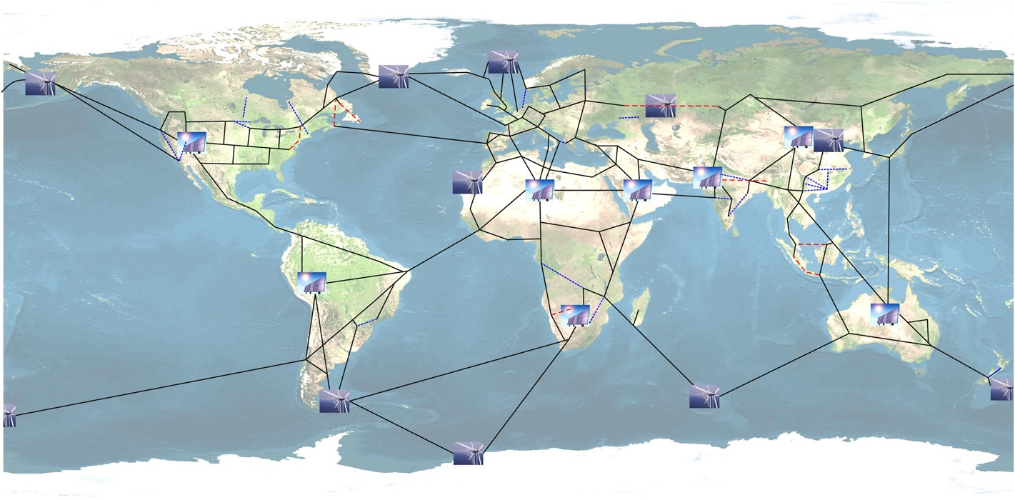
Network
Independent HVDC system
Backbone of the transmission network
Enabler for the system: Super node
Not just a “Network of networks”
22.03.2022

Slide 5
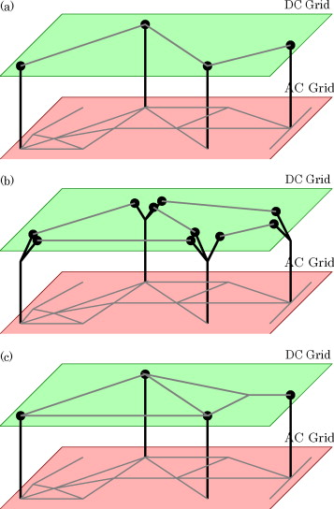
Topology
a) Single DC line and multi-terminal AC-DC interconnection
  Zero redundancy
b) AC terminals and independent DC grid
  Simple to utilize existing HVDC lines in new DC grid
c) Meshed DC grid and multi-terminal AC-DC interconnection
  More reliable than the single DC line system
22.03.2022

Slide 6
Benefits
Challenges
Cost efficient solution to fight climate change
Provides possibility to transfer renewable energy for long distances
  EU, 45% renewable energy share by 2030
Provides flexibility and reliability for power systems
  Large volume
  No bottlenecks
High investments cost.
Challenges in technical constrains:
  Line losses
  Mechanical component implementation
  AC-systems limited capabilities to move and support offshore Supergrid
Political and economic arguments:
  Who owns and pays the grid?
Challenges in national energy regulations and technical specifications:
  Voltage quality
  Power balance
22.03.2022

Slide 7
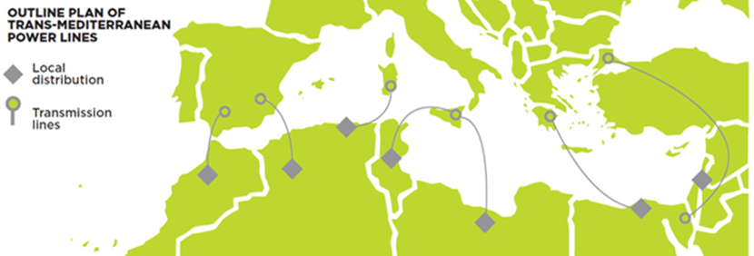
Current Supergrid Solutions & Projects
Development of new circuit breaker and converter technology for HVDC-lines to form a flexible power grid. Gives possibility to combine power from distributed renewable energy sources.
China is leading country for development of UHVDC transmission network. Transition system comprises 35 000 km of HVDC transmission lines and 500 billion kWh of annual transmission.
India & ABB are building 800 kV UHVDC network from Central India to South India. Transmission line will be 1830 km long and serving about 80 million people. Aim is to transmit wind power from South India to the exceed energy demand in the North and transmit thermal power from North India to South India.
Medgrid project: Created in 2010, aims to build electricity network to provide renewable electricity to North Africa & Europe.
22.03.2022

Slide 8
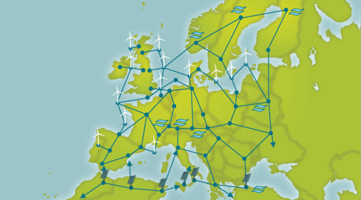
Future Supergrid Solutions & Projects
Supergrids voltage loss problems could be avoided by cooling transmission cable with liquid hydrogen pipeline.
Coordination and control of the Supergrid can be handled with Smart grid technologies such as phasor measurement units to react imbalances rapidly in the network.
The Asian Supergrid: Project to establish an electrical power transmission network connecting China, South Korea, Taiwan, Mongolia, Russia, and Japan.
European Supergrid: Future project to interconnect the various European countries with a HVDC-power grid to transit energy from renewable energy sources.
22.03.2022

Slide 9
Conclusions
Future objective of Supergrids is to response to global energy transition by transmitting renewable energy intercontinentally with the aim of improving the electricity supply, while achieving carbon neutrality.
Energy transition requires crucial modifications to the transmission system and Supergrids could be the answer.
Future challenges for implementing Supergrids are possible to overcome with cooperation between nations and technology companies.
22.03.2022

Slide 10
Thank you for your attention!
Questions?
22.03.2022

Slide 11
References
http://www.epcc-workshop.net/archive/2015/Presentations/EPCC2015-Presentation_S2-1-Panciatici.pdf
https://www.economist.com/the-economist-explains/2017/01/17/what-is-a-supergrid
https://www.irena.org/-/media/Files/IRENA/Agency/Publication/2019/Sep/IRENA_Supergrids_2019.pdf?la=en&hash=4C6639C08B1BEC582B700609C6D3C3B2E126AE70
https://assets.kpmg/content/dam/kpmg/ie/pdf/2018/07/ie-super-grids-making-the-right-connections-for-a-sustainable-future.pdf
https://www.eesc.europa.eu/sites/default/files/resources/docs/presentation-by-eddie-oconnor.pdf
https://publications.parliament.uk/pa/cm201012/cmselect/cmenergy/1040/104005.htm
https://www.wiley.com/en-us/HVDC+Grids%3A+For+Offshore+and+Supergrid+of+the+Future-p-9781118859155
https://people.montefiore.uliege.be/ernst/uploads/news/id140/Global_Grid_RENE_final.pdf
22.03.2022

