Slide 1
ELEC-E8423 - Smart Grid Sector Coupling of Power and Heat
Valtteri Hytti
Noora Majamaa
29.03.2022

Slide 2
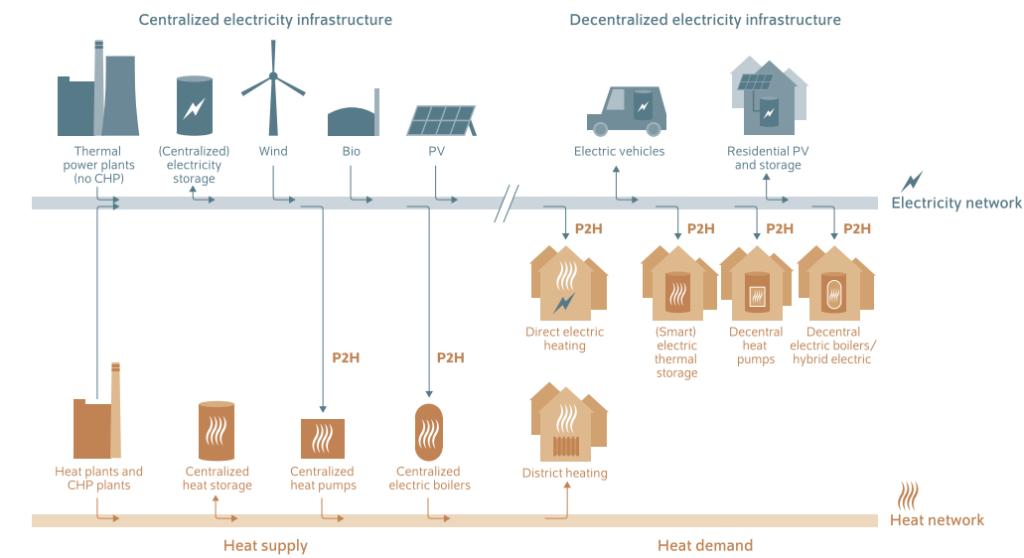
Introduction
Combining the use of electricity and heat for a sustainable energy system

Slide 3
Background
Twice as much energy is consumed as heat compared to electricity
In Helsinki, 56% of emissions are produced by heating
The current scheme for producing heat highly depends on fossil fuel​ (in Helsinki, 50% is coal)
Decarbonisation of heating is needed as much as decarbonisation of electricity
Increasing the percentage of electricity production from variable renewable
energy sources (VRE) demands more flexibility from the grid​
Weather dependent VRE production could be balanced, and its increased integration enabled by using the VRE surplus power in heating sector
Sector coupling thus would add flexibility, storage and distribution options to the use of VRE
Getting rid of expensive and polluting peak power plants
Balance the supply and demand by increasing demand adjustability

Slide 4
Implementation
Thermal loads have higher inertia than electric loads
The excess electricity from VRE can be used to produce heat​
The produced heat can be used directly, or stored for later when the demand exists​
Key technologies include heat pumps, combined heat and power, power to gas, power to heat and power to liquid
Heat pumps use electricity and a refrigerant to absorb heat from air, geothermal heat, or ground water
Electricity can be used to heat substantial amounts of water, which are then circulated in district heating networks
Power-to-X allows excess power to be channeled into other forms of energy, like power to gas or power to liquid.
Excess heat from biogas plants can also be used in such heating networks

Slide 5
Benefits
Great potential for reduced GHG emissions and reducing reliance on fossil fuels
Utilization of renewable electricity to replacement of fossil fuels in heating sector
Relatively cost-efficient technology to reduce GHG emissions (depending on the chosen technology)
Increased power system flexibility and possibility to increase share of VRE
Decreases the need for VRE curtailment during peak production
Utilization of thermal storages decreases the need of peak load plant
Existing storage technologies for heat
Especially long-term storage of electricity is challenging
Heat is easier and (currently) less costly to store than electricity

Slide 6
Challenges & barriers
Requires a large amount of excess renewable energy
Large investments on renewable electricity production are needed
Increased electrification may have negative impacts to the stability of power grids
Increase of the peak power demand
Can be mitigated by flexible operation & demand-side management and energy storages
Full electrification of heating sector may require upgrades of transmission & distribution networks
Heat pump efficiency when high output temperatures are required
COP of heat pumps is much lower with low source temperatures and high output temperatures
A limiting factor especially for industrial use with high output temperature requirements, but also relevant for DH and domestic water use
Regulatory barriers: lack of incentives for demand side flexibility, electricity taxes etc.

Slide 7
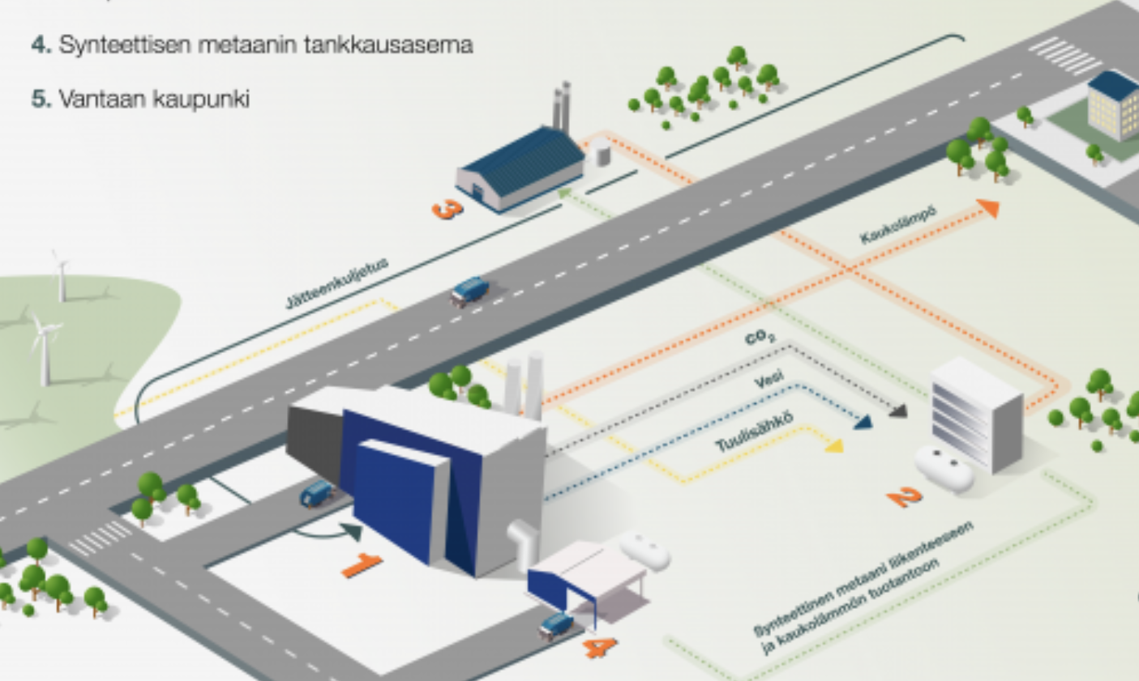
Example: Coupling of heat and power utilizing power-to-gas concept
Combustion plant
Power-to-gas plant: electrolyser + methanation
Heat plant
Gas station
District heating
Wind power production
Picture: https://www.vantaanenergia.fi/suomen-suurin-power-to-gas-laitos-wartsila-ja-vantaan-energia-ovat-sopineet-suunnittelun-jatkamisesta-kohti-investointipaatosta/

Slide 8
Conclusions
Heat production is currently largely dependent on fossil fuels
Coupling of power and heat is a possible solution for decarbonising the heating sector and introducing a larger share of renewables in electricity production
Large-scale implementation requires investments on renewable electricity production and more demand-side flexibility and energy storages

Slide 9
Sources
Bashir, Lund, Pourakbari-Kasmaei & Lehtonen. (2020). Minimizing Wind Power Curtailment and Carbon Emissions by Power to Heat Sector Coupling—A Stackelberg Game Approach. DOI 10.1109/ACCESS.2020.3039041.
Bloess,Schill & Zerrahn, (2018). Power-to-heat for renewable energy integration: A review of technologies, modeling approaches, and flexibility potentials. https://doi.org/10.1016/j.apenergy.2017.12.073.
Fridgen, Keller, Körner, Schöpf. (2020). A holistic view on sector coupling. https://doi.org/10.1016/j.enpol.2020.111913.
International Renewable Energy Agency. (2020). Renewable Energy Policies in a Time of Transition: Heating and Cooling. Pp. 51-52. ISBN 978-92-9260-289-5.
Javanshir, Syri, S., Teräsvirta, A., & Olkkonen, V. (2022). Abandoning peat in a city district heat system with wind power, heat pumps, and heat storage. Energy Reports, 8, 3051–3062. https://doi.org/10.1016/j.egyr.2022.02.064
Jimenez-Navarro, Kavvadias, Filippidou, Pavičević, Quoilin. (2020). Coupling the heating and power sectors: The role of centralised combined heat and power plants and district heat in a European decarbonised power system. https://doi.org/10.1016/j.apenergy.2020.115134
Munster et al. (2020). Sector Coupling: Concepts, Potentials and Barriers. DOI: 10.23919/AEIT50178.2020.9241201.
Vantaan Energia. Suomen suurin power-to-gas laitos. Accessed 23.3.2022. Available: https://www.vantaanenergia.fi/suomen-suurin-power-to-gas-laitos-wartsila-ja-vantaan-energia-ovat-sopineet-suunnittelun-jatkamisesta-kohti-investointipaatosta/

