Slide 1
ELEC-E8423 - Smart Grid Battery Energy Storage Systems
Eero Niklander
Sampo Saari
29.03.2022

Slide 2
Introduction
BESS = Battery energy storage systems
Structure:
Why we need energy storage
Types of BESS
BESS in the grid
BESS architecture
Development in BESS
Projects in Finland
Notes:
There are also other types of energy storage systems (for example mechanical and thermal); we will focus on batteries.

Slide 3
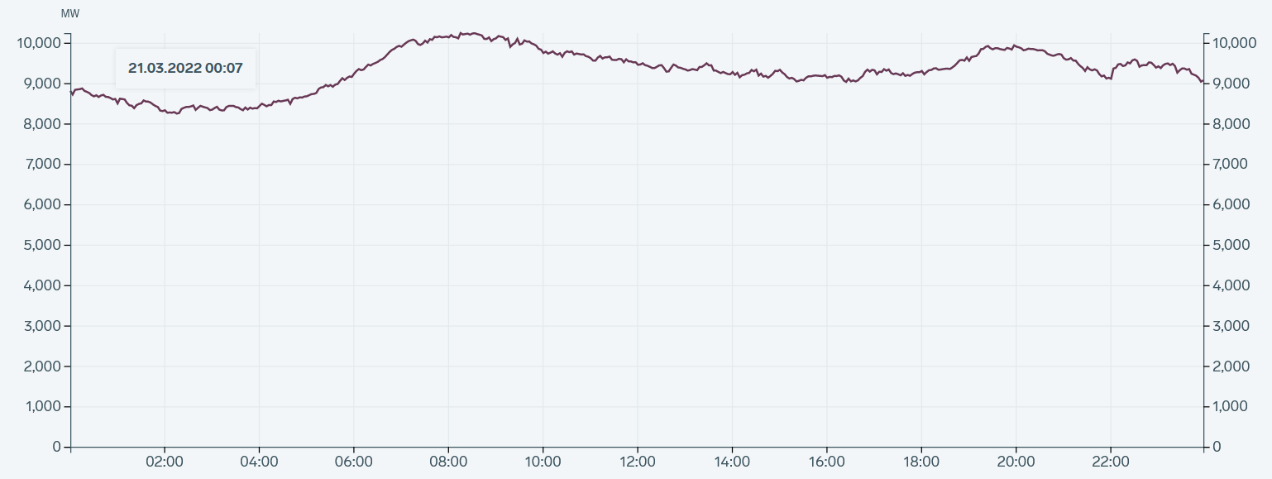
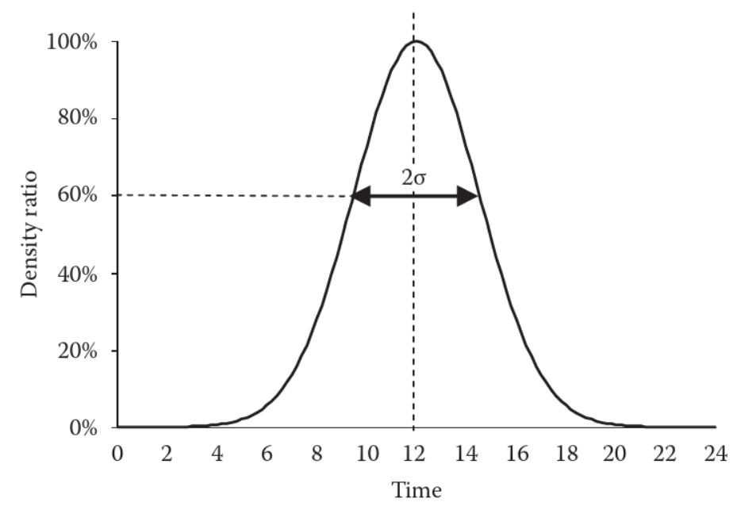
Why is storage needed?
Increasing share of wind and solar, which are intermittent and hard to predict
Timing mismatch of renewable production and consumption
Left: Electricity consumption in Finland on a Monday in March.
Right: Typical solar production profile.
Notes:
Left picture: Electricity consumption in Finland on March 21st, 2022 (a Monday). Source: https://www.fingrid.fi/sahkomarkkinat/sahkojarjestelman-tila/ (retrieved 26.3.2022). Right picture: Typical solar production graph. Source: El-Sharkawi, Mohamed A. Electric Energy, An Introduction (Third Edition). 2012. E-book ISBN 9781466504318. Publisher: Taylor & Francis Group. Page 102.

Slide 4
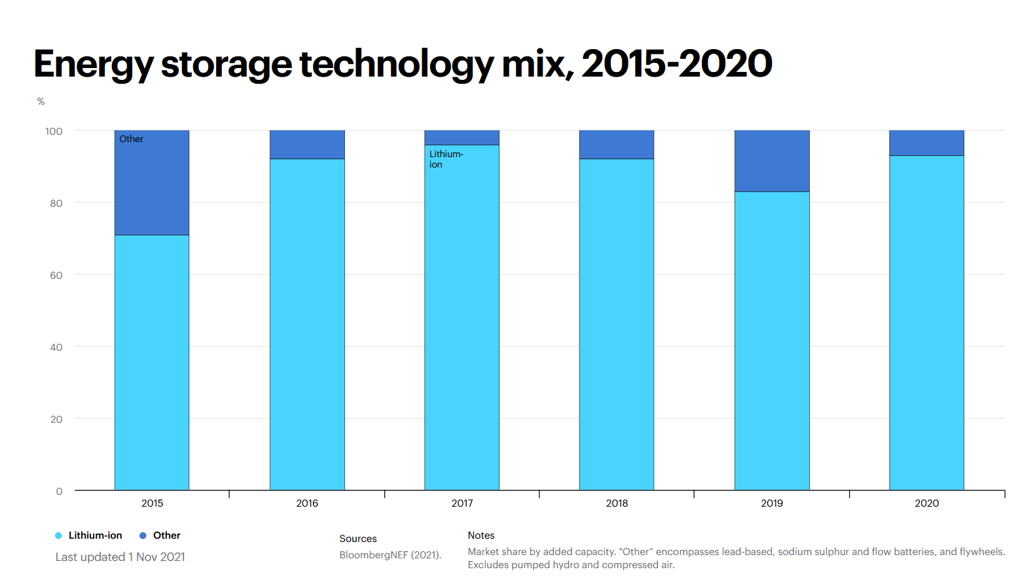
Different types of BESS
Lithium-ion is most common: great efficiency (78-98%) and energy density (75-200 Wh/kg), but high investment cost
Many others, such as lead acid, sodium sulfur, nickel cadmium, zinc hybrid cathode, vanadium redox batteries

Slide 5
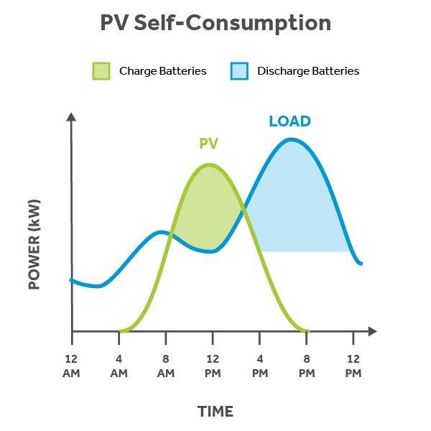
BESS in the grid
Load shifting
Emergency backup
Voltage and frequency control (response times < 1 s)

Slide 6
BESS architecture
Battery Energy Storage System
Battery System
Chemical energy is converted into electrical energy.
Cells in modules that form battery packs.
Battery Management System (BMS)
Protects cells from harmful operation and hazards.
Monitors the condition of the battery cells.
Power Conversion System (Converter)
Converts power flow between the grid and the battery.
Supervisory Control and Data Acquisition (SCADA)
Collects and analyzes energy data.
Coordinates the components.
BMS
Converter
Grid
Battery system
SCADA

Slide 7
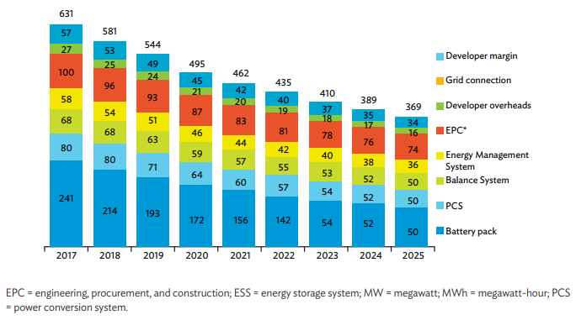
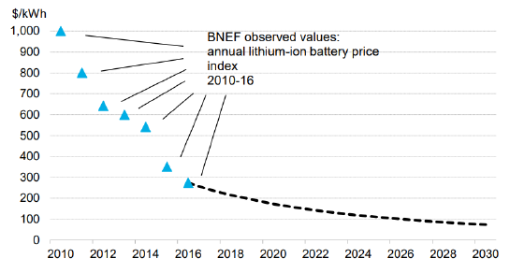
Development in BESS
Expansion in manufacturing capacity of lithium-ion batteries.
Decreasing costs and higher efficiencies.
Estimated market value of 25.07 billion by 2027.

Slide 8
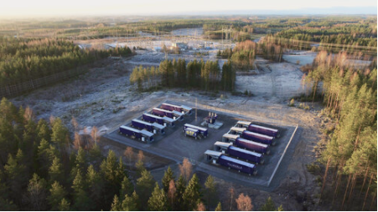
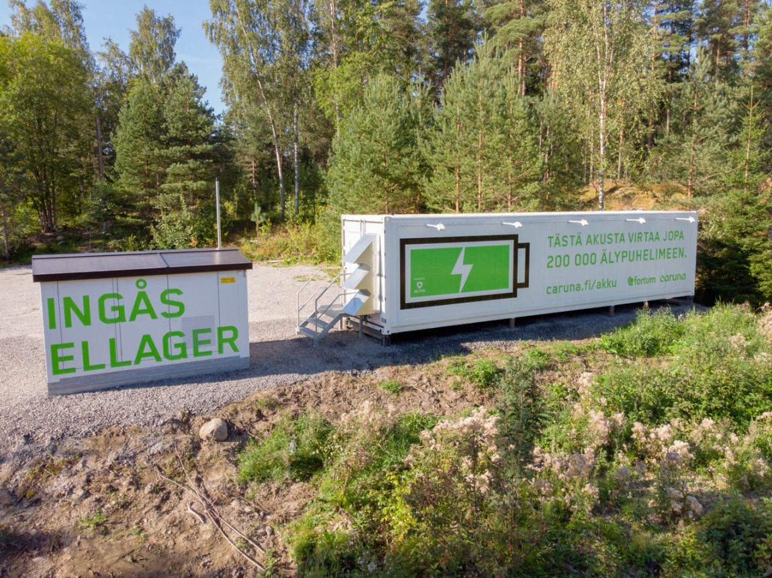
Projects in Finland
Helen Oy 10 MWh capacity BESS system that is going to be connected to a new wind farm called Lakiakangas 3.
Neoen’s 30 MWh capacity Yllikkälä Power Reserve One Project.
Fortum and Caruna: Inkoo 1028kWh BESS system that has been operated succesfully for over a year.

Slide 9
Conclusions
BESS can be used to overcome challenges related to renewables.
Lithium-ion is currently the main technology for BESS.
BESS systems are becoming more economically viable options.

Slide 10
Source material used
Datta U, Kalam A, Shi J. A review of key functionalities of battery energy storage system in renewable energy integrated power systems. Energy Storage. 2021;3:e224. https://doi.org/10.1002/est2.224.
IEA: Energy Storage Tracking Report (November 2021). Available online: https://www.iea.org/reports/energy-storage (viewed 27.3.2022).
Kebede A A, Kalogiannis T, Van Mierlo J, Berecibar M. A comprehensive review of stationary energy storage devices for large scale renewable energy sources grid integration. Renewable and Sustainable Energy Reviews, Vol. 159 (2022). ISSN 1364-0321. https://doi.org/10.1016/j.rser.2022.112213.
Koohi-Fayegh S, Rosen M.A, A review of energy storage types, applications and recent developments. https://doi.org/10.1016/j.est.2019.101047
Badeda J, Fleer J, Zurmühlen S, Meyer J, Stenzel P, Hake J and Sauer D. 11th International Renewable Energy Storage Conference. Price development and bidding strategies for battery storage systems on the primary control reserve market. https://doi.org/10.1016/j.egypro.2017.09.497
Cranney J, Davidson M, Townsend C and Summers T.J. 2018 7th International Conference on Renewable Energy Research and Applications. Decentralised Energy Market for Implementation into the Intergrid Concept - Part 2: Integrated System. DOI: 10.1109/ICRERA.2018.8566719

Slide 11
Image sources
Electricity consumption in Finland on a Monday: https://www.fingrid.fi/sahkomarkkinat/sahkojarjestelman-tila/ (retrieved 26.3.2022)
Typical solar production graph: El-Sharkawi, Mohamed A. Electric Energy, An Introduction (Third Edition). 2012. E-book ISBN 9781466504318. Publisher: Taylor & Francis Group. Page 102.
Energy storage technology mix: Adapted from IEA. Original available online: https://www.iea.org/data-and-statistics/charts/energy-storage-technology-mix-2015-2020 (viewed 27.3.2022)
PV Self consumption: Sustainable Solar Services. Available online: https://www.solarsponsoring.com.au/battery-storage-use-in-australia/ (viewed 28.3.2022)
Asian Development Bank. 2018. Handbook on battery energy storage system. : https://www.adb.org/sites/default/files/publication/479891/handbook-battery-energy-storage-system.pdf
Caruna. Inkoon sähkövarasto: https://www.caruna.fi/tietoa-meista/kestavaa-sahkonjakelua/inkoon-sahkovarasto
Helen. 2021. Helen investoi suurimpaan sähkövarastoonsa, joka auttaa turvaamaan koko pohjoismaiden energiajärjestelmää. Available online: https://www.helen.fi/uutiset/2021/helen-investoi-suurimpaan-sahkovarastoonsa
Utilities. Neon’s 30MW/30MWh battery storage project in Finland to help stabilize grid.: https://www.utilities-me.com/news/15594-neons-30mw30mwh-battery-storage-project-in-finland-to-help-stabilise-grid-in

