Slide 1
ELEC-E8423 - Smart Grid ENERGY COMMUNITIES
Alessia Pucciarini
03.05.2022

Slide 2
Introduction
In 2019 the European Union (EU) has developed a new legislative package (Clean Energy for All Europeans - CE4ALL) which implements the EU climate and energy policy for the period between 2021 and 2030. With this package, the EU aims at facilitating the clean energy transition and making the energy system fit for future challenges based on the increasing share of renewables in the system.
In December 2018, the recast Renewable Energy Directive 2018/2001/EU entered into force, as part of the Clean energy for all Europeans package. This included in particular new provisions to enable citizens to play an active role in the development of renewables - enabling renewable energy communities and self-consumption of renewable energy.
For the first time, consumers have been put at the heart of the Energy Union, allowing them to actively take part in the clean energy transition.

Slide 3
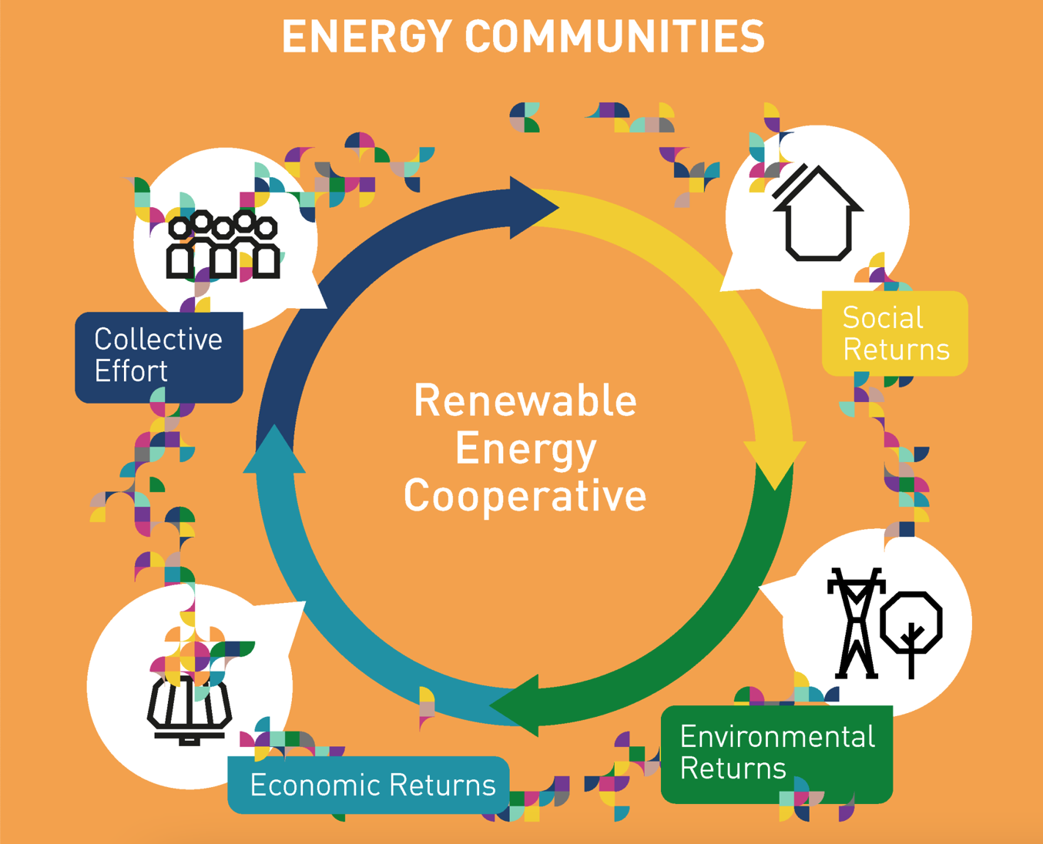
What is an Energy Community?
Energy communities represent an innovative model for the production, distribution and consumption of energy from renewable sources.
Through the Smart Grid everyone can become part of an energy community: whoever owns a photovoltaic system connected to the grid (and is therefore a prosumer) can share his excess energy with other consumers.
This communities share clean energy, thus reducing energy waste, bills, and their own carbon footprint.
https://decarbeurope.org/solutions/energy-communities/

Slide 4
Definition of Energy Community
In the directive (EU) 2018/2001 of the European Parliament and of the Council of 11 December 2018 on the promotion of the use of energy from renewable sources it is defined as:
a legal identity which, in accordance with the applicable national law, is based on open and voluntary participation, is autonomous, and is effectively controlled by shareholders or members that are located in the proximity of the renewable energy projects that are owned and developed by that legal entity;
its shareholders or members are natural persons, SMEs or local authorities, including municipalities;
its primary purpose is to provide environmental, economic or social community benefits for its shareholders or members or for the local areas where it operates, rather than financial profits.

Slide 5
Energy Community in Finland
The concept of energy community in Finland is relatively new and unstable.
Before 2021, Finnish legislation didn’t identify energy communities. As a result, electricity produced in the energy community, which was distributed between different places of use, was treated as electricity for sale. In that case, electricity had to pay transmission fees and electricity taxes, even though the energy was used inside the property.
The legislation on energy companies changed at the turn of 2021, when Government Decree 1133/2020 entered into force.
In February 2022, a centralized information exchange system for the retail electricity market, Datahub, was introduced in Finland. It will enable energy communities in all distribution networks to distribute electricity to their shareholders.

Slide 6
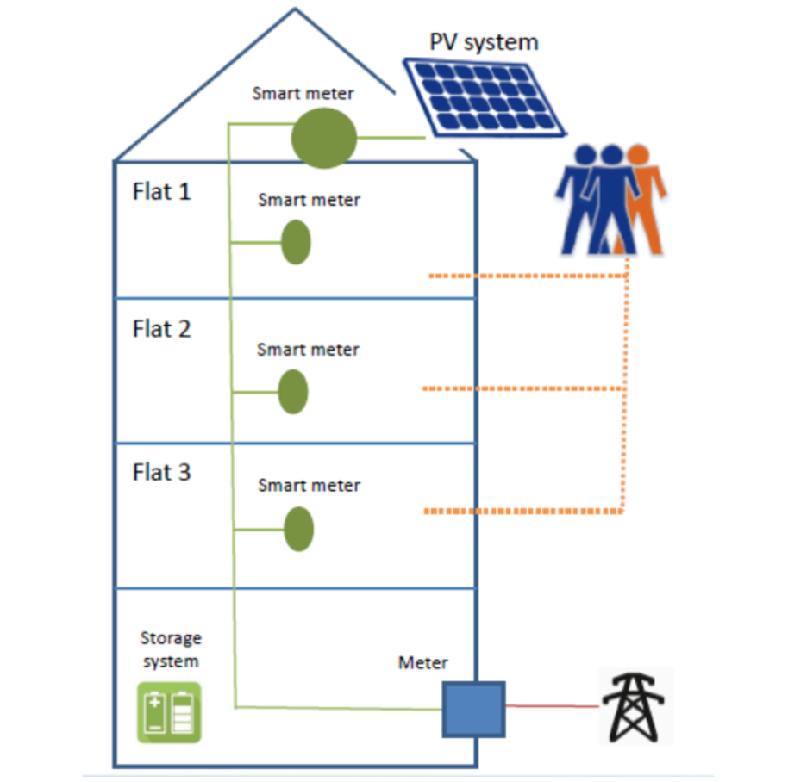
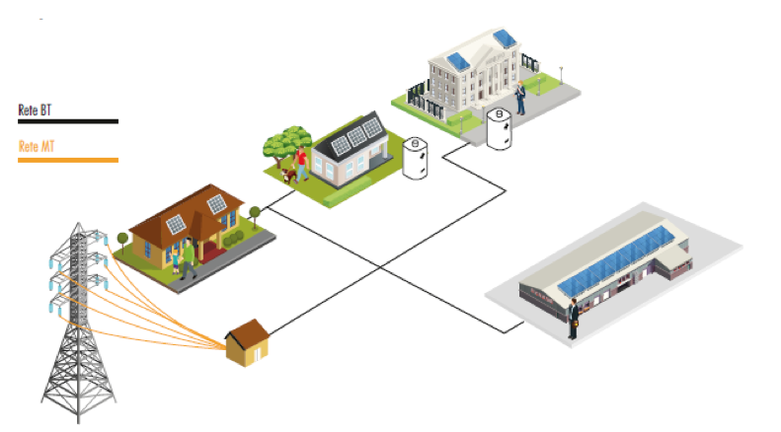
Different types of Energy Communities
LOCAL ENERGY COMMUNITIES
Within the property
Energy production, consumption and other energy-related resources are located within the same property.
Is typically a housing company but can also be a commercial property where several companies are located.
Shareholders share the initial acquisition investment.
Across the property boundaries
The electricity production isn’t located on the property managed by the customer, but on a neighbour's site.
Small-scale electricity production would be utilized together and the benefits shared between the members of the community.
Not all the members have to be the owner of the power plants.
https://rienergia.staffettaonline.com/articolo/33085/Prosumer+fotovoltaico:+il+consumatore+è+davvero+protagonista/Battisti
PM Service , Piccolo manuale delle comunità energetiche, 2020.

Slide 7
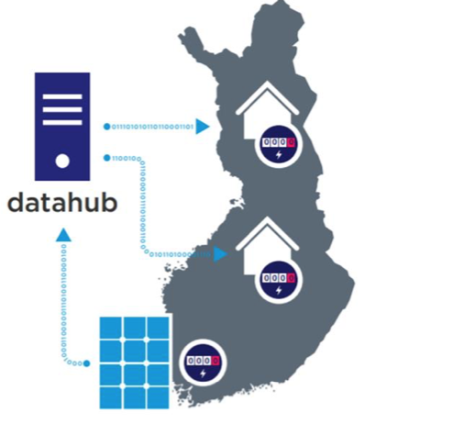
Different types of Energy Communities
DECENTRALIZED ENERGY COMMUNITIES
Electricity is produced somewhere physically located away from one's own property.
Several shareholders invest in the production unit.
Use the existing distribution and transmission network to relocate production
A decentralized energy community would increase energy production capacity. This would lead to more profitable investments in several scenarios, when optimal energy production sites are exploited and surplus energy is not excluded from the energy community.
Possibility to invest in wind power plants or hydropower.

Slide 8
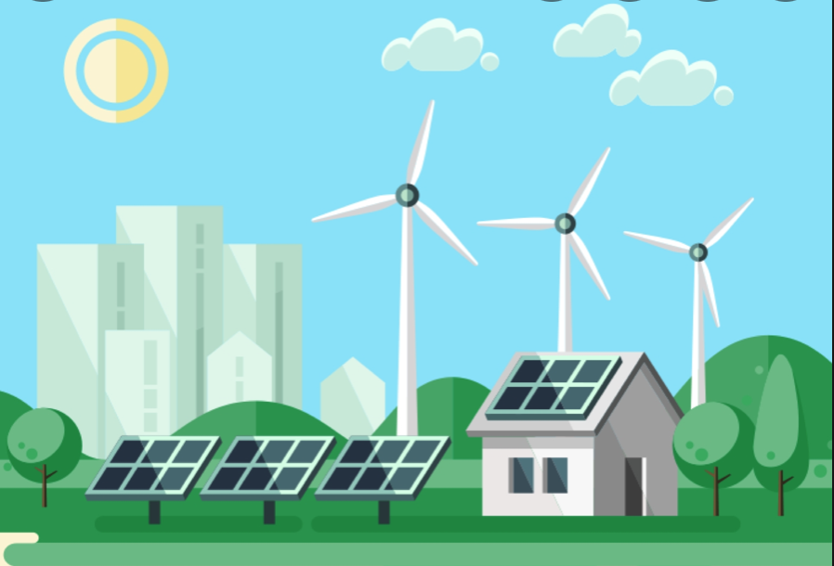
Conclusions
Energy communities represent a new model of production and distribution of renewable energy in which individual citizens decide independently to join in order to obtain economic and environmental returns
Change in law in 2021 enabled the financial benefits of the energy community
Energy communities can be local or decentralized
https://www.euneighbours.eu/sites/default/files/2017-08/Energy2.jpg

Slide 9
Source material used
https://energy.ec.europa.eu/topics/renewable-energy/renewable-energy-directive-targets-and-rules/renewable-energy-directive_en
https://data.europa.eu/doi/10.2833/21366
https://tem.fi/en/-/government-decree-on-electricity-supply-settlement-to-improve-customer-service-and-to-make-it-easier-to-change-suppliers
https://trepo.tuni.fi/bitstream/handle/10024/137770/Aspects_of_development_needs.pdf?sequence=1&isAllowed=y
https://www.theseus.fi/bitstream/handle/10024/504487/Roosa_Nevalainen.pdf?sequence=2&isAllowed=y
https://www.theseus.fi/bitstream/handle/10024/499794/Blomqvist_Kim_2021_05_27.pdf?sequence=2&isAllowed=y

Slide 10
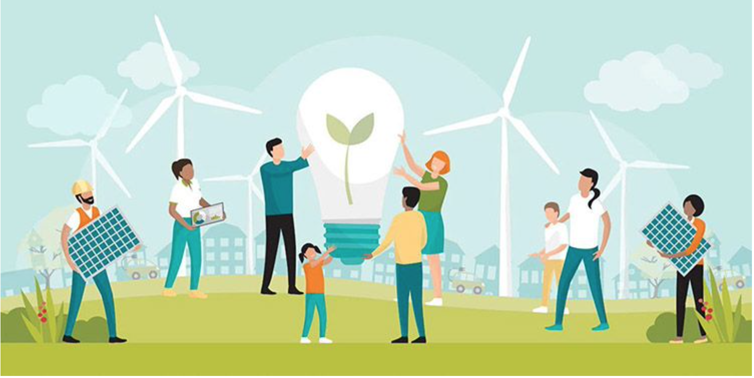
THANK YOU FOR YOUR ATTENTION!

