Slide 1
ELEC-E8423 - Smart Grid Compressed Air Energy Storages
Mikael Niutanen
Sakari Harjunpää
29.03.2022
Notes:
Sakari

Slide 2
Introduction
Compressed Air Energy Storage (CAES) is a way to store mechanical energy by compressing air and releasing the pressure in later time.
Key points about CAES:
- Often used to store excess power in utility scale to underground chambers
- When compressing air there is also a lot of heat generated making heat capture important for better efficiency
- Can also be used in smaller scales with pressure tank.
Notes:
Define broad scope of the presentation and explain the key terms
Sakari
https://www.sciencedirect.com/topics/engineering/compressed-air-energy-storage

Slide 3
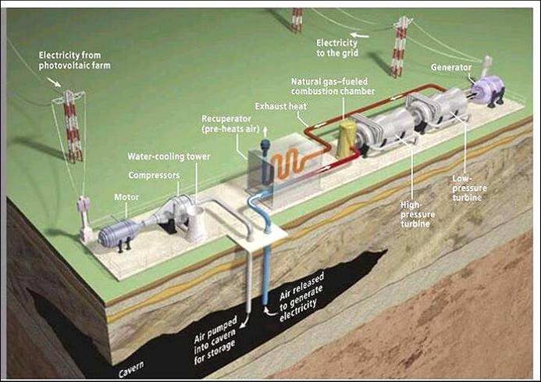
Working principles
Notes:
Sakari

Slide 4
Technical and economical information
Efficiency: 42%-55%, depends on waste heat utilization
Volumetric energy density: 4 kWh/m³
Lifetime: >30 years
Power Investment Cost: 400-800 $/kW vs. Li-ion > 1200 $/kW
Energy Investment Cost: 20-50 $/kWh (Alabama) vs. Li-ion > 500 $/kWh

Slide 5
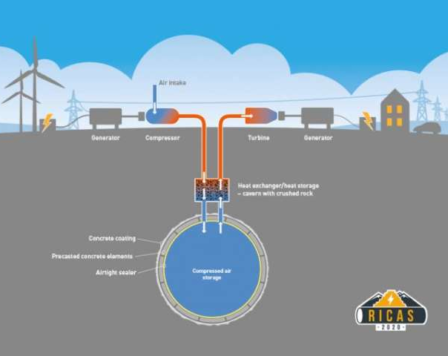
Temperature control
The ideal gas law (pV = nRT) tells us about relation between temperature and pressure
Preheating and cooling allow better efficiency
Increased ambient temperature lowers the density of the inlet air -> reduces massflow

Slide 6
Storage capacity:
For isothermal storage:
$$E=\int_{V_{A}}^{V_{B}}{p dV}=\int_{V_{A}}^{V_{B}}{\frac{nRT}{V} dV}=p_{B}V_{B}ln\left(\frac{V_{B}}{V_{A}}\right){=p}_{B}V_{B}ln\left(\frac{p_{A}}{p_{B}}\right)$$
(Note: $\frac{V_{B}}{V_{A}}=\frac{p_{A}}{p_{B}}$)
A typical CAES system has a pressure of around 70 bar (7 MPa). Let’s imagine a storage V = 300 m3
$$W=p_{B}V_{B}ln\left(\frac{p_{A}}{p_{B}}\right)+\left(p_{B}−p_{A}\right)V_{B}=7 MPa∗300m^{3}∗ln\left(\frac{0.1 MPa}{7.0 MPa}\right)+$$
$$\left(7 MPa −0.1 MPa\right)∗300m^{3}≈−6850 MJ→1900 kWh$$

Slide 7
Current utilization – Notable plants
1978 first utility-scale compressed air energy storage was built in Germany. Capacity of 580 MWh energy.
1991 Alabama. Capacity of 2860 MWh energy.
2012 Texas. Capacity of 300 MWh
2019 Ontario. Capacity of 10MWh.
Many smaller plants and many in the planning phase
Notes:
https://www.researchgate.net/publication/261848307_Technology_Roadmap_Energy_storage
Sakari

Slide 8
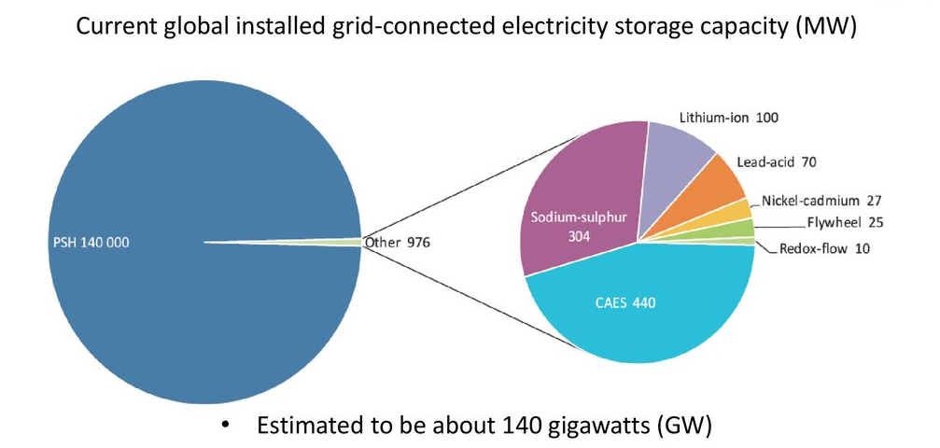
Current utilization
Second biggest energy grid connected storage method
(PUMPED-STORAGE HYDROPOWER)
Notes:
https://www.researchgate.net/publication/261848307_Technology_Roadmap_Energy_storage
https://www.energy.gov/sites/prod/files/2020/12/f81/Energy%20Storage%20Market%20Report%202020_0.pdf
Sakari

Slide 9
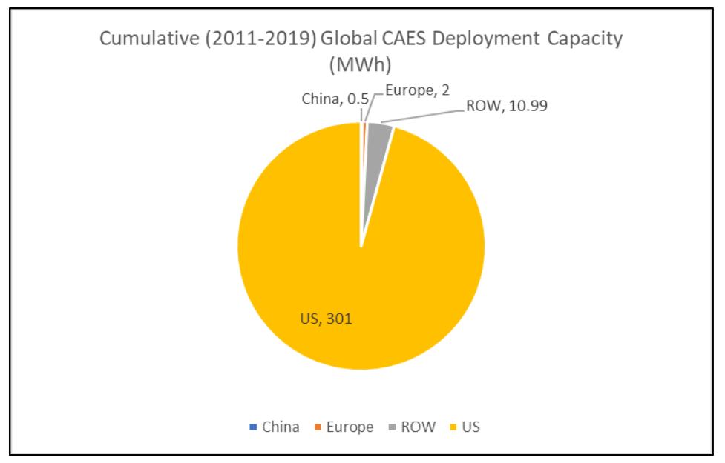
Current utilization
(Rest Of The World)

Slide 10
Limitations and conclusions
Role of heat control is critical for energy efficiency
Limited availability of suitable salt caverns in Europe
Problem with scalability
CAES is good solution for energy storage where pumped hydro is not available
In the future CAES might have even more prevalent role in the energy system

Slide 11
Sources
-Budt, M., Wolf, D., Span, R., &amp; Yan, J. (2016). A review on compressed air energy storage: Basic principles, past milestones and recent developments. Applied Energy, 170, 250–268. https://doi.org/10.1016/j.apenergy.2016.02.108
-Energy Storage Market Report 2020 - Department of Energy. (2020). Retrieved March 29, 2022, from https://www.energy.gov/sites/prod/files/2020/12/f81/Energy%20Storage%20Market%20Report%202020_0.pdf
-Technology Roadmap: Energy Storage - Researchgate. (2014) Retrieved March 29, 2022, from https://www.researchgate.net/publication/261848307_Technology_Roadmap_Energy_storage
-Kushnir, R., Ullmann, A., &amp; Dayan, A. (2012). Thermodynamic models for the temperature and pressure variations within adiabatic caverns of compressed air energy storage plants. Journal of Energy Resources Technology, 134(2). https://doi.org/10.1115/1.4005659
-An introduction to the compressed air energy storage. (2014). Computational Models for CO2 Geo-Sequestration & Compressed Air Energy Storage, 463–474. https://doi.org/10.1201/b16790-23

