Slide 1
ELEC-E8423 - Smart Grid
Pumped Hydro Energy Storage
Timi Tiira & Carlo Porru
29.03.2022

Slide 2
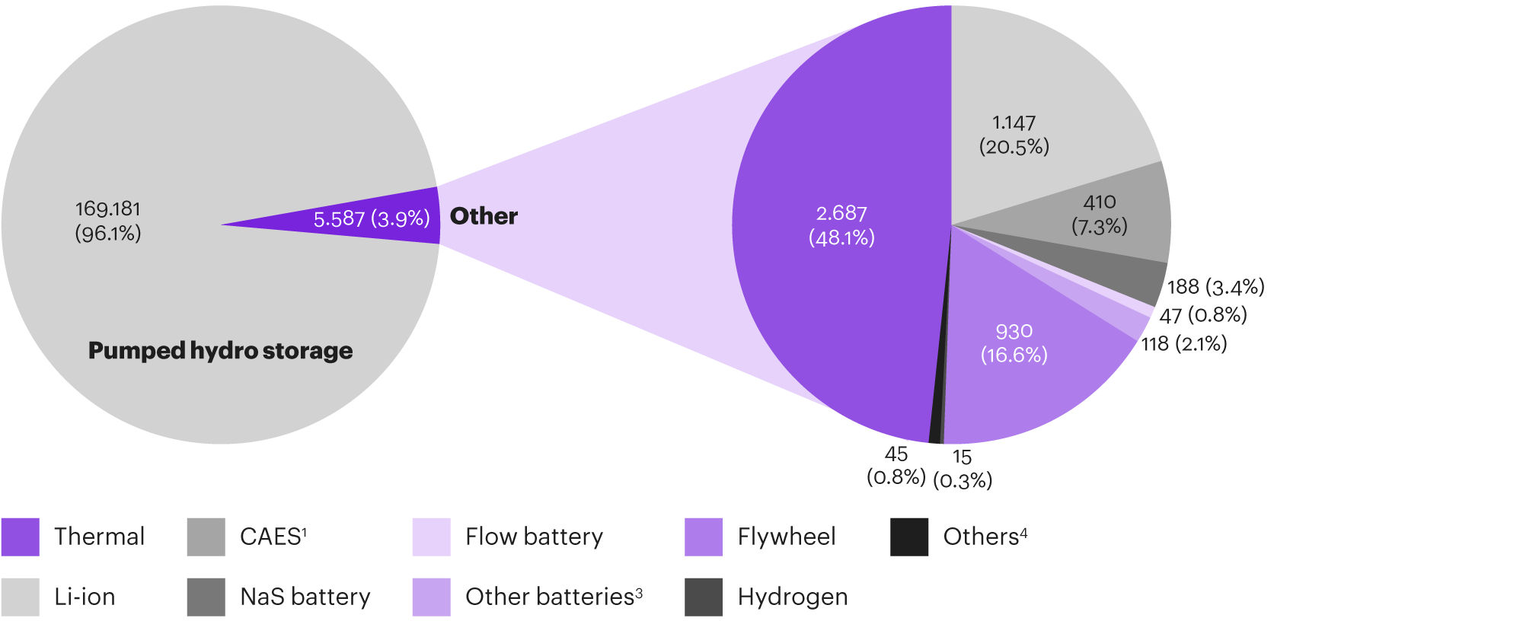
Introduction
Energy stored in potential energy of the water mass.
Good roundtrip efficiency ~70-80%
Approximately 180 GW of power and 2.25 TWh of capacity installed worldwide.
  Approx. 95% of power and 99% of capacity of all energy storages.

Slide 3
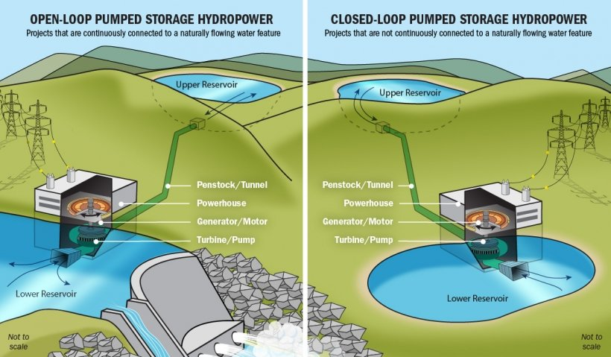
Working principles

Slide 4
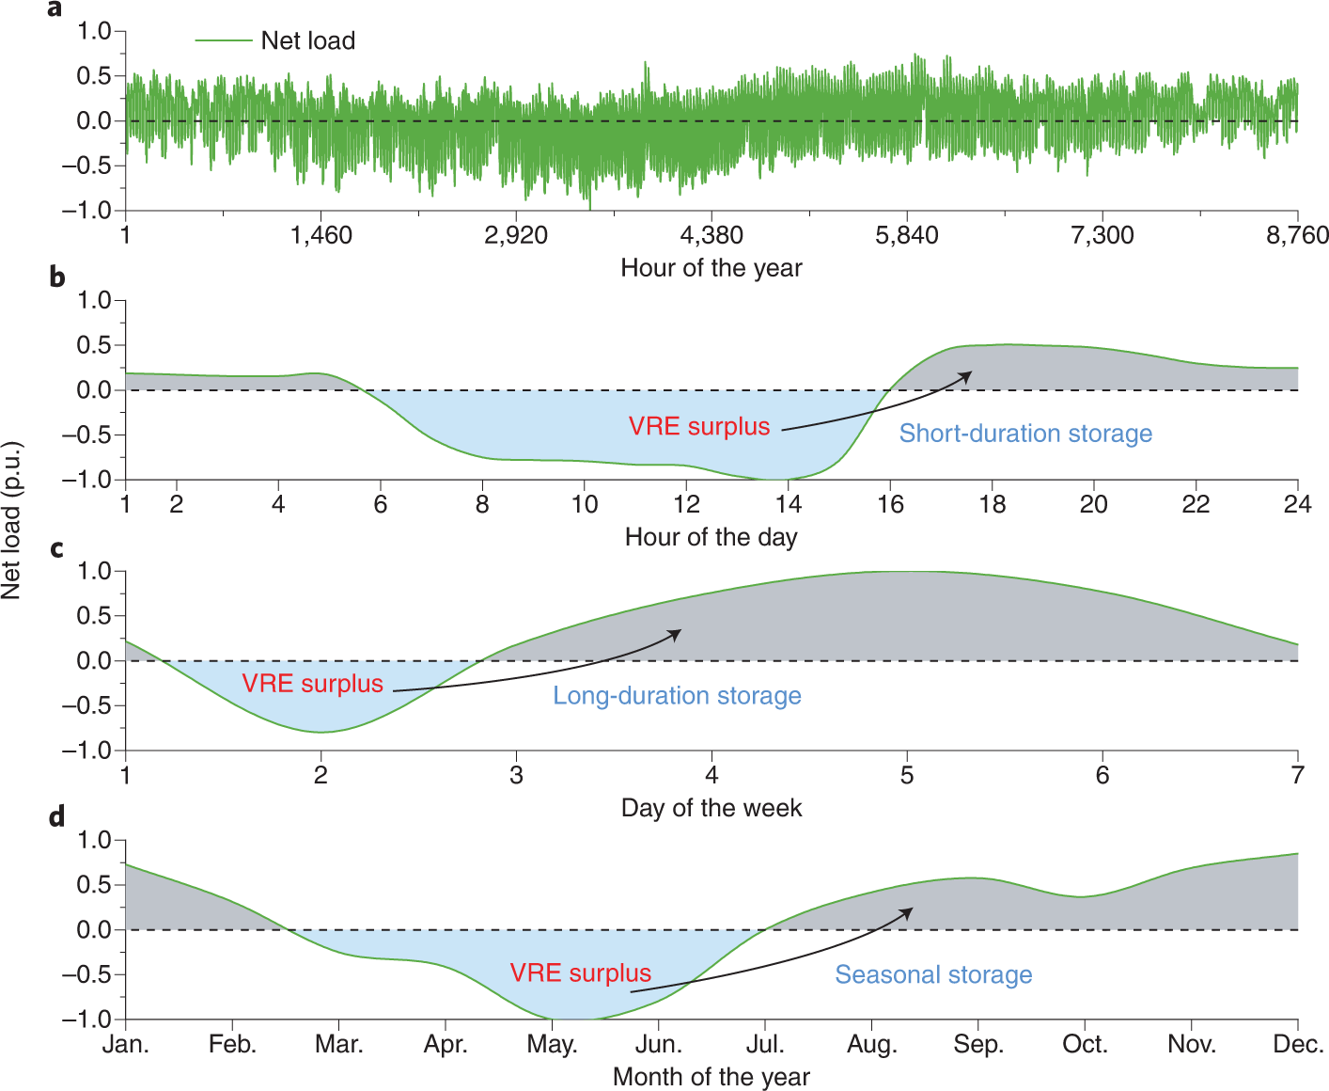
Applications
Energy storing
  Long term or short term
Energy balancing
  Balancing load peaks, or unexpected loads
Large emergency reserve

Slide 5
Potential
The worldwide potential of PHS is huge!
  A computer program has identified over 600 000 potential locations from map analysis
  These would combine to over 23 million GWh in storage capacity
Finnish potential is also existent, but not that big
  In Finland there are old mines that could be utilized
  Minimum height for PHS is considered to be
  100 m, so there are some hills that could be utilized
  New technologies could change this

Slide 6
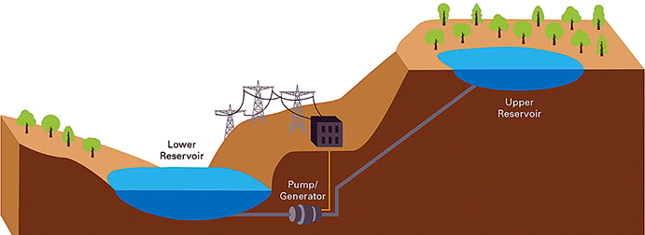
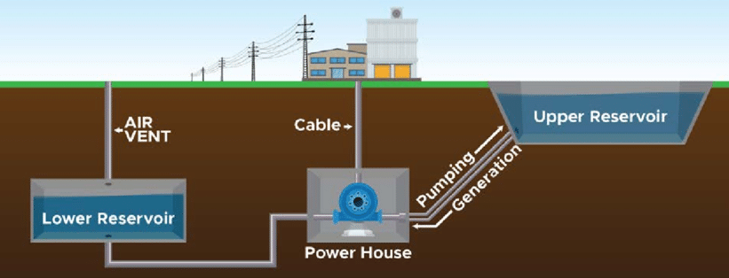
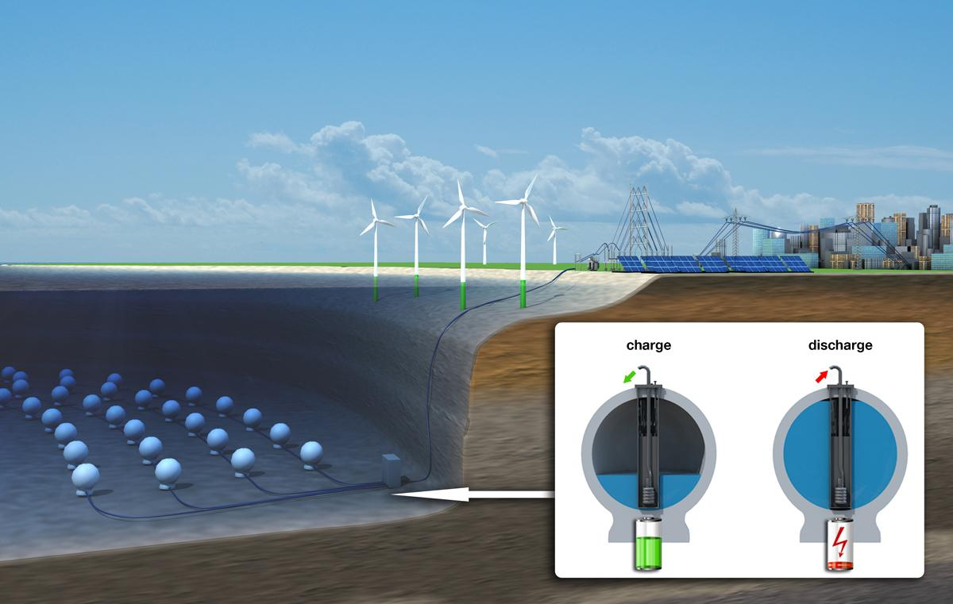
Pumped hydro storage technologies
Surface-based pumped storage
Most commonly used
Requires high elevation differences and close proximity of water
Underground reservoirs
Usually implemented in unused underground facilities, such as mines
Usable in flat regions
Underwater reservoirs
Utilization of high pressure differences in the depths of seabed
Charging = water is pumped out Discharging = water is let in

Slide 7
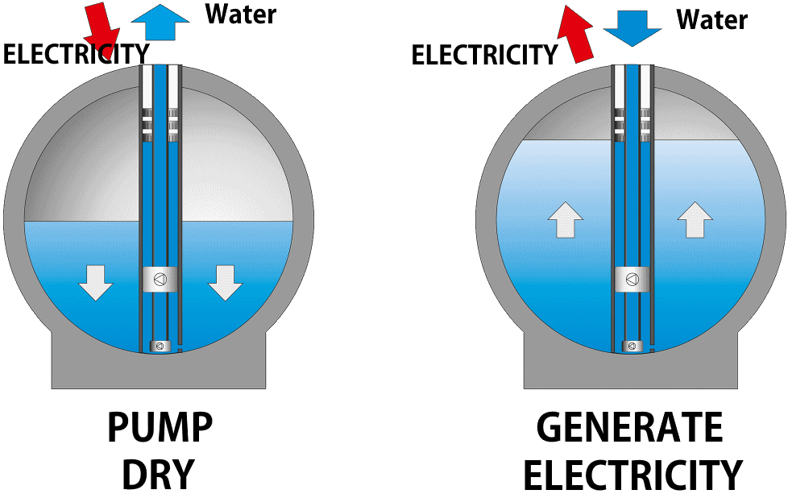
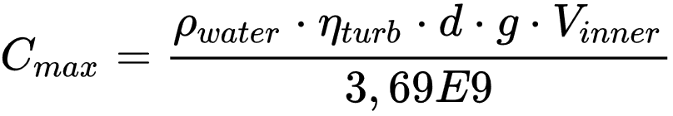
Stored Energy at Sea (StEnSEA)
Background: The potential of traditional
surface-based PHS has been largely used up
Key parametres:
Pros: No land use, efficient, cost competitive
Cons: High production and installation costs and the presence of maritime conditions

Slide 8
Advantages and disadvantages
+ Assists renewables
integration
+ Fast response times in
energy balancing
+ Best round-trip efficiency among
large-scale energy storage
+ Reliable and simple
technology with long lifetime
+ Ability to install very large storage
capacity
- High capital costs and long payback
periods
- Low power and energy density
- Environmental and societal
issues
Surface-implemented PHS:
  - Vast land usage
  - Strict geographical
  requirements

Slide 9
Conclusions
Pumped hydro energy storage comprises roughly 95% of installed global storage power capacity and 99% of global storage energy volume
New technologies enable unprecedented installation opportunities in new areas, particularly, in non-mountainous regions
Helps to integrate intermittent energy sources into the energy system with load-shifting, balancing and allows saving excess electricity even from continuous base-load producers

Slide 10
Bibliography
Advanced Energy Technologies. 2019. Overview of energy storage technologies. [Online]. [Accessed 24.3.2022]. Available at: https://aenert.com/es/tecnologias/energy-efficiency-environmental/energy-storage/.
Blakers, A., Stocks, M., Lu, B. & Cheng, C. 2021. A review of pumped hydro energy storage. Progress in Energy. Vol. 3(2). P. 022003. [Accessed 24.3.2022]. Available at: https://doi.org/10.1088/2516-1083/abeb5b.
Breeze, P.A. 2018. Hydropower, chapter 8. London: Academic Press. ISBN 9780128129067.
China Energy Storage Alliance (CNESA). 2019. CNESA Global Energy Storage Market Analysis – 2019 Q4. [Online]. [Accessed 24.3.2022]. Available at: http://en.cnesa.org/latest-news/2020/2/29/cnesa-global-energy-storage-market-analysis-2019q4-summary.
Dubbers, D. 2021. Comparison of underwater with conventional pumped hydro-energy storage systems. Journal of Energy Storage. Vol. 35. P. 102283. [Accessed 24.3.2022]. Available at: https://doi.org/10.1016/j.est.2021.102283.
Energy Transition Institute. 2020. Electricity Storage Factbook. [Online]. [Accessed 24.3.2022]. Available at: https://www.energy-transition-institute.com/insights/electricity-storage/electricity-storage-factbook.
Guerra, O.J. 2021. Beyond short-duration energy storage. Nature Energy. Vol. 6(5). P. 460-461. [Accessed 24.3.2022]. Available at: https://doi.org/10.1038/s41560-021-00837-2.
Hahn, H., Hau, D., Dick, C. & Puchta, M. 2017. Techno-economic assessment of a subsea energy storage technology for power balancing services. Energy. Vol. 133. P. 121-127. [Accessed 24.3.2022]. Available at: https://doi.org/10.1016/j.energy.2017.05.116.
Hunt, J.D., Byers, E., Wada, Y., Parkinson, S., Gernaat, E., Langan, S., Van Vuuren, D. & Riahi, K. 2020. Global resource potential of seasonal pumped hydropower storage for energy and water storage. Nature Communications. Vol. 11. P. 947. [Accessed 24.3.2022]. Available at: https://doi.org/10.1038/s41467-020-14555-y.
Kougias, I., Aggidis, G., Avellan, F. et al. 2019. Analysis of emerging technologies in the hydropower sector. Renewable and Sustainable Energy Reviews. Vol. 113. P. 109257. [Accessed 24.3.2022]. Available at: https://doi.org/10.1016/j.rser.2019.109257.
Muelaner, J. 2019. New experimental energy storage system may be the key to a zero-carbon future. [Online]. [Accessed 28.3.2022]. Available at: https://www.engineering.com/story/harnessing-seabed-pressure-to-store-renewable-energy.
Office of Energy Efficiency & Renewable Energy. 2022. Pumped Storage Hydropower. [Online]. [Accessed 25.3.2022]. Available at: https://www.energy.gov/eere/water/pumped-storage-hydropower.
Rahman, M., Olufemi Oni, A., Gemechu, E. & Kumar, A. 2020. Assessment of energy storage technologies: A review. Energy Conversion and Management. Vol. 223. P. 113295. [Accessed 28.3.2022]. Available at: https://doi.org/10.1016/j.enconman.2020.113295.
Yle Uutiset. 2019. Pyhäsalmen kaivokseen rakennetaan pumppuvoimalan ja energiavaraston testilaitos. [Online]. [Accessed 25.3.2022]. Available at: https://yle.fi/uutiset/3-11099952.
Zvirgzdins, J. & Linkevics, O. 2020. Pumped-Storage Hydropower Plants as Enablers for Transition to Circular Economy in Energy Sector: A Case of Latvia. Latvian Journal of Physics and Technical Sciences. Vol. 57. P. 20-31. [Accessed 24.3.2022]. Available at: https://doi.org/10.2478/lpts-2020-0012.

