Slide 1
ELEC-E8423 - Smart Grid Power to gas applications
Joona Kerttula
Henri Kaijomaa
15.03.2022

Slide 2
Introduction
Power to gas (P2G) is a process where electricity is used to produce gaseous fuels.
Most applications use electrolysis to produce hydrogen, which can be further converted into other fuels, like methane.
P2G is an effective way to store and transport surplus energy.
Stored hydrogen can be converted back to electricity, used for heat production or to power transportation.
P2G is a potential technology to balance the difference between production and demand.

Slide 3
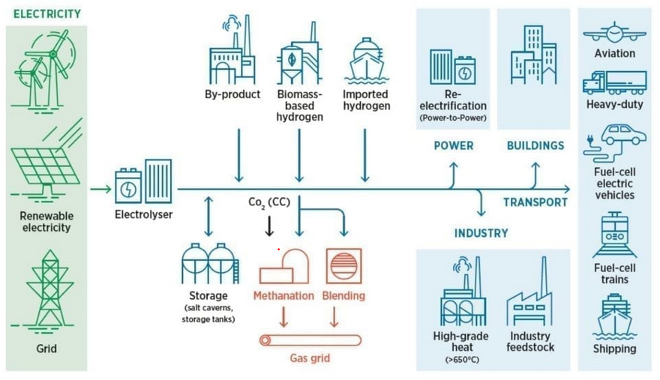
P2G-system

Slide 4
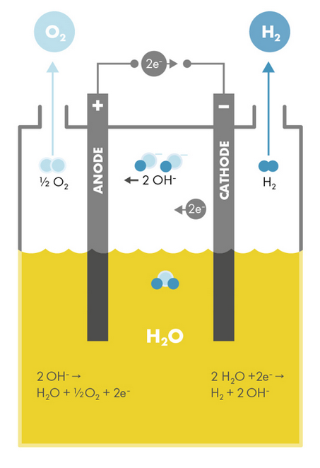
Electrolysis of water
Electricity is used to split water into hydrogen and oxygen .
An electrolyser unit consists of an anode, a cathode and a power unit.
An electrolyte is used to increase the ionization in the water.
About 9 liters of water is needed to produce 1 kg of H2 and 8 kg of O2 as by-product.
Oxidation at anode:
Reduction at cathode:
2 H₂O → O₂ + 4 H⁺ + 4e⁻
2 H⁺ + 2e⁻ → H₂

Slide 5
Different types of electrolysers
 | Alkaline electrolyser | PEM electrolyser (Polymer Electrolyte Membrane) | SOEC electrolyser (Solid Oxide Electrolysis Cell)
Electrolyte | Liquid form alkaline | Polymer electrolyte membrane and pure water | Ceramics
Efficiency | 65-70% | 65-83% | 74-81%
+ | Robust and mature technology Lowest investment cost | Better response to load changes -> no efficiency or purity drops | The process can be reversed to work as fuel cell
- | Efficiency and hydrogen purity drops in partial load operation | High investment costs | High cost Not yet in commercial use

Slide 6
Applications
H₂
Methanation
Material Use
Energetic Use
CH₄
Coolant
Heat
Electricity
„Green“ Methane, since CO₂ is bound during methanation
Ammonia synthesis
Methanol-Production
Mobility
Storage
Feed into Natural Gas Infrastructure (up to 1-10%)
Many more applications in the industry
$H_{2}$ and it’s derivates are currently too expensive to make with electrolysis.
Improving tech, the economy of scale, higher CO2 credit prices are making this economically viable in the near future.
introduction of renewables into the cycle lowers electricity prices and

Slide 7
Potentials
Due to low efficiencies of the whole process, the idea is not to replace electricity just load balance and serve certain sectors. Such as transportation
Existing storage structures (e.g. natural caverns) and natural gas infrastructure can be used and transformed. Even some existing engines such as from Wärtsilä can take hydrogen as fuel instead of natural gas.
Excess energy can be saved during peak production and can be saved inertly for a long time, sometimes up to years.
Provides a more energy-dense way of storing and transporting energy without losses.
This energy can be released back to grid quickly.

Slide 8
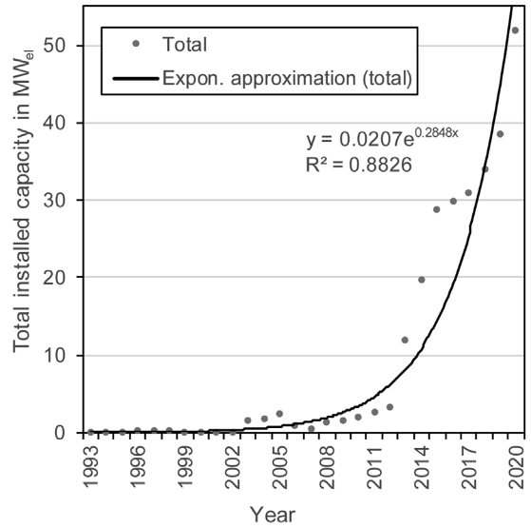
Outlook
P2G is a relatively new Technology, seriously considered only since the late 90s, lately investments have peaked.
Many projects are currently planned. For example, in February 2020 Shell announced its plan to convert offshore wind energy (up to 10 GW) to hydrogen, and Neste has announced plans for green hydrogen at Rotterdam. Some projects even in Finland.
Power to Gas will become more important:
P2G plants can generate additional income by offering grid balancing services due to their fast startup time
Increasing demand of “Green” Hydrogen due to CO2 price certificates
Importance in grids with high renewable penetration to balance seasonal changes
Globally installed electrical power of electrolyzers [5]

Slide 9
Conclusions
Power to Gas technologies offer a good way of storing excess energy in carbon neutral ways, which allow it easily to be used in multiple applications
Provides the ability for wider use of recyclables and will work as an important balancer between renewables and fossil fuels.
Cost effiency of these methods has increased and price of CO2 credits have increased. Investments to the field are starting to make financial sense and are growing fast, especially in the light of recent war in Ukraine.

Slide 10
Sources
Patel, S (2019): Why Power-to-Gas May Flourish in a Renewables-Heavy World (https://www.powermag.com/why-power-to-gas-may-flourish-in-a-renewables-heavy-world/)
Birol, F (2019) : The Future of Hydrogen (https://www.iea.org/reports/the-future-of-hydrogen)
Naimi, Y & Antar, A (2018): Hydrogen Generation by Water Electrolysis. (https://www.intechopen.com/chapters/60944)
Electrochemical Energy Outreach Group (2022): Electrolysers.
(https://ucellucl.com/electrolysers/)
Petrova, V (2020) Neste to host green hydrogen production at Rotterdam refinery (https://renewablesnow.com/news/neste-to-host-green-hydrogen-production-at-rotterdam-refinery-690496/) Vasconcelos, B & Lavoie, J (2019); Recent Advances in Power-to-X Technology for the Production of Fuels and Chemicals. https://www.frontiersin.org/articles/10.3389/fchem.2019.00392/full?&field&journalName=Frontiers_in_Chemistry&id=454241
Sawas, Abdullah (2019): Optimal Sizing of Power–to–Gas Units toward Elevated Renewable Power Penetration IEEE

