Slide 1
ELEC-E8423 - Smart Grid Thermal heat storages for daily and seasonal use
Atte Turpeinen
Sami Salonen
15.03.2022

Slide 2
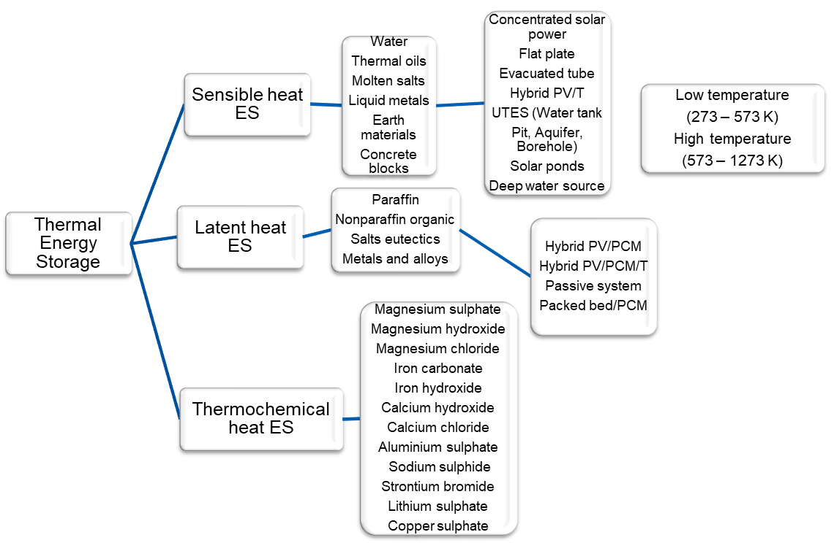
Introduction
System
Material
Classification
Notes:
Definition:
TES is the system of storing energy in the form of heat energy for later usage

Slide 3
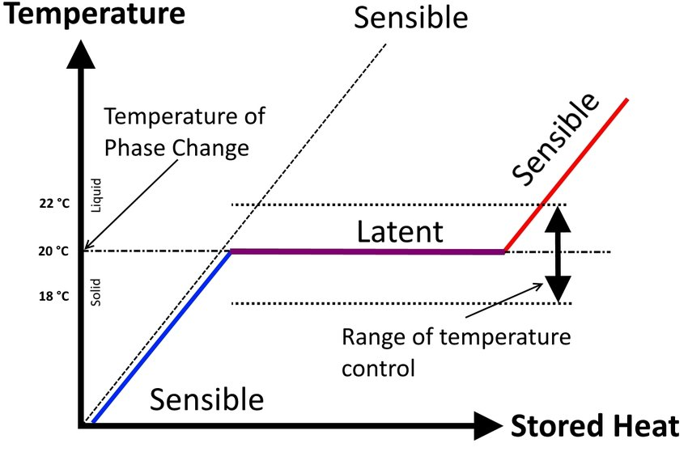
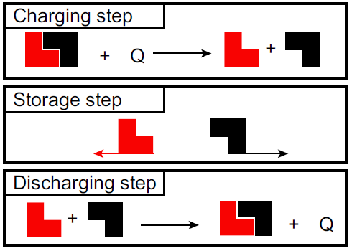
Technologies
Sensible heat
Temperature increase of storage material
Latent heat
Phase-change of storage material (PCM)
Thermochemical heat
Chemical reaction of two materials
For example MgCl2 and H2O

Slide 4
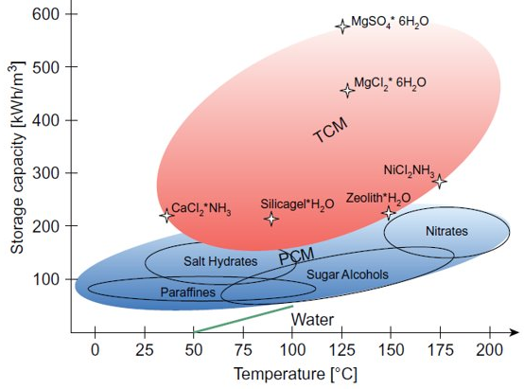
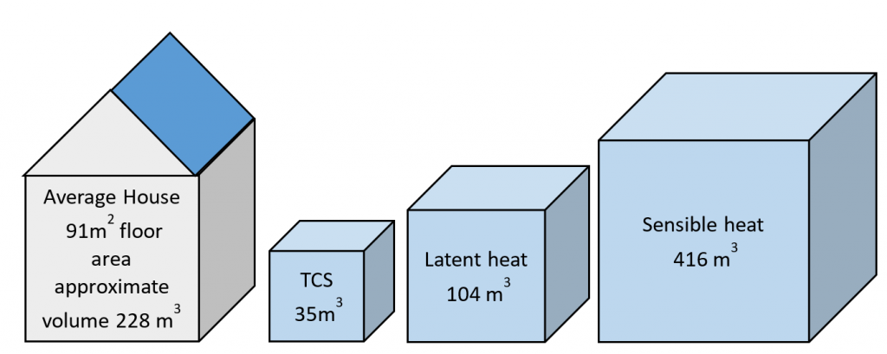
Characteristics of Storage Systems
Sensible heat storage
Pros:
Low costs, 0.1-10 €/kWh
High temperature ranges
Cons:
Large volumes required
Mostly low efficiencies
Latent heat storage
Pros:
Medium cost, 10-50 €/kWh
Storage occurs in small temperature variation
Cons:
High risk of leakage
Low thermal conductivity
Thermochemical heat storage
Pros:
High storage capacity and energy density
Low heat loss
Cons:
High costs, 8-100 €/kWh
Low reliability
Issues about recyclability

Slide 5
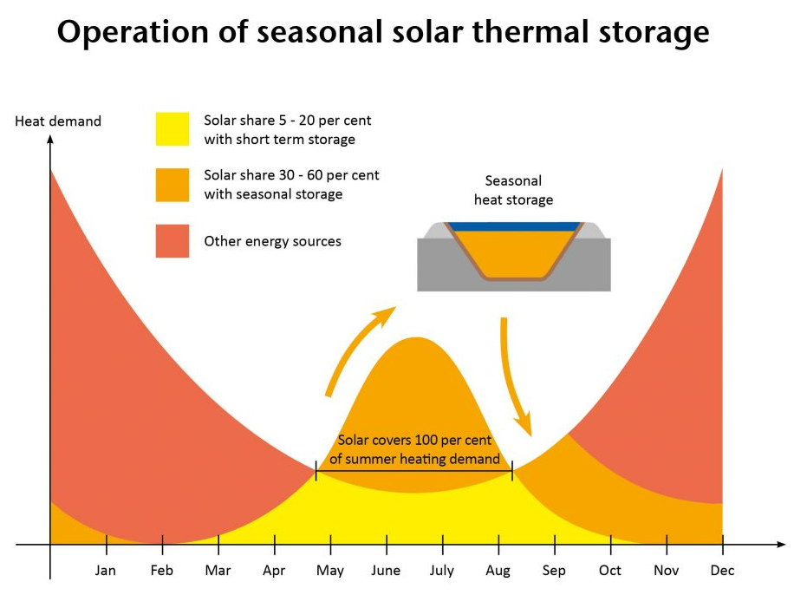
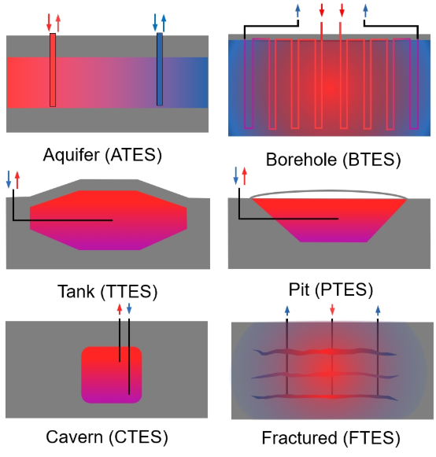
Daily and Seasonal Storages
Daily Storage Technologies
- Mainly used for the day-night cycle of fluctuations in demand and production and for production variability due to weather variations
Seasonal Storage Technologies
Charging during summer, discharging during winter
The difference between heat demand during winter and summer can be up to 10x.
Underground TES Methods
Notes:
Selitys ja esimerkit

Slide 6
Thermal Heat Storages in Smart Grid
Energy storage increases flexibility in the energy system
Thermal heat storages can be used to integrate renewables into power system
Electiricity demand and price peak reduction
Increase grid reliability and power quality
Enhanching the efficiency of energy system
Available for both heating and electrification

Slide 7
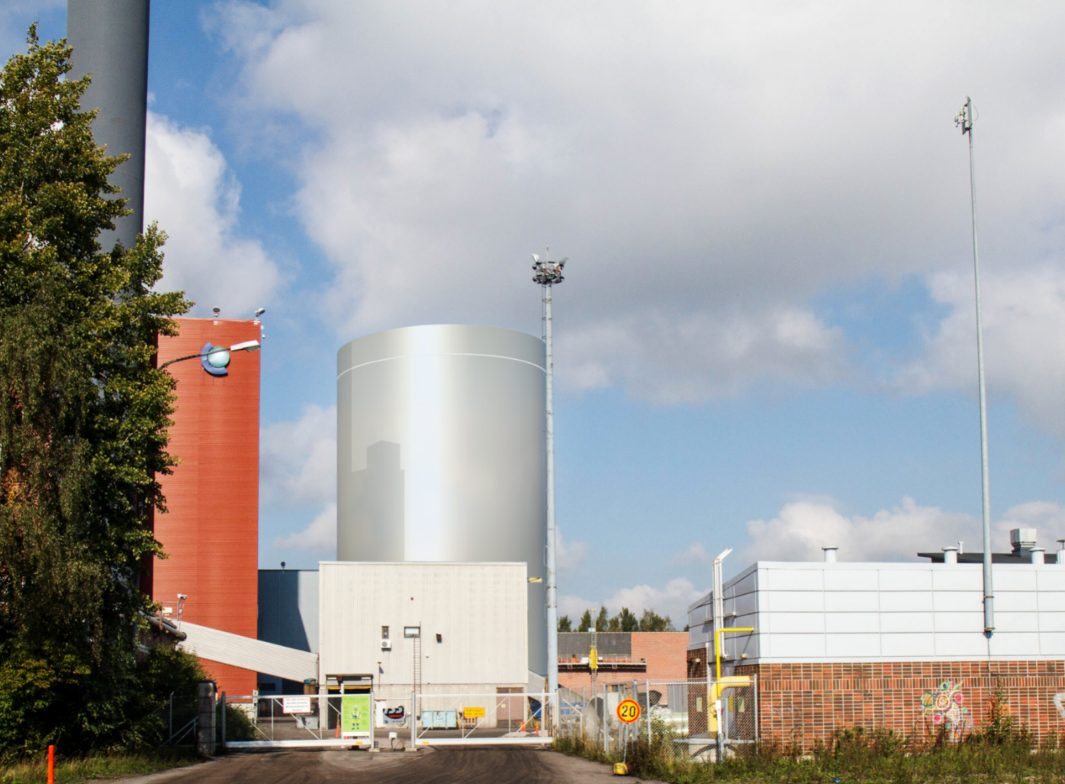
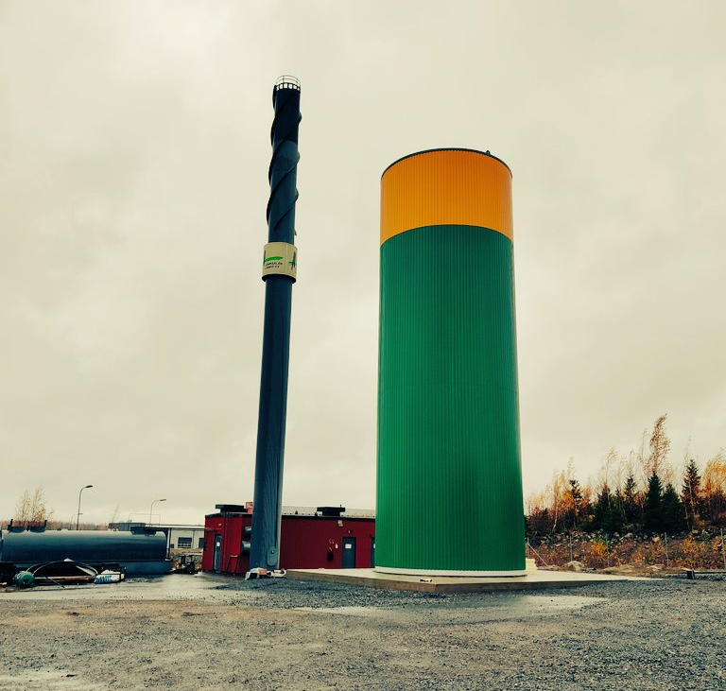
Thermal Heat Storages in Finland
Helen seasonal heat storages
Lempäälä energy community and Suomenoja heat battery

Slide 8
Conclusions
Thermal energy storages can be divided to sensible, latent and thermochemical technologies
Storages can be utilized for either day or seasonal use
Increase the flexibility of the energy system; reducing peak demand and peak price

Slide 9
Source material used
https://www.diva-portal.org/smash/get/diva2:956741/FULLTEXT01.pdf
https://celsiuscity.eu/thermal-energy-storage/
https://kuntatekniikka.fi/wp-content/uploads/sites/2/2015/03/Fortun_Suomenoja_Lampoakku.jpg
https://www.sciencedirect.com/topics/engineering/latent-heat-storage
https://www.researchgate.net/figure/Sensible-heat-vs-latent-heat-and-temperature-control-during-the-phase-change-7_fig1_312868057
https://www.sciencedirect.com/topics/engineering/thermal-energy-storage
https://www.sciencedirect.com/topics/engineering/thermochemical-energy-storage
Sarbu (2012) Thermal Energy Storage. https://doi.org/10.1016/B978-0-12-811662-3.00004-9
Fang (2018) An overview of thermal energy storage systems. https://doi.org/10.1016/j.energy.2017.12.037
https://savosolar.com/article/solar-heat-an-emission-free-and-affordable-source-of-district-heating/
Refer to student presentations 2019-2021 (MyCourses materials) for topics in TES

