Slide 1
Integrated Marketing Communications
Teacher: Laura Rosenberg
Spring 2023

Slide 2
Agenda
Introduction of the course & course practicalities
  Learning goals
  Readings
  Schedule
  Deliverables
Introduction to IMC
Q&A

Slide 3
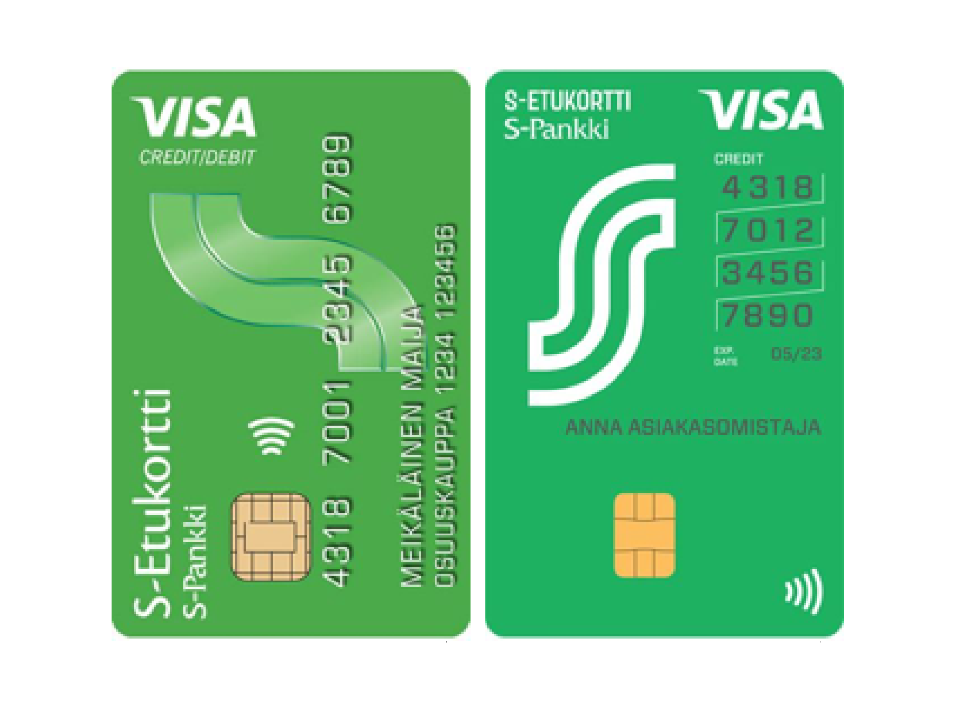



About me
McS, Aalto University
Work experience 2014-2018
  Brand associate at Danone Finland
  Marketing manager, S-group
Start of academic career in 2018
  PHD researcher at the marketing department
  Research interests: access-based consumption, circular economy, carbon farming

Slide 4
Now it’s your turn!
How many of you are marketing major students?
What about marketing minor students?
Others?
How many of you know what Integrated Marketing Communications is?

Slide 5

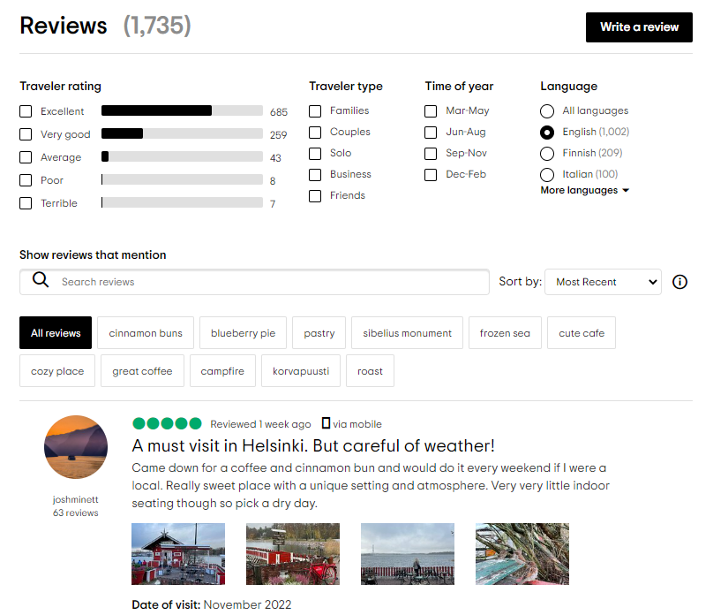
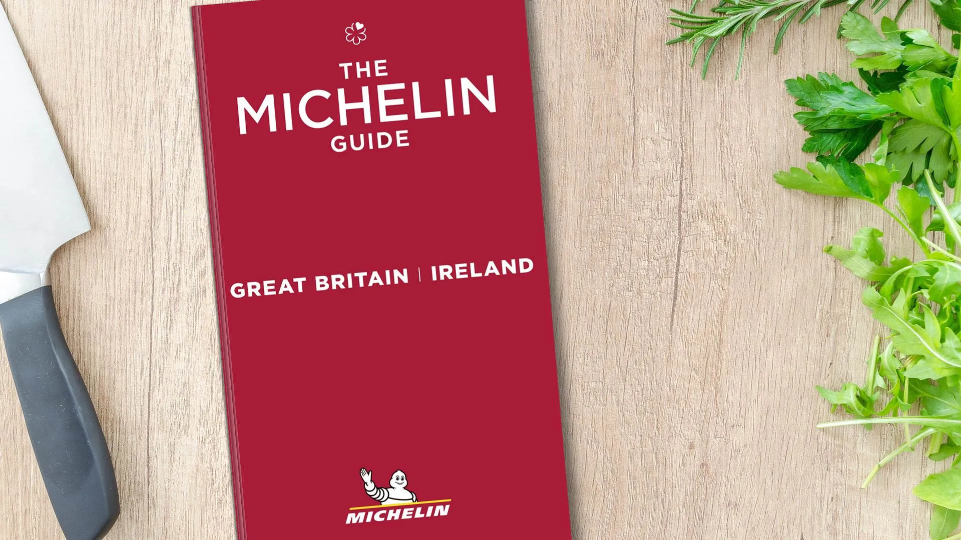
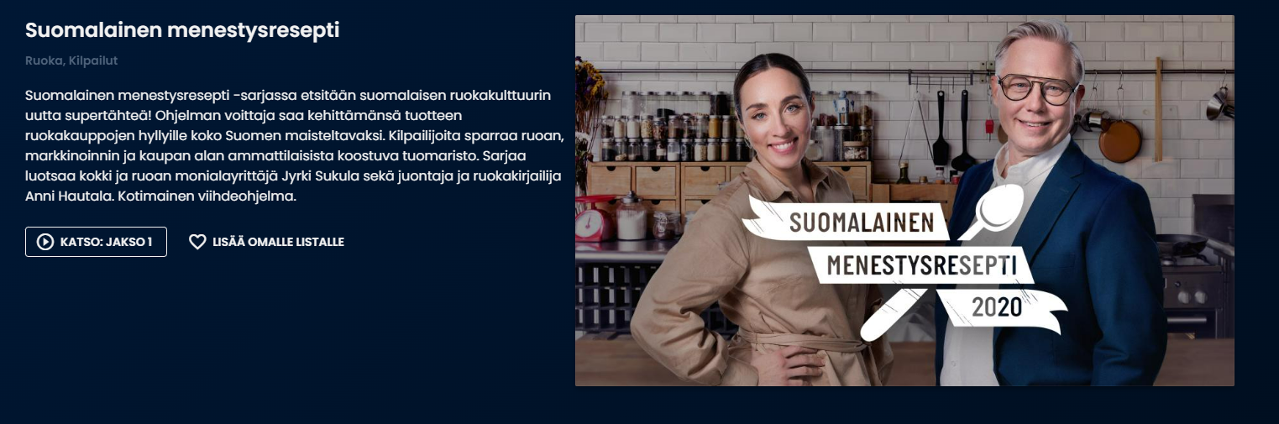
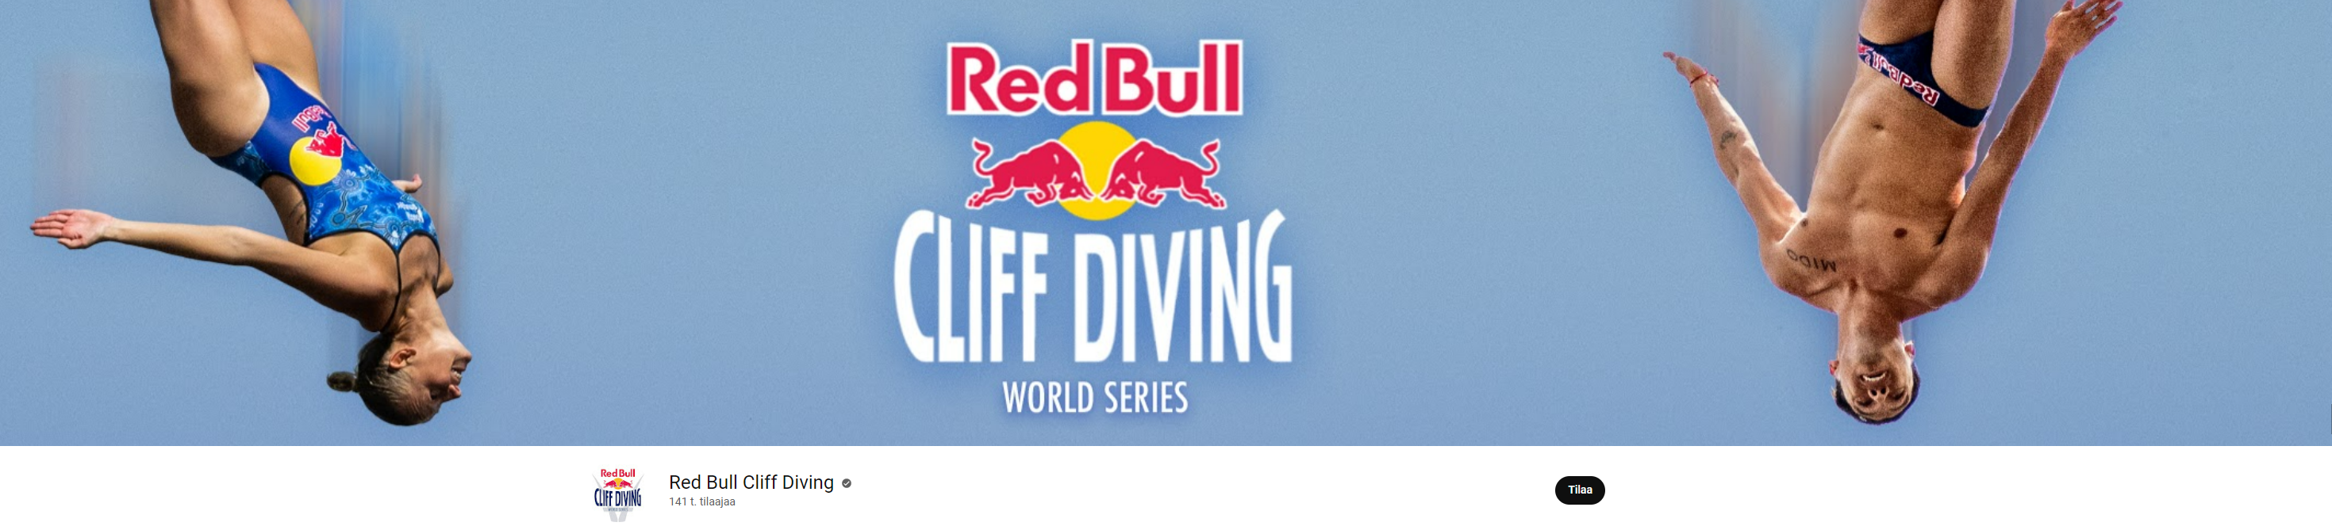
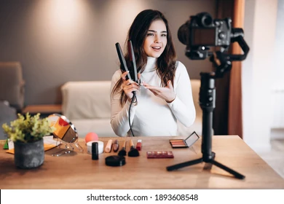
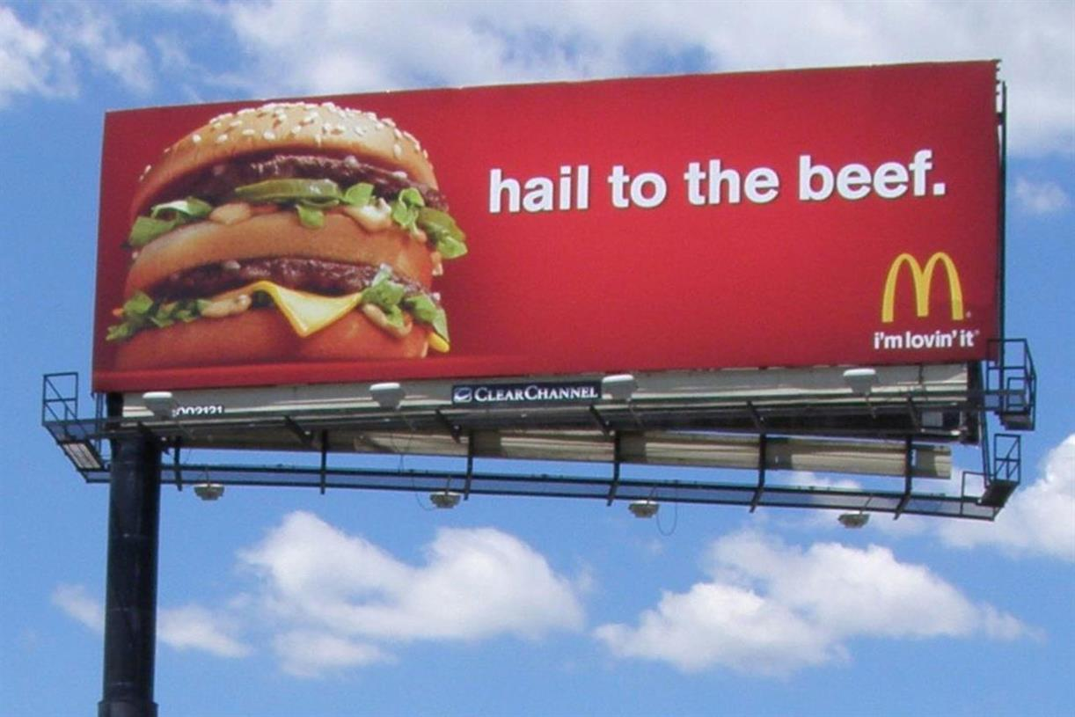
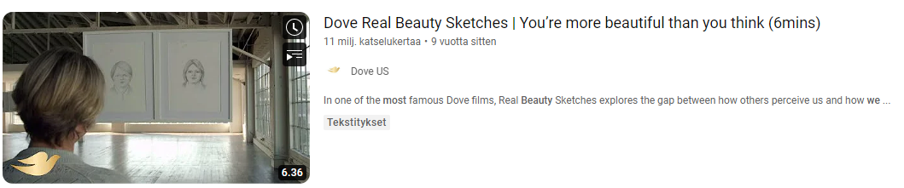
What do all of these have in common?

Slide 6
The challenge?
How to manage marketing from a strategic viewpoint, create engaging content, make relevant media decisions and most importantly, integrate the sheer amount of different touch points together in order to create consistent, meaningful marketing (advertising).

Slide 7
Broad learning goals of the course (1/2)
1. Familiarize students with the role of integrated marketing communications (IMC) in marketing & a company’s business processes
2. Learn to identify different promotional functions and how they work together
3. Understand the effects of advertising and promotion, and ways to measure and study these effects

Slide 8
Broad learning goals of the course (2/2)
4. Get to know the IMC planning process
5. Be able to plan and execute promotional campaigns
6. Understand career prospects in the promotion industry, including ethical considerations of the industry
Notes:
So

Slide 9
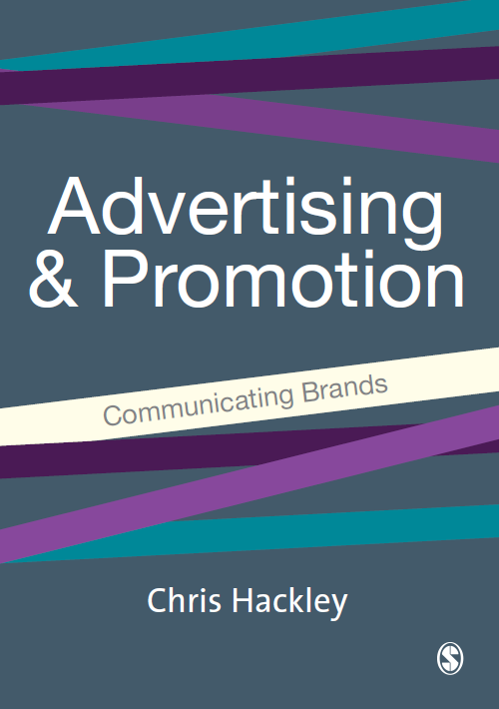
Readings
Each class will have compulsory readings.
Some are book chapters; some are journal articles. Some articles are assigned for multiple lectures.
The exam will be based on the readings and the content of the lectures!

Slide 10
Grade structure
Group work (60%)
Final report (40%)
Presentation of report (20%)
Individual work (40%)
Final exam
→ All evaluation will happen at the end of the course. However, I am happy to give you feedback from your assignments already during the course, so feel free to send me questions via e-mail!

Slide 11
Schedule: Guest lectures are mandatory

Slide 12
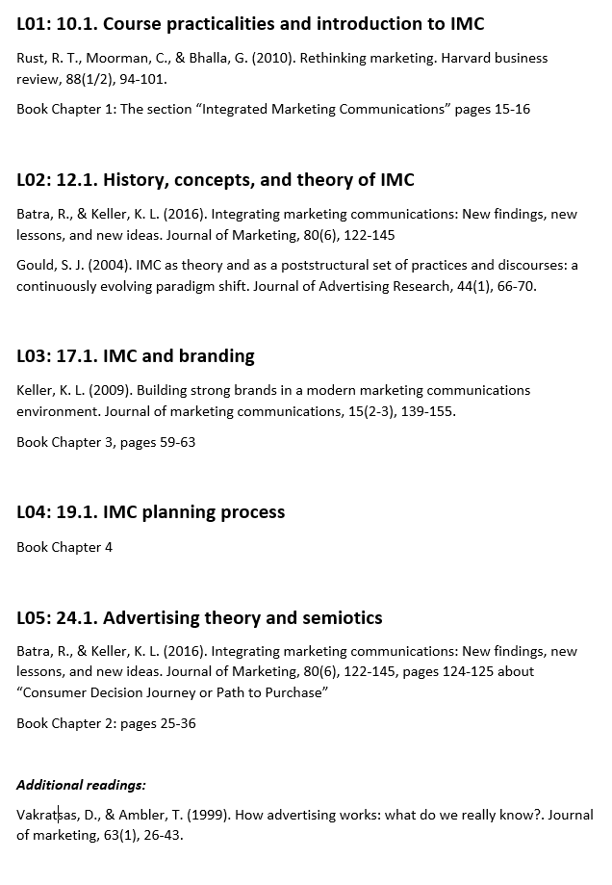
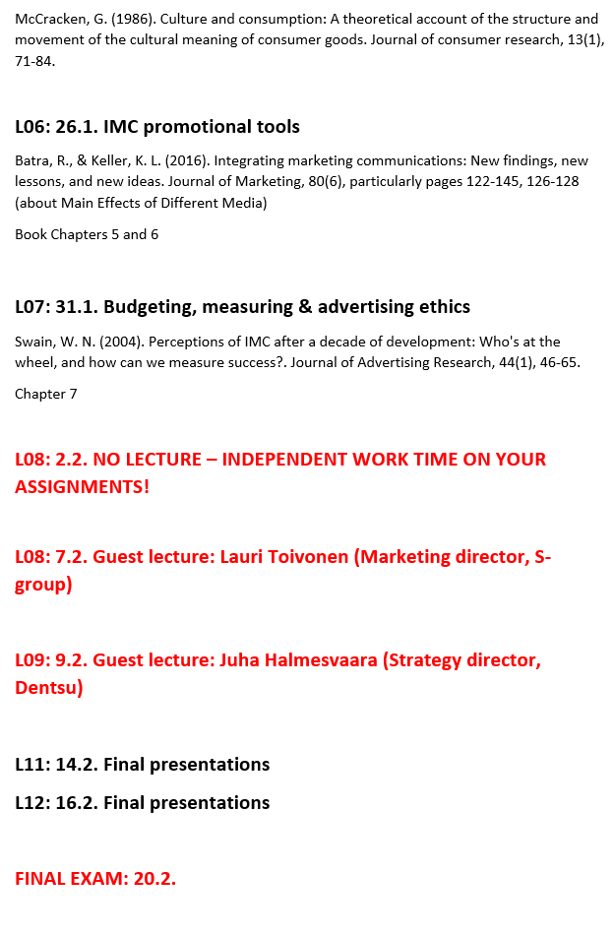
Reading list (on Mycourses)

Slide 13
Assignment deadlines
Group work
  Presentation of report 13.2.
  Final report 18.2.
Individual work (40%)
  Final exam 20.2.

Slide 14
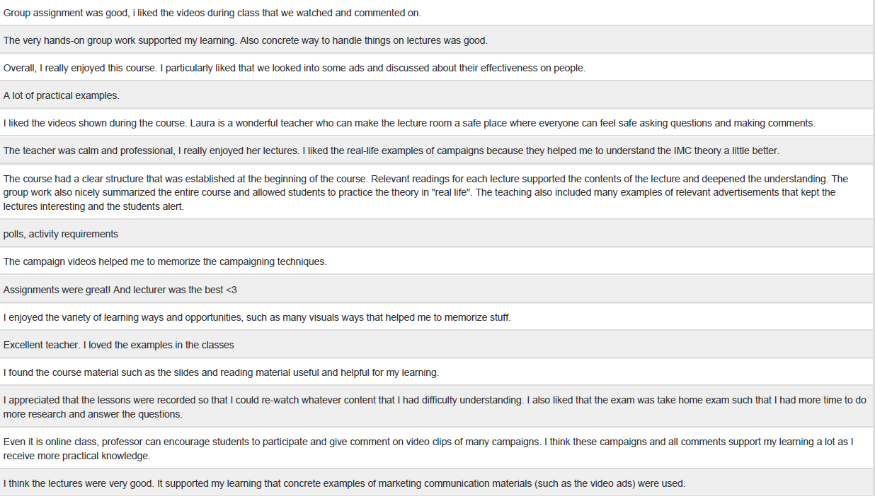
Last year’s feedback in a nutshell:
Overall, the course was very liked (average over 4). Students particularly enjoyed the group assignment, real-life examples during lectures, and overall, the course materials.

Slide 15
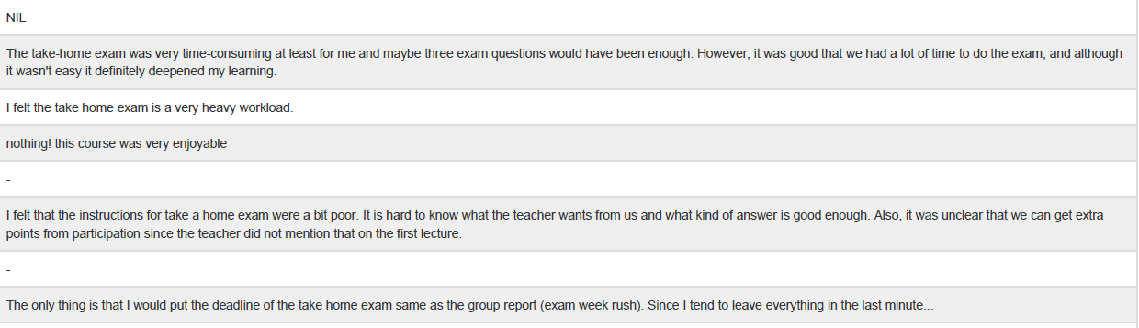
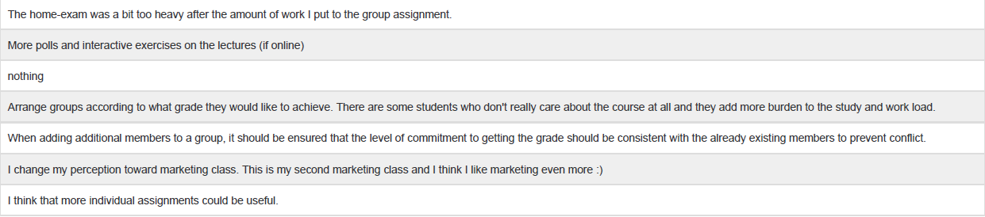
What could be done better according to students?
Suggestions for improvement related to the take-home exam, timing of the deadlines, and forming groups. Some students also wanted more discussions during class.

Slide 16
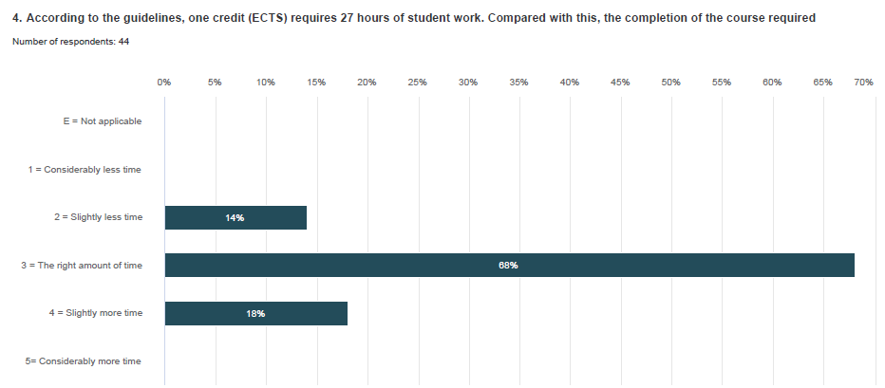
Students were pleased with the time that took them to accomplish the assignments and the exam

Slide 17
What happened after the feedback:
As students where happy with their study efforts / the time it took them to accomplish everything, I decided to keep the assignment structure the same. The course has a long history in Aalto, and students have always loved doing the IMC campaign for the course. Having the exam at the end of the course gives students more time to go through the readings. However, if you disagree after the course, please let me know!
I made some changes to course readings and lectures, but mainly they stayed the same.
Changes: I have changed the exam and will formulate exam questions more clearly (case questions vs. topic-related). We will have more time for class discussions. I have changed the timing of the deadlines (now all of them are before the final exam, as suggested). Also, I hope you will be active in forming groups based on your grade ambitions!

Slide 18
Form groups of 4-6 people after class and let me know your group members (full names) via e-mail: laura.rosenberg@aalto.fi
If you don’t have a group, let me know asap via e-mail. I will allocate you to a group. Please make sure to tell me the level of your ambition (grade-wise), so I can form coherent teams.

Slide 19
Final exam
The exam will include essay questions, from which you are asked to answer 3. Answer them based on course readings and course lectures.

Slide 20
Group work (60%) – general instructions
Throughout the course, you will be working on a group project where you design a comprehensive, 12-month Integrated Marketing Communications (IMC) campaign for a product or brand of your own choosing.
Grading rubric can be found on MyCourses, under the section “Materials” and “Schedule and readings”

Slide 21
Group work deliverables
1. Final report (40%)
Delivered at the end of the course
Around 10-15 pages (not counting appendices), double spaced, 1” margins, 12-point font, Times New Roman.
2. Final presentation (20%)
During the last two class sessions
10-15 minute presentation (same content than in your report, but in “presentation style”) → imagine you are pitching your IMC campaign to the CEO/board of directors of the company

Slide 22
Final report and presentation structure
Executive Summary (included only in the report)
Introduction of the brand and the market
Brand Challenge
Objectives & target audiences
Creative approach
Media plan & schedule
Budget & measuring

Slide 23
Final report and presentation structure
Executive Summary: summarize your entire campaign in 1 page (only in the report)
Introduction of the brand and the markets
  Introduce your product / brand!
  What product category is the brand competing in? What are the current trends in that category (What is driving consumer demand? What do consumers want / value? Any changes? What is driving those changes – legislation, ethical issues, environmental issues,…?).
  What are its main competitors? How is the product / brand positioned?
  → In this section you lay down the starting situation as detailed as you can. This will also help you set out your objectives.
Brand Challenge: What is the brand struggling with? Why is the campaign needed? Make sure to link this section to your brand and market analysis section!

Slide 24
Final report and presentation structure
Objectives & target audiences
  What is the current target audience of the product / brand?
  Who are you trying to influence via your campaign? Primary audience? Do you have secondary audiences?
  What are you trying to accomplish with this campaign (why are you doing it)? (Increasing / defending market share? Changing the positioning of the brand? Changing customer attitudes? Something else?)? (= this section is linked with the brand challenge)
Creative approach
  Introduce your creative idea that will help you achieve your objectives and make a difference in the market!
  Make sure to use also visual materials (mood boards, campaign visuals,…) → put your AD skills into use!

Slide 25
Final report and presentation structure
Media plan & schedule
  What does your big idea mean in practice? What promotional tools are you using and why (remember to refer to course readings!)
  How is your creative approach (big idea) leveraged through different channels and customer touch points?
  Utilize the media plan chart format to visualize your plan
Budget & measuring
  Estimate the total budget of the campaign
  Allocate your budget amongst at least the following: planning, project management, creative agency cost, media cost (this is usually the biggest chunk), post campaign costs (such as evaluating the campaign in the form of market research)
  What are your metrics that you’ll use to evaluate the success of the campaign?

Slide 26
Further tips
Highly recommended to choose known brands/products
Include a brand book / brand guidelines (some brands have published them online) that you stay true to – if not published, try to figure out what the brand stands for based on past marketing campaigns
Be innovative in terms of your big creative idea and media strategy – try to think outside the box!
Try to be realistic with budgeting and scheduling!
    I want to see numbers, or at least attempts of measuring and basing your decisions on research
  Wherever you can, use references (both academic and business-related) to back up the choices you have made (for example, you can use the article of Batra & Keller (2016) to justify the selection of promotional tools)
And remember: IMC is very analytical in its approach! And everything needs to be connected!
Check the grading rubrics at MyCourses to further understand how your work will be evaluated!

Slide 27
Questions so far about course practicalities?

Slide 28
Introduction to Integrated marketing communication (IMC)

Slide 29
Let’s recap the basics: what is marketing?

Slide 30
Marketing → activities a firm or company undertakes to promote and sell their goods to consumers and/or customers; as well as maintain relationships with them
We do so through the so-called “marketing mix” tools

Slide 31
The 4Ps marketing mix – the set of tools that management can use to influence sales
Anything that can be offered to a market for attention, acquisition, use or consumption that may satisfy a want, need or desire: physical objects, services, persons, organizations, ideas,…
All the company activities that make the product or service available to the market, incl. distribution channels, sales efforts etc.
Product
Place
Promotion
Price
The amount of money charged for a product or service. Different pricing strategies: premium pricing, cost-based pricing…

Slide 32
Promotion
Product
Place
Promotion
Price
All the activities that communicate the product or service and its benefits to target customers and persuade them to buy. Nowadays there are NUMEROUS promotional tools available.

Slide 33
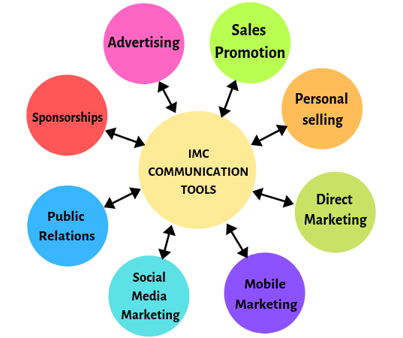
Promotional tools

Slide 34
How has marketing evolved during the past 50 years?

Slide 35
How has marketing evolved?
From product centricity to customer centricity

Slide 36
Marketing has evolved dramatically during the past 50 years
After the World War 2
  Firms had access to mass production technology and the infrastructure needed to facilitate mass production and distribution
  Many unmet customer needs
    → Customers were happy with standardized products at reasonable prices
(Seth et al. 2000)

Slide 37
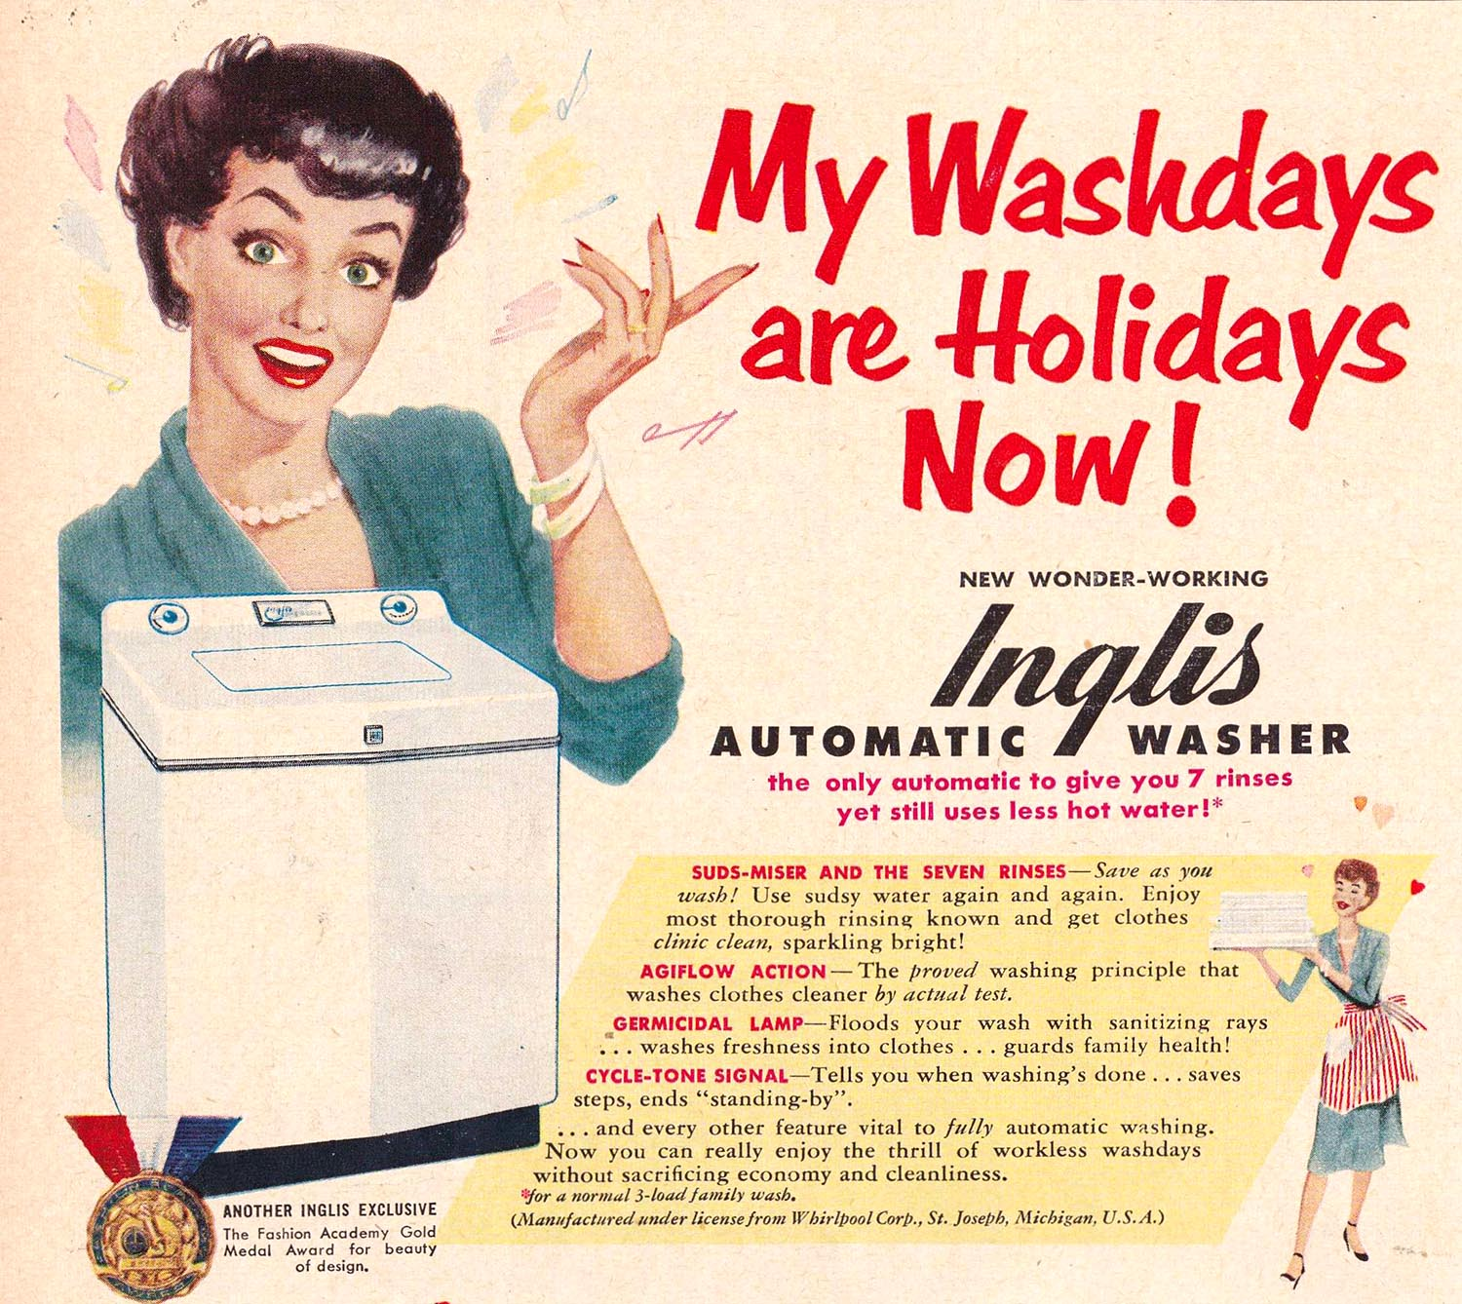
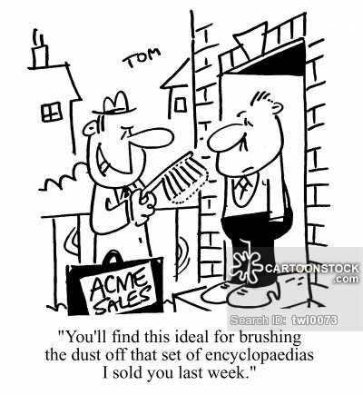
Product centricity

Slide 38
The focus of marketing: promoting, pricing, and distributing products for the mass market → companies organized their activities around products instead of markets & customers
(Seth et al. 2000)

Slide 39
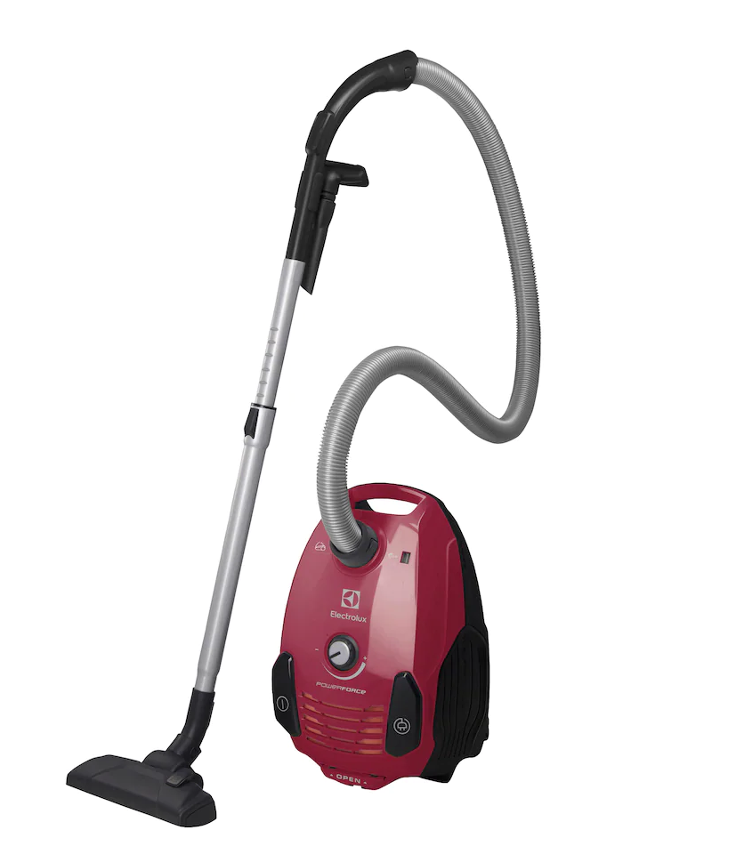
Product focus:
Make a quality product → better than the competitor
Have a product, find a customer
Come up with a value proposition - predominantly based on utility (functionality)
Transactional sales logic
One-way communication
All promotional material produced to support this logic
Consumer:
Passive recipient
Need to be persuaded
Consumer processing model
Company structure:
Hierarchical
Silos
Product development & sales oriented

Slide 40
The challenge with this approach over time?
The more companies entered the markets, the more difficult it became to compete with standardized products, targeted at mass markets.
(Seth et al. 2000)

Slide 41
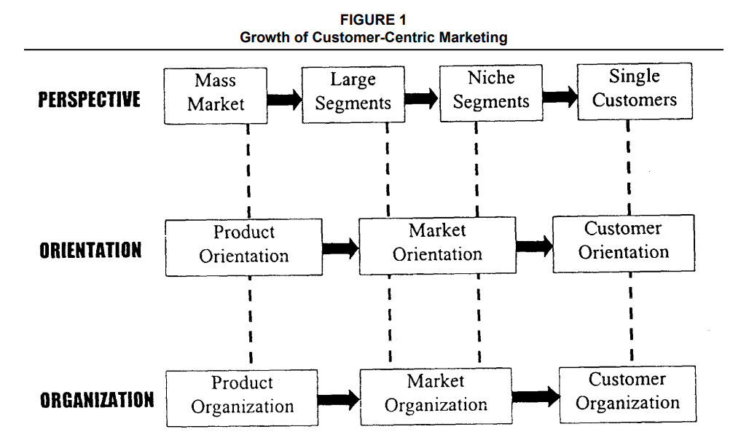
“With increased competition, marketers started defining smaller and smaller segments, including niche segments. The manifestation of this phenomenon was a proliferation of brands and channels.”
(Seth et al. 2000)

Slide 42
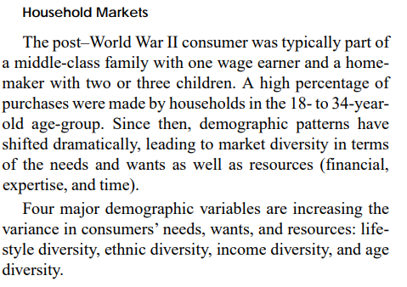
From segments to individual customers – what was driving the change?
Markets are fragmenting at a fast pace, creating a need for customized offerings and marketing.
(Seth et al. 2000)

Slide 43
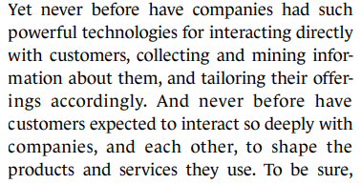
“To compete in this aggressively interactive environment, companies must shift their focus from driving transactions to maximizing customer lifetime value.”
→ making products and brands that contribute to building long-term customer relationships.
(Seth et al. 2000; Rust et al. 2010)

Slide 44
From product and segment marketing to customer centricity:
Understanding & satisfying the needs and wants of individual customers
Two-way communication & focus on building long-term relationships
Focus on analytics & customer insights (= targeted offerings and mapping the relationships)
“The key distinction between a traditional and a customer-cultivating company is that one is organized to push products and brands whereas the other is designed to serve customers and customer segments.”
(Seth et al. 2000; Rust et al. 2010)

Slide 45
What does it mean to build relationships with customers?

Slide 46
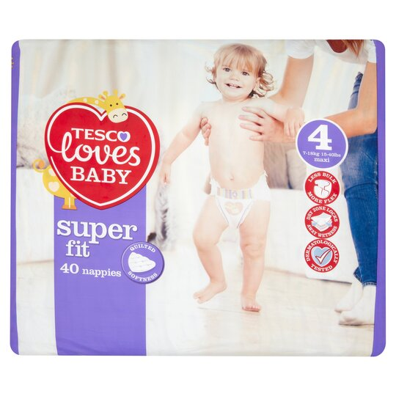
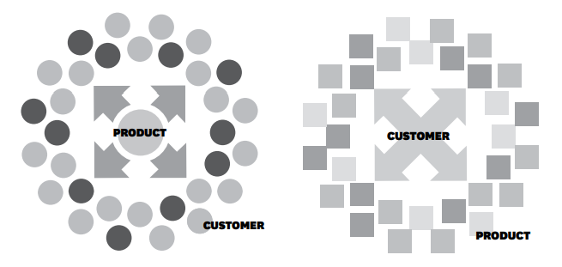
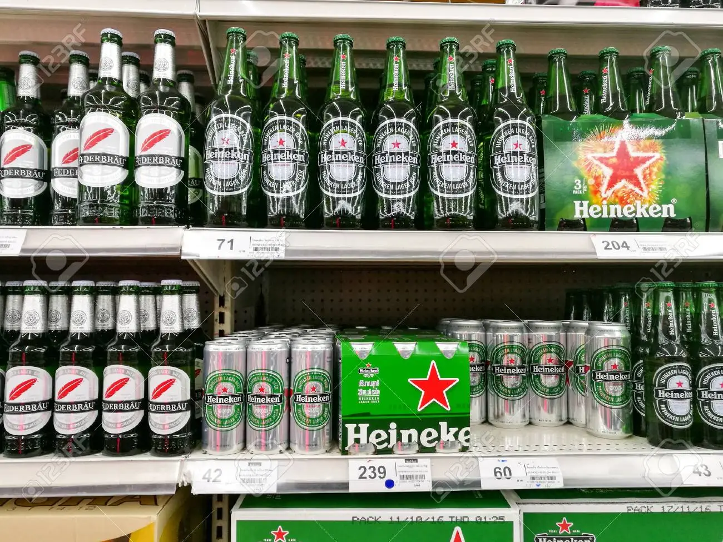
Companies that operate with a customer centric approach, approach customer relationships as not static but dynamic, evolving through time.
→ e.g., selling different brands to different customers & adjusting brand offerings and sales as customer’s needs change.
(Rust et al. 2010)

Slide 47
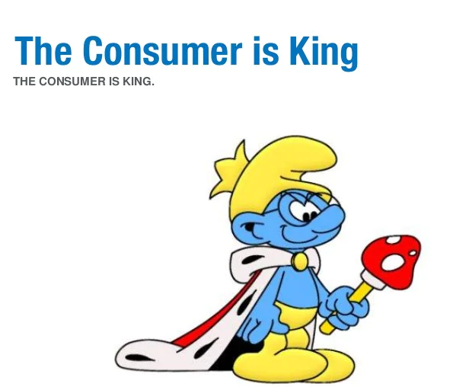
Adopting a customer centric approach changes the organizational structure
Communication and branding not only done by a marketing department or marketing managers alone, but concerns the whole of the company
The rise of the Chief Customer Officer (CCO) → Brand Manager!
Integration of organizational functions (CRM , Market research, IT, R&D…) → better understanding of consumers wants, needs and the maintenance of relationship with them! (CLV – customer lifetime value)

Slide 48
Let’s watch two videos and have a discussion!

Slide 49
The department store John Lewis Christmas Ad

Slide 50


Slide 51
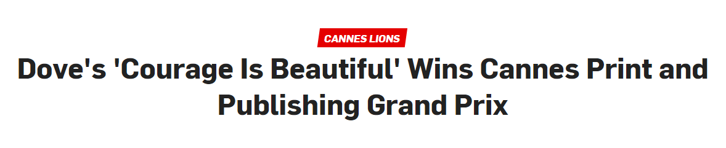

Slide 52
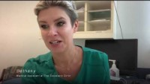

Slide 53
Thoughts about these videos?

Slide 54
Key takeaways from these videos

Slide 55
When we think of marketing as a concept, we usually tend to think of advertising as ads. And for obvious reasons: ads are usually the most visible thing we see about a brand, a product or a company. They invoke emotions, communicate functional attributes of products, create dream-like fantasies for us to desire…
  Yet, coming up with advertising ideas is only a small fraction of what marketing is and what companies do in order to create lasting relationships with consumers
Making an ad – a brilliant story – is not enough. Leveraging the story through multiple channels and media in a meaningful way is what gets you heard and seen by the customer.

Slide 56
Hackley and Hackley (2022) on advertising
“We use the term advertising to cover all media content that has, at some level, a promotional motive, from social media content to street billboards, TV spots to radio ads, branded packaging to branded content, product placement to sponsored influencer posts, not excluding the content produced by social media users such as likes, shares, and reviews of, or comments on, brands, products and consumer experiences.
This is a broader definition of advertising than is common in introductory advertising, marketing, or ‘marketing communications’ textbooks. Advertising is often defined as a paid-for promotional message on a mass medium with an identifiable source, but our view is that this definition has never been adequate to cover the vast realm of promotional media content in which the promotional motive is implicit, the author/source uncertain, and/or the payment indirect or absent.”
(Hackley & Hackley 2022)

Slide 57
Introduction to Integrated marketing communications

Slide 58
How would you explain IMC?

Slide 59
Some definitions of IMC over the years…

Slide 60
IMC
“IMC is the concept and process of strategically managing audience-focused, channel centered, and results-driven brand communication programs over time.” (Kliatchko, 2005)
“IMC is a process for planning, executing, and monitoring the brand messages that create customer relationships.” (Duncan, 2007)

Slide 61
IMC
“IMC campaigns utilize the qualities of different media in a communications onslaught designed to project consistent brand values regardless of whatever communication source the consumer encounters.” (Hackley 2017)

Slide 62
IMC
“Companies communicate with everything they do.” (Olins, 1989)
“One look, one voice.” (e.g. Miller & Rose, 1994)
“IMC is essentially a matter of consistency.” (Fill, 2001)

Slide 63
IMC
“There are so many different definitions and ideas of what IMC is about and what it entails, right through to its implementation.” (Kitchen, 2005)
“IMC is just a management fad lacking any theoretical content or rigor.” (Cornelissen & Lock, 2000)

Slide 64
IMC
“There do seem to be common elements in the various definitions and uses of IMC, which involve managing marketing communications in some holistic manner to achieve strategic objectives.” (Gould, 2009)

Slide 65
So what is IMC really, REALLY about?

Slide 66
IMC
“A concept of marketing communication planning that recognizes the added value of a comprehensive plan that evaluates the strategic roles of a variety of promotional tools – for example, general advertising, direct response, sales promotion, and PR – and combines them to provide clarity, consistency and maximum communication impact through the seamless integration of discrete messages.” (AAAA*, 1989 definition of IMC)
*AAAA → American Association of Advertising Agencies

Slide 67
IMC
“IMC is the process of developing and implementing various forms of persuasive communications programs with customers and prospects over time. The goal of IMC is to influence or directly affect the behavior of the selected communications audience. IMC considers all sources of brand or company contacts which a customer or prospect has with the product or service as potential delivery channels for future messages. In sum, the IMC process starts with the customer or prospect and then works back to determine and define the forms and methods through which persuasive communications programs should be developed. (Schultz, 1993a, p. 17)”

Slide 68
IMC
IMC as brand management approach
Underscores integration as an important and distinct facet of marketing communications
Emphasize creativity, process, metrics and evaluation of IMC brand communication programs over time

Slide 69
IMC and branding
Your role as a future brand manager or a CMO or CCO (Chief Cultural Officer) is to manage a brand or a number of brands
IMC offers a framework or a logic through which brand management and branding is carried out
Brands require constant tinkering. There are many reasons for why this is the case:
  Change in consumer preferences and taste
  Competitor moves
  Innovation
  Disruptive innovation
  And other…

Slide 70
Q&A

