Slide 1
Electric vehicles and their charging system
Md Tausif Alam, Suman Khadka

Slide 2
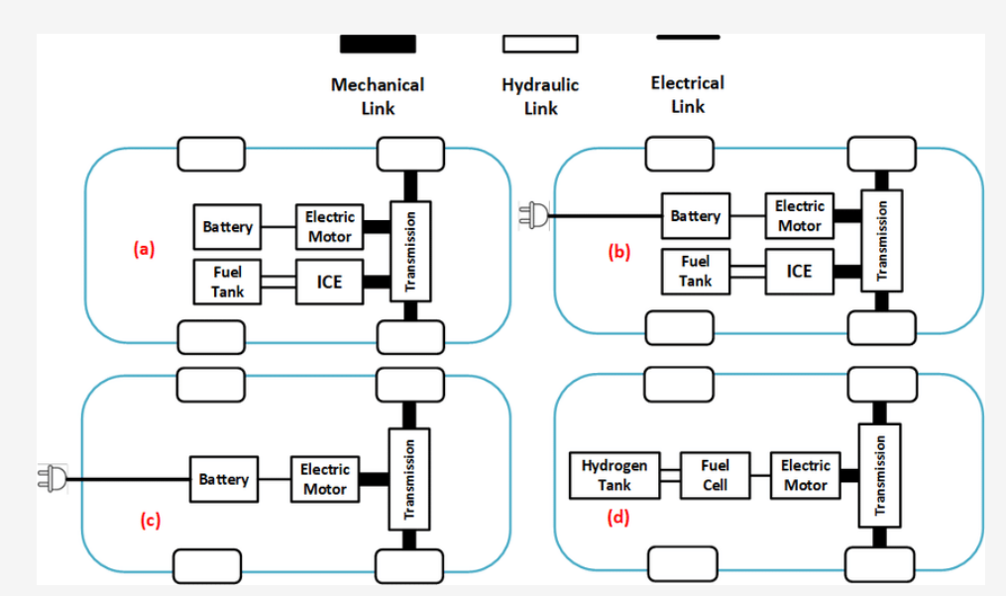
Electric Vehicle
Vehicles that are partially or fully powered by electricity
Types of EVs:
Hybrid Electric Vehicle
Plug-in Hybrid Electric Vehicle
Battery Electric Vehicles
Fuel cell Electric Vehicles

Slide 3
Electric Vehicle Market size
Global market size accounted for USD 205.58 billion in 2022.
Expected to increase USD 1716.83 billion by 2032.
Compound growth of 23.1% from period 2023-2032.
The global electric vehicle market is dominated by major companies such as Tesla, BYD, Nissan, BMW, Volkswagen etc.

Slide 4
Electric and hybrid Vehicles in Finland
In 2021, roughly 77 thousand hybrid electric vehicles and 22.9 thousand fully electric vehicles registered in Finland.
From 2015 onwards, the use of plug-in hybrid electric vehicles increased sharply while fully electric vehicles grew somewhat slower.

Slide 5
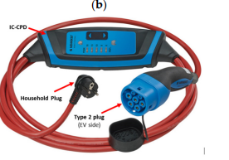
Charging Modes of EVs
Four charging modes defined by IEC 61851-1, based on power delivery, protection installation, communication/control of the charging system:
Mode 1 :
Also known as Shuko mode, refers to charging from residential outlet with extender cable.
Does not have any protection equipment.
Not recommend for EV charging application.
Mode 2 :
Refers to charging using residential outlet with the control and protection system known as in-cable control and protective device (IC-CPD)
The charging capacity is limited to maximum power of the socket outlet.

Slide 6
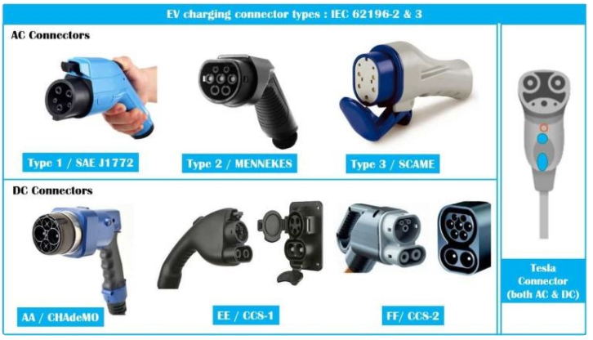
Charging modes of EVs
Mode 3:
Dedicated charging station with adequately protected and controlled.
single or three phase charging,
Extended functionalise such; no voltage unless properly connected, possibility of the charging station to control the maximum current that can be drawn from the network.
Mode 4:
DC charging mode , supplies DC voltage to the EV.
Cable are fixed in the charging station
Charging power up to 400KW

Slide 7
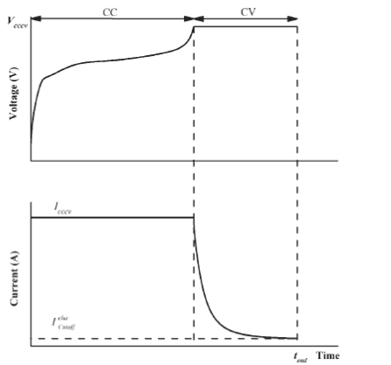
Charging algorithm for Li-ion
Must be charged when the terminal voltage reaches cut-off voltage, or the SOC reaches below 20%
Key criterion is not to charge excess and to charge battery without exceeding temperature
Constant current and constant voltage charging (CC/CV)
Regulated charging current is applied until the battery voltage rises to a predefined voltage,
Charging current depends on batteries and their charge acceptance
The CC can be generally chosen to be 0.5 C to 3.2C.

Slide 8
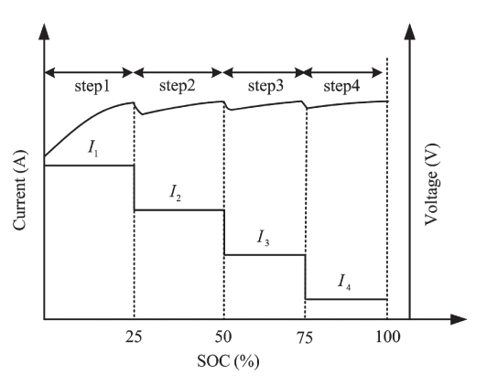
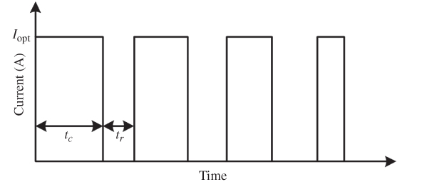
Charging algorithm for Li-ion
Multistep Constant Current Charging
First proposed to Lead-acid batteries,
Minimizes over charging and improves cycle efficiencies.
Difference approaches are used to search optimum charging current pattern .
Pulse charging
Employs a pulse current or voltage to charge the battery periodically.
The rest period allows the electrolyte to distribute evenly.
Fast and efficient charging algorithm

Slide 9
List of References
Rachid, A.; El Fadil, H.; Gaouzi, K.; Rachid, K.; Lassioui, A.; El Idrissi, Z.; Koundi, M. Electric Vehicle Charging Systems: Comprehensive Review. Energies 2023, 16, 255. https://doi.org/ 10.3390/en16010255
Alam, Mohammad Saad, and Mahesh Krishnamurthy. Electric Vehicle Integration in a Smart Microgrid Environment. Ed. Mohammad Saad Alam and Mahesh Krishnamurthy. First edition. Boca Raton, FL: CRC Press, 2021. Web.
https://www.precedenceresearch.com/electric-vehicle-market
https://www.statista.com/statistics/1177464/number-of-electric-and-hybrid-passenger-cars-in-finland/

