Slide 1
ELEC-E8423 - Smart Grid Electrical energy use in residential buildings, flexibility and DR potential of different energy uses
Abbasi Mohammad
14.03.2023

Slide 2
Introduction
Demand response
Residential electricity consumption
DR potential of different energy uses
DR programs
Challenges
Conclusions

Slide 3
Demand Response (DR)
What is DR? (Definition by the European Commission)
voluntary changes by end-consumers of their usual electricity use patterns – in response to market signals (such as time-variable electricity prices or incentive payments) or following the acceptance of consumers' bids (on their own or through aggregation) to sell in organized energy electricity markets their will to change their demand for electricity at a given point in time. [1]
Why DR?
To maintain power balance: Traditionally, supply is adjusted to match demand using capacity reserves.
An alternative approach is to adjust demand to match supply by using the potential of demand-side resources.

Slide 4
Demand Response (DR)
Benefits [2,3]
Grid
Efficiency
Reliability
Economic
Lower price of electricity
Environmental
Reducing greenhouse gases emissions

Slide 5
Residential Electricity Consumption
Finland Household Electricity Consumption in 2021 [4]
 | GWh | Share
Heating of spaces | 11,428 | 47.10 %
Household appliances | 9,143 | 37.68 %
Lighting | 1,482 | 6.11 %
Cooking | 790 | 3.26 %
Other electrical equipment | 6,871 | 28.32 %
Heating of saunas | 1,233 | 5.08 %
Heating of domestic water | 2,458 | 10.13 %
Total | 24262

Slide 6
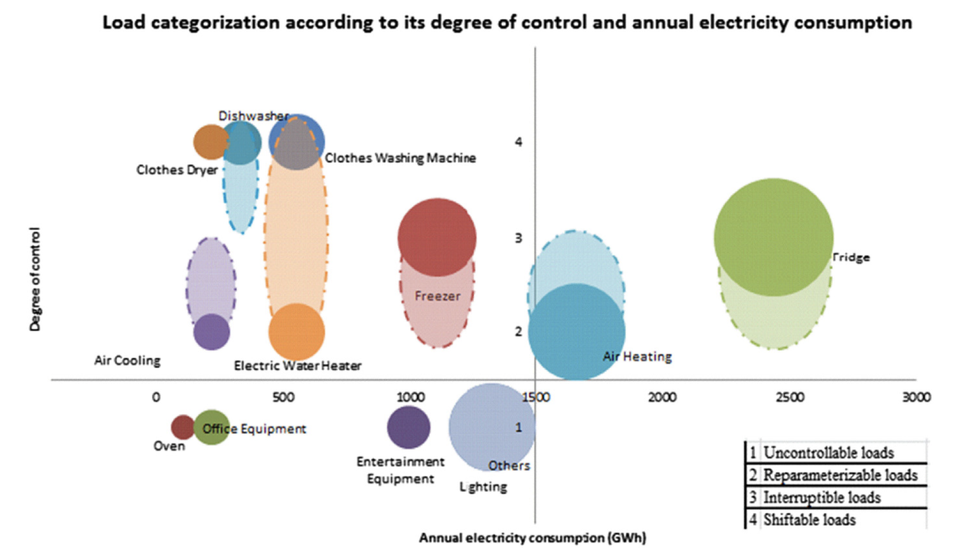
Load Categorization Based on DR [5]
Figure. Load categorization according to its degree of control and annual electricity consumption, data from Portugal
1. Non-controllable loads 3. Interruptible loads
2. Re-parameterizable loads 4. Shiftable loads

Slide 7
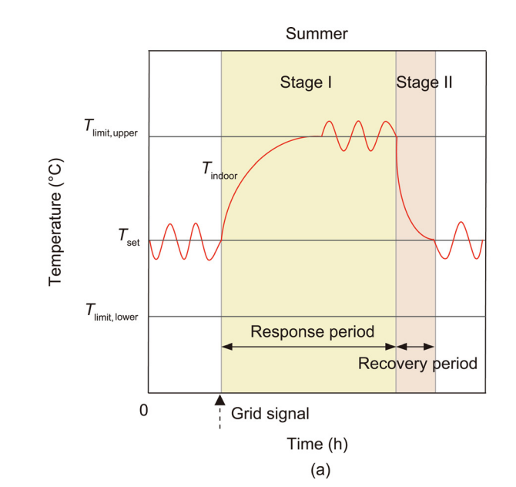
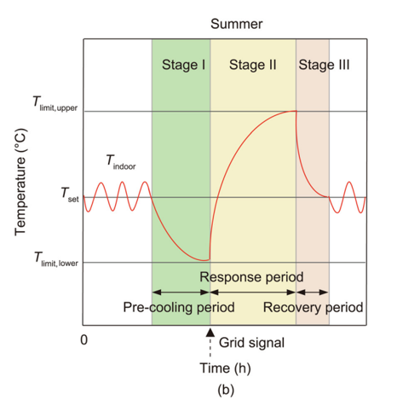
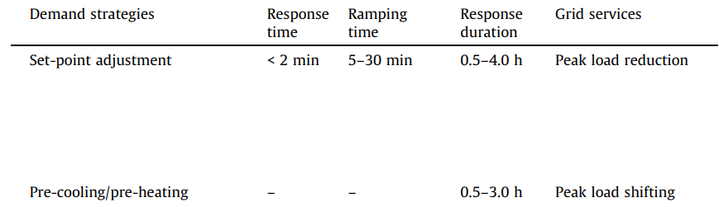
An Example: HVAC Potential [6]
(a) global thermal zone temperature reset; (b) pre-cooling
Figure. Response characteristics of HVAC loads

Slide 8
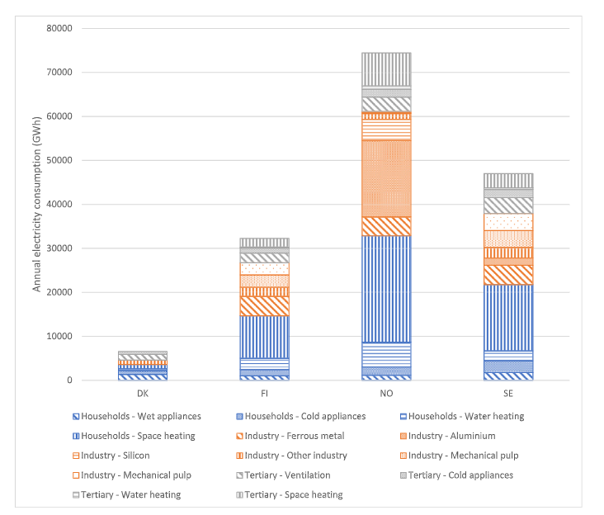
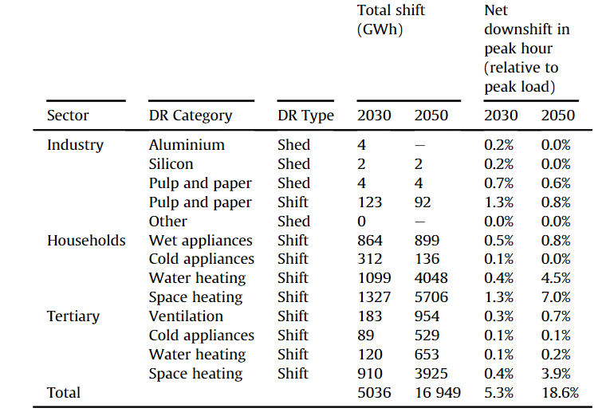
DR Potential of Residential Loads and Future [7]
Impact of DR Categories in 2030 and 2050 in Nordic Countries
Flexible Loads Annual Electricity Consumption in Nordic Countries

Slide 9
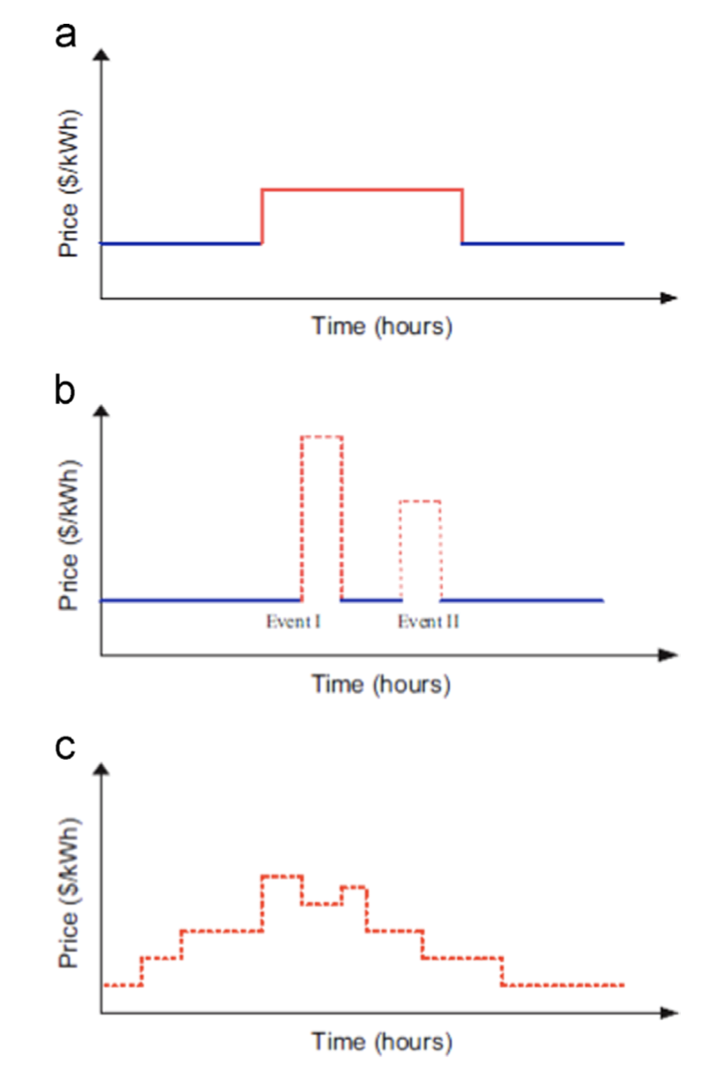
DR Programs
DR schemes [8,9] :
Time-of-Use (ToU)
Price-based:
Time-of-use
Critical Peak Pricing
Real Time Pricing
Critical-Peak Pricing
Incentive-based:
Critical Peak Rebate
Direct Load Control
Real-Time-Pricing
Type of control [10]:
Centralized
Distributed
Hierarchical
Figure. Time varying price schemes

Slide 10
Challenges [9]
Familiarity and trust:
Unfamiliarity with demand response and concerns around privacy and autonomy can contribute to mistrust.
Modeling customers’ behavior and participation:
User routines and could influence their participation in DR.
Complexity and effort to respond and shift demands:
The level of complexity and effort associated with demand response can affect consumer engagement.

Slide 11
Conclusions
Demand response is voluntary changes by end-consumers of their usual electricity use patterns, according to the DR schemes.
Residential loads have great potential for DR, and the degree of control reveals the potential of different energy use for DR.
DR in residential buildings faces challenges such as trust and complexity and effort.

Slide 12
Source material used
[1] Incorporating demand side flexibility, in particular demand response, in electricity markets, EuropeanCommission, 2013. [Online]. Available: https://energy.ec.europa.eu/system/files/2014-10/com_2013_public_intervention_swd07_en_0.pdf
[2] M. S. Behera and S. K. Jain, "A review on different techniques of demand response management and its future scopes," in 2021 International Conference on Control, Automation, Power and Signal Processing (CAPS), 2021: IEEE, pp. 1-8.
[3] P. Pinson and H. Madsen, "Benefits and challenges of electrical demand response: A critical review," Renewable and Sustainable Energy Reviews, vol. 39, pp. 686-699, 2014.
[4] Energy consumption in households - Statistics Finland. [Online]. Available: https://stat.fi/en/statistics/asen
[5] A. Soares, Á. Gomes, and C. H. Antunes, "Categorization of residential electricity consumption as a basis for the assessment of the impacts of demand response actions," Renewable and Sustainable Energy Reviews, vol. 30, pp. 490-503, 2014.
[6] Z. Luo et al., "Demand flexibility of residential buildings: definitions, flexible loads, and quantification methods," Engineering, 2022.
[7] J. Kirkerud, N. O. Nagel, and T. Bolkesjø, "The role of demand response in the future renewable northern European energy system," Energy, vol. 235, p. 121336, 2021.
[8] H. T. Haider, O. H. See, and W. Elmenreich, "A review of residential demand response of smart grid," Renewable and Sustainable Energy Reviews, vol. 59, pp. 166-178, 2016.
[9] B. Parrish, P. Heptonstall, R. Gross, and B. K. Sovacool, "A systematic review of motivations, enablers and barriers for consumer engagement with residential demand response," Energy Policy, vol. 138, p. 111221, 2020.
[10] D. S. Callaway and I. A. Hiskens, "Achieving controllability of electric loads," Proceedings of the IEEE, vol. 99, no. 1, pp. 184-199, 2010.

