Slide 1
ELEC-E8423 - Smart Grid Demand response of industrial loads
Joona Kukkonen
21.03.2023

Slide 2
Introduction
Demand Response (DR) is the change in power consumption of demand side to better match the supply side to maintain system stability
The industrial sector is a major electricity consumer in Finland
A DR program is used to help control peak demand load and lower electricity cost in the wholesale markets
Utility companies can instruct industrial customers to reduce their load to help combat dispatching additional power plants
Any large industrial consumer is required to curtail demand whenever the load of the grid is critically high

Slide 3
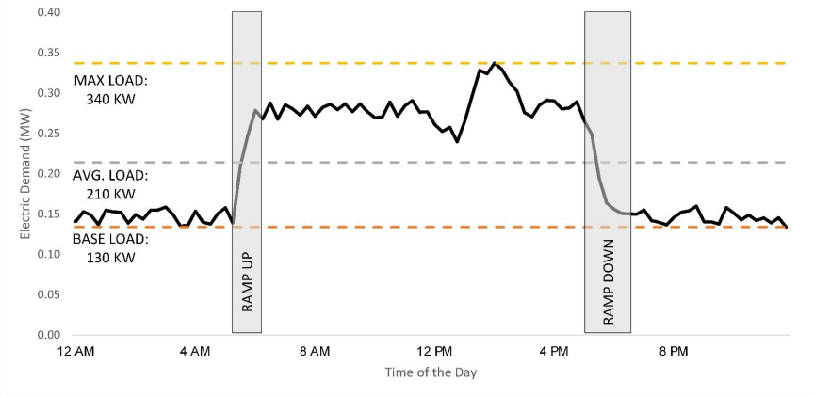
Consumption and demand
Electricity consumption is measured in kilowatt-hours (kWh)
Electricity demand is the rate (in kW) at which electricity is consumed
Figure below illustrates daily demand, as opposed to seasonal demand
(U.S. DEPARTMENT OF ENERGY, 2022)

Slide 4
Comparison of Industrial consumption
Industry consumption in Finland amounted to around 44%
In the EU, industry uses on average 26% of all energy
Finland has good long-term prospects in energy efficiency
(Räsänen, 2022)

Slide 5
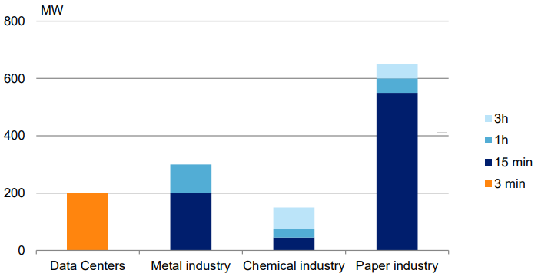
Demand side flexibility in Finland
Up to 60-70% of paper industry demand offers flexibility
On average, roughly 200MW of flexibility is estimated to be available for the metal industry
The chemical industry has the least demand side flexibility
(Pöyry, 2018)
Major industries in Finland:
Paper
Metal
Chemical

Slide 6
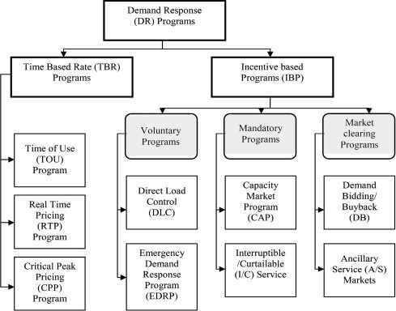
Demand response programs
DR programs can be generalized into two categories:
Time-based rate programs
Incentive-based programs
In time-based rate programs the electricity price changes for different periods according to the electricity supply cost
In incentive based programs, customers receive incentives or avoid penalties for reducing their load during a specific period
(Moghaddam et al., 2011)

Slide 7
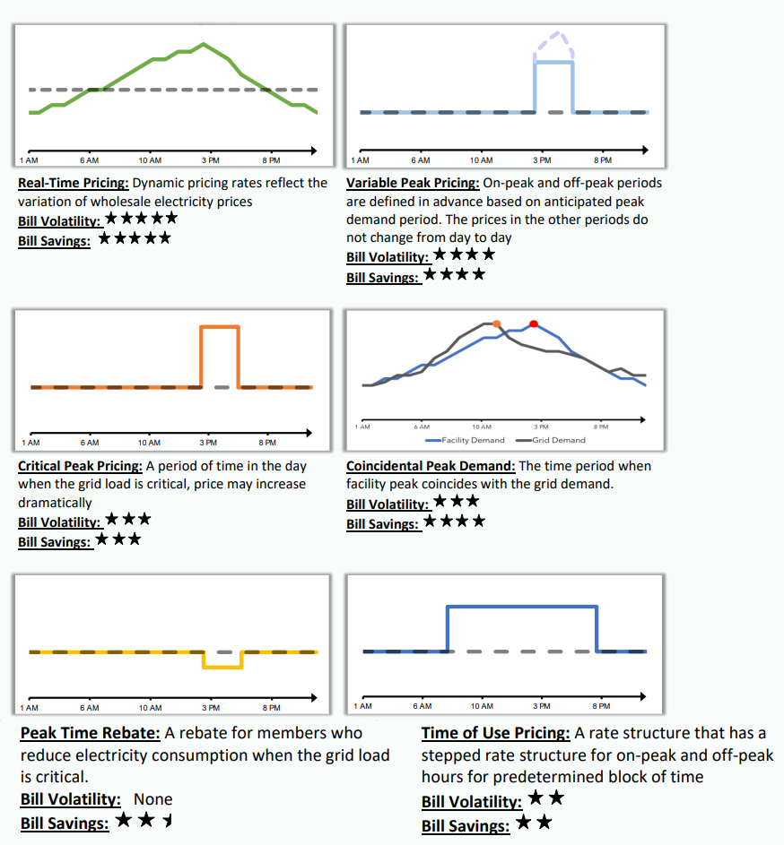
Types of time-varying rates
(U.S. DEPARTMENT OF ENERGY, 2022)
Each time-varying rate is associated with a certain risk and financial reward
Varying power prices can be changed based on the tariff, time of day, or market prices
These types of DR programs do not wait for a seasonal event to trigger the program protocol, unlike in the incentive based programs

Slide 8
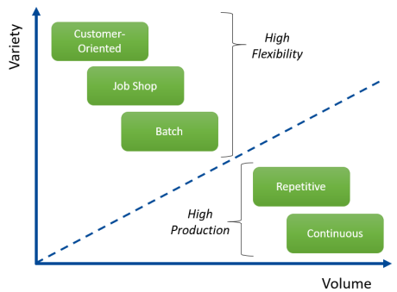
Demand response in industrial facilities
Flexible load refers to the strategic use of appliances to shift the timing of electricity demand and restore balance to the grid during peak events
The most advanced and newest technology in DR relies on smart manufacturing methods in order to prepare for the dispatch of a DR program
Industrial sectors are good candidates for DR programs, because the operations in an industrial facility are more complicated compared to e.g. commercial, leading to more complicated DR utility structure
(U.S. DEPARTMENT OF ENERGY, 2022)

Slide 9
Conclusions
Industry consumes 44% of electricity in Finland, and thus has good opportunity to increase energy efficiency
DR programs aim to lessen the strain on the electricity grid during peak demand events to avoid grid failures
Industrial sectors are good candidates for DR programs, because the utilization of flexible loads allows effective demand-side management

Slide 10
Source material used
Räsänen, M. (2022). Energy saving must be started in Finland – but we need the additional input of industry. [online] Korkia blog, 16 August. Available at: https://www.korkia.fi/en/energy-saving-must-be-started-in-finland-but-we-need-the-additional-input-of-industry/ [accessed 20.03.2023]
U.S. DEPARTMENT OF ENERGY, 2022. Demand Response in Industrial Facilities:. [online] ORNL/SPR-2021/2299. Available at: https://betterbuildingssolutioncenter.energy.gov/sites/default/files/attachments/Demand%20Response%20in%20Industrial%20Facilities_Final.pdf [accessed 20.3.2023]
McDevitt, C. (2022). What are Flexible Loads? [online] EnergySage blog, 30 September. Available at: https://news.energysage.com/what-are-flexible-loads/ [accessed 20.03.2023]
Pöyry. (2018). DEMAND AND SUPPLY OF FLEXIBILITY. [online] report no. 102001447 Available at: https://www.fingrid.fi/globalassets/dokumentit/fi/sahkomarkkinat/kehityshankkeet/dalyve-fingrid_flexibility-study_final-report_v300-id-151641.pdf [accessed 20.03.2023]
Moghaddam, M.P., Abdollahi, A., Rashidinejad, M. (2011). Flexible demand response programs modeling in competitive electricity markets. Applied Energy, vol. 88, no. 9, pp. 3257–3269. Available at: DOI: 10.1016/j.apenergy.2011.02.039

