Slide 1
ELEC-E8423 - Smart Grid Power markets in the Nordic countries: Frequency containment and restoration reserves
Peetu Melanen
25.04.2023

Slide 2
Introduction
Frequency control in the Nordic countries (Frequency containment and restoration reserves)
What is frequency control?
How is frequency controlled?
How is frequency control operated?
How are the reserves dimensioned & procured?
Nordic synchronous area
Conclusions
Sources

Slide 3
What is frequency control?
The forecasted electricity production’s and consumption’s, and the true production’s and consumption’s imbalance causes fluctuation from 50 Hz, which frequency control aims to contain.
50 Hz equals balance in production and consumption

Slide 4
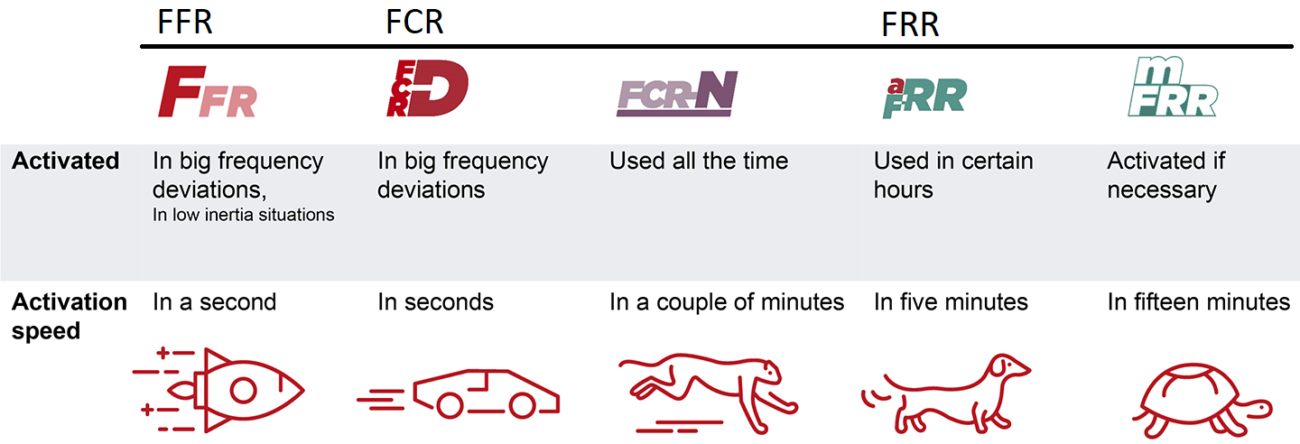
How is frequency controlled?
Frequency is controlled with reserve products.
Reserve products are units which adjust their power by system’s needs.
The reserve product categories:
FCR, Frequency Containment Reserve
FRR, Frequency Restoration Reserve
FFR, Fast Frequency Reserve

Slide 5
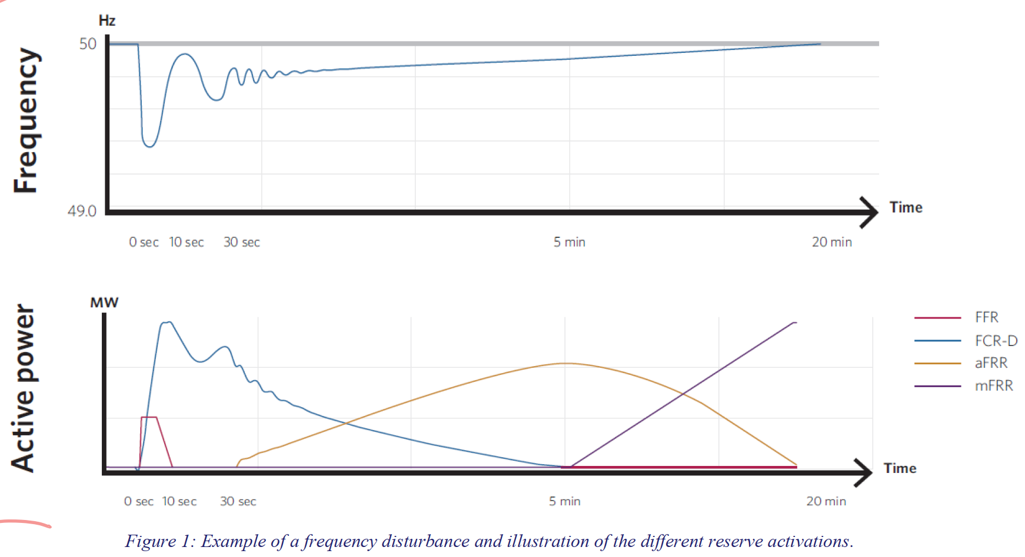
How is frequency controlled?
Notes:
Frequency containment and restoration.

Slide 6
How is frequency control operated?
In Finland the reserve products are activated by Fingrid purchasing bids from the corresponding frequency control markets. Operators are present 24/7 in a control room purchasing the bids.
At the time Fingrid pays for the activated reserves, yet eventually after an imbalance settlement the responsible market parties pay for their imbalances to Fingrid.
Fingrid = the TSO in Finland

Slide 7
How are the reserves dimensioned & procured?
For secure operation the TSOs must ensure availability of sufficient frequency reserves to avoid disconnections.
Dimensioning and procurement of the reserve products is set by EU legislation and further elaborated in Nordic System Operation Agreement.
The reserve products are procured by the TSO’s according to their obligations and needs.
In a nutshell, TSO’s contact possible reserve providers and make contracts with them to fulfill the national obligations and needs.
The reserve providers are then implemented into the market allowing them to submit their bids.

Slide 8
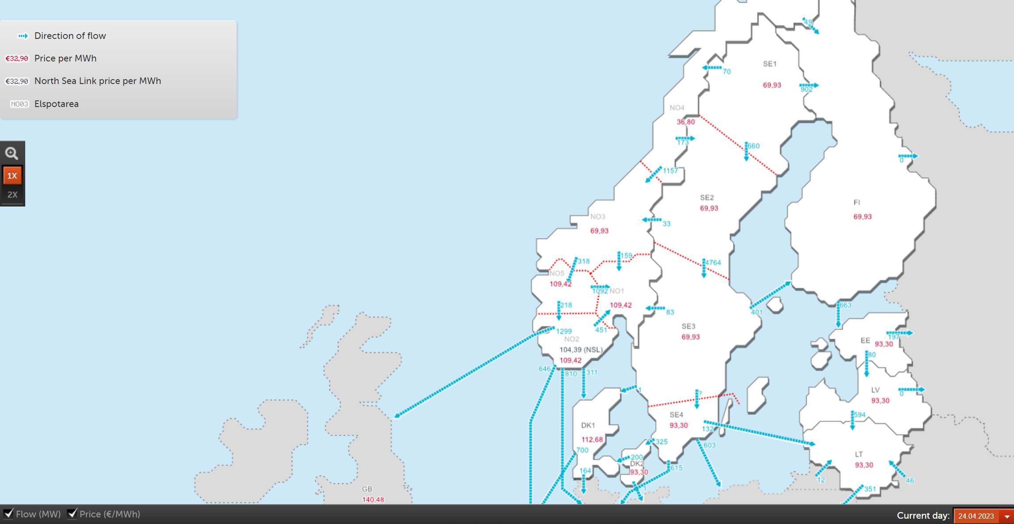
Nordic synchronous area
The Nordic synchronous area consists of Finland, Norway, Sweden and Eastern Denmark.
Finland is linked to the Nordic synchronous area with AC links to Northern Norway and Sweden. Additionally active HVDC links from Finland to Estonia and Sweden.
Notes:
Frequency control products are traded across borders.

Slide 9
Conclusions
The imbalance in production and consumption causes fluctuation from 50 Hz, which frequency control aims to contain.
The reserve products FCR, FRR and FFR are used to control the fluctuation with market terms.
Nordic TSO’s are responsible of procuring and operating their obligated reserves.
Notes:
Nordic TSO’s are responsible of procuring and operating their obligated reserves, activation signal wise.

Slide 10
Source material used
ENTSO-e
https://www.epressi.com/media/userfiles/107305/1648196866/overview-of-frequency-control-in-the-nordic-power-system-1.pdf
Fingrid
https://www.fingrid.fi/en/electricity-market/reserves_and_balancing/
Statnett
https://www.statnett.no/en/for-stakeholders-in-the-power-industry/data-from-the-power-system/
Nordpool

