Slide 1
ELEC-E8423 - Smart Grid Different market mechanisms for SG: bidding, real-time pricing, blockchains
Erno Huotari
14.03.2023

Slide 2
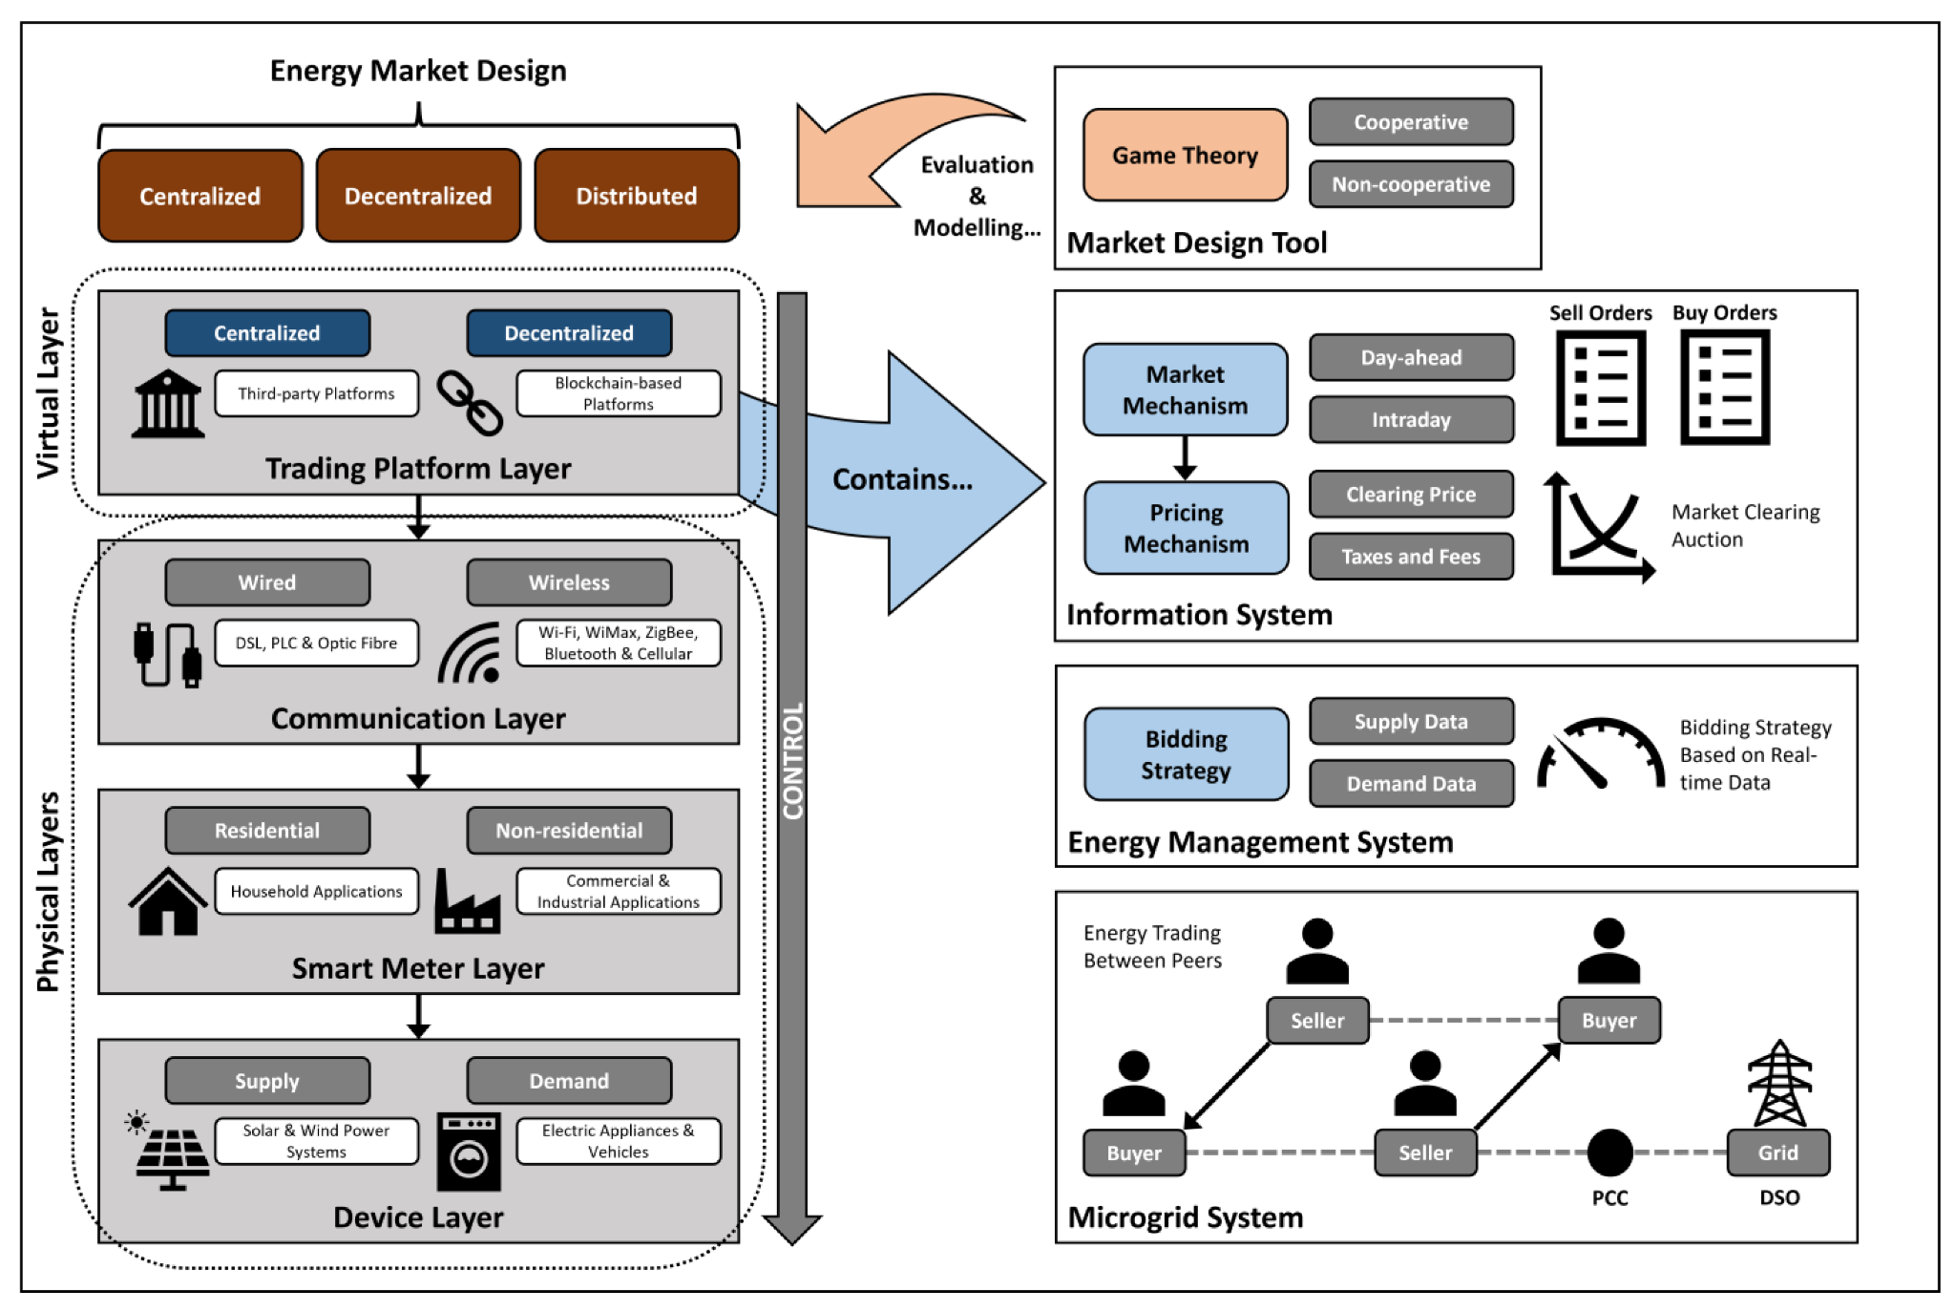
Introduction
To ensure the efficient functioning of the Smart Grid, market mechanisms have been established, that facilitate the buying and selling of electricity
This presentation will focus on various market mechanisms used in the Smart Grid, including Bidding, Real-Time pricing, Blockchains, Capacity Market and Demand Response Programs
These market mechanisms are designed to improve the efficiency and reliability of electricity trading, stimulate the adoption of renewable energy sources, and ensure grid stability.
Typical structure of a Local Electricity Market (LEM) (Bandeiras et al., 2023)

Slide 3
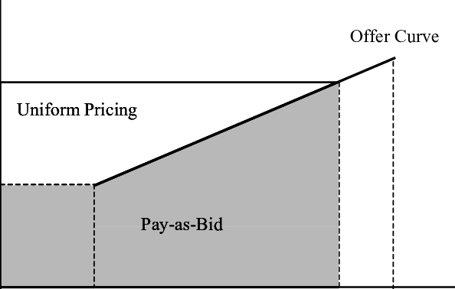
Bidding
A market mechanism used to allocate electricity resources efficiently by allowing market participants to buy and sell electricity in real-time
Can be conducted through different types of auctions, such as Pay-as-Bid or Uniform Price auctions
Enables market participants to respond quickly to changes in supply and demand conditions
Examples of bidding mechanisms used in Smart Grid:
Real-Time Pricing (RTP)
Day-Ahead Bidding
Balancing Market
Capacity Market
Ancillary Services Market
Revenue in Pay-as-Bid vs. Uniform Pricing auctions (Skoulidas et al., 2002)

Slide 4
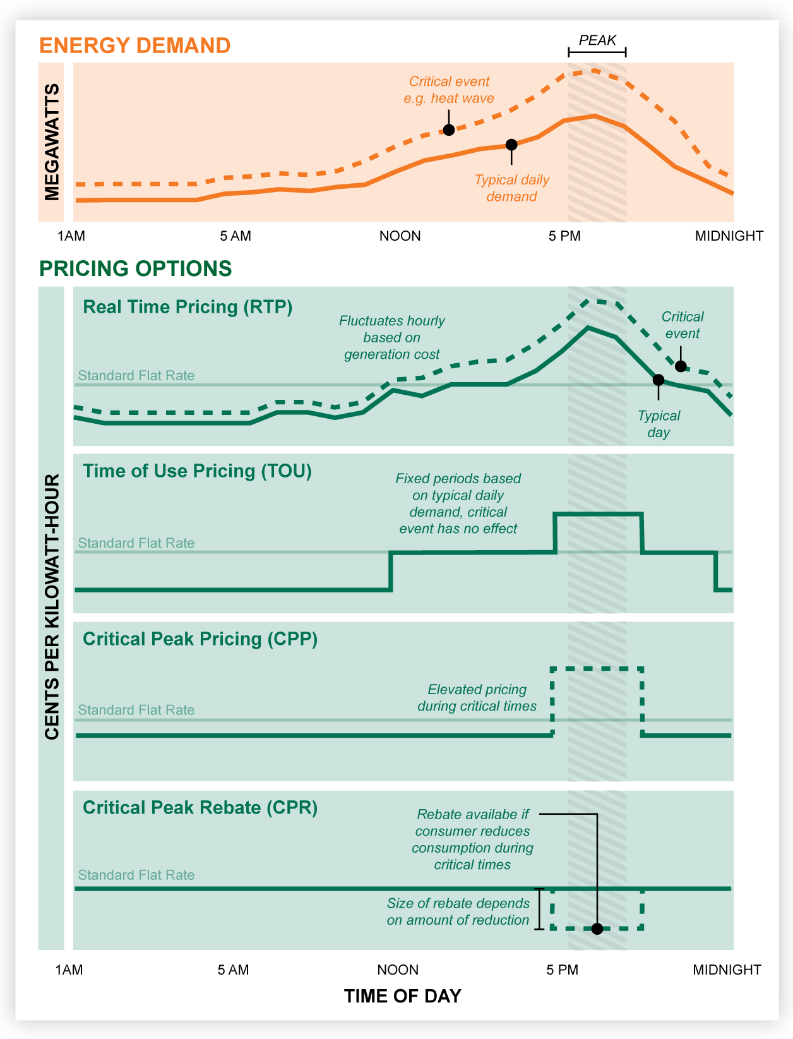
Real-Time Pricing
Allows electricity suppliers to set prices in real-time
Provides incentives for consumers to shift their electricity usage to periods of low demand
Helps reduce the need for new electricity infrastructure by reducing peak demand
Can be combined with other market mechanisms
Helpful in integrating renewable energy sources into the grid
Real-Time Pricing compared to other types of Time-Variant Pricing strategies (Spiller, 2015)

Slide 5
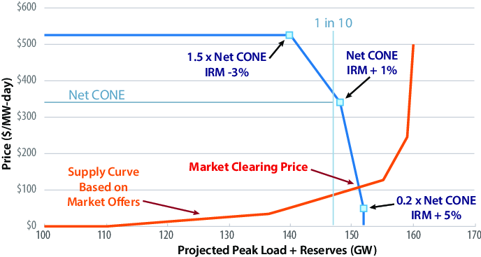
Capacity Market
A market mechanism that provides incentives for electricity suppliers to invest in new capacity
Helps to ensure grid stability and reliability and prevent blackouts or brownouts
Can be designed in different ways
Good in complementing other market mechanisms
Incentivizes the development of new energy storage and demand side management systems
Capacity supply and demand curves at PJM in the US (Moye & Meyn, 2017)

Slide 6
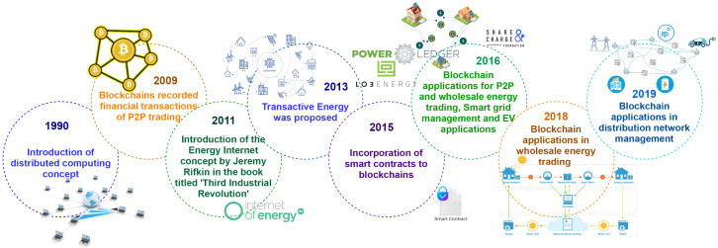
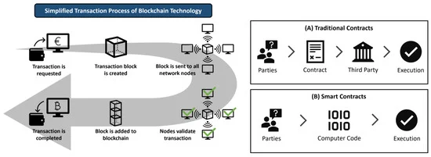
Blockchains
A secure, decentralized and transparent technology
Can enable the creation of new market mechanisms, such as peer-to-peer energy trading
Can also be used to enable the tracking and verification of renewable energy credits
Can help increase the resilience and reliability of Smart Grids
Main challenges include scalability, interoperability, and regulatory issues
Evolution of blockchain for Smart Grid (Yapa et al., 2021)
Transaction in a blockchain (Traditional Contracts/Smart Contracts) (Bandeiras et al., 2023)

Slide 7
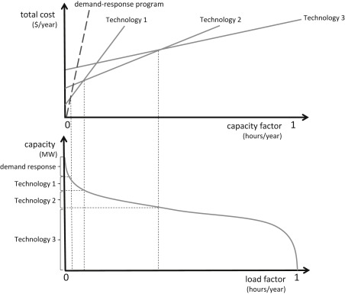
Demand Response Programs
Programs that encourage consumers to reduce or shift their electricity usage during periods of high demand or when the grid is stressed
Usually based on different incentives
Can be enabled by Smart Grid technologies, such as Advanced Metering Infrastructure (AMI) and Automated Demand Response (ADR)
Can also be used in conjunction with other market mechanisms
Main challenges comprise of uncertain consumer engagement, privacy concerns, and regulatory issues
Potential of a Demand Response Program for consumer curtailment (Hochstetler, 2007)

Slide 8
Conclusions
Smart Grid market mechanisms optimize energy usage and improve the reliability and efficiency of the Smart Grid
They help with the integration of Variable Renewable Energy (VRE)
Each of the mechanisms have their benefits and drawbacks
Usually multiple market mechanisms are used in conjunction to complement each other, and achieve the desired result

Slide 9
Source material used
Bandeiras, F., Gomes, Á., Gomes, M. and Coelho, P. (2023) Exploring Energy Trading Markets in Smart Grid and Microgrid Systems and Their Implications for Sustainability in Smart Cities. http://dx.doi.org/10.3390/en16020801.
Skoulidas, C., Vournas, C., & Papavassilopoulos, G.P. (2002). An Adaptive Game for Pay-as-Bid and Uniform Pricing Power Pools Comparison.
https://www.researchgate.net/figure/Mode-of-payment-in-Uniform-Pricing-and-Pay-As-Bid_fig3_242102105.
Yapa, C., de Alvis, C., Liyanage, M. and Ekanayake, J. (2021) Survey on blockchain for future smart grids: Technical aspects, applications, integration challenges and future research.
https://doi.org/10.1016/j.egyr.2021.09.112
Spiller, B. (2015) All Electricity is Not Priced Equally: Time-Variant Pricing 101.
https://blogs.edf.org/energyexchange/2015/01/27/all-electricity-is-not-priced-equally-time-variant-pricing-101/.
Moye, R. & Meyn, S. (2017). Redesign of U.S. Electricity Capacity Markets.
https://www.researchgate.net/figure/PJM-Capacity-Market-Demand-Curve_fig3_321935365.
Hochstetler, R. L. (2021). Markets for flexibility: Product definition, market design, and regulation. In F. Sioshansi (Ed.), Variable Generation, Flexible Demand (pp. 451-476). Academic Press. https://doi.org/10.1016/B978-0-12-823810-3.00003-0.
Kiyak, C. and de Vries, A. (2017) Electricity Market Mechanism regarding the Operational Flexibility of Power Plants. Modern Economy, 8, 567- 589. https://doi.org/10.4236/me.2017.84043.

