Slide 1
ELEC-E8423 - Smart Grid Network impacts of distributed generation -voltages and relay protection
Pinja Leppänen & Pyry Vaara
28.03.2023

Slide 2
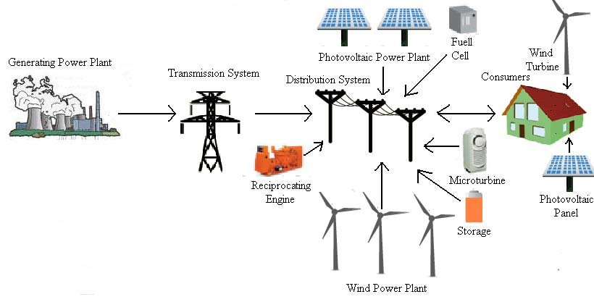
DISTRIBUTED GENERATION
International Energy Agency:
“Distributed generation is a generating object, generating electricity at the customer's location or providing support for the distribution network, connected to the network with a voltage distribution level”
A set of technologies that allows generating an electricity near its place of consumption.
Notes:
First a quick reminder about distributed generation:
There is a number of different definitions based on the installed power, location, purpose and operation mode
However I chose one from International Energy Agency: “ “.
Power sources can be based on for example renewable energy sources (wind and solar), non-renewable energy sources (diesel generator) or energy storage devices
However, in general it can be concluded that DG is a set of technologies that allows generating electricity near its place of consumption.

Slide 3
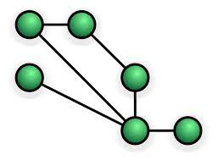
Introduction [1]
Why DG?
growing energy demand
need for renewable energy
economical reasons
technical development
Quality and quantity assessment of the impacts of DG is complicated
topology (radial, meshed), power equipment
capacity and location of DG units
type of DG
automatic control and relay protection systems
Notes:
Why distributed generation?
global energy demand is growing so there is need to increase energy production with renewable energy sources
Also economical reasons make local on-site energy production appealing for homeowners and companies. They also might want to store the produced energy or perhaps sell it to the grid
technical development enables that people can have their own electricity production at a reasonable cost
Quality and quantity assessment of DG impact is a rather complicated scientific and technical task, because there are a number of factors that have an effect
For example
power systems topology can be radial or meshed
and different types of power equipment (such as solar panels, wind turbines, transformer)
capacity and location of DG units
different types of DG can be categorized based on their real and reactive power delivering capabilities
These factors affect
the voltage profile, power losses, short-circuit current level etc.
next these impacts in more detail

Slide 4
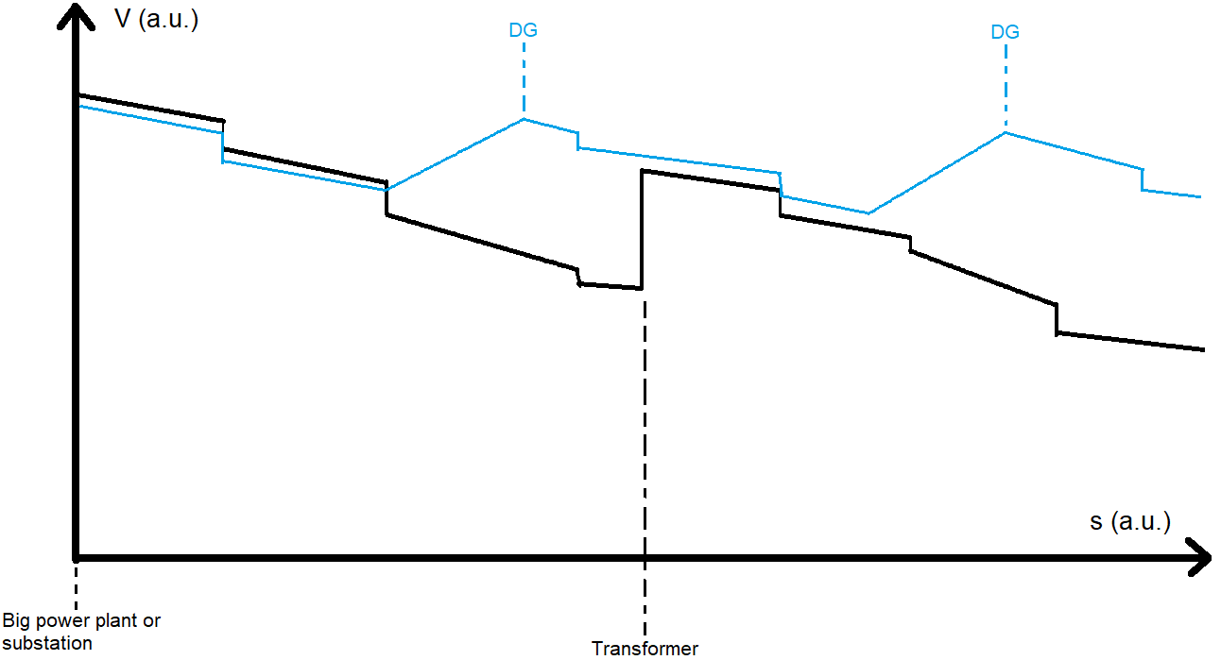
Impacts of DG (1/2)
Positives
Improved voltage profile
Reduced need for power transmission
Lower line losses
Less/smaller lines required
Increased efficiency
Reliability and power quality improvement?
P_{losses} = r * s * I² = €_{losses}
Notes:
https://ieeexplore.ieee.org/abstract/document/1489406
https://ieeexplore.ieee.org/abstract/document/6298062

Slide 5
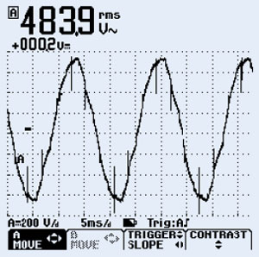
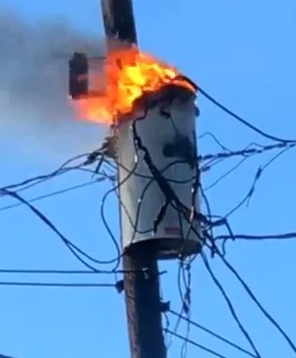
Impacts of DG (2/2)
[2]
Negatives
Reverse power flows
Injection of harmonics by inverters
Potentially higher fault currents
Stability issues?
Logic of old control systems
Logic of old protection equipment
[3]
Notes:
https://ieeexplore.ieee.org/abstract/document/1489406
https://ieeexplore.ieee.org/abstract/document/6298062

Slide 6
Impacts on relay protection
Relay = electrically operated switch
DG may change amplitude and direction of short-circuit current
can lead to the failure or false operation of the relay protection system
can damage the switching equipment
interrupting capacity, thermal and electrodynamic resistance of circuit breakers should be updated
Notes:
DG impacts also on relay protection:
A relay is an electrically operated switch. Those are used to detect and isolate fault from the grid.
faults can be anything from one phase earth fault, caused by trees growing up into an overhead transmission line, to three phase short circuits
during fault, current increases and when it is high enough the relay opens the circuit to prevent damage to equipment or people
As mentioned before Distributed Generation may change the amplitude and direction of short-circuit current
which can lead to the failure or false operation of the relay protection system
this creates a need to update relays and their settings

Slide 7
Solutions related to relay protection (1/2)
Most proposed solutions are based on gathering and processing more data [4],[6]
More detailed measurements of voltages and currents
More measurements from more locations
Data links between control systems
New smarter control algorithms
More voltage and power compensation equipment (STATCOM, SVC, energy storages…)
Notes:
with old technology
mostly local measurements
mostly local decision making and actions
difficult to correctly determine fault type and location
difficult to respond correctly
with new technology
more measurements from more locations
shared data and cooperation between new intelligent control systems
accurate location and identification of faults
coordinated isolation of faults
coordinated rerouting of power and compensation of oscillations
There are several approaches proposed to update the distance protection system, for example application of multiple relays [53,54], additional communication and multipoint synchronized measurements measurement tools [55,56], use a strategy to compensate for the infeed/fault resistance effect on distance relays [57] or an optimization algorithm for setting the distance relay [58] and other. However, these approaches significantly increase the cost of the protection scheme, an application of additional communication tools decrease the reliability (in particular, due to communication errors the protection systems may not operate) and do not solve the problem of coordination with lateral protection system. [1]
Protection techniques with renewable resources and smart grids—A survey
https://doi.org/10.1016/j.rser.2015.08.031

Slide 8
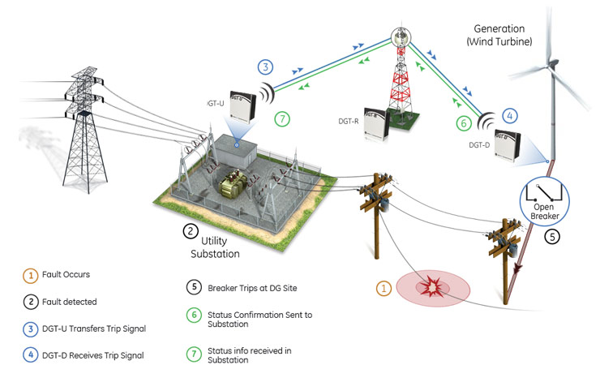
Solutions related to relay protection (2/2)
How does more data help?
Intelligent real-time cooperation between control systems
Fast identification and isolation of faults
Intelligent rerouting of power
Coordinated voltage control and compensation by multiple systems
[5]
Notes:
with old technology
mostly local measurements
mostly local decision making and actions
difficult to correctly determine fault type and location
difficult to respond correctly
with new technology
more measurements from more locations
shared data and cooperation between new intelligent control systems
accurate location and identification of faults
coordinated isolation of faults
coordinated rerouting of power and compensation of oscillations

Slide 9
Conclusions
Great potential to help meet growing electricity demand and mitigate some associated problems
New challenges for control and protection systems
Must be implemented correctly

Slide 10
References
[1] R.A. Ufa, Y.Y. Malkova, V.E. Rudnik, M.V. Andreev, V.A.Borisov. 2022. A review on distributed generation impacts on electric power system. International Journal of Hydrogen Energy. Vol. 47:47. Pages 20347-20361. https://doi.org/10.1016/j.ijhydene.2022.04.142.
[2] http://www.frequencyinverter.org/frequency-inverter-harmonics-solutions.html (visited 27.3.2023)
[3] https://www.wwaytv3.com/cold-temperatures-likely-cause-of-blown-transformer/ (visited 27.3.2023)
[4] M.M. Eissa. 2015. Protection techniques with renewable resources and smart grids—A survey. Renewable and Sustainable Energy Reviews. Vol. 52. Pages 1645-1667. https://doi.org/10.1016/j.rser.2015.08.031.
[5] https://www.gegridsolutions.com/multilin/smartgrid_innovations.htm (visited 27.3.2023)
[6] Davood Yoosefian, Hossein Askarian-Abyaneh, Mostafa Kheshti, Qi Li, Vladimir Terzija. 2023. Fault ride through constrained protection scheme for distribution networks with DFIG-based wind parks. Electric Power Systems Research. Vol. 215, Part A. 108973. https://doi.org/10.1016/j.epsr.2022.108973.

