Slide 1
ELEC-E8423 - Smart Grid Concentrating solar power and its comparison to photovoltaics
Markus Manninen
Eljas Virtanen
04.04.2023

Slide 2
Introduction
Technical overview of Concentrating Solar Power (CSP)
Geographic barriers
Potential of CSP
Technical comparison of CSP and photovoltaics (PV)
Economical comparison of CSP and PV
CSP-PV hybrid system

Slide 3
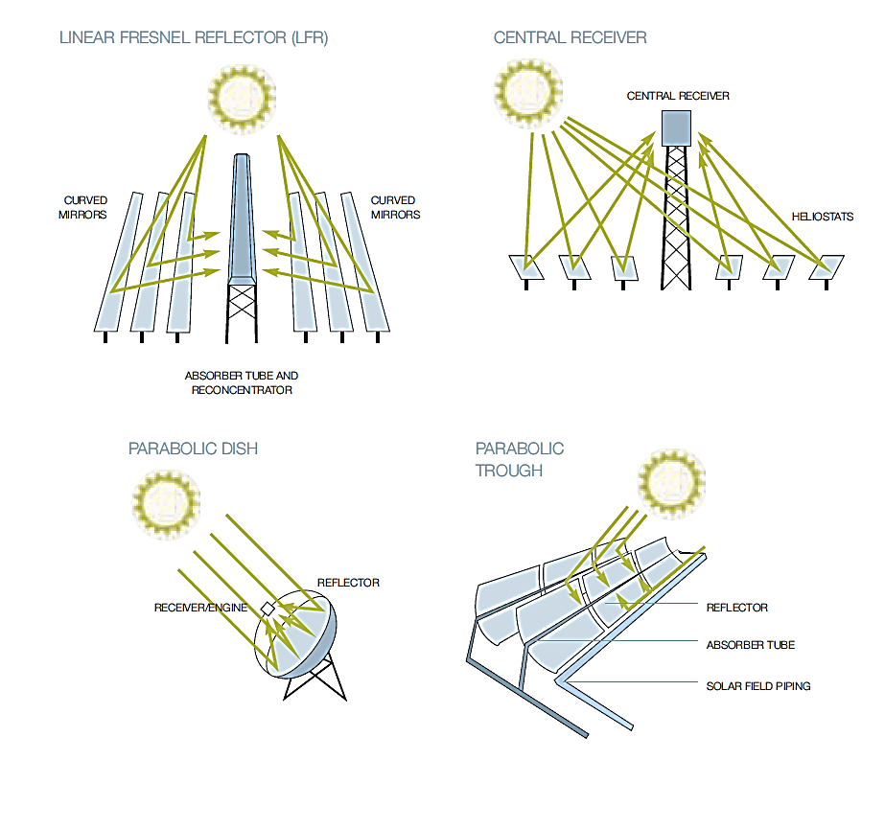
Technical overview of CSP
Basic principle: Mirrors reflect solar radiation onto a heat transfer fluid, which then flows through a system to generate electricity using a turbine and generator
Different working fluids: molten salt, thermo oil, air and water
Main differences to PV: reflection vs absorption of solar radiation, primary production heat vs electricity
https://energypedia.info/index.php?curid=17919
Notes:
Starting with technical overview:
The basic principle of CSP is relatively simple: solar radiation is reflected by mirrors to heat up a heat transfer fluid. The heat is utilized with a turbine-generator to produce electricity similarly to a conventional power plant.
CSP can have different configurations, the most mainstream ones are illustrated here. Some 80% of installed CSP is parabolic trough and 13% is central receiver and the rest are more niche.
They all have the same basic properties and can use different heat transfer fluids such as molten salt, thermo oil, air and water
The most obvious and major difference to PV panels is the fact that with CSP, the solar radiation is first reflected instead of absorbed and the primary production is heat instead of electricity. The latter is important in smart grid and we will go into more detail to it.

Slide 4
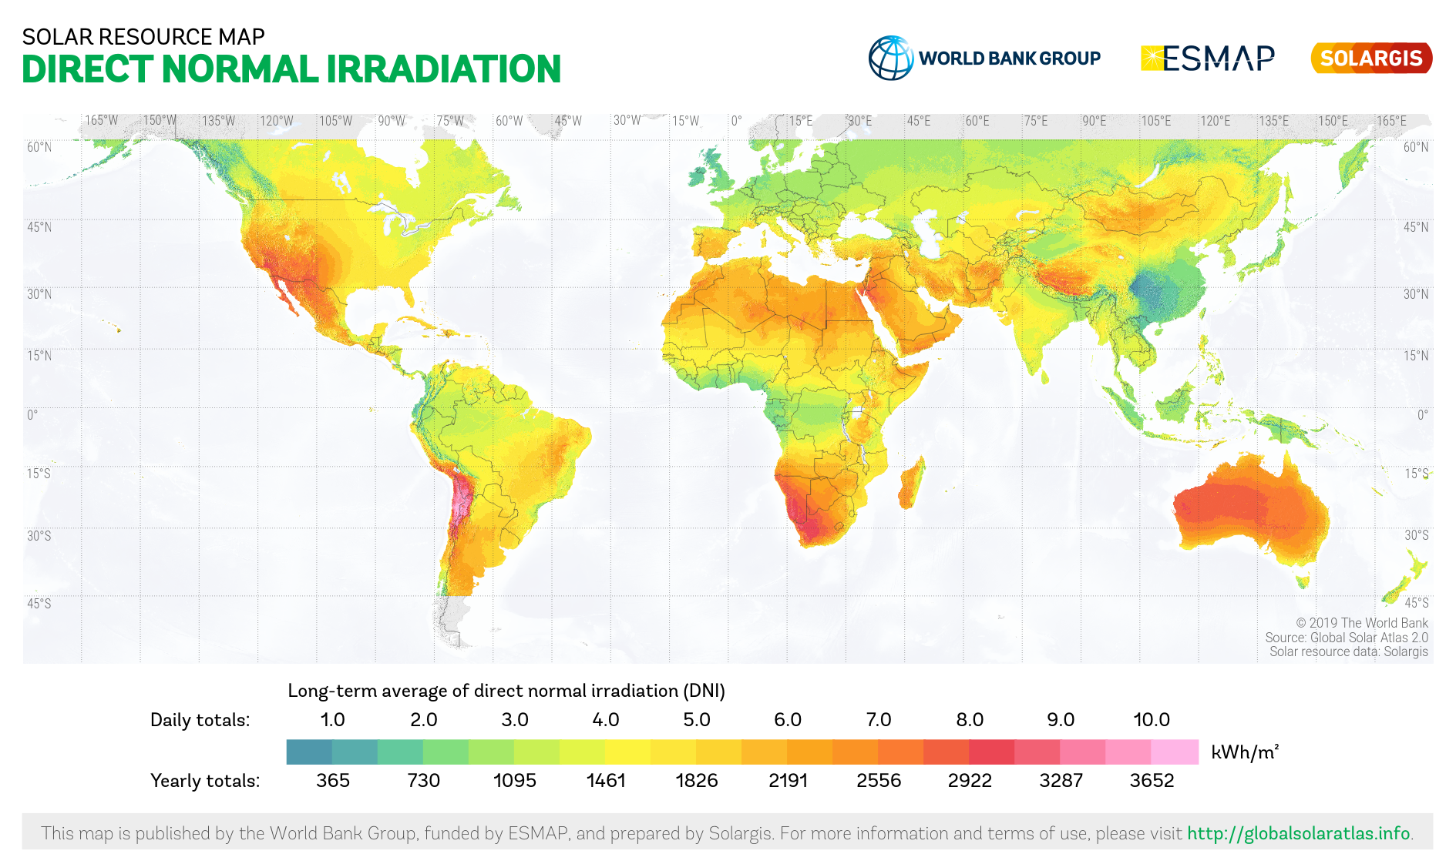
Geographic barriers
CSP is only viable in certain areas of the world:
Annual minimum for suitable CSP 1 600 kWh/m^2
Site requirements: large flat shadeless area
Notes:
To operate efficiently, CSP systems require a significant amount of flat, clear land with no shading from buildings, trees, or other structures.

Slide 5
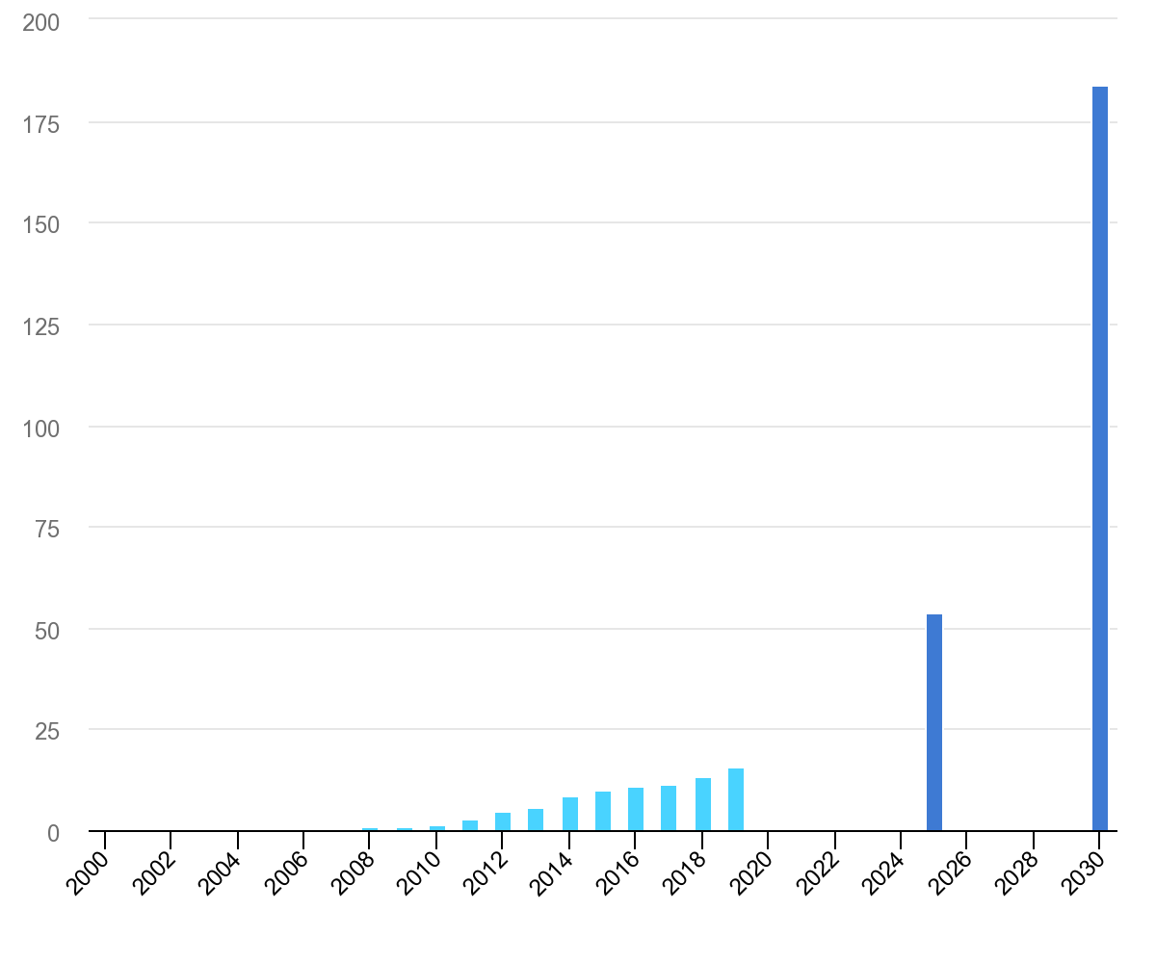
CSP potential
World-wide capacity 6 391 MW (2021)
Production 13 113 GWh (2021)
Can be coupled with Thermal Energy Storage (TES)
Hybrid systems:
CHP
CSP-PV
Desalination
IEA, Concentrating solar power generation in the Sustainable Development Scenario
Notes:
The current state of CSP is modest: there is only 6 391 MW of installed capacity word-wide even though the technology was first used in the 1960s
This is due to the fact that CSP alone is not very economic way of producing electricity and the regions where CSP can be built don’t really need extra heating.
Where CSP shines though is the fact that thermal energy is relatively easy and cheap to store instead of electricity.
Marginal value of intermittent renewables is roughly inversely proportional to their share of the electricity system. CSP with storage on the other hand can produce 24 h a day in the right conditions.
CSP can also be coupled in a hybrid system to produce CHP.
Desalination is expensive and fundamentally necessary technology in hot and arid countries that need fresh water for drinking and agriculture. Majority of desalination is done with gas and oil in energy intensive processes, therefore CSP could very well be a good alternative.

Slide 6
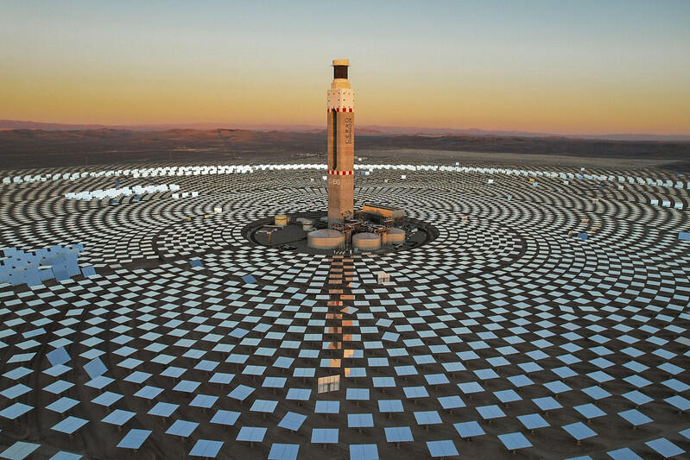
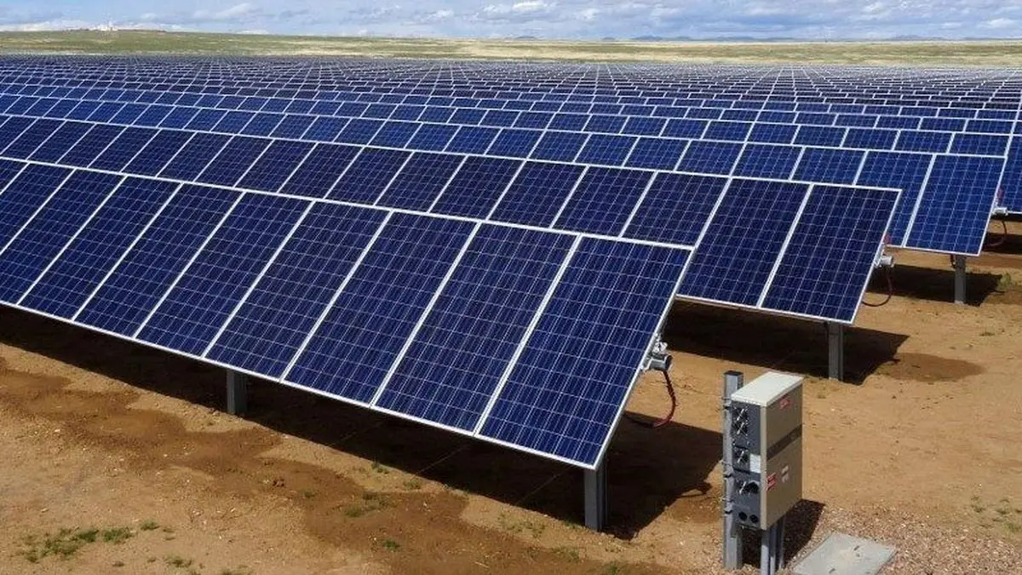
Technology comparison of CSP and PV
CSP systems can offer flexible, dispatchable solar energy
TES is more affordable than batteries utilized in PV systems
CSP plants can have better electrical output and capacity utilization factor compared to PV plants
PV systems are more suitable for small scale power generation
Notes:
- CSP systems are capable of storing energy by the use of Thermal Energy Storage (TES) technologies
o Provides dispatchability and flexibility
o Good for smart grids
- Batteries used for energy storage in PV systems
o flexibility more expensive for PV
- PV-based systems are more suitable for small-scale electricity generation (Ahmadi et al., 2018)
o CSP systems require high capital cost

Slide 7
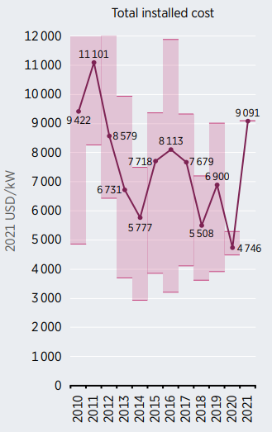
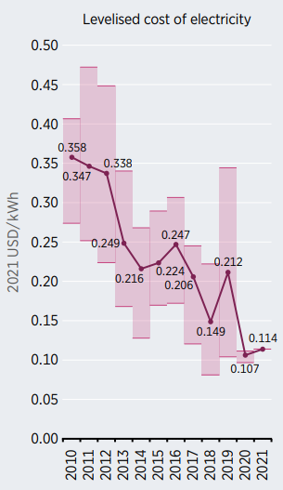
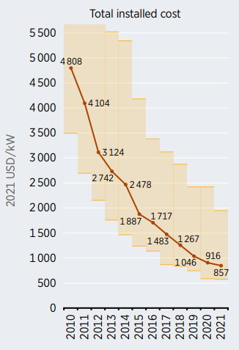
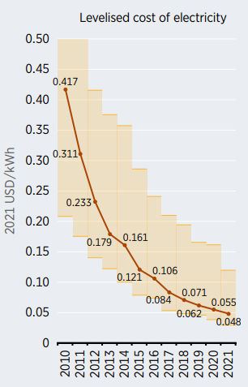
Cost comparison of CSP and PV
PV plants have far better economic performance compared to CSP
Cost of both technologies is expected to decrease in the future
Instead of a competing technology, CSP with TES may also be perceived as a complementary technology for PV and other intermittent renewables
Installed costs and LCOE for CSP (IRENA, 2022).
Installed costs and LCOE for PV (IRENA, 2022).
Notes:
Installed costs are about 6 times higher for CSP compared to PV.
The increase in installed cost to 9091 USD/kW in 2021 from 4746 USD/kW in 2020 is because there was only one plant commissioned in 2021. It was the Cerro Dominador project in Chile, which was delayed and had an installed cost structure that is more indicative of projects commissioned three to four years ago (IRENA, 2022).
LCOE is about 2 times higher for CSP compared to PV.
Instead of a competing technology, CSP with TES may be perceived as a complementary technology that enables high penetration of PV and other renewables in future power systems
- CSP with TES could be enabling 100% RES penetration in future power systems due to its dispatchability.

Slide 8
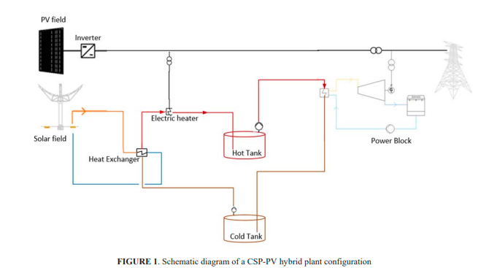
CSP-PV hybrid system
Addition of PV to CSP systems provide clear benefits to cost-competitiveness
PV provides electricity cost advantage and CSP provides high flexibility in power dispatch
https://doi.org/10.1063/5.0086236
Notes:
PV provides cheap daytime power while the CSP provides flexibility and balances the intermittency of PV.
The PV in the hybrid plant of the picture is not only utilized for lower-cost daytime power generation, but excess PV power is stored into molten salt TES of the CSP plant, improving storage and conversion efficiency (Gedle et al., 2022).

Slide 9
Conclusions
CSP can have different configurations, parabolic trough collector most common
CSP systems with TES can offer flexible and dispatchable solar energy
Costs of CSP are high, making PV more attractive to investors
Hybrid systems more cost-competitive than stand-alone CSP

Slide 10
Source material used
Ahmadi, M. H., Ghazvini, M., Sadeghzadeh, M., Alhuyi Nazari, M., Kumar, R., Naeimi, A., & Ming, T. (2018). Solar power technology for electricity generation: A critical review. Energy Science & Engineering, 6(5), 340–361. https://doi.org/10.1002/ESE3.239
Awan, A. B., Zubair, M., Praveen, R. P., & Bhatti, A. R. (2019). Design and comparative analysis of photovoltaic and parabolic trough based CSP plants. Solar Energy, 183, 551–565. https://doi.org/10.1016/J.SOLENER.2019.03.037
Desideri, U., Zepparelli, F., Morettini, V., & Garroni, E. (2013). Comparative analysis of concentrating solar power and photovoltaic technologies: Technical and environmental evaluations. Applied Energy, 102, 765–784. https://doi.org/10.1016/J.APENERGY.2012.08.033
Gauché, Paul et al. System value and progress of CSP
https://doi.org/10.1016/j.solener.2017.03.072
https://energypedia.info/index.php?curid=17919
Gedle, Y., Schmitz, M., & Gielen, H. (2022). Analysis of an integrated CSP-PV hybrid power plant. 2445, 30009. https://doi.org/10.1063/5.0086236
Global Solar Atlas. https://globalsolaratlas.info/download/world
IEA, Concentrating solar power generation in the Sustainable Development Scenario, 2000-2030, IEA, Paris https://www.iea.org/data-and-statistics/charts/concentrating-solar-power-generation-in-the-sustainable-development-scenario-2000-2030, IEA. Licence: CC BY 4.0
IRENA. (2022). Renewable Power Generation Costs in 2021. In Renewable Power Generation Costs in 2021. https://www.irena.org/publications/2022/Jul/Renewable-Power-Generation-Costs-in-2021
Papadopoulou, A. G., Vasileiou, G., & Flamos, A. (2020). A Comparison of Dispatchable RES Technoeconomics: Is There a Niche for Concentrated Solar Power? Energies 2020, Vol. 13, Page 4768, 13(18), 4768. https://doi.org/10.3390/EN13184768
Wang, Zhifeng. Site Selection, Power Load, and Power Generation Procedures. Design of Solar Thermal Power Plants, 2019
https://doi.org/10.1016/B978-0-12-815613-1.12001-2

