Slide 1
ELEC-E8423 - Smart Grid Sector Coupling of Power and Heat
Linn Krumtünger & Jimi Bäck
18.04.2023

Slide 2
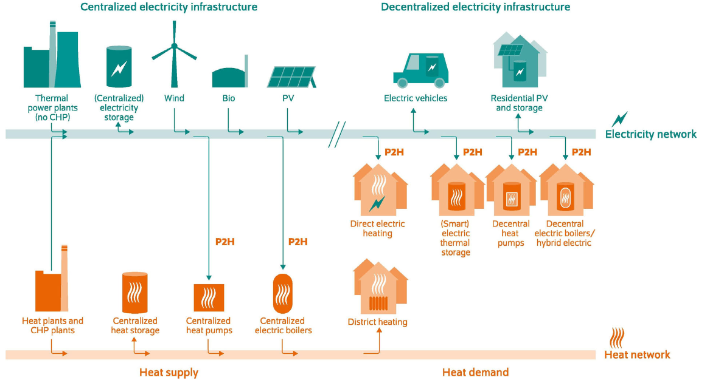
Introduction
Combining the use of electricity and heat for a sustainable energy system

Slide 3
Benefits
Can contribute to the decarbonization of the heating sector
Utilization of renewable electricity to replacement of fossil fuels in the heating sector
Provide balancing services to the power sector
Decreases the need for VRE curtailment during peak production which increases their revenue
Reduce the costs for the transition to a decarbonized energy system
Decreases the need for expensive peak power plants and electric storage

Slide 4
Technologies for Sector Coupling
Combined Heat and Power (CHP)
Plants generate electricity and heat from a single energy source
The electricity can be used to power nearby homes, while the heat can be used for district heating and industrial processes nearby
Thermal Energy Storages (TES)
Allows excess heat to be stored and used later
Can help to balance the supply and demand of heat in a district heating
Reduces the need for backup boilers or other sources of heat
Heat Pumps
Uses electricity and a refrigerant to absorb heat from air, geothermal heat, or ground water
Can help to increase the efficiency of the system and reduce the need for fossil fuels

Slide 5
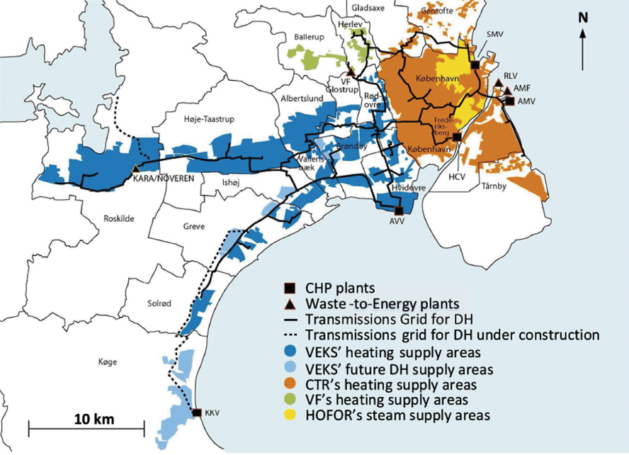
Examples of Sector Coupling Projects
The Copenhagen district heating system
Supplying heat for approximately 98% of the city buildings
Uses a combination of waste heat from electricity production, biomass, and geothermal energy
Reduces the city's carbon emissions by approximately 1,2 million tons per year

Slide 6
Challenges to Sector Coupling
Technical Challenges: Integrating various energy systems may require modifications to grid infrastructure, and managing and optimizing a complex system requires advanced tools and algorithms.
Full electrification of the heating sector may require upgrades to transmission and distribution networks to manage increased demand and to ensure grid stability.
Peak electricity demand: Large-scale implementation of heat pumps for sector coupling can lead to significant increases in peak electricity demand, which can create challenges for grid management.
One way to mitigate peak electricity demand is through flexible operation of heat pumps and storage systems, which can help balance electricity supply and demand.
COP of heat pumps: The coefficient of performance (COP) of a heat pump decreases as the source temperature decreases and the output temperature increases, which can make it less efficient to use heat pumps for sector coupling.
Existing district heating networks or domestic hot water supplies may have minimum output temperature restrictions that prevent the use of low-temperature heat sources such as heat pumps.

Slide 7
Policy and Regulatory Framework
Renewable energy targets: Some governments and regulatory bodies have set renewable energy targets as part of their climate change mitigation strategies.
These targets can drive investment in clean energy technologies and promote sector coupling
Incentives for clean energy: Policies and regulations can provide financial incentives for the use of clean energy sources in sector coupling, such as subsidies for renewable energy sources or tax credits for clean energy investments.
These incentives can encourage investment in clean technologies and help drive the transition towards a low-carbon energy system.
Fossil fuel and emission allowance prices: Low prices of fossil fuels and emission allowances may discourage investment in clean technologies for sector coupling.
Higher fossil fuel and emission allowance prices could encourage investment in clean technologies for sector coupling, speeding up the transition to a low-carbon energy system.

Slide 8
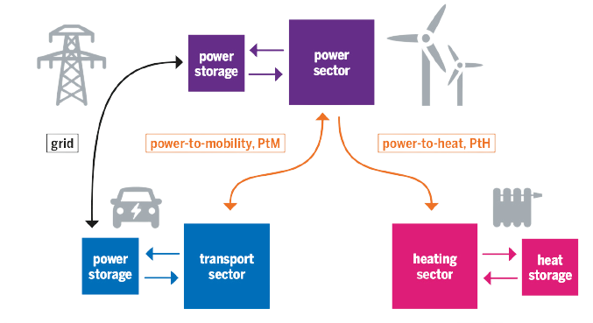
Future of Sector Coupling
The development of new technologies, such as advanced energy storage systems, smart grid technologies, and carbon capture and utilization technologies, could enable more efficient and effective sector coupling.
The electrification of transport and heating sectors could further increase the demand for sector coupling, as these sectors represent a significant portion of energy consumption.
Sector coupling is expected to play an increasingly important role in the transition to a low-carbon energy system, as it can help to integrate renewable energy sources and improve energy efficiency.

Slide 9
Conclusions
Sector coupling of power and heat is a key strategy for achieving decarbonization goals, as it enables the integration of renewable energy sources into heating systems.
This approach involves utilizing excess renewable electricity to produce heat through technologies such as heat pumps, which can be used in buildings, industry, and transportation.
Sector coupling of power and heat has the potential to create new business models and market opportunities, as well as provide greater energy security by reducing reliance on fossil fuels.

Slide 10
Source material used
Slide 2: Jasmine Remsebner, Reinhard Haas, Amela Ajanovic, Martin Wietschel (2021), The sector coupling concept: A critical review
Slide 3: Luc Van Nuffel, João Gorenstein Dedecca, Tycho Smit, Koen Rademaekers (2018) Sector coupling: how can it be enhanced in the EU to foster grid stability and decarbonise?
Slide 5: Bjarne Bach, Jesper Werling, Torben Ommen, Marie Münster, Juan M. Morales, Brian Elmegaard (2016), Integration of large-scale heat pumps in the district heating systems of Greater Copenhagen, https://www.sciencedirect.com/science/article/pii/S0360544216304352
Slide 8: https://eu.boell.org/en/2018/04/24/linking-sectors-power-transport-heat-united

