Slide 1
ELEC-E8423 - Smart Grid Energy communities
Xavi Edo, Eira Selonen
18.04.2023

Slide 2
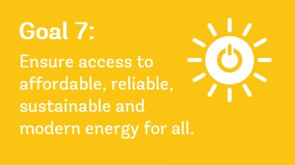
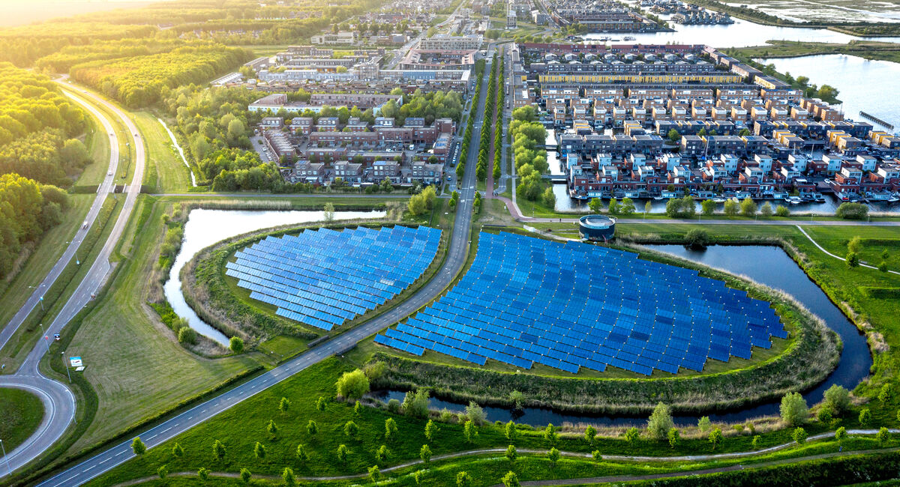
Introduction
WHAT ARE ENERGY COMMUNITIES?
“Citizen-driven energy actions that contribute to the clean energy transition, advancing energy efficiency within local communities.”
Produce, consume, store and sell energy among members in EC
Open and voluntary participation
Primary objective: provide environmental, economic or social community benefits rather than financial profits
Notes:
Define broad scope of the presentation and explain the key terms
In this presentation I’m going to explain what energy communities are and their main characteristics. I’m going to show the benefits that they bring to the energy transition and the challenges that they are still facing. Finally I’m going to show an example of an operating energy community.
These are groups of people, associations, companies, or even public administrations that are organized to achieve common goals related to the use of energy. In their neighbours or even in little villages they can share the energy they produce fomenting the distributed generation and improving the demand response.[1]
For example, in a small village or a neighbourhood, an energy community could be composed by the city council, neighbours, shops, and even little companies. In this case, there could be solar PV panels in the rooftop of the sports centre and of some neighbours’ houses. This way, the energy generated by one prosumer can be purchased by other member of the community by a much better price than the company. It is not that the produced energy is directly consumed by the members (because it is uploaded to the grid) but virtually send from one member to the other through the marketplace. In this case, the city council would be the manager of the community, developing tasks like policy making, maintenance of the public solar panels and of the marketplace.[2]

Slide 3
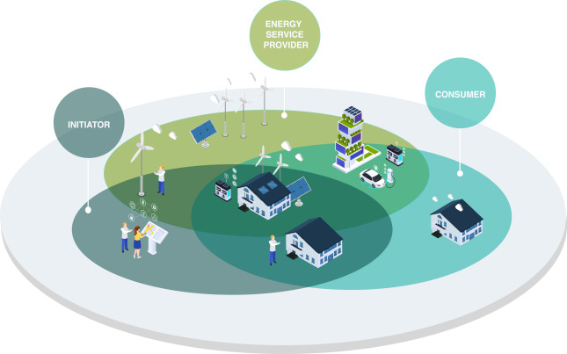
Main characteristics of energy communities
Goals of energy communities:
Environmental
Economic
Social
Produce, consume, store and sell energy among members in EC
Actors in an energy community:
Consumer
Energy service provider:
supplier, prosumer
Initiator: set in motion the organization or coordination of the community project

Slide 4
Categories
​ | Renewable Energy Community​ | Citizen Energy Community​
Participation​ | Natural persons, local authorities, SMEs​
Activities​ | Production, consumption, storage, selling​ | REC + Supply, Distribution​
Geographical scope​ | Local​ | No limit​
Energy Source​ | Renewable specific​ | REC + Fossil fuel​

Slide 5
Generation models
Direct participation
Generation unit have large-scale generation
Feature characteristics of these two extreme models
Generation units are too small to participate directly in the markets
Aggregator

Slide 6
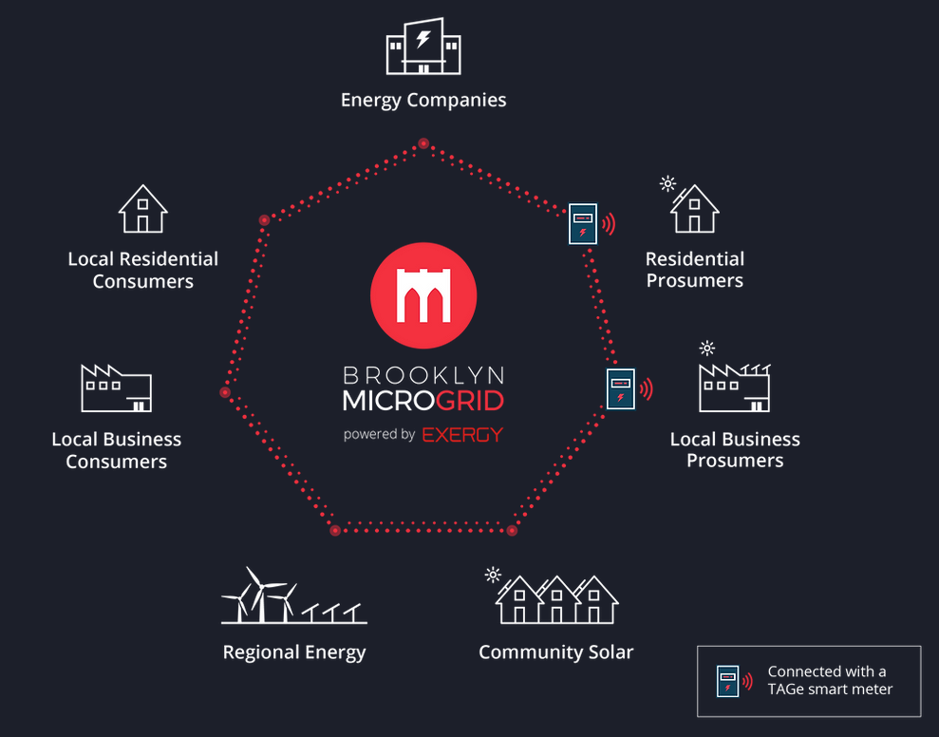
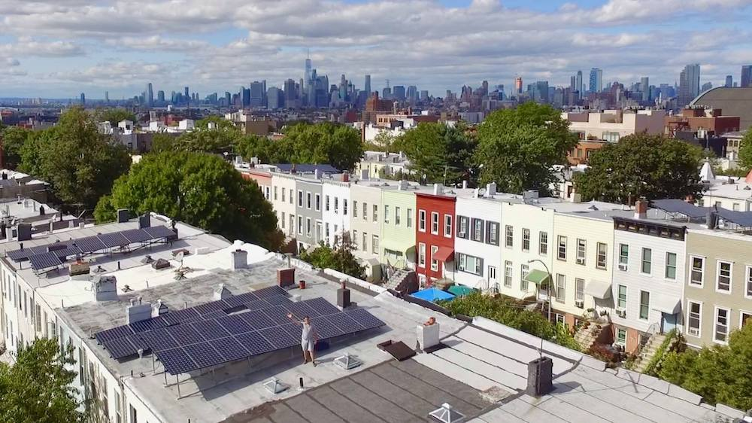
Brooklyn microgrid (BMG)
Energy marketplace
Community-driven initiative that began in April 2016 in Park Slope, Brooklyn, NYC
BMG was created by parent company, LO3 Energy
Participants access the local energy marketplace through the Brooklyn Microgrid mobile app
The network connects people in NYC who own solar arrays (“prosumers”) with people who want to purchase local solar energy (“consumers”)
New Yorkers can buy and sell locally-generated, renewable energy

Slide 7
Benefits of Energy communities
Deployment of distributed generation technologies
Contribute to increase public acceptance of renewable energy projects
Attract private investment in the clean energy transition
Increasing energy efficiency of the users
Lowering electricity bills of their users
Crating local job opportunities
Provide flexibility to the electricity system through demand-response and storage
It helps contribute to a more decarbonized flexible energy system
Means to restructure our energy systems (Energy communities EU)
Reduce carbon footprint
Combat energy poverty with access to lower prices for neighbours with fewer resources.
They favour the energy independence of citizens, associations, companies and administrations.

Slide 8
Challenges for energy communities
Organizational issues
Market discrimination against big companies
Institutional barriers
Lack of resources
Saturation effect
Limitation of the distribution network capacity
Socio-economic issues
Misalignments of interest between stakeholders

Slide 9
Conclusions
Energy communities contribute to the clean energy transition, advancing energy efficiency within local communities
Contribute to deploy distributed electricity generation
They can be very helpful for demand response
Still face some technical and socio-economic challenges

Slide 10
Source material used
E. Mengelkamp, J. Gärttner, K. Rock, S. Kessler, L. Orsini, and C. Weinhardt, “Designing microgrid energy markets: A case study: The Brooklyn Microgrid,” Appl. Energy, vol. 210, pp. 870–880, 2018, doi: 10.1016/j.apenergy.2017.06.054.
V. Brummer, “Community energy – benefits and barriers: A comparative literature review of Community Energy in the UK, Germany and the USA, the benefits it provides for society and the barriers it faces,” Renew. Sustain. Energy Rev., vol. 94, pp. 187–196, Oct. 2018, doi: 10.1016/J.RSER.2018.06.013.
[E. M. Gui and I. MacGill, “Typology of future clean energy communities: An exploratory structure, opportunities, and challenges,” Energy Res. Soc. Sci., vol. 35, pp. 94–107, Jan. 2018, doi: 10.1016/J.ERSS.2017.10.019.
“Energy communities in the clean energy package - Publications Office of the EU.” https://op.europa.eu/en/publication-detail/-/publication/4b7d5144-91c9-11eb-b85c-01aa75ed71a1/language-en (accessed May 01, 2023).
[B. Lennon, P. Velasco-Herrejón, and N. P. Dunphy, “Operationalizing participation: Key obstacles and drivers to citizen energy community formation in Europe’s energy transition,” Sci. Talks, vol. 5, p. 100104, Mar. 2023, doi: 10.1016/j.sctalk.2022.100104.
V. Z. Gjorgievski, S. Cundeva, and G. E. Georghiou, “Social arrangements , technical designs and impacts of energy communities : A review,” Renew. Energy, vol. 169, pp. 1138–1156, 2021, doi: 10.1016/j.renene.2021.01.078.
I. Petri, M. Barati, Y. Rezgui, and O. F. Rana, “Blockchain for energy sharing and trading in distributed prosumer communities,” Comput. Ind., vol. 123, no. August, 2020, doi: 10.1016/j.compind.2020.103282.
R. Lazdins, A. Mutule, and D. Zalostiba, “PV energy communities—challenges and barriers from a consumer perspective: A literature review,” Energies, vol. 14, no. 16, 2021, doi: 10.3390/en14164873.
“Energy communities.” https://energy.ec.europa.eu/topics/markets-and-consumers/energy-communities_en (accessed Mar. 31, 2023).
​
‌

