Slide 1
Let’s practice curriculum development: group work

Slide 2
Instructions for the group work
Aim:
to practice curriculum development through a small exercise in mixed groups
to familiarize with one aspect of the curriculum development cycle in a deeper level
get acquainted with the material, support and tools available
Instructions:
Individually choose one of six topics, that is most relevant/interesting for you and join that table
With your group: in all exercises first decide the context of the exercise (ie. which curriculum or a module of studies you wish to work with), then proceed with the instructions
Time for group work 55min.
Wrap-up: short presentation of the group work, 10min. per group
Aim of the wrap-up: to introduce the method you tried to others and analyse when and how this way of working could be beneficial in curriculum work

Slide 3
Mixed group work topics
1. Setting the development goals What are the internal and external demands that need to be considered when deciding about the development goals of the curriculum? What needs to be done concretely to achieve the goals? | 2. Designing intended learning outcomes What does our purpose / educational goals mean as students’ learning? What should the graduate be able to know or do? | 3. Curriculum mapping How are current courses supporting student in achieving the intended learning outcomes? How should the programme organize its courses in order to best support students learning?
4. Responding to the needs of the future: integrating sustainability What changes in the society should we consider when developing our programme? What knowing, acting and being do these changes require from our graduates? | 5. Data-assisted evaluation of the curriculum What needs to be evaluated? What is relevant knowledge and data? | 6. Relationships and collaboration in curriculum development Who need to be involved in the development of the curriculum and how?

Slide 4
Instructions for each topic (1-6)

Slide 5
1
Setting the development goals
When identifying the needs, you can utilize the evaluations made during the sessions 1 (curriculum contents) and 2 (co-development, process). The joint university-level needs can be found from aalto.fi.
Choose 1 internal need (programme’s own need) and 1 external need (strategic goal) for your development.
Formulate development goals of the two chosen needs and plan what needs to be done in order to reach the development goals (concrete tasks, responsibilities, follow-up).
First, discuss and identify the different internal and external demands or development goals there are for curriculum development at Aalto.
Aim:
To synchronise the programme’s internal development goals and the university-level strategic goals and make a development plan
Key questions:
How can you synchronise the different demands that need to be considered when deciding about the development goals of the curriculum?
What needs to be done concretely to achieve the goals?

Slide 6
Setting the development goals
Demands for university education |  | Choose one of the needs for this exercise
What kind of internal needs (programme’s own needs) for development you can identify? | - done by March 2024 - needs of students: what do they need to learn (guided by what the industry/society requires) - needs of teachers: what do they want to teach (constrained by resources and expertise
What kind of university-level strategic goals you can identify? | Here you can list the identified strategic goals

Slide 7
Plan for development: template for the group
Development needs | Development goals: the aim is to… | Concrete task: how to do it? | Responsible actor: who? | Target schedule: when? | Follow-up
Internal need: | 1.
 | 2.
 | 3.
External need: | 1.
 | 2.
 | 3.

Slide 8
Useful links
Aalto University Strategy:
Our strategy
Our plan
The guidelines for curricula 2022-2024 | Aalto University
Programme Director’s Handbook: Evaluation of achieved learning outcomes and the current state of teaching

Slide 9
2
Intended Learning Outcomes
Based on the existing purpose and objective of the curriculum, recognize 1-3 things in the three curricular domains (knowing, acting, being)
Then, design 1-3 intended learning outcomes for the studies: you can utilize the tools provided (Bloom’s taxonomy, instructions for designing ILO’s)
Choose one curriculum or module of studies you wish to concentrate on.
Aim:
To formulate curriculum-level intended learning outcomes
Key questions:
What does our purpose / educational goals mean as students’ learning?
What should the graduate be able to know or do?

Slide 10
Designing intended learning outcomes: template for group
Aim and objective of the curriculum
AIM / PURPOSE | GOAL / OBJECTIVE
Broad general statement of the teaching intention | Specific statement of the teaching intention: what is hoped to be achieved
Curricular domains | Curricular domains
Knowing | Acting | Being
Core knowledge of the discipline | Skills and actions to be acquired | Student’s personality and identity

Slide 11
Designing intended learning outcomes: template for the group
Here you can design the new intended learning outcomes.
Example: Our graduate is able to identify the societal context relevant to the water and environment and comprehend the different scales and key drivers applicable to water and environmental engineering.
After completing the programme, the graduate is able to | After completing the programme, the student is able to
example | identify | the societal context | relevant to the water and environment
ILO 1 | verb | desired learning* | context
ILO 2 | verb | desired learning* | context
ILO 3 | verb | desired learning* | context
*Desired learning: knowledge, skills, attitudes / knowing, acting, being / content

Slide 12
Designing intended learning outcomes: tools, support
Programme Director’s Handbook:
Instructions on how to design intended learning outcomes
at the programme level
At the course level
Bloom’s Taxonomy (next slide) in: Writing and using learning outcomes: a practical guide (Hyland & Kennedy 2007) and Biggs & Tang 2007: Teaching for Quality Learning at University
Core content analysis (next slide): Levander, L. & Mikkola, M. (2009). Core Curriculum Analysis: A Tool for Educational Design, The Journal of Agricultural Education and Extension, 15:3, 275-286. DOI: 10.1080/13892240903069785. Link to article

Slide 13
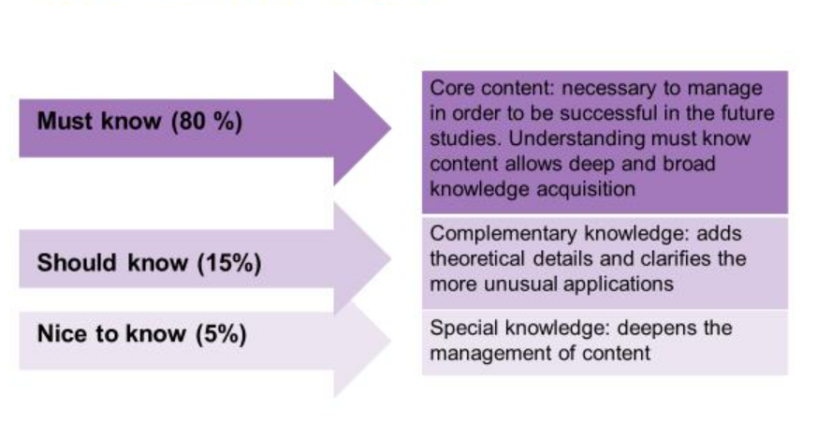
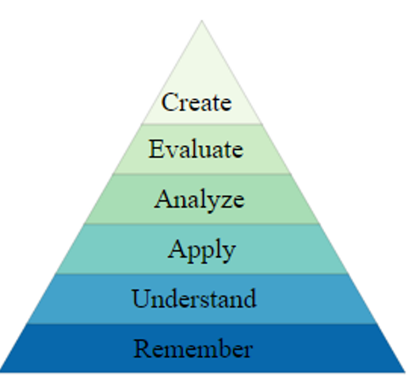
Core content analysis
For identifying the core content, complementary knowledge and special knowledge in the curriculum or a course.
Bloom’s taxonomy
For classifying of learning objectives into levels of complexity and specificity.
Review, interpret, justify, predict
Categorise, generalise, to lead, plan, prepare, propose
Analyse, organise, calculate, categorise, classify, compare, merge, criticise, try
Apply, select, add to, build, develop, produce, utilise
Change, classify, defend, distinguish, discuss, explain, generalise
Describe, locate, identify, list, remember, name
Picture: Wikipedia Commons

Slide 14
3 Curriculum mapping
Select the approach (which topics you wish to review) for curriculum mapping, e.g., intended learning outcomes, contents, teaching methods, or specific skills, like teamwork skills or sustainability.
Fill in the curriculum map: issues to be mapped on the rows, courses on the columns.
In the exercise you can concentrate on 1-2 issues
Identify (in a dialogue with your teaching team), how students learn the issues throughout the courses. You can evaluate the current state or ideate development possibilities.
Remember to discuss the alignment with the teaching community and update the curriculum map regularly!
Aim:
to assess programme alignment regarding intended learning outcomes and other selected topics and identify possibilities to improve alignment
Key questions:
How are current courses supporting student in achieving the intended learning outcomes?
How should the programme organize its courses in order to best support students learning?

Slide 15
What can curriculum mapping be used for?
We can map different things…
Programme ILO’s
Programme contents
Particular themes e.g., sustainability
Teaching methods
Workload
...
…and from different directions
Building alignment
How do courses match with renewed programme ILOs?
Are the courses organized so that students can build upon what they have learnt on previous courses?
How can we balance the workload throughout the studies?
Ensuring the alignment when making updates
When making changes, how are the programme ILOs and courses aligned?
Tracing hidden elements
What kind of sustainability related topics are we currently teaching?
Mapping the future potential
Which courses could contribute to sustainability related ILOs?

Slide 16
Conducting a curriculum mapping exercise
When planning a curriculum mapping exercise you can utilize the instructions in Programme director’s handbook: Curriculum mapping
The page includes 1) instructions, 2) a template for curriculum mapping and 3) a workshop template

Slide 17
Template A (for developing alignment)
Instructions: Fill in the intended learning outcomes (ILO) and courses. Map each course to the ILOs
Individually: write, how does your course contribute to each of the ILOs. Collectively: Regarding each ILO, what is expected from students when they come to the course. What do they know after the course?
ILOs | Courses
 | Course 1 | Course 2 | Course 3 | Course 4 | Course 5 | Course 6 | Course 7 | Course 8 | Course 9 | Course 10 | Course 11 | Course 12 | Course 13 | Course 14 | Course 15
ILO 1
ILO 2
ILO 3
ILO 4
ILO 5
ILO 6
ILO 7
ILO 8

Slide 18
Template B: (for communicating the alignment)
Instructions: Fill in the intended learning outcomes (ILO) and courses. Map each course to the ILOs 1= this ILO is a minor part of this course 2= This course supports the fulfillment of this learning outcome 3= this ILO is a central element of this course
ILOs | Courses
 | Course 1 | Course 2 | Course 3 | Course 4 | Course 5 | Course 6 | Course 7 | Course 8 | Course 9 | Course 10 | Course 11 | Course 12 | Course 13 | Course 14 | Course 15
ILO 1
ILO 2
ILO 3
ILO 4
ILO 5
ILO 6
ILO 7
ILO 8

Slide 19
4 Responding to the needs of the future
What’s the future we envision?
​Identify, what are the key changes happening in the society. E.g. megatrends or sustainability challenges
What is our role in the society?
Create an understanding how these changes and challenges are connected to the field and programme? What is our responsibility as educators in higher education?
What knowing, acting and being do these challenges require?
Identify relevant knowing, acting and being related to understanding the challenges and creating solutions to them.
What are our actions?
Where can we start, what can we implement now? What should we strive for, what is needed in order to achieve our goals?
Aim:
To ensure that the programme has a broadly considered view on the societal needs and opportunities of the programme
Key questions:
What changes in the society should we consider when developing our programme?
What knowing, acting and being do these changes require from our graduates?

Slide 20
Questions and supportive material
 | What’s the future we envision? | What is our role in the society? | What knowing, acting and being do these challenges require? | What are our actions?
Questions | How does the future look like? What kind of futures are desireable? | What kind of expectations do our stakeholders have towards us? What kind of goals do we set for ourselves? What is our responsibility as educators in higher education? | What is the knowing, acting and being we want to foster? What is most important for the students to learn? | What changes are needed in our curriculum? Where can we start, what can we implement now? What should we strive for, what is needed in order to achieve our goals? What kind of barriers are there and how do we break them?
Supportive material | https://www.sitra.fi/en/topics/megatrends/ |  | A framework for integrating sustainability into disciplinary curriculum (Slide 49)

Slide 21
Notes
What’s the future we envision? | What is our role in the society? | What knowing, acting and being do these challenges require? | What are our actions?

Slide 22
Goal: Graduates that are able to contribute to a more sustainable world
Sustainability related knowledge
Sustainability related skills/ competencies
Knowledge about the connections of one’s own field to sustainability challenges and solutions.
Skills to participate in solving sustainability challenges from the perspective of one’s own field
Motivation and courage to act
Field(s) specific knowledge
Field(s) specific skills
Academic knowledges and skills
E.g., critical thinking, research skills, interpersonal skills

Slide 23
5
Data-assisted evaluation
First choose the relevant question (1-3) you wish to find answers to through evaluation. You can utilize the self-evaluation questions in identifying your question.
Then, identify the knowledge and data that is needed to perform an evaluation. Get acquainted with the material available in aalto.fi.
Aim:
to conduct a critical analysis of the status of the curriculum and to identify best practices and potential challenges in the programme
Key questions:
What needs to be evaluated?
What is relevant knowledge and data?
Finally, plan how and with whom you would perform the evaluation.

Slide 24
Different aspects to evaluate | Spesific question (choose 1-3) | Knowledge needed | Data available | With whom and how
Programme purpose and aims
The ability to reach potential students and secure commitment
Quality of teaching and learning
Competencies achieved by graduates and programme outcomes

Slide 25
Support and tools available:
When choosing the question you wish to work with, you can use the Self-evaluation questions provided in the Programme Director’s Handbook.
When defining the knowledge and data, you can use the material provided in Programme Director’s Handbook: Using data in the development of the programme

Slide 26
6 Relationships in curriculum development
1. Choose a context (programme, major) for this task. Recognize the different roles that are involved in the curriculum development
2. Estimate the importance of this specific role / relationship
3. Define the goal of the relationship with each role
4. Describe the practices that are needed for this relationship to be productive and reach the goals that have been set
5. Think about what kind of support would be needed in order to maintain and develop the critical relationships?
6. Present your work to others
Aim:
To identify the critical partners in curriculum development
Key question:
Who need to be involved in the development of the curriculum and how?

Slide 27
Analysis matrix of relationships
Relationship | Importance | Goal of cooperation | What are the practices needed to achieve the set goals for cooperation? | Support needed to maintain the relationships
Teacher 1 | 10
Teacher 2 | 10
Teacher 3 | 9
Head of a Major | 8
Dep. head | 9
Planning officer | 8
Student rep | 10
Industry rep | 7
Alumni rep | 6

