Slide 1
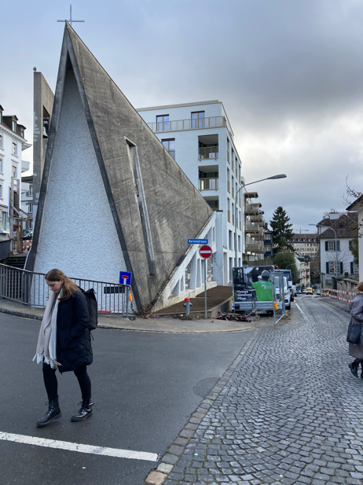

METAXOGRAPHY IN ARCHITECTURE: ADAPTIVE RE-USE AND BEYOND
Antti Ahlava | ABDS
2023
Notes:
Adaptive reuse as a soft cushion or interval – it would be too much to jump directly to metaxography.
Visiting fellowship, Aalto, School of Arts, Design and Architecture (QS ranking 5th in world in art and design), KH, HZ
Image: HZ: Evangelic-Lutheran Parish, ZRH, new mixed-use building and an adaptive reuse project about to become finished. AR = existing buildings changed with new uses, renovations and extensions. – HZ’s strategy has been on utilising research and development from Aalto and ETH Zürich.
Partners Kivi Sotamaa, Fredrik Lindberg, Tommi Mäkynen, Mirjam Niemeyer.

Slide 2
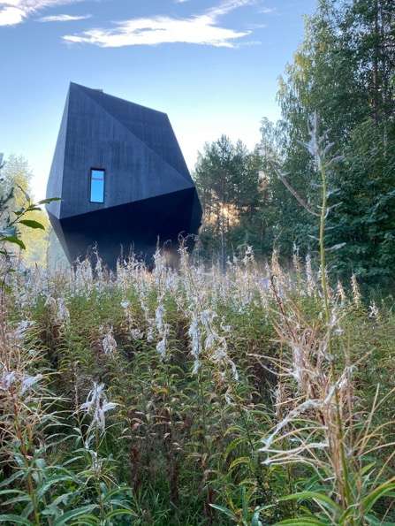
SUSTAINABLE ARCHITECTURE
Notes:
Regarding sustainability and architecture, different cultures have varying emphasis – for example architetcure departments at Aalto uni and CU seem to concentrate on technical sustainability – CO2 emission and energy. This project in the image is made by Kivi from our Kissing Helsinki Group and represents quite typical Nordic approach to sustainability through wooden construction and prefabrication.

Slide 3
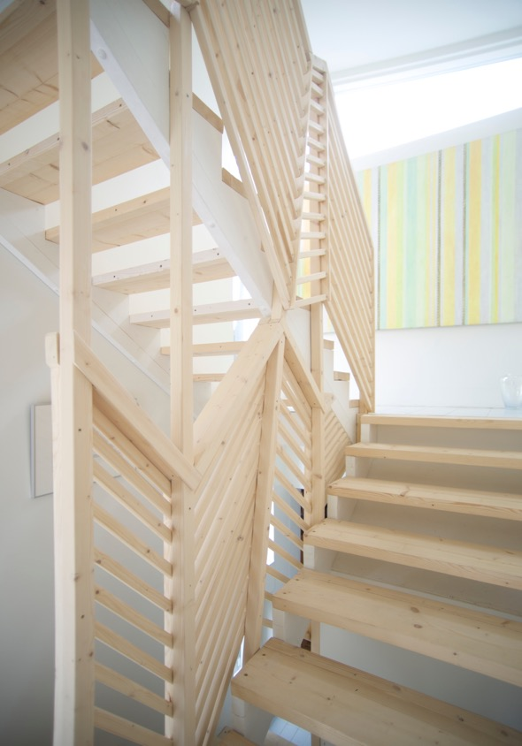
SUSTAINABLE ARCHITECTURE
Notes:
Circular economy: upgraded construction scaffolding parts.

Slide 4
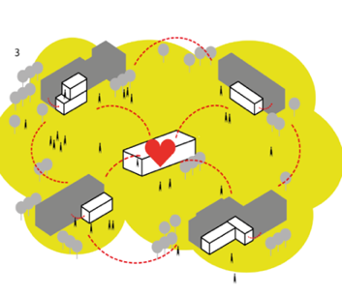
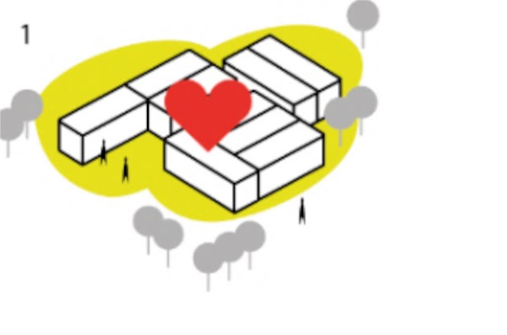


School as a Product
School as a Service
Traditional model creates isolated units
School as a Service utilizes surrounding resource to organize education
Slow implementation
Inflexible structures
High environmental effect
Investment intensive
Decreases areal prosperity
Product based solution
Rapid implementation
Flexible resource network
Lower environmental effect
Lower investment cost
Increases areal prosperity
Service centered
Notes:
An example of our projects in social sustainability: school education model that supports equality, helps cgildren, increases social learning, immersed in a network of spaces in existing city centres instead of hermetic school buildings.

Slide 5
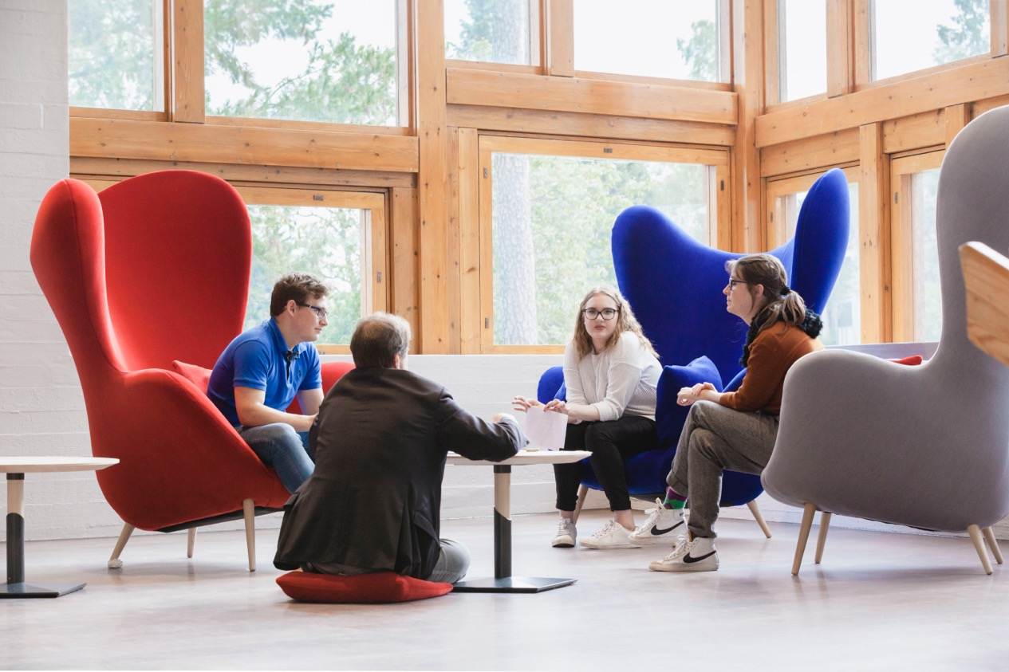
Notes:
1800 pupils, increased academic results, increased user satisfaction, 150% more applicants.

Slide 6
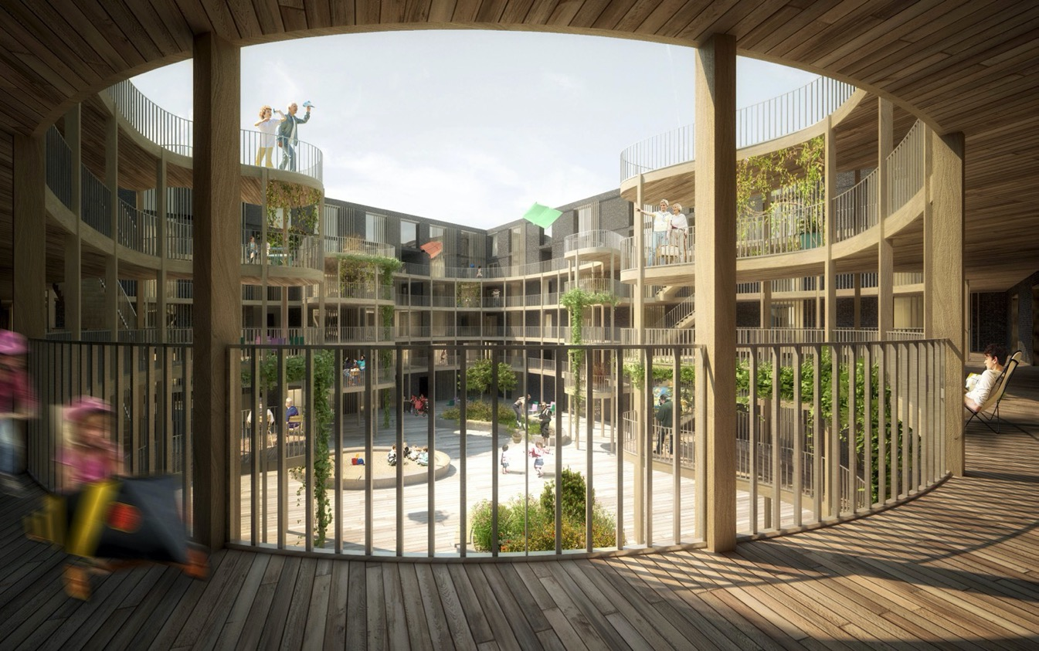
Communality
Notes:
Ongoing housing project in Helsinki – the courtyard supports the communality and inclusiveness of the block by the continuous, meandering, wooden balcony, which is spacious enough to accommodate not only circulation but activity areas as well.

Slide 7
ADAPTIVE REUSE
Notes:
My speciality

Slide 8
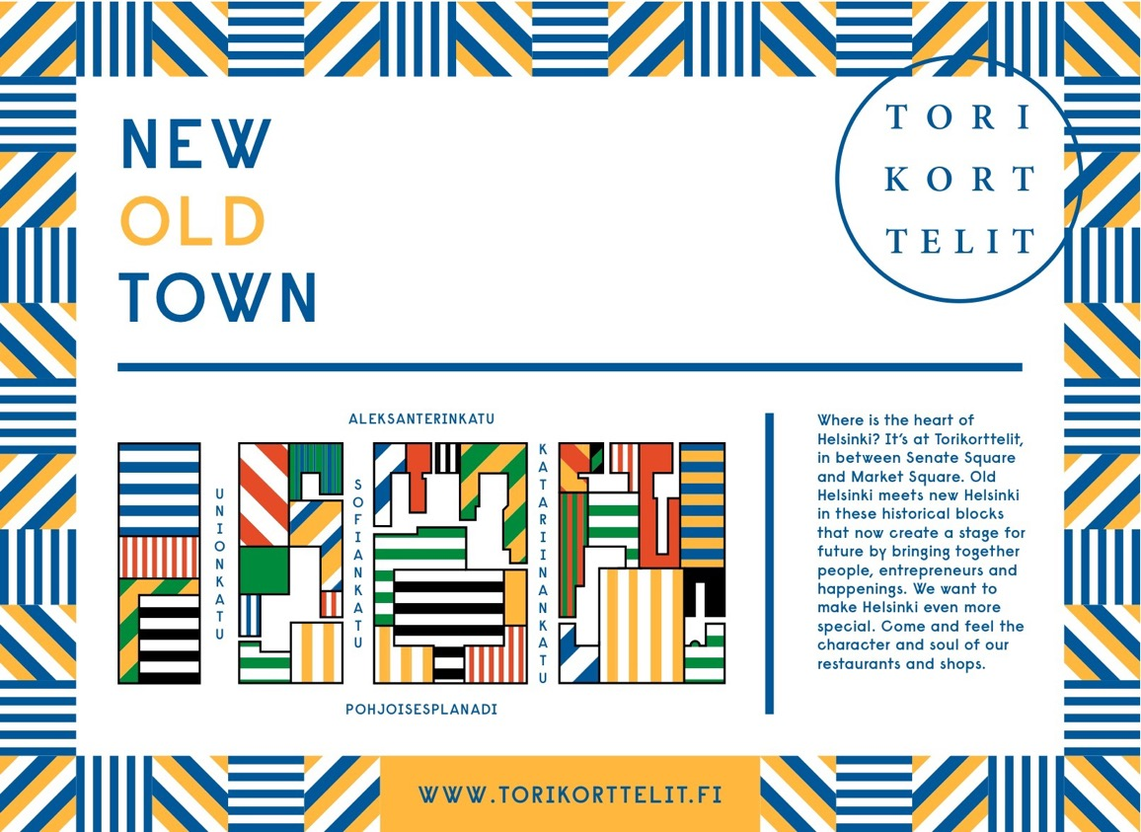
Helsinki City Hall Quartier Renewal
Notes:
Systematic user collaboration – engagement in project development stage with numerous user groups, including students, citizens, authorities, tourism agencies, companies and cultural producers.
Ground floor spaces opened to the public, replacing city’s offices by cultural activitities such as galleries and working spaces for designers, restaurants, shops and a hotel.
The place used to be dead with very limited use even if this is the core of the historic city.

Slide 9
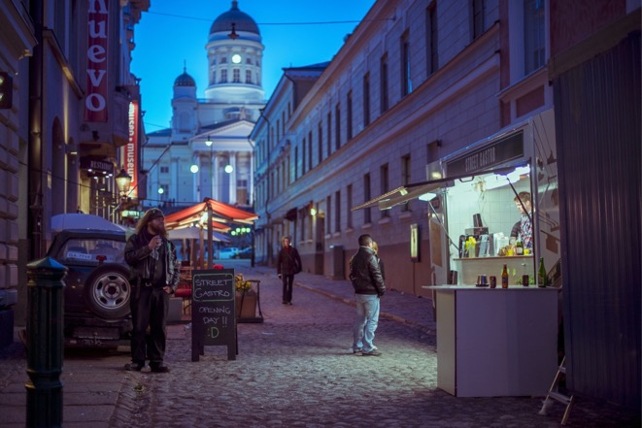
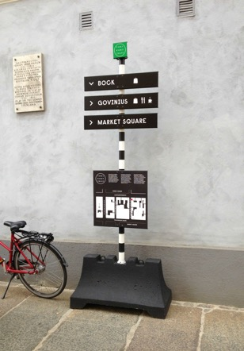
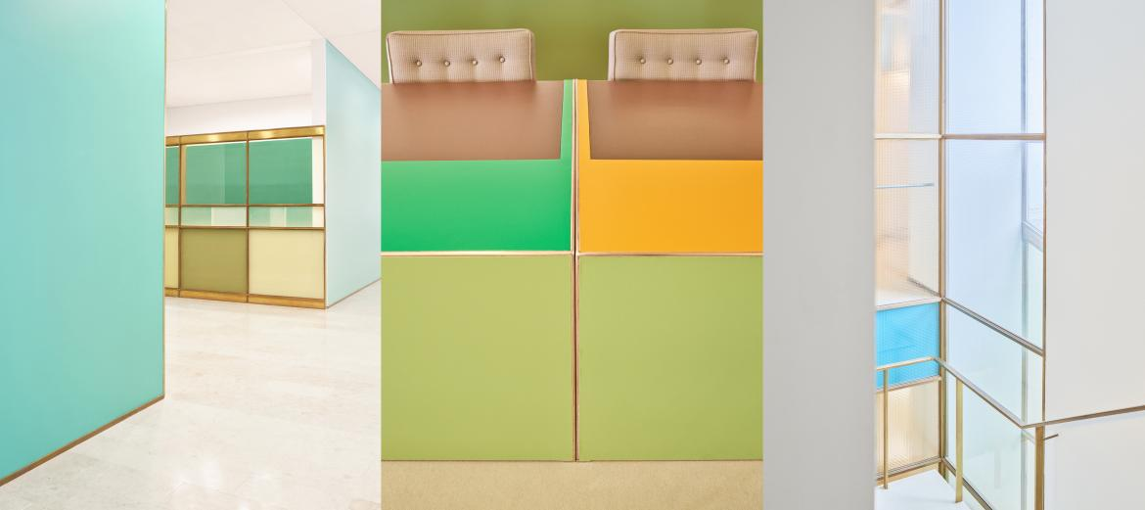
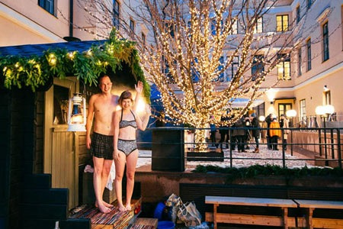
Adaptive reuse
Revitalised city core
Activated courtyards
Open ground floor
Public living room
Increase openness and public access in the city
Notes:
The creation of a suitable atmosphere was crucial – avoiding technocrary and instead aiming at human-frioendliness and liveability and for example signage became an important signal in the orchestration of the welcoming character of the area.

Slide 10
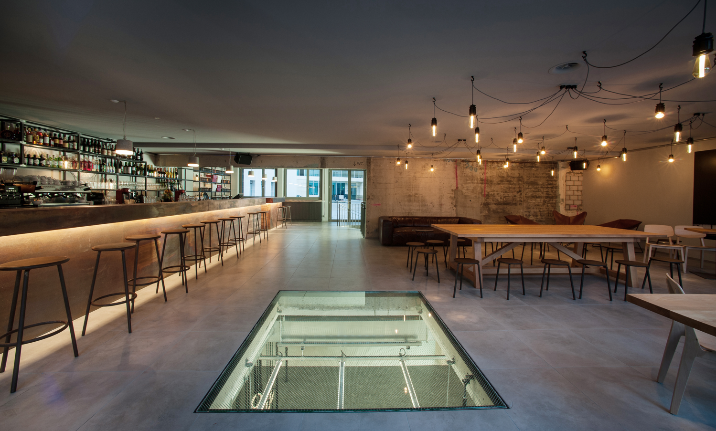
Notes:
Two basically opposite user groups and functions together – bar drinkers and gym rats (Balboa Gym). The spaces combined by the roughness of surfaces and comfortability of lights. Two locations in Zürich.

Slide 11
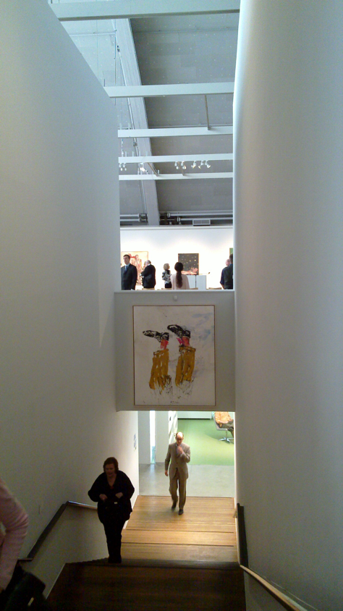
Notes:
Helsinki City Art Museum (HAM) renovation in former functionalism-era Tennis Palace bld

Slide 12
Notes:
A Grid – conversion of electrical engineering research facilities into a large startup centre

Slide 13
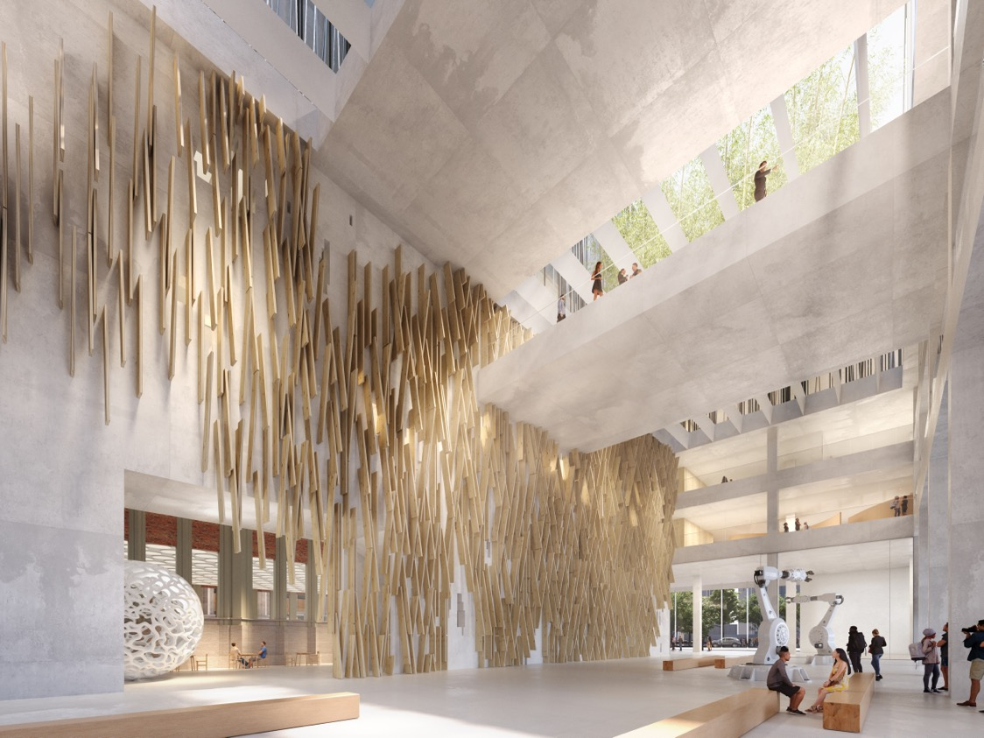
Notes:
SIDI – extension of a building to become a new A&D university. Collage

Slide 14
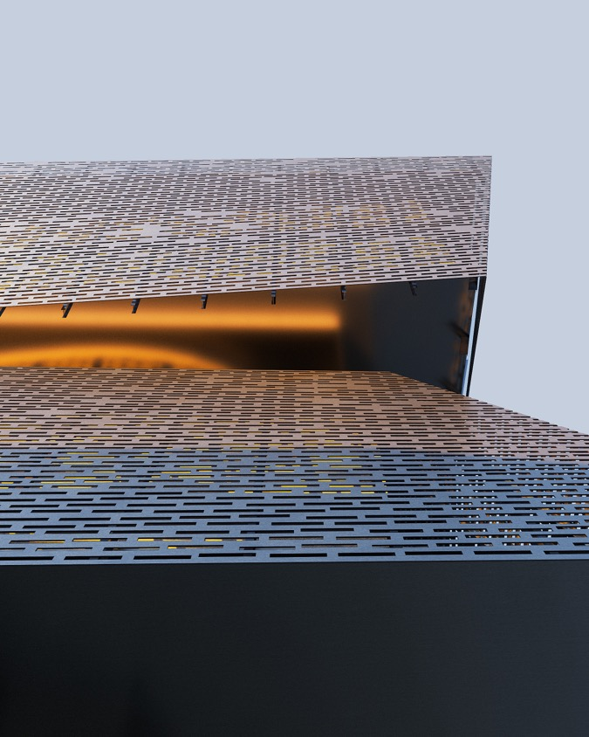

Slide 15
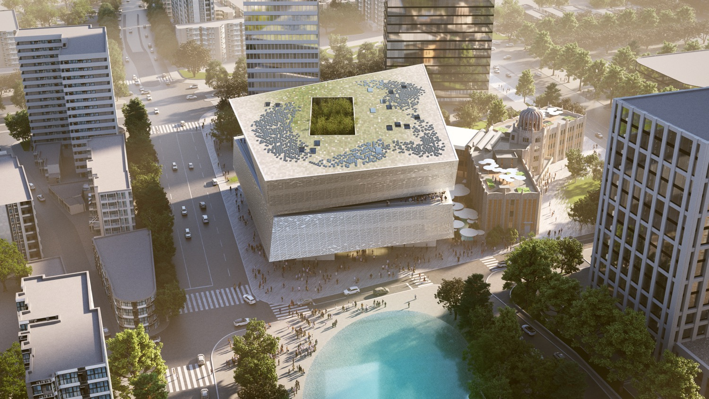
Notes:
A pursuit to connect metaxographic thinking to architecture: SIDI competition entry with Teemu Kurkela from JKMM. Relationships in many scales

Slide 16
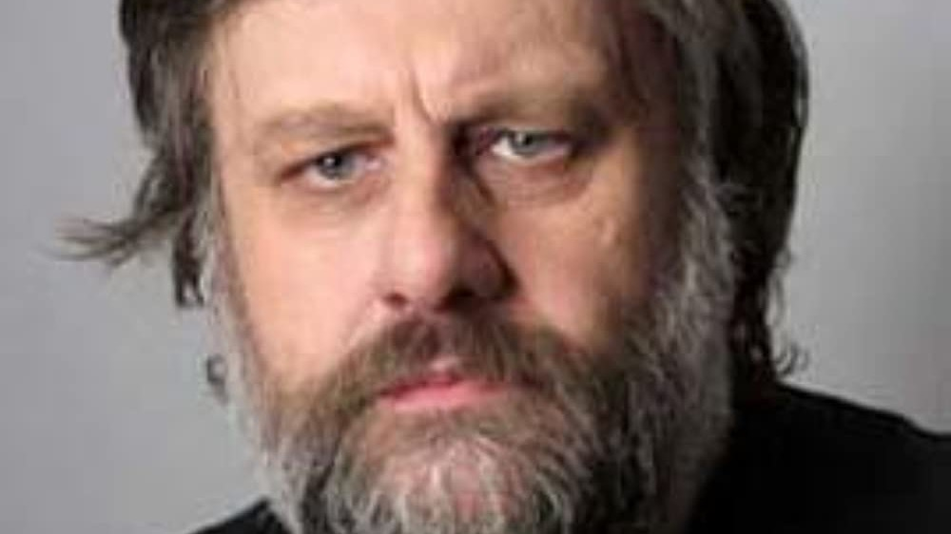
CONSTRUCTING SELF
Notes:
Why this kind of formalist approach is essential?
The self, identity and meaningfuilness in life constructed in interaction with the environment and other people. Here key role in fantasies, mental structures reflecting physical ones (mythologicaö process), relationship to the unknown and non-rational. Key theorists Immanuel Kant, Georg Wilhelm Friedrich Hegel, Jacques Lacan and Slavoj Zizek.
(Architecture embodies unknown knowns)
This means thinking with buildings and not about them.
(Function vs excessive art: only the rich prefer aestchetism. The poor prefer luxury.
Sustainability: should be calculated per capita).
Inside-outside relationship crucial.
In architectural theory, Alejandro Zaera-Polo (FOA): relationships between public and private spaces. Privately controlled exclusivity.
Tradition: inside protected from outside.
Now: Commercial exclusivity.
Against hierarchies.
Zizek on architecture: https://www.youtube.com/watch?v=xdbiN3YcuEI
Architecture has politico-ethical responsibility: materialising not public ideology but dreams of the people who use the buildings (obscene, secret public ideology (nightmare) or more open systems?.

Slide 17
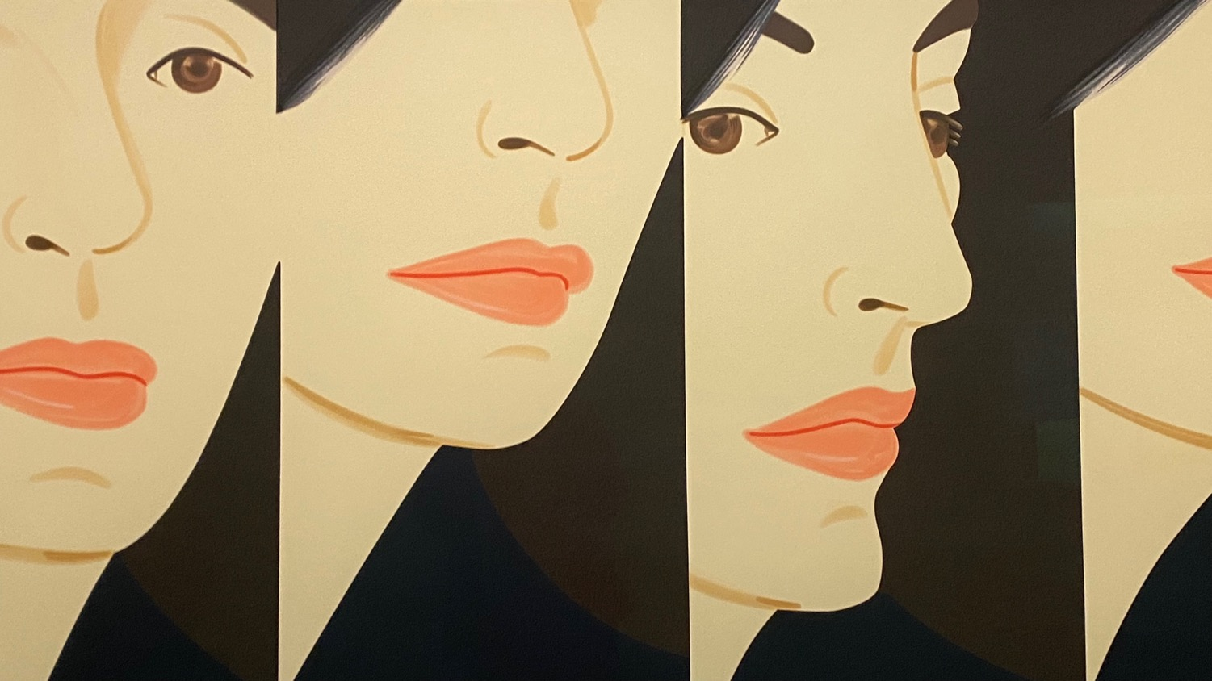
METAXOGRAPHY – REFERENCES
Notes:
Architecture is sometimes not that much connected to contemporary culture as some other more dynamically charged and evolving or popular fields such as cinema, literature …or urban activism, or epidemiology, for example. Could architecture gain some of their vitality, if it followed the same relationship patterns as inherent as them?

Slide 18
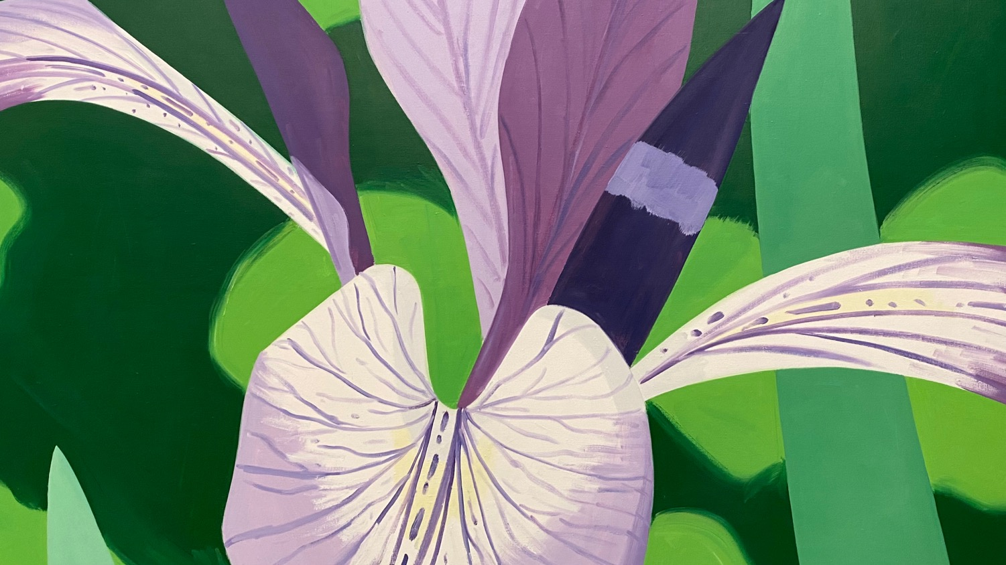

Slide 19
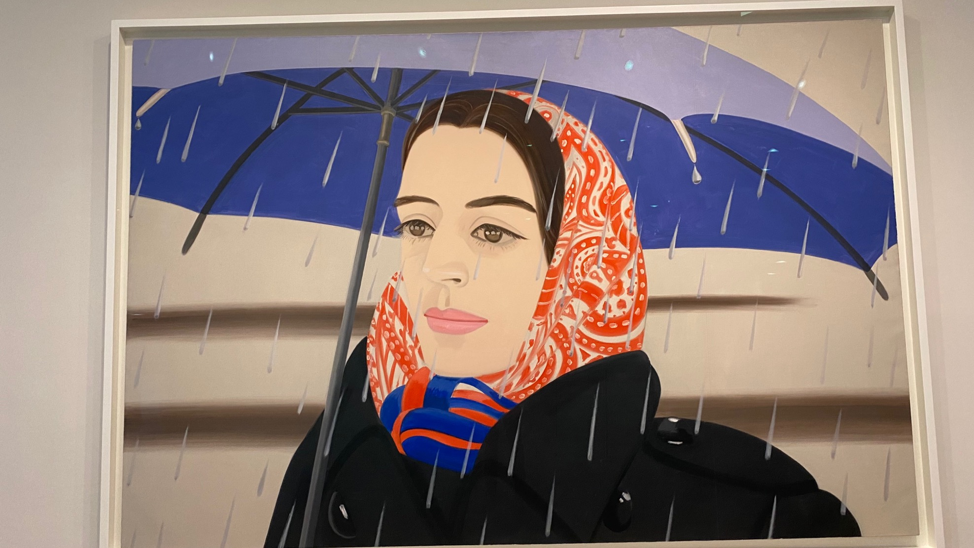

Slide 20
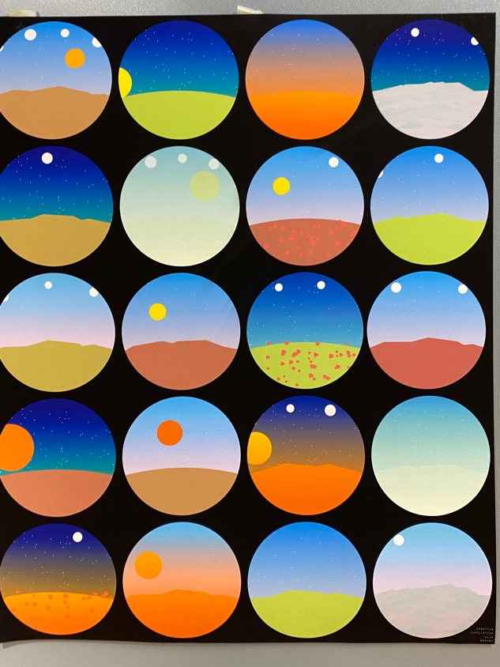
Notes:
The importance of variation

Slide 21
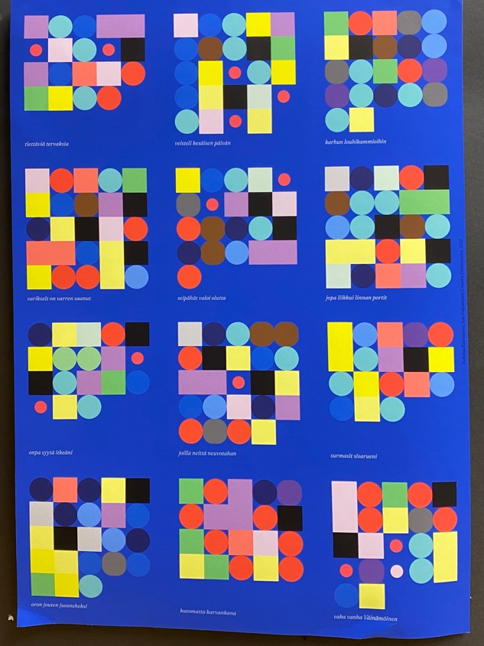

Slide 22
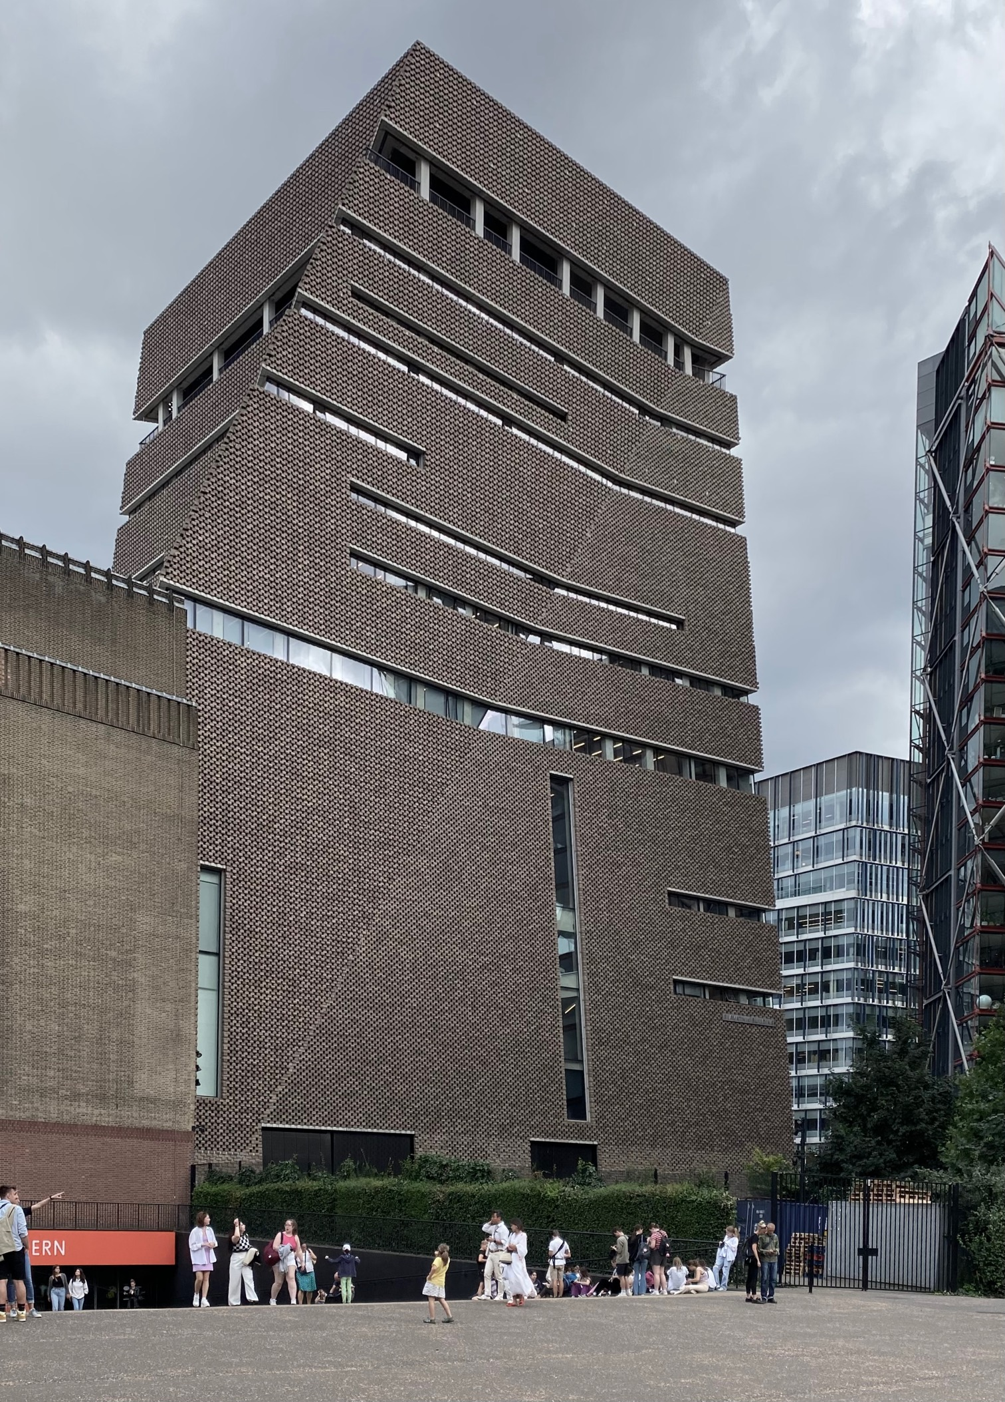
Notes:
H&deM: suhteet: taide/arkkitehtuuri, pintaä/tila, luonto/taide, kantava/ei-kantava, Semperin teorian tapaan.
Semper was the first architectural theorist to privilege the surface or external appearance of architecture over structure, a position which grew out of his commitment to the principle of polychromy in the architecture of the ancient Greek temples.
Semper believed that the use of colour on an architectural exterior served to clarify form. He regarded abstraction and whiteness as unnatural, while polychromy represented the 'feelings of the masses'. To support his theory, he traced the etymology of 'wall' to its origins in the term 'pares', signifying a soft, woven partition made of coloured textiles, in opposition to the later term 'mures' meaning a tough, defensive, external structure.
This understanding led him to develop a strong argument for the primary importance of the decorated surface of architecture, in opposition to the position of his fellow theorist Karl Boetticher, who stated that structure was the primary element.
Semper reasoned that it was the surface of architecture which made an impression on the viewer, summoning forth particular responses or feelings in the presence of a building. He also drew an analogy with the body defined as central to the formation and maintenance of human relationships.
These views resonate in architectural practice today, because of the persistent influence of Modernist dogma in highly moralistic terms, rejected entirely the surface or decorative elements of architecture in favour of the 'honest' expression of 'undressed structure', and the paradigm of whiteness.
A radical break with this tradition, based on Semper's ideals, is represented by the exploration of surface in the work of Herzog and de Meuron. The architects have explicitly referred to decorative facade treatments as 'building materials' equivalent in importance to concrete, bricks and glass - that is, structure. But they take Semper's argument a step further, arguing that the physical materials used in dressing architecture are less important than the phenomenon of dressing itself, understood as a physical presence which exists only through our perception of it. Thus they open up the possibility of a physical dissolution of walls going beyond anything that could ever have been contemplated by Semper.

Slide 23
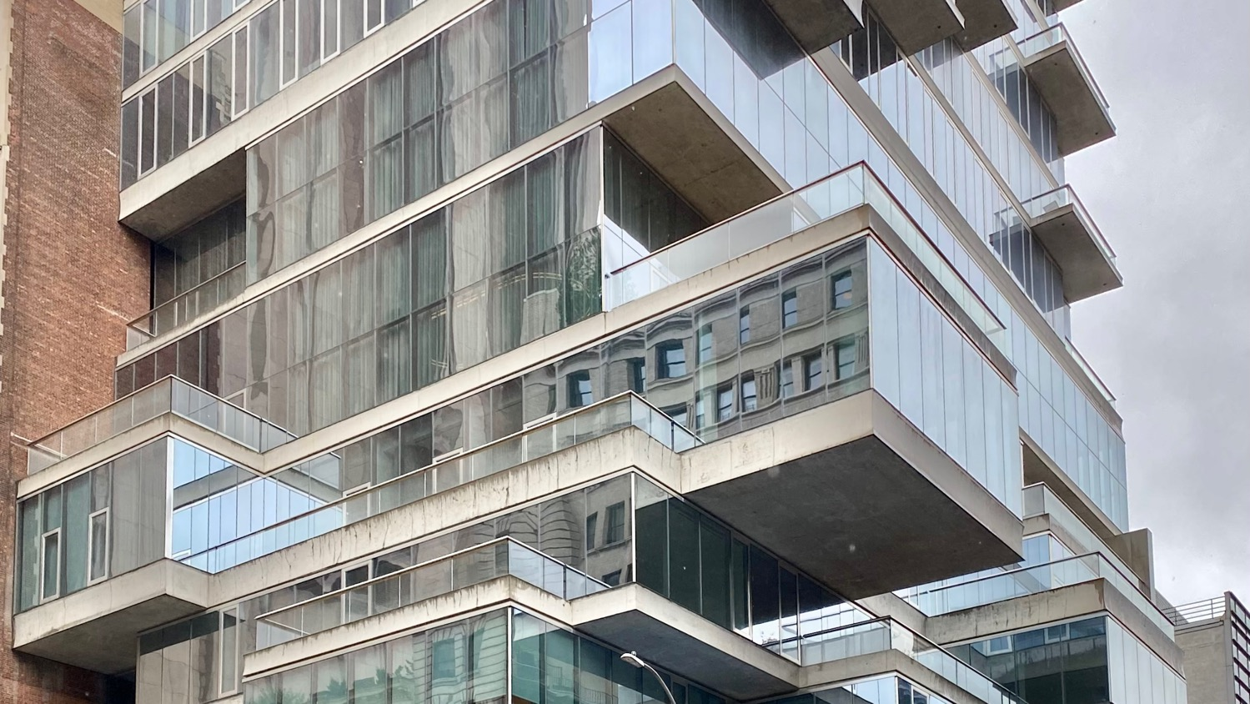
Notes:
NYC: dressing floors?
H&deM: sisätilan ja sen rajan suhde joka tapauksessa…
NYC: asunnon ja rakennuksen suhde = OK-talo vs neighbourhood unit

Slide 24
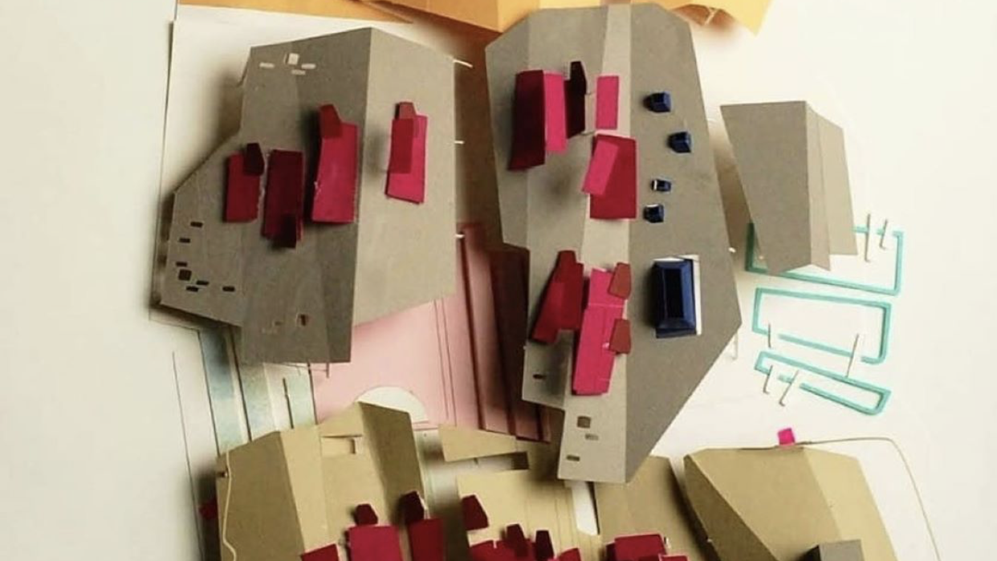
Notes:
Cannot be reduced to individual pieces or their effects (Graham Harman)

Slide 25
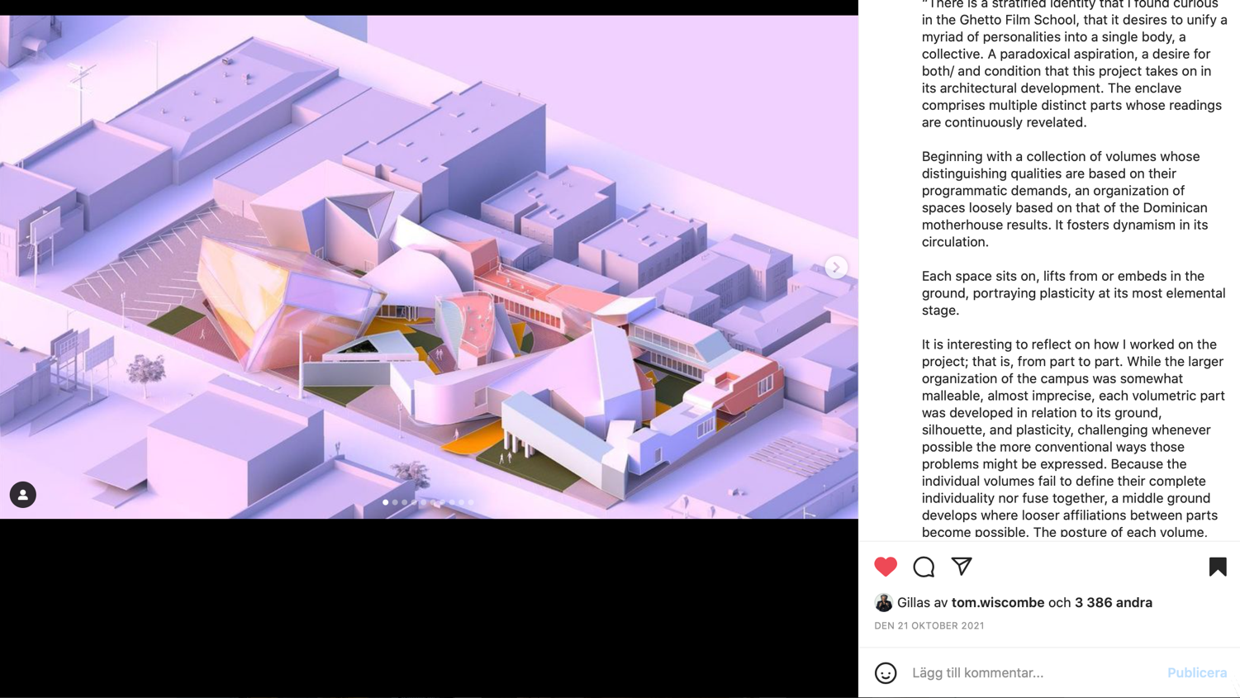
Notes:
Object-relationships (collage systems) live beyond human motivation.

Slide 26
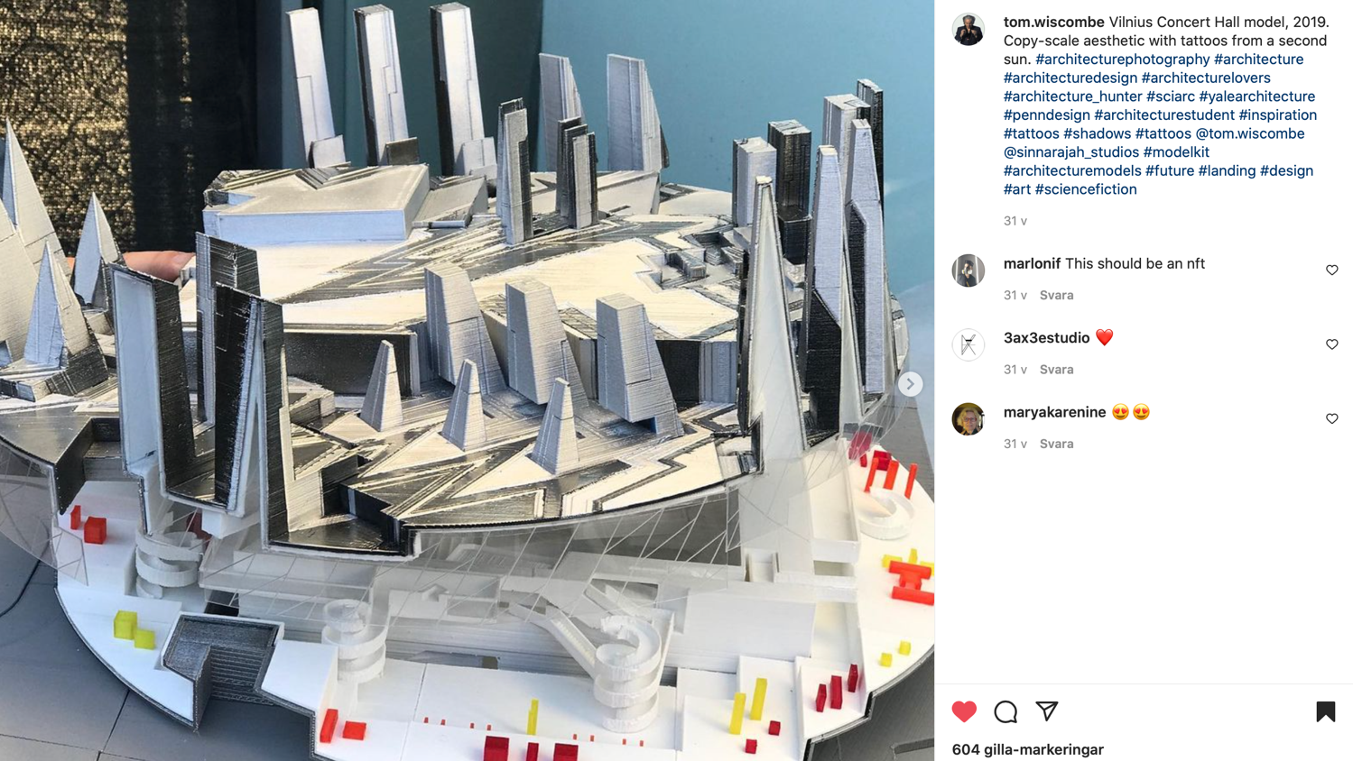
Notes:
Tilallisten järjestelmien lisääminen eikä vähentäminen.

Slide 27
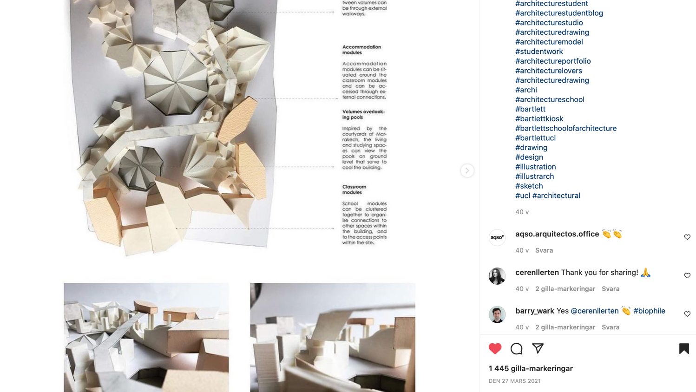

Slide 28
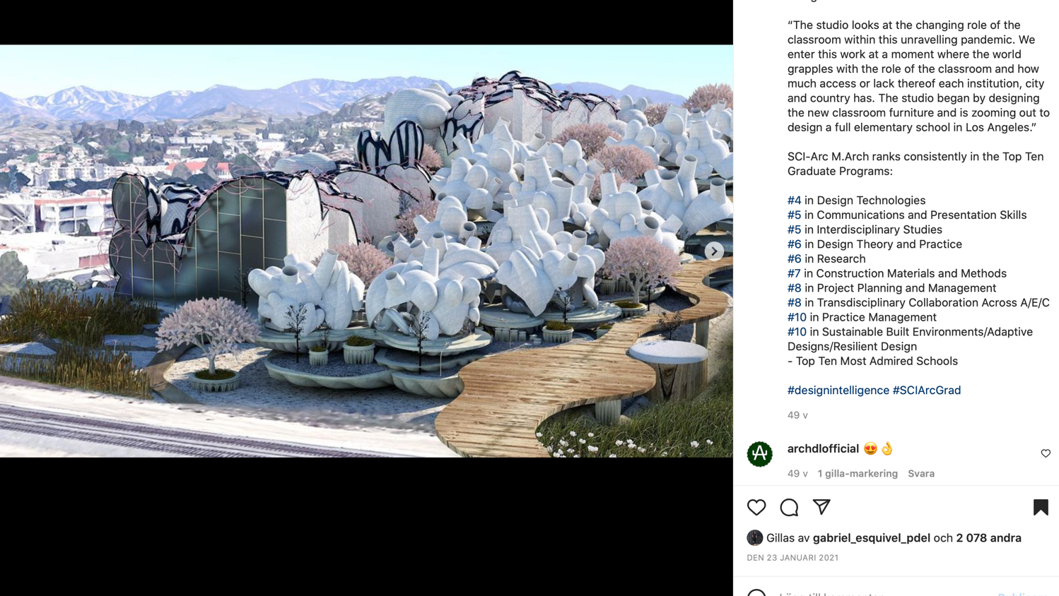
Notes:
World-making instead of incremental development.
”Spekulatiivisten” maailmojen suunnittelu ei riitä, vaan ajatukset on vietävä käytäntöön. Scifi-sarjakuvien kuvastosta ammentaminen arkkitehtuuri-illustraatioihin ei vielä riitä.

Slide 29
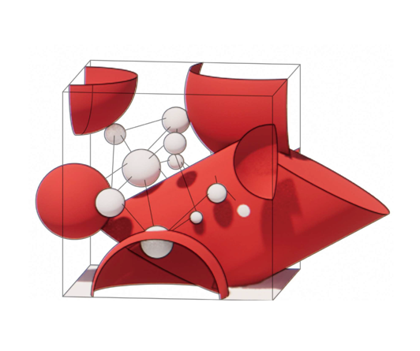
METAXOGRAPHY IN ARCHITECTURE

Slide 30
Metaxographic architecture – a method
1 Summary
– stems from the interplay between architecture and anthropology during the ongoing ontographic turnaround (the descriptive and speculative study of people and their world of objects).
– from anthropological ontography into metaxography (the descriptive study of relationships between them)
– the method is pragmatist and involves multidisciplinary perspectives to architecture
The method’s importance lays in:
a) rereading many of the classic 19th century architectural writings from a new perspective of architectural relationships (Kurokawa, Maki, Rossi, Rowe – Koetter and Venturi)
b) expanding the ontographic method from anthropology to the study of relationships in architecture
c) employing relationship-centred design methodologies from other fields to architecture
d) laying new theoretical basis for relationship-based computational architecture
e) Participating the development of non-anthropocentric culture
Notes:
The research on metaxography in architecture originates on one hand from a review to some of the canonical metabolist and post-modernist writings from the 1960’s to 90’s. On the other hand, it stems from the interplay between architecture and anthropology during the ongoing ontographic turnaround. This research takes a step from anthropological ontography (the descriptive and speculative study of people and their world of objects) into metaxography (the descriptive study of relationships between them) as inherent in the writings of Alexander et al., Kurokawa, Maki, Rossi, Rowe – Koetter and Venturi. The project is experiental and pragmatist and involves multidisciplinary perspectives to architecture and its importance lays in
a) rereading many of the classic 19th century architectural writings from a perspective of architectural relationships
b) expanding the ontographic method from anthropology to the study of relationships in architecture
c) employing relationship-centred design methodologies from other fields to architecture
d) laying new theoretical basis for relationship-based computational architecture
e) participating in the development of non-anthropocentric culture

Slide 31
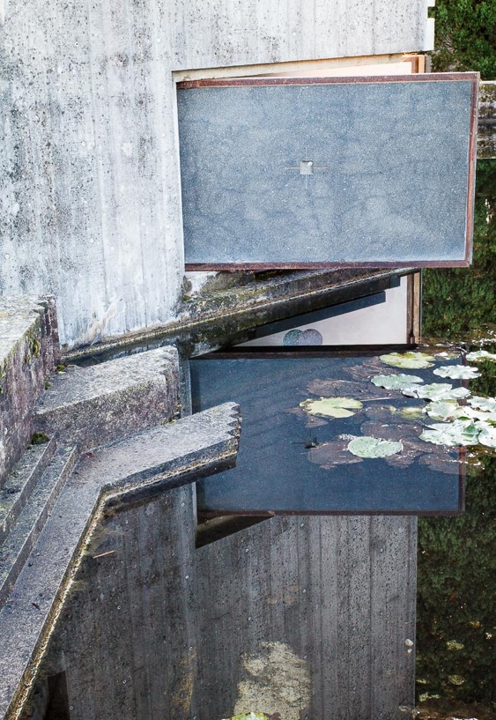
Ontographic art objects are made of non-anthropocentric things, which withdraw from human-oriented explanation and even look.
Such architecture as Carlo Scarpa’s Tombe Brion (1978), a funeral site, made without human-based functions or forms such as walkable routes, fits to the definition.

Slide 32
NON-ANTHROPOCENTRIC ARCHITECTURE
human-based
-user-based
-collaborative and participatory design
nature-based
-biophilic
-biomimetic
-circular
object-based
-ontographic
-OOO in architecture
relationship-based
-metaxographic
Notes:
Metaxographic studies can essentially question people’s perceptions of for example object relationships by revealing unnecessary preoccupations and suggesting a non-anthropocentric and non-metaphysical look at relationships.

Slide 33
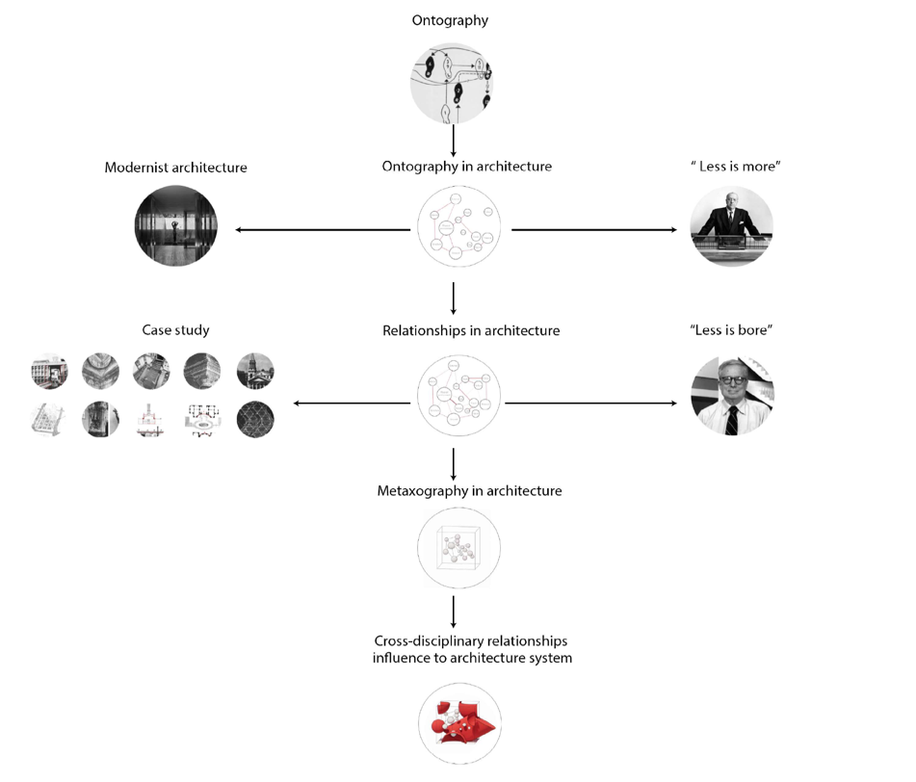
FROM ONTOGRAPHY TO METAXOGRAPHY
Idealism
rationalist reproduction
immateriality, minimalism
Modernist architecture
Abstraction
Human-object relationships
language, phenomenology
Case studies
Material culture
Ontography, OOO
Cross-disciplinary learnings to architecture
Metaxography
Pragmatism

Slide 34
From ontography to metaxography
Similarities
– Architecture exceeds utilitarian and rational ends.
– Ontography involves a disclosure of objects without necessarily providing any clarification or meaning.
– Ontological anthropology focusses on recognizing differences and variation, creativity, experimentation, and questioning.
– Art historical perspective to architecture is similar – trying to find aesthetic motifs, influences and styles between different authors and works of architecture, without going too deep into asking: why?
– Difference between art history and ontography: ontography more interested in objects, or things, and their systems than their human authors.
– Metaxography as improved ontography: We will not concentrate on human-object relationships, but object-object relationships.
– Traditionally, architecture has been considered to be the design of physical objects (which people can enter), and not that much the design of relationships between objects.
– Without this shift from objects to relationships, the full capacity of ontography remains unused.

Slide 35
Metaxographic architecture
Relationships occur, for example,
•between a component and a whole (context)
•between different components: e.g. their relative locations, distance, directions, sizes, numbers of, forms, textures and patterns
•between similar components
•between scales
•within a whole
•in temporal relationships with changes in time
– Metaxis refers to in-betweenness (relationships) and graphe to descriptive analysis.
– Objects can have relationships with other objects and interact, influence and shape each other. Relationships between objects can be analysed and developed with the use of analogies, types and with the recognised mechanisms of interaction.
– It might be possible to represent general relationships as diagrams, which can be implemented as strategies on other disciplinary fields.
– The relationship perspective urges us to be open to multiple logics in design and its evaluation by putting focus not only on the diverse perspectives opened by the study of relationships in other fields, but also by the plurality of principles.

Slide 36
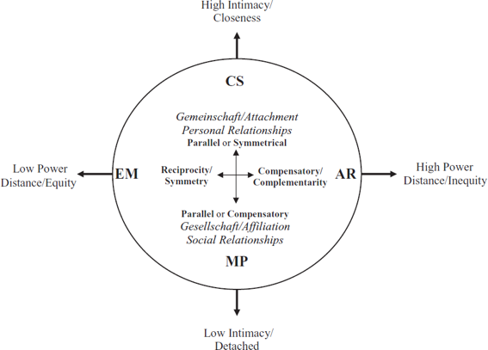
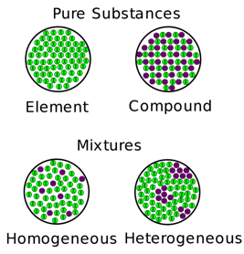
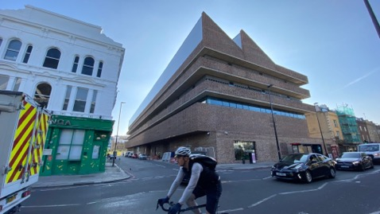
Cross-disciplonary learnings
Chemical substance classification
Robert Hinde (1996)
Herzog & de Meuron (2022)
Notes:
Architecture is sometimes not that much connected to contemporary culture as some other more dynamically charged and evolving or popular fields such as cinema, literature …or urban activism, or epidemiology, for example. Could architecture gain some of their vitality, if it followed the same relationship patterns as inherent as them?
When looking for relationship models to implement in architecture, we could concentrate on structured studies on relationships in other art fields. This includes, for example, the astonishingly analytical dramaturgical tool Dramatica used by script writers in cinema. Its way of working through roles, patterns and dynamics of relationships may be implemented in architectural design, as many other relationship-oriented methods in multiple forms of art and science.
E.g. in chemistry, one handy analytical tool could be the way how mixtures can be typified by differences between element and compound substances and heterogeneous and homogeneous mixtures:
Robert Hinde (1996) made the next graph describing personal relationships.
The graph arouses the question if there can be architecture, which engages not only such relationships as symmetry, parallels, compensation, reciprocity or complementarity but also different levels of closeness, weak or strong equality and detachment?
The relevance of different situations of relationships seems to depend on the interests of the specific architects. For example, in the work of Swiss architects Herzog and de Meuron, we can encounter these relational object pairs, which the architects also themselves recognize and play with:
art – architecture
surface – space
nature – art
bearing components – non-bearing components
For example, Herzog and de Meuron’s architecture is in great extent based on manipulating the relationships of these dichotomies in creative and often radical ways, which question traditional and normative expressions. H&deM: suhteet: taide/arkkitehtuuri, pintaä/tila, Semperin teorian tapaan.
Metaxographic building design is thus a deviation from ontographic paradigm. It is not that much interested just in creating obscure objects and forms, but creative relationship conditions – new types of collage, fitting to different situations. Which kinds of object–relationships and systems of them there are? Are they intentional or accidental? This method frees architecture from its stereotypical programmes and its techno-econo-rationalistic context.

Slide 37
Architecture of relationships: history
Fumihiko Maki's Investigation in Collective Form (1964) researched relationships and links between a whole and its parts and linking acts in architecture.
Aldo Rossi’s The Architecture of the City (1966) described the city as a collage (a specific type of relationship) of individual and collective memories.
Robert Venturi’s Complexity and Contradiction in Architecture (1966) analysed that ambiguity and tension are the key relationships in architecture
Christopher Alexander et al.’s A Pattern Language (1977) was about how specific physical design choices (recognizable patterns in space) can help us build better human relationships.
Colin Rowe’s and Fred Koetter’s Collage City (1979) described the city as a set for colliding intentions in space.
Kisho Kurokawa's The Philosophy of Symbiosis (1994) also concentrated in the relationship between a part and a whole.
Notes:
Metaxography is more than people-centered design, it is relationship-centered design. The metaxographic process requires designers (such as architects) to commit constructively and productively to new spatial thinking and advance the typological and conceptual diversity of relationships to architecture. The metaxographic process brings joy to the design process and can produce buildings which trigger unique and dynamic relationships between objects and people. The results can be experientially deeper as well as creatively more satisfying and sustainable buildings and places. Ontographic building design projects can present more diverse and revealing (of myths, preoccupations, cliches and biases) architecture than conventional methods. Metaxography destabilises reductionism and dichotomies and creates a liminal space for relational and collective development.
In a similar manner as Christopher Alexander’s work supported the creation of computer programming based on generative grammar and object-oriented programming, metaxography could possibly contribute to the theoretical and experimental basis of computational architecture, leading to new kinds of algorithms for architecture. The present computational architecture is very much performance-based, while as it could also be relationship-based.

Slide 38
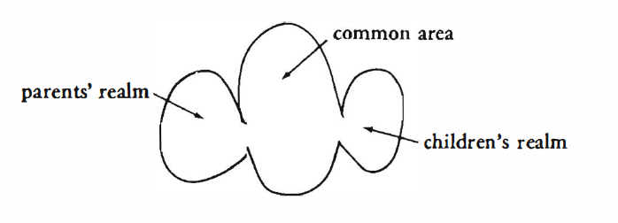
Christopher Alexander
“A Pattern Language” is about how specific design choices (patterns) can help us build better relationships: you get a room, a house, a neighborhood and eventually a city. A pattern is the way physical design responds to human relationships.
A pattern describes the field of physical and social relationships which are required to solve a stated problem

Slide 39
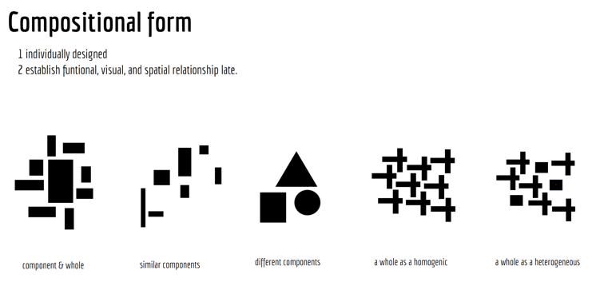
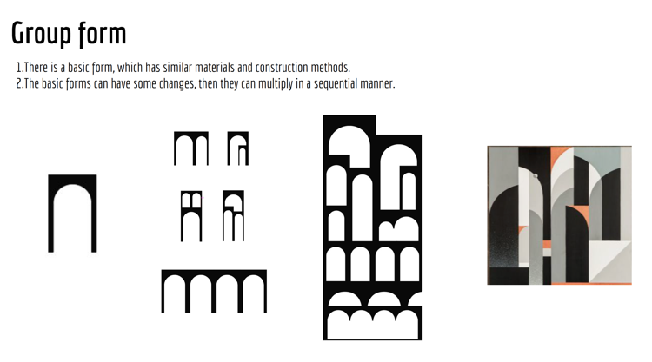
Fumihiko Maki
Notes:
Investigations in collective form scrutinises relationships between parts and whole and linking acts.
Metaxography = collages of groupforms.

Slide 40
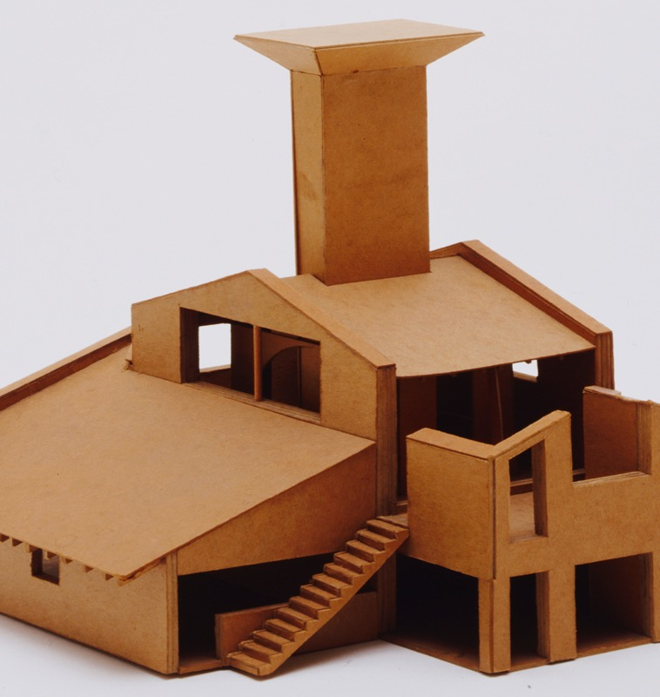
Robert Venturi
Ambiguity and tension as key relationships in architecture
Complexity and Contradiction in Architecture, 1966

Slide 41
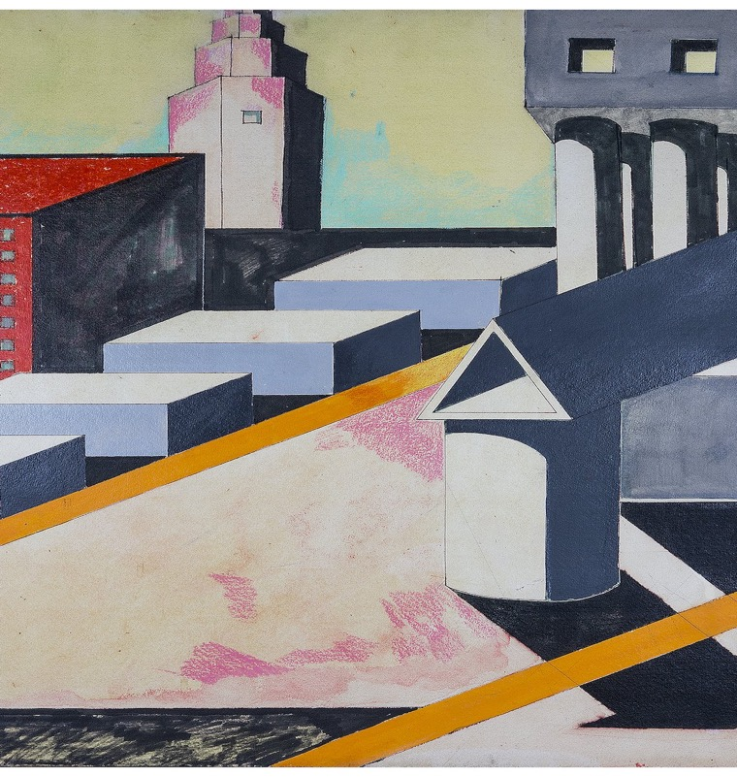
Aldo Rossi
The city as a collage of individual and collective memories
The juxtaposition and amalgamation of different sources
Individual and collective experience of history using a mosaic
Aldo Rossi, L’architettura della città, 1982

Slide 42
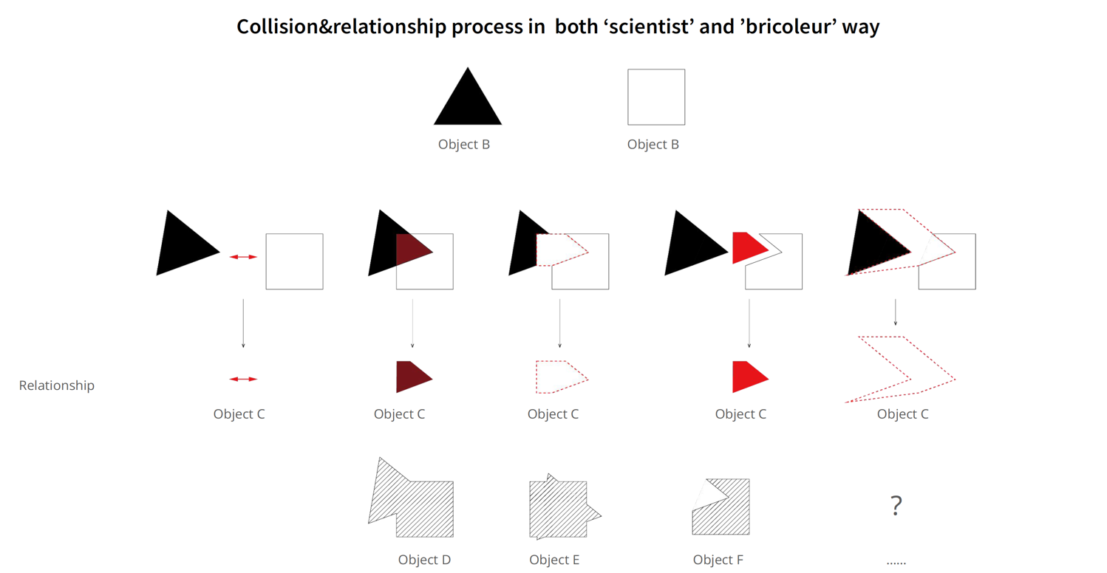
Rowe & Koetter
…collision of palaces, piazza and villas… that inextricable fusion of imposition and accommodation, that highly successful and resilient traffic jam of intentions

Slide 43
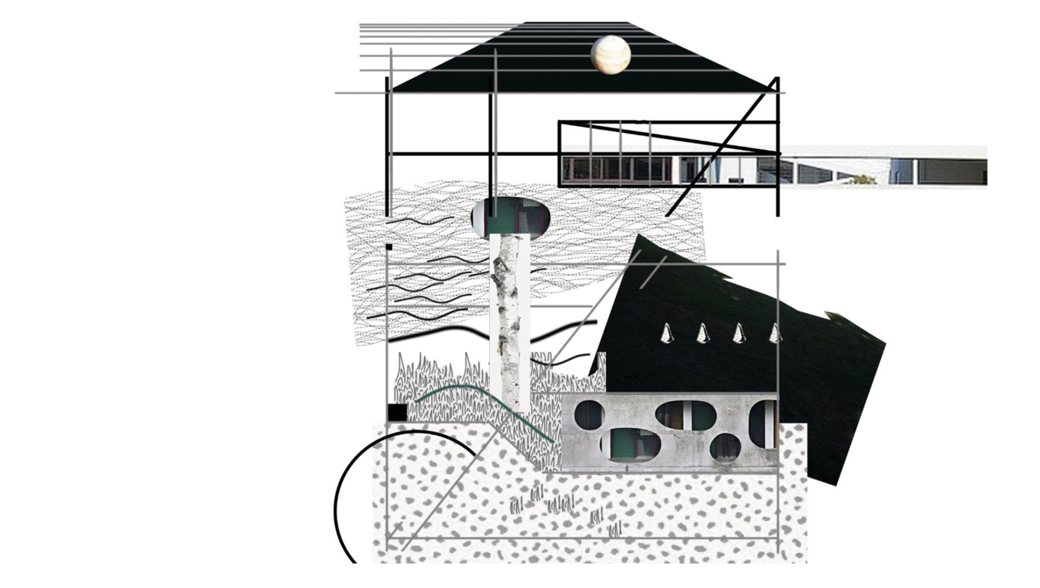
Rowe & Koetter
Notes:
Collage

Slide 44
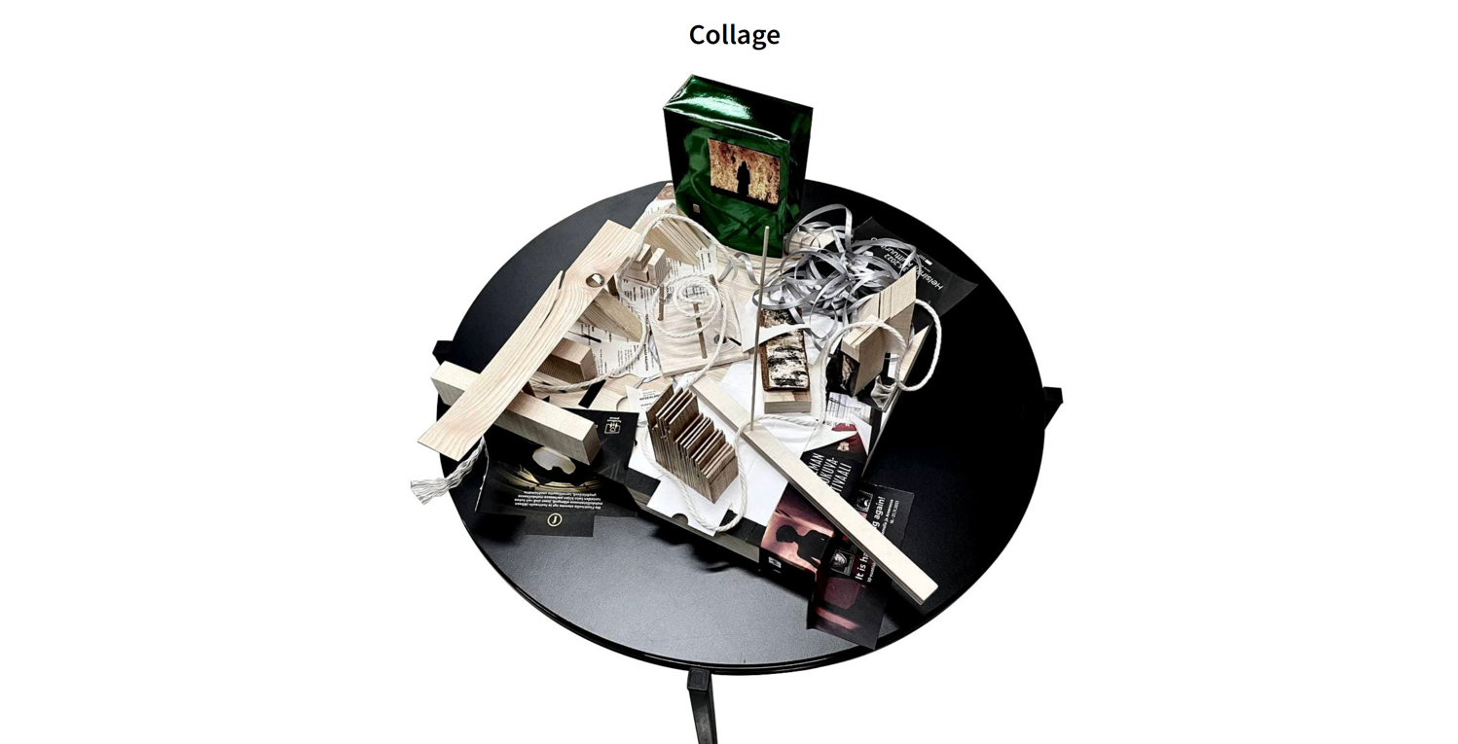
Rowe & Koetter
- Consider multiple possibilities of functions
- Shape the space from the things in between
- Be positive to changes and conflicts. Keep it developing spontaneously
Notes:
These

Slide 45
Design Method
2 Design stage
2.1 Create an original elemental part of a collage. The element should have original geometry and the collage should be a bunch of spaces. It can be 2D or 3D. In Qi Qi’s sample work, you can see the idea: the autonomous object here is a circular dining space surrounded by a sphere of other rooms.
2.2 Multiply the object, fitting the whole gameboard to the building site.
2.3 Find images of architecture (architectural situations) from the works you analysed in the previous stage, where interesting relationships are apparent. Present these relationships as abstract 3-D diagrams.
2.4 Implement the same relationships (interstitial connections) between them, their superimpositions or other interaction. Include an aspect of transforming each original
2.5 Mix diagrammatic relationships and building programmes in collage
2.6. Merge your work together with the design of your pair
2.6 Adopt architectural solutions from unusual scales, building types or locations to the design work – for example, implementing city-scale solutions in building scale, or furniture-scale solutions in room scale. Or design a hotel part based on an art museum layout, for example.
1 Analysis stage
The first tasks for students of architecture is a metaxographic description and analysis of
1.1 one of the above mentioned classic texts (its descriptions of the study of relationships in architecture) and
1.2 Image analysis of different “object systems” of architectural reference projects by white outlines and classified by Ren’s diagrammatic categories (with possible other categories recognised). The images should be both perspective pictures and projections.
1.3 Analyse how the specific architectural works (mixed-use complexes) have copied, multiplied and modified already existing architectural elements and situated these to new contexts, programmes and functions, as sort of tropes. These findings can later be applied to the creation of new architecture as well in the design stage – partly recycled and partly new.

Slide 46
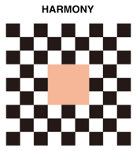
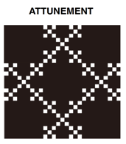
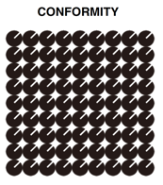
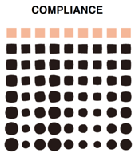
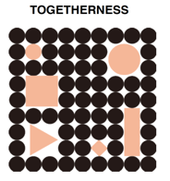
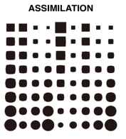







Different types of relationships
Ren Zhuoying & Antti Ahlava 2021
Notes:
We have also analysed canonical examples from history of arch fitting to these categhories of relationships.

Slide 47


Slide 48

Qi Qi, Aalto University 2021

Slide 49

Qi Qi, Aalto University 2021

Slide 50

Peiyao Xu, Aalto University 2022
Notes:
Peiyao Xu

Slide 51

Peiyao Xu, Aalto University 2022

Slide 52

Peiyao Xu, Aalto University 2022
Notes:
Regarding sustainability and architecture, different cultures have varying emphasis – for example architetcure departments at Aalto uni and CU seem to concentrate on technical sustainability – CO2 emission and energy. This project in the image is made by Kivi Sotamaa in our Kissing Helsinki gropup and represents quite typical Nordic approach to sustainability through wooden construction and prefabrication.
However, my own preference has been on the dimensions of social sustainability in architecture. This kind of social approach is typical for example in Sweden.

Slide 53

Peiyao Xu, Aalto University 2022
Notes:
Regarding sustainability and architecture, different cultures have varying emphasis – for example architetcure departments at Aalto uni and CU seem to concentrate on technical sustainability – CO2 emission and energy. This project in the image is made by Kivi Sotamaa in our Kissing Helsinki gropup and represents quite typical Nordic approach to sustainability through wooden construction and prefabrication.
However, my own preference has been on the dimensions of social sustainability in architecture. This kind of social approach is typical for example in Sweden.

Slide 54

Peiyao Xu, Aalto University 2022
Notes:
Regarding sustainability and architecture, different cultures have varying emphasis – for example architetcure departments at Aalto uni and CU seem to concentrate on technical sustainability – CO2 emission and energy. This project in the image is made by Kivi Sotamaa in our Kissing Helsinki gropup and represents quite typical Nordic approach to sustainability through wooden construction and prefabrication.
However, my own preference has been on the dimensions of social sustainability in architecture. This kind of social approach is typical for example in Sweden.

Slide 55

Peiyao Xu, Aalto University 2022
Notes:
Regarding sustainability and architecture, different cultures have varying emphasis – for example architetcure departments at Aalto uni and CU seem to concentrate on technical sustainability – CO2 emission and energy. This project in the image is made by Kivi Sotamaa in our Kissing Helsinki gropup and represents quite typical Nordic approach to sustainability through wooden construction and prefabrication.
However, my own preference has been on the dimensions of social sustainability in architecture. This kind of social approach is typical for example in Sweden.

Slide 56

Peiyao Xu, Aalto University 2022
Notes:
Regarding sustainability and architecture, different cultures have varying emphasis – for example architetcure departments at Aalto uni and CU seem to concentrate on technical sustainability – CO2 emission and energy. This project in the image is made by Kivi Sotamaa in our Kissing Helsinki gropup and represents quite typical Nordic approach to sustainability through wooden construction and prefabrication.
However, my own preference has been on the dimensions of social sustainability in architecture. This kind of social approach is typical for example in Sweden.

Slide 57

Qi Qi, Aalto University 2022

Slide 58

Qi Qi, Aalto University 2022

Slide 59

Qi Qi, Aalto University 2022

Slide 60

Qi Qi, Aalto University 2022

Slide 61

Qi Qi, Aalto University 2022

Slide 62

Yue Zhang, Aalto University 2022
Notes:
Importance of variation within a fixed 3-D relationship

Slide 63

Yue Zhang, Aalto University 2022

Slide 64

Yue Zhang, Aalto University 2022

Slide 65

Yue Zhang, Aalto University 2022

Slide 66

Yue Zhang, Aalto University 2022

Slide 67

Yue Zhang, Aalto University 2022

Slide 68

Xinghe Guo, Aalto University 2022

Slide 69

Xinghe Guo, Aalto University 2022

Slide 70

Xinghe Guo, Aalto University 2022

Slide 71

Xinghe Guo, Aalto University 2022

Slide 72

Jenna Hukkinen, Aalto University 2022

Slide 73

Jenna Hukkinen, Aalto University 2022

Slide 74

Jenna Hukkinen, Aalto University 2022

Slide 75

Jenna Hukkinen, Aalto University 2022

Slide 76

Jenna Hukkinen, Aalto University 2022

Slide 77

Jenna Hukkinen, Aalto University 2022

Slide 78


Slide 79


Slide 80


Slide 81


Slide 82


Slide 83


Slide 84


Slide 85


Slide 86


Slide 87


Slide 88


Slide 89


Slide 90


Slide 91


Slide 92

Notes:
Metaxography is more than people-centered design, it is relationship-centered design and through that mind-centered. The metaxographic process requires designers (such as architects) to commit constructively and productively to new spatial thinking and advance the typological and conceptual diversity of relationships to architecture. The metaxographic process brings joy to the design process and can produce buildings which trigger unique and dynamic relationships between things. The results can be experientially deeper as well as creatively more satisfying and sustainable buildings and places. Metaxographic building design projects can present more diverse and revealing architecture (revealing of myths, preoccupations, cliches and biases) architecture than conventional methods. Metaxography destabilises reductionism and dichotomies and creates a liminal space for relational development.

