Slide 1
Theory of the Firm

Slide 2
What is a firm/business/company?
Would it be possible to have economic activity without these organizations called firms?
At its most basic level, a firm is an organization that turns inputs into outputs
It is possible to have econ activity w/o them but…
Transaction costs

Slide 3
Any disadvantages with producing outputs via firms?
Principal-agent problem

Slide 4
Of course most real firms use many different inputs (like what?) to produce several different outputs
But to introduce the ideas, we’ll keep it simple and assume:
One type of output (widgets)
Two inputs (labor and capital)

Slide 5
Even though this is a huge simplification, hopefully the insights we learn can help guide our thinking when applied to actual production

Slide 6
Sometimes it is helpful to illustrate the connection between inputs and outputs with a “production function”

Slide 7
The production function shows the relationship between quantity of inputs used to make a good and the quantity of output of that good.
For example:
Q = 4L + 2K
Q = (3L)(K)
Q = (4L^{1/2})(K^{1/2})

Slide 8
To better understand the nature of production and costs, economists make the distinction between “short run” and “long run”
In the short-run, at least one input is fixed (stuck at its current level)
The long-run is a period long enough so that all inputs can be adjusted

Slide 9
For some firms, most or all of the inputs can be adjusted pretty quickly
For others, some inputs might be stuck at their current level for a long time

Slide 10
So fixed inputs are inputs that are stuck at their current level (at least in the SR)
And variable inputs are inputs that we can freely adjust easily/quickly
Note that later we’ll talk about fixed and variable costs…don’t get confused!

Slide 11
For starters, let’s first assume we are in the SR
A classic way to think about this is to allow labor to be variable, but keep capital fixed.
Of course in some industries, esp ones where the labor is heavily organized, it might actually be easier to adjust capital!

Slide 12
The marginal product of any input in the production process is the increase in output that arises from an additional unit of that input.
For example:
Marginal product of L
Marginal product of K

Slide 14
Diminishing marginal product is the short-run phenomenon whereby the marginal product of an input declines as the quantity of the input increases.
This may not happen immediately…in fact, often we observe increasing marginal product at first. But it almost always occurs eventually.

Slide 15
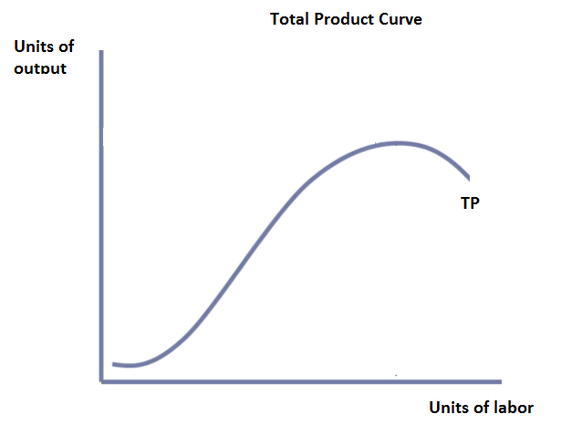
TP with more L, holding K constant

Slide 16
Here we have a production function with increasing and then decreasing marginal returns to labor.
Can we think of intuition that might explain this?

Slide 17
The slope of the production function measures the marginal product of an input, such as a worker.
When the marginal product declines, the production function becomes flatter.

Slide 18
Questions:
What is the optimal level of labor to hire in the above production function?
Recall that diminishing MP of labor is the result of the level of capital being fixed. If capital were also allowed to adjust, do you think MP labor would always diminish? Explain.
Agree or disagree and explain: “Never hire a worker beyond the point where marginal product begins to diminish.”

Slide 19
The Firm’s Objective
The economic goal of the firm is to maximize profits (duh!)

Slide 20
Total Revenue
The amount a firm receives for the sale of its output.
TR= P x Q
Total Cost
The market value of the inputs a firm uses in production.

Slide 21
Profit is the firm’s total revenue minus its total cost.
Profit = Total revenue - Total cost

Slide 22
Difference between explicit and implicit costs
Explicit costs are input costs that require a direct outlay of money by the firm.
Implicit costs are input costs that do not require an outlay of money by the firm.
Should we include implicit costs when calculating total costs?

Slide 23
Economists measure a firm’s economic profit as total revenue minus total cost, including both explicit and implicit costs.
Accountants measure the accounting profit as the firm’s total revenue minus only the firm’s explicit costs.

Slide 24
Example:
For Reynholm Industries in 2021
TR=$12 million
Total Explicit Costs: $8 million (wages, materials, etc)
Accounting profit: $4 million
They also own office space that could have been rented out for $3 million and capital equipment that could have been rented out for $1 million.
Economic profit=$0

Slide 25
When total revenue exceeds both explicit and implicit costs, the firm earns economic profit.
Economic profit is smaller than accounting profit.
Is zero economic profit necessarily bad?

Slide 27
What is the connection between TP and costs?

Slide 30
Costs of production can be divided into fixed and variable costs
Don’t get this mixed up with fixed and variable inputs!
Fixed costs are those costs that do not vary with the quantity of output produced.
Variable costs are those costs that do vary with the quantity of output produced.

Slide 31
Total Costs
Total Fixed Costs (TFC)
Total Variable Costs (TVC)
Total Costs (TC)
TC = TFC + TVC

Slide 33
Average Costs
Average costs can be determined by dividing the firm’s costs by the quantity of output it produces.

Slide 34
Average Costs
Average Fixed Costs (AFC)
Average Variable Costs (AVC)
Average Total Costs (ATC)
ATC = AFC + AVC

Slide 35
AFC= TFC/Q
AVC= TVC/Q
ATC= TC/Q

Slide 37
Marginal Cost
Marginal cost (MC) measures the increase in total cost that arises from an extra unit of production.
Marginal cost helps answer the following question:
How much does it cost to produce an additional unit of output?

Slide 42
Marginal cost rises with the amount of output produced.
This reflects the property of diminishing marginal product.

Slide 43
The average total-cost curve is U-shaped.
At very low levels of output average total cost is high because fixed cost is spread over only a few units.
Average total cost declines as output increases.
Average total cost starts rising because average variable cost rises substantially.

Slide 44
The bottom of the U-shaped ATC curve occurs at the quantity that minimizes average total cost. This quantity is sometimes called the efficient scale of the firm.

Slide 46
Relationship between Marginal Cost and Average Total Cost
Whenever marginal cost is less than average total cost, average total cost is falling.
Whenever marginal cost is greater than average total cost, average total cost is rising.
The marginal-cost curve crosses the average total-cost curve at the efficient scale

Slide 51
Three Important Properties of Cost Curves
Marginal cost eventually rises with the quantity of output
The average-total-cost curve is U-shaped.
The marginal-cost curve crosses the average-total-cost curve at the minimum of average total cost.

Slide 52
For many firms, the division of total costs between fixed and variable costs depends on the time horizon being considered.
In the short run, some costs are fixed.
In the long run, fixed costs become variable costs.
Because many costs are fixed in the short run but variable in the long run, a firm’s long-run cost curves differ from its short-run cost curves.

Slide 54
Economies of scale refer to the property whereby long-run average total cost falls as the quantity of output increases.
Diseconomies of scale refer to the property whereby long-run average total cost rises as the quantity of output increases.
Constant returns to scale refers to the property whereby long-run average total cost stays the same as the quant of output increases

Slide 56
Review Questions
What is marginal product? What unit is it measured in? What does it mean to say it is diminishing?
Draw a production function that exhibits diminishing marginal product of labor.
Give an example of a cost that an economist would consider, but an accountant might ignore.

Slide 57
Review Questions
What is our “golden rule” of profit maximization?
True of false and explain: “If there exist economies to scale, long run total costs are falling”
Draw a marginal cost curve for a typical (“textbook”) firm. Why does it have this shape?

Slide 58
Practice Questions
Question 1:
Bernie’s Bagels uses workers (L) and units of capital (K) to produce bagels. The production process can be represented by:
Q= 3L*K
Assume that for the short-run, K is fixed at 1 unit.
What is the MP_{L} of the third worker?
What is AP_{L} of the third worker?

Slide 59
<answers provided in class>

Slide 60
Practice Questions
Question 2:
Recall that diminishing MP of labor is the result of the level of capital being fixed. If capital were also allowed to adjust, do you think MP labor would always diminish? Explain.
Question 3:
How might the marginal costs for firms in the computer software industry differ from firms in the automotive industry?

Slide 61
<answers provided in class>

Slide 62
Practice Questions
Question 4:
Consider the following statement about economies of scale: “If there are economies of scale in an industry, total costs fall as output levels increase.”
Is this statement about econs of scale true? False? Explain.

Slide 63
<answers provided in class>

Slide 64
Practice Questions
Question 5:
Cobblestone Tours charges participants $20 each to go on a “Savannah Haunted Pub Crawl” tour. Each tour could can accommodate up to 30 people. The tour company pays the city of Savannah $500 per year for the license to operate a tour company. They pay their tour guide, Rhett, a wage of $60 per tour conducted. And each tour participant gets a lovely, complementary, commemorative plastic cup with custom printing, which Cobblestone Tours purchases from the printer for $0.50 each.
For each of the three costs mentioned above, discuss if they are fixed or variable and explain.
i) The $500 license fee paid to the city:
ii) The $0.50 per cup amount paid to the printer:
iii) The $60 paid to Rhett, the tour guide (warning: this is a tricky one and might not easily fit into either category):

Slide 65
<answers provided in class>

